Slide 1
Macroeconomics:
Taking into account environment and well-being (week 4)
Thorn Pitidol
Faculty of Economics, Thammasat University
EC212, Semester 2/2556

Slide 2
Agenda
Adding environment dimension to the GDP
Why GDP does not measure well-being?
Human Development Index

Slide 3
Major problems with GDP
The lack of environmental dimension
Not sufficient to measure well-being

Slide 4
Adding environmental dimension to GDP
Natural environment performs crucial roles in sustaining our quality of life.
Yet, its depletion is not taken into account in our measurement of GDP.
What do we do?
  Tracking the stocks of each available resources
  Adding environmental damages to the GDP

Slide 5
Accounting for the environment
What can be done?
  Tracking the “stock” of natural resources
    Creating the physical accounts that track the availability of natural resources
      For example: tracking the availability of fishing stocks
        http://www.popsci.com/science/article/2013-01/overfishing-causes-pacific-bluefin-tuna-stock-dip-dangerously-low

Slide 6
Accounting for the environment
What can be done?
  Adding the “flow” in terms of the “depletion” of natural resources to the consideration of GDP
    Seeing the depletion of natural resources in the same way as the depreciation of manufactured capital
  Environmental-adjusted net domestic product (eaNDP) = GDP – Depreciation of manufactured capital – Depreciation of natural capital

Slide 7
Accounting for the environment
Nonetheless, in adding environmental damages to our measurement of GDP, we still faces with one major problem
  How do we measure the value of the environment?
    Complication arises both because we don’t have direct basis for valuation, and also because we have to discount the environment future value.

Slide 8
Why GDP does not measure well-being?
Several ways in which the measurement of GDP does not give an accurate picture of well-being.
  Some products are welfare-reducing (mostly in the longer-run)
  Loss of leisure
  Loss of human and social capital
  Welfare-reducing production methods
  Unequal distribution

Slide 9
Moving away from GDP
The capability approach (Amartya Sen)
  Development is about expanding people’s freedom to achieve what they value in life.
  Income, in this sense, is only one of the means to achieve such a goal.
  Other important aspects of freedom include, for example;
    Health and education
    Political freedom
    Safety-nets

Slide 10
Moving away from GDP: HDI
Operating the capability approach → the Human Development Index (HDI)
  Taking into account the multi-dimensionality of development, the index is measured by UNDP
    HDI find the average value of three indicators:
      life expectancy at birth
      An index reflecting a combination of the adult literacy rate and statistics on enrollments in education
      GDP per capita

Slide 11
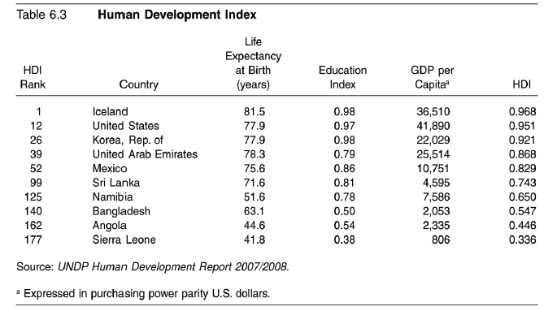
Human Development Index
http://hdr.undp.org/en/data/explorer/

