Slide 1
Learning
PY211/ PY200 General Psychology
Dr. Jaruwan Sakulku

Slide 2
Outlines
Classical condition
Operant conditioning
Cognitive approaches to learning
Notes:
How do we learn from associations between S and R
The roles of rewards and punishments
Applications for behavioural change
The roles of cognition and thoughts in learning

Slide 3
What is learning
Learning is a relatively permanent change in behaviour that brought about by experience

Slide 4
Classical Conditioning

Slide 5
Classical Conditioning
Is the sound of a bell delicious?
Ivan Pavlov, a Russian physiologist who studied digestion
Used dogs to study salivation when dogs were presented with meat powder
Ivan Pavlov trained a dog’s mouth to water at the sound of a bell.
By presenting the sound just before food was brought into the room, eventually the dog began to salivate at the sound of the bell alone.
Classical conditioning involves pairing a response naturally caused by one stimulus with another, previously neutral stimulus.
It is the learning of relationships among events.
Notes:
Pavlov was looking at salivation in dogs in response to being fed
When he noticed that his dogs would begin to salivate whenever he entered the room even when he was not bringing them food
There are some things that a dog does not need to learn

Slide 6
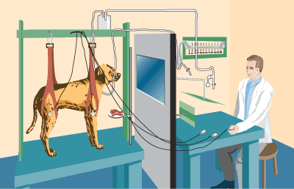

Slide 7
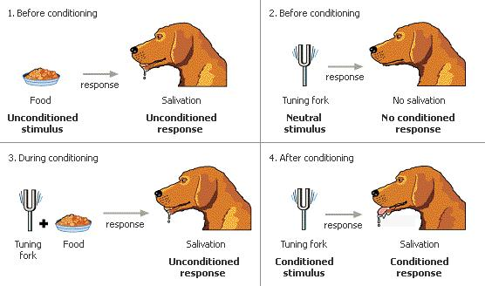
Classical Conditioning

Slide 8
Key Concepts
Unconditioned Stimuli (US)
  A stimulus that invariably causes an organism to respond in a specific way.
Unconditioned Response (UR)
  A response that takes place in an organism whenever an unconditioned stimulus occurs.
Conditioned Stimuli (CS)
  An originally neutral stimulus that is paired with an unconditioned stimulus and eventually produces the desired response in an organism when presented alone.
Conditioned Response (CR)
  After conditioning, the response an organism produces when a conditioned stimulus is presented.
Notes:
The cs is a neutral stimulus
US is biological potent
UR is an unlearned reflex response
CR is similar to UR but CR must be acquired through experience and it is relatively impermanent

Slide 9
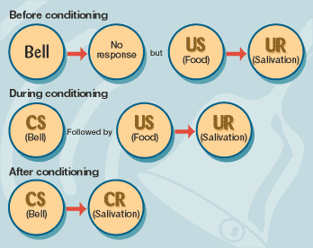

Slide 10
Classical Conditioning in Human
John B. Watson was the first person to study human emotions systematically
Because of his and subsequent research, we now recognize that most of our emotional reactions are learned and they are learned mainly through classical conditioning
Watson & Rayner (1920 & 1921) began their research by testing a number of infants to see their reactions to fire, dogs, cats, laboratory rats, and other stimuli thought to be innately frightening; none of these were

Slide 11
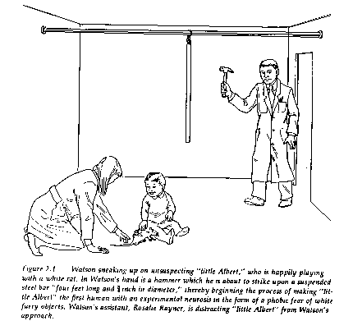
“Little Albert” Experiment

Slide 12
Classical Conditioning in Human
Watson & Rayner (1920) found that a loud noise did elicit an innate fear reaction (crying and other fear-like responses)
They then did the famous Little Albert study where they paired a white lab rat (CS) with striking a steel bar with a hammer behind Albert’s head (US)
Little Albert began to show fear (crying and crawling away = CR) to the white lab rat fairly quickly
Generalize to fear other white fluffy objects

Slide 13
Generalization and Discrimination
stimulus generalization
Stimulus discrimination
In classical conditioning, similar situations or stimuli may cause the same reaction
Are people who are afraid of heights afraid of tall buildings?
differences among stimuli are noticed, so that not all similar things cause the response.
Are people who are afraid of spiders afraid of other bugs?

Slide 14
Extinction & Spontaneous Recovery
When the CS (rat) and the US (loud noise) are no longer paired together, extinction occurs.
The strength and/or frequency of the conditioned response (fear at sight of rat) diminishes.
However, after a while, this response may reappear without retraining in a process called spontaneous recovery.

Slide 15
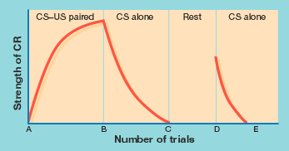
Rat with noise
No rat
Rat alone
Rat alone

Slide 16
Example of Classical Conditioning
E.g. A man feels stressful and nervous whenever he hears the old song, “Yesterday,” by the Beatles. Why?
When he was a little boy, his father used to come home from work and drink whiskey and listen to the Beatles song “Yesterday,” over and over again. Then, he would come into the boy’s room and find a reason to beat him (US). This made him afraid (UR). It happened many times during his childhood. Now when he hears the song (CS), he feels fear (CR).

Slide 17
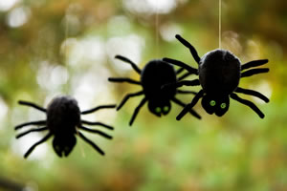
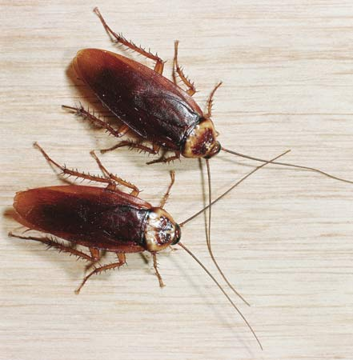
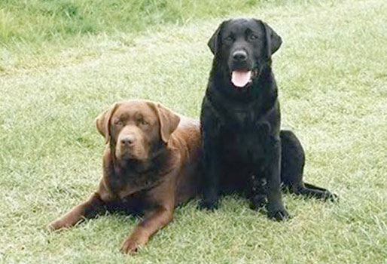

Classical Conditioning in Human
Many of our intense fears come from classical conditioning. We learn to associate a harmless thing with something frightening.
Phobia

Slide 18
Beyond Traditional Classical Conditioning: Challenging Basic Assumptions
John Garcia
  Found that some organisms were biologically prepared to quickly learn to avoid foods that smelled or tasted like something that made them sick
    Learned taste aversion
      Could even occur
        When the interval between exposure and sickness was as long as 8 hours
        After just one exposure

Slide 19
Operant Conditioning

Slide 20
OPERANT CONDITIONING
While classical conditioning concerns learning the relationships between objects and events,
Operant conditioning is the learning that occurs based on the result of a specific action.
The person or animal does something to get something good or avoid something bad.
The law of effect says behavior followed by a desirable experience will be more likely to occur in the future.
And behavior followed by undesirable experience will be less likely to occur

Slide 21
The Basics of Operant Conditioning
Reinforcement: Process by which a stimulus increases the probability that a preceding behavior will be repeated
Reinforcer: Any stimulus that increases the probability that a preceding behavior will occur again
Primary reinforcers
  Satisfy biological need and works naturally, regardless of a person’s previous experience
Secondary reinforcers
  Stimulus that becomes reinforcing because of its association with a primary reinforcer
  Token systems used in treatment of psychological disorders

Slide 22
Types of Reinforcers
Positive Reinforcement – presentation of something good.
Negative Reinforcement – involves the removal of a bad consequence when the response is performed.
Positive Punishment – involves the presentation of a bad consequence when the response is performed
Negative Punishment – involves the removal of a good consequence when the response is performed
Notes:
Skinner (1938) also found that consequences resulting in the removing an aversive (painful, uncomfortable, or undesired) stimulus that was already present could also increase the probability that a certain behavior would occur
Positive- student does something good and gets something they like in return. Studies hard for a test a gets a good grade. This will increase the likelihood of the behavior happening again.
Negative reinforcement-can be argues that it is a punishment
Positive punishment –serves to decrease the likelihood of the response in the future.
Negative punishment – also serves to decrease the likelihood of the response in the future
We focus mainly on primary reinforcement to shape behavior we want and negative punishment to eliminate behavior we don’t want.

Slide 23
Operant Conditioning
Positive reinforcement – something good is presented.
  Studying for exam to get a car from parents
Negative reinforcement – something bad is removed.
  Loud buzz in some cars when ignition key is turned on; driver must put on safety belt in order to eliminate irritating buzz
  Cleaning the house to get rid of your mother's nagging
Positive punishment – something negative is presented,
  Slapping a dog every time he/she barks
Negative punishment - something positive is removed.
  Parents took away your mobile phone and computer when you wake up after 7.00am

Slide 24
Negative reinforcement & Punishment
One mistake that people often make is confusing negative reinforcement with punishment.
Remember, however, that negative reinforcement involves the removal of a negative condition in order to strengthen a behavior.
Punishment, on the other hand, involves either presenting or taking away a stimulus in order to weaken a behavior.

Slide 25
Schedules of Reinforcement
Different patterns of frequency and timing of reinforcement following desired behavior
Continuous reinforcement schedule: Reinforcing of a behavior every time it occurs
Partial (intermittent) reinforcement schedule: Reinforcing of a behavior some but not all of the time

Slide 26
Schedules of Reinforcement in Operant Conditioning
Fixed-interval schedule
Variable-interval schedule
Fixed-ratio schedule
Variable-ratio schedule

Slide 27
Schedules of reinforcement
A fixed-interval schedule provides reinforcement of the first correct response after a fixed, unchanging period of time.
A variable-interval schedule reinforces the learner for the first correct response that occurs after various periods of time, so the subject never knows exactly when a reward is going to be delivered.
In a fixed-ratio schedule, behavior is rewarded each time a fixed number of correct responses is given;
in a variable-ratio schedule, reinforcement follows a varying number of correct responses.

Slide 28
Examples
Fixed interval (time)
  paychecks (every month, same date)
  Performance assessment for Bonus
Variable interval (time)
  unannounced visits by the manager once a month, who gives verbal praise for good work.
  Surprise quizzes
  Fishing: a fish may be caught at intervals of approximately every two minutes; every hour; or every two days

Slide 29
Examples
Fixed ratio (amount) – piece-rate pay scheme – e.g.
  Workers get paid 20 baht for 5 complete units.
  Frequent flyer program: getting a free flight after accumulating x number of flight miles.
Variable ratio (amount)– intermittent rewards for desirable behaviors:
  occasional cash bonuses
  Slot machines at a gambling casino

Slide 30
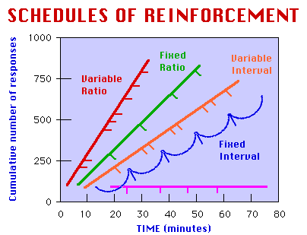
Schedules of reinforcement
Variable ratio is most effective in producing a consistently high level of performance.
  Gambling
  Intimidation
Which is least effective? Fixed interval. They are most commonly used in organizations (monthly paychecks).

Slide 31
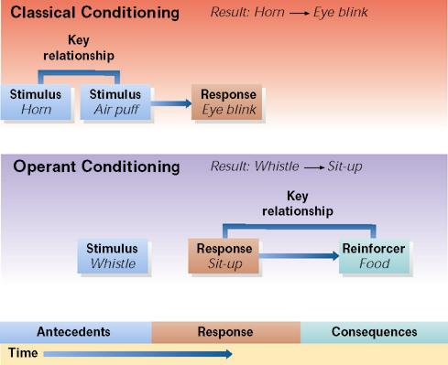

Slide 32
Summary
In classical conditioning, a stimulus that does not produce a response is paired with a stimulus that does elicit a response. After many such pairings, the stimulus that previously had no effect begins to produce a response.
In the example shown, a horn precedes a puff of air to the eye. Eventually the horn alone will produce an eye blink.
In operant conditioning, a response that is followed by a reinforcing consequence becomes more likely to occur on future occasions. In the example shown, a dog learns to sit up when it hears a whistle

Slide 33
Cognitive Approaches to Learning

Slide 34
Bandura’s Triadic Model of Reciprocal Determinism
Overt
Behavior
Environmental
Influences
Personal Factors
(beliefs, expectations,
self-perceptions)

Slide 35
Beyond Reinforcement
External reinforcement isn’t the only way in which behavior is acquired, maintained, or altered
We can also learn by observing, reading, or hearing about others’ behavior
  We develop anticipated consequences for our behaviors
    Even for behaviors we’re never engaged in
  Our cognitive abilities give us the capability for insight and foresight
Bandura’s biggest contribution to learning theory:
  New patterns of behavior can be acquired in the absence of external reinforcement
  We can pay attention to what others do, and repeat their actions
    i.e., We learn through observation, rather than through direct reinforcement

Slide 36
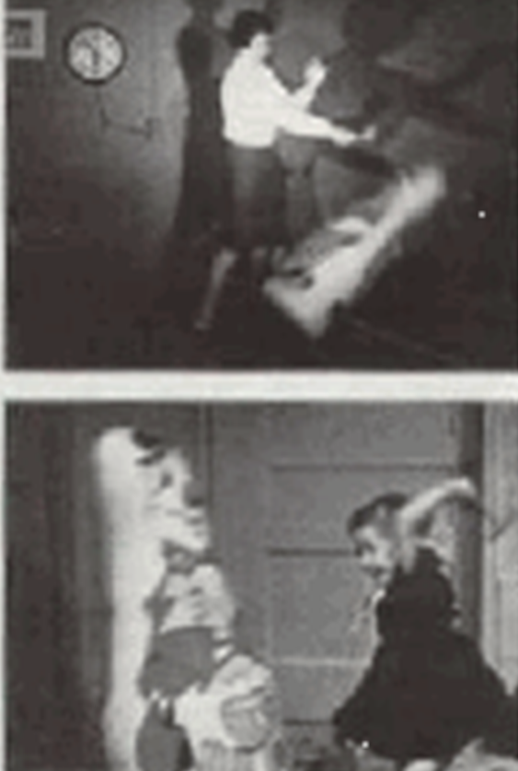
Modeling
We learn much of what we do through observing and speaking with others (“models”), rather than through personal experience
We form a cognitive image of how to perform certain behaviors through modeling, and use this image as a guide for later behaviors

Slide 37
The Observational Learning Process: 4 Steps
Attentional processes
Retention processes
Production processes
Incentive and motivational processes

Slide 38
Step 1: Attentional Processes
Developing cognitive processes to pay attention to a model- more developed processes allow for better attention
Must observe the model accurately enough to imitate behavior

Slide 39
Step 2: Retention Processes
To later imitate behavior, must remember aspects of the behavior
Retain information in 2 ways:
  Imaginal internal representation: Visual image Ex: Forming a mental picture
  Verbal system: Verbal description of behavior Ex: Silently rehearsing steps in behavior

Slide 40
Step 3: Production Processes
Taking imaginal and verbal representations and translating into overt behavior- practice behaviors
Receive feedback on accuracy of behavior- how well have you imitated the modeled behavior?
Important in mastering difficult skills
  Ex: Driving a car

Slide 41
Step 4: Incentive and Motivational Processes
With incentives, observation more quickly becomes action, pay more attention, retain more information
Incentive to learn influenced by anticipated reinforcements

Slide 42
Reinforcement in Observational Learning
Types of Reinforcement
Vicarious reinforcement (our tendency to repeat or duplicate behaviors for which others are being rewarded)
  Vicarious positive reinforcement
  Vicarious punishment
Self-reinforcement
  Reward or punish self for meeting or failing to meet own standards

Slide 43
We learn all kinds of behaviors by observing others
Why don’t we all just run around imitating every behavior we see?
Notes:
Performing the Right Behavior at the Right Time:
Self-Regulation

Slide 44
Triadic Model of Reciprocal Determinism
Overt
Behavior
Environmental
Influences
Personal Factors
(beliefs, expectations,
self-perceptions)

Slide 45
Self-Regulation
An important “personal factor” is the ability to self-regulate
Some people are pretty good at this, some people aren’t so good
Self-regulation is probably domain-specific
  Can regulate some things, but not others

Slide 46
Self-Regulation and Cognition
We can exercise control over our behavior through self-regulation
  We are not slaves to environmental influences
  We have free will
Cognition allows us to use previous experiences, rather than trial-and-error, to foresee probable consequences of our acts, and behave accordingly
Self-regulation allows us to choose behaviors that help us to avoid punishments and move towards long-term goals

