Slide 1

Mutual fund
Presented by
Chanisara Sintoowong 5504640169
Chomprang Wongrusmeeduan 5504640219
Nichaphat Surawattananon 5504640797
Nontrakarn Horpattaporn 5504640821
Palida Netayasupha 5504640948

Slide 2

What is Mutual Fund?
Mutual fund is an investment alternative chosen by people who pool their money to buy stocks, bonds and other securities selected by professional managers employed by an investment company.
Each mutual fund has different objectives such as growth mutual fund or income mutual fund.

Slide 3
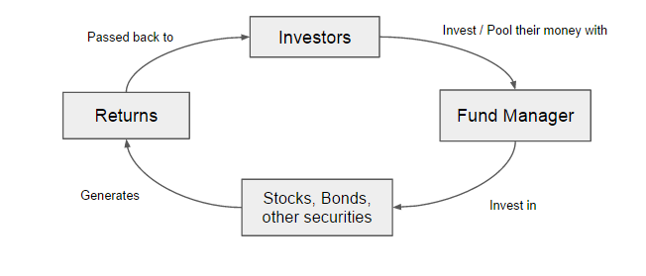
How does mutual fund work?

Slide 4

Types of Mutual Funds
Type of fund according to maturity period
1.Open-ended Fund
Do not have fixed maturity period.
Allow the investors and fund managers to buy and sell shares at net asset value (NAV) per share on daily basis throughout the year.
Do not limit amount of shares issued by the fund, depends on demand of investors.

Slide 5

The fund manager monitors the portfolio and trade the securities properly.
The most common type of mutual fund, also in Thailand.
High liquidity

Slide 6
Type of fund according to maturity period (cont.)
2.Close-ended Fund
Have the maturity period e.g.3,5 and 10 years (in Thailand).
Normally the fund issues shares to public once through initial public offering (IPO).
After IPO, investors can trade shares to other investors in stock exchange market only.

Slide 7

The price received from selling or buying shares from the market is different from NAV.
Discount: lower than NAV
Premium: higher than NAV
Less liquid than open-ended fund

Slide 8

Types of fund according to investment objective
There are 10 types of funds
following the Thai SEC
(Securities and Exchange Commission, ก.ล.ต.)

Slide 9
Types of Funds | Properties
1.Equity Funds | • invest in stocks • objective is a long-term capital growth with some income.
2.General Fixed income Funds | •mobilized through sales of unit trusts in several types of debt instruments, including government bonds, state enterprise bonds, treasury bills, corporate debentures and various types of deposits. •suitable for investors with low risk appetite, since the Fixed Income Fund usually generates regular returns in a form of interest.
3.Long-term fixed income funds | •The fixed income fund with the portfolio duration, the weighted average of the individual duration of bonds within the portfolio, more than 1 year.

Slide 10
Types of Funds | Properties
4.Short-term fixed income funds | •The Fixed income fund with the portfolio duration less than 1 year.
5.Balanced Funds | •invest in a mix of equities and fixed income securities. •suitable for investors with moderate growth appetite.
6.Flexible Portfolio Funds | •seeks high total return by investing in common stock, bonds, and other debt and money-market securities.
7.Funds of Funds | •Funds invest in other funds •The benefit received from this fund is the lower risk which results from the risk diversification. However, the drawback of this fund is the redundant fees from the cost of managing the funds.

Slide 11
Types of Funds | Properties
8.Warrant Funds | •the investors need a warrant paper to claim the right to buy a stock or to buy a debenture.
9.Sector Funds | •invest in the company with the same industry •diversification of risk is low then the risk is high.
10.Money market Funds | •funds invest in safer short-term debt instruments, such as treasury bills, commercial paper and government securities. •a safer investment, but with a lower potential return than other types of mutual funds. •suitable for investors with low risk appetite looking for a short-term period investment.

Slide 12

Advantage and Disadvantage of Mutual Fund

Slide 13
Advantages of the mutual fund
1.Risk Reduction (Safety)
By owning shares in a mutual fund instead of owning individual stocks or bonds, your risk is spread out.
2. Professional Management
Mutual funds do not require a great deal of time or knowledge from the investor because they are managed by professional fund managers.
3. Liquidity
A mutual fund allows you to request that your shares be converted into cash at any time.
4. Easily to get started
Investing in a mutual fund usually doesn’t require a large sum of money.

Slide 14
Disadvantage of mutual fund
1. High Expense Ratios and Sales Charges
Expenses are charged on an ongoing basis, unlike stock investments, for which a commission is paid only when you buy and sell.
2. Unpredictable Performance
The return on your investment depends heavily on that manager’s skill and judgment.
3. Dilution
Because funds have small holdings in so many different companies, high returns from a few investments often don't make much difference on the overall return.

Slide 15
Risk
Level of Risk | Type of investment affected | How the fund could lose money
1 | Money Market Fund | Invest in Government Bond, Treasury Bills or domestic financial instrument which has maturity date less than 1 year
2 | Money Market Fund and Short-term Foreign Bond | Same as the level 1 and also invest in short-term foreign bond so the risk increases a little bit
3 | Government Bond | Invest in government bonds that have both short-term and long-term maturity so there is maturity risk included
4 | Bond Fund | Invest in every type of bond. The credit rating will also determine the risk.
5 | Flexible Fund / Balanced Fund | Allow capital to be invested as the financial professional sees fit.
6 | Equity Fund | Invest in equity which has risk almost equal to investing in equity directly.
7 | Sector Fund | Invests solely in businesses that operate in a particular industry or sector of the economy. Lack of diversification creates high risk.
8 | Alternative Investment | Invests in more complicated assets such as oil, gold etc. Usually has high risk because of complex nature, limited regulations and relative lack of liquidity.

Slide 16
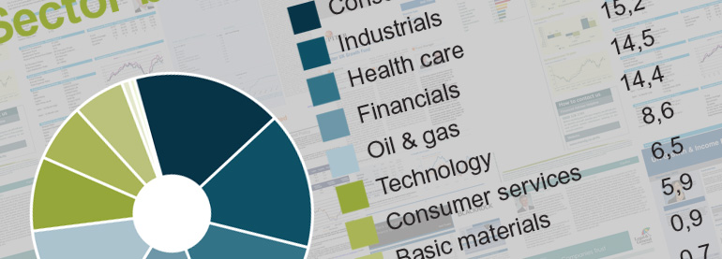
Investing in Mutual Funds
Investors need to evaluate their financial status, goal, time horizon (short-term, medium-term or long-term), risk tolerance and the benefits from the fund.
  For example, if the investor would like to invest for a long-term fund, equity fund could be the choice.
  If the investor couldn’t bare with the swing in portfolio value or prefers less risk, fixed income fund could be the right choice.
To help the investor make the decision, “fund fact sheet” could be used to considered.
Notes:
Financial status
Target of investment such as education, retirement
Time horizon
Risk tolerance

Slide 17
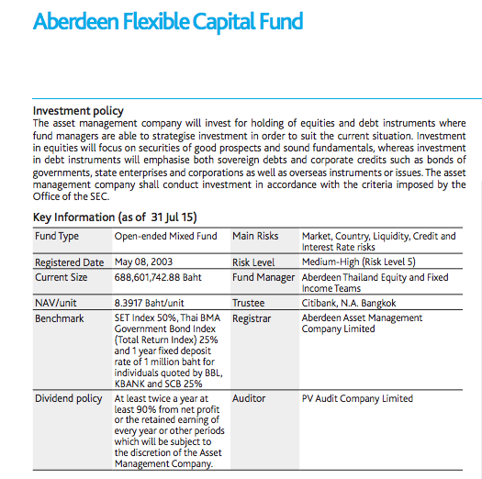
Fund Fact Sheet
Fund fact sheet provides the product features as well as the performance of the fund. It is provided by the asset management company such as Aberdeen.
Investors could use the information to compare the performance with the same type of fund.
The critical information we need to know when investing in the fund is:
  Investment Policy
  Fund Type
  Main Risks
  Risk Level
  Benchmark
  Dividend Policy
Notes:
Should study product’s features, conditions and relevant risks before making investment decision

Slide 18
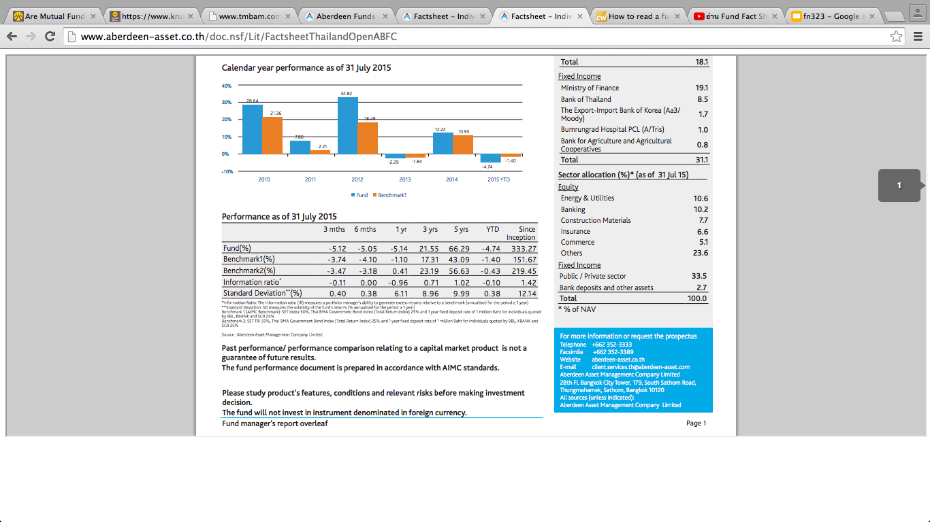
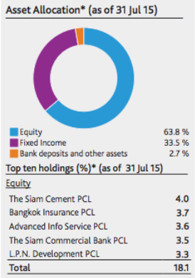
Fund Fact Sheet
Asset Allocation is one of the important part.
Investor could research further more about where their money would be invested.

Slide 19
Fund Fact Sheet
Performance is about the relative results from the fund itself and the benchmark.
Investors should compare the return from the fund with the benchmark.
If the fund’s return is above benchmark index, the performance is quite impressive.
Information ratio measures the fund manager ability to generate excess return relative to benchmark.
Standard deviation measures the volatility of the fund’s returns.

Slide 20
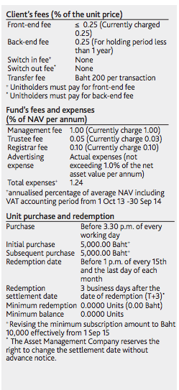
Fund Fact Sheet
Client’s fees affect on the net return for the investors so investors should concern this part as well
  Front-end fee incurs when the investors purchase the fund
  Back-end fee is charged when investors sell the fund.

Slide 21


