Slide 1
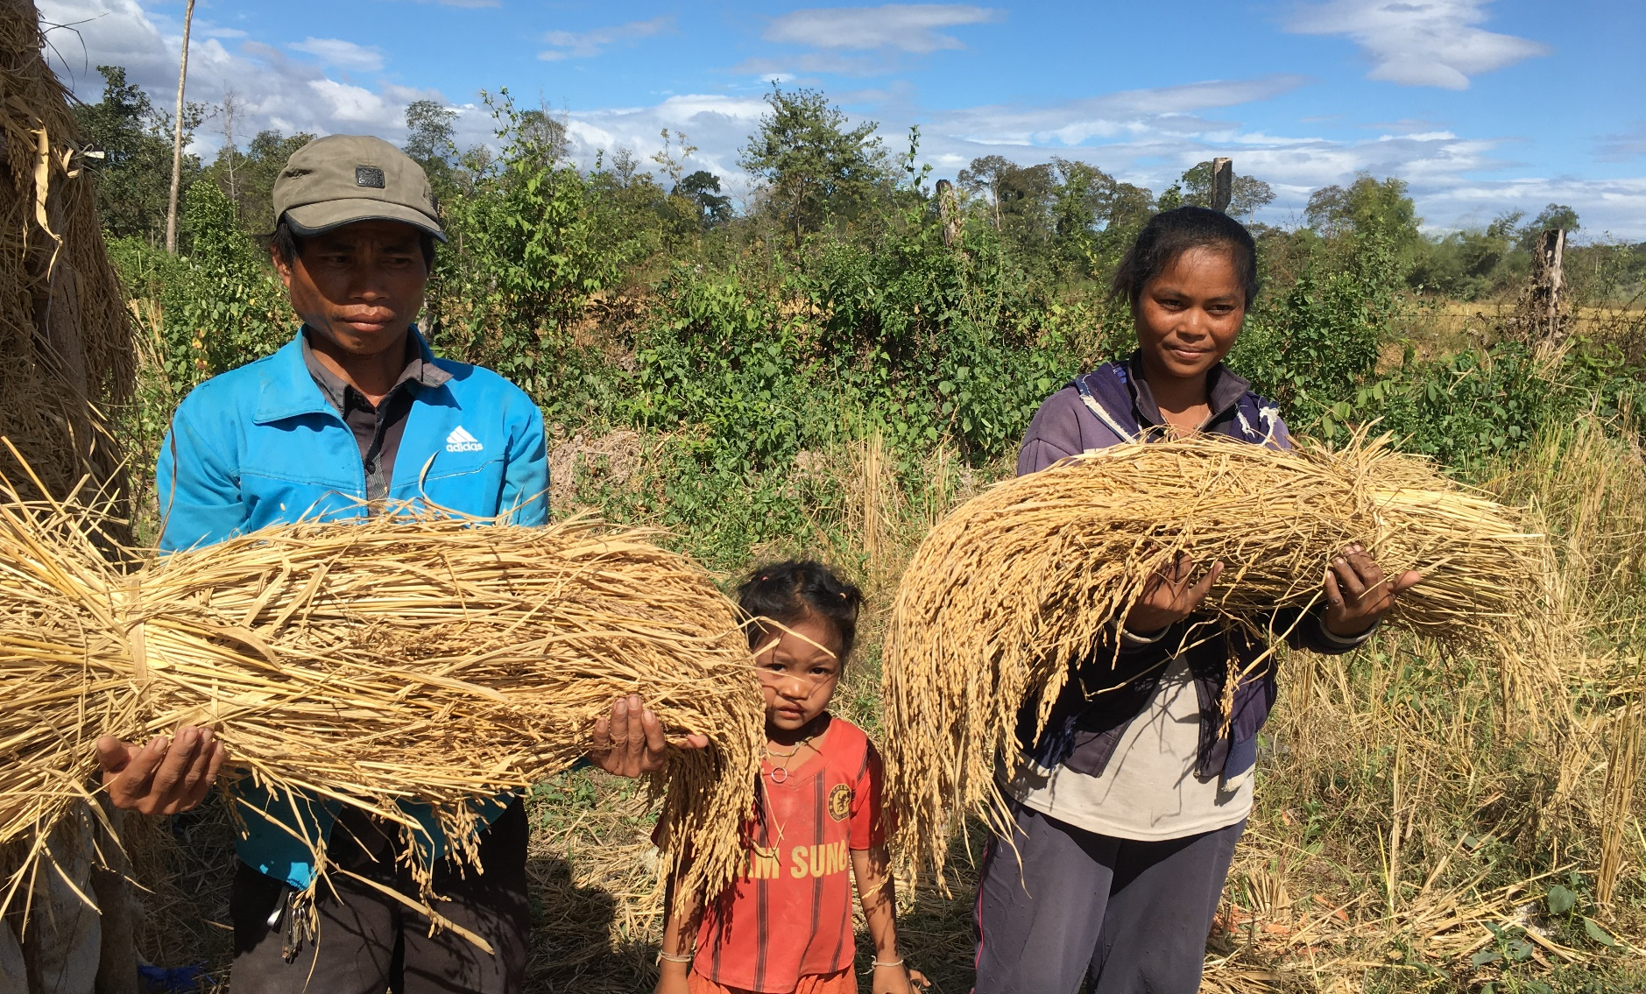
PATTERNS OF economic growth
FACULTY OF ECONOMICS, THAMMASAT UNIVERSITY
MODULE 3

Slide 2
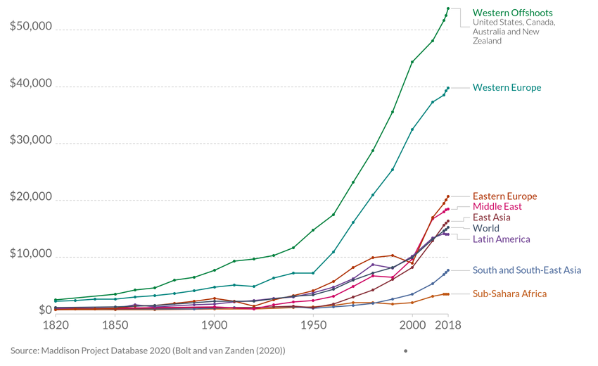
GDP/capita long-term trend, 1820-2018

Slide 3
Differences in development trajectories
Countries that have regressed
Macroeconomic and political instability; decline in GDP
Negative growth (< 0%) Ukraine, Argentina, Madagascar, Zambia
Countries remained stagnant
Insignificant economic growth, no structural change
Slow growth (0-3%): Myanmar, North Korea, Papua New Guinea, Ethiopia, Peru, Brazil
Fast growing economies
Increased output and productivity; some structural problems
Moderate to rapid growth (3-5%): India, China, Malaysia, Thailand, Viet Nam; Botswana, Chile, Estonia and Mauritius
Achieved developed country status
Continued long term economic growth; structural change
Exceptional growth (>5% for a long period) : South Korea, Taiwan, Hong Kong and Singapore

Slide 4
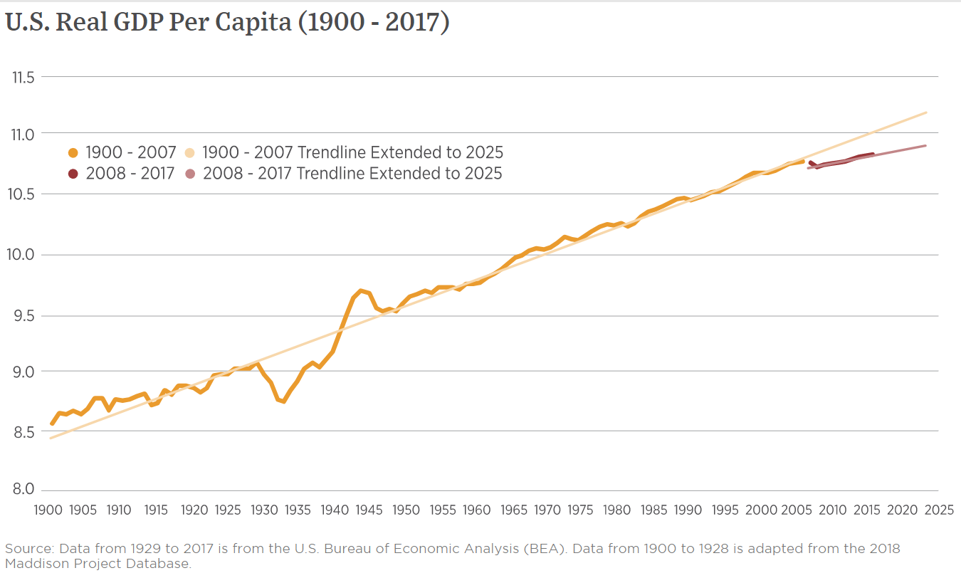
Why are some countries rich? poor?
Long-run economic growth is the single, fundamental explanation of why countries become rich
Examples
United States, starting 1900
Japan, 1950-1990
South Korea, starting 1970
Taiwan: starting 1980
Singapore: starting1980
China: starting 1990

Slide 6
Determining factors of economic growth
Macroeconomic and political stability
Investments in health and education
Favorable geography
Economic growth
Trade, openness and growth
Effective governance and institutions
Favorable business environment

Slide 7

Macroeconomic and political stability
Democratic Republic of Congo (1990-1992): suffered inflation (2,800%) due to civil war and social conflict
Cambodia, Lao PDR and Viet Nam (1960s-1980s): post war social conflicts; isolated from the outside world
Sub-Saharan Africa (late 1990s): cross-border and civil war
The Balkans (late 1980s): conflict led to genocide and ethnic cleansing in Bosnia
The Asian financial crisis of 1998: Negative growth for South Korea, Malaysia, Thailand and Indonesia

Slide 8
Case study: Congo, 1990-1994
GDP per capita, in US$
Decline in economic growth: Democratic Republic of Congo
During 1990-1992, Congo suffered inflation (2,800%) due to civil war and social conflict
Lowest growth rate occurred in 1994 (-4%) before resuming growth the following years
observation period
Source: World Bank Open Data

Slide 9
Case study: Cambodia, Laos and Vietnam
Post war isolation, conflict and reform, 1980s-1990s)
After suffering from social conflicts (1970s-80s) and isolation (1980-86), the region embarked on economic reforms and resumed economic growth
isolation
reforms
resumption of economic growth
Source: World Bank Open Data

Slide 10
Case study: Asian financial crisis 1998
The Asian financial crisis spread quickly from Korea, Thailand and other countries in East and Southeast Asia
GDP per capita fell drastically for South Korea, Malaysia, Thailand and Indonesia in 1998 before rebounding in 2000
Source: World Bank Open Data

Slide 11
GDP growth for select countries
The economic contraction is indicated in GDP growth figures for South Korea, Malaysia, Thailand and Indonesia in 1998
Source: World Bank Open Data

Slide 12
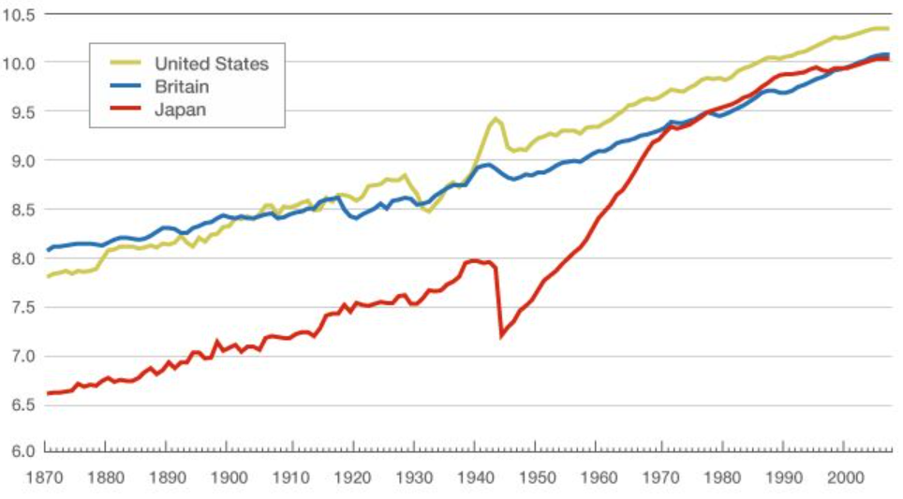
GDP per capita, 1870-2000
WW II
GDP per capita figures for the US, UK and Japan, 1820-2000
Great depression

Slide 13

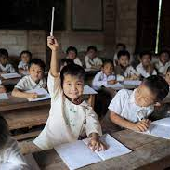
Investments in health and education
Healthy and educated workforce = high productivity
Access to affordable health care facilities, clean water and sanitation
Disease control, reproductive maternal and child health programs
Education provides needed skills to attracts investments; good mix of vocational and educational training programs provides variety

Slide 14
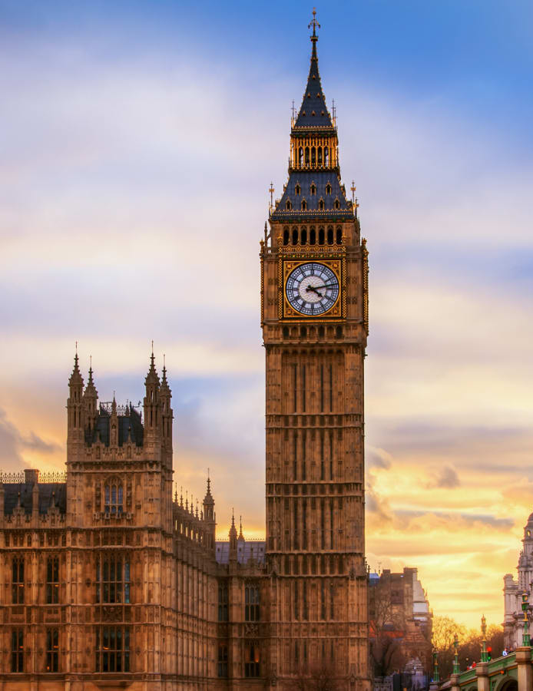
Effective governance and institutions
Positive relationship between economic growth and the rule of law
Strong institutions support financial; health and education systems; trade; and legal systems
Good governance improves investment climate, reduces risks and increases profitability
Strong legal systems help settle commercial disputes in predictable, rational manner
Low level of corruption reduces costs of investment

Slide 15
Favorable business environment
Businesses make decisions regarding saving, investment, education and job opportunities
Businesses need a conducive environment: a strong legal system, access to financial resources, and adequate physical infrastructure
Business decisions are based on government regulations and policies: taxes, subsidies, penalties, benefits, permits and license
Most business decisions are based on government regulations and policies such as:
Taxes
Subsidies
Penalties
Benefits
Permits
Licenses

Slide 16

Trade, openness and growth
Trade enables countries to accumulate physical and human capital; and increase productivity
Outward-oriented policies encourage export promotion; examples are South Korea, Taiwan Singapore, Malaysia
Inward-oriented policies encourage import substation; examples are Brazil and Argentina

Slide 17
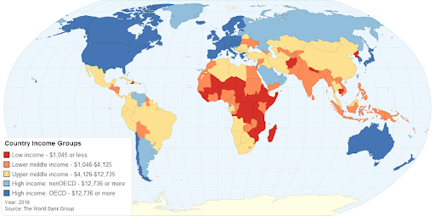
Favorable geography
Most poor countries are located in the tropics
Tropics: prone to spread of disease and erratic climate
Natural resource endowment alone does not guarantee economic growth
Most advanced industrialized countries are located in temperate and subtropical zones, between the Tropic of Cancer and Tropic of Capricorn

Slide 18
Conclusion
Development experiences vary from one country to another, depending on whether they are able to accumulate capital and increase productivity over time
Among several explanations are macroeconomic and political stability, investments in health and education, governance and institutions, trade openness, and a favorable geography

Slide 19
Notes:
© Copyright Showeet.com – Free PowerPoint Templates

