Slide 1
Topic 3 Part 3
The Theory of Demand
(Chapter 5)

Slide 2
Summary
When the price of a good changes, its quantity demanded changes.
The total effect on demand (TE) is due to the sum of two effects:
  Income Effect (IE)
  Substitution Effect (SE).
That is, TE = SE + IE.

Slide 3
Summary
When the price of a good falls…
Substitution Effect implies that the consumer will ALWAYS buy more of the good.
Income Effect implies that the real income increases
AND
  the consumer will buy more of the good if it is a normal good.
  the consumer will buy less of the good if it is an inferior good.

Slide 4
Summary
To represent these two effects in the consumer choice diagram, economists adjust the BL with two steps:
“PIVOT” to represent the SE
“SHIFT” to represent the IE
Moreover, there are two approaches when we try to identify the SE by “pivoting” the BL.
These approaches are
  Hicksian Approach
  Slutskian Approach

Slide 5
Summary
Hicksian Approach
We find the SE by pivoting the BL (to reflect the price change) along the original indifference curve.
We are essentially asking ourselves:
Which Bundle after the price change, would keep the consumer at the utility level that he had prior the price change?
Hicksian Definition of the SE:
“the change in the demand for a good as its price changes, holding the utility constant”.

Slide 6
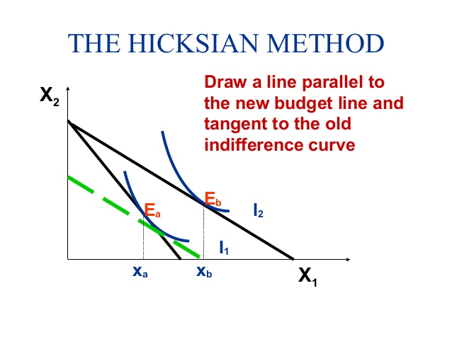

Slide 7
Summary
Slutskian Approach
We find the SE by pivoting the BL (to reflect the price change) around the original bundle.
We are essentially asking ourselves:
Which Bundle after the price change, would keep the consumer at the purchasing power that he had prior the price change?
Slutskian Definition of the SE:
“the change in the demand for a good as its price changes, holding the purchasing power constant”.

Slide 8
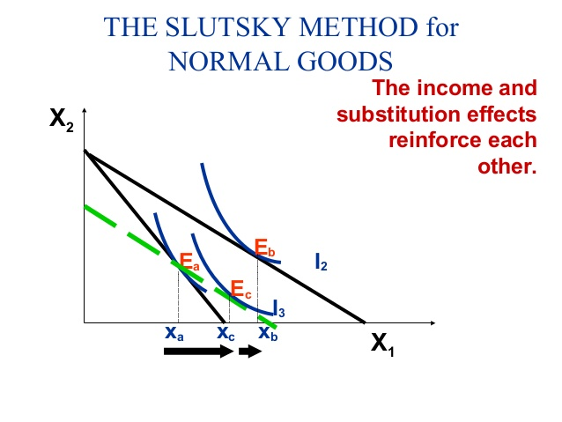

Slide 9
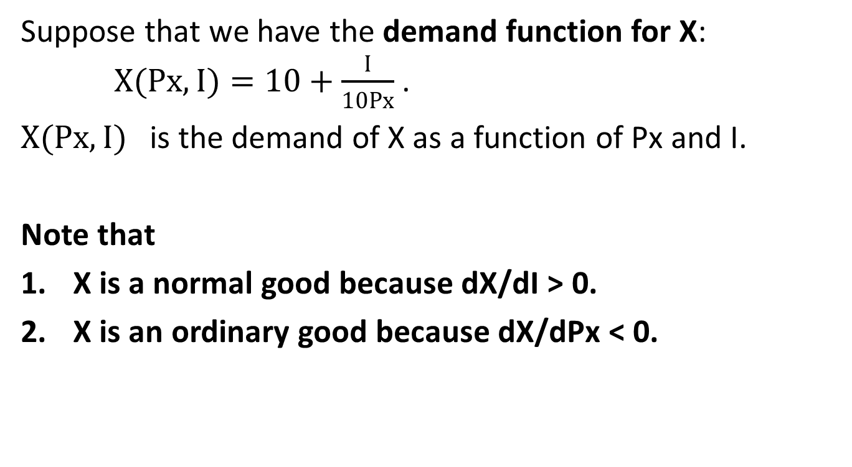
Slutskian Method Example
Suppose that we have the demand function for X:
$X(Px,I)=10+\frac{I}{10Px}$ .
$X(Px,I)$ is the demand of X as a function of Px and I.
Note that
X is a normal good because dX/dI > 0.
X is an ordinary good because dX/dPx < 0.

Slide 10
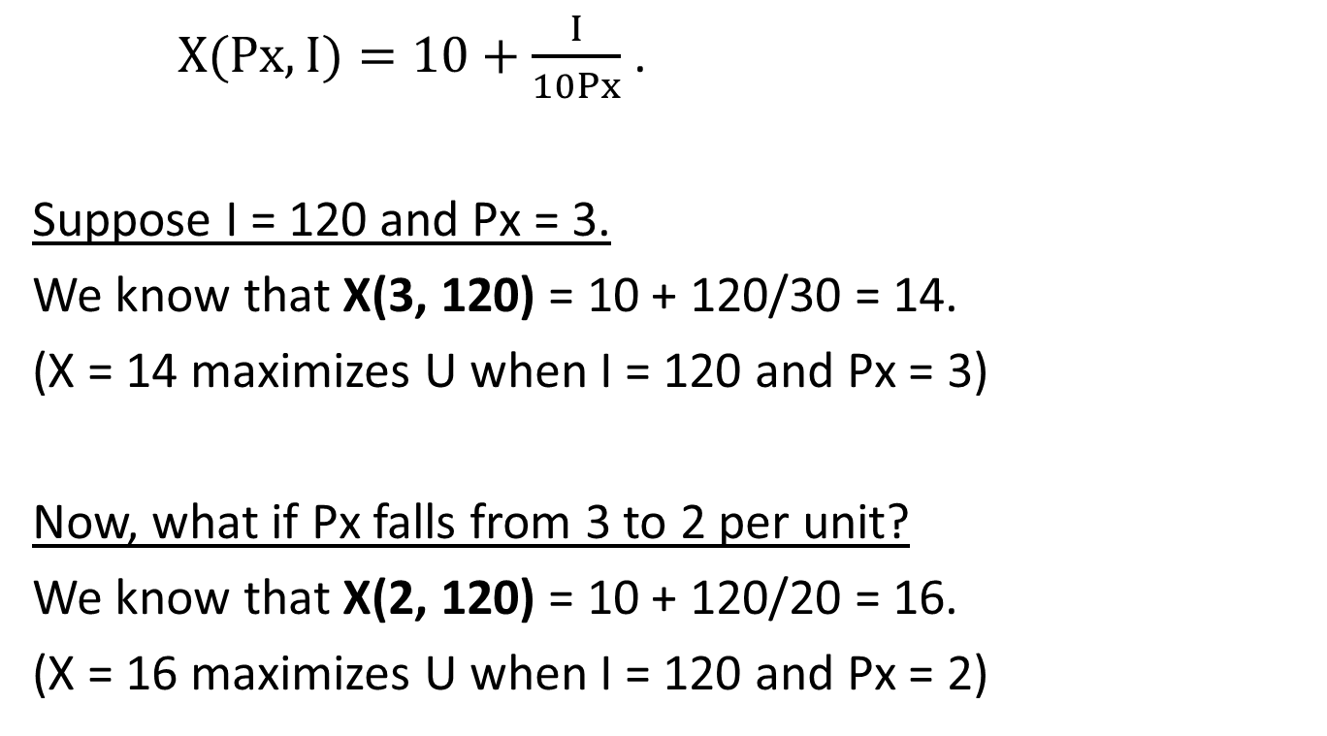
Slutskian Method Example
$X(Px,I)=10+\frac{I}{10Px}$ .
Suppose I = 120 and Px = 3.
We know that X(3, 120) = 10 + 120/30 = 14.
(X = 14 maximizes U when I = 120 and Px = 3)
Now, what if Px falls from 3 to 2 per unit?
We know that X(2, 120) = 10 + 120/20 = 16.
(X = 16 maximizes U when I = 120 and Px = 2)

Slide 11
Slutskian Method Example
The demand for X increases by 2 units.
That is, we buy more because X is cheaper.
This is the Total Effect (TE) of the price change.
Now, we want to know how much the Income Effect (IE) and the Substitution Effect (SE) are.
Note that TE = SE + IE.

Slide 12
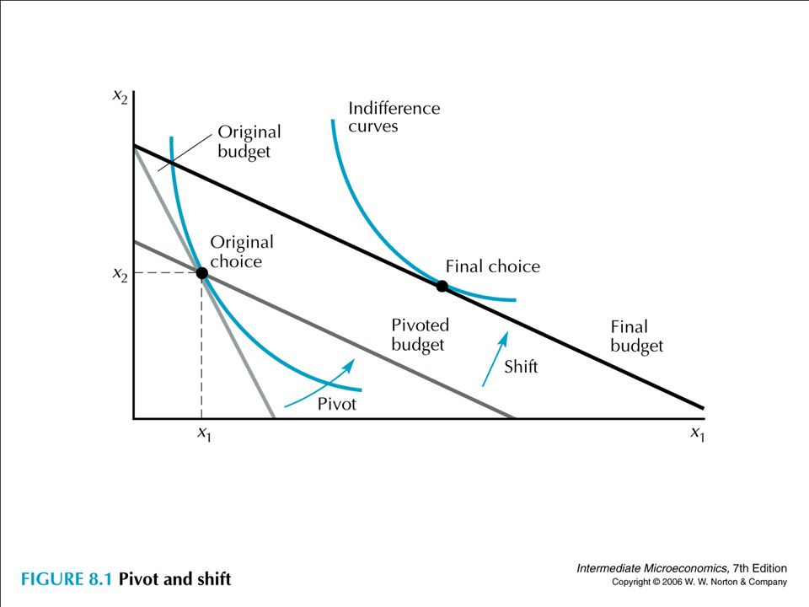
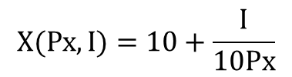
SE = X_{B}(P_{X}’,I’) – X_{A}(P_{X},I)
IE = X_{C}(P_{X}’,I) – X_{B}(P_{X}’,I’)
TE = SE + IE
= X_{B}(P_{X}’,I’) – X_{A}(P_{X},I) + X_{C}(P_{X}’,I) – X_{B}(P_{X}’,I’)
= X_{C}(P_{X}’,I) – X_{A}(P_{X},I)
Y
$$X(Px,I)=10+\frac{I}{10Px}$$
X_{A}(P_{X}, I)
X_{C}(P_{X}’, I)
X_{B}(P_{X}’, I’)
A B C
X
Slope =
– Px’/Py
SE IE

Slide 13
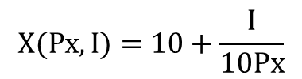
SE = X_{B}(2, I’) – 14
IE = 16 – X_{B}(2, I’)
TE = SE + IE
= – 14 + 16 = 2
We need to find X_{B}(2, I’).
Y
$$X(Px,I)=10+\frac{I}{10Px}$$
X_{A}(3, 120)
X_{C}(2, 120)
X_{B}(2, I’)
14 B 16
X
SE IE

Slide 14
Slutskian Method Example
Substitution Effect (holding purchasing power constant)
To find the SE,
Find the new income (I’) of the pivoted BL.
Find the optimal bundle (Bundle B) on this pivoted BL by using the demand equation.

Slide 15
Slutskian Method Example
To find the SE,
Find the new income (I’) of the pivoted BL.
First, notice that the Pivoted BL is parallel to the Final BL.
This implies that I’ must be less than $120.
Also notice that Bundle A is on the Pivoted BL (where the price has already changed).
This is to keep the purchasing power constant.

Slide 16
Slutskian Method Example
To find the SE,
Find the new income (I’) of the pivoted BL.
Since Bundle A (X_{A}, Y_{A}) is on both BL’s, this means
Original BL: PxX_{A} + PyY_{A} = I 3(14) + PyY_{A} = 120
Pivoted BL: Px’X_{A} + PyY_{A} = I’ 2(14) + PyY_{A} = I’
Both BL’s intersect (i.e. they are equal) at Bundle A,
solving by equating the two BL’s gives I’ = 120 – 14 = 106.

Slide 17
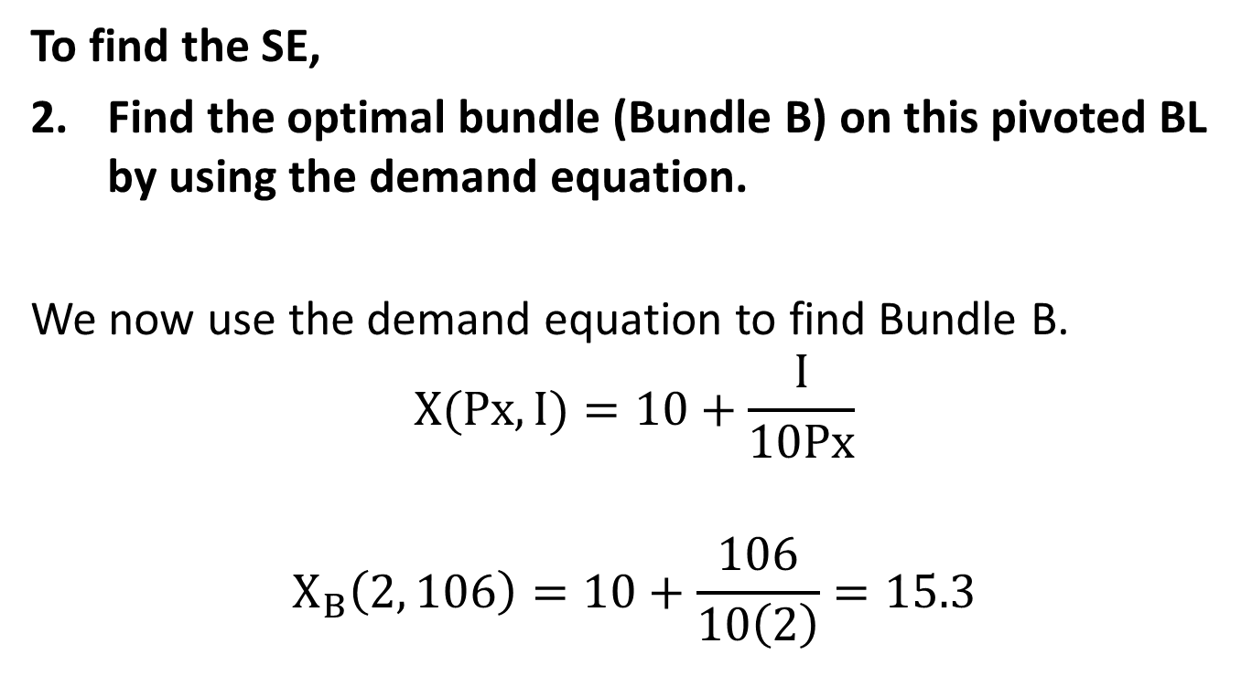
Slutskian Method Example
To find the SE,
Find the optimal bundle (Bundle B) on this pivoted BL by using the demand equation.
We now use the demand equation to find Bundle B.
$$X(Px,I)=10+\frac{I}{10Px}$$
$$X_{B}\left(2, 106\right)=10+\frac{106}{10\left(2\right)}=15.3$$

Slide 18
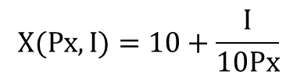
SE = 15.3 – 14 = 1.3
IE = 16 – 15.3 = 0.7
TE = SE + IE = 1.3 + 0.7 = 2
or TE = – 14 + 16 = 2
Y
$$X(Px,I)=10+\frac{I}{10Px}$$
X_{A}(3, 120)
X_{C}(2, 120)
X_{B}(2, 106)
14 15.3 16
X
SE IE

Slide 19
Income Compensation for the SE
In the diagram before, Bundle B is on the BL with a lower income of $106 although the consumer has the income of $120. WHY?
As previously mentioned in Topic 3 Part 2 Page 23, Slutskian and Hicksian Methods “compensate” income of the consumer when identifying the substitution effect.

Slide 20
Income Compensation for the SE
“Compensate” refers to the approach that
  Slutskian Method gives the consumer just enough money to get back to his original bundle A, so that his purchasing power is constant.
  Hicksian Method gives the consumer just enough money to get back to his original utility, so that his utility is constant.

Slide 21
Income Compensation for the SE
However, when Px falls, it is obvious that the consumer can still get back to his original Bundle A, and he should have excess money to buy something else. Thus, his purchasing power is greater after Px falls.
Since Slutskian Method holds the purchasing power constant, money has to be taken from the consumer to reduce his purchasing power.
This is why at Pivoted BL, Income falls to $106.

Slide 22
Income Compensation for the SE
Thus, according to Hicks and Slutsky,
to “compensate” the consumer,
  the income at the Pivoted BL will be reduced when Px falls.
  the income at the Pivoted BL will be raised when Px rises.

Slide 23
Slutskian Method Example
Note: Use the “Slutskian” Substitution Effect
To find the solution:
Step 1: Find the demand equation
Step 2: Use the demand equation to find Bundles A and C.
Step 3: Find the compensated income and plug into the demand equation to find Bundle B.

Slide 24
Ans(c): SE = 21, IE = 0 for the Hicksian Approach

Slide 25
Deriving Slutsky Equation
From TE = SE + IE, we can write it in a symbolic form.
∆X = ∆X_{SE} + ∆X_{IE}
…then..
∆X = ∆X_{SE} – (∆X_{NIE})
where
∆X = X_{C}(P_{X}’ , I) – X_{A}(P_{X} , I)
∆X_{SE} = X_{B}(P_{X}’ , I’) – X_{A}(P_{X} , I) >>> Slutskian Method
∆X_{IE} = X_{C}(P_{X}’ , I) – X_{B}(P_{X}’ , I’)
∆X_{NIE} = – ∆X_{IE} = X_{B}(P_{X}’ , I’) – X_{C}(P_{X}’ , I) >>> “Negative” IE

Slide 26
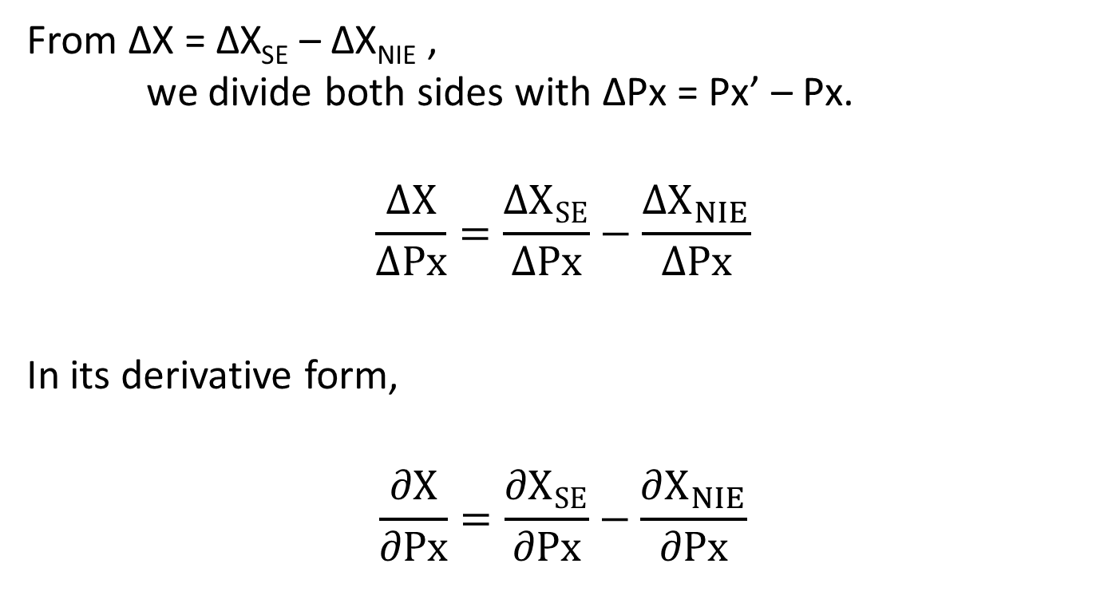
Deriving Slutsky Equation
From ∆X = ∆X_{SE} – ∆X_{NIE} ,
we divide both sides with ∆Px = Px’ – Px.
$$\frac{∆X}{∆Px}=\frac{∆X_{SE}}{∆Px}−\frac{∆X_{NIE}}{∆Px}$$
In its derivative form,
$$\frac{∂X}{∂Px}=\frac{∂X_{SE}}{∂Px}−\frac{∂X_{NIE}}{∂Px}$$

Slide 27
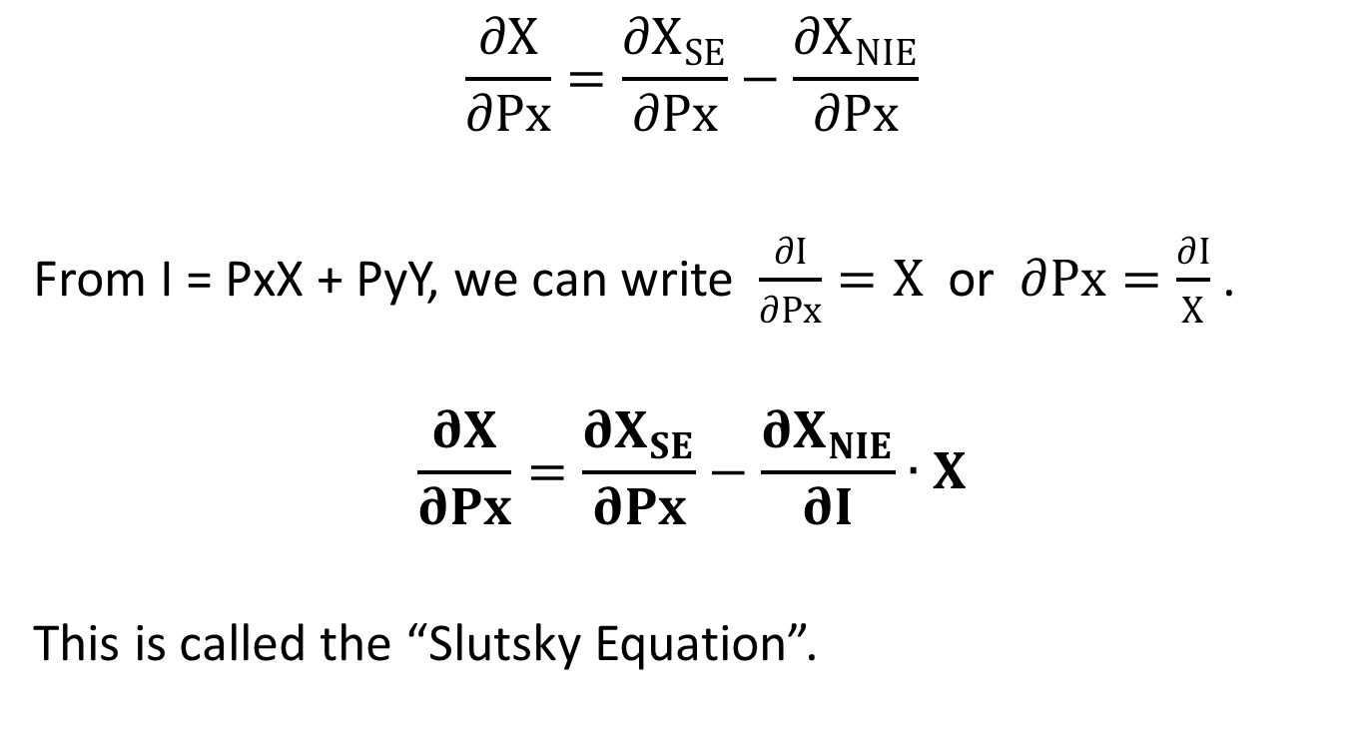
Deriving Slutsky Equation
$$\frac{∂X}{∂Px}=\frac{∂X_{SE}}{∂Px}−\frac{∂X_{NIE}}{∂Px}$$
From I = PxX + PyY, we can write $\frac{∂I}{∂Px}=X$ or $∂Px=\frac{∂I}{X}$ .
$$\frac{∂X}{∂Px}=\frac{∂X_{SE}}{∂Px}−\frac{∂X_{NIE}}{∂I}∙X$$
This is called the “Slutsky Equation”.

Slide 28
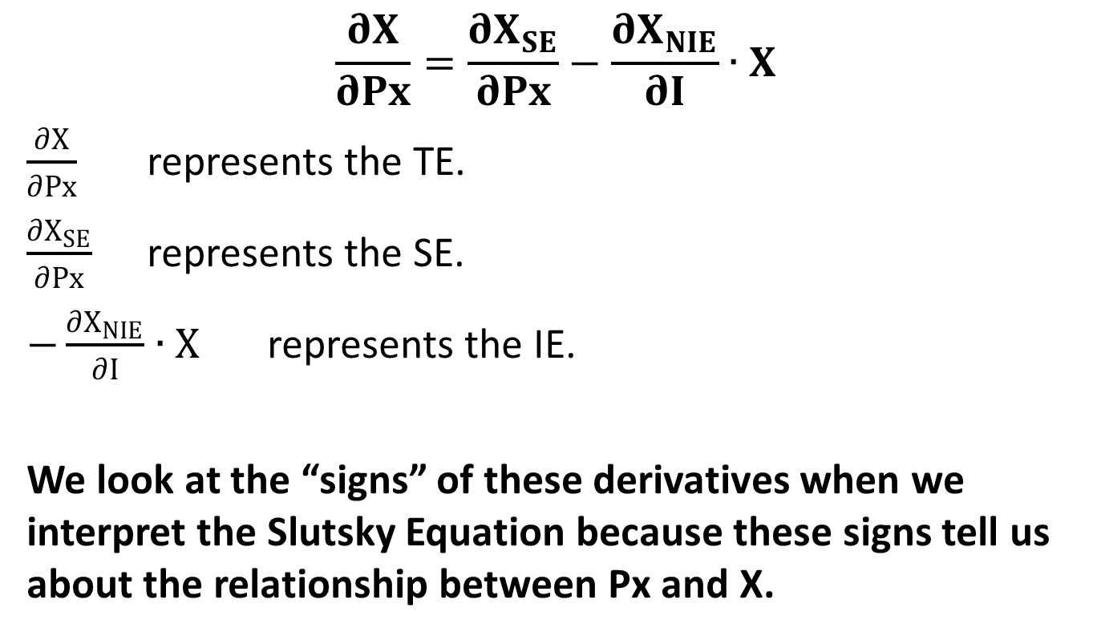
Slutsky Equation
$$\frac{∂X}{∂Px}=\frac{∂X_{SE}}{∂Px}−\frac{∂X_{NIE}}{∂I}∙X$$
$\frac{∂X}{∂Px}$ represents the TE.
$\frac{∂X_{SE}}{∂Px}$ represents the SE.
$−\frac{∂X_{NIE}}{∂I}∙X$ represents the IE.
We look at the “signs” of these derivatives when we interpret the Slutsky Equation because these signs tell us about the relationship between Px and X.

Slide 29
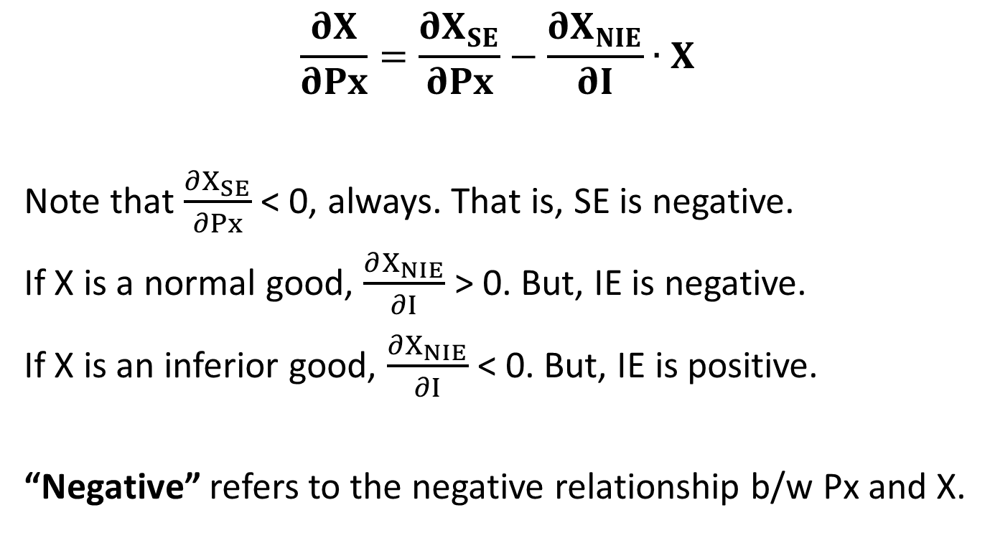
Slutsky Equation
$$\frac{∂X}{∂Px}=\frac{∂X_{SE}}{∂Px}−\frac{∂X_{NIE}}{∂I}∙X$$
Note that $\frac{∂X_{SE}}{∂Px}$ < 0, always. That is, SE is negative.
If X is a normal good, $\frac{∂X_{NIE}}{∂I}$ > 0. But, IE is negative.
If X is an inferior good, $\frac{∂X_{NIE}}{∂I}$ < 0. But, IE is positive.
“Negative” refers to the negative relationship b/w Px and X.

Slide 30
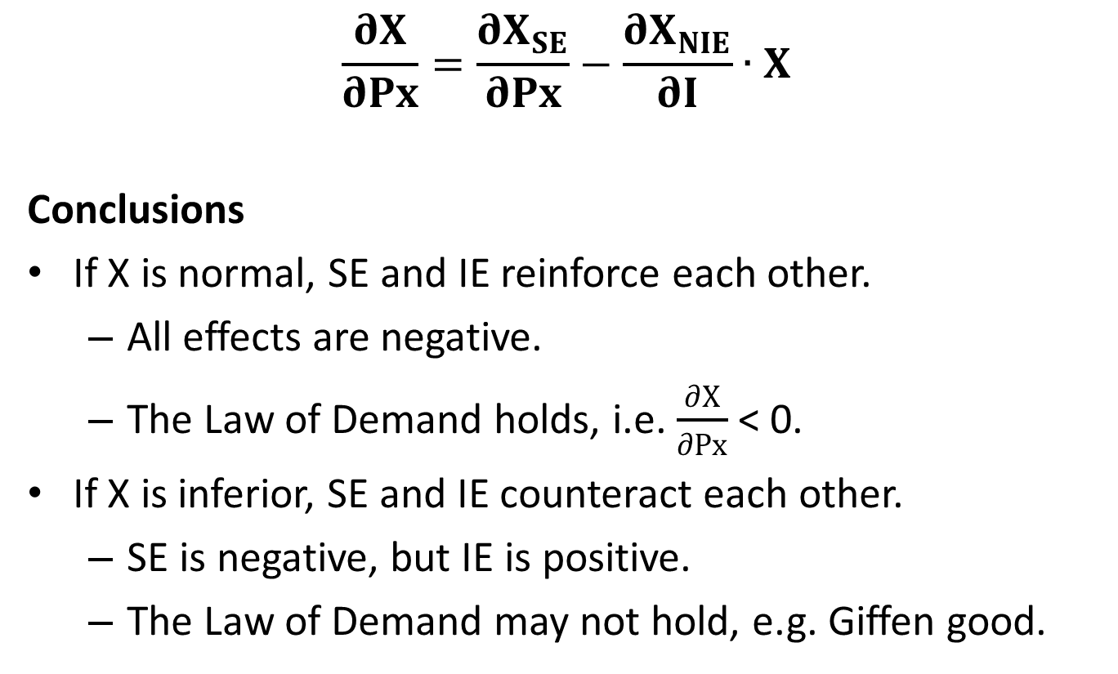
Slutsky Equation
$$\frac{∂X}{∂Px}=\frac{∂X_{SE}}{∂Px}−\frac{∂X_{NIE}}{∂I}∙X$$
Conclusions
If X is normal, SE and IE reinforce each other.
  All effects are negative.
  The Law of Demand holds, i.e. $\frac{∂X}{∂Px}$ < 0.
If X is inferior, SE and IE counteract each other.
  SE is negative, but IE is positive.
  The Law of Demand may not hold, e.g. Giffen good.

