Slide 1
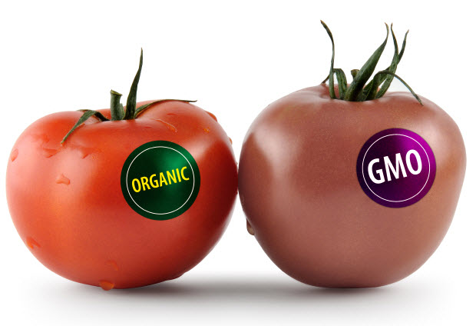
Who benefits and loses
from GMOs?
Pimolporn Jintarith
Shoko Tanaka
Suthasinee Temrat
Akiyuki Maeda
Mei Deng
Haruka Hachiya
Notes:
Good morning everyone. Today we will be doing a presentation on the topic of GMOs. Our topic is: who benefits and loses from GMOs? We will be discussing the benefits and the disadvantages of BMOs in modern day society.

Slide 2
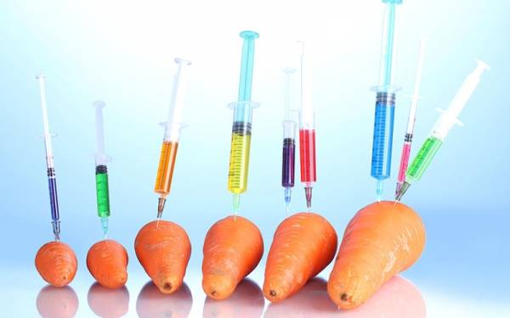
What is GMO?
GMO = genetically modified organism
Plants or animals created through the process of Genetic Engineering (GE)
Experimental technology by obtaining DNA from one species into a different species
  Foreign gene may come from bacteria, viruses, insects, animals or even humans
Biotechnology VS conventional methods
UNSTABLE combination of plants, animals, bacterial and viral genes that CANNOT OCCUR IN NATURE or in traditional breeding
Notes:
What is a GMO? I’m sure you have all heard of GMOs as it is the newest fad in the health and nutrition industry and it is all social media as a very controversial topic. To those that do not not, GMO stands for “genetically modified organism.” GMOs are plants or animals created through the process of genetic engineering. This is an experimental technology by which one obtains DNA from one species and inputs into a different species. The DNA genes come from various organisms like bacteria, viruses, insects, animals, and even humans. This method is very different from our conventional methods of growing plants. It is also an unstable combination of plants that do not regularly occur in nature so that also raises a point of ethics.

Slide 3
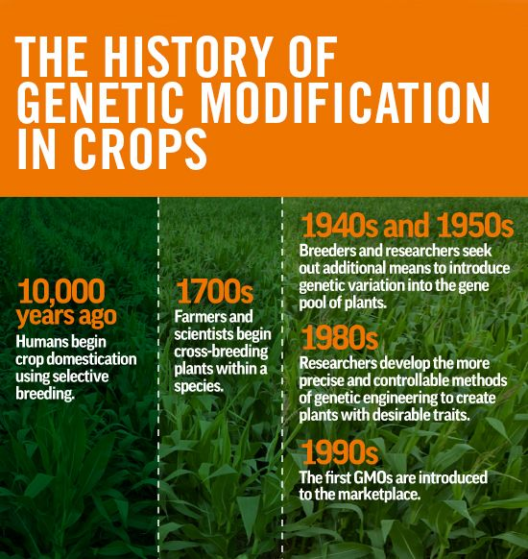
History of GMOs
(1982) First GM crop: antibiotic-resistant tobacco plant
(1994) First GMO food: Flavr Savr tomato by Calgene
(1995) Other GMO crops:
  Bacillus thuringiensis (Bt) potato
  canola with modified oil composition
  cotton resistant to the herbicide bromoxynil
  virus-resistant squash
  delayed ripening tomatoes
Notes:
GMOs were only recently popularized within the health industry, but it has been around hundreds of years. It began around ten thousand years ago when humans began using selective breeding to produce crops. This means that people picked out the best crops to grow in harsh weather conditions and long seasons. In 1700s, farmers and scientists got together to begin cross-breeding plants within a species. In the mid 1900s, between 1940s and 1950s was when genetic mutation of plants was introduced and further developed into the 1980s and 1990s. The first GM crop to be produced was an antibiotic-resistant tobacco plant. Following that was the first GMO food, the Flavr Savr tomato that would take longer to rot than a regular tomato. Other GMO crops also became readily available in 1995, such as GMO crops of potatos, canola, cotton that was resistant to certain herbicides, virus-resistant squash, and other tomatoes.

Slide 4
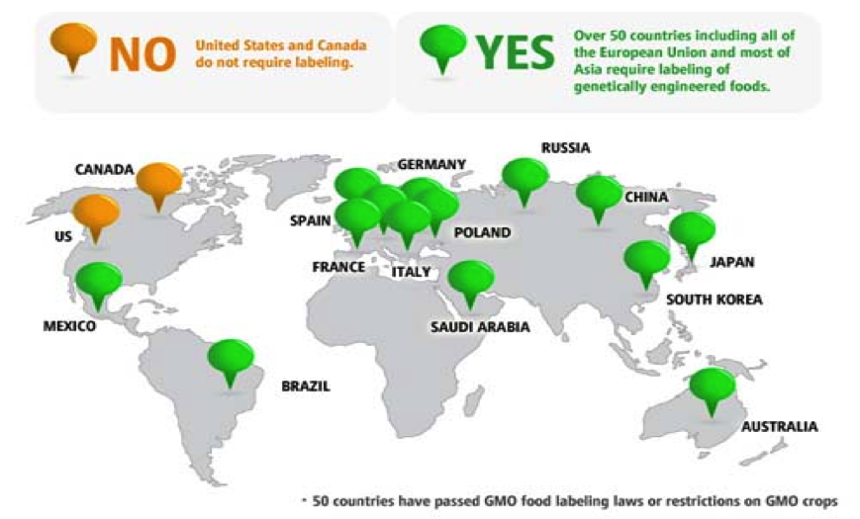

Slide 5
The USA and Canada, largest producers of GMOs crops but do not mandate labels for GMO foods
Some the countries with severe restrictions or bans against GMO food production or sales include:
Germany
Switzerland
Hungary
Ireland
Philippines
Australia
Peru
Japan
Countries with mandatory labeling include:
Australia
China
Japan
New Zealand
Russia
All countries in the European Union

Slide 6
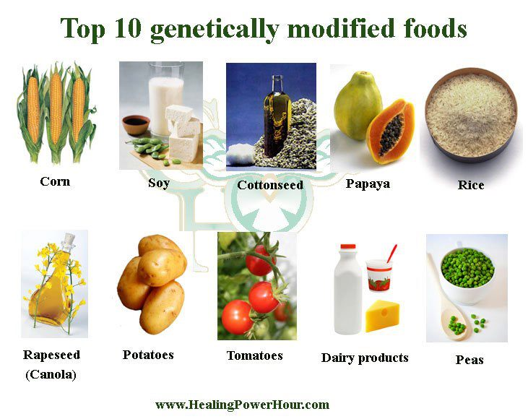

Slide 7
Benefits of GMOs
(Pros)

Slide 8
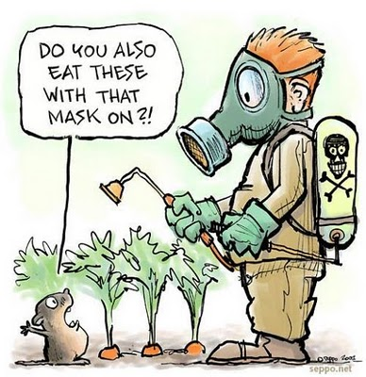
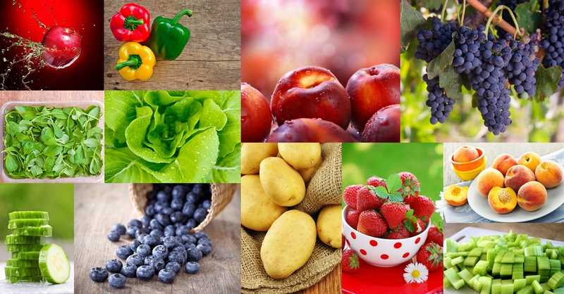
Benefits of GMOs - Consumer Side
Reduced world’s hunger; provide sufficient food for humans
Reduced pesticide residue products, which are healthier for all people. Particularly, for women and children who are sensitive to their impacts.
Enhanced nutritional content to benefit consumer’s health
  For example: soybean with an increased level of omega-3 fatty acids

Slide 9
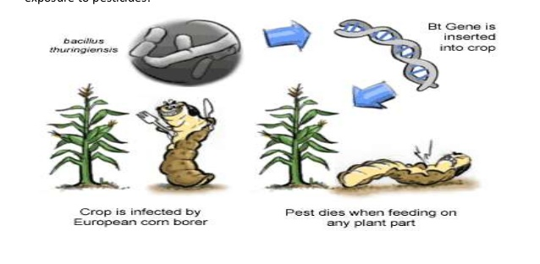
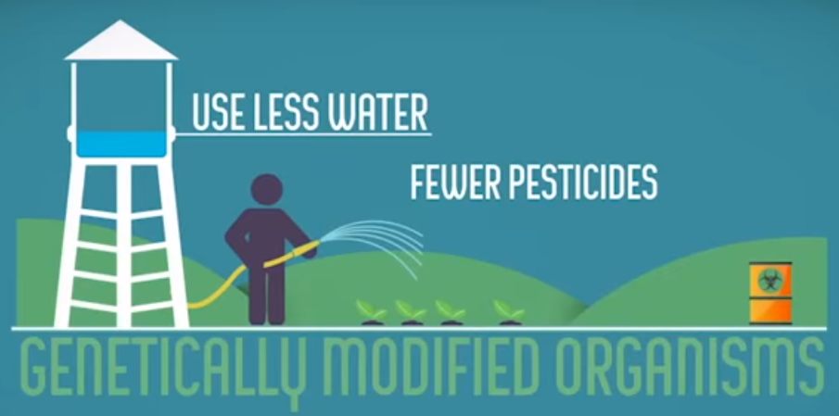
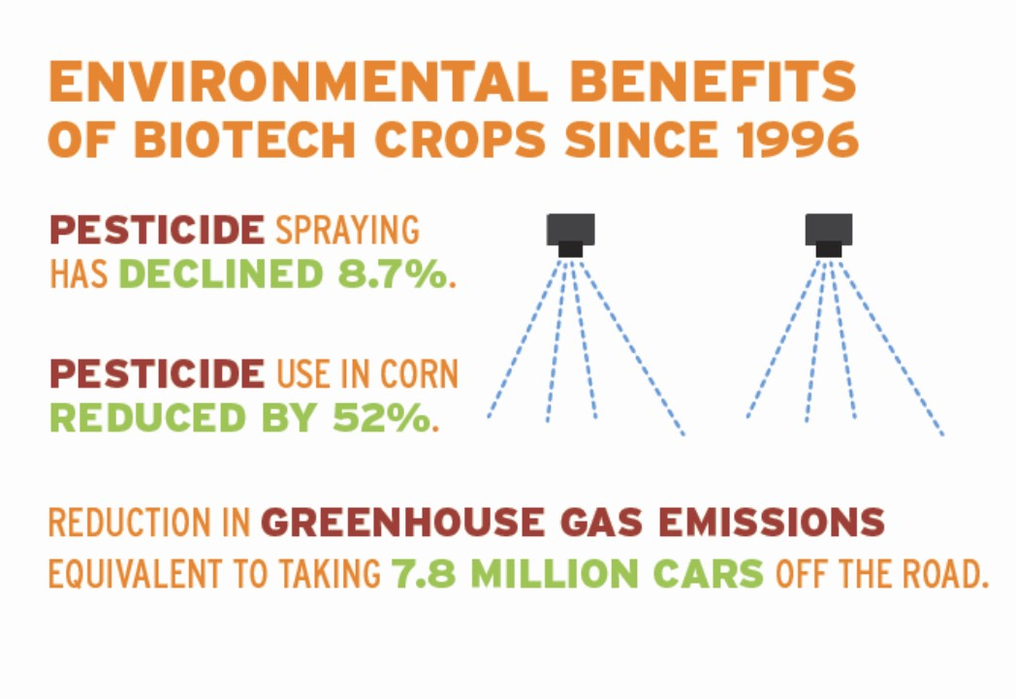

Benefits of GMOs - Producer Side
Bigger yields to create more efficient use of land
Delivering high yields in tough environmental conditions
Creating plants better resistant to weeds, pest and other diseases
less uses of herbicides and other pesticides
Foods with a longer shelf life for easier shipping
Crop biotechnology helps farmers earn reasonable incomes for their work
Crop biotechnology continues to be a good investment for farmers around the world especially for developing countries

Slide 10
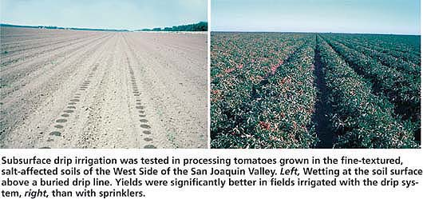
Benefits of GMOs - Environmental Impacts
Fewer chemical Applications
Improve water quality
Reducing Greenhouse gases
CASE STUDY: Soil salinity in San Joaquin Valley, USA
Crops less able to grow and in some cases unable to grow at all
A gene from the grey mangrove, Avicennia marina, has been genetically implanted into the crops, making it able to tolerate salt stress as well as showing tolerance to other ionic stresses.

Slide 11
Disadvantages of GMOs
(Cons)

Slide 12


Disadvantages of GMOs - Key Disadvantages
Risks on the environment or people’s health?
Monopolizing GMO production?
Hybrid seeds? Superbugs, Superweeds?
Death of vital beneficial bugs(bees, butterflies)?
Cross contamination of other crops and plants?
Increased GMO farmer’s suicide rates?
etc…..
Notes:
There are many disadvantages of GMOs and we have narrowed it down to a few that we will discuss about in the following slides, such as the environmental risk and the health risks. There is also the concern of the monopolization of GMO production by a specific company known as Monsanto. GMO creates hybrid seeds and superbugs and super weeds that will be harder to get rid of, as well as death of the more natural and beneficial bugs like bees and butterflies. There is also the cross contamination of other crops and plants. Lastly, GMOs have been reported to affect suicide rates, which we will later discuss.

Slide 13
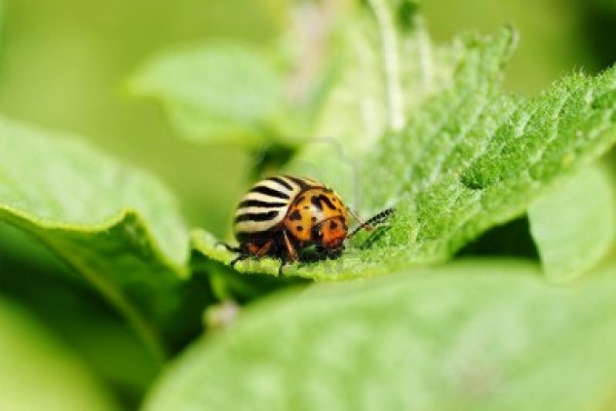
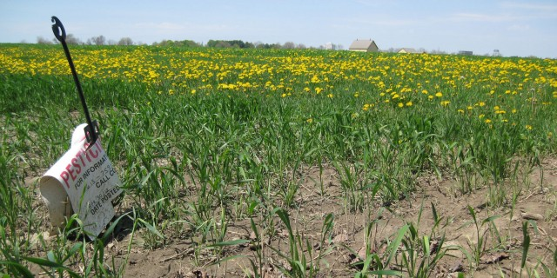

Cons of GMOs - Environmental Risks
〈Risk on Environment〉
Harm Biodiversity…worsing the influences of large-scale monoculture, kill bees and butterflies
Cross-Pollination Contaminates Regular Crops...it’s hard to get rid of hybrids, even if they are harmful
Environmental Pollutions because of contradictorily increased use of herbicides(weeds killer) and petroleum, or Appearance of Superbugs and Superweeds immune to these chemicals

Slide 14
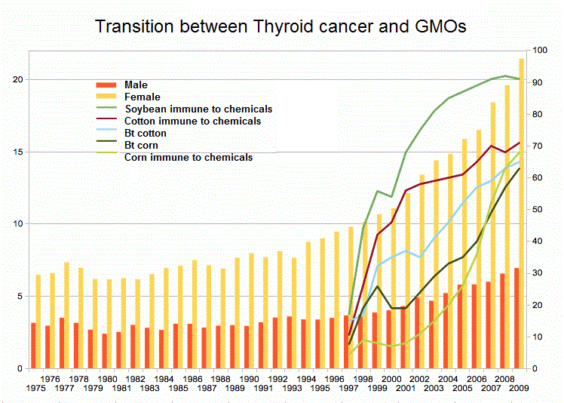
Cons of GMOs - Human Health Risks
〈Risk on People’s Health〉
contaminates soil and groundwater, the residents who drink or use it suffer them.
Increased Chronic Diseases such as cancer, allergy, leukemia
Difficult to prove the causation between GMOs and health problems

Slide 15

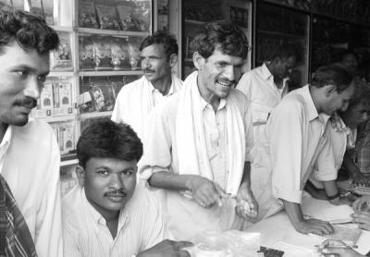
Cons of GMOs - Case Study : Producer Impact
About 300,000 Indian farmer suicides between 1990 to 2014
Monsanto monopolized in USA, selling GMO agricultural products
Monsanto’s seeds bought at a high price, causing farmers to go into debt
Harvest was small because bags had tolerance and seeds were not fit for India soil.
Farmers commit suicide because they cannot pay off loans

Slide 16

Conclusion
Notes:
In conclusion, GMOs both are good and bad. Ultimately it is the consumer’s decision to decide whether or not they want to purchase it at the supermarket or grocery store because this will either increase or decrease demand of these crops for the farmers. You make the decision!

Slide 17
fin
Notes:
Thank you.

