Slide 1
EE401 Political Economy
Chapter 4 Market and Resource Constraints:
Thomas Robert Malthus
Ploy Thammapiranon 2/2017
BE, Thammasat University

Slide 2
Market and Resource Constraints: Thomas Robert Malthus
The Industrial Revolution and its consequences
Thomas Robert Malthus
But why still famines and poverty?
Multhus’ modern impacts
Scarcity and the markets

Slide 3
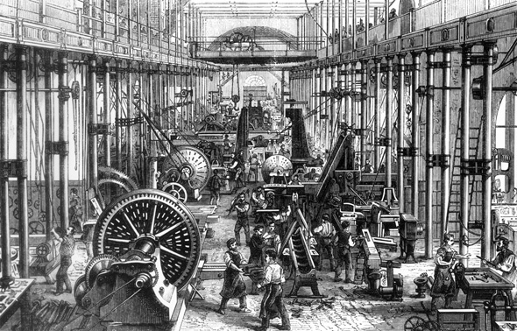
1. The industrial revolution and its consequences
1.1 The industrial revolution
Industrial revolution from the 1750s.
The rise of the industrial factory system.
  Mechanization of working life.
  Hard labor, low wages, long working day.
  Exploitation of women and children.
Rapid technological progress.

Slide 4
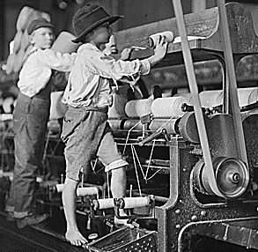
1. The industrial revolution and its consequences
1.2 Social Consequences
Technological progress comes with social changes.
Destruction of social and family life; obsolete knowledge and jobs.
Rapid urbanization.
  Regimented factory life, low wages, long working hours.
  Slums, diseases, lack of sanitation.
  Beggars, prostitution, crimes, orphans.

Slide 5
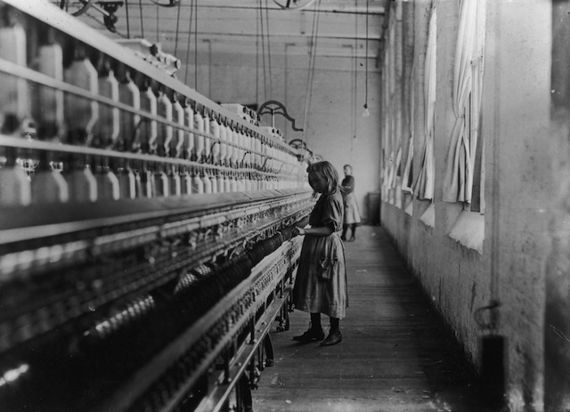
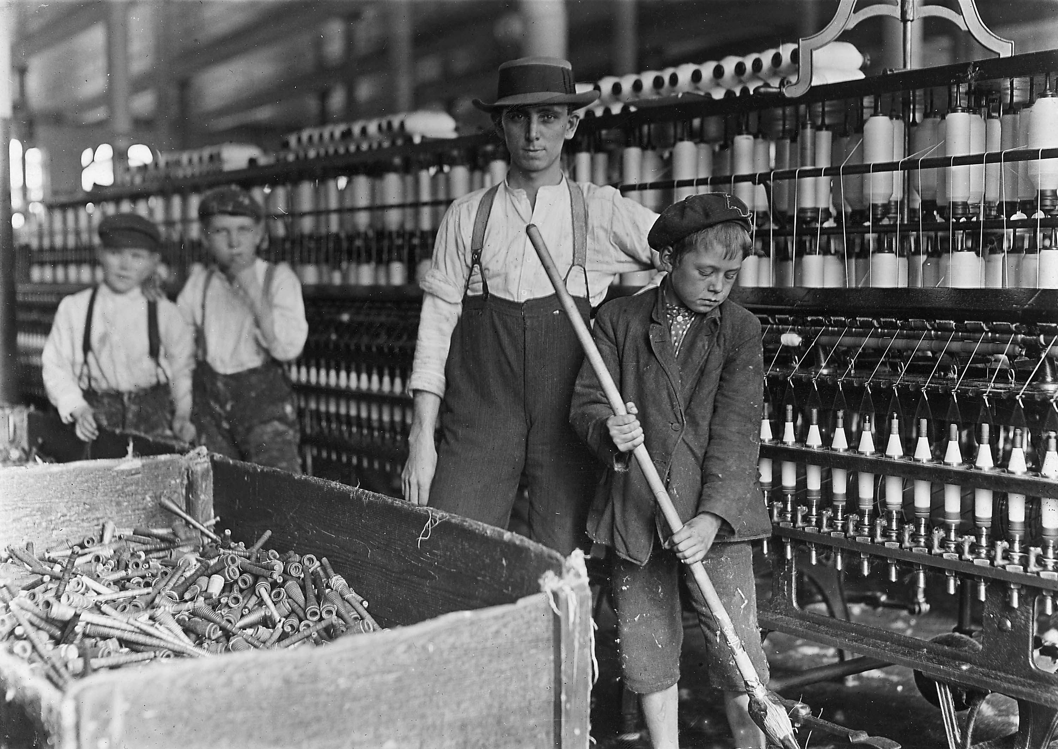

Slide 6

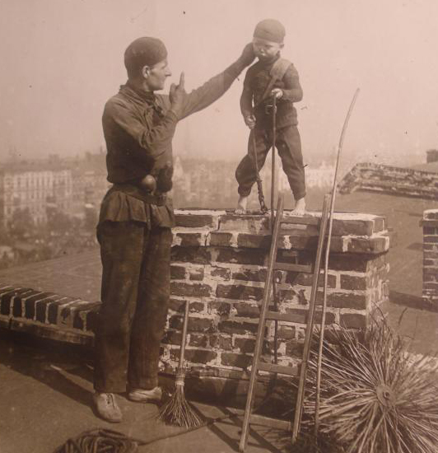

Slide 7
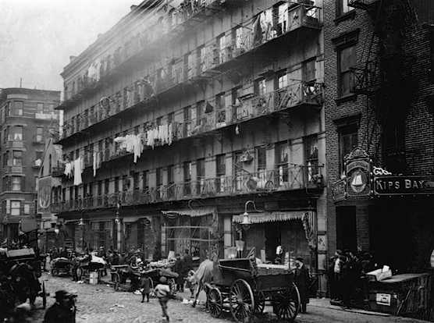
1. The industrial revolution and its consequences
1.2 Social Consequences
Rapid population growth in Britain.
  6.5 millions in 1750 to 17.9 millions in 1850.
  Environmental destruction and the fear of resource exhaustion.
Intense class conflict:
  The Luddite revolts.
  Riots and social upheavals 1811-48.
  1799 first labor union formed and suppressed.

Slide 8
2. Thomas Robert Malthus (1766-1834)
2.1 Biography
Mathematics and linguistics in Cambridge.
Ordained a minister of the Church of England.
‘An Enquiry on the Principle of Population as It Affects the Future Improvement of Society, with Remarks on the Speculations of Mr. Godwin, M. Condocet, and Other Writers’.
expanded 2nd ed. with Malthus’s name.
‘The Principles of Political Economy’.
1784
1788
1798
1803
1820
8

Slide 9
2. Thomas Robert Malthus (1766-1834)
2.2 Theory of Population
The basic contradiction between population growth and food supply growth.
  Population grows at the geometric rate, to double every 25 years.
  Food production increases at the arithmetic rate – the diminishing returns.
The imbalance is solved by ‘checks’.
  Positive checks: increase the death rate e.g. famines, wars, plagues, misery.
  Preventive checks: reduce the birth rate e.g. sterility, sexual abstinence, birth control.
Moral restraint: postpone marriage; married only if ones can afford children.
The lower class suffers because the lack of moral restraint.
9

Slide 10
2. Thomas Robert Malthus (1766-1834)
2.2 Theory of Population
Higher wages lead to more leisure, more children, falling wages to subsistence, declining production and rising misery.
Population pressure keeps the wage rate at the subsistent level --- ‘the iron law of wages’.
The wealthy class has moral restraint.
  Limited number of children and accumulation of wealth.
10

Slide 11
2. Thomas Robert Malthus (1766-1834)
2.3 Public Policies
Existing Poor Laws with relief and child support worsened the condition of workers and society.
  Encouraging the poor to have more children and less incentives for work.
Support for the Corn Laws.
  To raise food prices and induce more production at home.
  Trade protectionism on agricultural products.
11

Slide 12
2. Thomas Robert Malthus (1766-1834)
2.4 Political and Social Impacts
The Poor Laws amendment of 1834:
  No relief for able-bodied persons.
  Breakup of families in separate ‘houses’, hard works and harsh treatment of the poor.
  Social stigma for the poor.
  In line with values of hard work, thrift, duty, respectable behaviors and characters (1860s- ).
12

Slide 13
2. Thomas Robert Malthus (1766-1834)
2.5 Criticisms of Malthusianism
No empirical support for differences in food and population growth rates.
  Malthus’s US data lumped immigration with natural birth.
Modern theory of demographic transition:
  High birth; high death; constant population.
  High birth; low death; fast rising population.
  Falling birth and death; slow population.
  Low birth; low death; stable population.
13

Slide 14
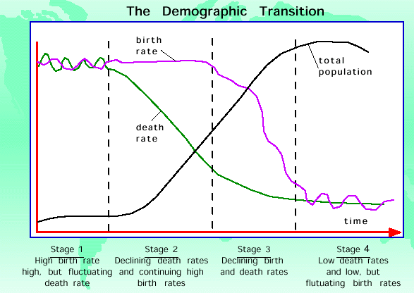

Slide 15
2. Thomas Robert Malthus (1766-1834)
2.5 Criticisms of Malthusianism
3) Agricultural output has grown faster than population since c.18.
  Diminishing returns: constant technology and fixed inputs in the short run.
  Under-estimation of technical progress which overcomes diminishing returns over time.
  In the long run, all factors are variable.
  Modern agriculture is more industrialized and is not subject to decreasing returns to scale.
  Land becomes less important in the modern industrialized economy.
15

Slide 16
3. But why still famines and poverty?
Socialists and NGOs: capitalist exploitation; overpopulation and environmental crisis.
Modern economics: political and institutional factors of poverty.
  Political and social remnants from pre-capitalist society (feudalism, slavery, colonialism).
  Political system which concentrates opportunities and resources in the hands of the few.
  Obstacles to markets for resource distribution.
16

Slide 17

3. But why still famines and poverty?
3.1 Man-made famines
Amartya Sen, Nobel Prize 1998.
Famine is not a result of overpopulation or food shortages.
  Highly unequal income distribution and mistakes in government policy (Bengal 1943).
  Political dictatorship (China versus India)
  Civil and tribal wars, warlord systems (Africa)
  Errors in government policy (Ireland 1845-52)
Amartya Sen (b 1933), Harvard University.
17

Slide 18

3. But why still famines and poverty?
3.2 Economics of human resources
Gary S. Becker, Nobel Prize 1992.
Having children is an economic decision.
  Demand and supply of children (cost-benefits).
  Social and economic changes shift the balance of cost-benefits of having children.
  Availability of new birth control techniques and changes in moral attitude are secondary.
Gary S. Becker (1930-2014), University of Chicago.
18

Slide 19
4. Multhus’ modern impacts
4.1 Neo-Malthusianism
Malthusianism: various theories of ‘exhaustion of natural resources’
Neo-Malthusianism:
  Growing population depletes natural resources and destroys the environments.
  Capitalism encourages greed, profit-making and consumerism.
    Waste resources and harm the environments.
    Markets are not efficient, unstable and not fair.
  Poverty, global disasters, environmental crisis.

Slide 20

4. Multhus’ modern impacts
4.2 Global Warming Doomsday
Al Gore, ‘An Inconvenient Truth’ (2006)
‘Scientific consensus’ on global warming:
  It is catastrophic and human-caused.
  The three pushes
  These release huge greenhouse gases into the atmosphere.
  Average global temperature rises above normal.
Al Gore (b.1948)
Vice President under President Bill Clinton, Nobel Peace Prize 2007.

Slide 21
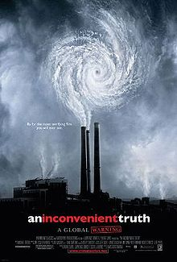
4. Multhus’ modern impacts
4.2 Global Warming Doomsday
Consequences:
  Melting glaciers, extreme weather anomalies.
  Rising sea levels, extinction of species, spreading pests.
Economic and environmental disasters.
  Falling freshwater supplies, diseases, frequent natural catastrophes, etc.
Government control, reduced consumption
and economic growth.
Academy Award for Best Documentary 2007.

Slide 22
4. Multhus’ modern impacts
4.3 Opinions, not consensus
Climate fluctuates widely over time.
Pre-human Earth used to be much warmer than today.
  Much higher CO₂ before.
  Warm climate comes with growth of species.
Fact:
Most estimates show very slight/no increases in average temperature during the last 200 years.
  Rise in temperature occurs before the rise in CO₂.
Debates: How much does human activity contribute to such warming?
  Doomsdayers: humans cause current global warming.
  Skeptics: human activity is insignificant.

Slide 23
4. Multhus’ modern impacts
4.3 Wrong prediction by doomsayers
North polar ice cap will disappear by 2013.
Average temperature will rise by 0.2F per decade.
Fact:
It still exists now and is expanding.
  It rises only 0.36F between 1979-2014.
  It has fallen by 1.08F from its peak in 1998.

Slide 24
4. Multhus’ modern impacts
4.3 Wrong prediction by doomsayers
Antarctica’s ice sheets are melting and causing sea levels to rise.
Most CO₂ comes from human.
Fact:
  Antarctica gained 112 billion tons of ice annually during 1992- 2001.
  A slowdown during 2003-2008, still gains at 82 billion tons of ice pa.
  Most CO₂ comes from rainforests in South America, Africa and China.

Slide 25
4. Multhus’ modern impacts
4.4 Politics of global warming
Coalitions of environment NGOs, climate scientists and politicians..
  Anti-market, anti-trade agenda among NGOs.
  Government control of private consumption and energy use; reduction in economic growth.
  Government funding for activities and researches.
  Corporations seek funding for ‘alternative, clean energy’ and ‘green’ technology.

Slide 26

4. Multhus’ modern impacts
4.5 Environmental Determinism
Jared diamond, ‘Collapse: How Societies Choose to Fail or Succeed’ (2005).
Collapse Hypothesis: factors of past civilization collapses
  Climate change
  Hostile neighbors
  Collapse of essential trading partners
  Environmental problems
  Failure to adapt to environmental issues.
Jared M. Diamond (b.1937)
University of California, Los Angeles

Slide 27
4. Multhus’ modern impacts
4.5 Environmental Determinism
  The fundamental issue is environment. Institutional factors are secondary.
Absolutist political institutions: failure to innovate and manage resources.
Extractive economic institutions: tendency to stagnation and decay, infighting and destruction.

Slide 28
4. Multhus’ modern impacts
4.6 Green Economics
Fixed supply of the resource: unresponsive to rising price
Rising demand with zero price elasticity
Markets are not efficient in allocating resources to fulfill the needs of rising population.
International trade and investment serve the profits of multinational corporations and rich countries only.
Zero economic growth, reduced population, consumption and trade.
  Consumption of local products, use of traditional technologies, alternative energies.
  Recycle everything at all costs.
  The village economy with minimal trade.

Slide 29
5. Scarcity and the markets
The market allocates scarce resources to fulfill the growing demand of a rising population.
  Prices and property rights as incentives .
Supply: resources are responsive to demand in the long-run.
  As the resource becomes more scarce, its price rises --- price signal as incentive.
  Incentive to supply more and to seek substitutes.
  New technology reduces costs of alternatives.

Slide 30
5. Scarcity and the markets
Demand: rising price provides incentives to economize on its use and to seek substitutes.
Alternative resources (previously not viable) become available if the system of property rights exist to reap benefits.
Rising population has double effects:
  Increasing consumption and resource uses.
  Increasing man power and production.
  Sources of new ideas, knowledge and technologies.

