Slide 1

EE376
Part 1
Climate Change Science

Slide 2
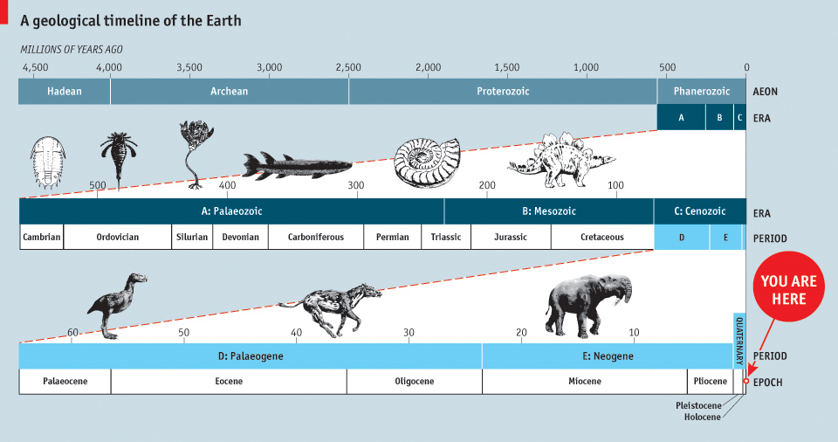
A Geological timeline of the Earth
Key distinction:
in geology and earth science, periodisation involves exceptionally long timespans demarcated by stratigraphic evidence

Slide 3
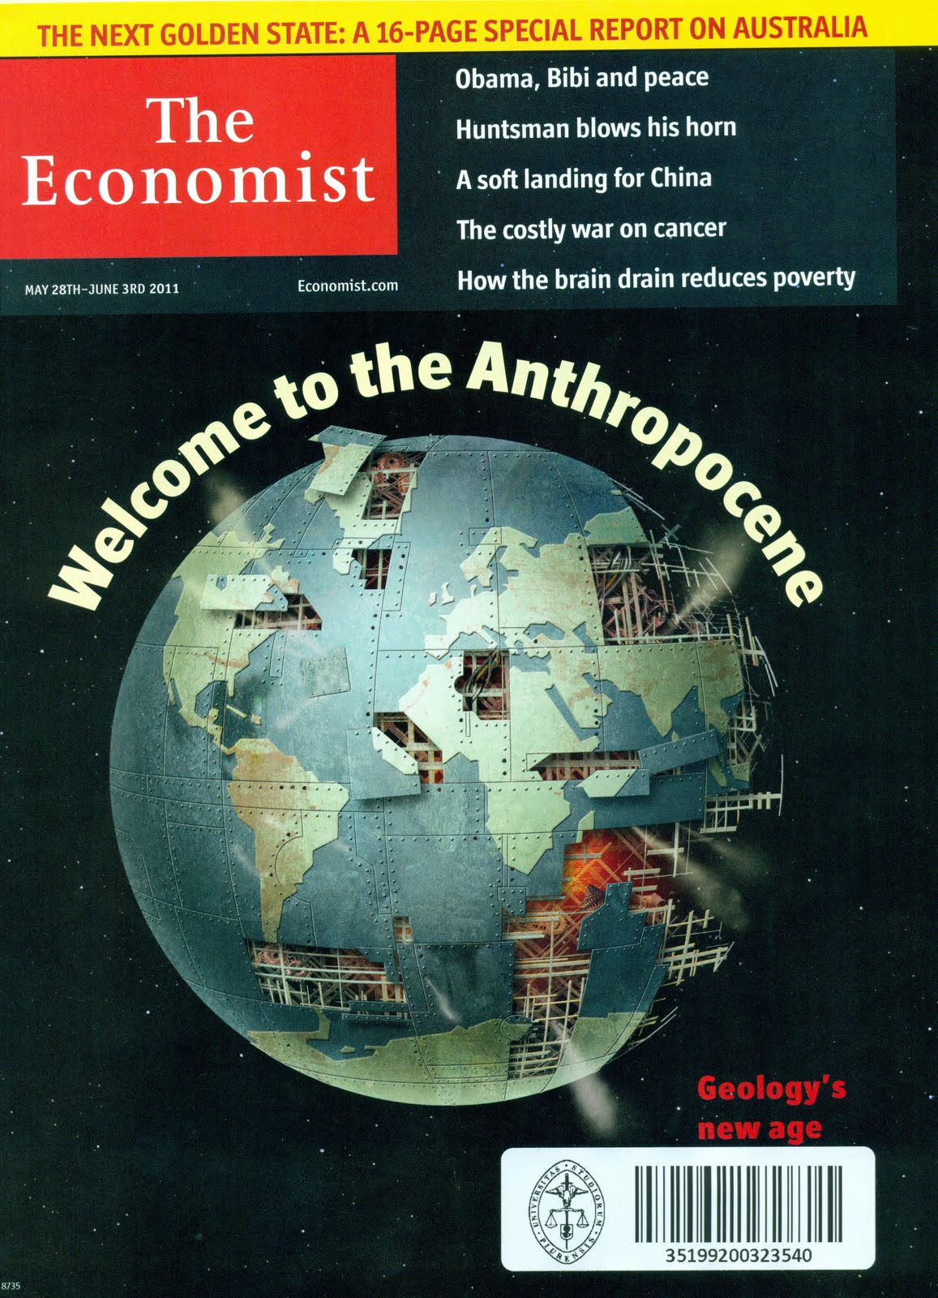
Anthropocene
Have we left the Holocene (recent age began 10,000 years ago) and entered the Anthropocene?
Some geologists are debating whether the human impact on the earth is significant enough to justify designating a new geological epoch named after us.
Paul Crutzen, who won the Nobel Prize in 1995 for work on the Ozone layer.
The Anthropocene refers to "the current epoch in which humans and our societies have become a global geophysical force" (Steffen, Crutzen and McNeill 614).
The scale of humanity's effect on the earth has risen from the local scale to the global.

Slide 4
Before the Anthropocene:
The Agricultural Revolution began 10,000 to 12,000 years ago.
Humans domesticated animals and plants, cleared forests, and discovered fire.
Humans did not yet possess the technology or organization to dominate nature above a transitory regional level.
About 10,000 years ago, written language allowed the “accumulation of knowledge and social learning,” which the authors describe as “an impressive catalytic process”.

Slide 5
The origins of the Anthropocene I:
The Industrial Era (ca. 1800-1945)
The Industrial Revolution
The widespread use of coal (fossil fuels)
The expansion of economic society
Human population expands from about 750 million to about 2.5 billion.

Slide 6
The Anthropocene II: The Age of Acceleration (1945-ca. 2015)
“This first stage of the Anthropocene ended abruptly around 1945, when the most rapid and pervasive shift in the human-environment relationship began.”
An inflection point starts around mid-20th century.

Slide 7
Human impacts are massive
Consume ½ earth’s surface fresh water & dam most of the earth’s rivers
Use 35% net primary productivity of plants
Fix more nitrogen than all other terrestrial sources
Devastated sea life with over fishing
Homogenize ecosystems with our exotics
Causing species extinction at 10 to 1000 times background rate
Climate change likely to raise temperatures 2-5 degrees Celsius, affecting climates globally--and thus virtually all organisms

Slide 8
Anthropocene III:
Stewards of the Earth (ca. 2015-?)?
“Humankind will remain a major geological force for many millennia, maybe millions of years, to come. … Can humanity meet this challenge?”
“In the blink of a geological eye, through our need for energy, food, water, minerals, for space in which to live and play, we have wrought changes to Earth’s environment and life that are as significant as any known in the geological record.”

Slide 9

Weather and climate
‘Weather’ or ‘Climate’? Test
The ___________ today in Bangkok is nice!
China and Thailand have a different _________ pattern.
The ___________ changes quickly from its last hour. Now it’s raining!
The ___________ in Thailand has significantly changed from the last decade. The winter becomes much shorter!

Slide 10
Weather and climate
Weather characterizes our immediate environment in terms of atmospheric conditions such as temperature, wind speed, cloud cover, and precipitation.
The word describes conditions at the locale in which we reside or to which we are going and the time we are or will be there.
At any locale, weather can vary significantly over small (hourly) time changes, as well as from one season to another.
Climate represents long-term averages of atmospheric conditions for a particular region.
We can describe in general terms winter and summer climates of regions such as the American Southwest and Northeast, Siberia, and sub-Saharan Africa.
The climate of any region can also experience statistically significant variations, but unlike weather, changes to climate have historically occurred over much longer time frames, commonly measured in millennia.

Slide 11
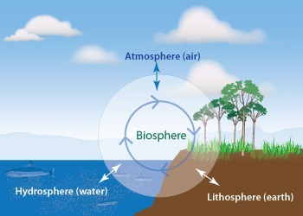
The Earth’s climate system
For the Earth as a whole, the climate system is determined by interactions between several large contributors.
  The amount of incident solar radiation and the chemical composition and circulation of the atmosphere.
  The processes associated with the hydrosphere and terrestrial (land-based) portions of the lithosphere: The biosphere:
  Cryosphere.

Slide 12
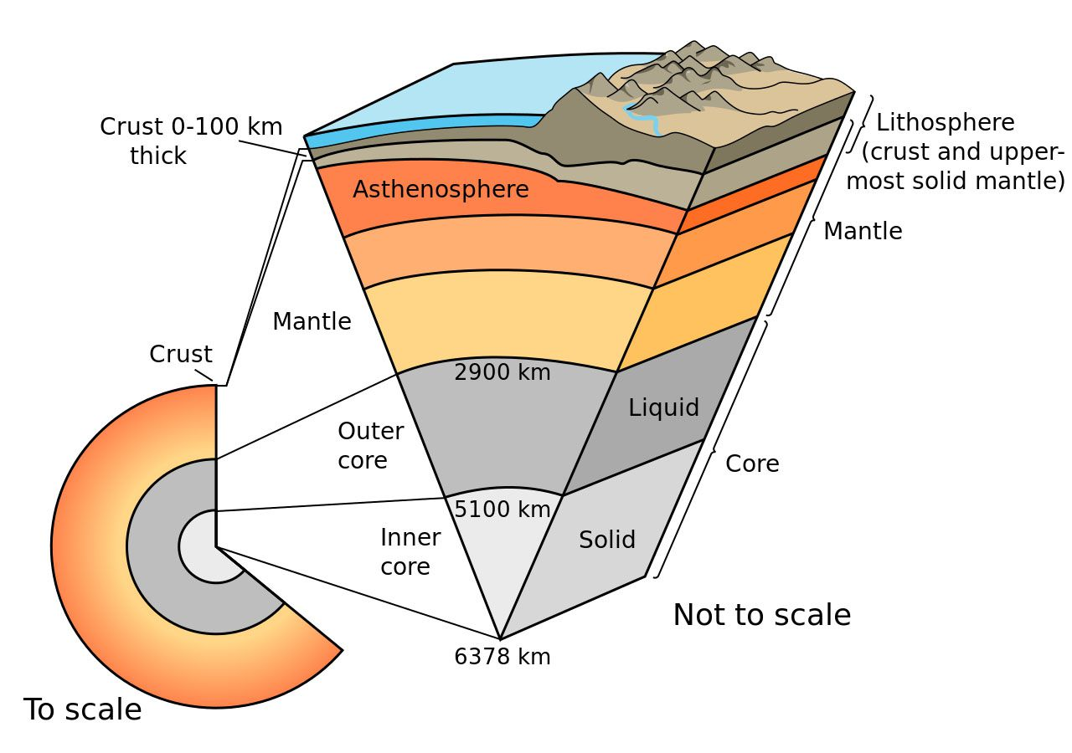
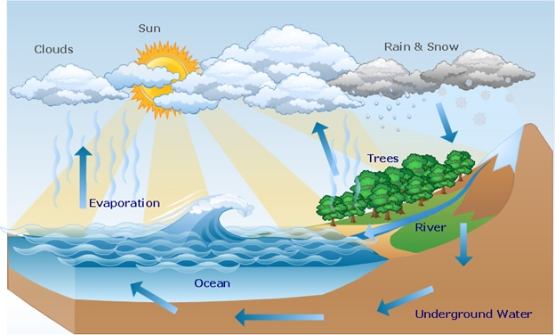
The Earth’s climate system
Hydrosphere
Lithosphere
  Climate is strongly influenced by global ocean currents, as well as by the oceans’ large capacity for storing thermal energy (and chemical species such as carbon dioxide).

Slide 13
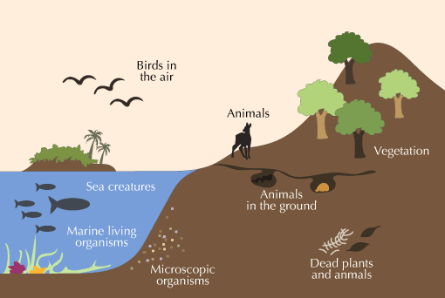
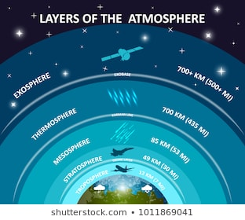
The Earth’s climate system
Biosphere
  Photosynthesis and respiration the biosphere exchanges carbon dioxide with its surroundings and plays a central role in the Earth’s carbon cycle.
Atmosphere

Slide 14
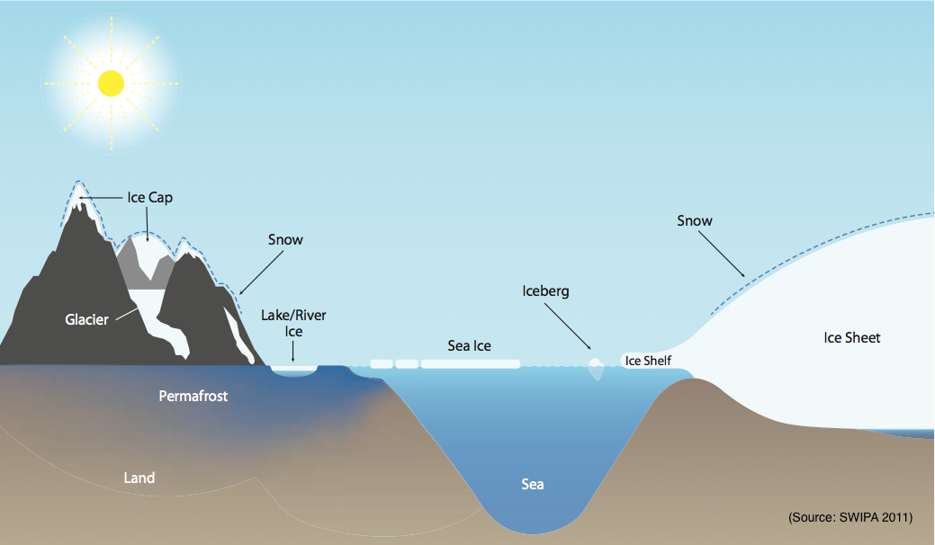
Cryosphere: consists of all terrestrial snow, ice, and permafrost, as well as ice residing on and below the surface of the oceans.
An enormous amount of the Earth’s water is stored as ice, much of it in sheets covering vast amounts of land and extending from coastal regions as shelves.
Two major ice sheets remain after the last ice age, one on Greenland and the other on Antarctica.
Significant melting of the cryosphere would affect sea levels around the world and accelerate the pace of warming itself.

Slide 15
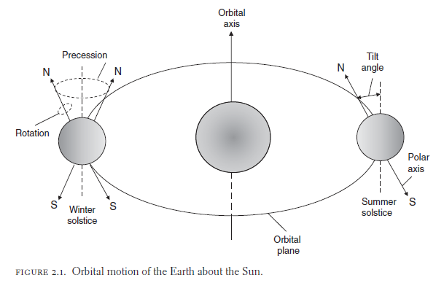
The Earth’s climate system
The Holocene era, which spans 12,000 years since the last ice age, is the most recent manifestation of geologic time.
It has been a period of enormous growth in human potential, as well as a time of unusual climate stability
Transitions into and out of an ice age are determined by changes in the rate at which the Earth intercepts solar radiation, which depends on the Earth’s motion relative to the Sun.
Over the last 700,000 years, glacial cycles were strongly influenced by changes in the eccentricity of the Earth’s orbit over periods of approximately 100 kyr.
In coming centuries global temperatures are unlikely to be affected by natural (orbitally driven) cooling, and transition into another ice age is unlikely for at least 30 kyr.

Slide 16
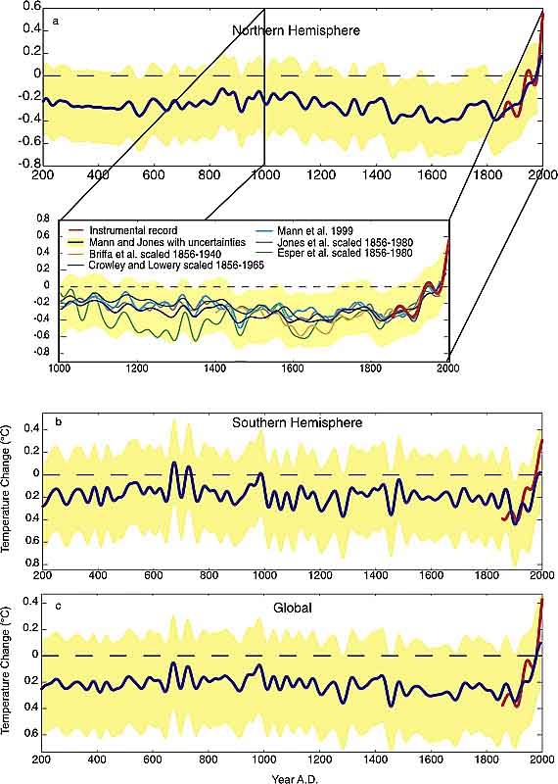
The Holocene era, which spans 12,000 years since the last ice age, is the most recent manifestation of geologic time.
It has been a period of enormous growth in human potential, as well as a time of unusual climate stability
Transitions into and out of an ice age are determined by changes in the rate at which the Earth intercepts solar radiation, which depends on the Earth’s motion relative to the Sun.
Over the last 700,000 years, glacial cycles were strongly influenced by changes in the eccentricity of the Earth’s orbit over periods of approximately 100 kyr.

Slide 17
IPCC-AR5 WGI, Fig.6.1: Simplified schematic of the global carbon cycle
Numbers represent reservoir mass, also called ‘carbon stocks’ in PgC (1 PgC = 1 GtC = 10¹⁵ gC) and annual carbon exchange fluxes (in PgC yr–1 = GtC/yr).
Black numbers and arrows indicate reservoir mass and exchange fluxes estimated for the time prior to the Industrial Era, about 1750.
Red arrows and numbers indicate annual ‘anthropogenic’ fluxes averaged over the 2000–2009 time period. These fluxes are a perturbation of the carbon cycle during Industrial Era post 1750.

Slide 18
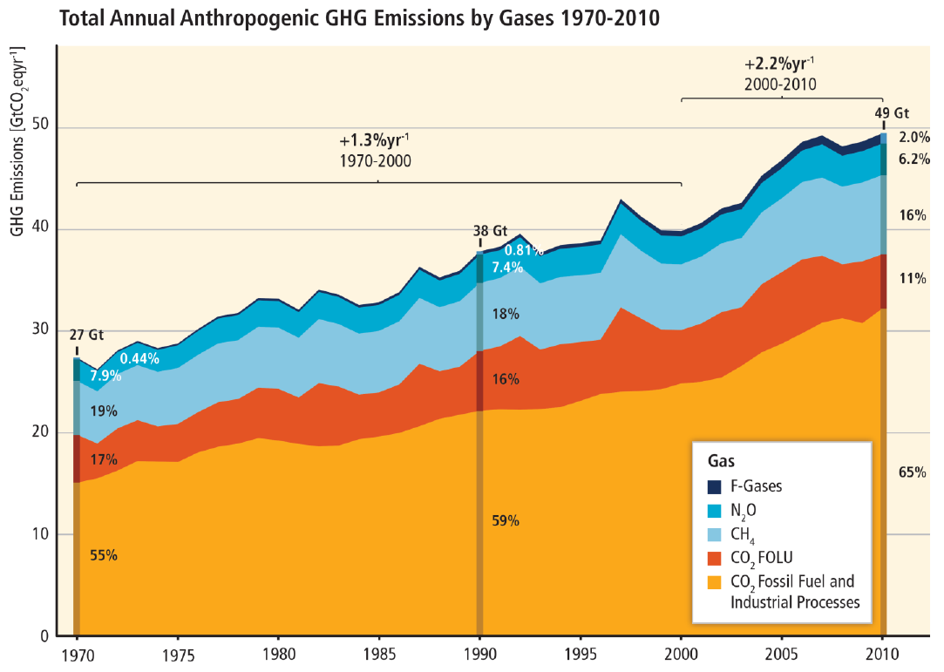
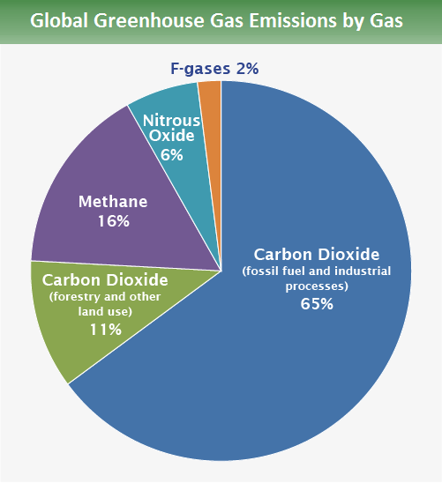
F-Gas: There are four types: hydrofluorocarbons (HFCs), perfluorocarbons (PFCs), sulfur hexafluoride (SF₆) and nitrogen trifluoride (NF₃).

Slide 19
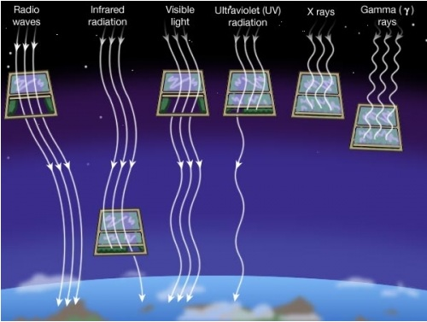
Shortwave radiation (visible light) contains a lot of energy; longwave radiation (infrared light) contains less energy than shortwave radiation (shortwave radiation has a shorter wavelength than longwave radiation).
Solar energy enters our atmosphere as shortwave radiation in the form of ultraviolet (UV) rays (the ones that give us sunburn) and visible light.
The sun emits shortwave radiation because it is extremely hot and has a lot of energy to give off.
Once in the Earth’s atmosphere, clouds and the surface absorb the solar energy. The ground heats up and re-emits energy as longwave radiation in the form of infrared rays.
Earth emits longwave radiation because Earth is cooler than the sun and has less energy available to give off.

Slide 20
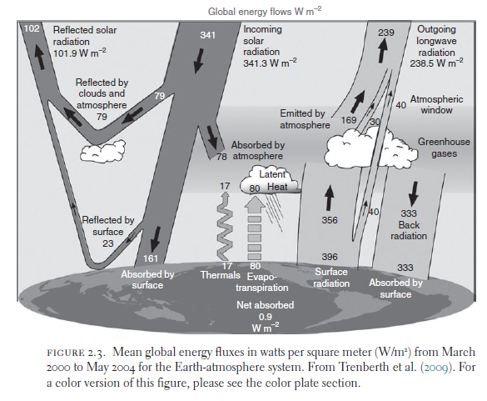
Climate change is sensitive to the global energy budget and is driven by energy imbalances.
If the Earth absorbs as much short-wave solar radiation as the long-wave radiation it emits to space, it is in a state of thermal equilibrium.
There is no change in its thermal energy and hence average temperature.

Slide 21
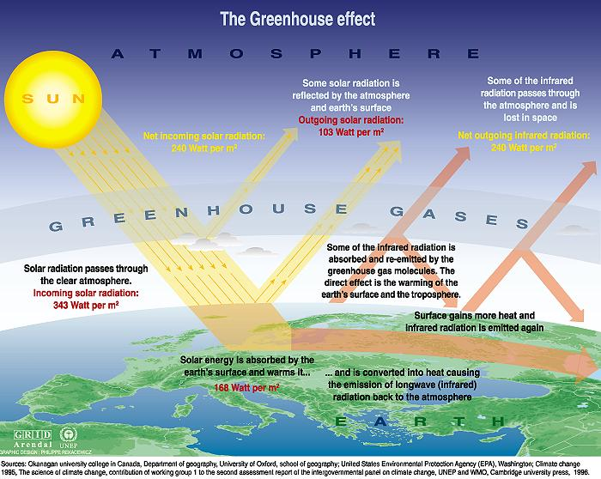

Slide 22
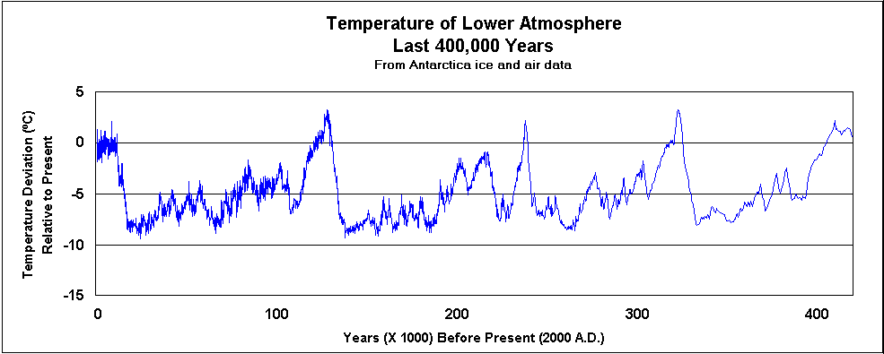
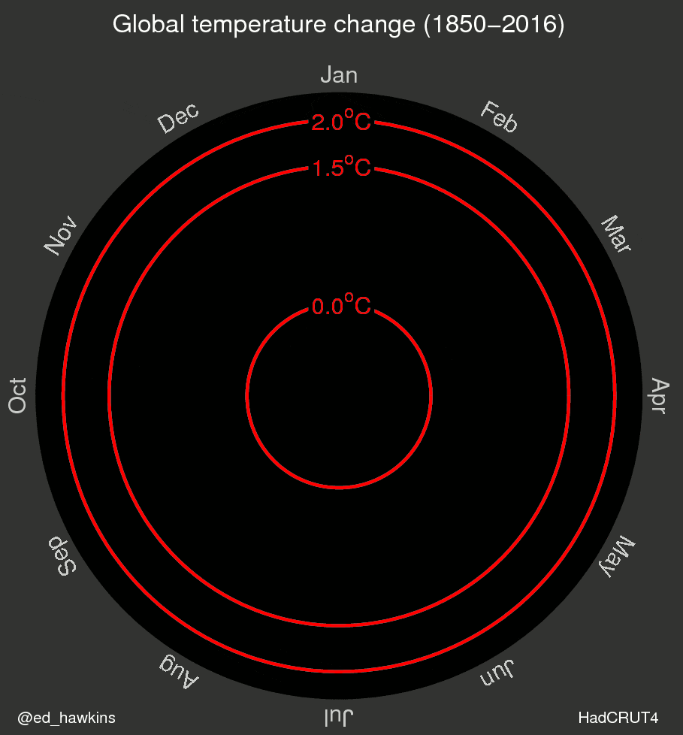
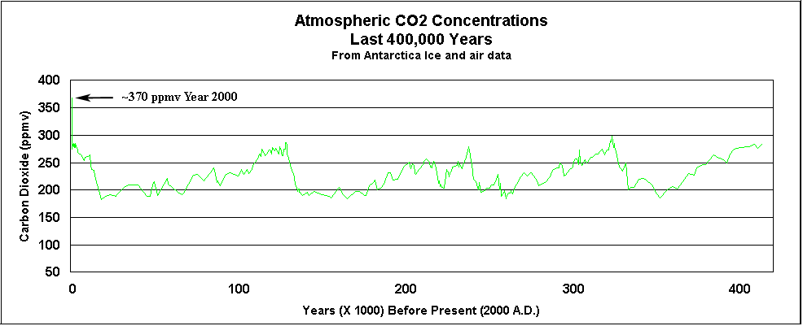
http://blogs.reading.ac.uk/climate-lab-book/files/2016/05/spiral_optimized.gif

Slide 23
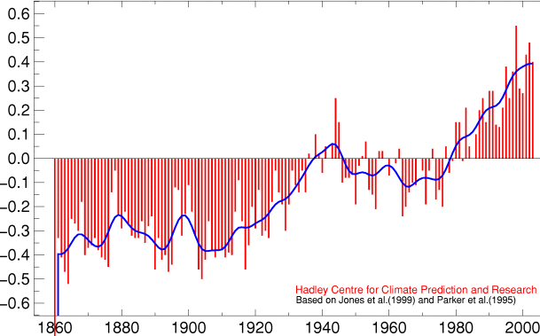
Global Mean Temperature since 1860

Slide 24
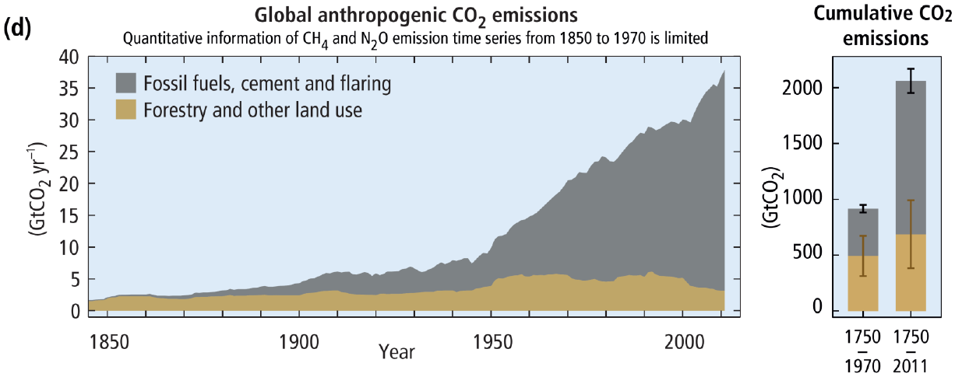

Slide 25
Global GHG
Emissions ↑
Atmospheric GHG
Concentrations ↑
Climate Related
Impacts
Global Mean
Temperature ↑

Slide 26
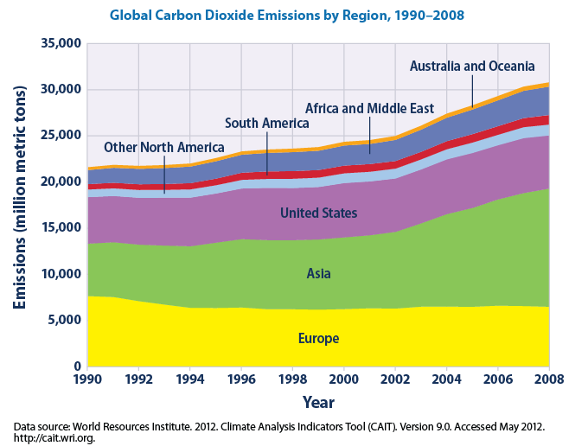
CO2 emissions

Slide 27
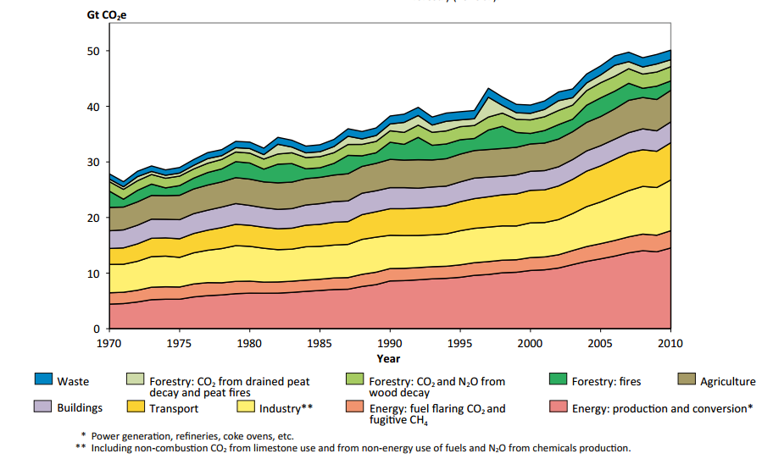
GHG emissions

Slide 28
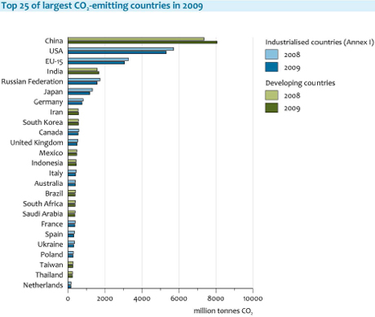
CO2 emissions

Slide 29
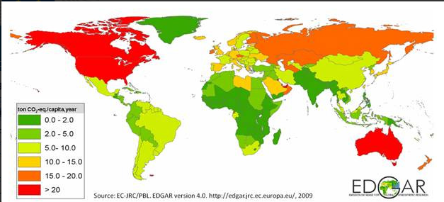
Per capita CO2 emission

Slide 30
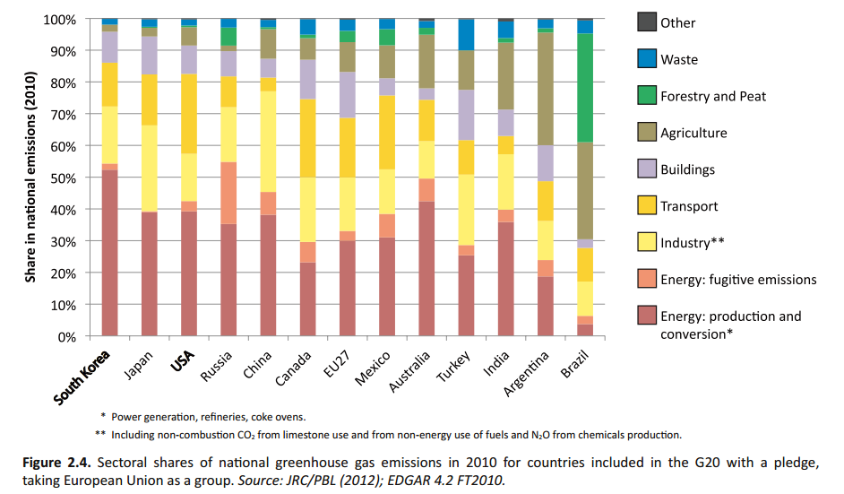
GHG emissions

Slide 31
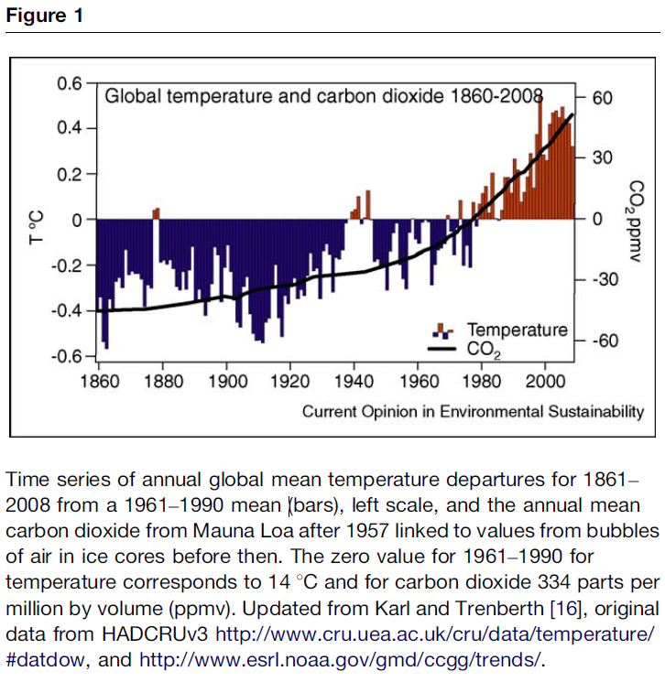
Notes:
http://www.cgd.ucar.edu/cas/Trenberth/trenberth.papers/EnergyDiagnostics09final2.pdf
See http://www.economist.com/node/21533360 for a comparison of HadCru to Nasa, Noaa, Berkeley Earth….same.

Slide 32
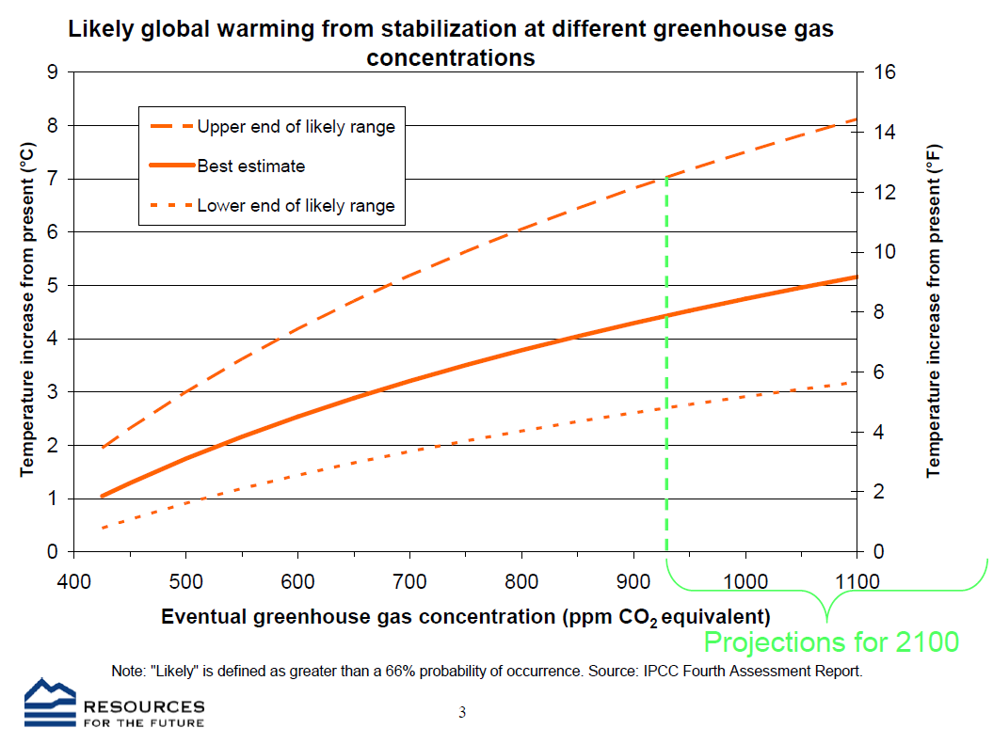
Temperature as function of GHG
Notes:
The Use of Economic Modeling in the Climate Change Debate: Failures and Opportunities
Billy Pizer
10th Anniversary Conference on Global Economic Analysis, Purdue University
https://www.gtap.agecon.purdue.edu/events/conferences/2007/documents/Pizer.pdf

Slide 33
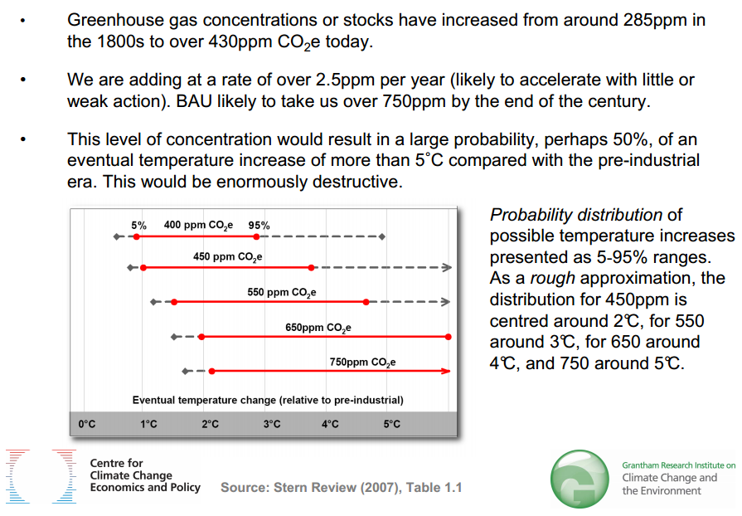

Slide 34
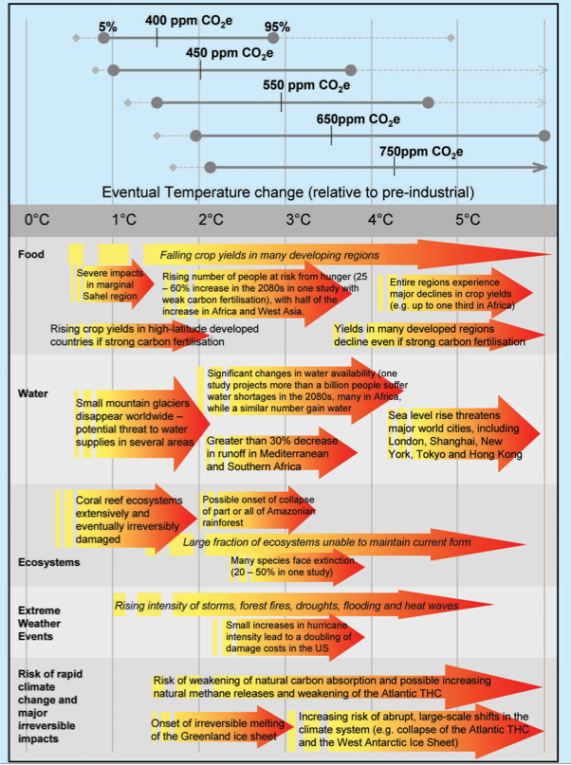
IPPC (2007)
Notes:
IPCC, 2007: Summary for Policymakers. In: Climate Change 2007: Impacts, Adaptation and Vulnerability. Contribution of Working
Group II to the Fourth Assessment Report of the Intergovernmental Panel on Climate Change, M.L. Parry, O.F. Canziani,
J.P. Palutikof, P.J. van der Linden and C.E. Hanson, Eds., Cambridge University Press, Cambridge, UK, 7-22.
Figure SPM.2. Illustrative examples of global impacts projected for climate changes (and sea level and atmospheric carbon dioxide where relevant)
associated with different amounts of increase in global average surface temperature in the 21st century [T20.8]. The black lines link impacts, dotted
arrows indicate impacts continuing with increasing temperature. Entries are placed so that the left-hand side of the text indicates the approximate
onset of a given impact. Quantitative entries for water stress and flooding represent the additional impacts of climate change relative to the conditions
projected across the range of Special Report on Emissions Scenarios (SRES) scenarios A1FI, A2, B1 and B2 (see Endbox 3). Adaptation to climate
change is not included in these estimations. All entries are from published studies recorded in the chapters of the Assessment. Sources are given in
the right-hand column of the Table. Confidence levels for all statements are high.

Slide 35


