Slide 1



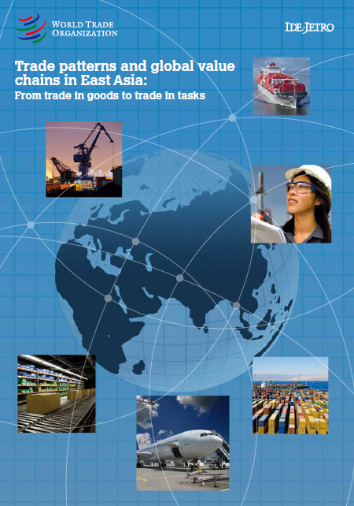
Trade patterns and global value chains in East Asia :
From Trade in Goods to Trade in Tasks
Christophe Degain, WTO
Notes:
The publication takes place within the MIW initiative
This presentation illustrates some snapshots from the publication

Slide 2
Global production chains – Ins and outs
International consumer demand
Emergence of “Trade in tasks”:
Lower applied tariffs
and trade policy incentives
Predominancy of trade in intermediate goods
Development of intra-firm trade
Increase of processing trade
Development of infrastructure
and technological progress
Global production chains and world trade
Export processing zones
Outsourcing and offshoring strategies
and FDI
Need for new statistical
measures of international trade
Notes:
The development of GPCs and of world trade in the last decades relate to the conjunction of several factors.
(Incentives and causes for globalized industry -> global eco -> new trade patterns)
First of all, everything started with the rise of mass consumption in industrialized economies (with the US as starting point followed by Europe). Nowadays GPCs support consumption in all continents.
Another key element in fostering the development of GPCs and facilitating world trade are the better market access conditions and lower applied tariffs which resulted from the negotiations undertaken under the multilateral trade system (WTO)
Infrastructure services constitute a precondition for the development of GVCs. For example, the invention of containers changed not only international transportation but also the management and organization of international trade and production. (some figures: about 100 million containers cross the oceans every year, carrying almost 90% of world trade, in volume terms)
EPZs are areas with special administrative and fiscal status to promote trade and investment. They largely contributed to the internationalzation of production. They take place in developing economies but not only.
Since production becomes more and more complex and fragmented, specialization in some core activities and outsourcing has become inevitable. Companies can decide to move some of their corporate functions or part of their production to other companies within the country or abroad (in that case we talk about offshoring). FDI corresponds to the case when a company creates an affiliate abroad to benefit from comparative advantages and optimize the production process. Outsourcing can inter alia be justified by lower labour cost, coming closer to primary resources or benefiting from a specific technology or a know-how
The globalization of the economy has led to changes in the nature of world trade and the rise of specific types of trade.
Nowadays, international trade is dominated by trade in intermediate goods, which takes place between the various countries involved in global production chains.
Trade in tasks corresponds to the new distribution of tasks and activities carried out within the value chains.
Intra-firm trade represents exchanges between the main company and its affiliates created abroad through FDI
The increase of processing trade is obviousy the result of th production taking place within EPZs
All these changes in trade patterns main resulting from the internationalization of production have led to look for new ways of measuring international trade to take into account the new reality of trade
Following slides will present some of these elements along with core graphics and messages picked up from the publication

Slide 3
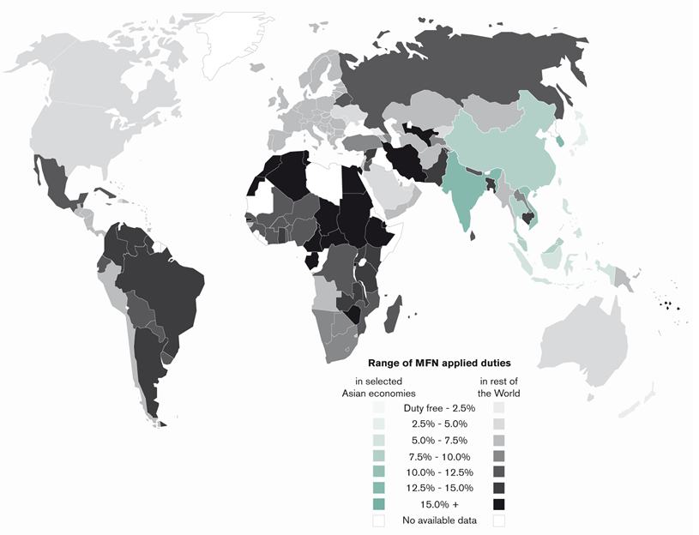
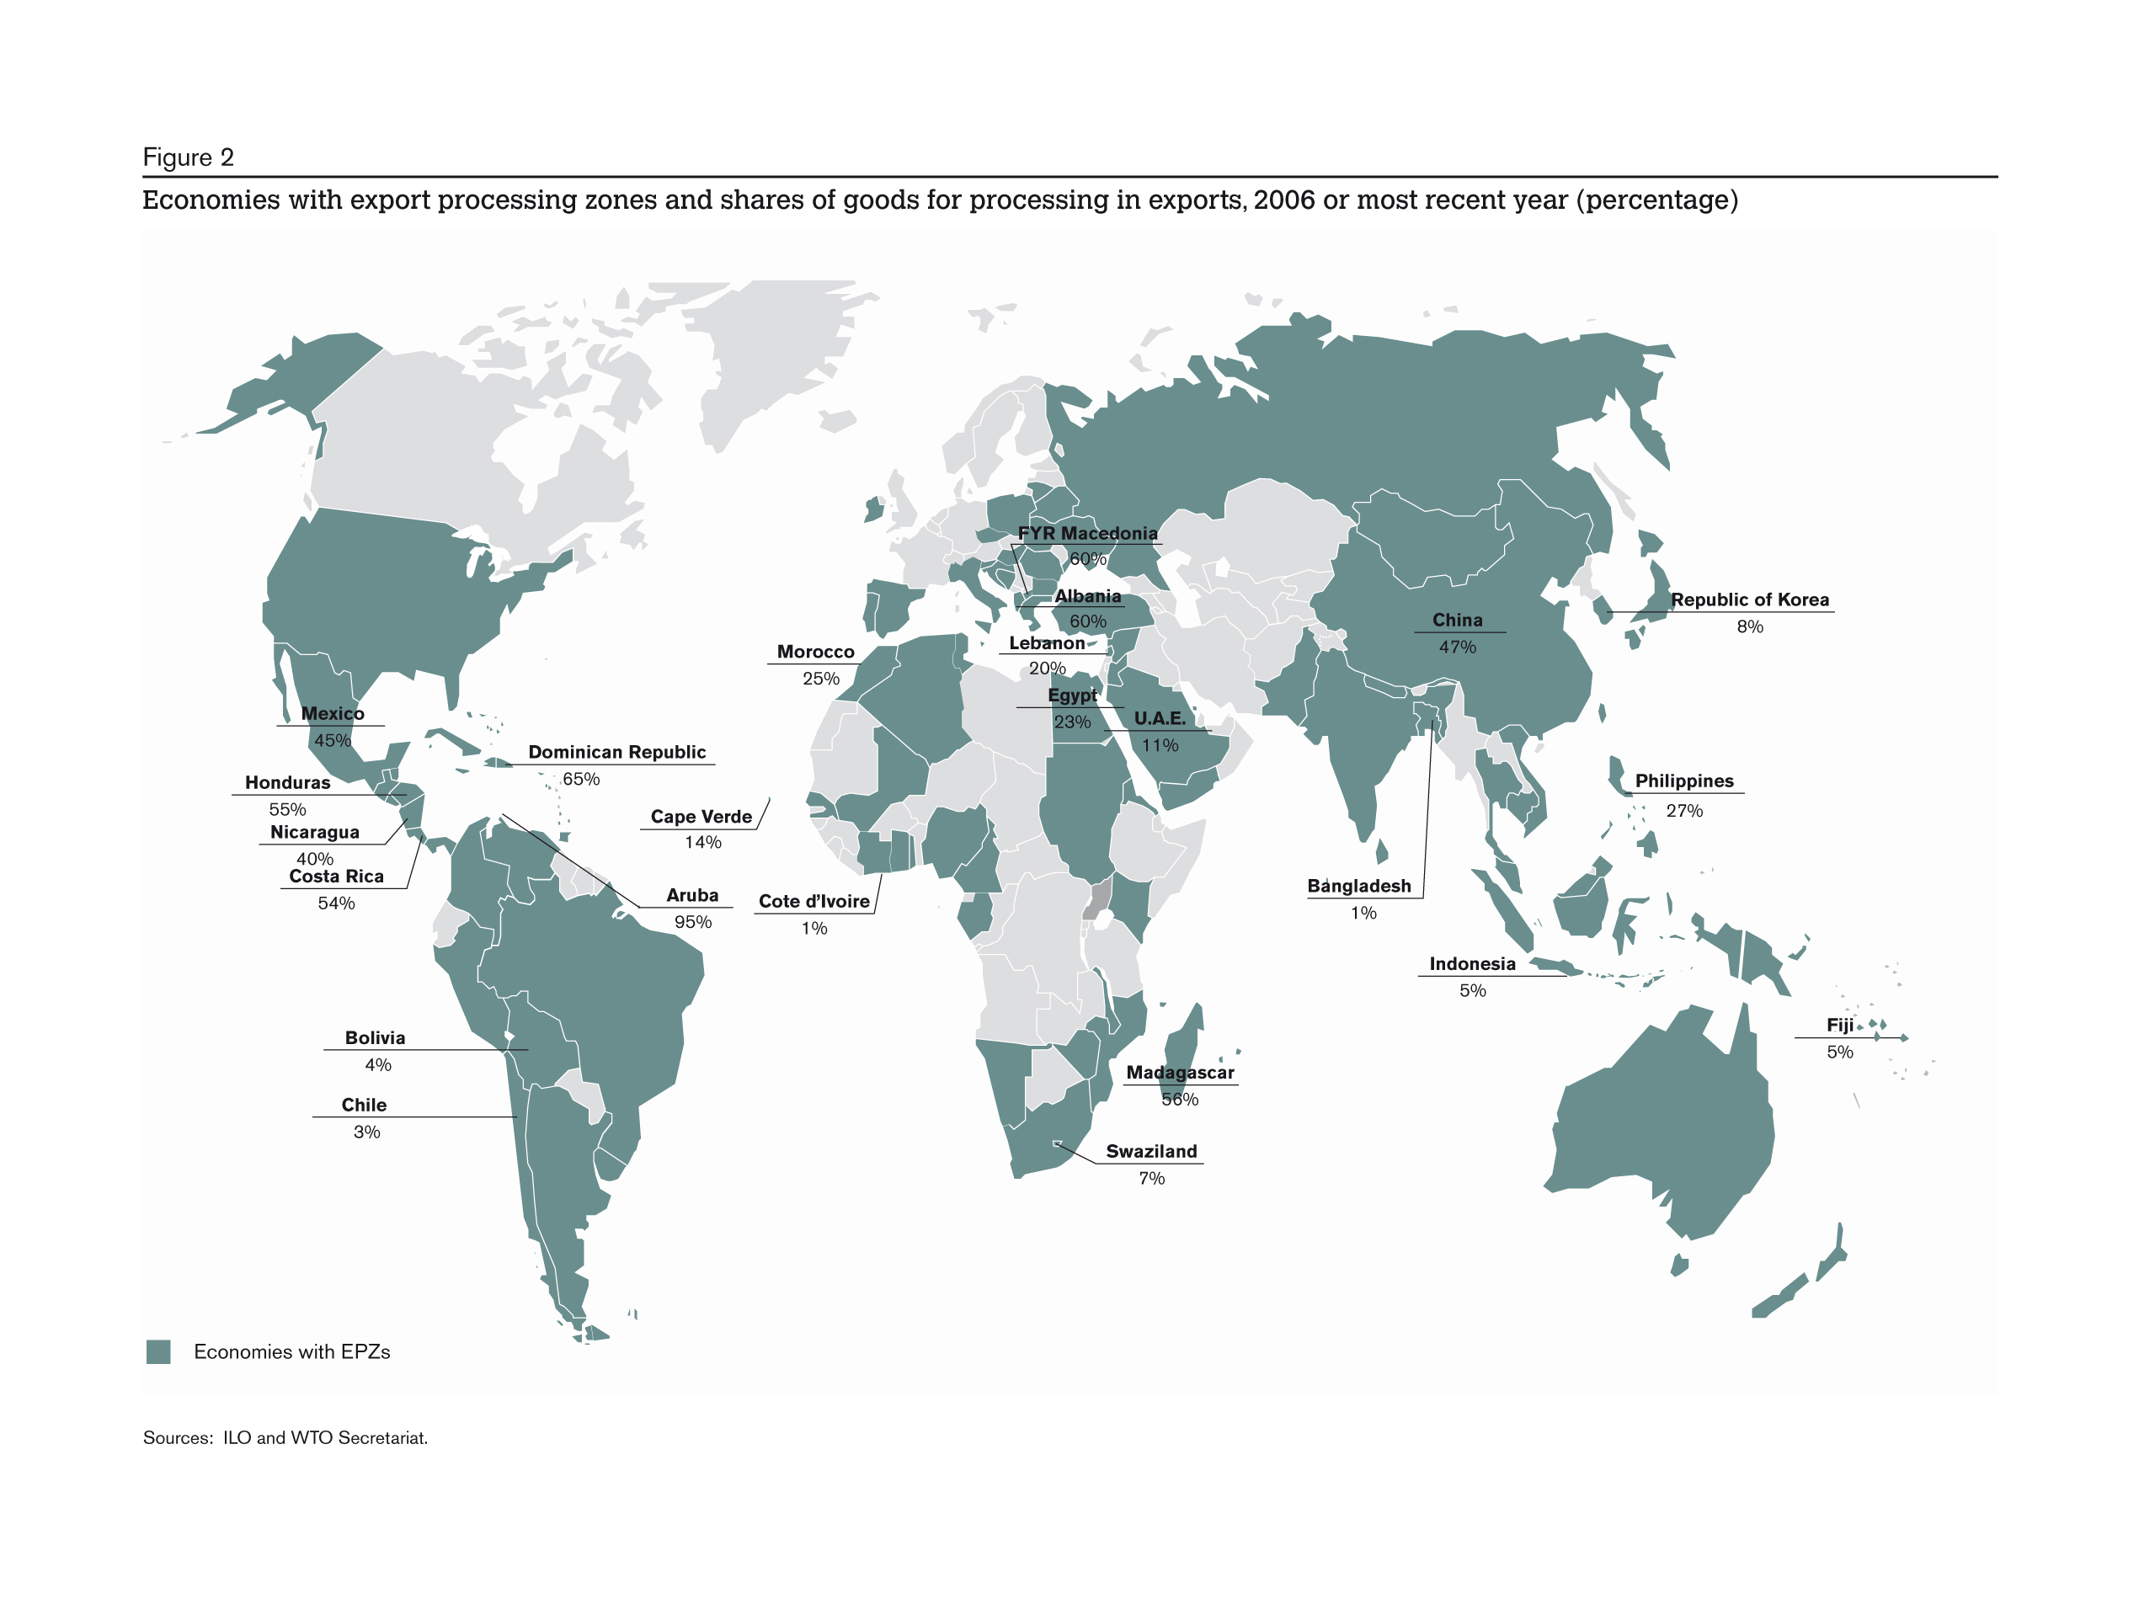
Asian economies have relatively low applied tariffs on imports
(especially on semi-processed goods)
Source: WTO
Notes:
Market access is a mandatory condition for trading and building / organising international production chains.
The tariffs applied on imported goods represent the backbone of trade policy = market access . They are key elements in facilitating international trade.
This map identifies the level of applied tariffs. Low in Asia ... And there are still decreasing
The South-East Asian countries fall mainly in the same colour cluster as European or South Africa. This map refers to 2009 data (AoA+NAMA=All goods).
The range which EU and most ASEAN countries belong is 5% - 9.9 %. EU's average is 5.3 (closer to the lower limit).
Phil 6.3%
Indonesia 6.8%
Malaysia 8.4%
Thailand 9.9%
The ASEAN countries' tariff average is closer to the upper limit of the range.
Applied tariffs largely behind bound tariffs negotiated at WTO
[Bound tariffs communicate the concessions made by countries in negotiations which are currently renegotiated in the Doha Development Agenda to gradually move them to lower levels]
+ NTM (= licensing, quantitative restrictions, health/phytosanitory measures) mitigates the benefits of low tariffs -> to be discussed within WTO negotiations

Slide 4
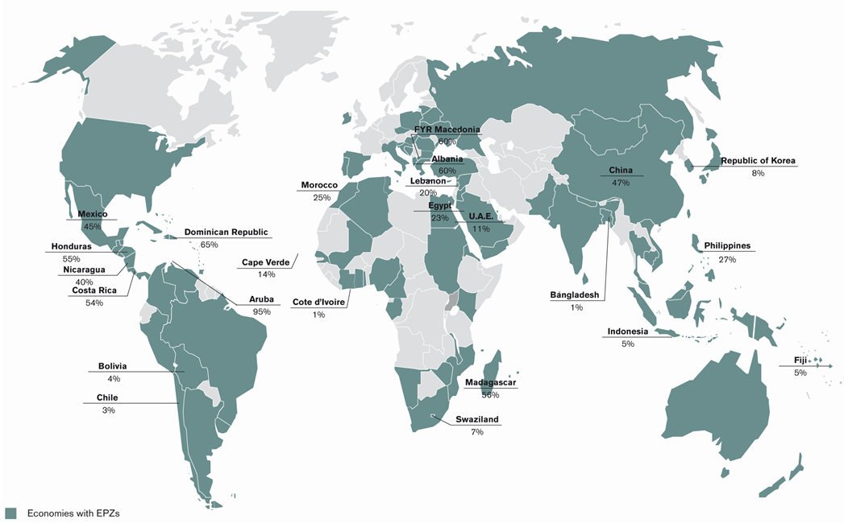
Export processing zones account for about 20% of total merchandise exports of developing economies
: economies with EPZs
(2006 or most recent year)
Sources: ILO & WTO
Notes:
Globalization of the production mainly concerns manufacturing = global manufacturing
EPZs have spread all over the world, mainly in DVG economies but also in DVD ones (eg Ireland)
As mentioned in the title of the slide, 20% of trade of DCG relies on EPZs
For China, the main trader in the world since this year (or 2010 -> CHECK), EPZ trade = 50 % of total X

Slide 5
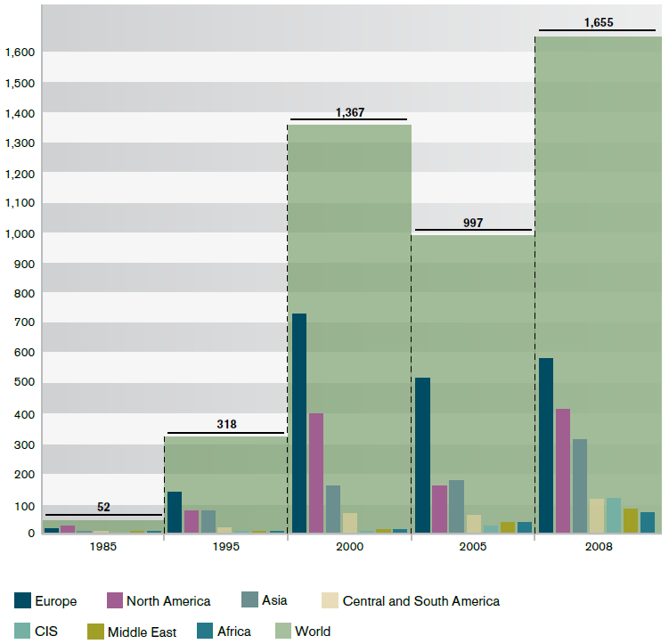
Asia is the most attractive FDI destination in the developing regions
(Billions of US$)
Source: UNCTAD
Notes:
Weight of Asia is increasing
China 1st with India receiving more and more FDI

Slide 6
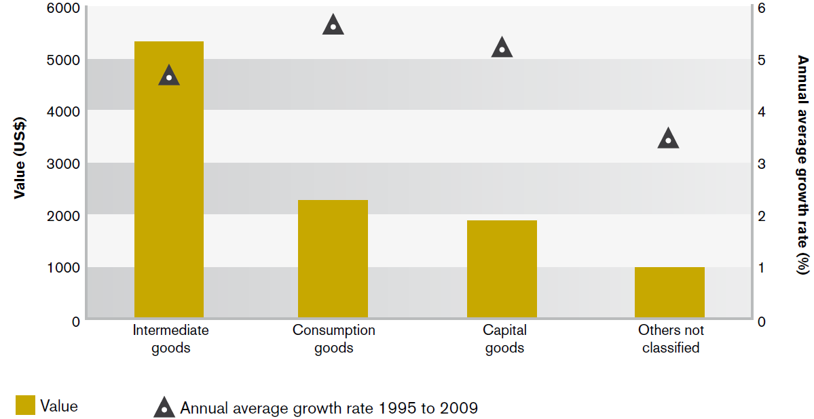
Intermediate goods dominate world non-fuel merchandise exports
Key facts on Asia trade in intermediate goods …
Asia’s share in world exports of intermediate goods increases : 35% in 2009
Intra-Asian trade is predominant
Asia imports more intermediate goods than it exports
Intermediate goods traded by Asian economies are more and more sophisticated
More and more concentrated trade on few components
Billions of US$
… Confirming that:
Asia is the “World manufacturer”
Asian supply chains boost the regional markets
Asian economies present a high degree of industrial specialization
2009 value
Source: UNSD & WTO

Slide 7
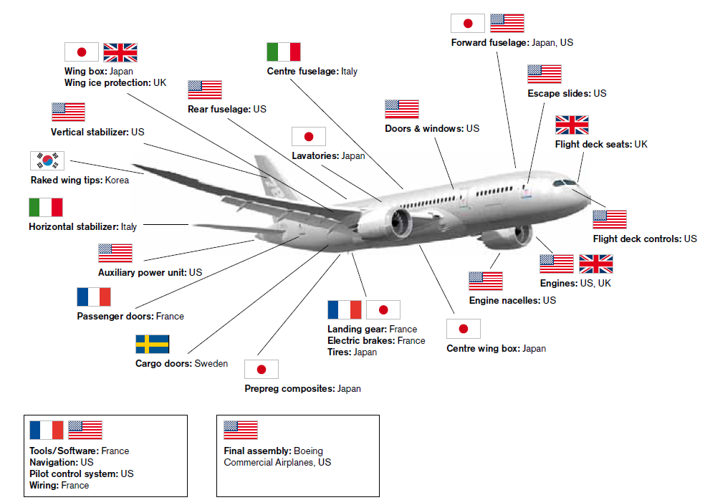
Fragmentation of production: the example of the Boeing 787 Dreamliner
Made in the world
Source: Meng & Miroudot

Slide 8
Towards a new measure of international trade
Traditional statistics present some biases:
  Multi-counting of trade flows in intermediate goods
  Difficult attribution of the country of origin of an imported product
Measuring trade in value added terms allows:
  To circumvent the biases observed with traditional statistics
  To take into account the specificity of trade occurring between the different actors of a production chain

Slide 9
Some benefits of trade in value added
A better evaluation of the actual contribution of international trade to an economy
(incl. development, employment, environment)
To highlight the interdependency of economies, and the counter-productive effects of protectionist measures on economies and enterprises they are supposed to protect
Better evaluation of the contribution of the services sector on trade
To provide a more realistic evaluation of bilateral trade balances and regional trade

Slide 10
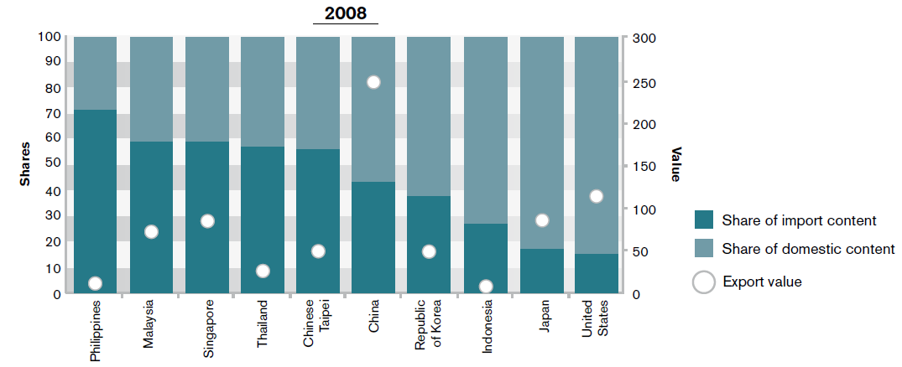
Computers and electronic equipment exports and their domestic and imported contents
(in billions of $ and percentage)
Source: WTO, based on IDE-JETRO Asian Input-Output tables

Slide 11
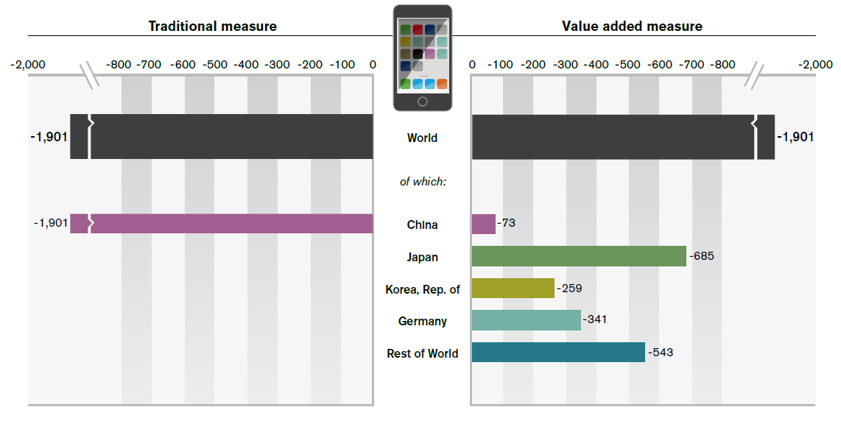
2009 US trade balance in iPhones (in millions of US$)
Source: Meng and Miroudot, based on Xing and Detert (2010)
Notes:
example on 1 product which may be generalized for many manufactured products

Slide 12
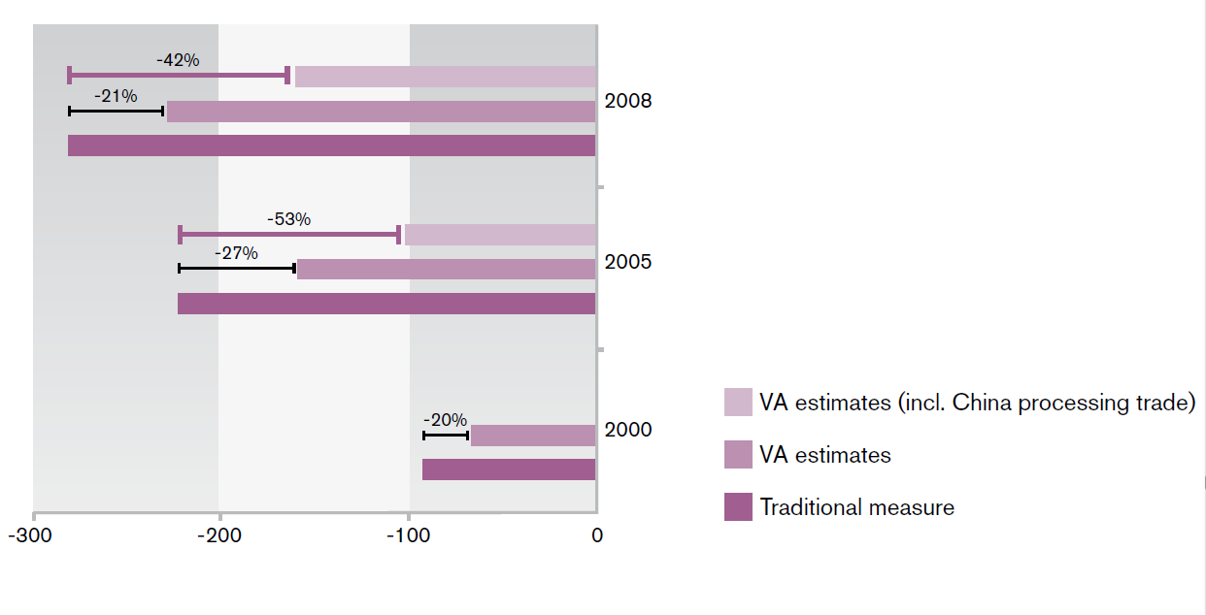
United States-China trade balance
Traditional vs VA measure (in billions of US$)
Sources: UN Comtrade Database, IDE-JETRO AIO table and WTO estimates

