Slide 1
Production and Costs in the Short run
EE311
Chayun Tantivasadakarn
Faculty of Economics, Thammasat University

Slide 2
What tasks should be done in-house and what should be done by out-sourcing?
In-house production generates internal managerial costs that increase with the production scale
  Monitoring costs: costs associated with quality assurance and shirking minimization
  Coordination costs: the cost related to team-work coordination efforts

Slide 3
What tasks should be done in-house and what should be done by out-sourcing?
Out-sourcing generates transaction costs that decrease with the production scale
  Information costs
  Negotiation costs
  Enforcement costs
The optimal firm size is where the combined costs are minimized.

Slide 4
Transaction costs: determinants
The faster we need the information, the higher the information costs.
  Inventory can decrease the transaction costs.
The more the market is changed, the higher the transaction cost.
  Need to update information.
Advertisement and middlemen can reduce the transaction costs.
Standardization decreases transaction costs.

Slide 5
Transaction costs: applications
Similar products are sold at different prices
  Each product has different quality, terms.
  Each consumer has different information.
  Each consumer has different opportunity cost of time --> willing to search for information differently.
Hotels often have extra rooms. Restaurants, theaters, barber shops often have excess seats.

Slide 6
Production Decisions of a Firm
Production Technology
  Describe how inputs can be transformed into outputs
    Inputs: land, labor, capital & raw materials
    Outputs: cars, desks, books, etc.
  Firms can produce different amounts of outputs using different combinations of inputs
  We can represent the firm’s production technology in for form of a production function
Notes:
4

Slide 7
The Technology of Production
Production Function:
  Indicates the highest output (q) that a firm can produce for every specified combination of inputs.
  For simplicity, we will consider only labor (L) and capital (K)
  Shows what is technically feasible when the firm operates efficiently
The production function for two inputs:
q = F(K,L)
Notes:
5

Slide 8
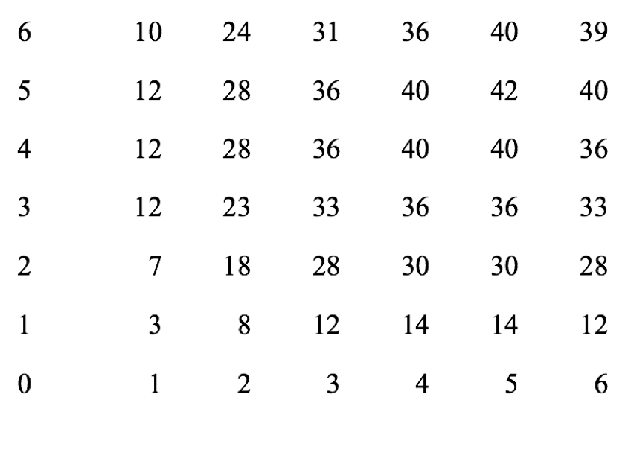
Representation of a production function
K
q
L

Slide 9
Representation of a production function
q
TP_{L}(K₃)
TP_{K}(L₃)
TP_{K}(L₂)
TP_{L}(K₂)
TP_{K}(L₁)
TP_{K}(L₀)
TP_{L}(K₁)
K
TP_{L}(K₀)
K₃
L
K₂
L₃
L₂
K₁
L₁
0

Slide 10
The Technology of Production
Short Run
  Period of time in which quantities of one or more production factors cannot be changed.
  These inputs are called fixed inputs.
  Those that can change are called variable input.
Long-run
  Amount of time needed to make all production inputs variable.
Short run and long run are not time specific

Slide 11
S-R Production: One Variable Input
We will begin looking at the short run when only one input can be varied
We assume capital is fixed and labor is variable
  Output can only be increased by increasing labor
  Must know how output changes as the amount of labor is changed

Slide 12
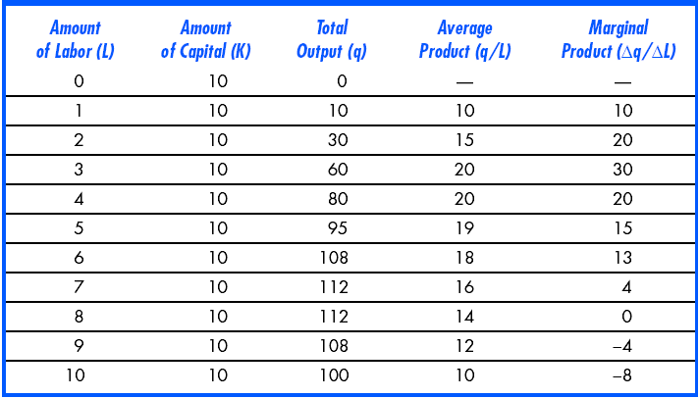
S-R Production: One Variable Input

Slide 13
S-R Production: One Variable Input
Observations:
  When labor is zero, output is zero as well
  With additional workers, output (q) increases up to 8 units of labor.
  Beyond this point, output declines
    Increasing labor can make better use of existing capital initially
    After a point, more labor is not useful and can be counterproductive
Notes:
18

Slide 14
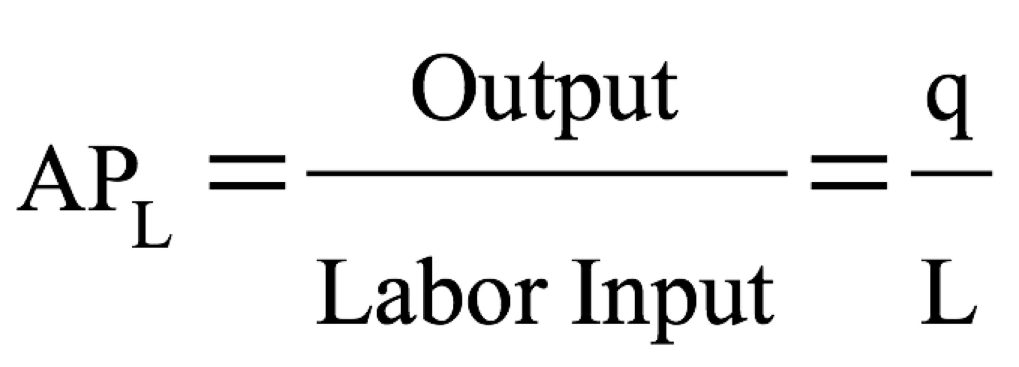


S-R Production: One Variable Input
Average product of Labor - Output per unit of a particular product
Measures the productivity of a firm’s labor in terms of how much, on average, each worker can produce
=

Slide 15
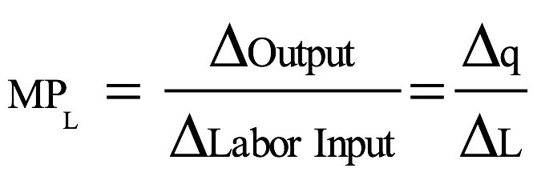
S-R Production: One Variable Input
Marginal Product of Labor – additional output produced when labor increases by one unit
Change in output divided by the change in labor
MP_{L} is the slope of TP_{L}
MP_{L}=
+
Notes:
20

Slide 16
S-R Production: One Variable Input
We can graph the information in the Table to show
  How output varies with changes in labor
    Output is maximized at 112 units
  Average and Marginal Products
    Marginal product is positive as long as total output is increasing
    Marginal Product crosses Average Product at its maximum

Slide 17
S-R Production: One Variable Input
Output
per
Month
Total Product
D
112
C
At point D, output is maximized.
60
B
A
0
1
2
3
4
5
6
7
8
9
10
Labor per Month
Notes:
23

Slide 18
S-R Production: One Variable Input
Left of E: MP > AP & AP is increasing
Right of E: MP < AP & AP is decreasing
At E: MP = AP & AP is at its maximum
At 8 units, MP is zero and output is at max
Output
per
Worker
30
Marginal Product
E
20
Average Product
10
0
1
2
3
4
5
6
7
8
9
10
Labor per Month
Notes:
27

Slide 19
Marginal & Average Product
When MP > AP, AP is increasing
When MP > AP, AP is decreasing
MP crosses AP at its maximum
When MP = 0, TP is at its maximum
Notes:
28

Slide 20

Example
= 70kg/person
50 kg
+
< 70kg/Person
+
90 kg
> 70kg/Person

Slide 21
Product Curves
We can show a geometric relationship between the total product and the average and marginal product curves
  Slope of line from origin to any point on the total product curve is the average product
  At point B, AP = 60/3 = 20 which is the same as the slope of the line from the origin to point B on the total product curve

Slide 22
Product Curves
AP is slope of line from origin to point on TP curve
q
q/L
112
30
C
60
20
B
10
0
1
2
3
4
5
6
7
8
9
10
0
1
2
3
4
5
6
7
8
9
10
Labor
Labor

Slide 23
AP_{L} = the slope of the line from the origin to the point on TP_{L} curve.
Output
per
Month
Total Product
D
112
95
At point A, AP_{L} = 30/2 = 15.
C
B
At point C, AP_{L} = 80/4 = 20.
60
At point D, AP_{L} = 112/8 = 14.
A
0
1
2
3
4
5
6
7
8
9
10
Labor per Month
Notes:
23

Slide 24
Product Curves
Geometric relationship between total product and marginal product
  The marginal product is the slope of the line tangent to any corresponding point on the total product curve
  For 2 units of labor, MP = 30/2 = 15 which is slope of total product curve at point A

Slide 25
Product Curves
MP is slope of line tangent to corresponding point on TP curve
q
D
q
112
30
60
15
30
10
A
0
1
2
3
4
5
6
7
8
9
10
0
1
2
3
4
5
6
7
8
9
10
Labor
Labor

Slide 26
MP_{L} = the slope of the line tangent to the TP_{L} curve.
Output
per
Month
Total Product
D
112
E
C
0
95
15
-8
B
60
A
20
0
1
2
3
4
5
6
7
8
9
10
Labor per Month
Notes:
23

Slide 27
Production: One Variable Input
From the previous example, we can see that as we increase labor the additional output produced declines
Law of Diminishing Marginal Returns: As the use of an input increases with other inputs fixed, the resulting additions to output will eventually decrease.
Notes:
31

Slide 28
Law of Diminishing Marginal Returns
When the labor input is small and capital is fixed, output increases considerably since workers can begin to specialize and MP of labor increases
When the labor input is large, some workers become less efficient and MP of labor decreases
Notes:
32

Slide 29
Law of Diminishing Marginal Returns
Easily confused with negative returns – decreases in output.
Explains a declining marginal product, not necessarily a negative one
  Additional output can be declining while total output is increasing
Notes:
33

Slide 30
The Effect of
Technological Improvement
Output
As move from A to B to C labor productivity is increasing over time
C
100
O₃
B
A
O₂
50
O₁
Labor per
time period
0
1
2
3
4
5
6
7
8
9
10
Notes:
37

Slide 31
Measuring Cost:
Which Costs Matter?
Accountants tend to take a retrospective view of firms costs, where as economists tend to take a forward-looking view
Accounting Cost
  Actual expenses plus depreciation charges for capital equipment --> only explicit costs
Economic Cost
  Cost to a firm of utilizing economic resources in production, including opportunity cost -->both explicit and implicit costs

Slide 32

Economics versus Accountancy
How an Economist
How an Accountant
Views a Firm
Views a Firm
Economic
profit
Opportunity
cost of own
resources
Accounting
profit
Implicit
Total Revenue
costs
Total
Revenue
Total
opportunity
e.g.
Wages
Raw materials
costs
Explicit
Explicit
costs
costs

Slide 33

Measuring Cost:
Which Costs Matter?
Economic costs distinguish between costs the firm can control and those it cannot
Opportunity cost
  Cost associated with the highest opportunities that are foregone when a firm’s resources are used.
  The minimum payment needed to pay the resource owners so it continues to be used in that operation.

Slide 34

Opportunity Cost
An Example
  A firm owns its own building and pays no rent for office space
  Does this mean the cost of office space is zero?
  The building could have been rented instead
  Foregone rent is the opportunity cost of using the building for production and should be included in economic costs of doing business

Slide 35
Opportunity Cost
A person starting their own business must take into account the opportunity cost of their time
  Could have worked elsewhere making a competitive salary
Accountants and economists often treat depreciation differently as well
  depreciation in economic means the user cost of that capital
  the different between the value of capital selling today and selling one year from now.

Slide 36
Accounting Versus Economic Profit
Item
Accounting Profit
Economic Profit
Total Revenue
Less Explicit costs:
Wages & salaries
Materials
Interest paid
Other payments
Less implicit costs:
Foregone salary
Foregone rent
Foregone interest
Equals profit
$500,000
$400,000
$50,000
$10,000
$10,000
0
0
0
$30,000
$500,000
$400,000
$50,000
$10,000
$10,000
50,000
10,000
5,000
-$35,000

Slide 37
Accounting Versus Economic Profit
Item
Accounting Profit
Economic Profit
Total Revenue
Less Explicit costs:
Wages & salaries
Materials
Interest paid
Other payments
Less implicit costs:
Foregone salary
Foregone rent
Foregone interest
Equals profit
$535,000
$400,000
$50,000
$10,000
$10,000
0
0
0
$65,000
$535,000
$400,000
$50,000
$10,000
$10,000
50,000
10,000
5,000
$0

Slide 38
Normal profit
Normal profit is a minimum accounting profit that is just sufficient to compensate for the opportunity costs of the firm owner
When a firm earns a normal profit, the economic profit must be zero
The firm owner is compensated exactly equals to his best alternative

Slide 39

Measuring Cost:
Which Costs Matter?
Although opportunity costs are hidden and should be taken into account, sunk costs should not
Sunk Cost
  Expenditure that has been made and cannot be recovered
  Should not influence a firm’s future economic decisions.

Slide 40

Sunk Cost
Firm buys a piece of equipment that cannot be converted to another use
Expenditure on the equipment is a sunk cost
  Has no alternative use so cost cannot be recovered – opportunity cost is zero
  Decision to buy the equipment might have been good or bad, but now does not matter

Slide 41
Measuring Cost:
Which Costs Matter?
Some costs vary with output, while some remain the same no matter amount of output
Total cost can be divided into:
Fixed Cost
  Does not vary with the level of output
Variable Cost
  Cost that varies as output varies

Slide 42
Fixed and Variable Costs
Total output is a function of variable inputs and fixed inputs.
Therefore, the total cost of production equals the fixed cost plus the variable cost
TC = TFC + TVC
TC = rK wL
Example: If q = 5 units needs K = 2, L = 10, r = 10, w = 0.5. TC = (10)(2) + (0.5)(10) = 20 + 5

Slide 43
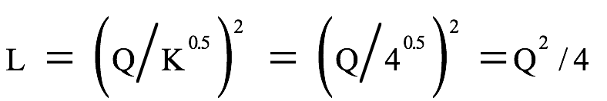
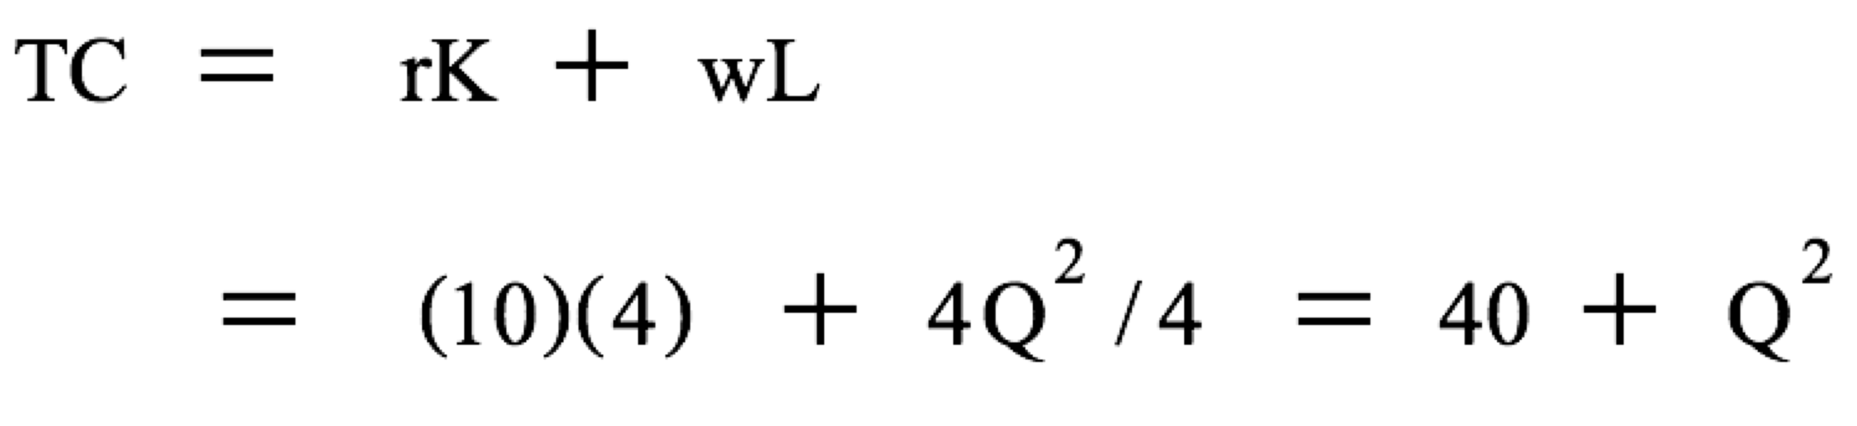
Example
From Q = K^{0.5}L^{0.5}. Capital is fixed, K = 4; hence
If r = 10, w = 4, then

Slide 44
(A) TP_{L} curve that varies with L
(C) 45º Line for switching the axis
Q
TP_{L}
Q
Q₃
Q₃
F
B
C
Q₂
Q₂
E
_{Inflection point}
Q₁
Q₁
D
A
Q₀
Q₀
L
45
Q
O
L₀
L₁
L₂
L₃
O
Q₂
Q₃
Costs
Costs
Q₀
Q₁
TVC
wL
U
G
TVC₃
TVC₃
T
TVC₂
H
TVC₂
S
Slope = w
I
TVC₁
TVC₁
_{Inflection point}
TVC₀
TVC₀
O
L
O
Q
L₀
L₁
L₂
L₃
Q₀
Q₁
Q₂
Q₃
(B) TVC that varies with w and L
(D) TVC curve that varies with Q

Slide 45
Fixed Cost Versus Sunk Cost
Fixed cost and sunk cost are often confused
Fixed Cost
  Cost paid by a firm that is in business regardless of the level of output
  It is avoidable when the firm exit the market
Sunk Cost
  Cost that have been incurred and cannot be recovered
  It is not avoidable when the firm exit the market

Slide 46
Fixed Cost Versus Sunk Cost
Example: You are about to invest to make a casting mold worth ฿50 Th. The mold is specifically designed and cannot be used for other things.
Before the payment is done, the investment is avoidable, so it is not a sunk cost.
  It is a fixed cost and can be used for making decision whether you should continue your business or not.
After the payment is done, the cost is sunk.
  The cost should not be used for making decision whether you should continue your business or not.

Slide 47
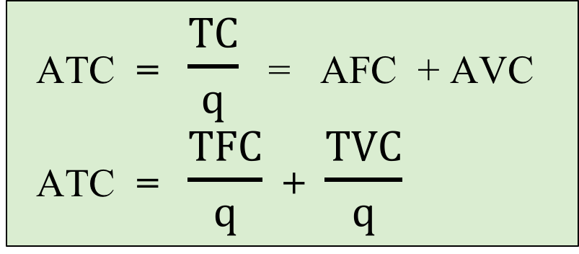
Measuring Costs
Average Total Cost (ATC)
  Cost per unit of output
  Also equals average fixed cost (AFC) plus average variable cost (AVC).
ATC = $\frac{TC}{q}$ = AFC + AVC
ATC = $\frac{TFC}{q}$ + $\frac{TVC}{q}$

Slide 48
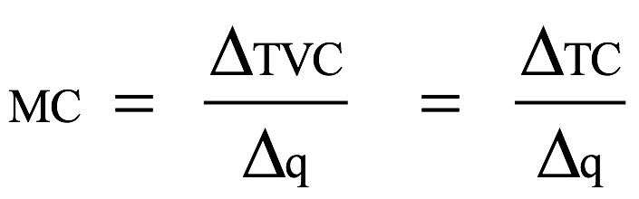
Measuring Costs
Marginal Cost (MC):
  The cost of expanding output by one unit.
  Fixed cost have no impact on marginal cost, so it can be written as:

Slide 49
Cost Curves for a Firm
TC
Cost
($ per
year)
400
Total cost
is the vertical
sum of FC
and VC.
VC
300
Variable cost
increases with
production and
the rate varies with
increasing &
decreasing returns.
200
FC
100
Fixed cost does not
vary with output
50
FC
0
1
2
3
4
5
6
7
8
9
10
11
12
13
Output

Slide 50
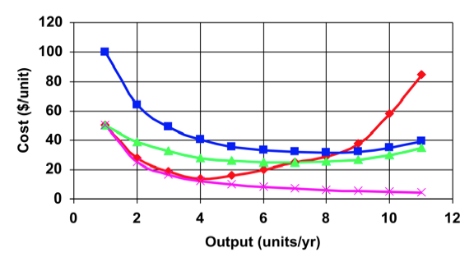
Cost Curves
MC
ATC
AVC
AFC

Slide 51
Cost Curves for a Firm
The line drawn from the origin to the variable cost curve:
  Its slope equals AVC
  The slope of a point on TVC or TC equals MC
  Therefore, MC = AVC at 7 units of output (point A)
P
TC
400
VC
300
200
A
100
FC
1
2
3
4
5
6
7
8
9
10
11
12
13
Output

Slide 52
Determinants of Short-run Costs
If marginal product of labor decreases only slightly as labor increase
  Costs will not rise very fast when output is increased
If marginal product of labor decreases significantly as more labor is hired
  Costs of production increase rapidly
  Greater and greater expenditures must be made to produce more output

Slide 53
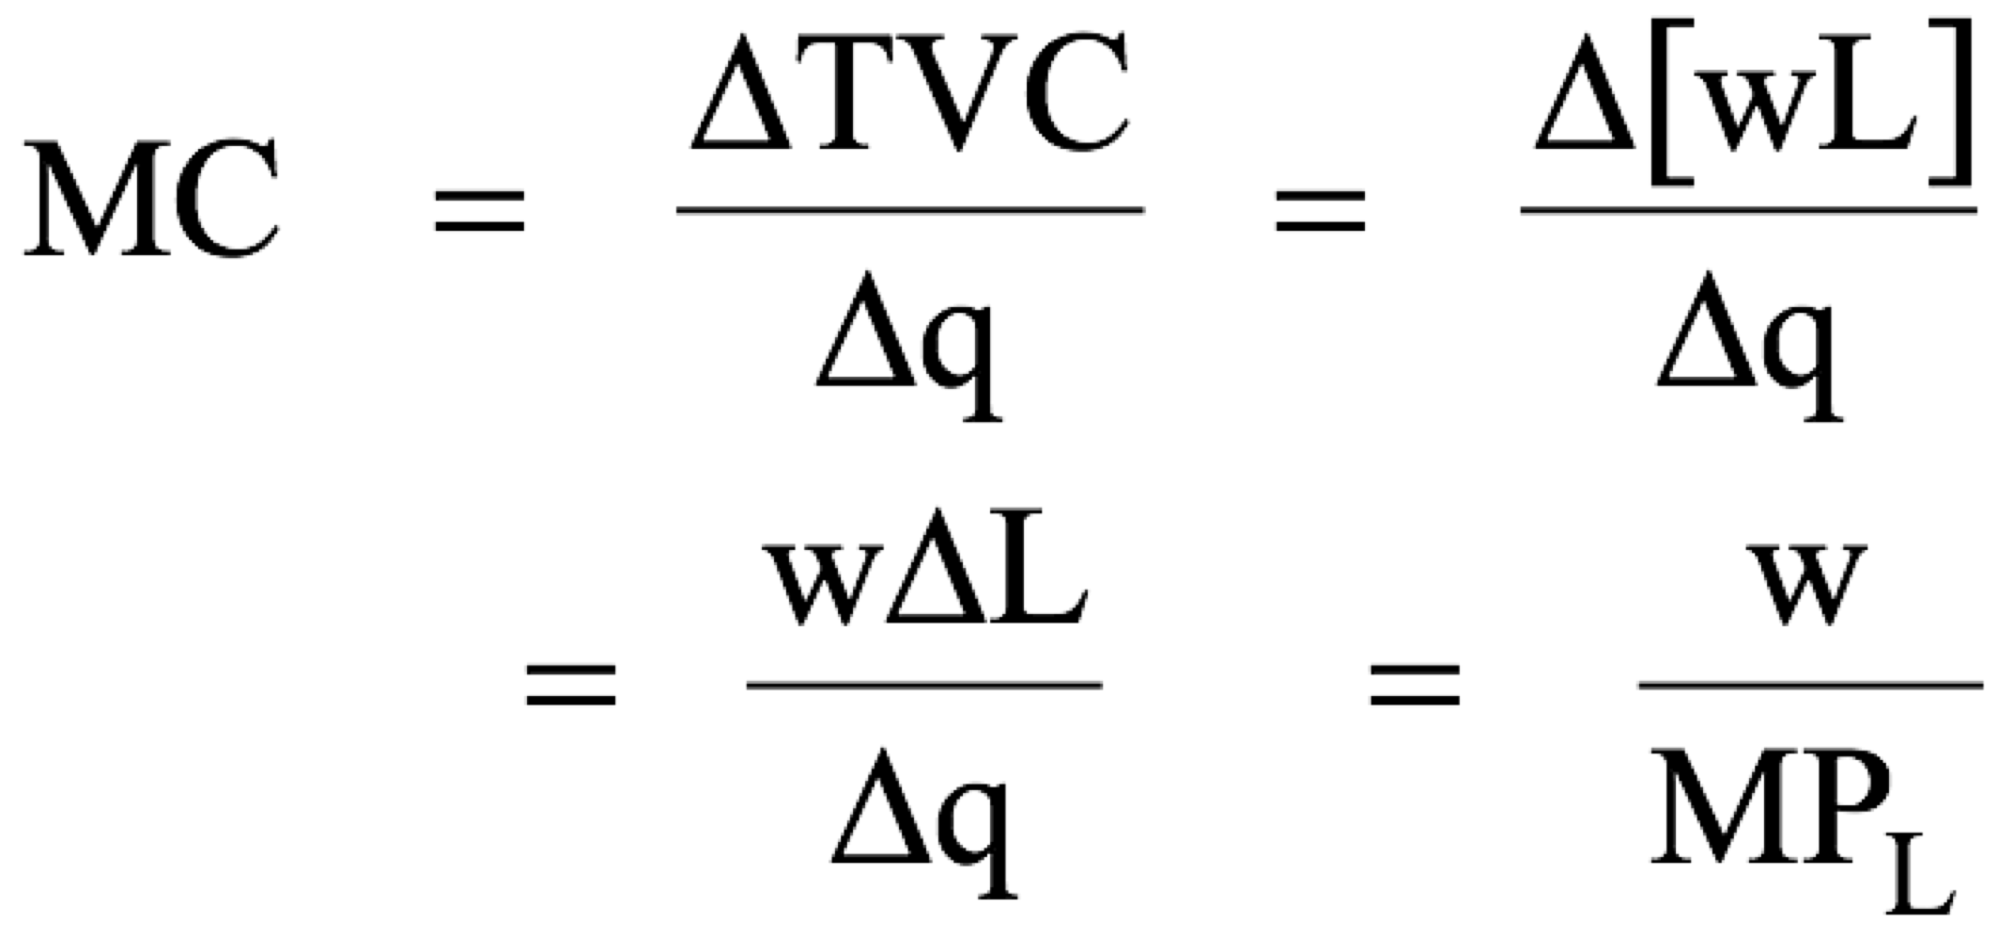
Determinants of Short-run Costs
Assume the wage rate (w) is fixed, TVC = wL.
…and a low marginal product (MP) leads to a high marginal cost (MC) and vise versa.

Slide 54
The Average – Marginal relationship
When MC is below AVC, AVC is falling
When MC is above AVC, AVC is rising
When MC is below ATC, ATC is falling
When MC is above ATC, ATC is rising
Therefore, MC crosses AVC and ATC at the minimums

