Slide 1
FN 281: Personal Finance
Thanachote Rungsitivat, CFA, FRM

Slide 2
Time Value of Money (continued)

Slide 3
Present Value
Is also know as the discount rate, or the interest rate used to bring future dollars back to the present.
Present-value interest factor (PVIF_{i,n}) is a value used to calculate the present value of a given amount.

Slide 4
Present Value Equation
PV = FV_{n} (PVIF_{i,n})
  PV = the present value, in today’s dollars, of a sum of money
  FV_{n} = the future value of the investment at the end of n years
  PVIF_{i,n} = the present value interest factor
This equation is used to determine today’s value of some future sum of money.

Slide 5
Calculating Present Value
If promised $500,000 in 40 years, assuming 6% interest, what is the value today?
PV = FV_{n} (PVIF_{i},_{n})
PV = $500,000 (PVIF_{6%, 40 yr})
PV = $500,000 (.097)
PV = $48,500

Slide 6
Annuities
Definition : a series of equal dollar payments coming at the end of a certain time period for a specified number of time periods.
Examples : life insurance benefits, lottery payments, retirement payments.

Slide 7
Compound Annuities
Definition : depositing an equal sum of money at the end of each time period for a certain number of periods and allowing the money to grow
Example : saving $50 a month to buy a new stereo two years in the future
  By allowing the money to gain interest and compound interest, the first $50, at the end of two years is worth $50 (1 + 0.08)² = $58.32

Slide 8
Future Value of an Annuity Equation
FV_{n} = PMT (FVIFA_{i,n})
  FV_{n} = the future value, in today’s dollars, of a sum of money
  PMT = the payment made at the end of each time period
  FVIFA_{i,n} = the future-value interest factor for an annuity

Slide 9
Calculating the Future Value of an Annuity
Assuming $2000 annual contributions with 9% return, how much will it be worth in 30 years?
FV_{n} = PMT (FVIFA _{i, n})
FV₃₀ = $2000 (FVIFA _{9%,30 yr})
FV₃₀ = $2000 (136.305)
FV₃₀ = $272,610

Slide 10
Present Value of an Annuity Equation
PV_{n} = PMT (PVIFA_{i,n})
  PV_{n} = the present value, in today’s dollars, of a sum of money
  PMT = the payment to be made at the end of each time period
  PVIFA_{i,n} = the present-value interest factor for an annuity

Slide 11
Present Value of an Annuity Equation
This equation is used to determine the present value of a future stream of payments, such as your pension fund or insurance benefits.

Slide 12
Calculating Present Value of an Annuity: Now or Wait?
What is the present value of the 25 annual payments of $50,000, assuming a 5% discount rate?
PV = PMT (PVIFA _{i,n})
PV = $50,000 (PVIFA _{5%}, ₂₅)
PV = $50,000 (14.094)
PV = $704,700

Slide 13
Amortized Loans
Definition : loans that are repaid in equal periodic installments
With an amortized loan the interest payment declines as your outstanding principal declines; therefore, with each payment you will be paying an increasing amount towards the principal of the loan.
Examples : car loans or home mortgages

Slide 14

Buying a Car With Four Easy Annual Installments
What are the annual payments to repay $6,000 at 15% interest?
PV = PMT(PVIFA _{i%,n yr})
$6,000 = PMT (PVIFA _{15%, 4 yr})
$6,000 = PMT (2.855)
$2,101.58 = PMT

Slide 15
Perpetuities
Definition – an annuity that lasts forever
PV = PP / i
  PV = the present value of the perpetuity
  PP = the annual dollar amount provided by the perpetuity
  i = the annual interest (or discount) rate

Slide 16
Summary
Future value – the value, in the future, of a current investment
Rule of 72 – estimates how long your investment will take to double at a given rate of return
Present value – today’s value of an investment received in the future

Slide 17
Summary
Annuity – a periodic series of equal payments for a specific length of time
Future value of an annuity – the value, in the future, of a current stream of investments
Present value of an annuity – today’s value of a stream of investments received in the future

Slide 18
Summary
Amortized loans – loans paid in equal periodic installments for a specific length of time
Perpetuities – annuities that continue forever

Slide 19
Assessment: The Expensive Car
You graduate from BE and you really want that new $35,000 BMW 320i that your buddy has. You estimate that you can borrow the money for the car at 9%, paying $8,718 per year for 5 years.
  (a) Your first thought is that you buy the car and begin investing in year 6 the $8,718 per year for 25 years at 9%.
  (b) Your second thought is to keep your old Honda Civic with 150,000 miles and invest the $8,718 per year for the full 30 years at 9%.
Even though 9% may be a high return to obtain, what is the difference in future value between thought (a) and thought (b)? What was the cost of the car in retirement terms?

Slide 20
Answer: The Car
Payment = $8,718, N = 25, I = 9%
  Future value = $738,422
Payment = $8,718, N = 30, I = 9%
  Future value = $1,188,329
The cost of the car in retirement terms is $449,907

Slide 21
Assessment: The Costly Mistake
Bob and Tom are both currently 45 years old. Both are concerned for retirement; however, Bob begins investing now with $4,000 per year at the end of each year for 10 years, but then doesn’t invest for 10 years. Tom, on the other hand, doesn’t invest for 10 years, but then invests the same $4,000 per year for 10 years. Assuming a 9% return, who will have the highest amount saved when they both turn 65?

Slide 22
Answer: The Costly Mistake
Time makes a real difference (10% return)
Time Really makes a difference!

Slide 23
Answer: The Costly Mistake
Clear memories, set calculator to end mode.
  Solve for Tom:
    N = 10 PMT = -4,000 I = 9%, solve for FV
    FV = $60,771
  Solve for Bob:
    1. N = 10 PMT = -4,000 I = 9%, solve for FV
    FV = $60,771
    2. N = 10 PV = 60,771 I = 9%, solve for FV
      FV = $143,867
  Bob will have $83,096 more than Tom – Begin Investing Now!!

Slide 24

Achieving Financial Goals
Strategies
1
5
Obtain financial records.
Borrow wisely.
2
Plan how you will spend your money.
6
Invest to increase current income and for long-term growth
3
7
Spend wisely.
Manage risk.
4
8
Save on a regular basis.
Plan for retirement.

Slide 25
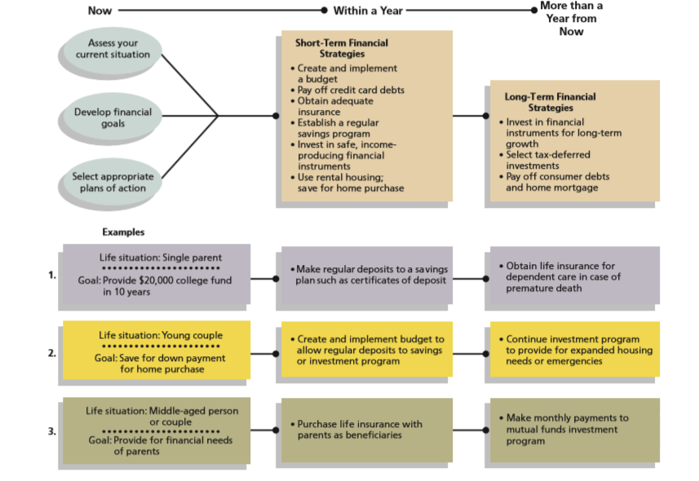
Financial Plan
A financial plan is a formalized report that summarizes your current financial situation, analyzes your financial needs, and recommends future financial activities

Slide 26
Stages of Career Planning and Advancement
Assess and Research Personal Goals, Abilities, and Career Fields
Evaluate Employment Market and Identify Specific Employment Opportunities
Develop Resume and Cover Letter and Apply for Available Positions
Interview for Available Positions and Assess Your Interview Performance
Evaluate Financial and Other Factors of Positions You are Offered
Plan and Implement a Program for Career Development

Slide 27
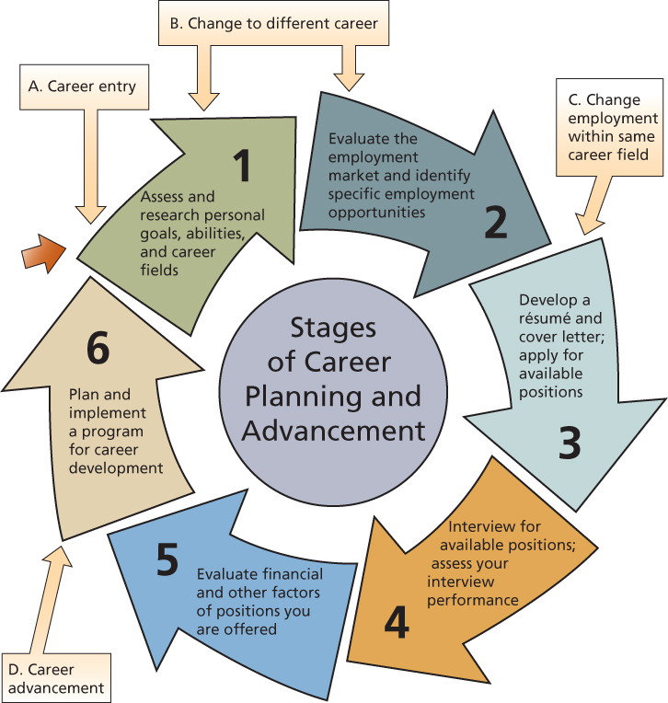
Stages of Career Planning and Advancement

Slide 28
Career Choice Factors
Trade-offs of Career Decisions
Career Training and Skill Development
Personal Factors
Career Decision Making

Slide 29

Career Choice Factors
Trade-offs of Career Decisions
Career choices alternatives have risks and opportunity costs
Career choices require periodic evaluation of trade-offs related to personal, social, and economic factors

Slide 30
Career Choice Factors
Career Training and Skill Development
Level of formal training affects financial success
Training may be viewed in two main categories:
  Technical Skills refers to specialized career training for a specific profession.
  General Skills are traits adaptable to most work situations. Some can be acquired at school, while others require experience.

Slide 31
Career Choice Factors
Personal Factors
Aptitudes
Interests inventories
Your personality
Do you perform best in low-pressure or high-pressure working environments?
Personal SWOT analysis

Slide 32
Career Opportunities: Now and in the Future
Social Influences
  Demographic trends
  Geographic trends
Economic Conditions
  Interest rates
  Inflation
  Consumer demand
Industry Trends
  Foreign competition
  Changing uses of technology

Slide 33
Career Opportunities: Social Influences
Demographic trends
Geographic trends
  Where jobs are; salaries, and living costs
Working Parents | More food service and child care
Leisure time | More interest in health and recreation
Longer life spans | Demand for travel, health care, and retirement facilities
Employment training | Demand for teachers, trainers, and related careers

Slide 34
Career Opportunities: Economic Conditions
Career Opportunities are affected by:
  High interest rates
  Price increases
  Decreased demand for goods and services

Slide 35
The Situation
Smith is in his third year of bachelor degree. After taking several business courses, he thinks that the sales and marketing field would be an interesting career. He wonders whether his personality would be suited for this career, what a sales and marketing person would do and what skills he would need to be successful in this career.

Slide 36
Industry Trends
Information technology
Health Care
Business Services
Social Services
Sales and Retailing
Hospitality and Food Services
Management and Human Resources
Education
Financial Services
Smith learned that the manufacturing jobs are going to deli e, but he also learned that these jobs are being replaced by service sector jobs.

Slide 37
Obtaining Employment Experience
Part-time Employment
Volunteer Work
Internships
Campus Projects
Smith is very much aware of the issue of lack of experience that many new graduates face when applying for work. In order to gain work experience, Smith will have to work summers or part time.

Slide 38
Identifying Job Opportunities
Job Advertisements
Career Fairs
Employment Agencies
Other Job Search Methods

Slide 39
Career Strategies in a Weak Job Market
Acknowledge stress, anxiety and fear
Assess your financial situation
Evaluate your current and future employment potential
Maintain focus and keep a positive outlook
Connect with others in professional and social settings
Consider part-time work, consulting and volunteering

Slide 40

Resume

Slide 41
Developing a Resume
Personal data section
Career objective section
Education section
Experience section
Related information section
References section

Slide 42
Three Types of Resumes
Chronological
  - Most common; focuses on experience and education in reverse-time sequence
Functional
  - Focuses on your skills
Targeted
  - Prepared for a specific job
E-resumes for applying for a job online
  - Use a simple format and no attachments

Slide 43

Resume Preparation
Presented in a professional manner
Limit your resume to one page
Use the STAR principle to highlight experiences and achievements:
Situation, or the setting
Task, your duties
Actions you took
Result, the outcome

Slide 44
Creating a Cover Letter
Introductory paragraph
  Get reader’s attention
  Overview your qualifications
Development paragraph
  Specific qualifications
  Refer to details on resume
  Experiences and training
Concluding paragraph
  Ask for interview
  Include how to contact you
  Summarize how you can help the company

Slide 45
The Job Interview
Prepare for the interview by getting information about your prospective employer
  Library resources such as annual reports or recent articles
  Internet searches of company and industry information
  Observations during company visits
Prepare questions to ask about your interests, the organization, policies, and benefits
Practice interview skills

Slide 46
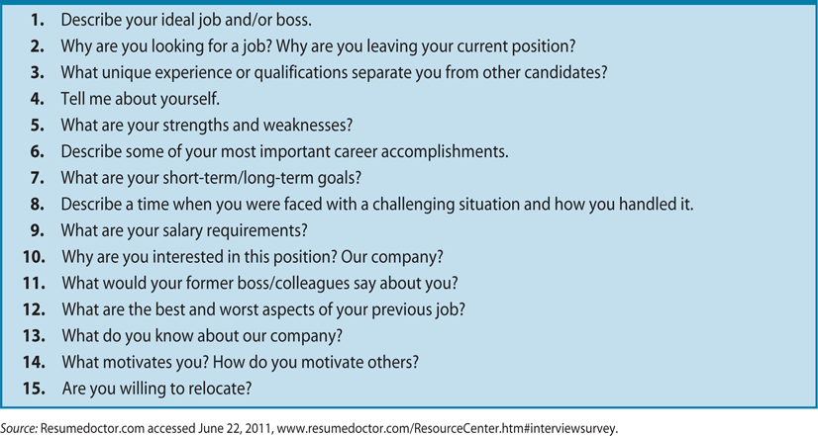
Most Common Interview Questions

Slide 47
Financial and Legal
Aspects of Employment
***Research the job and the company before
accepting an employment position
THE WORK ENVIRONMENT
  Corporate culture
  Company policies and procedures
FACTORS AFFECTING SALARY
  Education, training, company size, and salaries for comparable positions

Slide 48
Financial and Legal
Aspects of Employment (continued)
EVALUATING EMPLOYEE BENEFITS
  Nonsalary benefits include: child care, leaves of absence, and elder care
  Cafeteria-style benefits allow workers benefit credits that they can choose to meet their needs
  Flexible spending and medical savings accounts
  Compare job offer benefits based on market value or future value
  Know your employment rights

Slide 49
Financial and Legal
Aspects of Employment (continued)
A career can be for a lifetime
Skills and attitudes that can lead to a fulfilling work life:
  Communicate well with others
  Flexible and open to new ideas
  Develop efficient work habits
  Use lists, goal setting, and time management techniques
  Anticipate problems and areas for actions
  Creativity and a willingness to assist others

Slide 50
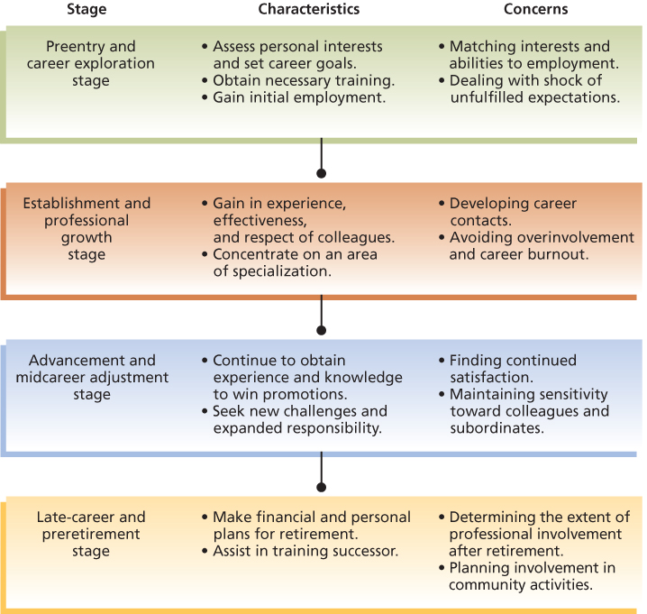
Stages of career development

Slide 51
Long-Term Career Development
(cont’d)
TRAINING OPPORTUNITIES
Continue to learn about new technology and the global economy
Formal methods for expanding knowledge:
  company programs, seminars, and college courses
Informal methods:
  reading and discussions with colleagues
  meetings with employees from other companies

Slide 52
Long-Term Career Development
(cont’d)
CAREER PATHS AND ADVANCEMENT
Career choices must be evaluated in light of changing values, goals, and economic conditions
A mentor is an experienced employee who serves as a teacher and counselor for a less experienced person
  Mentors are attracted to those who show initiative
  Mentors should be receptive to assisting others, and help in both technical and social areas of their careers

Slide 53
Long-Term Career Development
(cont’d)
CHANGING CAREERS
About 10 million career moves occur each year
Changing jobs can be more difficult than selecting the first job
Carefully assess the financial and personal costs and benefits of changing careers
Determine whether a career change will serve your needs and goals

Slide 54
Long-Term Career Development
(cont’d)
  To cope with job termination while seeking new employment you should:
    Maintain appropriate eating, sleep, and exercise habits
    Involve yourself in family and community activities
    Improve your skills through classes and volunteer work
    Target your search towards high growth industries
    Consider opportunities with non-profit organizations
    Target your skills to the needs of an organization

Slide 55
Financial and Legal Aspects of Employment
Accepting an Employment Position
  The Work Environment
  Factors Affecting Salary
Evaluating Employee Benefits
  Meeting employee needs
  Comparing benefits
Your Employment Rights

Slide 56
Employee’s Benefit Comparison Sheet
Corporate Culture
Health Insurance
Life Insurance
Retirement
Holidays
Training Opportunities
Child Care
Vacation Time (period)
Sick Leave
Tuition Reimbursement
Provident Funds
Other Benefits

Slide 57
Thank you

