Slide 1
FN 331: Financial Institutions Management
Class 12
Copyright © 2014 by the McGraw-Hill Companies, Inc. All rights reserved.
Notes:
1

Slide 2
Overview
This chapter discusses the nature of market risk and appropriate measures
  RiskMetrics
  Historic or back simulation
  Monte Carlo simulation
  Expected shortfall
  Links between market risk and capital requirements
Ch 15-2
Notes:
2

Slide 3
Trading Risks
Trading exposes banks to risks
  Late 2006 through mid-2009: housing prices plummeted, affecting mortgage lending industry
  2007: Bear Stearns hedge funds losses in subprime mortgage market
  2007-2008:
    Bankruptcy of Lehman Brothers
    Merrill Lynch bought by BOA
    WAMU acquired by J.P. Morgan Chase
Ch 15-3

Slide 4
Implications
Emphasizes importance of:
  Measurement of exposure
  Control mechanisms for direct market risk and employee created risks
  Hedging mechanisms
Of interest to regulators
Ch 15-4

Slide 5
Market Risk
Market risk is the uncertainty resulting from changes in market prices
  Affected by other risks such as interest rate risk and FX risk
  Can be measured over periods as short as one day
  Usually measured in terms of dollar exposure amount or as a relative amount against some benchmark
Ch 15-5

Slide 6
Question 1
What is meant by market risk?
  Market risk is the uncertainty of the effects of changes in economy-wide systematic factors that affect earnings and stock prices of different firms in a similar manner.
  Some of these market-wide risk factors include volatility, liquidity, interest-rate and inflationary expectation changes .

Slide 7
Question 2
Why is the measurement of market risk important to the manager of a financial institution?
  Measurement of market risk can help an FI manager in the following ways:
  a. Provide information on the risk positions taken by individual traders.
  b. Establish limit positions on each trader based on the market risk of their portfolios.
  c. Help allocate resources to departments with lower market risks and appropriate returns.
  d. Evaluate performance based on risks undertaken by traders in determining optimal bonuses.
  e. Help develop more efficient internal models so as to avoid using standardized regulatory models.

Slide 8
Question 3
What is meant by daily earnings at risk (DEAR)?
  DEAR or Daily Earnings at Risk is defined as the estimated potential loss of a portfolio's value over a one-day unwind period as a result of adverse moves in market conditions, such as changes in interest rates, foreign exchange rates, and market volatility .
What are the three measurable components?
  DEAR is comprised of (a) the dollar value of the position, (b) the price sensitivity of the assets to changes in the risk factor, and (c) the adverse move in the yield.
What is the price volatility component?
  The product of the price sensitivity of the asset and the adverse move in the yield provides the price volatility component.

Slide 9
Market Risk Measurement
Important in terms of:
  Management information
  Setting limits
  Resource allocation (risk/return tradeoff)
  Performance evaluation
  Regulation
    BIS and Fed regulate market risk via capital requirements leading to potential for overpricing of risks
    Allowances for use of internal models to calculate capital requirements
Ch 15-9

Slide 10
Calculating Market Risk Exposure
Generally concerned with estimated potential loss under adverse circumstances
Three major approaches of measurement:
  JPM RiskMetrics (or variance/covariance approach)
  Historic or Back Simulation
  Monte Carlo Simulation
  Expected Shortfall
Ch 15-10

Slide 11
RiskMetrics Model
  Idea is to determine the daily earnings at risk = dollar value of position × price sensitivity × potential adverse move in yield or
  DEAR = dollar market value of position × price volatility
where,
price volatility = price sensitivity of position × potential adverse move in yield
Ch 15-11

Slide 12
RiskMetrics
For Fixed Income Securities,
DEAR can be stated as:
  DEAR = (MD) × (potential adverse daily yield move)
  where,
  MD = D/(1+R)
  MD = Modified duration
  D = Macaulay duration
Ch 15-12

Slide 13
Confidence Intervals
  If we assume that changes in the yield are normally distributed, we can construct confidence intervals around the projected DEAR (other distributions can be accommodated but normal is generally sufficient)
  Assuming normality, 90% of the time the disturbance will be within ±1.65 standard deviations of the mean
    (5% of the extreme values remain in each tail of the distribution)
Ch 15-13

Slide 14
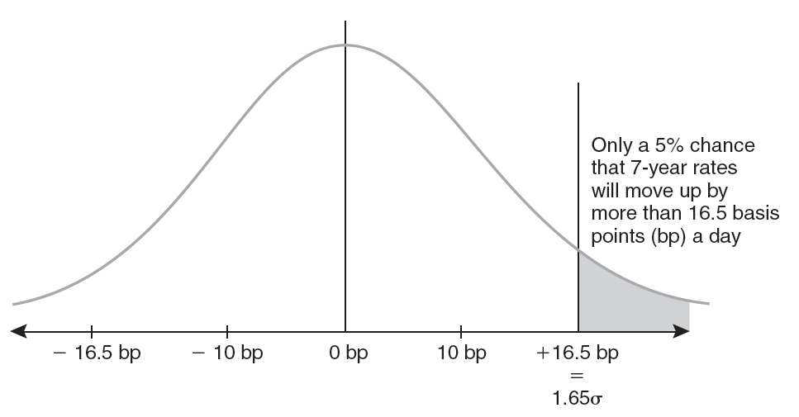
Adverse 7-Year Rate Move
Ch 15-14

Slide 15
Confidence Intervals: Example
  Suppose that we are long in 7-year zero-coupon bonds and we define “bad” yield changes such that there is only a 5% chance of the yield change being exceeded in either direction. Assuming normality, 90% of the time yield changes will be within 1.65 standard deviations of the mean. If the standard deviation is 10 basis points, this corresponds to 16.5 basis points. Concern is that yields will rise. Probability of yield increases greater than 16.5 basis points is 5%.
Ch 15-15

Slide 16
Confidence Intervals: Example
Yield on the bonds = 7.243%, so MD = 6.527 years
Price volatility = (MD) × (Potential adverse change in yield)
= (6.527) × (0.00165) = 1.077%
DEAR = Market value of position × (Price volatility)
= ($1,000,000) × (.01077) = $10,770
Ch 15-16

Slide 17
Confidence Intervals: Example
To calculate the potential loss for more than one day:
Market value at risk
(VAR_{N}) = DEAR ×
Example:
For a five-day period,
VAR₅ = $10,770 ×
= $24,082

Slide 18
Foreign Exchange
In the case of foreign exchange, DEAR is computed in the same fashion we employed for interest rate risk
DEAR = dollar value of position × FX rate volatility, where the FX rate volatility is taken as 1.65 σ_{FX}
Ch 15-18

Slide 19
Equities
For equities, total risk = systematic risk + unsystematic risk
If the portfolio is well diversified, then
DEAR = dollar value of position × stock market return volatility, where
market volatility taken as 1.65 σ_{m}
If not well diversified, a degree of error will be built into the DEAR calculation
Ch 15-19

Slide 20
Aggregating DEAR Estimates
Cannot simply sum up individual DEARs
In order to aggregate the DEARs from individual exposures we require the correlation matrix.
Three-asset case:
DEAR portfolio = [DEAR_{a}² + DEAR_{b}² +
DEAR_{c}² + 2ρ_{ab} × DEAR_{a} × DEAR_{b} + 2ρ_{ac} ×
DEAR_{a} × DEAR_{c} + 2ρ_{bc} × DEAR_{b} × DEAR_{c}]^{1/2}
Ch 15-20

Slide 21
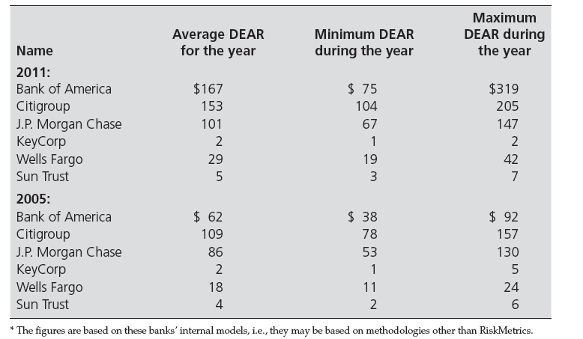
DEAR: Large US Banks 2005 & 2011
Ch 15-21
Notes:
21

Slide 22
Historic or Back Simulation
Basic idea: Revalue portfolio based on actual prices (returns) on the assets that existed yesterday, the day before that, etc. (usually previous 500 days)
Then calculate 5% worst-case (25th lowest value of 500 days) outcomes
Only 5% of the outcomes were lower
Ch 15-22

Slide 23
Estimation of VAR: Example
Convert today’s FX positions into dollar equivalents at today’s FX rates
Measure sensitivity of each position
  Calculate its delta
Measure risk
  Actual percentage changes in FX rates for each of past 500 days
Rank days by risk from worst to best
Ch 15-23

Slide 24
Historic or Back Simulation
Advantages:
  Simplicity
  Does not need correlations or standard deviations of individual asset returns
  Does not require normal distribution of returns (which is a critical assumption for RiskMetrics)
  Directly provides a worst case value
Ch 15-24

Slide 25
Weaknesses
Disadvantage: 500 observations is not very many from a statistical standpoint
Increasing number of observations by going back further in time is not desirable
Could weight recent observations more heavily and go further back
Ch 15-25

Slide 26
Monte Carlo Simulation
To overcome problem of limited number of observations, synthesize additional observations
  Perhaps 10,000 real and synthetic observations
Employ historic covariance matrix and random number generator to synthesize observations
  Objective is to replicate the distribution of observed outcomes with synthetic data
Ch 15-26

Slide 27
Expected Shortfall
Expected Shortfall = Conditional VAR = Expected Tail Loss
Average of the losses in the tail of the distribution beyond the 99th percentile
Ch 15-27

Slide 28
Regulatory Models
BIS (including Federal Reserve) approach:
  Simple standardized framework:
    Partial Risk Factor Approach
    Fuller Risk Factor Approach
  Subject to regulatory permission, large banks may be allowed to use their internal models as the basis for determining capital requirements
Ch 15-28

Slide 29
Large Banks: Using Internal Models
  In calculating DEAR, adverse change in rates defined as 99th percentile (rather than 95th under RiskMetrics)
  Minimum holding period is 10 days (means that RiskMetrics’ DEAR multiplied by ).
  Capital charge will be higher of:
    Previous day’s VAR (or DEAR × )
    Average daily VAR over previous 60 days times a multiplication factor ≥ 3

Slide 30
Question 4
Follow Bank has a $1 million position in a five-year, zero-coupon bond with a face value of $1,402,552. The bond is trading at a yield to maturity of 7.00 percent. The historical mean change in daily yields is 0.0 percent, and the standard deviation is 12 basis points?
    What is the modified duration of the bond?
      MD = 5 ÷ (1.07) = 4.6729 years
    What is the maximum adverse daily yield move given that we desire no more than a 5 percent chance that yield changes will be greater than this maximum?
      Potential adverse move in yield at 5 percent = 1.65σ = 1.65 x 0.0012 = 0.001980.

Slide 31
Question 4
    What is the price volatility of this bond?
      Price volatility = -MD x potential adverse move in yield
      = -4.6729 x .00198 = -0.009252 or -0.9252%
    What is the daily earnings at risk for this bond?
      DEAR = ($ value of position) x (price volatility).
      = $1,000,000 x 0.009252 = $9,252

Slide 32
Question 5
What is meant by value at risk (VAR)? How is VAR related to DEAR in J.P. Morgan’s RiskMetrics model?
  Value at Risk or VAR is the cumulative DEARs over a specified period of time and is given by the formula VAR = DEAR x [N]½.
What would be the VAR for the bond in problem (4) for a 10-day period?
  VAR is a more realistic measure if it requires a longer period to unwind a position, that is, if markets are less liquid.
  The value for VAR in problem four above is $9,252 x 3.1623 = $29,257.39.

Slide 33
Question 5
With what statistical assumption is our analysis taking liberties? Could this treatment be critical?
  The relationship according to the above formula assumes that the yield changes are independent.
  This means that losses incurred on one day are not related to the losses incurred the next day.
  However, recent studies have indicated that this is not the case, but that shocks are autocorrelated in many markets over long periods of time.

Slide 34
Question 6
The DEAR for a bank is $8,500. What is the VAR for a 10-day period? A 20-day period?
  For the 10-day period: VAR = 8,500 x [10]½ = 8,500 x 3.1623 = $26,879.36
  For the 20-day period: VAR = 8,500 x [20]½ = 8,500 x 4.4721 = $38,013.16
Why is the VAR for a 20-day period not twice as much as that for a 10-day period?
  The reason that VAR20 ≠ (2 x VAR10) is because [20]½ ≠ (2 x [10]½).
  The interpretation is that the daily effects of an adverse event become less as time moves farther away from the event.

Slide 35
Question 7
The mean change in the daily yields of a 15-year, zero-coupon bond has been five basis points (bps) over the past year with a standard deviation of 15 bps. Use these data and assume the yield changes are normally distributed:
    What is the highest yield change expected if a 90 percent confidence limit is required; that is, adverse moves will not occur more than one day in 20 ?
      If yield changes are normally distributed, 90 percent of the area of a normal distribution will be 1.65 standard deviations (1.65σ) from the mean for a one-tailed distribution.
      In this example, it means 1.65 x 15 = 24.75 bps. Thus, the maximum adverse yield change expected for this zero-coupon bond is an increase of 24.75 basis points in interest rates.

Slide 36
Question 7
    What is the highest yield change expected if a 95 percent confidence limit is required?
      If a 95 percent confidence limit is required, then 95 percent of the area will be 1.96 standard deviations (1.96σ) from the mean.
      Thus, the maximum adverse yield change expected for this zero-coupon bond is an increase of 29.40 basis points (1.96 x 15) in interest rates.

Slide 37
Question 8
In what sense is duration a measure of market risk?
  The market risk calculations typically are based on the trading portion of an FIs fixed-rate asset portfolio because these assets must reflect changes in value as market interest rates change.
  As such, duration or modified duration provides an easily measured and usable link between changes in the market interest rates and the market value of fixed-income assets.

Slide 38
Question 9
Bank Alpha has an inventory of AAA-rated, 15-year zero-coupon bonds with a face value of $400 million. The bonds currently are yielding 9.5% in the over-the-counter market:
    What is the modified duration of these bonds?
      Modified duration = (MD) = D/(1 + r) = 15/(1.095) = -13.6986.
    What is the price volatility if the potential adverse move in yields is 25 basis points?
      Price volatility = (-MD) x (potential adverse move in yield).
      = (-13.6986) x (.0025) = -0.03425 or -3.425%
    What is the DEAR?
      Daily earnings at risk (DEAR) = ($ Value of position) x (Price volatility)
      Dollar value of position = 400/(1 + 0.095)15 = $102.5293 million
      DEAR = $102.5293499 million x -0.03425 = -$3.5116 million

Slide 39
Question 9
    If the price volatility is based on a 90 percent confidence limit and a mean historical change in daily yields of 0.0 percent, what is the implied standard deviation of daily yield changes?
      The potential adverse move in yields (PAMY) = confidence limit value x standard deviation value.
      Therefore, 25 basis points = 1.65 x σ, and σ = .0025/1.65 = 0.001515 or 15.15 basis points.

Slide 40
Question 10
Bank Two has a portfolio of bonds with a market value of $200 million. The bonds have an estimated price volatility of 0.95 percent. What are the DEAR and the 10-day VAR for these bonds?
  Daily earnings at risk (DEAR) = ($ Value of position) x (Price volatility)
  = $200 million x 0.0095
  = $1.9million, or $1,900,000
  Value at risk (VAR) = DEAR x √N = $1,900,000 x √10
  = $1,900,000 x 3.1623 = $6,008,327.55

Slide 41
Question 12
Bank of Alaska’s stock portfolio has a market value of $10,000,000. The beta of the portfolio approximates the market portfolio, whose standard deviation (σm) has been estimated at 1.5 percent. What is the 5-day VAR of this portfolio, using adverse rate changes in the 99th percentile ?
  DEAR = ($ Value of portfolio) x (2.33 x σm ) = $10m x (2.33 x .015)
  = $10m x .03495 = $0.3495m or $349,500
  VAR = $349,500 x √5 = $349,500 x 2.2361 = $781,505.76

Slide 42
Question 15
What are the advantages of using the back simulation approach to estimate market risk?
  The advantages of the back simulation approach to estimating market risk are that (a) it is a simple process, (b) it does not require that asset returns be normally distributed, and (c) it does not require the calculation of correlations or standard deviations of returns.
Explain how this approach would be implemented?
  Implementation requires the calculation of the value of the current portfolio of assets based on the prices or yields that were in place on each of the preceding 500 days (or some large sample of days).
  These data are rank-ordered from worst case to best and percentile limits are determined.
  For example, the five percent worst case provides an estimate with 95 percent confidence that the value of the portfolio will not fall more than this amount.

Slide 43
Question 17
What is the primary disadvantage to the back simulation approach in measuring market risk?
  The primary disadvantage of the back simulation approach is the confidence level contained in the number of days over which the analysis is performed.
What affect does the inclusion of more observation days have as a remedy for this disadvantage?
  Further, all observation days typically are given equal weight, a treatment that may not reflect accurately changes in markets.
  As a result, the VAR number may be biased upward or downward depending on how markets are trending.
What other remedies are possible to deal with the disadvantage ?
  Possible adjustments to the analysis would be to give more weight to more recent observations, or to use Monte Carlo simulation techniques.

Slide 44
Question 18
How is Monte Carlo simulation useful in addressing the disadvantages of back simulation? What is the primary statistical assumption underlying its use?
  Monte Carlo simulation can be used to generate additional observations that more closely capture the statistical characteristics of recent experience.
  The generating process is based on the historical variance-covariance matrix of FX changes.
  The values in this matrix are multiplied by random numbers that produce results that pattern closely the actual observations of recent historic experience.

Slide 45
Question 19
In the BIS Standardized Framework for regulating risk exposure for the fixed-income portfolios of banks, what do the terms specific risk and general market risk mean?
  Specific risk is the risk unique to the issuing party for long-term bonds in the trading portfolio of a financial institution.
  Specific risk measures the decline in the liquidity or credit risk quality of the portfolio.
  General market risk measures reflect the product of duration and possible interest rate shocks to determine the sensitivity of the portfolio to market rate movements.

Slide 46
Question 19
Why does the capital charge for general market risk tend to underestimate the true interest rate or price risk exposure?
  The capital charge for market risk tends to underestimate interest rate risk because of (a) maturity timing differences in offsetting securities in the same time band, and (b) basis point risk for different risk assets that may not be affected in a similar manner by interest rate changes.
  Thus the capital charges may be adjusted for basis risk.
What additional offsets, or disallowance factors, are included in the analysis?
  These adjustments also reflect the use of excess positions in one time zone to partially offset positions in another time band.

Slide 47
Question 21
Explain how the capital charge for foreign exchange risk is calculated in the BIS Standardized model. If an FI has an $80 million long position in Euros, a $40 million short position in British pounds, and a $20 million long position in Swiss francs, what would be the capital charge required against FX market risk?
  Total long position = $80 m of Euros + $20 m of Swiss franks = $100 million
  Total short position = $40 million British pounds
  Higher of long or short position = $100 million
  Capital charge = 0.08 x $100 = $8 million

Slide 48
Question 23 (a)
What conditions were introduced by BIS in 1998 to allow large banks to use internally generated models for the measurement of market risk?
  Large banks are allowed to utilize internally generated models to measure market risk after receiving approval from the regulators.
  The models must consider a 99 percent confidence level, the minimum holding period for VAR estimates is 10 days, and the average estimated VAR will be multiplied by a minimum factor of 3.
  Further, the minimum capital charge must be the higher of the previous day’s VAR or the average VAR over the previous 60 days. Thus calculation of the capital charge is more conservative.

Slide 49
Question 23 (b)
What types of capital can be held to meet the capital charge requirements?
  However, FIs are allowed to hold three types of capital to meet this more conservative requirement:
  Tier I capital includes common equity and retained earnings.
  Tier II capital includes long-term subordinated debt with a maturity of over five years.
  Tier III capital includes short-term subordinated debt with a maturity of at least two years .

