Slide 1
Politics, Economics and Social welfare
TU 101
Department of Economics
Friday the 8th of September, 2017
Jesper Kulvmann, D.Phil
Department of Social Administration
Thammasat University

Slide 2

Aim of the lecture
Examine the provision of social welfare over time
Factors that has led the family to be insufficient providing adequate protection for individuals.
Describe ways of the government to provide “welfare” for the people.
Political and economic determinants of the development of social welfare
What is a welfare state?
What is a welfare state?

Slide 3
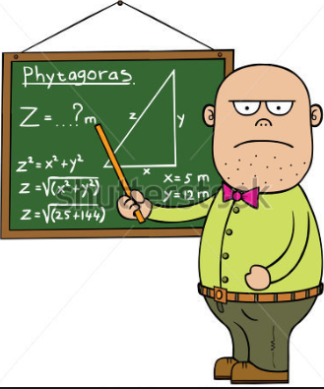
Outline of lecture
Clarifying concept
  Social development
  Social welfare
  Welfare state
Explanations for the need of a welfare state
Organization of a welfare state
  Aim of the welfare state
  Social rights
Student activities

Slide 4

Social development
“Social Development focuses on the needs to “put people first” in the development processes. Poverty is more than low income – it is about vulnerability, exclusion, unaccountable institutions, powerlessness, and exposure to violence.
(world bank, 2017)

Slide 5

Welfare= Well-being

Slide 6
welfare
Individual level
Well-being
  Good health
  Economic security
  Individual vitality
  Rewarding social relationships
  Sound interaction with circumstances
Group level
Welfare
  Good health
  Economic security
  Individual vitality
  No social conflicts
  Sound interaction with circumstances

Slide 7



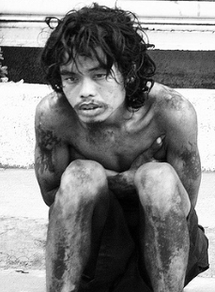

Social welfare
Social problems
  “A social condition that a segment of society views a as harmful to members of society and in need of remedy
Social welfare
  “Activities enabling individuals, families, groups or communities to cope with social problems”

Slide 8
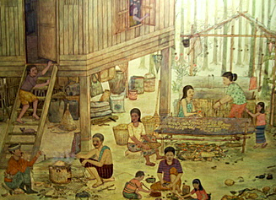
Social development: 20 century
UP till late 20th century Thailand a peasantry society
  Family primary source of social welfare
  Religious institutions main external assistance
Industrialization leads to urbanization, and dramatic alterations of family life and
new social needs .
Growth of nation states and civil services.
development of demand for democracy
Globalized society

Slide 9
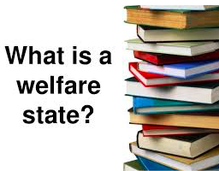
The need of a welfare state
Narrowly speaking, “the welfare state may refer to state measures for meeting key welfare needs (often confined to health, education, housing, income maintenance and personal social services). This provision may take the form of either services (funded or provided by the state) or income transfers”
  (C.Pierson, 2006)

Slide 10
5 explanations for the development of a welfare state
Industrialization
Demographic changes
Building of nation states
The rise of democracy and political citizenship
Global uncertainty

Slide 11

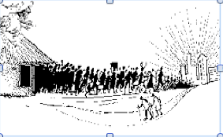
Societal development: Industrialization
Decline in agricultural employment and rural population
  Still 40% of population in the agricultural sector in Thailand
  But sharp decline in importance for the national economy
  Agricultural life style fading component of national culture
  Small farmers depending on supplementing their income
Extensive urbanization

Slide 12
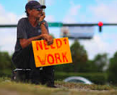
Societal development: Industrialization
Requirement for a skilled labour force.
  Industry
  Public services.
Development of a middle class.
  But, Thai industry still depends on
cheap labour.
Social risks:
  Unemployment
  Work accidents/sickness/disability
  Old age.

Slide 13

Societal development: Demographic changes
(Demography: the study about population)
Initially Rapid growth in population
  Decreased infant mortality and increased life expectancy.
Today an aging population in Thailand.
Changing pattern of home and community life
  Division between working and non-working population and home and work.
Increasing income inequality
  Rural vs urban
  Unskilled workers vs skilled workers
  Thai nationals vs migrant workers.
New needs to be met by the society.

Slide 14
Societal development: de-familization
Individuals less dependent on the family.
Inter-generational dependency reduced.
  Minimal income
  Housing
  Sickness
  Old age
  Life style
Welfare state takes over the role of the family.

Slide 15
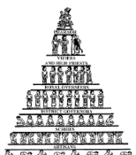
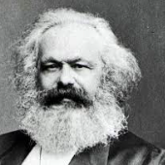
Societal development: Nation states
Centralization of government
  Development of central administration
Internal pacification
  Avoidance of social conflicts
  Adherence to ideas of capitalism
    Fear of Marxism
  Nation building (particularly after WW2 in Europe)

Slide 16

Societal development: The rise of democracy and political citizenship
Expansion of legal citizenship
  Right to vote, including women
  Social rights.
Multi-party systems
  Competition for electorates
  Development of Social Democratic parties.
Labour Unions

Slide 17

Political development: Democratization
New attitudes towards social issues, such as poverty and working conditions.
  Social science disciplines developed
  Changing attitudes towards origin of social risks.
Global dissemination of information

Slide 18
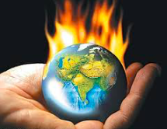
Welfare states: global factors
Global uncertainty
Financial crises
Climate change

Slide 19

Response
Family and local community?
Leave it to the market ?
Government interference ?
  Level of interference

Slide 20
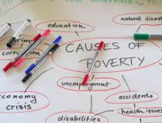
Major Social problems in Thailand
Income inequality
Big differences between
rural and urban living
Poverty
Education
Adequate health provision
Aging population
Unemployment

Slide 21
Social problems: Inequality
Increasing inequality between different social groups.
  The poor rice farmer vs. urban middle/upper class
  Urban middle/upper class vs. urban poor
  Migrant workers vs. Thai workers
The life of Thai peasants faced endless cycles of uncertainty, debt and poverty.
  They are on the losing side of "development“.
  Their best chances for a better life is to look for opportunities outside, but that comes at the cost of leaving their communities.

Slide 22
Social Problem: Poverty
Dramatic reduction in absolute poverty.
  2 dollars a day (survival level)
  3.4% 2005
UN measure 2012:
  12.6% (human development index)
    More than 8 million people (approx. equivalent to the total population of Sweden)
Poverty is still a major problem in Thailand

Slide 23
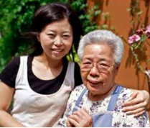
Social welfare: family
Advantages
Personal care
  Love and tenderness
  Obligation
No costs for the government

Slide 24
Social Welfare: family
Disadvantages
Individuals less dependence on the family.
  Incompatible with modern Life style
High level of inequality in ability to provide for the elderly in the family.
Living and working arrangements make reliance on family difficult.
Inter-generational dependency reduced due to:
  Minimal income
  Housing arrangements
  Complicated Sickness and disability among elderly

Slide 25
Community and cultured based welfare
Local communities also important providers of welfare
  temples
  Village and community Revolving Fund
    Supporting community economic activities
    Promote self-reliance
  Mutual Fund Society
  Sufficiency economy
Insufficient to meet new and growing social needs
  Rural development, urban poor (unemployed), neglected children, ethnic minorities.

Slide 26



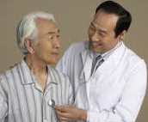
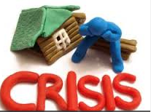
Welfare state
Social policies
Affecting the living conditions and social welfare.
Provides or pays for social services.
Public Services seen as “social goods”.
EQUAL
ACCESS ??

Slide 27
Redistribution
Redistribution of income and redistribution of wealth are respectively the transfer of income and of wealth (including physical property) from some individuals to others by means of a social mechanism such as taxation, monetary policies, welfare, land reform, charity, …
(wikipedia)

Slide 28
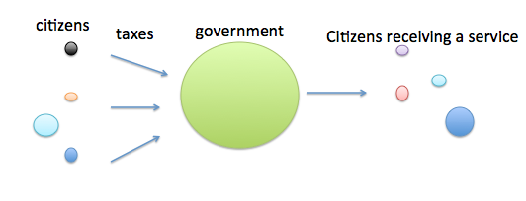
Redistribution

Slide 29

Welfare state
Narrowing insecurity.
Assisting those in need
by reallocating resources
between individuals.
  Redistribution
  Degree of equality
But, when is Robin Hood
a thief or a hero?

Slide 30
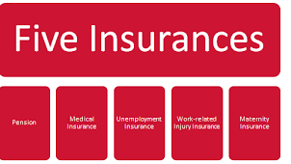
Funding
Taxation
  Flat tax or progressive income tax
Social insurance
  Commonly compulsory payment to an insurance scheme. Payment by employer, employee and the state.
  Compensation according to premium
Which system is most redistributive?

Slide 31

Types of welfare states
European style
Southeast Asian style

Slide 32

European Welfare state
Human rights perspective.
  Civil rights
    Free movement
    Freedom to own property
  Political rights
    Freedom of speech
    Democratic rights (freedom to vote, to run for office)
  Social rights (social citizenship)
    Being a citizens entitled you to some rights to have basic needs covered
    Outcome of a political process

Slide 33
European welfare state: social citizenship
Changing attitude towards citizenship.
Democratic demands, not just about meeting needs.
Equal status = equal citizenships
Opting for the “optimal” and not the “minimal”

Slide 34
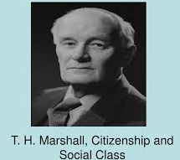
Social Citizenship
“A welfare state is a state in which organized power is deliberately used (through politics and administration) in an effort to modify the play of market forces in at least three directions:
Minimum income
Limit insecurity
Best standards available

Slide 35
European Welfare state
Typical welfare provisions of European welfare state
    Public Healthcare
    Public Education
    Unemployment benefits
    Social assistance to people in need
      Homeless, disabled, refugees (non citizens)
    Maternity leave
    Basic, sufficient pension
Funded through taxation or social insurance

Slide 36

European welfare states:
Social Rights
Universal
  Equal for everybody
  Optimal compensation
Selective
  Means tested
  Minimum compensation

Slide 37
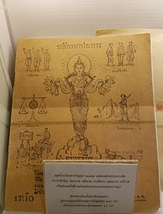
Thai welfare state
Government provision of social welfare not a “new idea”.
Democratic struggle for social security laws throughout the 20th century.
Attempts blocked by conservative authoritarian rulers.
First social security act passed in 1990.

Slide 38
Thai welfare state
(Developmental welfare state)
Welfare state set up to develop the economy
  Social policy instrumental for economic development.
  Social development achieved by “trickle down system”.
Sectors strategic for economic development favoured in terms of social protection.
  Employment based schemes (social insurance)
    Mandatory for companies with more than 10 employees
  Exemption: 30 baht scheme
Social role of family and local community high

Slide 39
Thai welfare state
Free basic education
30 baht scheme
  Limited to basic health care
    Infant mortality rate dropped dramatically (18 to 10)
    Financial risk reduced
      98% covered by scheme
    Healthier labour force
Limited pension
    600 baht a month
    Mandatory contribution to pension funds from 2018.

Slide 40
Thai welfare state
Social insurance for people in formal sector
  25 – 30% of work force
    State employees, big companies
  Provisions for health care
  Pension
  Short term unemployment
  Limited maternity leave
Low taxation

Slide 41
Pros and cons of the Thai welfare state
Pros
Stimulate the economy
Preserving existing paternal values in society.
Individualism
Low taxes
Cons
No insurance for the majority of the population.
Lead to high level of inequality.
  Social conflicts
Not taking into account the changing family pattern and division of work.

Slide 42
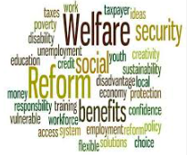
“sustainable and just social protection system”
Sustainability
Maintain the welfare state at affordable costs and uphold the support of the public.
  Funding
    Tax base?
    Level of redistribution?
  Costs
    Efficient delivery
      Transparency

Slide 43
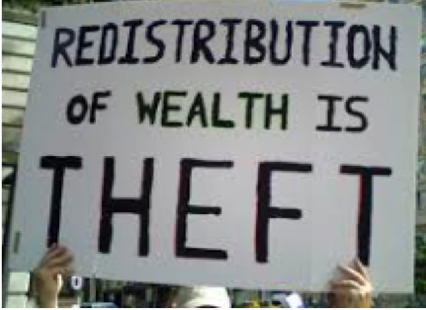
Discussion

Slide 44
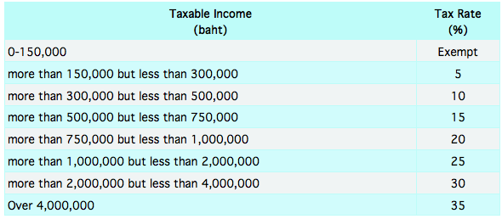
Tax rates in Thailand

Slide 45
Inheritance tax
From 2016, inherited assets above the value of 100 million baht for descendants will be taxed by 5%.
Assets
  houses and lands
  Bank deposits
  Shares
  Automobiles

Slide 46
Income tax
Income tax
Do you think that the tax rates in Thailand are fair?
Fair ____ ( present 3 arguments)
Unfair ____ (present 3 arguments)
2. If no
I think they are unfair because the highest incomes are taxed too little ______ (present 3 arguments)
I think they are unfair because the highest incomes are taxed too much ______ (present 3 arguments)

Slide 47
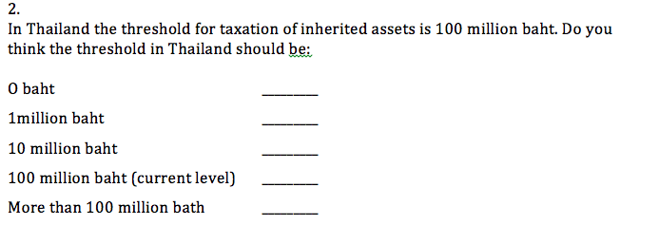
Ballot: taxation
Provide 3 arguments for your answer and possible contra-arguments

Slide 48
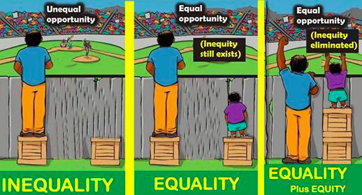
just social protection system ?
Equality vs. equity

Slide 49
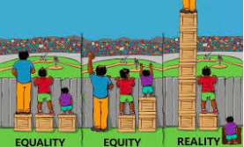
just social protection system ?
Should Thailand maintain focusing on economic development and less on income inequality or should Thailand aim at higher level of income equality (equity)?
Provide three arguments for your position?

Slide 50
Six reasons for a welfare state
Promoting economic growth
Reducing poverty
  “Free of the fear of want”
Promoting social stability
Promoting social equality
Promoting social inclusion
Promoting autonomy
(Goodin, 1988)

