Slide 1

MK 322 Retail Management
Chapter 5: Retail Market Strategy Part I
By Ajarn Suwalya K.

Slide 2

MK 322 Today’s Happenings
Chapter Presentation
Chapter 5
BREAK
Chapter 6

Slide 3
What is Retail Strategy?

Slide 4
Retail Strategy
A retail strategy is a statement identifying
The retailer's target market
The format and resources the retailer plans to use to satisfy the target market's needs
The bases which the retailer plans to build a sustainable competitive advantage
Notes:
1

Slide 5
Retail Strategy
The target market is the market segment(s) toward which the retailer plans to focus its resources and retail mix
A retail format describes the nature of the retailer's operations-its retail mix(type of merchandise and services offered, pricing policy, advertising,and promotional programs, store design and visual merchandising, typical locations, and customer services) that it will use to satisfy the needs of its target market.
Notes:
1

Slide 6
Retail Strategy
A sustainable competitive advantage is an advantage the retailer has over its competition that is not easily copied by competitors and thus can be maintained over a long period of time.
Notes:
1

Slide 7
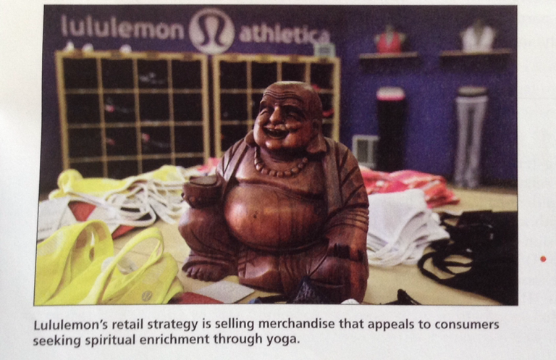
Retail Strategy
Notes:
1

Slide 8

Central Concepts in a Retail Marketing Strategy

Slide 9
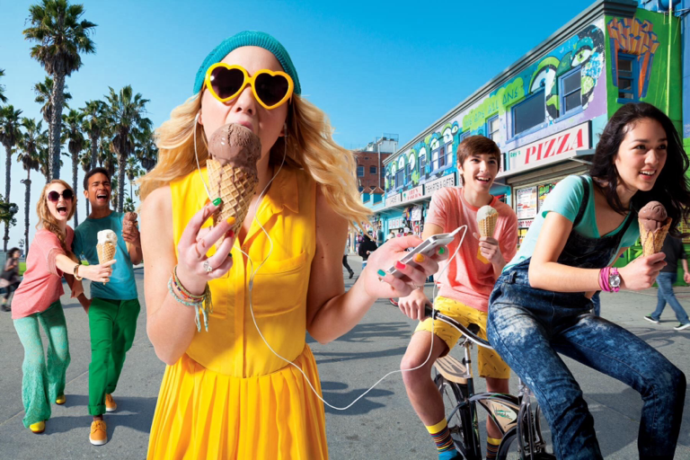
Target Market And Retail Format
A retail market is a group of consumers with similar needs and group of retailers that satisfy those needs using similar retail channels and formats.
Notes:
1

Slide 10
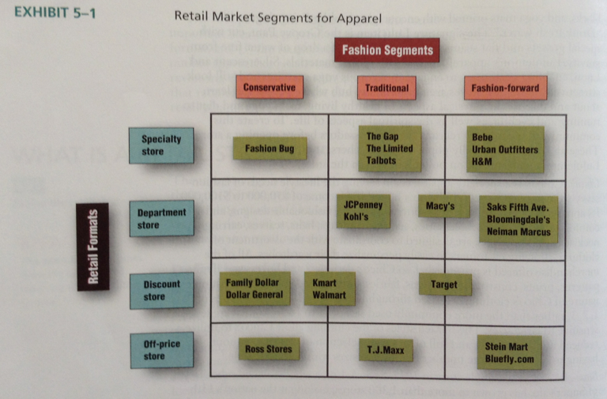
Target Market And Retail Format
Notes:
1

Slide 11
Building Sustainable Competitive Advantage (SCA)
Three approaches are
Building strong relationships with customers
Building strong relationships with suppliers
Achieving efficient internal operations
Each of these three approaches involves developing asset-loyal customers, strong vendor relationships, committed effective human resources, efficient systems, and attractive locations
Notes:
1

Slide 12
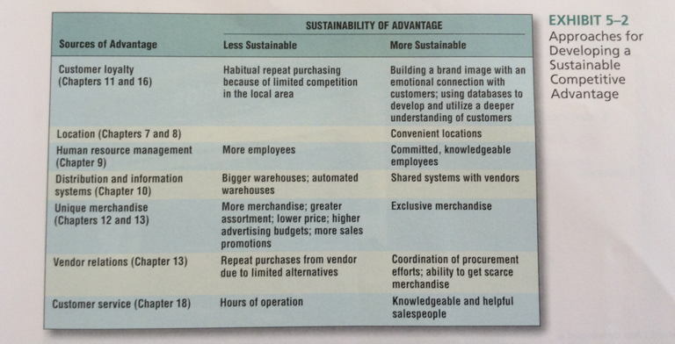
Building Sustainable Competitive Advantage (SCA)
Notes:
1

Slide 13
Relationships with Customers-Customer Loyalty
Customer Loyalty means that customers are committed to buying merchandise and services from a particular retailer
Loyalty is more than liking one retailer over another
Loyalty means that customers will be reluctant to switch and patronize a competitive retailer
Notes:
1

Slide 14
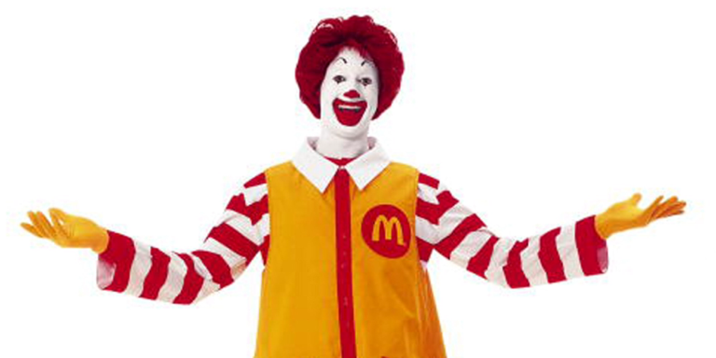
Brand Image
Brand Image-think of McDonald's, think of fast food; hamburgers, french fries, fast service, consistent quality, clean restrooms
Notes:
1

Slide 15
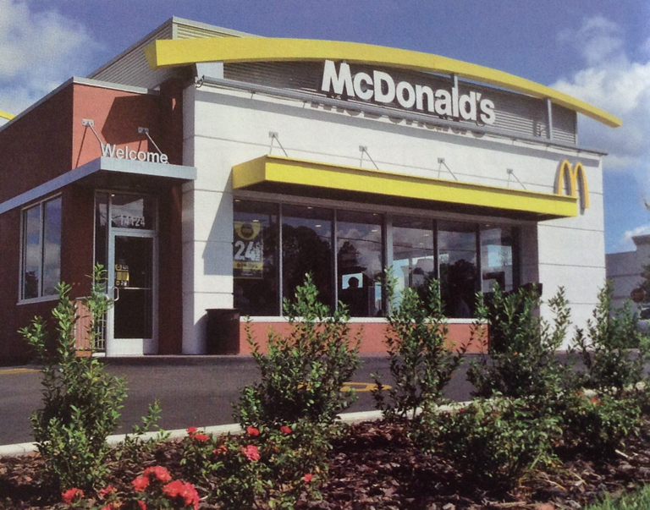
Relationships with Customers-Customer Loyalty
McDonald's has developed a competitive advantage by projecting an image of fast service, consistent quality, and clean restrooms
Notes:
1

Slide 16
Positioning
A retailer's brand image reflects its positioning strategy
Positioning is the design and implementation of a retail mix to create an image of the retailer in the customer's mind relative to its competitors
A perceptual map is frequently used to express the customer's image and preference for retailers
Notes:
1

Slide 17
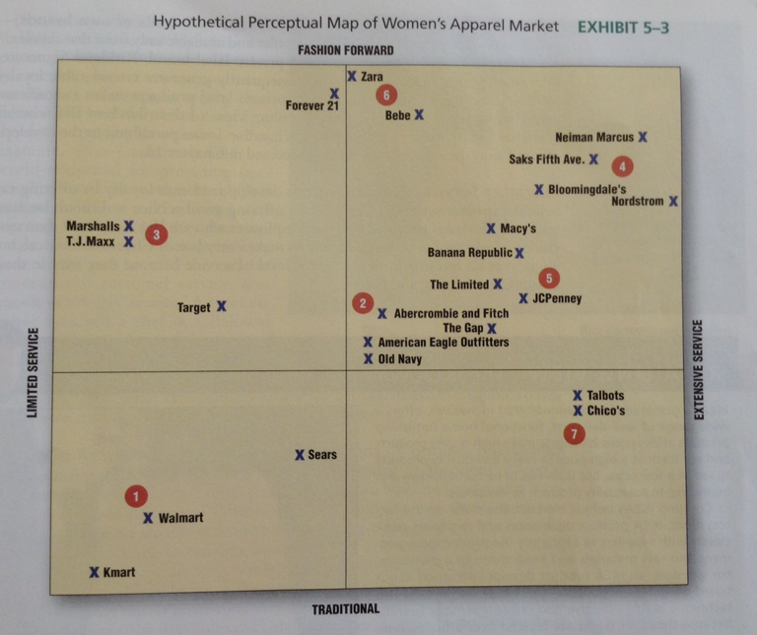
Positioning
Notes:
1

Slide 18

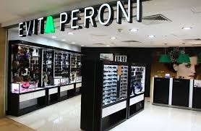
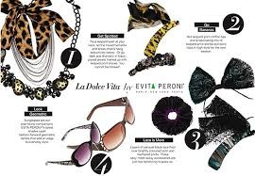
Unique Merchandise
Difficult for retailers to develop customer loyalty because most competitors can purchase and sell the same popular national brands
Many retailers develop private label brands or called store brands or own brands
Notes:
1

Slide 19
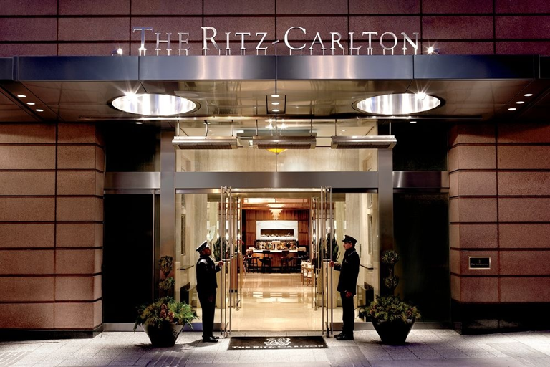
Customer Service
Retailers can develop customer loyalty by offering excellent customer service
For example:Ritz-Carlton "WOW"stories
Notes:
1

Slide 20
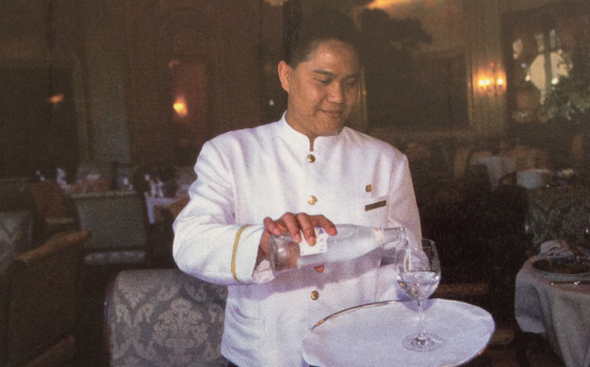
Customer Service
Ritz Carlton's outstanding service builds customer loyalty.
Notes:
1

Slide 21
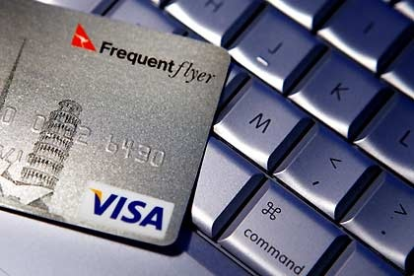
Customer Relationship Management Programs
Customer Relationship Management Programs Or called CRM programs are also called loyalty or frequent shopper programs
Notes:
1

Slide 22
Building a Retail Community Using Social Media
Retailers are beginning to use their websites and social media to develop retail communities
A retail community is a group of consumers who have a shared information with respect to retailer's activities
Increased involvement
Fan of facebook page, Starbucks in 2008 launched My Starbucks Idea
Notes:
1

Slide 23
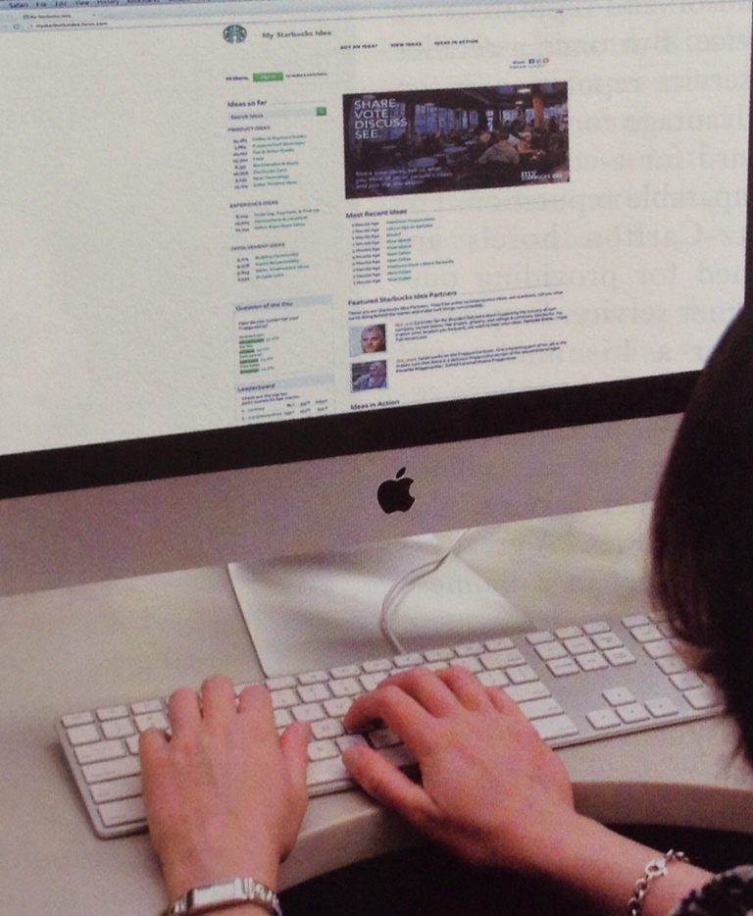
Building a Retail Community Using Social Media
Starbucks builds customer loyalty by developing a community of customers who offer suggestions for improving Starbucks' offering
Notes:
1

Slide 24
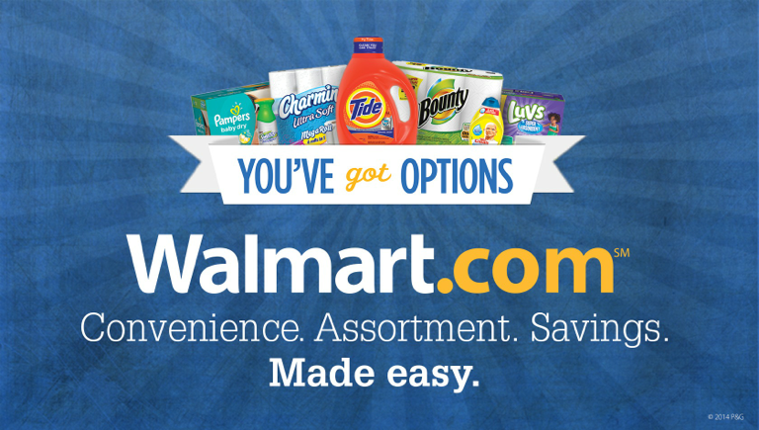
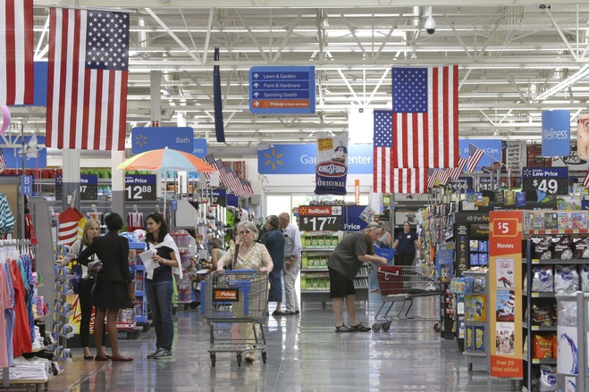
Relationship with Suppliers
Most important relationship with Vendor ie. Walmart and P&G
Developed over time and not be easily offset by competition
Notes:
1

Slide 25
Efficiency of Internal Operations
Efficiency of Internal Operations
Human Resource Management: labor intensive business
Distribution and Information systems
Notes:
1

Slide 26
Location
Location is a critical opportunity for developing competitive advantage for 2 reasons:
Location is the most important factor determining which store a consumer patronizes.
Location is a SCA because it is not easily duplicated
Notes:
1

Slide 27
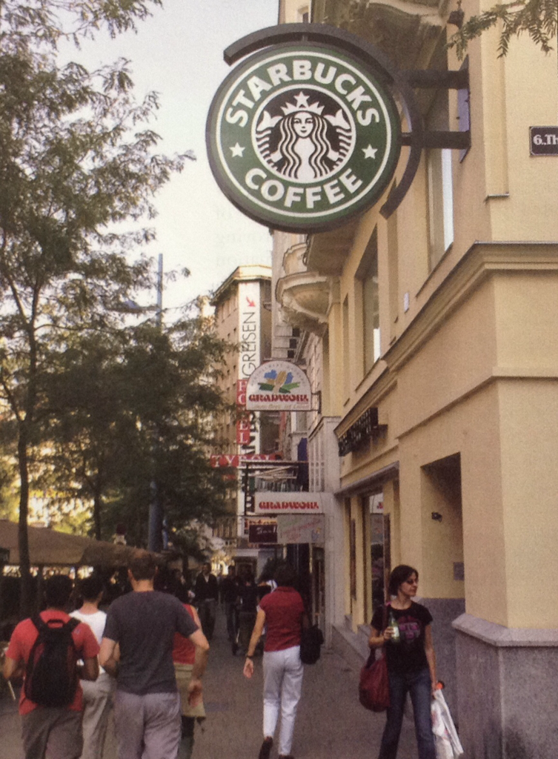
Location
Starbucks creates a competitive advantage by saturating an area with stores, which makes it difficult for competitors to find good locations.
Notes:
1

Slide 28


