Slide 1
Overview of Vietnam’s Economic, Business, Social and Political Environment
Sompong Sanguanbun
16 June B.E. 2558

Slide 2
Politics
single-party socialist republic -- one-party system led by the Communist Party of Vietnam
Executive Branch
President of Vietnam is the head of state, Chairman of the Council for Defence and Security, Commander-in-Chief of the Armed Forces, Rights to announce the State of Emergency and declare War
Prime Minister of Vietnam is the head of government

Slide 3
Legislative power
National Assembly of Vietnam --- highest organ of state power --- according to the Constitution
498 members, a 5-year term, appoint the President, Prime Minister and the cabinet, Chief Justice and Supreme People's Office of Supervision and Inspection
Under the influence of the Communist Party of Vietnam (150-member of the Central Committee which elects 15-member Politburo (the National Assembly is an arm of the Politburo)
Developments of the National Assembly
The 1st NA (1946-1960) after the first election held on 6 January 1946 following the gaining an independence led by Ho Chi Minh on 2 September 1945
The 5th NA was the shortest (1975-1976) because of the re-unification of VN and holding the 1st election of the unified VN
The 6th NA (1976-1981) approved the 1980 Constitution (of the unified VN)
The 7th NA (1981-1987) --- the launch of the Renewal Policy – Doi Moi
The 8th NA (1987-1992) approved the 1992 Constitution --- citizens personal ownership of properties was guaranteed
The 9th NA (1992-1997) enacted laws to serve Doi Moi policy
The 13th NA – current one consists of 500 deputies

Slide 4
Judiciary
Court is independent
Responsible for providing leadership to the Vietnamese court system, supervising the judicial process, and recommending bills to the National Assembly as appropriate under law.

Slide 5
Foreign Affairs
Foreign Policy Trends: Tensions have arisen in the past between Vietnam and its neighbors, especially in the case of China since both nations claim the Spratly Islands, an archipelago in a potentially oil-rich area of the South China Sea. Conflicting claims have produced over the years small scale armed altercations in the area. China's assertion of control over the Spratly Islands and the South China Sea has raised concern from Vietnam and its Southeast Asia neighbors (ASEAN). The territorial border between the two countries is being definitively mapped according to a Land Border Agreement signed in December 1999, and an Agreement on Borders in the Gulf of Tonkin signed in December 2000. Vietnam and Russia declared a strategic partnership in March 2001 during the first visit ever to Hanoi of a Russian head of state, largely as an attempt to counterbalance China's growing profile in Southeast Asia

Slide 6
Relations with Thailand
Presently – Excellent, matured, Joint Cabinet Meetings
Mechanism - Joint Committee on Bilateral Cooperation, Political Consultation Group, Joint Working Group on Political and Security Cooperation
Trade – 10.451 Billion US$ in 2013
11.826 Billion US$ in 2014
Thailand is the largest trading partner among ASEAN with Vietnam
Thailand ranks no. 10 as the foreign investor in VN
Problems - Thai prisoners in VN (2)
- VN fishing vessels intrude Thai territories
- VN labours in Thailand 3-50000

Slide 7
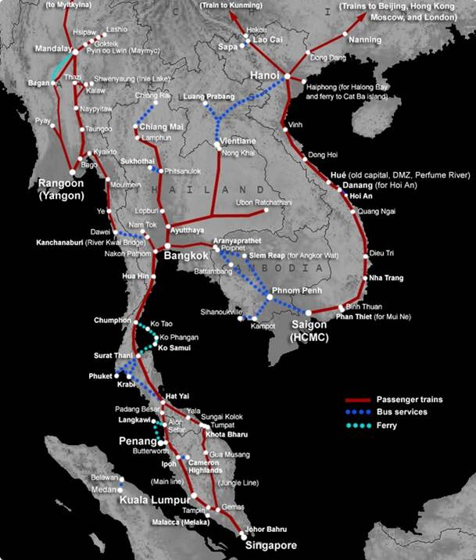
Connectivity

Slide 8
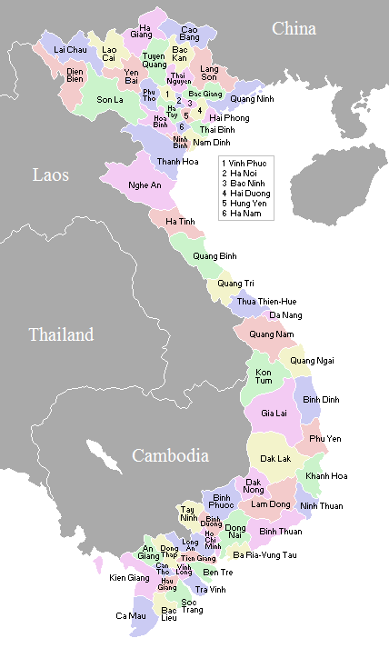
Connectivity

Slide 9
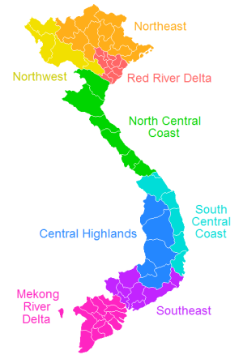
Connectivity

Slide 10
Connectivity
จังหวัดใน South Central Coast
Binh Dinh -
Binh Thuan - ๑,๑๖๗,๐๒๓
Khanh Hoa - ๑,๑๕๗,๖๐๔
Ninh Thuan - ๕๖๔,๙๙๓
Phu Yen - ๘๖๒,๒๓๑
Quang Nam - ๑,๔๒๒,๓๑๙
Quang Ngai - ๑,๒๑๖,๗๗๓
Da Nang City - ๘๘๗,๔๓๖

Slide 11
Connectivity
จังหวัดใน Southeast
Ba Ria – Vung - ๙๙๖,๖๘๒
Binh Doung - ๑,๔๘๑,๕๕๐
Binh Phuong - ๘๗๓,๕๙๘
Dong Nai - ๒,๔๘๖,๑๕๔
Tay Ninh - ๑,๐๖๖,๕๗๓
Ho Chi Minh City - ๗,๑๖๒,๘๖๔

Slide 12
Connectivity
Mekong Delta
An Giang - ๒,๑๔๒,๘๖๔
Bac Lieu - ๘๕๖,๕๑๘
Ben Tre - ๑,๒๕๕,๙๔๖
Ca Mau - ๑,๒๐๖,๙๓๘
Dong Thap - ๑,๖๖๖,๔๖๗
Han Giang - ๗๕๗,๓๐๘
Kien Giang - ๑,๖๘๘,๒๔๘
Long An - ๑,๔๓๖,๐๖๖
Soc Trang - ๑,๒๙๒,๘๕๓
Tien Giang - ๑,๖๗๒,๒๗๑
Tra Vinh - ๑,๐๐๓,๐๑๒
Vinh Long - ๑,๐๒๔,๗๐๗
Can Tho City - ๑,๑๘๘,๔๓๕

