Slide 1
FN 281: Personal Finance
Thanachote Rungsitivat, CFA, FRM

Slide 2

Textbook
Personal Finance, 11th Edition by Kapoor, Dlabay and Hughes

Slide 3
Grading
Class Participation and Quizzes 15%
  Active Class participation
    If I call your name and you are not in the class, points will be deducted.
    Encourage to ask questions during the class
  Scheduled and Unscheduled quizzes
Individual Assignments 20%
  Hand in the assignments to the office/in class on a timely manner
Group Assignments 30%
  Group Activities in class
  Case study for presentation
Final Exam 35%
  Covers ALL Materials including presentations and class discussion

Slide 4
Personal Finance
Personal Finance
  What is it?
What can you expect from this course?
What do I expect from you?

Slide 5
Personal Finance
Throughout life, our needs usually can be satisfied with the intelligent use of financial resources. Financial planning involves deciding how to obtain, protect, and use those resources.

Slide 6
Personal Financial Planning
Personal financial planning is the process of managing your money to achieve personal economic satisfaction.
A comprehensive financial plan can enhance the quality of your life and increase your satisfaction by reducing uncertainty about your future needs and resources.
• Increased effectiveness in obtaining, using, and protecting your financial resources throughout your lifetime.
• Increased control of your financial affairs by avoiding excessive debt, bankruptcy, and dependence on others for economic security.
• Improved personal relationships resulting from well-planned and effectively communicated financial decisions.
• A sense of freedom from financial worries obtained by looking to the future, anticipating expenses, and achieving your personal economic goals.

Slide 7
Financial Planning Process
Step 1. Determine Current Financial Position
Step 2. Develop Your Financial Goals
Step 3. Identify Alternative Courses of Action
Step 4. Evaluate Your Alternatives
Step 5. Create and Implement your Financial Action Plan
Step 6. Review and Revise your Financial Plan

Slide 8
Example of Situation
Jane Smith is a college senior who is majoring in marketing. She has realized she is near graduation and needs to make several decisions about her future. She wants to be financially secure and understands she needs to plan for her financial future.
She wants to use the financial planning process to ensure she will make better financial decisions.

Slide 9
Step 1. Determine Current Financial Position
Jane has the following:
  $6,000 in student loans and $2,500 in credit card debt
  A savings account with $1,000 in it and a checking (current) account with $300 in it.
  A part time job with a local department store where she earns about $750 per month. She also receives money from her parents to help with rent and other necessities of $500.
  Her expenditures each month total $1,300 for rent, food, clothing, and other items.

Slide 10
Step 2. Develop Your Financial Goals
Jane needs a new suit to use for interviews.
Jane wants to reduce her expenditures so that she can build up her savings account.
Jane wants to work to pay off her student loan and reduce her credit card debt.
Jane expects to purchase a car in one year’s time.
Jane wants a job with a large marketing company after she graduates.

Slide 11
Step 3. Identify Alternative Courses of Action
Jane could use her credit card or money from her savings account to purchase the suit.
Jane could use her employee discount, shop at the local mall, or go to the outlet mall.
Jane could fully explore the clothes in her closet to see if she already has a suitable outfit to wear for interviews.
Jane could borrow a suit from a friend or relative.

Slide 12
Step 4. Evaluate Your Alternatives
A new suit will help Jane look her best in interviews.
A new suit will make it harder for Jane to reduce expenditures and credit card debt and build her savings account.
It may take considerable time to find an appropriate suit.
Jane has been shopping with her employee discount and may already have a professional suit.

Slide 13
Step 5. Create and Implement your Financial Action Plan
Jane has decided to see if she has something suitable in her closet for her interviews.
She is determined to decrease her spending by 10%. She is going to evaluate her spending patterns to determine the best way to decrease her spending.
This will allow her to save %70 per month.
She plans to use this to reduce her credit card debt.

Slide 14
Step 6. Review and Revise your Financial Plan
Jane has been successful in reducing her credit card debt.
Jane is now six months closer to the time where she needs to pay for the car.
She realizes that she needs an entire professional wardrobe for her new job.
She also wants to start saving for a condominium near her work place.

Slide 15

Timing of Goals
Short-term goals – to be achieved within the next year
Intermediate goals – to be achieved from one to five years
Long-term goals – to be achieved beyond five years.
Short-Term Goals
Intermediate Goals
Long-Term Goals
One year or less
Two to five years
More than five years

Slide 16
Short term Goals
Accumulate Emergency Funds Equaling 3 Months’ Living Expenses
Pay Off Bills and Credit Cards
Purchase Insurance
Purchase a Major Item
Finance a Vacation

Slide 17
Intermediate Term Goals
Save for Older Child’s College
Save for a Down Payment
Pay Off Major Debt
Finance Large Items (Weddings)
Purchase a Vacation Home

Slide 18
Long Term Goals
Save for Younger Child’s College
Purchase Retirement Home
Create a Retirement Fund to Maintain Current Standard of Living
Take Care of Elderly Family Members
Start a Business

Slide 19
Goal-Setting Guidelines
S specific
M measurable
A action-oriented
R realistic
T time-based

Slide 20
Influences on Financial Planning
Life Situation and Personal Values
  College Senior
  Near Graduation
  Wants to be financially secure (will talk about this in detail towards the later part of the course)
Economic Factors
  Inflation
  Consumer Spending
  Interest Rates

Slide 21
What about YOU?
Come up with your own Goals
You will need to understand your current situation as well

Slide 22
Personal Goals
      I bargained with Life for a Penny,
      and Life would pay no more,
      However I begged at evening,
      When I counted my scanty store.
      For Life is a just employer,
      He will give you what you ask,
      But once you have set the wages,
      Why, you must bear the task.
      I worked for a menial's hire,
      Only to learn, dismayed,
      That any wage I had asked of Life,
      Life would have willingly paid.
(Jessie Rittenhouse, from Napoleon Hill, Think and Grow Rich, Ralston Society, 1937, p.40)

Slide 23
Assignment 1

Slide 24
Assignment 1
Encourage you to fill it everyday.
Do not make up the data. Try to fill up as much as possible and do it everyday for at least the next 4 months of this course.
In the notes column, you can list what you think about what you see the figures you input.
At the end of the course, write down 1 page on what you learn (individual) from this exercise.

Slide 25
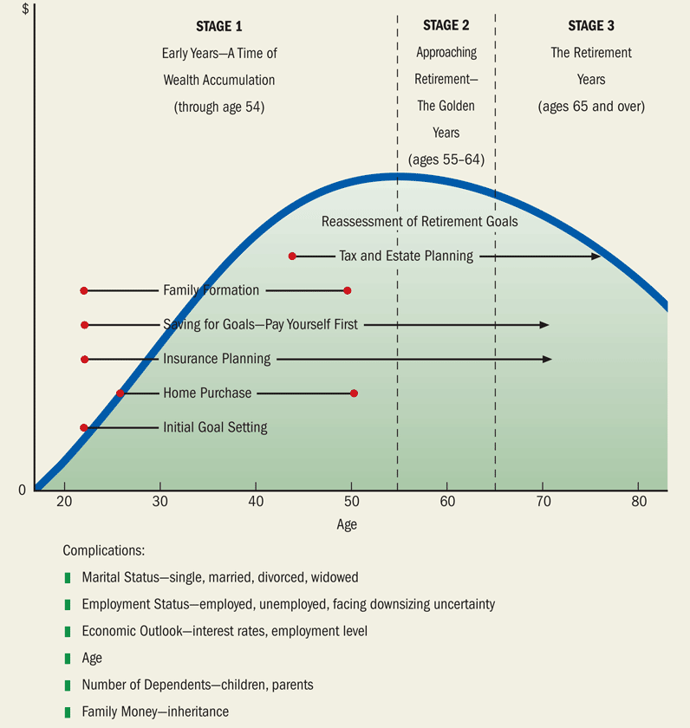
A Typical Individual’s Financial Life Cycle

Slide 26
Stage 1 The Early Years—A Time of Wealth Accumulation
Prior to age 54
Develop a regular savings pattern:
  How much can be saved?
  Is that enough?
  Where should the savings be invested?
Cost of raising children

Slide 27
Stage 2 Approaching Retirement—The Golden Years
Transition years between ages 55-64.
Depends on preparation for retirement.
Reassess financial goals and decisions—retirement, insurance protection and estate planning.

Slide 28
Stage 3 The Retirement Years
After age 65, live off savings
  Retirement age depends on savings.
Less risky investment strategy
Consider extended nursing home protection.
Estate planning decisions and documents are critical.

Slide 29
Ten Principles of Personal Finance

Slide 30
Principle 1: The Best Protection Is Knowledge
Understand the basics of personal finance.
Take responsibility for your lifetime financial plan.
Seek professional advice wisely.

Slide 31
Principle 2: Nothing Happens Without a Plan
Easier to think about spending than about saving.
Saving must be planned.
Putting off a financial plan means goals are harder to achieve.

Slide 32
Principle 3: The Time
Value of Money
Money received today is worth more than money received in the future.
Understand how savings and investments grow over time
Understand compound interest.
Understand spending now and paying later

Slide 33
Principle 4: Taxes Affect Personal Finance Decisions
Know the effect of taxes on the rate of return of investments.
Compare investment alternatives on an after-tax basis.
Understand tax laws.

Slide 34
Principle 5: Stuff Happens, or the Importance of Liquidity
Plan for unexpected events
Have money or liquid funds available
Liquid funds should cover 3 to 6 months of living expenses

Slide 35
Principle 6: Waste Not, Want Not - Smart Spending Matters
Differentiate want from need
Do homework before the purchase
Make the purchase at the best price
Maintain your purchase

Slide 36
Principle 7: Protect Yourself Against Major Catastrophes
Have the right kind of insurance before a tragedy occurs.
Know your insurance policy coverage.
Focus insurance on major catastrophes which can be financially devastating.

Slide 37
Principle 8: Risk and Return Go Hand in Hand
Saving and investing grows money.
Investors demand a minimum return above anticipated inflation.
Investors demand higher return for added risk.
Diversification by spreading money in several investments reduces risk.

Slide 38
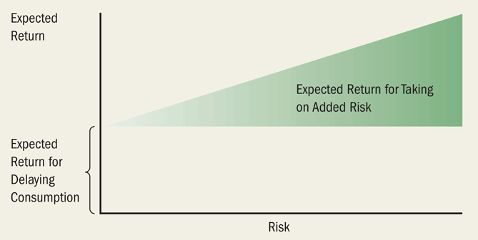
The Risk-Return Trade-Off

Slide 39
Principle 9: Mind Games, Your Financial Personality, and Your Money
Behavioral biases lead to big financial mistakes.
Mental accounting impacts financial decisions.
“Sunk cost effect” pours good money after bad money because of bias.

Slide 40
Principle 10: Just Do It!
Taking the first step towards your goals is difficult.
The following steps become easier.
First step is to pay yourself first—save then spend.
Saving early can make a big difference.

Slide 41
Assignment 2
Due Next Class
Come up with your own Financial Goal

Slide 42
Opportunity Cost and Time Value of Money

Slide 43
Time Value of Money
A dollar received today is worth more than a dollar received in the future.
The sooner your money can earn interest, the faster the interest can earn interest.

Slide 44

Interest and Compound Interest
Interest : is the return you receive for investing your money.
Compound interest : is the interest that your investment earns on the interest that your investment previously earned.

Slide 45
Future Value Equation
FV_{n} = PV(1 + i)^{n}
  FV = the future value of the investment at the end of n year
  i = the annual interest (or discount) rate
  PV = the present value, in today’s dollars, of a sum of money
This equation is used to determine the value of an investment at some point in the future.

Slide 46
Compounding Period
Definition : is the frequency that interest is applied to the investment
Examples : daily, monthly, or annually

Slide 47
Reinvesting : How to Earn Interest on Interest
Future-value interest factor (FVIF_{i,n}) is a value used as a multiplier to calculate an amount’s future value, and substitutes for the (1 + i)^{n} part of the equation.

Slide 48
The Future Value of a Bike
In 2012 the average motorbike costs $19,104. Assuming 4% inflation, what will it cost in 2042?
FV_{n} = PV (FVIF_{i},_{n})
FV_{n} = PV (1 + i)^{n}
FV₃₀ = PV (1 + 0.04)³⁰
FV₃₀ = $19,104 (3.243)
FV₃₀ = $61,954.27

Slide 49
The Rule of 72
Estimates how many years an investment will take to double in value
Number of years to double =
72 / annual compound growth rate
Example : 72 / 4 = 18 therefore, it will take 18 years for an investment to double in value if it earns 4% annually

Slide 50
Compound Interest With Nonannual Periods
The length of the compounding period and the effective annual interest rate are inversely related; therefore, the shorter the compounding period, the quicker the investment grows.

Slide 51
Compound Interest With Nonannual Periods (cont’d)
Effective annual interest rate =
amount of annual interest earned
amount of money invested
Examples : daily, weekly, monthly, and semi-annually

Slide 52
The Time Value of a Financial Calculator
The TI BAII Plus financial calculator keys
  N = stores the total number of payments
  I/Y = stores the interest or discount rate
  PV = stores the present value
  FV = stores the future value
  PMT = stores the dollar amount of each annuity payment
  CPT = is the compute key

Slide 53
The Time Value of a Financial Calculator
Step 1 : input the values of the known variables.
Step 2 : calculate the value of the remaining unknown variable.
Note: be sure to set your calculator to “end of year” and “one payment per year” modes unless otherwise directed.
Always make sure you clear and input all your known variables before computing the result

Slide 54
Tables Versus Calculator
REMEMBER -- The tables have a discrepancy due to rounding error; therefore, the calculator is more accurate.

Slide 55
Compounding and the Power of Time
In the long run, money saved now is much more valuable than money saved later.
Don’t ignore the bottom line, but also consider the average annual return.

Slide 56
The Power of Time in Compounding Over 35 Years
Selma contributed $2,000 per year in years 1 – 10, or 10 years.
Patty contributed $2,000 per year in years 11 – 35, or 25 years.
Both earned 8% average annual return.

Slide 57
The Importance of the Interest Rate in Compounding
From 1926-1998 the compound growth rate of stocks was approximately 11.2%, whereas long-term corporate bonds only returned 5.8%.
The “Daily Double” : states that you are earning a 100% return compounded on a daily basis.

Slide 58
Thank you

