Slide 1
EE460: Competitiveness and resilience of Thai Manufacture
Bhanupong
Lecture 14

Slide 2
Outline
Overview of the industry
Global competitiveness
Competitiveness and positioning of Thai manufacturing
Diversification of exports
Competitive wage and exchange rates
R&D revisited

Slide 3
1. Overview
Trend growth of industrial production
Identify major industrial goods
Analyze the cyclical pattern
Characterize products by market orientation

Slide 8
Recession and recovery

Slide 12
Capacity utilization by type of market orientation

Slide 14
Domestic Market oriented Products
(exported less than 30% of total production)
Weight in MPI
Total weight 34.01
Petroleum products 12.52
Beer 5.08
Passenger car 3.74
Downstream Petrochemical 1.62
Tobacco 1.58
Clinker 0.96
Motorcycle 0.87
Craft paper 0.83
Pulp 0.80
Vegetable oil 0.68
Carbonate water 0.56
Energy drink 0.54

Slide 15
Export Oriented Products
(X/Q between 30% to 60%)
Total 30.87 % weight in MPI
Garment 8.57
Weaving 3.16
Commercial car 2.74
Spinning 2.24
Sugar 1.95
Hot & cold-rolled sheet 1.50
Rice 1.19
Cement 1.14
Tire 1.14
Synthetic fiber 1.10

Slide 16
Ultra Export oriented products: (X/Q > 60%)
Total Weight in MPI 35.11%
Hard Disk Drive 6.14
Integrated circuit 4.96
T.V. 4.48
Products of Leather & Leather 3.68
Setting jewelry 3.53
Frozen seafood 2.18
Canned seafood 1.72
Printer 1.31
Wood furniture 1.27
Air-conditioners 1.12
Leather Footwear 0.91
Monitor 0.75
Block rubber 0.60
Canned Pineapple 0.58
Glass Sheet 0.45
Computer Keyboard 0.43
Rubber glove 0.40

Slide 17
2. Global Competitiveness
A country’s future prosperity depends on its growth in productivity, which government policies can influence.
Nations compete to choose policies to promote higher living standards.
International Institute for Management Development (IMD) and World Economic Forum (WEF) have their own ways of measuring competitiveness.

Slide 18
Paul Krugman
International trade is not a zero-sum game.
Countries do not compete in the same way as companies.
When two countries compete through trade, they both win.
Is “Competitiveness” a meaningless word?

Slide 19
Trade and growth relationship
Jeffrey Sachs (Columbia) found a fairly strong correlation between recent growth rates and the competitiveness index.
Critique: Correlation between the two variables does not guarantee that the competitive index will be a good predictor of economies’ future growth prospects.
Sachs’ definition of competitiveness:
The ability of a country to achieve sustained high rates of growth in GDP per capita.

Slide 20
World Economic Forum
Global Competitiveness Index
The rankings are calculated from both publicly available data and the Executive Opinion Survey, a comprehensive annual survey conducted by the World Economic Forum together with its network of Partner Institutes (leading research institutes and business organizations) in the countries covered by the Report.
Over 11,000 business leaders were polled in a record 131 countries.

Slide 21
Components of weighted index of competitiveness
Openness of an economy to trade and investment,
Role of government (public spending, low marginal tax rates),
Efficiency of the financial sector,
Levels of education and skills (two-thirds of the total index)
Quality of management, infrastructure and technology, the effectiveness of legal and political institutions (the rule of law).
Thailand’s judicial system ranks 9th from the total of 12 countries in the region.

Slide 22
How the index was constructed
The index is based on the ranking in 12 pillars: institutions (the strength of public and private institutions in creating sound and fair environment to generate income and wealth in the economy), infrastructure, macroeconomic environment, health and primary education, higher education and training, goods market efficiency, labour market efficiency, financial market development, technological readiness, market size, business sophistication, and innovation

Slide 23
WEF Report
"In addition to urgently improving its institutional framework, the country needs to step up its effort to improve its health and educational systems and encourage wider adoption of new technologies for productivity enhancements.
Such efforts will then buttress the country's innovation potential, which will become increasingly important as it moves towards the most advanced stage of economic development," WEF said in its report.

Slide 24
Asian Competitiveness
Leaders in Asia are:
Singapore
Japan
Republic of Korea
Hong Kong
What do these countries have in common?

Slide 25
Competitive characters
high-quality infrastructure,
flexible and efficient markets,
healthy and well-educated workforces,
high levels of technological readiness,
innovative capacity

Slide 26
The Global Competitiveness Report 2012-2013
Switzerland, for the fourth consecutive year, tops the overall rankings released today by the World Economic Forum.
Singapore remains in second position and Finland in third position, overtaking Sweden (4th).
These and other Northern and Western European countries dominate the top 10 with the Netherlands (5th), Germany (6th) and United Kingdom (8th).
The United States (7th), Hong Kong (9th) and Japan (10th) complete the ranking of the top 10 most competitive economies.

Slide 27
BRICS
The large emerging market economies (BRICS) display different performances. Despite a slight decline in the rankings of three places, the People’s Republic of China (29th) continues to lead the group.
Of the others, only Brazil (48th) moves up this year, with South Africa (52nd), India (59th) and Russia (67th) experiencing small declines in rankings.

Slide 28
BRICS
Despite growing its overall competitiveness score, the United States continues its decline for the fourth year in a row, falling two more places to seventh position.
In addition to the burgeoning macroeconomic vulnerabilities, some aspects of the country’s institutional environment continue to raise concern among business leaders, particularly the low public trust in politicians and a perceived lack of government efficiency.

Slide 29
Northern vs. Southern Europe
The country still remains a global innovation powerhouse and its markets work efficiently. The report indicates that Switzerland and countries in Northern Europe have been consolidating their strong competitiveness positions since the financial and economic downturn in 2008.
On the other hand, countries in Southern Europe, i.e. Portugal (49th), Spain (36th), Italy (42nd) and particularly Greece (96th) continue to suffer from competitiveness weaknesses in terms of macroeconomic imbalances, poor access to financing, rigid labour markets and an innovation deficit.

Slide 30
A window on the long-term trend
Behind Singapore, several Asian economies are performing strongly, with Hong Kong SAR (9th), Japan (10th), Taiwan, China (13th) and the Republic of Korea (19th) all in the top 20.
Xavier Sala-i-Martin, Professor of Economics, Columbia University, USA, said: “The Global Competitiveness Index provides a window on the long-term trends that are shaping the competitiveness of the world’s economies.
In this light, we believe it offers useful insight into the key areas where countries must act if they are to optimize the productivity that will determine their economic future.”

Slide 31
 | GCI 2012-2013 |  | GCI 2011-2012
Country/Economy | Rank | Score | Rank | Change
Switzerland | 1 | 5.72 | 1 | 0
Singapore | 2 | 5.67 | 2 | 0
Finland | 3 | 5.55 | 4 | 1
Sweden | 4 | 5.53 | 3 | -1
Netherlands | 5 | 5.50 | 7 | 2
Germany | 6 | 5.48 | 6 | 0
United States | 7 | 5.47 | 5 | -2
United Kingdom | 8 | 5.45 | 10 | 2
Hong Kong SAR | 9 | 5.41 | 11 | 2
Japan | 10 | 5.40 | 9 | -1

Slide 32
 | GCI 2012-2013 |  | GCI 2011-2012
Country/Economy | Rank | Score | Rank | Change
Denmark | 12 | 5.29 | 8 | -4
Korea, Rep. | 19 | 5.12 | 24 | 5
Australia | 20 | 5.12 | 20 | 0
Malaysia | 25 | 5.06 | 21 | -4
China | 29 | 4.83 | 26 | -3
Spain | 36 | 4.60 | 36 | 0
Kuwait | 37 | 4.56 | 34 | -3
Thailand | 38 | 4.52 | 39 | 1
Czech Republic | 39 | 4.51 | 38 | -1
Panama | 40 | 4.49 | 49 | 9
Poland | 41 | 4.46 | 41 | 0
Italy | 42 | 4.46 | 43 | 1

Slide 33
3. Competitiveness of Thai Manufacturing sector
Characteristics of manufactured products
Growth of exports in each product group
BCG model

Slide 34
Competitive Positioning
Reveal competitiveness (Ż>0)and income elasticity of demand (η)
Export the right commodity
 | Rising share of that product in world trade (η>1) | Declining share that product in world trade (η<0)
Gaining world market share (Ż>0) | Rising stars (Stars) | Falling stars (Cash Cows)
Losing world market share(Ż<0) | Lost Opportunity (Problem Child) | Retreat (Dog)
Export the commodity right

Slide 35
The 2004 OIE Study
Office of Industrial Economics employed the
Boston Consulting Group Model (BCG)
RISING STARS: air conditioners
FALLING STARS: garments
LOST OPPORTUNITY: plastic, cargo transportation vehicles, pulp and paper, primary petrochemicals
RETREAT: medicine, artificial fiber, chicken
What export products were rising stars in 2010?

Slide 36
Two opposing views: Quo Vadis?
“Thailand does not necessarily have to compete in the manufacturing, since it can specialize in the production of agricultural commodities and in tourism, where it has a definite comparative advantage.”
“Thailand has to continue its industrialization drive to generate additional industrial employment and incomes, and to raise general living standards through linkages with other sectors, particularly agriculture and service.”
Which view would you endorse?

Slide 37
Michael Porter (1990) The Competitive Advantages of Nations
There are two basic types of competitive advantages: lower cost and product differentiation.
Pure cost advantages are less sustainable than differentiation: any new source of lower costs can nullify a firm’s cost advantage.
Differentiation is the ability to provide unique and superior value to buyers in terms of product quality, special features, or after-sale service.
Examples: differentiation in services provided by banks, supermarkets, and gasoline stations.

Slide 38
More advice from
Michael Porter
Differentiation allows a firm to command a premium price, which leads to superior profitability provided costs are comparable to those of competitors.
Pure cost advantages are more vulnerable because new product designs or other forms of differentiation can eliminate a cost advantage.
The government can raise the odds of gaining competitive advantage but lacks the power to create advantage itself.

Slide 39
Manufacturing value-added and exports
Despite impressive performance, Thai manufacturing sector did not generate net foreign exchange earnings between 1980 and 1996 before the crisis.
Thailand’s nature of rapid industrialization is characterized by its heavy and persistent reliance on imported capital goods, intermediate inputs and technology, contributing to the widening trade deficit in the manufactured goods.
How about now?
Thailand’s future growth pattern may exhibit significant balance of payments deficit, unless the import-dependent pattern of industrialization is altered.
Is it true?

Slide 40
Net user of foreign exchanges
The manufacturing sector exported nearly 40% of its product in 1997, but because of the heavy reliance on imported intermediate inputs, the net export was just 16% (10% if resource-based food and rubber products are excluded).
What are implications of currency depreciation and appreciation?
If imports of capital equipment are included, the manufacturing sector as whole was a net users of foreign exchanges.

Slide 41
4. Diversification of Thai exports
A country is considered competitive in products in which it is increasing its world market share.
An export product is considered dynamic in world trade if it is growing faster than the average for all products (either rising or falling stars).
Thailand’s exports were in the rising stars category for 54% in 1996, but they fell to 15% by 2000.
Ten years after this study, the figures were totally different in 2006.
Thailand did not do as well as its major competitors during the 1996-2000 boom in electronic exports.
Thus the share of loss opportunity category increased from 3% to 43% of total exports.

Slide 42
Export Product Diversification
Electronics 31%
Food and beverages 15%
Chemicals and plastics 7%
Electrical goods 6%
Machinery , garments 5%
jewelry and furniture 5%
Vehicle and parts 4%

Slide 43
De-concentration
The reliance on top five export products (50%) diminished in the 1988-2000 period.
The reliance on labor-intensive food, garments, jewelry and furniture has declined.
But the reliance on the top exports, electronic products, increased significantly from 11 to 31 percent.
Manufacturing exports accounted for 86% of total exports of $70billion in 2000.

Slide 44
Vulnerability to external shocks
Electronic products such as computer parts, integrated circuits concentrated in five major markets accounted for 70% of total exports.
Thai garment's exports to USA accounted for 54% of total market.
Top five importers of Thailand’s electrical and plastic products accounted for 55%.
Need to diversify to lessen vulnerability and to upgrade productivity.
But diversification would not help if business cycles are synchronized all over the world.

Slide 45
Geographical Diversification
Thailand was dependent on just three countries for nearly of its half exports in 2000.
USA 21%
Japan 15%
Singapore 9%
What was the geographical diversification of Thai exports in 2010?
How was the manufacturing sector be affected by the global recession in 2010?
Did free trade agreements prevent Asian countries from global recession?

Slide 49
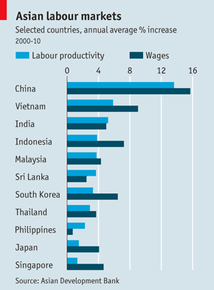

Slide 50
Competitiveness and the exchange rate
Strong baht may curb output (Bangkok Post, 16 Sep 2010)
“An exchange rate of 31-32 baht to the US dollar is considered sufficient for local exporters to survive”.
Chairman of the Federation of Thai Industries said exporters in the agro-industrial, textile and furniture sectors are possibly unable to receive orders from abroad due to severe price competition from regional competitors.
"The possibility is high that we'll see export value contract in the fourth quarter even if we meet the target volume”
"The current situation is worrisome, especially for food processing manufacturers, which normally use low import content and thus do not benefit from the strong baht"

Slide 51
R&D once more
Thailand has been slow to expand its research and development (R&D) capability, placing it in danger of losing out to global competition in its quest for economic growth via the production of higher value-added goods.

Slide 52
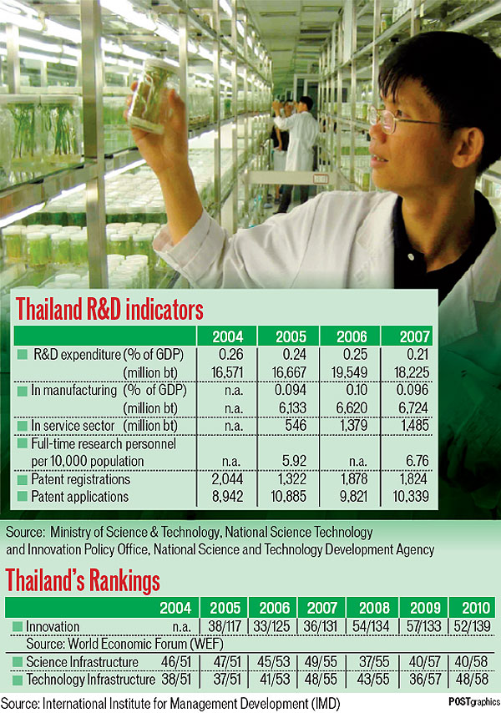

Slide 53
Siam Cement Group
The Siam Cement Group (SCG) as a successful case study in increasing revenue from higher value-added products via R&D.
Half of its gross revenue for last year - 46 billion baht - was generated by such products after it spent almost 800 million baht on R&D in 2009.
The number of SCG employees holding doctoral degrees increased from only 40 in 2004 to 1,000 in 2009.
A recent success in agricultural innovation was the modification of aromatic rice that can tolerate longer periods underwater.
In medical science, an advanced testing kit for HIV and blood diseases was created.

