Slide 1

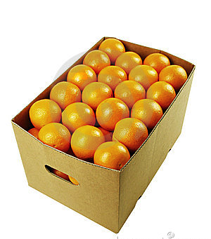
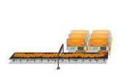
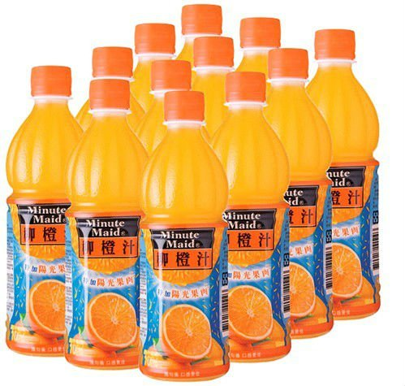

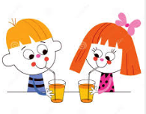
Farmers : oranges
Factory : orange juice in bottles
4,000 Bht
5,000 Bht
7,000 Bht
1,000 Bht
Consumers: eat
Consumers: drink

