Slide 1

Chapter 1
Chapter 7
Marketing Mix Decisions I: Product
MK 312 Marketing Management
By
Aj.Suwalya K.

Slide 2
Ch. 7 - Learning objectives
After studying this chapter you should be able to:
■ define the terms product and product levels
■ discuss the differences between services and goods
■ explain the different product differentiation strategies
■ discuss the steps in new product development processes
■ explain the different product stretching strategies.
■ discuss important issues in brand equity and global branding.

Slide 3

Levels of product decisions
The first level of product decisions concerns individual products or services that a firm manufactures and markets.
A product item is, then, by definition a separate product entity, identified by a certain design quality, features, packaging and branding.
Individual product items that are closely related in some way to another are classed as product lines.
The product mix (see next slide) then constitutes the sum of individual product items and product lines.

Slide 4

Exhibit 7.1 Harley-Davidson’s ‘total experience’ product (HOG)

Slide 5
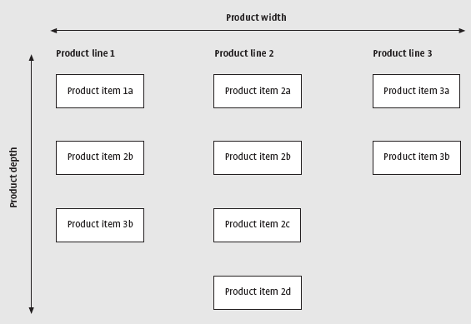

The product mix: ’Width’ and ’depth’
1.b
1.c
Please note the errors: Should be 1.b and 1.c for Product line 1

Slide 6
Different product levels
The core product is the basis element of the firm’s offer to its customers. It has to be right in order for customers to consider the other elements.
The core of the offer is exemplified by a product or service in its simpliest form: The long distance telephone call, the bank account, the hotel room or flight to Paris.

Slide 7
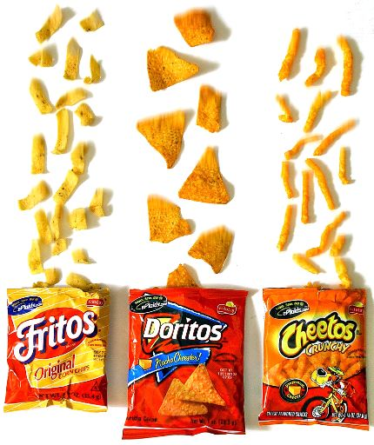
Decisions about new products
Decisions about new products should reflect consistency with existing product lines in relation to previously determined marketing objectives set for product provision in specified markets.
Hence the addition to the width of the mix and the depth within each product line should be compatible with the planned long-term marketing strategy,

Slide 8
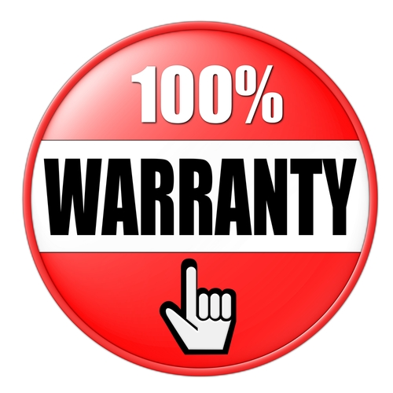
Support services
Services such as deliveries, repairs, installation, warranties and payment plans help to differentiate a company and provide added value for customers by reducing psychological sources of irritation, time or energy costs.

Slide 9
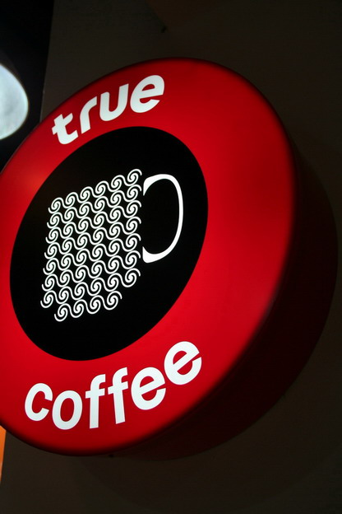
Support services
Enhancing the core product through the addition of services is a very sound strategy, but many of the services and enhancements that we may consider adding are, as mentioned above, easily copied by the competition and have in fact become standard equipment in the value proposition of many companies

Slide 10

Service excellence
At the technical performance level, companies strive to deliver on their promises and establish themselves as leaders in ‘service excellence’.
They are becoming more aware of this level as a driver of customer satisfaction because it is more difficult to achieve and for the competition to replicate.

Slide 11
Service excellence
Achieving ’service excellence’ at this level depends on many factors:
Top management commitment is essential since time and money must be spent in order to develop processes and technologies, as well as to attract, retain and train staff to perform at the highest level.
The payback from this investment comes from the customer’s perception of increased value. Customers who value excellence in service will be more satisfied and will tend to remain loyal.

Slide 12

Exhibit 7.2 Dell’s online service program

Slide 13
Dell’s on-line service programme
Dell has created many features and services online to help the customer see the whole purchasing process clearly:
Customers can create and view their service records online. This includes product support, shipment and delivery dates.
Each purchase comes with a service tag code, which can track the model bought and its service requirements. This allows Dell customer service representatives to handle requests quickly and efficiently.

Slide 14
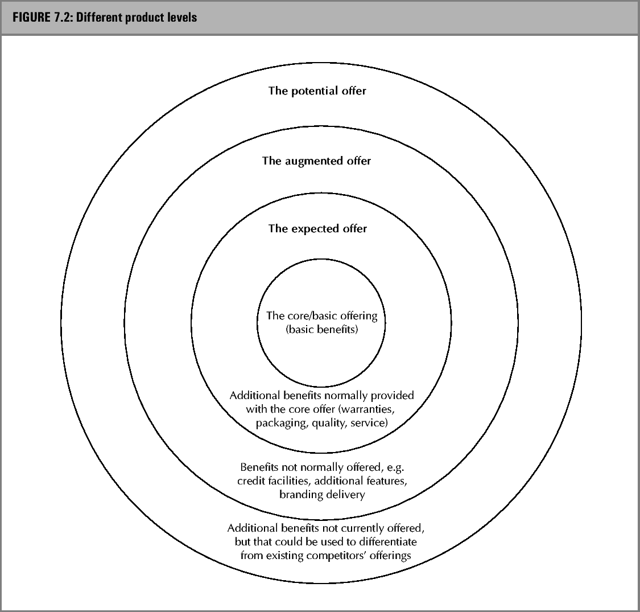
Different product levels

Slide 15
Five Product Levels
Core Benefit
the fundamental need or want that consumers satisfy by consuming the product or service.
Expected
is a set of attributes or characteristics that buyers normally expect and agree to when they purchase a product.
Augmented
Potential
includes additional product attributes, benefits, or related services that distinguish the product from competitors.
includes all the augmentations and transformations that a product might ultimately undergo in the future.

Slide 16




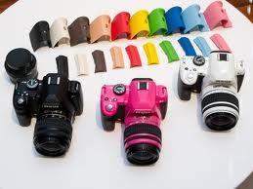
Core Benefit
the fundamental need or want that consumers satisfy by consuming the product or service.
Expected
is a set of attributes or characteristics that buyers normally expect and agree to when they purchase a product.
Augmented
Potential
includes additional product attributes, benefits, or related services that distinguish the product from competitors.
includes all the augmentations and transformations that a product might ultimately undergo in the future.

Slide 17
Differentiating the augmented product
Differentiation of the augmented product can be achieved by offering more to customers on top of existing features
(eg. Offering a lifetime guarantee on videotape rather than a one-or-two year guarantee) or by offering new features that are of value to customers.

Slide 18
Differentiating the augmented product
Quality: A prime factor in differentiating the product or service form that of competitors is quality. Quality concerns the fitness of purpose of the product or service. For manufactured products this can include the durability, appearance or grade of the product, while in services it often comes down to the tangible elements of the service, the reliability and responsiveness of service provider,the assurance provided of the value of the service, the empathy or caring attention received.

Slide 19

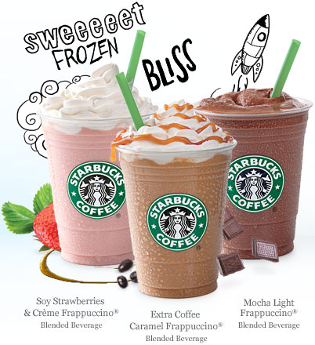
Brand Quality

Slide 20
Differentiating the augmented product
Packaging can be used to differentiate the product. Packaging has five main functions, each of which can be used as a basis for differentiation.
  1. Packaging stores the product, and hence can be used to extend shelf life or facilitate physical storage (e.g. tetra packs for fruit juice and other beverages).
  2. Packaging protects the product during transit and prior to consumption, to ensure consistent quality (eg. The use of foil packs for potato crisps to ensure freshness)
  3. Packaging facilitates use of the product (eg. Applicator packs for floor cleaners, wine boxes, domestic liquid soap dispensers).
  4. Packaging helps create the image for the product through its visual impact, quality of design, illustration of uses, etc.
  5. Packaging helps promote the product through eye-catching, unusual colors and shapes, etc.(ie. Absolut Vodka brand)

Slide 21
Packaging
From the perspective of both the firm and consumers, packaging must achieve a number of objectives:
Identify the brand
Convey descriptive and persuasive information
Facilitate product transportation and protection
Assist at-home storage
Aid product consumption
  Susan B. Bassin, “Value-Added Packaging Cuts through Store Clutter,”
  Marketing News, 26 September 1988, 21.

Slide 22
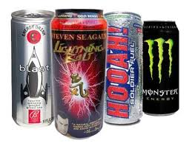
Packaging Can Influence Taste
Our sense of taste and touch is very suggestible, and what we see on a package can lead us to taste what we think we are going to taste.

Slide 23
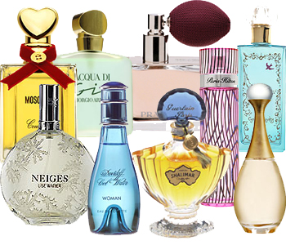
Packaging Can Influence Value
Long after we have bought a product, a package can
still lead us to believe we bought it because it was a
good value.

Slide 24
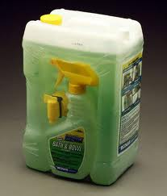
Packaging Can Influence Consumption
Studies of 48 different types of foods and personal care products have shown that people pour and consume between 18% and 32% more of a product as the size of the container doubles.
Valerie Folkes, Ingrid Martin and Kamal Gupta,
“When to Say When: Effects of Supply on Usage,”
Journal of Consumer Research, 20 December 1993, 467-477.

Slide 25
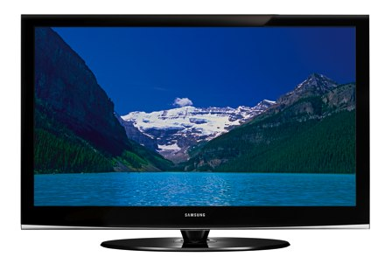
Packaging Can Influence How a Person Uses a Product
One strategy to increase use of mature products has been to encourage people to use the brand in new situations, like soup for breakfast, or new uses, like baking soda as a refrigerator deodorizer.
An analysis of 26 products and 402 consumers showed that twice as many people learned about the new use from the package than from television ads.

Slide 26

Differentiating the augmented product
Branding: A particular way of differentiating at the tangible level is to create a unique brand with a favorable image and reputation. Brand and company reputation can be powerful marketing assets for the company.
The brand name or symbol is an indication of pedigree and guarantee of what to expect from a product – a quality statement or value-for money-signal.

Slide 27
What is branded?
Physical goods
Services
Retailers and distributors
Online products and services
People and organizations
Sports, arts, and entertainment
Geographic locations
Ideas and cause
Notes:
1

Slide 28

What are the strongest brands?

Slide 29
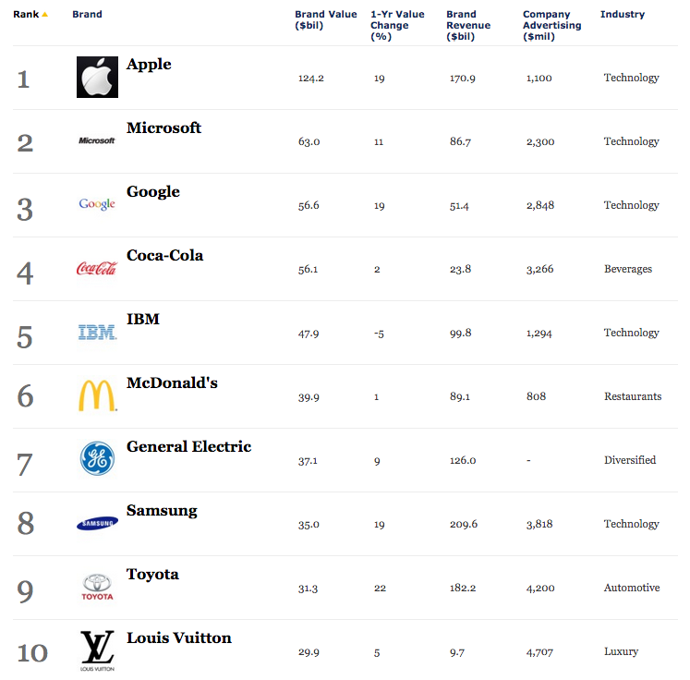
Forbes Top 10 Most Valuable Brands

Slide 30
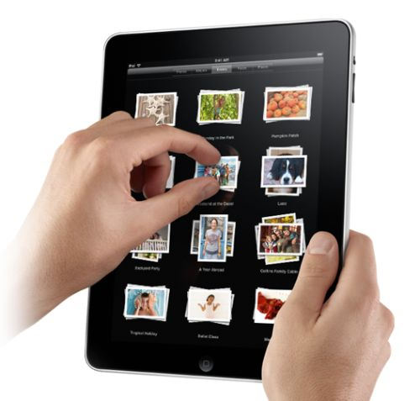
Differentiating the augmented product
Product complementarity: Software-product companies expend a lot of effort developing products that complement, support or enhance the functionality of existing and established products. By leveraging the potential for products to complement each other, vendors can gain larger market size and make it more costly for customers to switch.

Slide 31
Brand equity
Brand equity can be defined as:
■ the total value of a brand as a separable asset – when it is sold or included on a balance sheet
■ a measure of the strength of consumers’ attachment to a brand
■ a description of the associations and beliefs the consumer has about the brand.

Slide 32

Brand equity
Brand equity exists in the minds of various stakeholders, shareholders, employees, end users and distribution channels in particular.
The customer/end user of that dominates most analysis and has been defined as the differential effect of brand knowledge on consumer response to the marketing of the brand.

Slide 33
Brand equity
Aaker (1991) describes five components of brand equity:
Brand loyalty.
Name awareness.
Perceived quality.
Brand associations.
A bundle of intellectual properties such as patents, trademarks and channel relationships.

Slide 34
Judgment Dimensions
Brand quality
Value
Satisfaction
Brand credibility
Expertise
Trustworthiness
Likeability
Brand consideration
Relevance
Brand superiority
Differentiation

Slide 35
Feelings Dimensions
Warmth
Fun
Excitement
Security
Social Approval
Self-respect

Slide 36
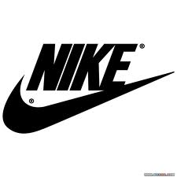

Brand Associations

Slide 37
Table 7.1 Valuing the brand

Slide 38
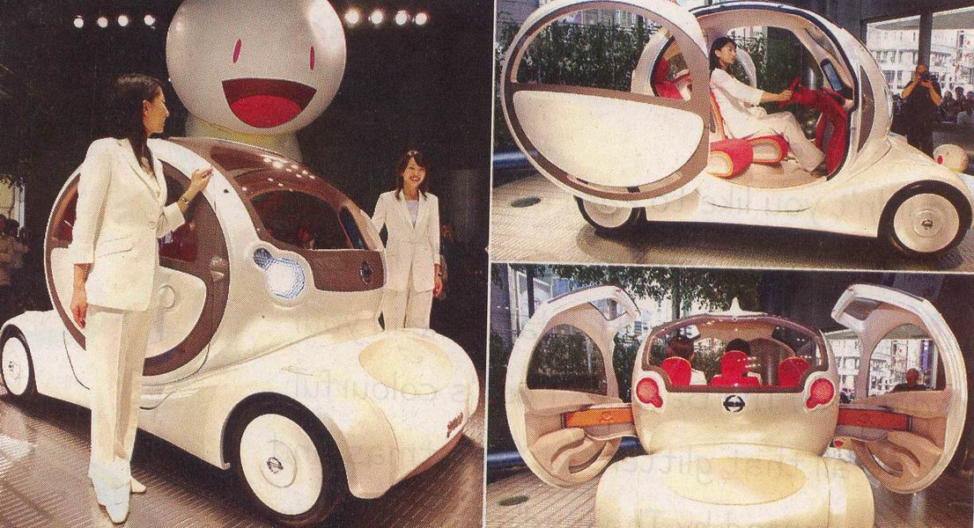
The New product development process
Product development is the heart of global marketing process.
New products should be developed, or old ones modified, in order to fit new or changing customer needs on a global or regional basis.

Slide 39
Characteristic of NPD
Use of structural development process: providing the ’rules of the game’ and describing entry and exit criteria between key program milestones, primary tasks, schedules and resource assignments.
A team of senior executives, called review board which provides oversight of the program by resolving cross-project issues, setting project priorities, resolving issues and making ‘go/kill’ decisions
A use of realization teams(cross-functional execution teams) operating under a product ‘champion’ and reporting to the assigned management oversigh board.
‘Phase or stage/gate reviews’ at major development milestone, when funding resources and product schedules are approved or rejected by the review board.

Slide 40

Characteristic of NPD
These activities are generally organized into distinct phases that are carried out sequentially by the realization teams and separated by ‘stage/gate’ reviews held by the review board.

Slide 41
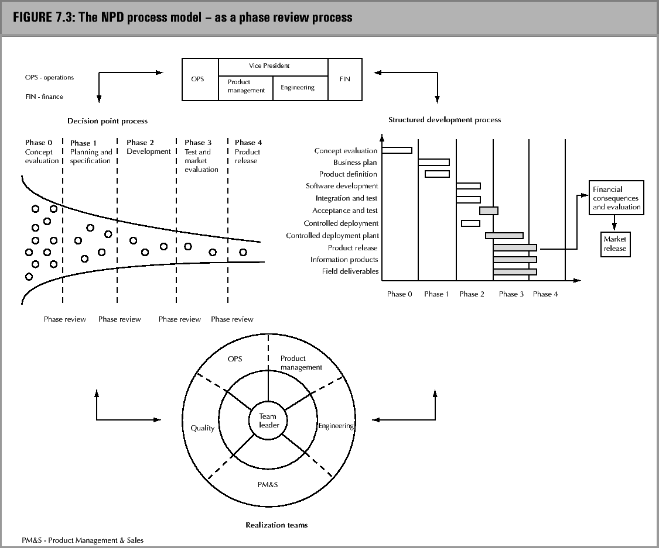
New Product Development Process (1)

Slide 42

Exhibit 7.3 The NPD process for a medicine

Slide 43
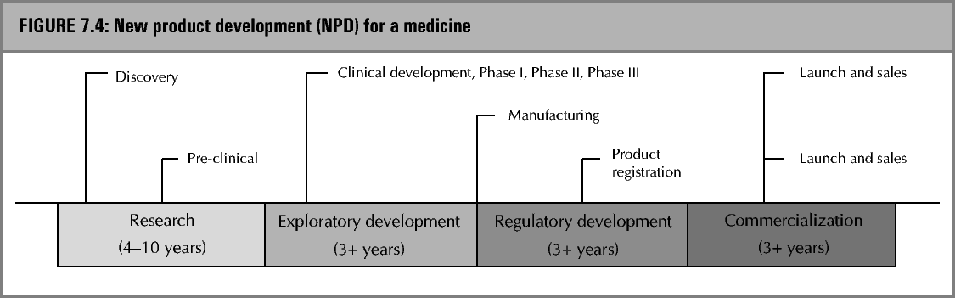
New Product Development Process (2)

Slide 44

NPD framework activities
Develop and test the product concept
Formulate a marketing strategy
Analyze the impact on the business in terms of sales, costs and profit projections.
Develop the concept into a product
Market test the product, and time its design and market strategy
Build and launch the product

Slide 45
Brand Stretching
Brand stretching – the use of an existing brand name for a new product in a different product class – have been used extensively by many consumer goods organizations. The use of existing brand names to access new markets is based on the premise that established brands which have high name recognition and significant consumer loyalty, at least parts of which will get transferred to the new product.
Brand stretching on the other hand involves the use of an existing brand name for introducing new products in the same category.

Slide 46
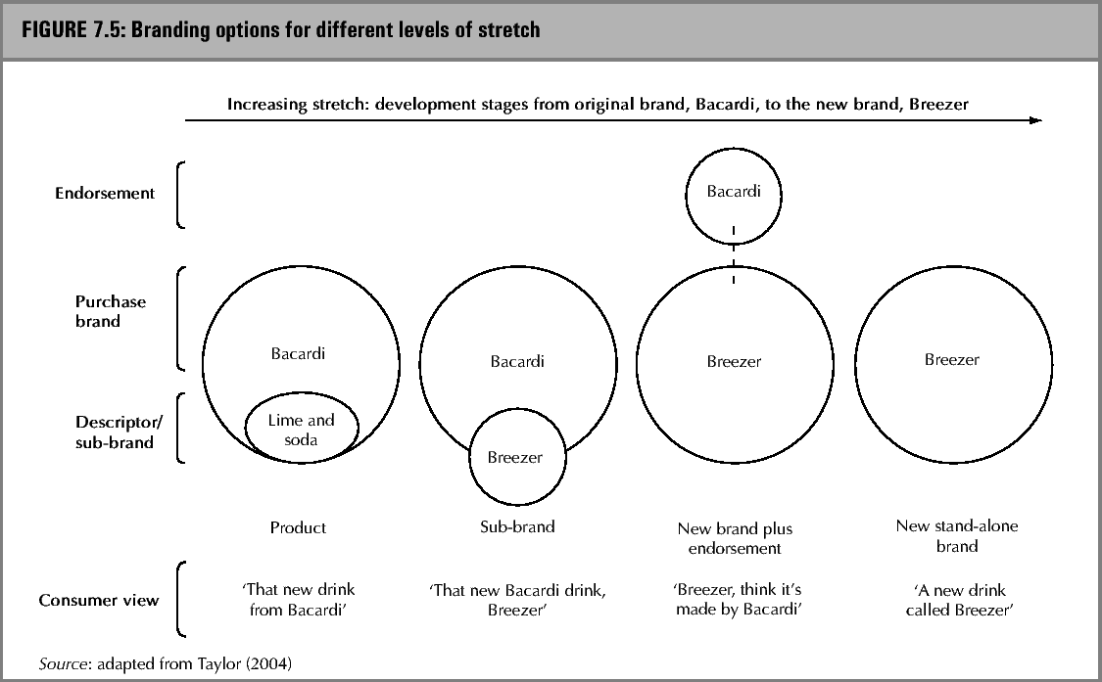
Brand stretching strategies

Slide 47
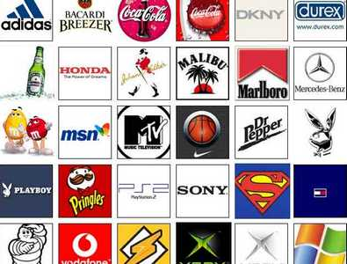
Global branding
A global brand, in other words, is one that expresses the same values in all of its markets and owns a similar position vis-à-vis its competitors around the world. This creates several critical advantages, including:
■ improved efficiency in costs for new product development and R&D because their outputs create revenues globally and not just locally or regionally
…….. (see more on next slide)

Slide 48
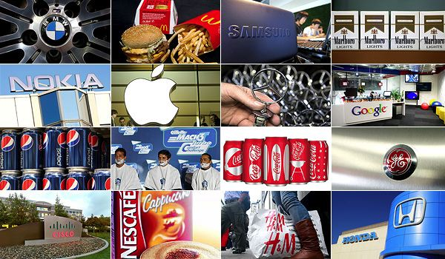
Global branding
(Global branding – advantages - cont.)
■ increased leverage with channel partners, especially in the packaged goods sector, which faces the constant parallel challenge of a consolidating and globalizing retail industry
■ economies of scale in marketing communication because copy can be produced along identical guidelines, and even shared, across markets, and
■ improved alignment across the organization, boosting speed to market, workforce flexibility and the sharing of best practices.

Slide 49
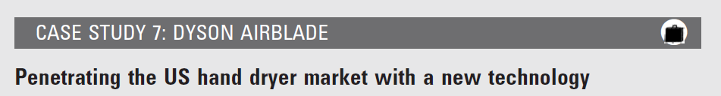
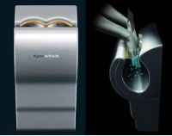
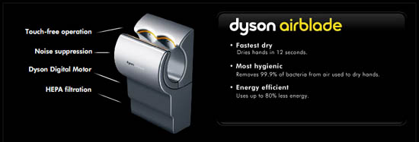

Slide 50
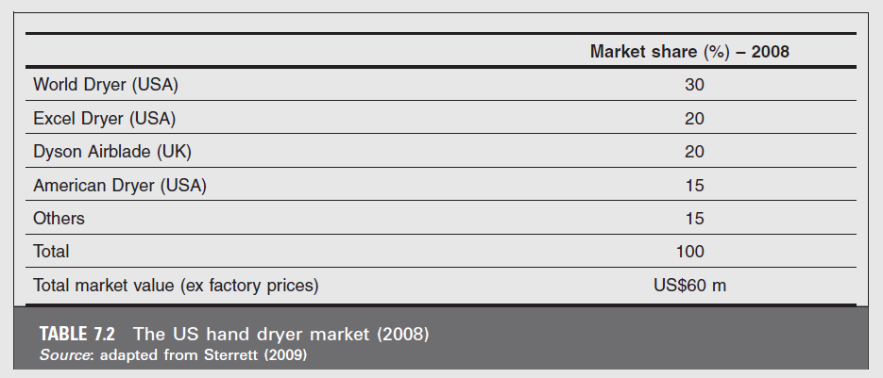

Slide 51


