Slide 1
Macroeconomics: Fiscal Policy
Thorn Pitidol
Faculty of Economics, Thammasat University
EE212, Semester 2/2017

Slide 2
Agenda
Taxation
Government spending
Government debt

Slide 3
Additional insights on the roles of the government
Expansionary VS Contractionary fiscal policy
  Expansionary fiscal policy: the set of government fiscal policy that aims to stimulate a higher level of economic activity
    Example: raising government spending, raising transfer payment, and lower taxes
    Challenges: in order to spend, government needs to raise taxes, borrow, or print money. These create further problems to be managed
  Contractionary fiscal policy: opposite of expansionary fiscal policy. Used when trying to deal with the overheated economy and its associated inflation

Slide 4
Additional insights on the roles of the government
Automatic Stabilisers VS Discretionary Policy
  Automatic stabilisers: taxes and spendings that tend to increase government revenues and lower government spending during economic expansion, but lower revenues and raise government spending during economic recessions
    Example: unemployment benefits and income taxes
  Discretionary fiscal policy: government’s deliberate attempt in using fiscal means to solve macroeconomic problems
    Problem of discretionary fiscal policy: time lag

Slide 5
Additional insights on the roles of the government
Government roles in addition to the management of macroeconomy
  Solving market failures
    Public goods
    Externalities
    Asymetric information
    Imperfect competition

Slide 6
Taxation
Types of taxes (categorised from tax base)
  Income-based taxes
    Collected from personal and corporate income
  Consumption-based taxes
    Collected from transaction in buying and selling of goods and services
      Example: VAT, excise taxes (for ex. sin-tax)
  Import/export taxes
    Collected from import and export of goods. Used as means to protect the domestic market.

Slide 7
Taxation
Types of taxes (categorised from burden)
  Direct taxes
    Taxes on personal and corporate income.
    Tax-payers cannot push the burden on others
  Indirect taxes
    Taxes on transactions in buying and selling of goods and services
    Tax-payers can push the burden on other parties involved in the transactions

Slide 8
The Revenue Structure, Thai Government, 2533-2554 BE
Unit: Millions Baht
2,224,377
209,427
(9.4%)
1,123,109
(50.5%)
891,841
(40.1%)
Direct taxes
Indirect taxes
Non-tax revenues
Direct taxes: personal and corportate income taxes
Indirect taxes: VAT and excise taxes
Non-tax revenues : government services fees, and revenue from state-own enterprises

Slide 9
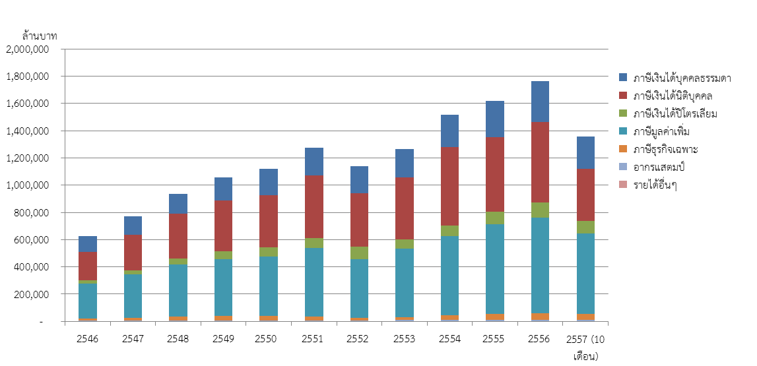
Tax Revenue, Thailand
Source: Sakon Varunyuwatttana (2014)

Slide 10
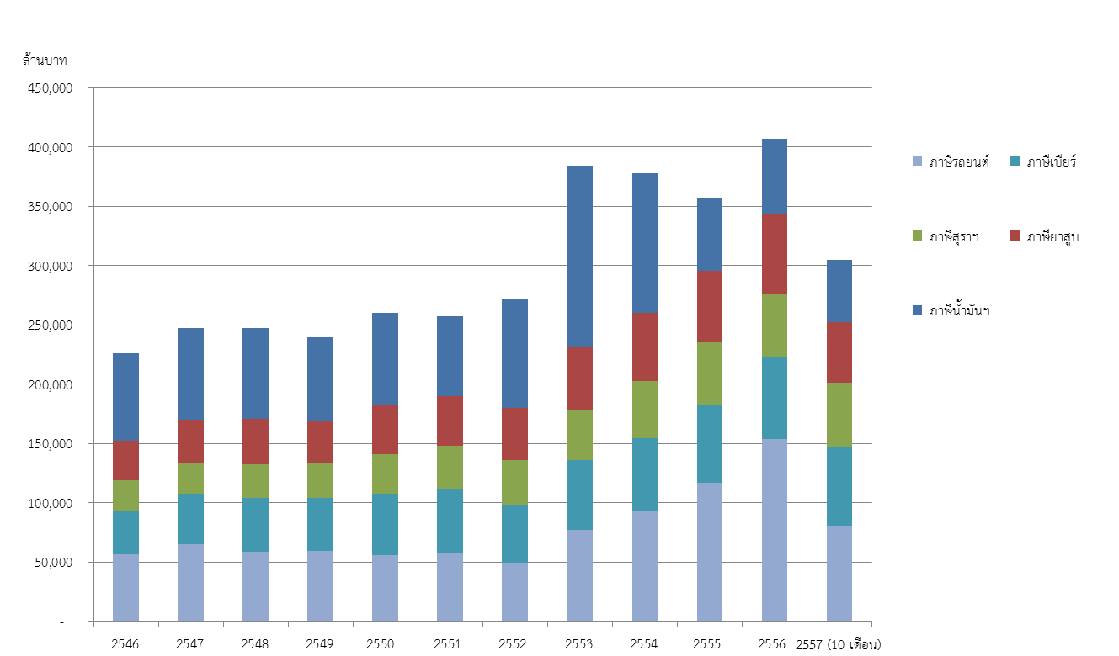
Excise Tax Revenue, Thailand
Source: Sakon Varunyuwatttana (2014)
คณะเศรษฐศาสตร์ มหาวิทยาลัยธรรมศาสตร์

Slide 11
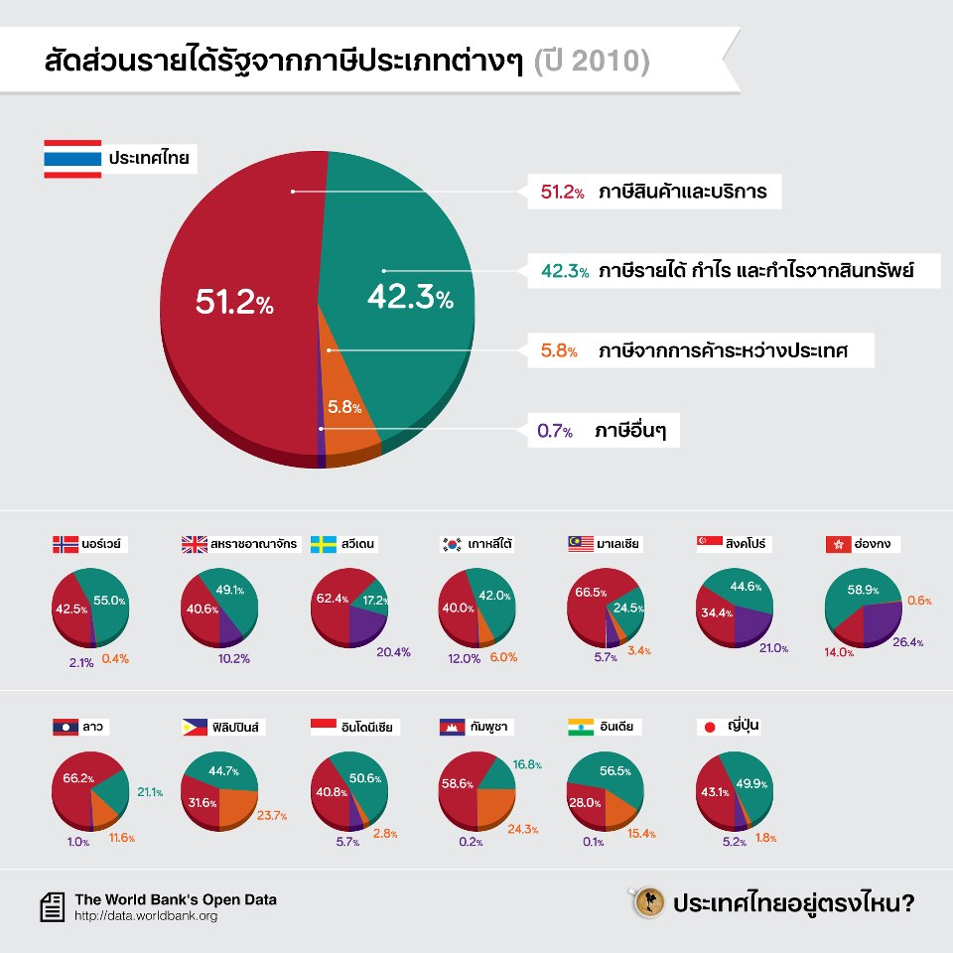
Comsumption-based taxes
Income-based taxes
Import-export taxes
Other taxes

Slide 12
Taxation
Types of tax regimes
  Progressive: a tax in which the tax rate (as % of tax base) increases as the taxable base amount increases
    i.e. the richer you’re, the more percentage of taxes you pay
  Regressive: a tax in which the tax rate decreases as the taxable base amount increases
  Proportional: a tax in which the tax rate stays the same as the taxable base amount increases
  What are the following taxes?
    VAT., import taxes, and income taxes

Slide 13
Taxation
Tax regimes (Example)
 | Tax rates (as % of income)
Income | Progressive tax regime | Proportional tax regime | Regressive tax regime
0-10000 | 5% | 15% | 25%
10001-20000 | 10% | 15% | 20%
20001-30000 | 15% | 15% | 15%
30001-40000 | 20% | 15% | 10%
40001-more | 25% | 15% | 5%

Slide 14
Taxation
Tax collectors
  The revenue department: responsible for collecting all types of taxes except excise taxes, and import/export taxes
  The excise department: responsible for collecting sin-taxes and other special taxes (such as taxes on cars, motorcycles, and fuel)
  The custom department: responsible for collecting taxes on imported and exported products

Slide 15
Government spending
Government budget
  Spending types (1)
    Investments: spending to stimulate economy, and to invest in machineries, equipments, and buildings
    Operations: spending to operate government’s tasks, such as wages and salary for civil servants, and government’s consumptions of non-capital products.

Slide 16
The Spending Structure, Thai Government, 2532-2554 BE
Unit: Millions Baht
114,488.6
(5.3%)
2,169,967.5
32,554.6
(1.5%)
355,484.6
(16.4%)
1,667,439.7
(76.8%)
Operation spendings
Investment spending
Debt repayment
Payment for treasury reserves

Slide 17
Government spending
Government budget
  Spending types (2)
    Spending based on tasks
      General public services: public services, defense, and internal security
      Social services: education, health care, social works, housing and community works, and religion-culture
      Economics: energy and petroleum, agriculture, mining and industry, transportation, others
      Others

Slide 18
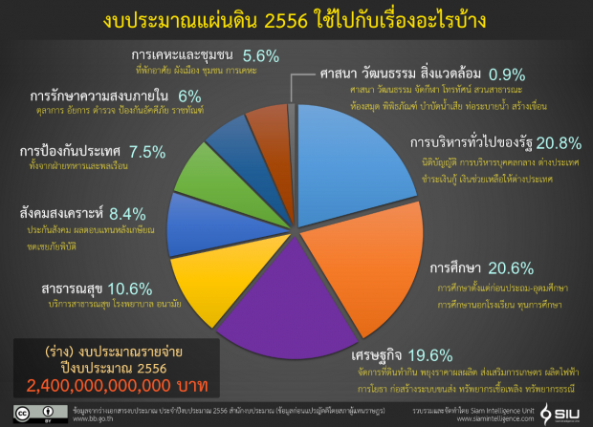
Accommodations and community
Religion culture and environment
Internal security
Public administration
National defense
Social work
Education
Health
Government Budget (draft)
2013 (Unit: Baht)
Economics

Slide 19
Government spending
Government outside-budget spending
  Outside-budget spending: spending that needs not be processed through government’s budget
  Sources of outside-budget spending
    Funds: the government-related funds which can keep their revenues for their operations.
      Example: social insurance fund
    Loans: project-based loans, or foreign aids
    Revenue of public institutions: such as revenue of public hospital or universities.

Slide 20
Government debt
Types of government debt
  Public debt: debt created for government’s operations
  Loan guarantee: government guarantee for debt that belongs to state-owned enterprises such as the national rail and the port authority.

Slide 21
Government debt
Purposes for creating public debt
  Investment (infrastructure, education, etc.)
  Stabilising the economy
  Making up for budget deficits
  Emergency spending (such as dealing with a natural disaster)
  Rechanneling unused savings (especially for domestic savings)
  Rolled-over debt

Slide 22
Government debt
Sources for information
  International comparison:
  http://en.wikipedia.org/wiki/List_of_countries_by_public_debt
  Thai government debt
  http://www.pdmo.go.th/popup_money_data.php?m=money&ts2_id=1

