Slide 1
Role of states and markets
E463 Globalization and international development
Faculty of Economics
Thammasat university

Slide 2
viewS on economic growth
Adam Smith: economic progress is achieved by individuals who work through the market to specialize in the production of one particular product (invisible hand)
David Ricardo: Growth = Savings + Investment + Accumulation of capital
Karl Marx: capital accumulation = central driving force of growth
Roy Harrod and Evsey Domar: Growth = Investment + Capital
Hollis Chenery: Foreign exchange is needed for poor countries to grow in the absence of investment and savings

Slide 3


viewS on economic growth
At the heart of the debate, the consensus is that:
Capital, and investment are critical to economic growth
Governments (state) and private firms (markets) have roles to play in economic growth
However to what extent do states and markets play in economic development?
How can poor/developing countries acquire capital?

Slide 4
Post World War II Experience: Europe and Japan
Devastation in Europe and Japan following World War II
$25 billion aid to reconstruct Western European (Marshall Plan)
$7 billion aid to reconstruct Japan (Dodge Plan)
Results were immediate and direct; high growth rates in Western Europe and Japan
US provided aid to strengthen ties with Western Europe and Japan and to contain further the spread of communism

Slide 5
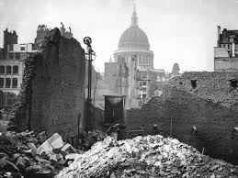
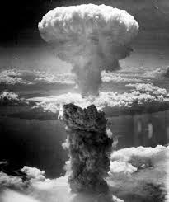
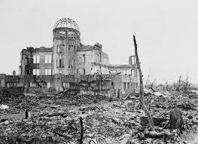
Clockwise from top left: Destruction of St. Paul’s Cathedral, London; atomic bomb over Nagasaki; destruction of Hiroshima

Slide 6
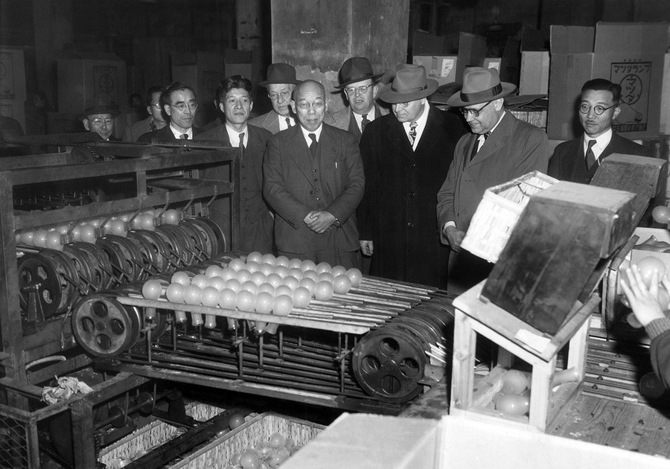
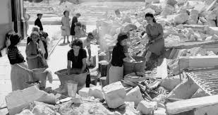
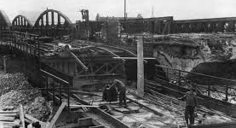
Clockwise from top left: electric bulbs production line at Shibaura Electric company; women help clear rubbles, France; Germany rebuilds its infrastructure

Slide 7
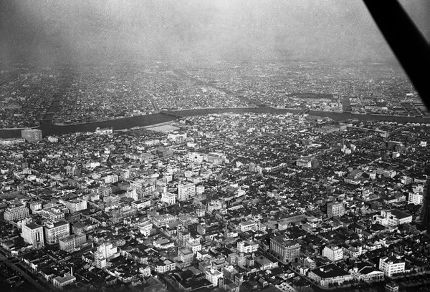
Aerial view of modern Tokyo, 1954

Slide 8
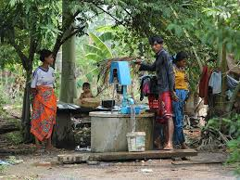

Post World war II Experience:
Developing countries
Development has occurred slowly/not occurred despite flow of foreign aid
Difficulties encountered in starting modern industries in developing countries; no market, no skills, no capital
Rural water supply project, Cambodia
Humanitarian assistance, Ethiopia

Slide 9
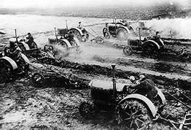
Post World War II Experience: Soviet Union
The Soviet Union growth model based on central command seemed to be working; allocation of resources done by the state
However the system was inefficient and became irrelevant after the collapse of the Soviet Union

Slide 10
What made the difference?
In Western Europe and Japan, although the countries were devastated by the war, institutions, legal systems, and know-how were intact. Key institutions were embodied in people; key business decisions were by the private sector (market)
In less developed countries (formerly under colonial rule, where capital was in the hands of colonialists), modern institutions and functioning markets did not exist. Key decisions to allocate resources were taken by the government
In the communist states, key decisions to allocate resources were taken by the state. Emphasis was on heavy industry and agriculture production

Slide 11
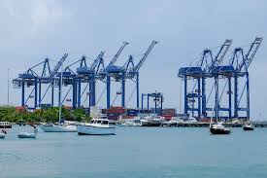
Approach by developing countries, 1950-70s
The situation facing developing countries cannot be left to the market; government planning and intervention was needed to achieve economic growth. The Soviet “central command” approach was preferred.
Governments set up planning commissions and embarked on national economic development plans; developed industrialized provided foreign capital/assistance and assisted in designing and managing development projects

Slide 12
Development in the 1970-80s
Growing criticism that foreign aid to developing countries was not having the intended effect. Too much aid, too few results. Furthermore, by borrowing money, developing countries began to build unsustainable debt
Too much effort to achieve economic growth, less focus on how benefits of growth are distributed; most development aid going to a few people
Shift in thinking: too much government interference impedes growth (excessive bureaucracy, red tape, government protection, tariffs)

Slide 13
Industrial strategies: Import substitution vs export orientation
Before World War II many countries imposed high tariffs on import goods. This prompted several Latin American countries to develop their industries based on import substitution. Goods that were previously imported are then made domestically. This requires government decisions on resource allocation and high tariffs were imposed on imports
After gaining independence, most developing countries considered that free trade worked to their disadvantage since they were only able to export raw materials at cheap prices

Slide 14
Import substitution vs export orientation
In the 1960s, South Korea, Taiwan, Hong Kong and Singapore started to develop labor intensive industries. The products were used to meet the demands of the large US market, which had dismantled its protective trade barriers.
In the 1970s the OPEC countries raised their oil prices which led to large amounts of money flowing to these countries, which were then reinvested in big international banks. This led to low interest rates which led firms and governments to borrow excessively.
When loans were due, many countries were not able to repay. Countries that pursued export- orientation strategies (receiving foreign currency/US dollars) benefited; while countries that pursued import substitution accumulated large debts in the 1980s.

Slide 15
Structural adjustment in 1990s
International lending institutions (World Bank, IMF) realized the poor performance of many developing countries and that excessive government intervention was a detriment to development and that changes
Structural adjustment: reforms aimed to restructure the economy to be more market-based, more efficient, more open to international trade
World Bank made structural adjustment a conditionality to receive aid and loans. However these measures also resulted in a backlash from well-connected elites
Structural adjustment measures: eliminating subsidies (for food, fuel, education) and tariffs, limiting wage increases, abolishment of price controls, and restructuring of state-owned enterprises

Slide 16
Washington consensus
John Williamson highlighted 10 areas that would need to be addressed for developing countries were to accelerate their development. This became known as the Washington Consensus:
Fiscal discipline
Reordering public expenditure priorities
Tax reform
Competitive exchange rates
Trade liberalization
Liberalization of interest rates
Liberalization of foreign direct investment
Privatization
Deregulation
Secure property rights

Slide 17
Transitioning towards market-based economy
In the 1980s as many developing countries faced heavy debt burdens, inefficiencies, and hyperinflation, centrally-planned economies began to shift towards a market-based approach and moving towards the direction of the Washington consensus:
Latin American countries began to pull out of the debt crisis
Eastern European countries were wrestling power from the Soviet Union
Three Baltic states (under the Soviet Union) became independent
The Soviet Union collapsed in 1989
China and Viet Nam embarked on economic reforms; modest reforms in India

Slide 18
The 2000s and beyond
Market-based reforms of the 1980s and 1990s had not addressed issues of equity
Citizens of former Soviet Union states and Eastern Europe were not able to afford accommodation, food, and other basic necessities as subsidies disappeared
With increased globalization, those who were not able to compete were marginalized. Dissatisfaction with globalization therefore increased and backlash against globalization increased

Slide 19
Transitioning towards market-based economy
Some lessons on transition from a centrally-planned to a market-based economy:
Governments were able to curb hyperinflation and relax price controls
Short-term drop in GDP and rise in unemployment
Medium-term economic depression
State-owned enterprises face difficulties competing a free market system because of subsidies and inefficiencies

Slide 20


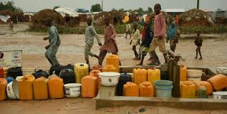
Images of the late 1980s and early 1990s as governments try to cope with huge debt burdens, inefficiencies and social unrest

Slide 21
summary
The role of the states and markets have been a central focus of debate since the time of Adam Smith and even more so following World War II
Following World War II, focus was on accumulating capital as key to economic growth; which was evident in the reconstruction of Western Europe and Japan
The perceived success of the Soviet Union’s central planning model and the difficulties of newly-independent countries to develop pointed to the need for expanded government role and rejected reliance on market forces
Developing countries (which mostly exported raw materials) viewed international trade benefited industrialized countries. There was an increased emphasis on self-sufficiency in production, which gave rise to large state-owned enterprises

Slide 22
summary
By the late 1970s, poor economic performance in many developing countries led to a doubt to government led models of development and the need to reexamine the potential benefits of market-based approaches. This was reinforced by the success of South Korea, Taiwan, Hong Kong and Singapore which pursued export-orientation policies
By the late 1980s and early 1990s developing countries faced huge debt which required macro-economic stabilization. International financing institutions and development agencies of industrialized countries provided lending on the condition that the developing countries followed strict fiscal discipline measures and longer terms measures, or structural adjustment.

