Slide 1
Review on Industrialization in Thailand and CLMV

Slide 2
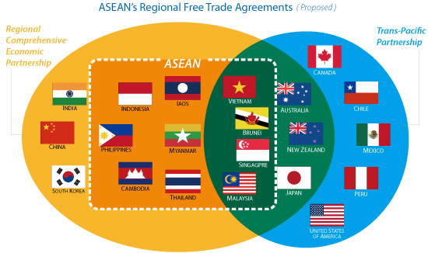
Big Picture on Trade: RCEP, TPP, and ASEAN
Source: ADB

Slide 3
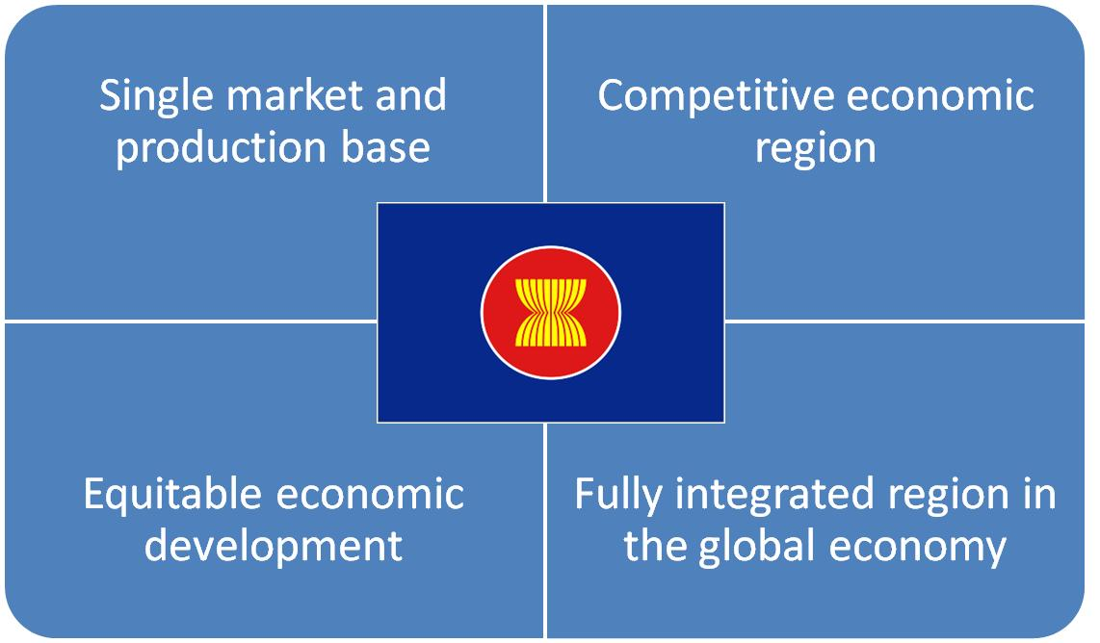
ASEAN Economic Community(AEC)
Source: ASEAN secretariat

Slide 4
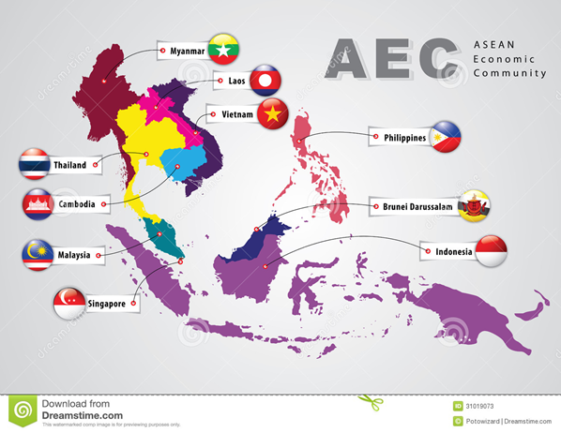
AEC
Source: ASEAN secretariat

Slide 5
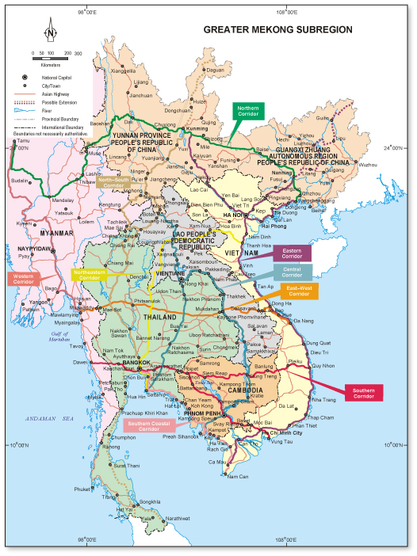
Greater Mekhong Sub-region: Land Bridge
Participating Countries: Cambodia, People’s Republic of China (Yunnan Province and Guangxi AR), Lao PDR, Myanmar, Thailand, and Viet Nam
Strategic Priorities:
  Vision – a more integrated, prosperous, and harmonious subregion
  “3Cs” – Connectivity, Competitiveness, Community
GMS projects: More than $17 billion in investment projects supported since 1992
Source: BOI Thailand

Slide 6
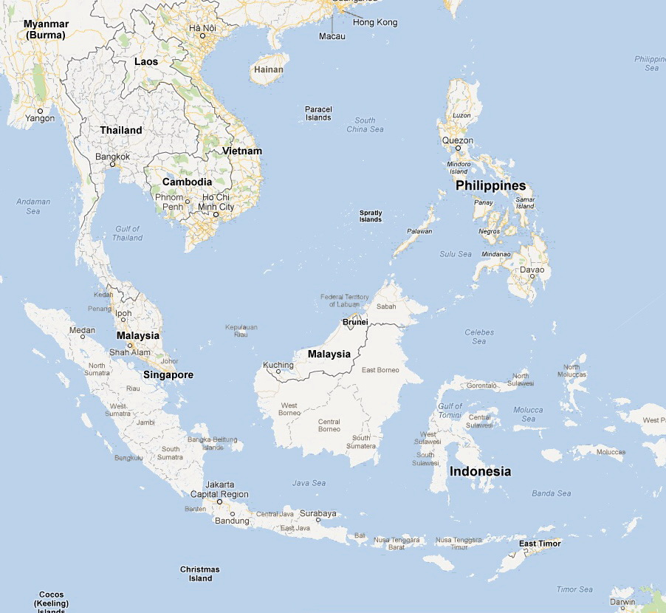
Energy Reserves in ASEAN Countries
Myanmar:
Oil 50 Mbbl
Gas 283 Bm³
Coal --- Mtons
Thailand:
Oil 443 Mbbl
Gas 342 Bm³
Coal 1239 Mtons
Philippines:
Oil 168 Mbbl
Gas 109 Bm³
Coal --- Mtons
Vietnam:
Oil 4400 Mbbl
Gas 680 Bm³
Coal 150 Mtons
Brunei:
Oil 1100 Mbbl
Gas 391 Bm³
Coal --- tons
Malaysia:
Oil 5800 Mbbl
Gas 2350 Bm³
Coal --- Mtons
Indonesia:
Oil 4000 Mbbl
Gas 3001 Bm³ Coal 5529 Mtons
Source: BP statistical review 2012
Notes:
Oil: Malaysia 24th (0.39%) Vietnam 28th Indonesia 30th Thailand 51st (0.03%)
Gas Indonesia 14^{th (1.58%)} Malaysia 16th (1.24%) Vietnam 32nd (0.36) Thailand 39th (0.18%)
Coal Indonesia 15th (0.6%) Thailand 21st (0.1%)

Slide 7
Energy Imports and Efficiency in
ASEAN Countries
Myanmar:
Energy Exports 48.4%
Energy Efficiency: GDP/KOE NA
Thailand:
Energy Imports 40.3%
Energy Efficiency:
GDP/KOE 4.5
Philippines:
Energy Imports 39.6%
Energy Efficiency:
GDP/KOE 8.2
Vietnam:
Energy Exports 19.7%
Energy Efficiency:
GDP/KOE 4.2
Cambodia
Energy Imports 29.2%
Energy Efficiency: GDP/KOE 5.6
Brunei:
Energy Exports 506.4%
Energy Efficiency:
GDP/KOE 5.5
Malaysia:
Energy Exports 34.2%
Energy Efficiency:
GDP/KOE 5.4
Singapore
Energy Imports 99.8%
Energy Efficiency:
GDP/KOE 8.1
Indonesia:
Energy Exports 74.2%
Energy Efficiency:
GDP/KOE 4.5
Source: IMF World Outlook 2012
Notes:
Oil: Malaysia 24th (0.39%) Vietnam 28th Indonesia 30th Thailand 51st (0.03%)
Gas Indonesia 14^{th (1.58%)} Malaysia 16th (1.24%) Vietnam 32nd (0.36) Thailand 39th (0.18%)
Coal Indonesia 15th (0.6%) Thailand 21st (0.1%)

Slide 8
Electricity 7%
Laos
Myanmar
Gas 21%
Middle East (75% of 81%)
Oil 81%
Coal 46%
Indonesia and Australia
Energy Imports to Thailand
Data: EPPO 2011

Slide 9
Basic Needs: Energy Access in
ASEAN Countries
Myanmar:
Electrification 13%
Electric Use 104 KwH
Modern Cooking 3%
Laos
Electrification 55%
Electric Use NA
Modern Cooking 3%
Thailand:
Electrification 99%
Electric Use 2045 KwH
Modern Cooking 63%
Philippines:
Electrification 90%
Electric Use 593 KwH
Modern Cooking 49%
Vietnam:
Electrification 98%
Electric Use 290 KwH
Modern Cooking 34%
Cambodia
Electrification 24%
Electric Use 131 KwH
Modern Cooking 7%
Brunei:
Electrification 100%
Electric Use 8662 KwH
Modern Cooking 100%
Malaysia:
Electrification 99%
Electric Use 3614 KwH
Modern Cooking 80%
Singapore
Electrification 100%
Electric Use 7949 KwH
Modern Cooking 100%
Indonesia:
Electrification 65%
Electric Use 590 KwH
Modern Cooking 46%
Source: World Development Indicators WB 2009, EIA 2012, WHO UNDP 2009, WB AusAID 2011
Notes:
Oil: Malaysia 24th (0.39%) Vietnam 28th Indonesia 30th Thailand 51st (0.03%)
Gas Indonesia 14^{th (1.58%)} Malaysia 16th (1.24%) Vietnam 32nd (0.36) Thailand 39th (0.18%)
Coal Indonesia 15th (0.6%) Thailand 21st (0.1%)

Slide 10
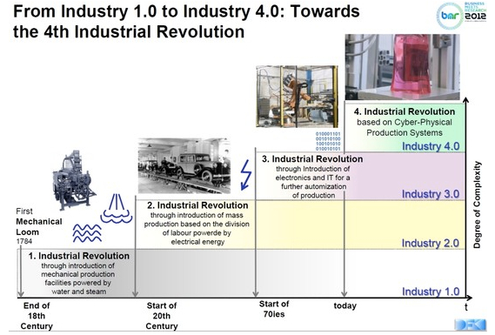
The world as we know it.

Slide 11
Path to Choose
NAIC
Resource-based Industrialization
Labor-Intensive goods
Capital-Intensive goods
Heavy Industry
Technologically intensive goods

