Slide 1
Memory, Cognition & Language
PY 211
General Psychology

Slide 2
Theory of memory
Information processing theory
Computer-liked
Stages of memory
  Encoding > Storage > Retrieving

Slide 3
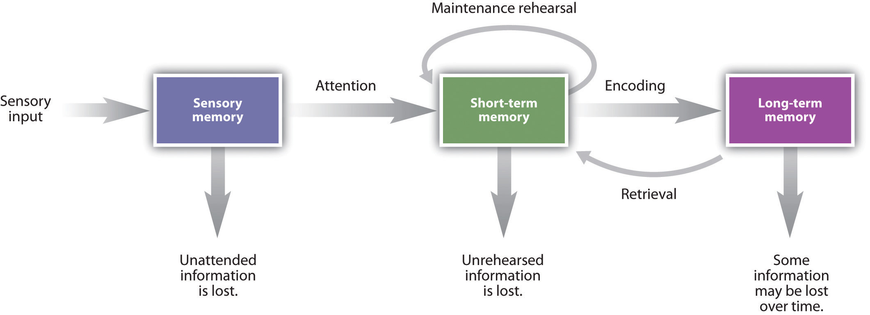
Models of memory
Unitary-store model
Multi-store model
  Atkinson & Shiffrin, 1968

Slide 4

Sensory register
Very brief
Hold an exact image of each sensory experience until it can be fully processed
Iconic memory ~1/4 sec
Echoic memory up to 4 sec
Sperling’s experiment (1960)

Slide 5
Short-term memory (STM)
Require attention(Not necessary intentionally)
Less than 30 seconds
Many different types of memory can be stored
Preference for acoustic code
Chunking can increase STM capacity
Rehearsal keeps STM alive

Slide 6
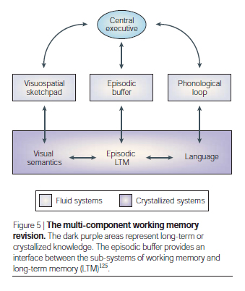
Working Memory
Replace the concept of STM
Consist of 4 components
  Central executive
  Phonological loop
  Visuo-spatial sketchpad
  Episodic buffer

Slide 7
Long-term memory (LTM)
More durable/permanent
Large amount of information
Index and cues
Semantic code

Slide 8
Long-term memory (LTM)
Declarative memory
  Episodic memory: events
  Semantic memory: knowledge
Non-declarative memory
  Priming
  Procedural memory: skill
  Associative learning (Conditioning)
  Non-associative learning: habituation

Slide 9
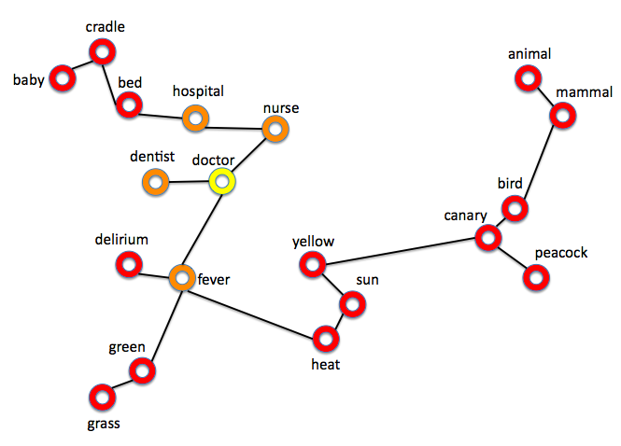
Memory organization
Semantic network
Mental representation
Spreading activation
Semantic network of our mental representations activates on the basis of spreading activation concept.

Slide 10
The neuroscience of memory
Explicit memory: Hippocampus + Amygdala > Frontal lobes
Implicit memory: Cerebellum
Memory consolidation: the processes of stabilizing a memory trace after the initial acquisition
  Long-term potentiation (LTP): Strengthened synapse, more firing, more neurotransmitters

Slide 11
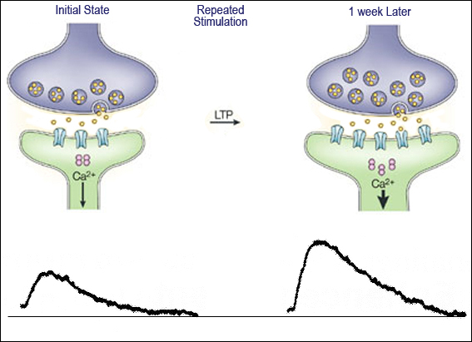
The neuroscience of memory
http://employees.csbsju.edu/ltennison/PSYC340/learning.htm

Slide 12
Encoding
Serial position effect
  Primacy effect
  Recency effect
Spacing effect
Generation effect
Isolation effect
Testing effect

Slide 13
Retrieval
Recall
Recognition
Relearning
Cues
  State
  Mood
  Contextual learning

Slide 14
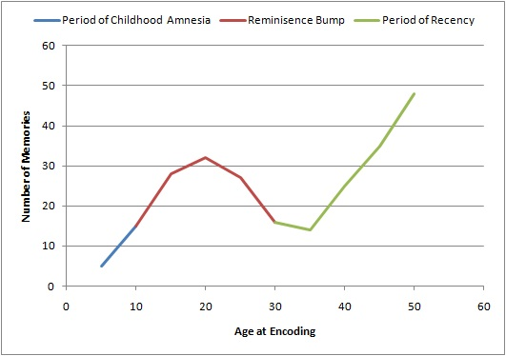
Everyday memory
Autobiographical memory
  Two types of autobiographical memory
    Redemptive story
    Contamination story
  Reminiscence bump
  Infantile amnesia

Slide 15
Everyday memory
Flashbulb memory: a detailed, vivid, snapshot-like memory when receiving a shocking or surprising piece of information
  9-11, USA
  Tsunami hitting SEA
  Coup d'état
Prospective memory: a memory of a planned action or thing you need to do at some future point in time

Slide 16
Level of processing
Craik & Lockheart (1972)
Levels of processing
  Shallow level
  Intermediate level
  Deepest level
Elaboration

Slide 17
Forgetting
Decay theory
Memories that are not used fade gradually over time
Commonsense
Only for sensory register and STM

Slide 18
Forgetting
Interference theory
Focus on LTM
Interference of other memories in the retrieval process of LTM
  Proactive interference
  Retroactive interference
Overload information in STM

Slide 19
Forgetting
Repression and motivated forgetting
Repression: pushing unpleasant or dangerous information into unconsciousness
However, memories that are tied with emotion are harder to forget.
Motivated forgetting: Forgetting occurs to outdated information.

Slide 20
Forgetting
Amnesia
Anterograde amnesia: an inability to store and/or retrieve new information in LTM
Reterograde amnesia: an inability to retrieve old LTMs

Slide 21
Cognition
The intellectual processes through which information is obtained, transformed, stored, retrieved, and used
Including perception, memory, imagining, problem solving, decision making, language, etc.

Slide 22
Decision making
Expected utility theory
Prospect theory
  100% to win 100$
  85% to win 120$ and 15 % to win nothing
  100% to lose 500$
  75% to lose 700% and 25 to lose nothing
  Emotion & decision making

