Slide 1
ASEAN Labour in Thailand
Part 1 B:
Thammasart 1 August 2016

Slide 2
ASEAN Population, Labor Force, GDP 2015
 | Population (Mil.) | Labor Force (Mil) | GDP (bil $) | GDP per Capita ($) | GDP growth (%)
Brunei | 0.42 | 0.3 | 11.236 | 26,804.4 | -1.5
Cambodia | 15.54 | 13.6 | 17.814 | 1,146.1 | 7.3
Indonesia | 255.1 | 173.2 | 895.68 | 3,511.4 | 5.5
Lao PDR | 7.03 | 5.5 | 12.76 | 1,815.8 | 7.0
Malaysia | 30.78 | 20.2 | 327.89 | 10,654.0 | 4.7
Myanmar | 51.85 | 34.4 | 69.14 | 1,333.6 | 8.3
Philippines | 101.42 | 65.1 | 308.03 | 3,037.1 | 6.4
Thailand | 68.84 | 49.8 | 386.29 | 5,611.6 | 3.0
Singapore | 5.52 | 3.7 | 296.06 | 53,604.2 | 3.6
Vietnam | 91.58 | 70.3 | 204.49 | 2,232.99 | 6.1
Total | 628.08 | 436.0
Notes:
Ref. Pop, GDP (current), GDP per capita from IMF World Econ Outlook Database 2015
LPR (ADB, Key Indicators for Asia & the Pacific; GDP growth ADB, Asian Development Outlook 2015

Slide 3

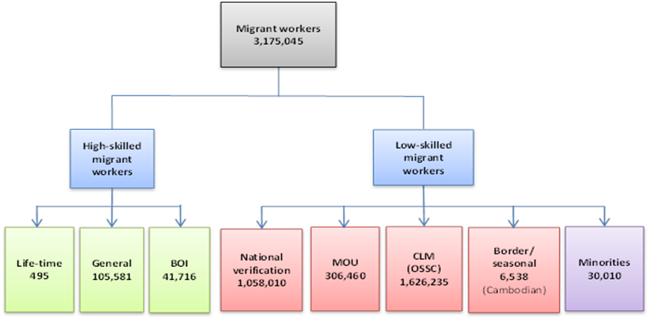

Slide 4
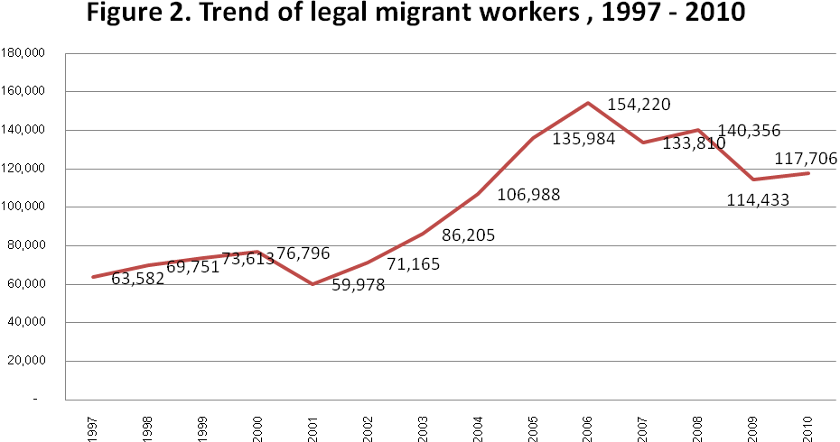
Trend of regular foreign labour 1997-2010
In 2012,
Regular not inc. CLM
(102,923)
Increasing but fluctuated with economic trends.
Regular: = Tem WP + BOI + Perm Residents exc. CLM (NV + import)
Notes:
From 1937 to 2007 about 962,819 foreigners were granted permanent resident status, of whom 705,463 have died, left the country or changed nationality. In the 1980s, 270,000 foreigners who had entered Thailand before 1972 received permanent resident status and life-long work permits. (Sciortino & Punpuing 2009, 49) The number of permanent resident declines to 14,423 as shown in the previous slide.

Slide 5
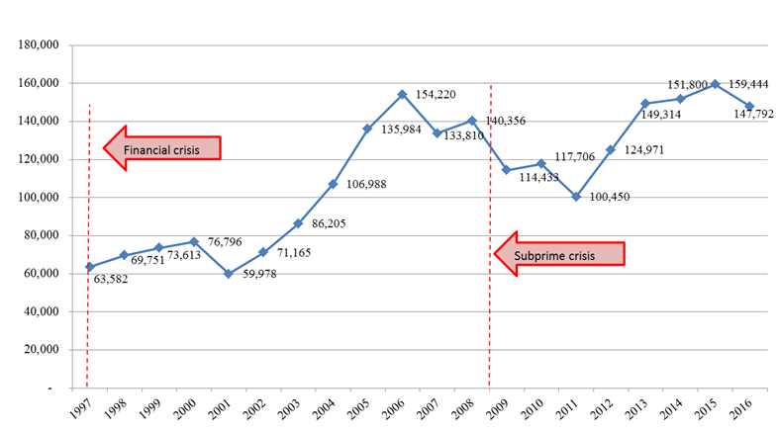
Trend of skilled migrant workers 1997-2016
Not inc. CLM
Skilled = Tem wkrs + BOI +Perm residents

Slide 6
Foreign labour under Art. 9 by nationality 2011 (exc. CLM and Perm Res)
Notes:
ที่มา:http://wp.doe.go.th/sites/default/files/statistic/7/sm12-54.pdf

Slide 7
Regular foreign labour under Art 9 (General-Employment) Stock 2011
By occupation and natinality | As of Dec 2011 |  |  | Unit: Position
(Occupations) | persons | Nationality
 |  | Philippines | ASEAN 7 * | ROW
Total | 80,985 | 7,192 | 5,111 | 68,682
1. Legislatives, exec., managers | 47,918 | 1,130 | 3,247 | 43,541
2. Professionals | 24,164 | 5,408 | 1,045 | 17,711
3. Technicians | 4,746 | 375 | 416 | 3,955
4. Clerks | 1,361 | 142 | 139 | 1,080
5. Services, sales | 1,275 | 43 | 110 | 1,122
6. Skilled wkrs in agr. | 32 | 3 | 4 | 25
7. Skilled wkrs | 310 | 9 | 19 | 282
8. Machine operators | 468 | 24 | 22 | 422
9. Primary wkrs | 263 | 2 | 53 | 208
T Trainees | 448 | 56 | 56 | 336
X Others | - | - | - | -
* = Cambodia, Myanmar, Malaysia, Laos, Vietnam, Singapore, Indonesia
** =ASEAN 7 + Philippines
From ASEAN15.2 % Others 84.8 %

Slide 8
Regular foreign labour under Art 9 (General-Employment) Stock 2011
Occupations | Total | Nationality
 |  | Phil | ASEAN 7* | ASEAN 8** | Other
Total positions | 80,985 | 7,192 | 5,111 | 12,303 | 68,682
Total (100%) | 100.0 | 100.0 | 100.0 | 100.0 | 100.0
1. Legislatives, exec., managers | 100.0 | 15.7 | 63.5 | 35.6 | 63.4
2. Professionals | 100.0 | 75.2 | 20.4 | 52.5 | 25.8
3. Technicians | 100.0 | 5.2 | 8.1 | 6.4 | 5.8
4. Clerks | 100.0 | 2.0 | 2.7 | 2.3 | 1.6
5. Services, sales | 100.0 | 0.6 | 2.1 | 1.2 | 1.6
6. Skilled wkrs in agr. | 100.0 | 0.04 | 0.1 | 0.1 | 0.04
7. Skilled wkrs | 100.0 | 0.1 | 0.4 | 0.2 | 0.4
8. Machine operators | 100.0 | 0.3 | 0.4 | 0.4 | 0.6
9. Primary wkrs | 100.0 | 0.03 | 1.0 | 0.4 | 0.3
T Trainees | 100.0 | 0.8 | 1.1 | 0.9 | 0.5
X Others | - | - | - | - | -
88 % of wkr from ASEAN are Professionals+
Exec.

Slide 9
Regular foreign labour under Art 12 (Investment) stock 2011
Occupations | Total | สัญชาติ
 |  | Phil | Malay | ASEAN 6 | ASEAN8 | Others
Total | 28,482 | 645 | 624 | 741 | 2,010 | 26,472
1. Legislatives, exec., managers | 22,218 | 391 | 491 | 619 | 1,501 | 20,717
2. Professionals | 1,969 | 115 | 41 | 34 | 190 | 1,779
3. Technicians | 3,150 | 115 | 72 | 46 | 233 | 2,917
4. Clerks | 418 | 9 | 8 | 22 | 39 | 379
5. Services, sales | 50 | 1 | 2 | 5 | 8 | 42
6. Skilled wkrs in agr. | 1 | - | - | - | - | 1
7. Skilled wkrs | 307 | 10 | 6 | 9 | 25 | 282
8. Machine operators | 359 | 4 | 4 | 7 | 15 | 344
9. Primary wkrs | 8 | - | - | - | - | 8
T Trainees | 2 | - | - | - | - | 2
X Others | - | - | - | - | - | -
ASEAN 7.1 % Other 92.9 %

Slide 10
สัดส่วนแรงงานต่าวด้าวถูกกฎหมาย มาตรา 12 (การลงทุน)คงเหลือ 2554
หมวดอาชีพ(Occupations) | Total jobs | Nationality
 |  | Phil | Malay | ASEAN 6 * | ASEAN8 | ROW
(Total)(Number of jobs | 28,482 | 645 | 624 | 741 | 2,010 | 26,472
Total)(%) | 100.0 | 100.0 | 100.0 | 100.0 | 100.0 | 100.0
1. Legislatives, exec., managers | 78.0 | 60.6 | 78.7 | 83.5 | 74.7 | 78.3
2. Professionals | 6.9 | 17.8 | 6.6 | 4.6 | 9.5 | 6.7
3. Technicians | 11.1 | 17.8 | 11.5 | 6.2 | 11.6 | 11.0
4. Clerks | 1.5 | 1.4 | 1.3 | 2.9 | 1.9 | 1.4
5. Services, sales | 0.2 | 0.2 | 0.3 | 0.6 | 0.4 | 0.2
6. Skilled wkrs in agr. | 0.004 | - | - | - | - | 0.004
7. Skilled wkrs | 1.1 | 1.6 | 1.0 | 1.2 | 1.2 | 1.1
8. Machine operators | 1.3 | 0.6 | 0.6 | 0.9 | 0.7 | 1.3
9. Primary wkrs | 0.03 | - | - | - | - | 0.03
T Trainees | 0.01 | - | - | - | - | 0.01
ASEAN 84.2% are Prof & Exec.

Slide 11
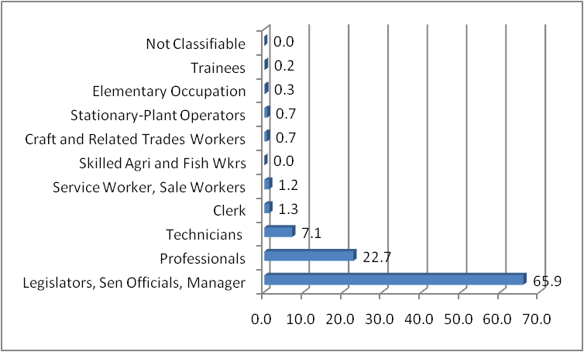
Occupational Structure of skilled wkr from ASEAN (Exc.CLM) 2553
(percentage)
Total 103,283
90 % are high level
Source: The Office of Foreign Workers Administration 2011, tables 7 and 11.
Notes:
About 90 percent are high level manpower.
Labor immigration is bimodal skill distribution. LCLM is high skilled, ICLM low skilled.(Wikipedia-Skills)

Slide 12
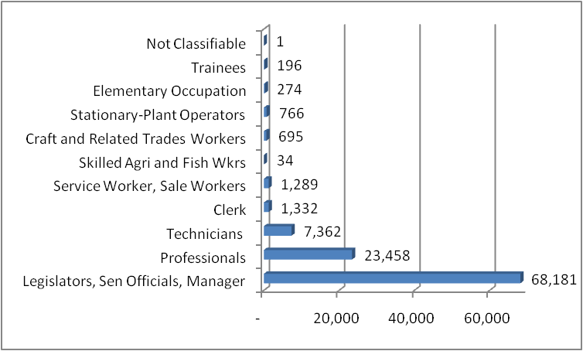
Occupational Structure of skilled wkr from ASEAN (exc. CLM) 2554
(Number)
Source: Office of Foreign Workers Administration, 2554

Slide 13
Thai labour in ASEAN

Slide 14
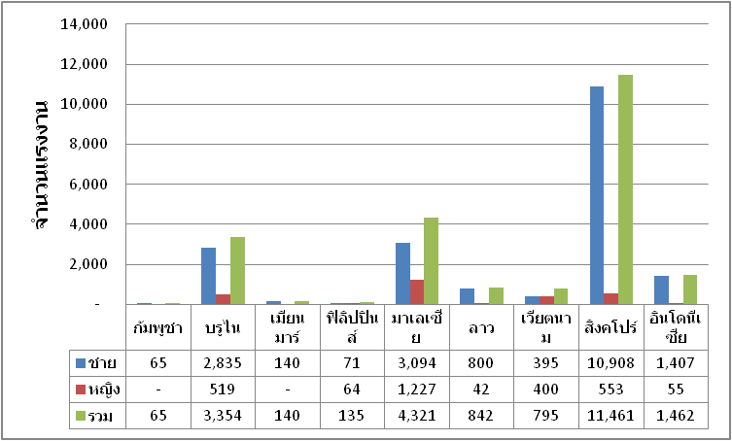
Thai labour in ASEAN by country of destination 2011
Worldwide 147,623 persons
Male 121,391 (82.2 %)
Female 26,232 (17.8%)
Re-entry 57,386
New 90,237
Number
ASEAN 22,575 (15%)
Male 19,715 (87.3%)
Female 2,860 (12.7%)
Cambodia
Brunei
Myanmar
Phil.
Malaysia
Laos
Vietnam
Singapore
Indonesia
M
F
To

Slide 15
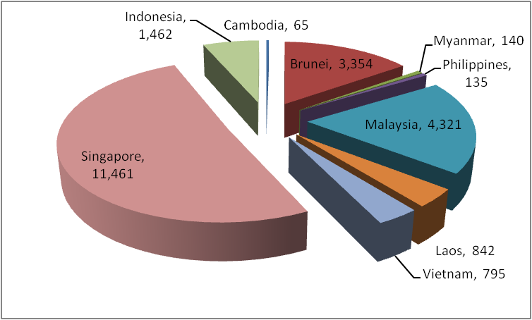
Thai labour in ASEAN by country 2011

Slide 16
ASEAN labour in Thailand 2011
 | ASEAN | Foreigners | % อาเซียน/ ทั่วโลก
Stock
Employment (Art. 9) | 12,303 | 80,985 | 15.2
Investment (Art. 12) | 2,010 | 28,482 | 7.1
Sub-Total | 14,313 | 109,467 | 13.1
Flow (in 2011 only)
Employment (Art. 9) | 547 | 4,532 | 12.1
Investment (Art. 12) | 30 | 750 | 0.04
Sub-total | 577 | 5,282 | 10.9

Slide 17
Thai labour in ASEAN 2011
In ASEAN 22,575 persons out of 147 623 persons worldwide accounting for 15.3 % of Thai labour abroad.
Cambodia | 65 | 0.3
Brunei | 3,354 | 14.9
Myanmar | 140 | 0.6
Philippines | 135 | 0.6
Malaysia | 4,321 | 19.1
Laos | 842 | 3.7
Vietnam | 795 | 3.5
Singapore | 11,461 | 50.8
Indonesia | 1,462 | 6.5
Mostly go to Singapore, Malaysia and Brunei

Slide 18
Competition with other AMS?
(Manning & Sidorenko 2007) classified AMS into 3 groups
High income: Singapore, Brunei, Malaysia and Thailand– importing skilled labour, providing medical services,
Middle income and low income: Philippines, Indonesia and Vietnam – Protecting their skilled labour, rarely import foreigners; exporting labour countries
Low income: Cambodia, Laos and Myanmar – rare import of skilled labour, export low-skilled workers

Slide 19

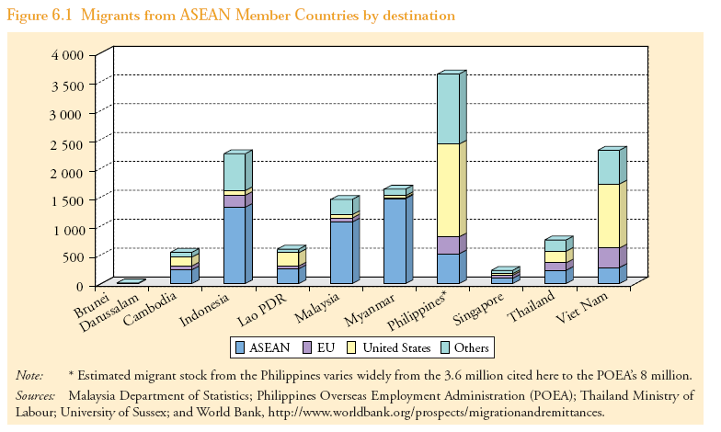
Asian migrants by countries of destination
They go everywhere around the world!
ที่มา -Manolo Abella, ILO Regional Office for Asia and the Pacific

Slide 20
ASEAN does not only partner with Thailand and Thailand does not only partners with ASEAN
Outside ASEAN:
ASEAN - China Free Trade Area
ASEAN - India Free Trade Area
ASEAN – Japan Free Trade Area
ASEAN – Korea Free Trade Area
ASEAN – Australia and New Zealand Free Trade Area
Negotiating :
ASEAN – Gulf Council Cooperation (GCC)
ASEAN – European Union
Thinking about:
ASEAN – MERCUSOR (Latin America)
ASEAN –South Africa Development Cooperation (SADC)
Thai FTA ith other than ASEAN
EU
Japan
China
India
USA
Peru
Australia
New Zealand
South Korea

Slide 21
Mobility of lower-skilled labour
Besides formal arrangements made on services mobility, intra-ASEAN labour flows also occur independently of trade-related institutions, driven mainly by the large inter-country differences in labour supply/demand, wage differentials, as well as demographic factors
(Ref: ASEAN What model for labour?)

