Slide 1
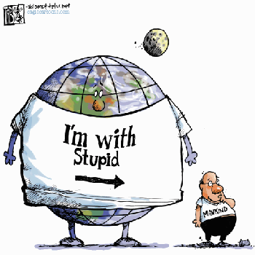
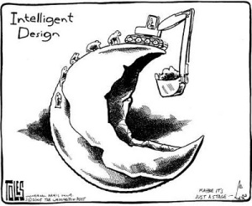
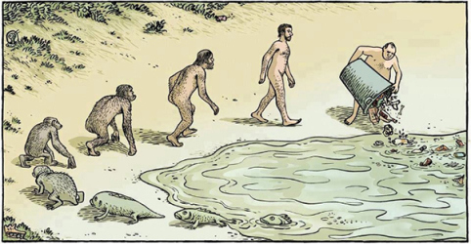
International trade & environment

Slide 2
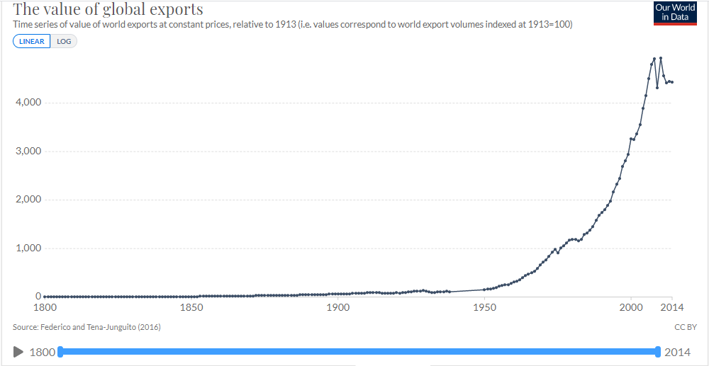

Slide 3
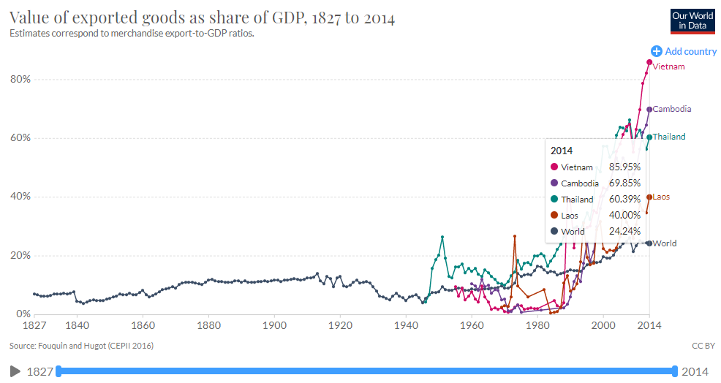

Slide 4
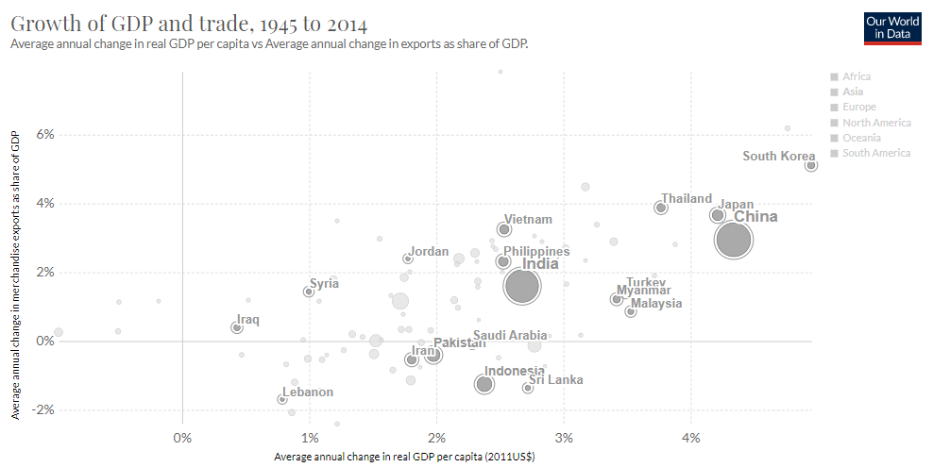

Slide 5
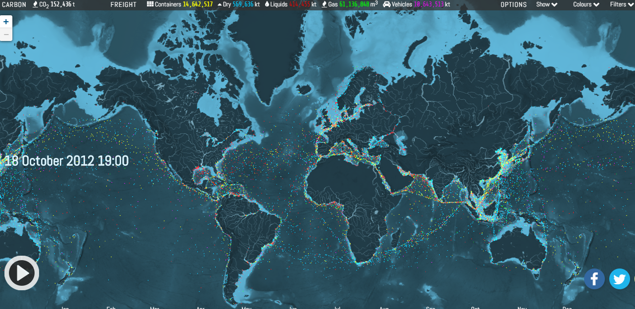
CLICK HERE

Slide 6
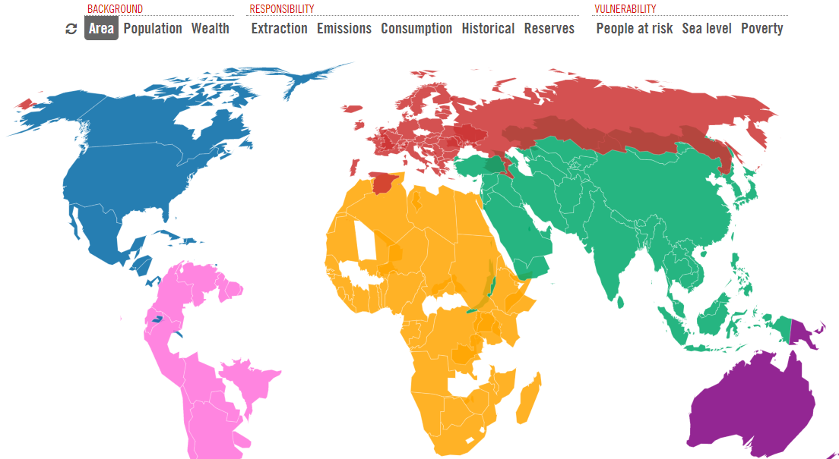
CLICK HERE

Slide 7
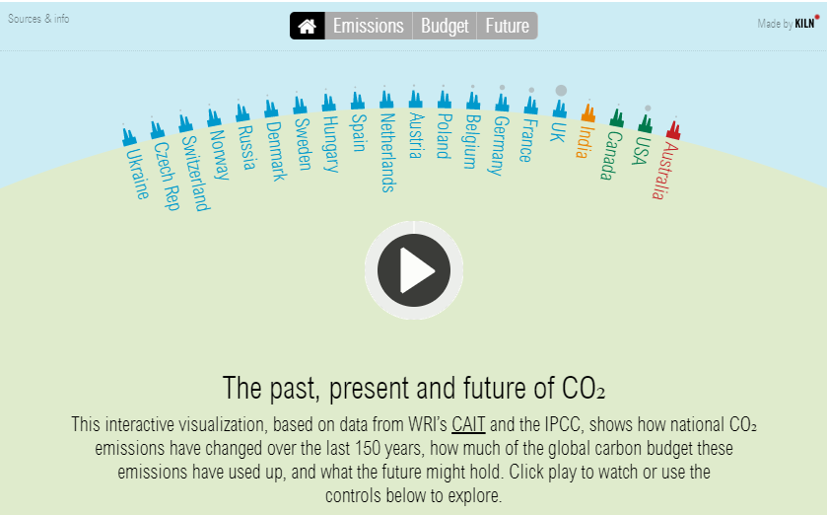
CLICK HERE

Slide 8
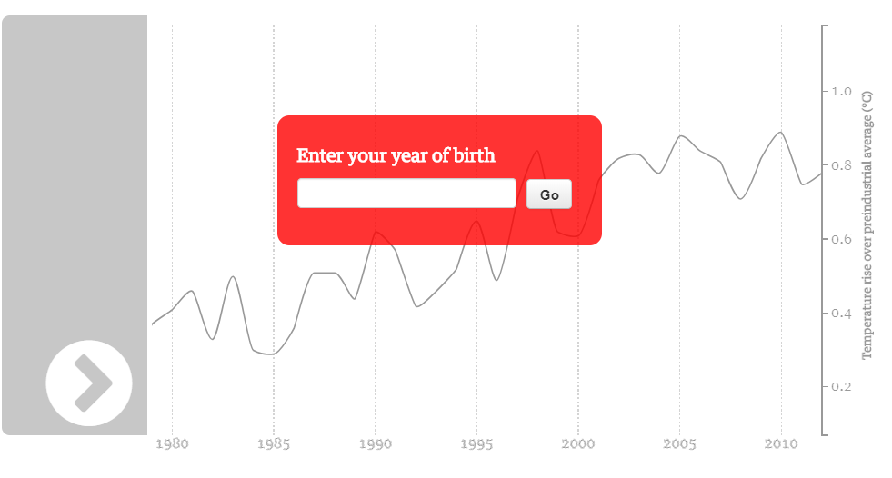
CLICK HERE

Slide 9
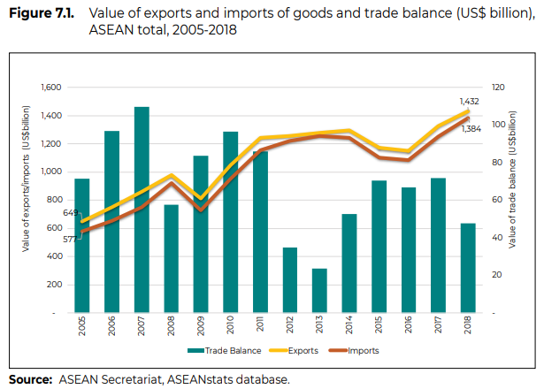

Slide 10
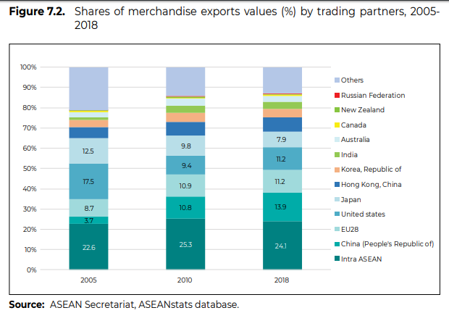

Slide 11
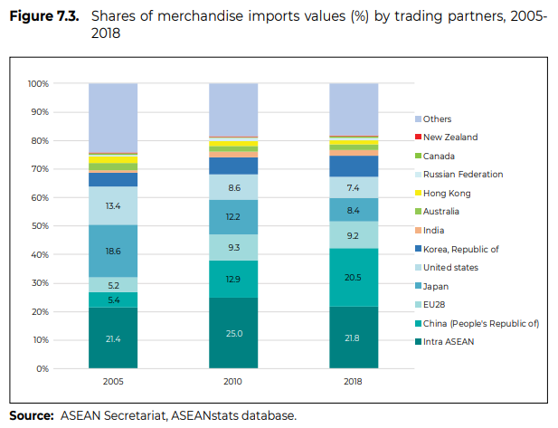

Slide 12
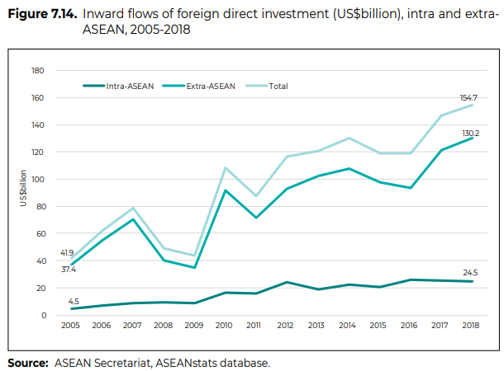

Slide 13
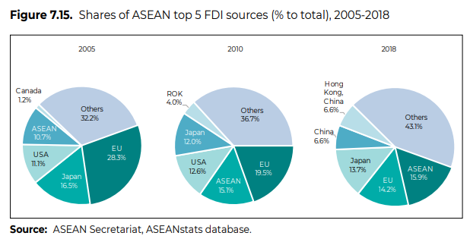

Slide 14
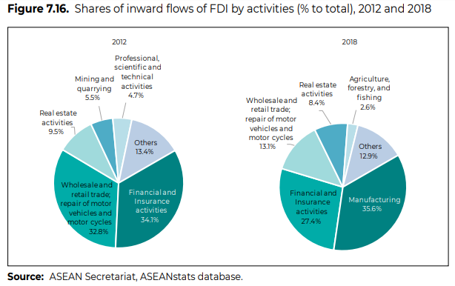

Slide 15
Is trade good or bad for the environment?

Slide 16
Is trade good or bad for the environment?
• Does globalization help or hurt, in achieving the tradeoff between environmental and economic goals?
– Do international trade & investment allow countries to achieve more economic growth for any given level of environmental quality?
– Or do they damage environmental quality for any given rate of economic growth?

Slide 17
Introduction
Free trade proponents argue that FTAs have a positive impact on the environment because after liberalization countries will
  have access to environmentally friendly technologies,
  produce goods in which they have a competitive advantage and
  have greater income due to trade liberalization.
On the other hand, environmentalists argue that trade liberalization is detrimental for the environment because it will
  expand more polluting industries
  encourage more polluting industries to locate in countries with lax environmental regulations. (“pollution heaven”)

Slide 18
Some of the common concerns…
  Reducing barriers to trade will reinforce the tendency for countries to export commodities that make use of resource-intensive production factors ➔ “comparative advantage in producing polluted products”
  Trade liberalization may directly affect environmental standards (“race to the bottom”).
  “Environmental tariffs” may be employed against trading partners deemed to have inadequate environmental standards.

Slide 19
But, some evidence seems to suggest otherwise…
Countries that are more open to trade adopt cleaner technologies more quickly.
Increased real income is often associated with increased demand for environmental quality .
Greater openness to trade also encourages cleaner manufacturing

Slide 20
International trade theory (basic)
Economists believe that free trade improves economic welfare. (assume no externalities)
Each country can produce A and B at the different cost.
  Relatively low production cost of A in country 1 ➔ 1 has comparative advantage in producing A➔ 1 should produce/export A and import B
  Relatively low production cost of B in country 2 ➔ 2 has comparative advantage in producing B➔ 2 should produce/export B and import A

Slide 21
International trade theory (basic)
The Heckscher-Ohlin theorem
A fundamental proposition regarding the pattern of trade between two economies.
The Heckscher-Ohlin theorem suggests that trade is determined by differences in factor endowments.
  A country will
    export those goods relatively intensive in its abundant factor of production and
    import those goods relatively intensive in its scarce factor of production.

Slide 22
The Heckscher-Ohlin theorem
For example, a country having an abundant supply of capital will find it cheaper to manufacture goods whose production is capital intensive.
    The country is said to have a ‘comparative advantage’ in the production of such goods.
HO theorem implies that countries well endowed with environmental resources should specialise on the production of environmentally damaging goods.

Slide 23
Environmental Kuznets Curve (EKC)
A model of this relationship is the environmental Kuznets curve (EKC), an inverted U shape, implying that:
  Early stages of industrialization are linked to relatively high pollution levels when growth is a priority
  environmental controls are lenient or nonexistent
  More advanced economic development ➔ greater concern for environmental quality and a strengthening of environmental regulation

Slide 24
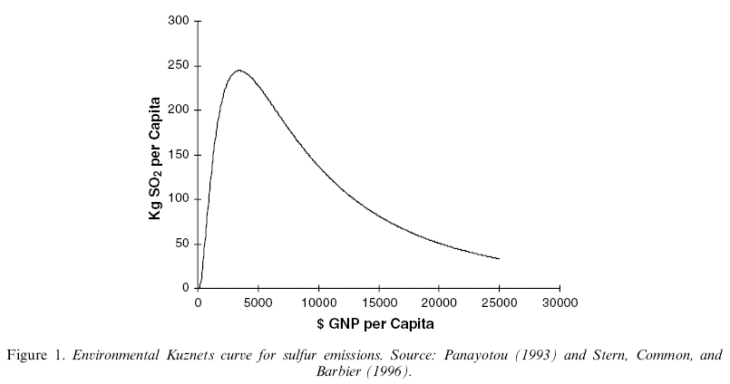
Environmental Kuznets Curve
Early stages of industrial development
More advanced stages of development
Pollution
EKC
Income per capita

Slide 25
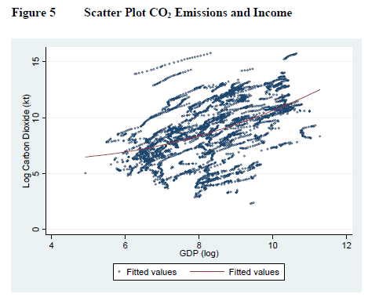
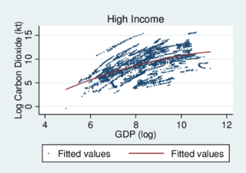
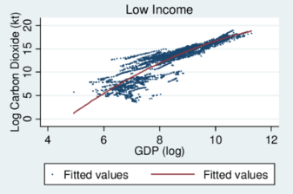
Grunewald, Nicole & Martínez-Zarzoso, Inmaculada. (2010). Driving Factors of Carbon Dioxide Emissions and the Impact from Kyoto Protocol.

Slide 26
The Environmental Kuznets Curve
Why does the curve rise at low levels of development?
  Pollution heaven and race to the bottom
Why does pollution tend to fall at higher levels of development?
  The stringency of environmental regulation reflect the population’s preference for environmental quality. Higher income ➔ Greener preference

Slide 27
Trade and Environment
Scale, composition and technique effects:
Environmental Impacts of a North American Free Trade Agreement
Grossman and Krueger (1993)
G & K give a useful decomposition for thinking about the reasons underlying changes in emissions.
Emissions are by definition equal to the overall scale of activity S, multiplied by the share of dirty goods in total output σ, multiplied by the emissions per unit of the dirty good, e.
This says that the percentage change in emissions is equal to
the percentage change in the scale of output plus the percentage change in the share of the dirty commodity plus the percentage change in emissions intensity of the dirty commodity.

Slide 28
Scale effects:
Trade liberalisation boosts market access which will generate economic growth, so likely to lead to an increase in the scale of economic activity.
Other things being equal the scale effect will be environmentally damaging.

Slide 29
Composition effects:
Trade liberalisation is also likely to alter the composition of output.
  If a country enjoys a relative abundance of the environmental factor of production then that country will increasingly specialise in the production of environmentally intensive ‘dirty’ commodities.
  Similarly, if a country possesses a relative abundance of capital then that country will specialise in the production of capital intensive commodities. In fact many goods are both capital intensive and environmentally intensive.
The overall effect of the composition effect on the environment is therefore ambiguous.

Slide 30
Technique effects:
technological dissemination through trade liberalization
through the importation of innovations embodied in both intermediate goods and capital goods (e.g. machinery or equipment used in the production of other goods and services) which a country could not have produced on its own.
the transfer of knowledge about new production methods and design from developed countries.
As trade liberalisation increases per capita income levels the public will call for greater environmental quality.
  compelling producers to adopt different production techniques and new technology.

Slide 31
Impact of trade liberalization
The expectation is that the scale effect will increase emissions and technique effect will decrease emissions.
The composition effect will increase or decrease emissions depending on the production mix of goods after trade liberalization.
  If production of dirty goods increases in the economy, then pollution will increase and
  if the economy produces cleaner goods after trade liberalization it will lead to decreases in emission level.
the overall impact of trade liberalization is an empirical question.

Slide 32
Resource Curse
WATCH THIS
READ THIS
https://www.globalwitness.org/en/campaigns/myanmar/cursed-treasure-report/#chapter-5/section-4
https://time.com/battling-for-blood-jade/

Slide 33
Resource Curse
There are evidences that many oil-, gas- and mineral-rich countries have failed to reach their full potential as a result of their natural resource wealth.
“The resource curse, also known as the paradox of plenty, refers to the paradox that countries with an abundance of natural resources (like fossil fuels and minerals), tend to have less economic growth, less democracy, and worse development outcomes than countries with fewer natural resources.”
Oil, mineral and gas wealth is distinct from other types of wealth because
  its large upfront costs, long production timeline, site-specific nature, price and production volatility and non-renewable nature.

Slide 34
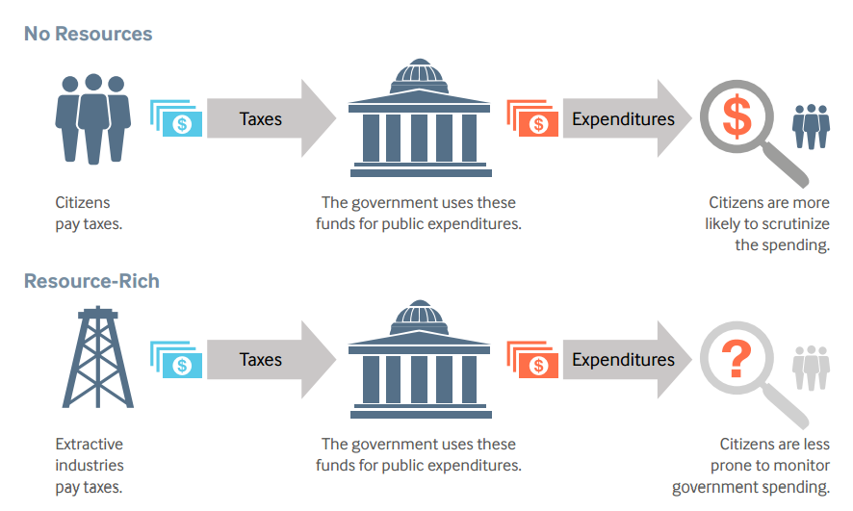
Cause of resources curse
The lack of Democracy
  Natural resource wealth has made it more likely for governments to become or remain authoritarian.
  large revenues from natural resources ➔ less dependent on levying taxes on citizens ➔ Politicians and government officers are less directly tied to citizen requests or demands.
  when resource revenues are secret, citizens do not have a clear sense of whether the resource revenues are being spent well or not.

Slide 35
Cause of resources curse
Conflict: natural resources can provoke and sustain internal conflicts as different groups fight for control of the resources or use natural resources to finance their fighting.
Inefficient spending and borrowing: The amount that governments collect in resource revenues can change drastically from year to year because of changes in commodities prices and production.

Slide 36
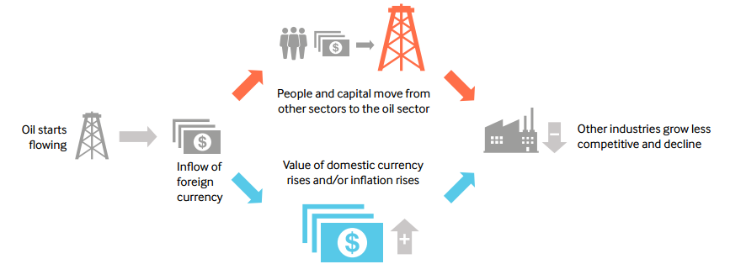
Cause of resources curse
Dutch disease: A large increase in natural resource revenues can hurt other sectors of the economy, particularly export-based manufacturing, by causing inflation or exchange rate appreciation and shifting labor and capital from the non-resource sector to the resource sector

Slide 37
Cause of resources curse
• Limited government capture of benefits:
  In some cases, only a small share of the production value of the resource stays in the country
  fail to compensate the state and communities for depleting their resources and related environmental damage or loss of livelihood.
  The point-source nature of extractive industries often creates challenges when trying to balance the needs of the people and environments that surround the mining area.

Slide 38
Environmental problem : Negative Externalities
By-products of consumption and production may harm others.
  Driving releases GHGs to the atmosphere
  Air pollution from power plants cause respiratory diseases.
Consumers and producers only take into account of private cost when they decide how much to consume and how much to produce.
Social cost = Private cost + Externality cost.
With externalities, consumers and producers tend to consume and produce too much.
  Think about gasoline consumption. from the social planner’s perspective, you consume too much?

Slide 39
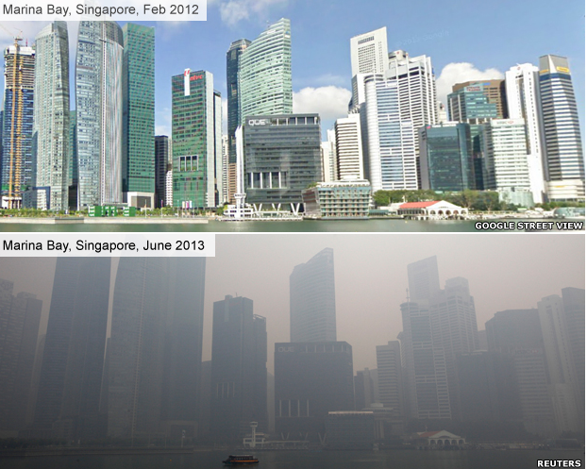
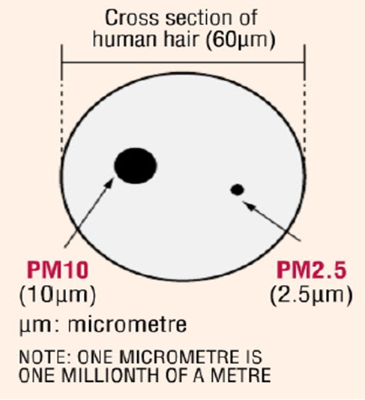
Transboundary pollution problem in ASEAN: HAZE

Slide 40
How to solve environmental problem?
Command-and-Control ➔ Standards, law and regulations
Tax / Cap and Trade ➔ putting price on pollution
Emission Trading
Border Carbon Adjustment to prevent “carbon leakage”

