Slide 1
Topic 3 Part 3
The Theory of Demand
(Chapter 5)

Slide 2
Summary
When the price of a good changes, its quantity demanded changes.
The total effect on demand (TE) is due to the sum of two effects:
  Income Effect (IE)
  Substitution Effect (SE).
That is, TE = SE + IE.

Slide 3
Summary
When the price of a good falls…
Substitution Effect implies that the consumer will ALWAYS buy more of the good.
Income Effect implies that the real income increases
AND
  the consumer will buy more of the good if it is a normal good.
  the consumer will buy less of the good if it is an inferior good.

Slide 4
Summary
To represent these two effects in the consumer choice diagram, economists adjust the BL with two steps:
“PIVOT” to represent the SE
“SHIFT” to represent the IE
Moreover, there are two approaches when we try to identify the SE by “pivoting” the BL.
These approaches are
  Hicksian Approach
  Slutskian Approach

Slide 5
Summary
Hicksian Approach
We find the SE by pivoting the BL (to reflect the price change) along the original indifference curve.
We are essentially asking ourselves:
Which Bundle after the price change, would keep the consumer at the utility level that he had prior the price change?
Hicksian Definition of the SE:
“the change in the demand for a good as its price changes, holding the utility constant”.

Slide 6
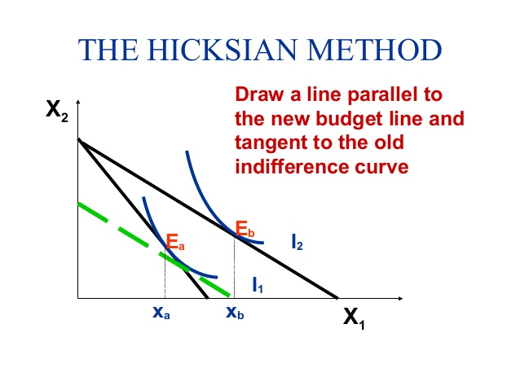

Slide 7
Summary
Slutskian Approach
We find the SE by pivoting the BL (to reflect the price change) around the original bundle.
We are essentially asking ourselves:
Which Bundle after the price change, would keep the consumer at the purchasing power that he had prior the price change?
Slutskian Definition of the SE:
“the change in the demand for a good as its price changes, holding the purchasing power constant”.

Slide 8
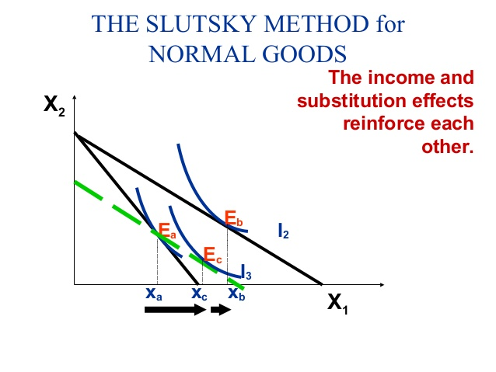

Slide 9
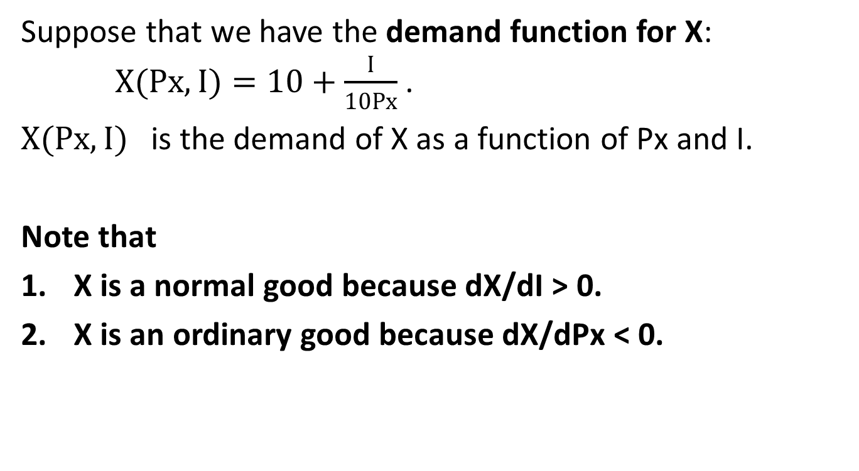
Slutskian Method Example
Suppose that we have the demand function for X:
$X(Px,I)=10+\frac{I}{10Px}$ .
$X(Px,I)$ is the demand of X as a function of Px and I.
Note that
X is a normal good because dX/dI > 0.
X is an ordinary good because dX/dPx < 0.

Slide 10
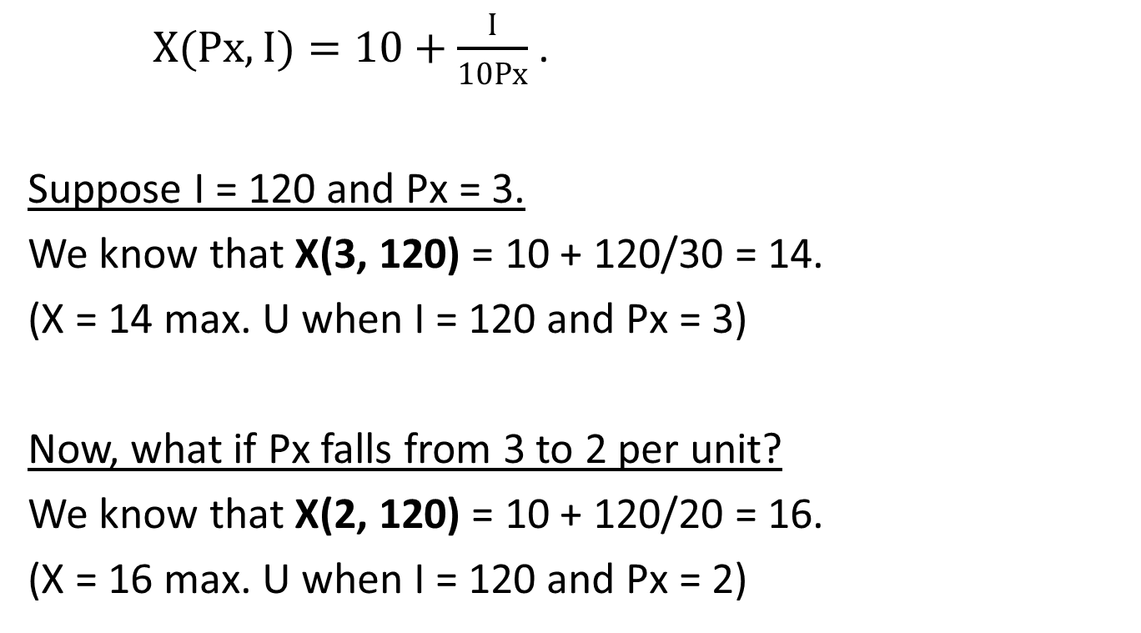
Slutskian Method Example
$X(Px,I)=10+\frac{I}{10Px}$ .
Suppose I = 120 and Px = 3.
We know that X(3, 120) = 10 + 120/30 = 14.
(X = 14 max. U when I = 120 and Px = 3)
Now, what if Px falls from 3 to 2 per unit?
We know that X(2, 120) = 10 + 120/20 = 16.
(X = 16 max. U when I = 120 and Px = 2)

Slide 11
Slutskian Method Example
The demand for X increases by 2 units.
That is, we buy more because X is cheaper.
This is the Total Effect (TE) of the price change.
Now, we want to know how much the Income Effect (IE) and the Substitution Effect (SE) are.
Note that TE = SE + IE.

Slide 12
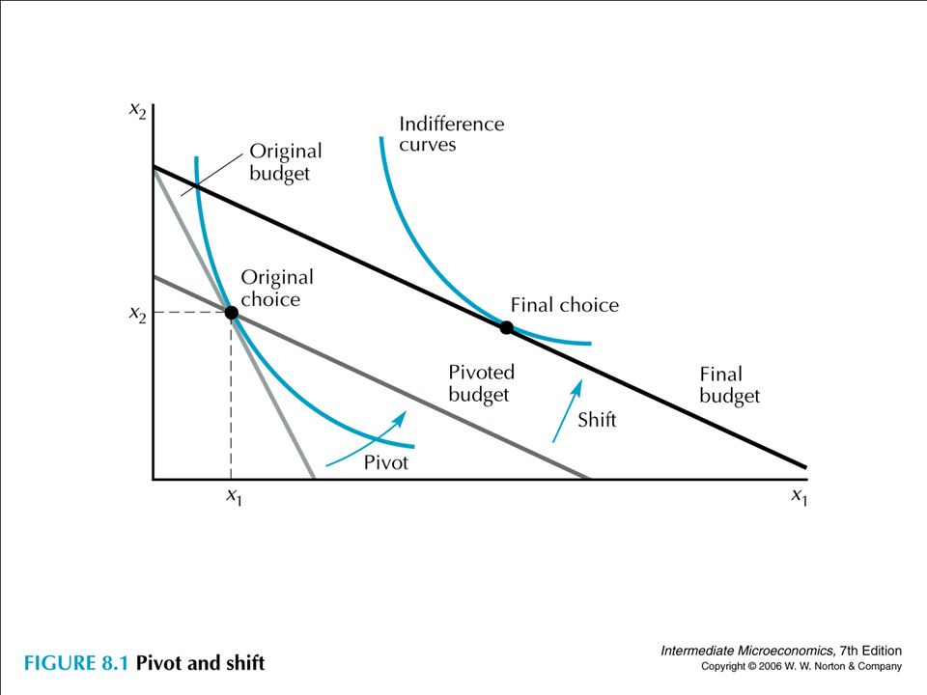
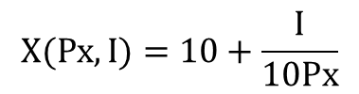
SE = X_{B}(P_{X}’,I’) – X_{A}(P_{X},I)
IE = X_{C}(P_{X}’,I) – X_{B}(P_{X}’,I’)
TE = SE + IE
= X_{B}(P_{X}’,I’) – X_{A}(P_{X},I) + X_{C}(P_{X}’,I) – X_{B}(P_{X}’,I’)
= X_{C}(P_{X}’,I) – X_{A}(P_{X},I)
Y
$$X(Px,I)=10+\frac{I}{10Px}$$
X_{A}(P_{X}, I)
X_{C}(P_{X}’, I)
X_{B}(P_{X}’, I’)
A B C
X
Slope =
– Px’/Py
SE IE

Slide 13
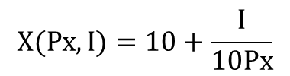
SE = X_{B}(2, I’) – 14
IE = 16 – X_{B}(2, I’)
TE = SE + IE
= – 14 + 16 = 2
We need to find X_{B}(2, I’).
Y
$$X(Px,I)=10+\frac{I}{10Px}$$
X_{A}(3, 120)
X_{C}(2, 120)
X_{B}(2, I’)
14 B 16
X
SE IE

Slide 14
Slutskian Method Example
Substitution Effect (holding purchasing power constant)
To find the SE,
Find the BL after Px changes, where the original bundle (X = 14 in this example) is still affordable.
Find the optimal bundle (Bundle B) on this new BL.
SE = Bundle B – Bundle A = X_{B}(P_{X}’, I’) – X_{A}(P_{X}, I)

Slide 15
Slutskian Method Example
To find the SE,
Find the BL after Px changes, where the original bundle (X = 14 in this example) is still affordable.
Original BL: 3X + PyY = 120 Pivoted BL: 2X + PyY = I’
We equate the two BL’s to solve for I’.
X = 120 – I’ or I’ = 120 – X.
We know that at both BL’s, X = 14 is affordable.
Thus, I’ = 120 – 14 = 106.

Slide 16
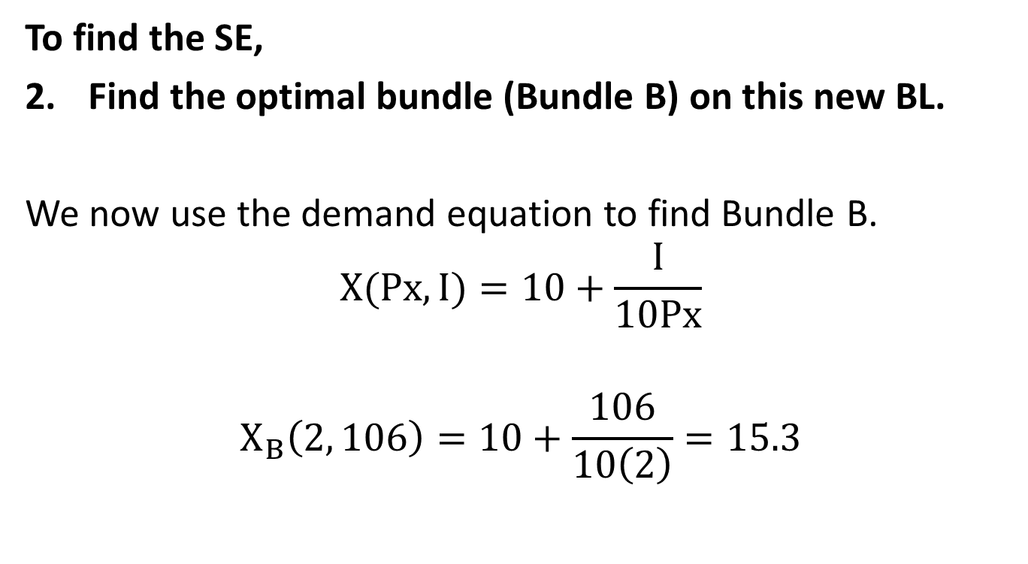
Slutskian Method Example
To find the SE,
Find the optimal bundle (Bundle B) on this new BL.
We now use the demand equation to find Bundle B.
$$X(Px,I)=10+\frac{I}{10Px}$$
$$X_{B}\left(2, 106\right)=10+\frac{106}{10\left(2\right)}=15.3$$

Slide 17
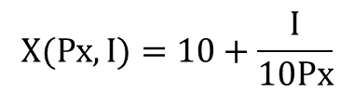
SE = 15.3 – 14 = 1.3
IE = 16 – 15.3 = 0.7
TE = SE + IE = 1.3 + 0.7 = 2
or TE = – 14 + 16 = 2
Y
$$X(Px,I)=10+\frac{I}{10Px}$$
X_{A}(3, 120)
X_{C}(2, 120)
X_{B}(2, 106)
14 15.3 16
X
SE IE

Slide 18
Hicksian Method Example
Note: Use the “Hicksian” Substitution Effect
To find the solution:
Step 1: Find Optimal Bundle before the price change (Bundle A)
Step 2: Find Optimal Bundle after the price change (Bundle C)
Step 3: Find Optimal Bundle after the price change (Bundle B)
that still gives U = U(Bundle A), i.e. keeping U constant

Slide 19
Deriving Slutsky Equation
From TE = SE + IE, we can write it in a symbolic form.
∆X = ∆X_{SE} + ∆X_{IE}
…then..
∆X = ∆X_{SE} – (∆X_{NIE})
where
∆X = X_{C}(P_{X}’ , I) – X_{A}(P_{X} , I)
∆X_{SE} = X_{B}(P_{X}’ , I’) – X_{A}(P_{X} , I) >>> Slutskian Method
∆X_{IE} = X_{C}(P_{X}’ , I) – X_{B}(P_{X}’ , I’)
∆X_{NIE} = – ∆X_{IE} = X_{B}(P_{X}’ , I’) – X_{C}(P_{X}’ , I) >>> “Negative” IE

Slide 20
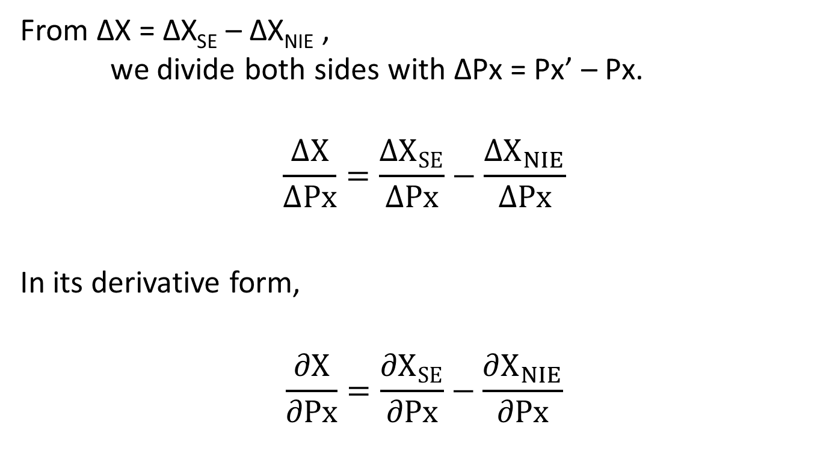
Deriving Slutsky Equation
From ∆X = ∆X_{SE} – ∆X_{NIE} ,
we divide both sides with ∆Px = Px’ – Px.
$$\frac{∆X}{∆Px}=\frac{∆X_{SE}}{∆Px}−\frac{∆X_{NIE}}{∆Px}$$
In its derivative form,
$$\frac{∂X}{∂Px}=\frac{∂X_{SE}}{∂Px}−\frac{∂X_{NIE}}{∂Px}$$

Slide 21
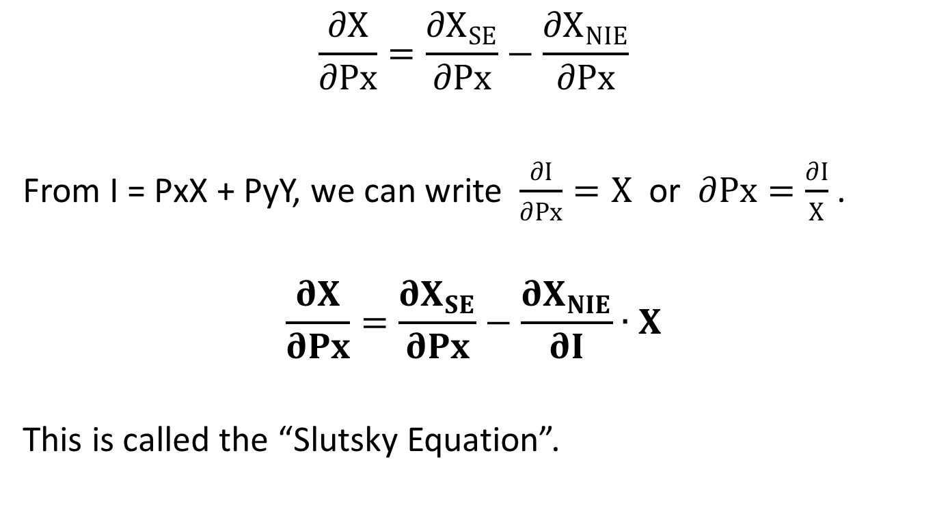
Deriving Slutsky Equation
$$\frac{∂X}{∂Px}=\frac{∂X_{SE}}{∂Px}−\frac{∂X_{NIE}}{∂Px}$$
From I = PxX + PyY, we can write $\frac{∂I}{∂Px}=X$ or $∂Px=\frac{∂I}{X}$ .
$$\frac{∂X}{∂Px}=\frac{∂X_{SE}}{∂Px}−\frac{∂X_{NIE}}{∂I}∙X$$
This is called the “Slutsky Equation”.

Slide 22
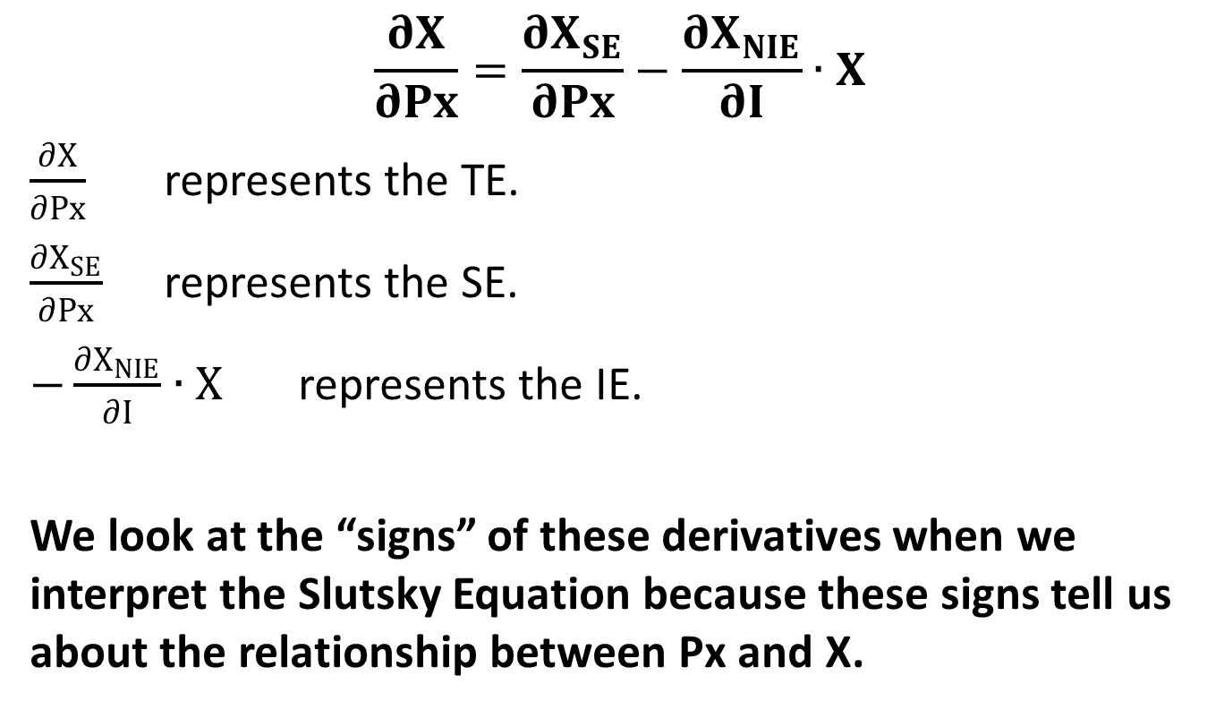
Slutsky Equation
$$\frac{∂X}{∂Px}=\frac{∂X_{SE}}{∂Px}−\frac{∂X_{NIE}}{∂I}∙X$$
$\frac{∂X}{∂Px}$ represents the TE.
$\frac{∂X_{SE}}{∂Px}$ represents the SE.
$−\frac{∂X_{NIE}}{∂I}∙X$ represents the IE.
We look at the “signs” of these derivatives when we interpret the Slutsky Equation because these signs tell us about the relationship between Px and X.

Slide 23
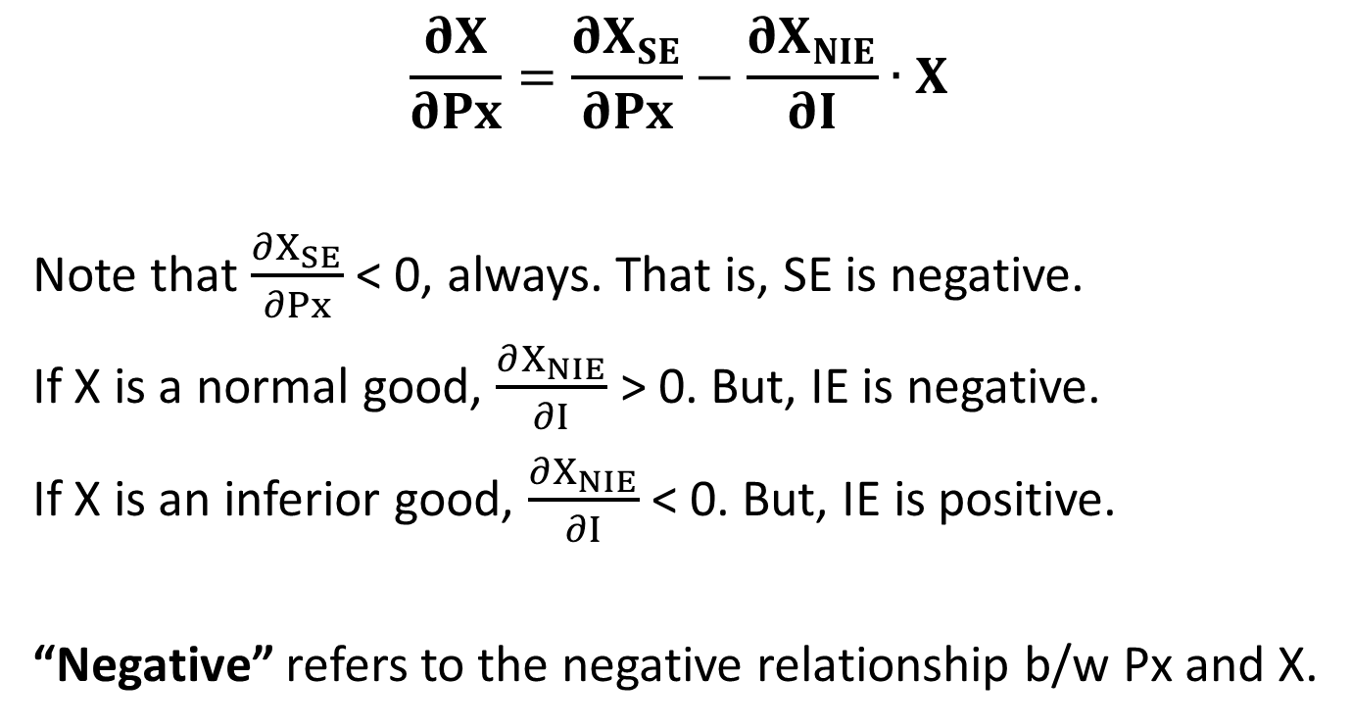
Slutsky Equation
$$\frac{∂X}{∂Px}=\frac{∂X_{SE}}{∂Px}−\frac{∂X_{NIE}}{∂I}∙X$$
Note that $\frac{∂X_{SE}}{∂Px}$ < 0, always. That is, SE is negative.
If X is a normal good, $\frac{∂X_{NIE}}{∂I}$ > 0. But, IE is negative.
If X is an inferior good, $\frac{∂X_{NIE}}{∂I}$ < 0. But, IE is positive.
“Negative” refers to the negative relationship b/w Px and X.

Slide 24
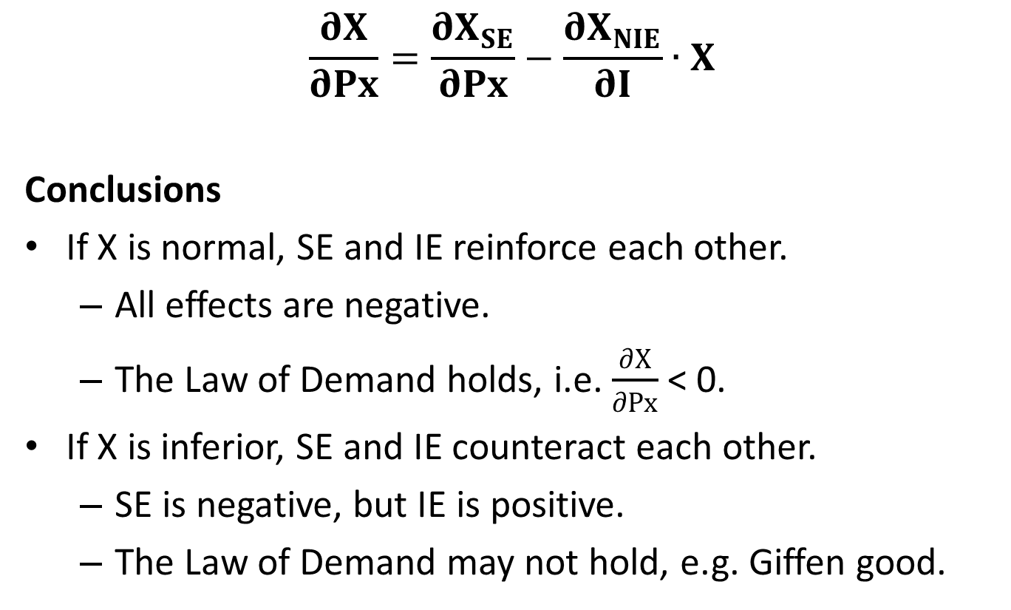
Slutsky Equation
$$\frac{∂X}{∂Px}=\frac{∂X_{SE}}{∂Px}−\frac{∂X_{NIE}}{∂I}∙X$$
Conclusions
If X is normal, SE and IE reinforce each other.
  All effects are negative.
  The Law of Demand holds, i.e. $\frac{∂X}{∂Px}$ < 0.
If X is inferior, SE and IE counteract each other.
  SE is negative, but IE is positive.
  The Law of Demand may not hold, e.g. Giffen good.

