Slide 1
Growth Effect of FSL
“Does FSL Spur Growth?” Geert Bekaert, Campbell Harvey, Christian Lundbald,
NBER No 8245, 2001

Slide 2
Financial Sector Liberalization (FSL)
Domestic Financial Liberalization (DFL) and Capital Account Liberalization (KAL)
FSL promises:
Improvement in global capital allocation
Enhance opportunities to savers and investors that will lead to an improved macroeconomic performance
Create more instruments, e.g., derivatives
Force government to bear a “healthy discipline” for macroeconomic stability.

Slide 3
Domestic Financial Liberalization (DFL) and
Capital Account Liberalization (KAL)
DFL: Two important policies are: (1) lower the reserve requirement (rr); and (2) raise competition in the banking sector. The idea is, lowering rr will increase credits, and increased competition will raise efficiency, hence better intermediaries and better credit allocation.
KAL: liberalizing capital account will let capital to flow more easily to be channeled through domestic intermediaries (either banks or firms), allowing more competition. In either case, pressures for higher efficiency in domestic banks are introduced, including greater willingness to take forex risks. KAL can also detect policy inconsistencies.

Slide 4
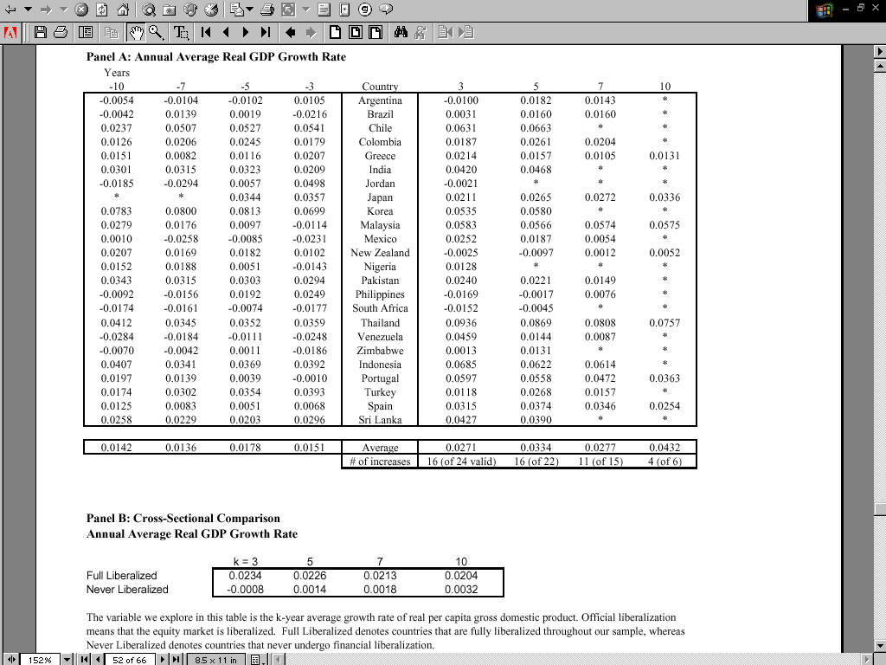

Slide 5
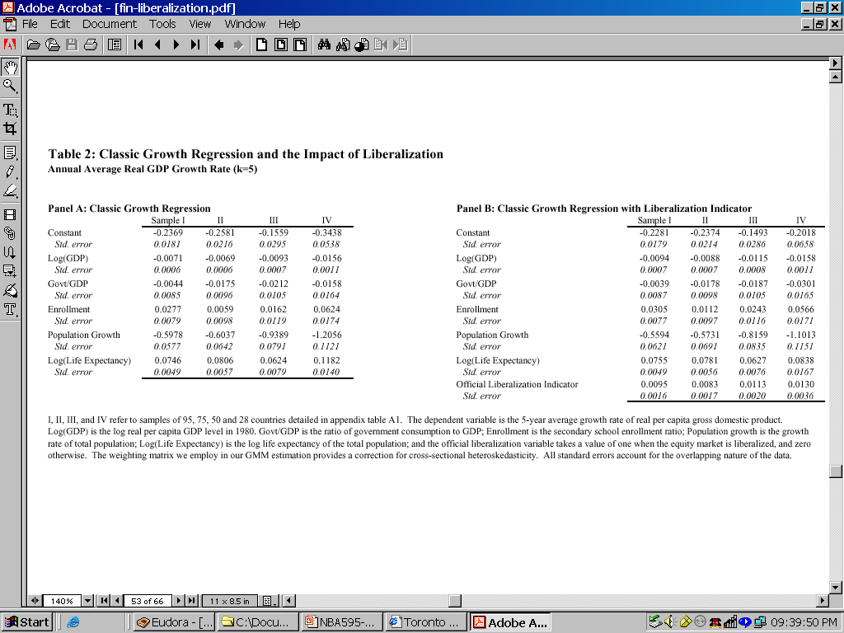

Slide 6
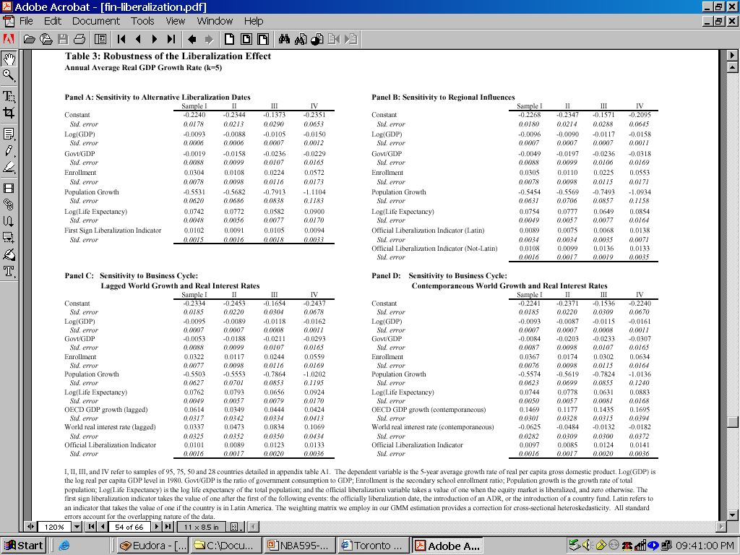

Slide 7
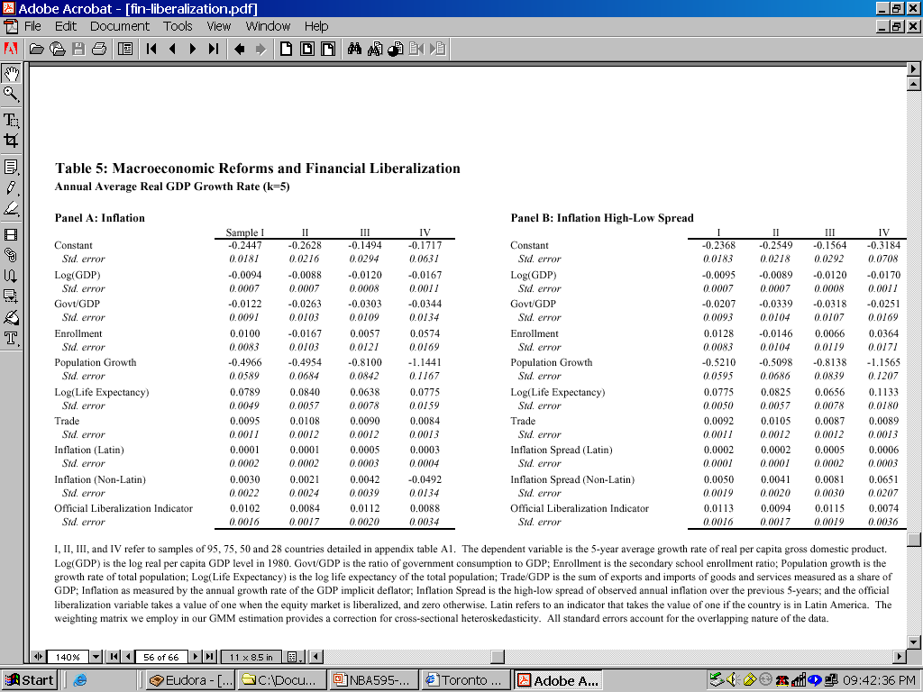

Slide 8
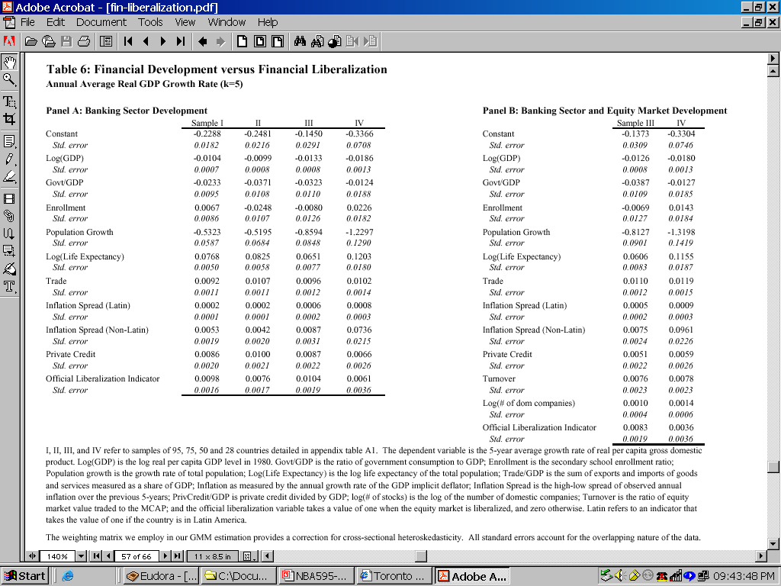

Slide 9
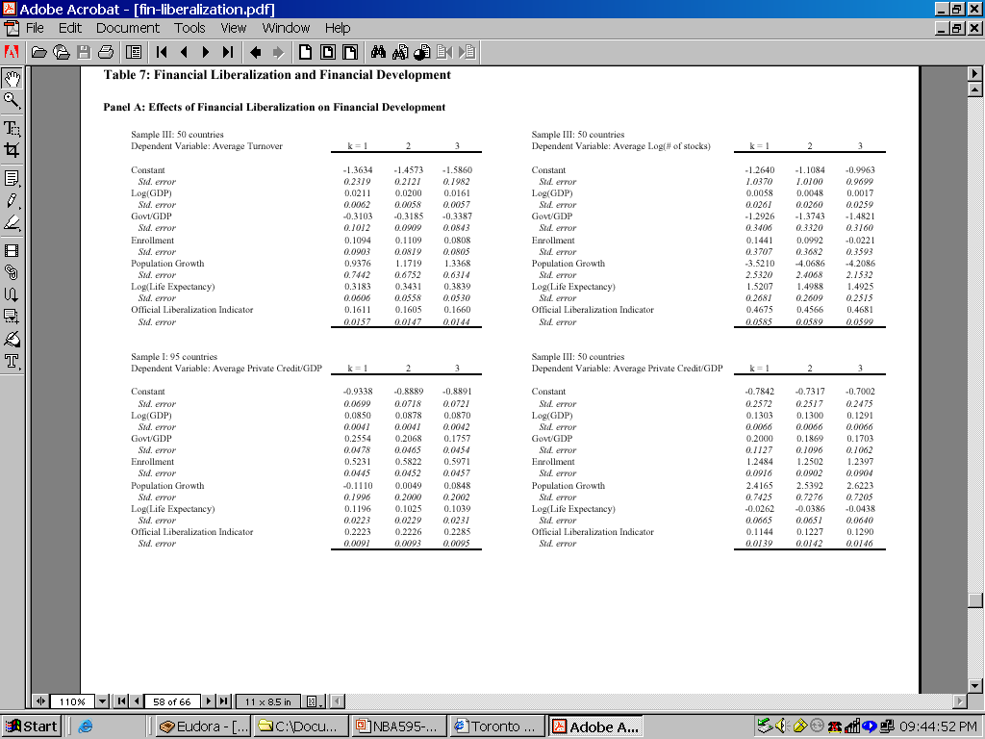

Slide 10
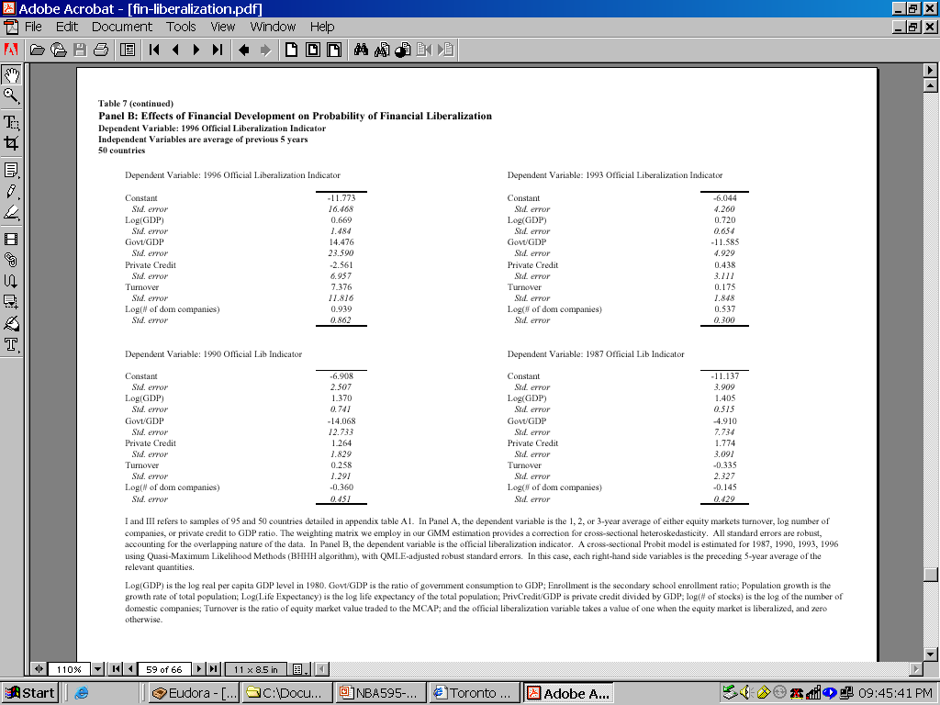

Slide 11
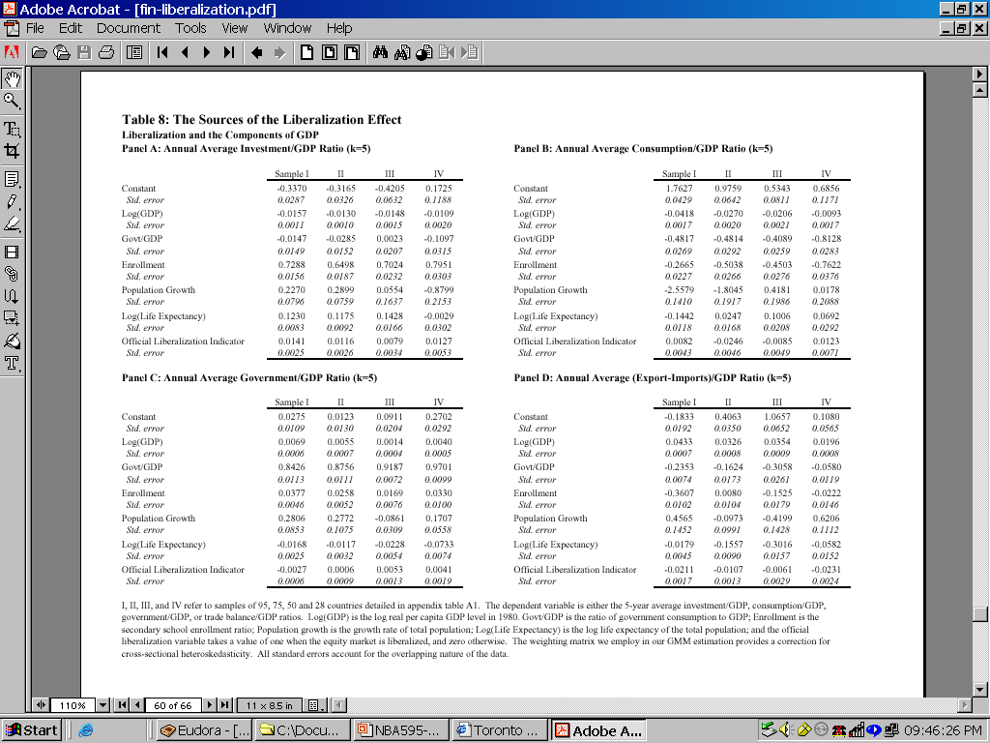

Slide 12
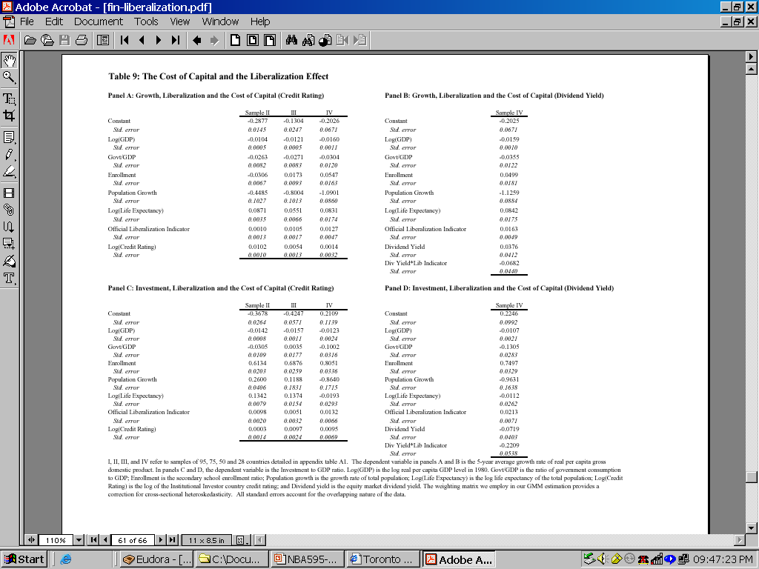

Slide 13
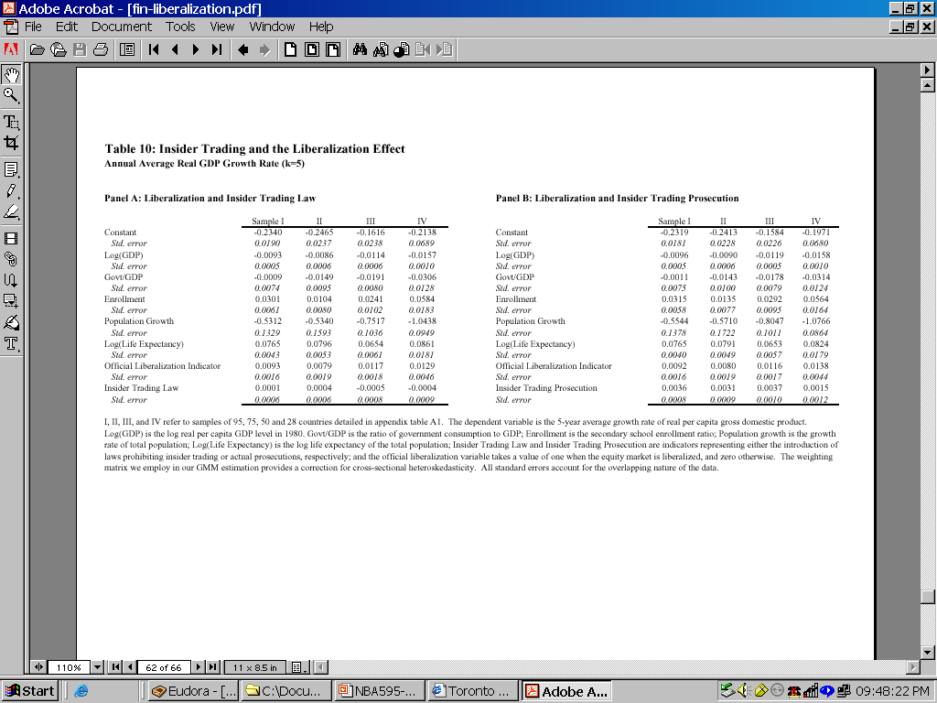

Slide 14
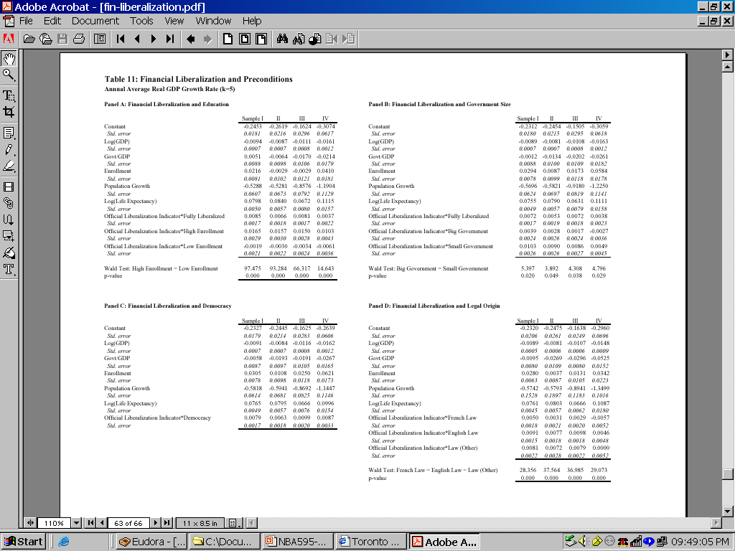

Slide 15
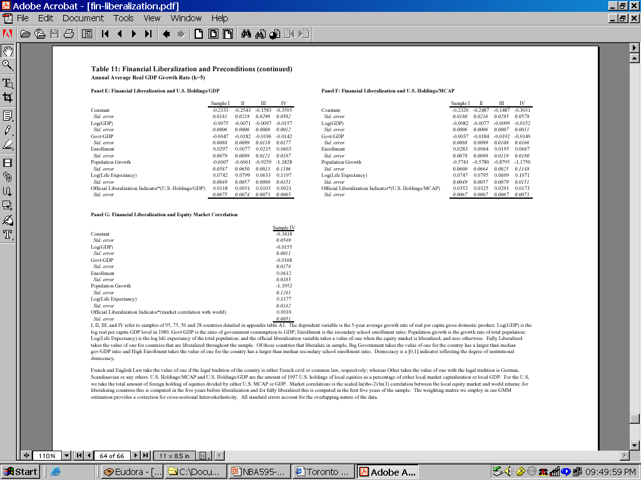

Slide 16
Findings
70% of FSL effect on growth takes place in the 5 years following FSL, and the effect is not permanent
FSL is associated with 0.83% to 1.13% of real per-capita GDP growth, although FSL also tends to lead to a widening current account deficit
When using insider-trading prosecution (enforcement), the results are significant and positive, and the FSL coefficient survives.
Foreign ownership is important to raise FSL benefit
FSL is not spuriously accounted for by macroeconomic reforms and does not reflect a business cycle effect.
Although FSL further fin development, measures of fin development fail to fully drive out the FSL effect
A large secondary SER, a small government sector, and Anglo saxon legal system enhance FSL effect

Slide 17
In Short……
On average, FSL led to a 1% increase in annual GDP growth rate
FSL raises I/Y through foreign capital inflows, and hence widens DCA
FSL does not reflect a business cycle effect
Effects of FSL are intensified after controlling for SER, size of government, and legal system

