Slide 1

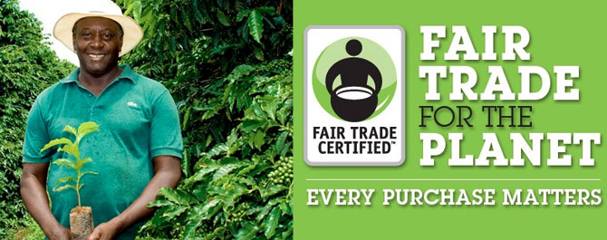

What is Fair trade ?
Not all trade is fair!
Farmers and workers at the beginning of the chain don’t always get a fair share of the benefits of trade. Fair trade enables consumers to put this right.
Products certified with International Fair trade Certification Mark
For example : Handicrafts, coffee , cocoa and etc …

Slide 2

Difference between fair trade and free trade
 | Fair trade | Free trade
Main goal | To empower marginalized people and improve the quality of their lives | To increase nations’ economic growth
Strategy | Balances concerns for people, environment, and profit | Aim on profit
Primarily benefits | Vulnerable farmers, artisans and workers in less industrialized countries | Multinational corporations, powerful business interests
Weakness | Interferes with free market, inefficient, too small-scale for impact | Punishing to marginalized people & the environment, sacrifices long-term relationships
Producer compensation determined | Technical assistance and training build broader skill set, and social premiums invest in social projects that benefit all residents. | Market & government policies
Supply chain | Includes fewer parties, more direct trade | Includes many parties between producer and consumer

Slide 3
Standard for fair trade organization
Standards for Small Producer Organizations
- Members must be small-scale producers
- Democracy
Standard for Hired Labor
- Management of the Fair trade Premium
- Freedom of association & collective bargaining
- Working conditions

Slide 4
Standard for fair trade organization
Standard for Contract Production
- The standard for small-scale producers who are not yet democratically organized
Trade standard
- the Fair trade Minimum Price
- the Fair trade Premium
- Partially pay in advance , when producers ask for it
- Sign contracts that allow for long-term planning

Slide 5
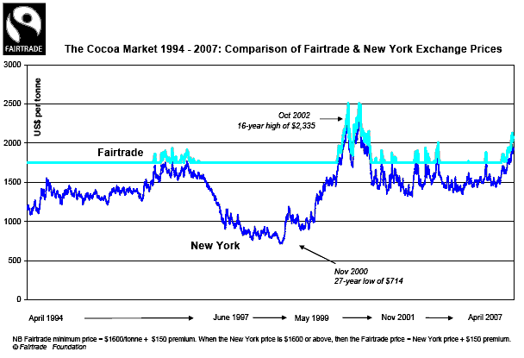
How to set price of fair trade products ?
The fair trade premium
The fair trade minimum price

Slide 6
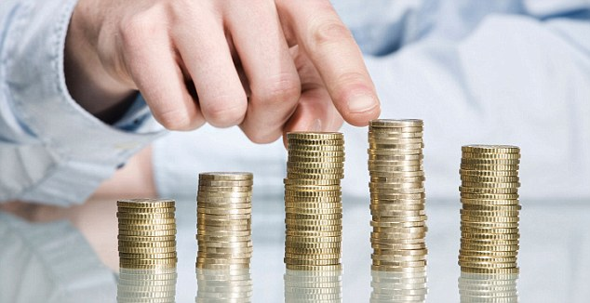
Advantages of fair trade
Price stability
The opportunity for small scale farmer
Decrease the disparity between producers and consumers
Better contribution of wealth

Slide 7
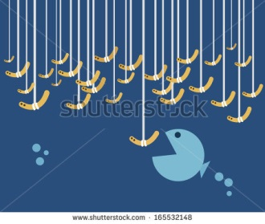
Disadvantage of fair trade
Excess supply
Doesn’t trade in finished good
Niche market

Slide 8
Fair trade in agriculture
ORGANIC AGRICULTURE + FAIR TRADE

Slide 9
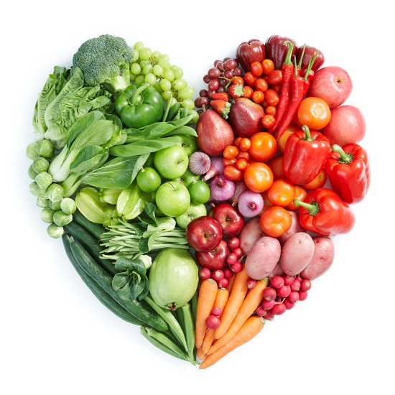



Organic agriculture
HEALTH
ECOLOGY
FAIRNESS
PRINCIPLE OF CARE

Slide 10
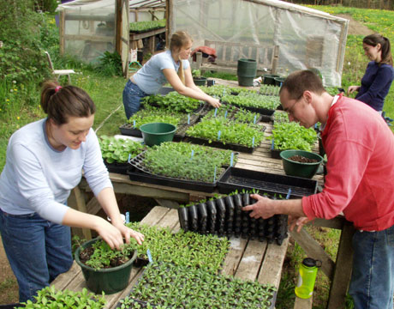

Why do the two concepts belong together?

Slide 11
Objective
To deal with Social Justice within agriculture.
- A defined part of the price (surplus) is paid for community tasks/social issues of the cooperative or farm workers community,
The trade relation should have a long term perspective,
Part of the price is paid in advance in order to make the producers independent from local credits (with exaggerated high interest rates).

Slide 12
Members of fair trade
Asia: WFTO-Asia
China, Cambodia, India, Indonesia, Thailand
Africa: COFTA
Cameroon, Egypt, Ethiopia, Israel, Kenya
Europe: WFTO-EUROPE
Austria, Belgium, France, Germany, Italy
Latin America: WFTO-LA
Paraguay
The Pacific-Rim: WFTO-PACIFIC
New Zealand, Australia, Japan, Canada, and USA

Slide 13
Success or not?
Fair trade Labeling Organizations International (FLO)
Increasing in demand
Relationship with Retail store

Slide 14
How about in Thailand ?
Some organizations have been involved in fair trade business for decades. However, we could define 3 streams of fair trade history in Thailand.

Slide 15
The first stream
- Started with religious organizations which were mostly related to Christian foundation from Europe such as Christian Service Foundation.
- In 1973 to export handicraft from the poor hill tribes in the Northern part of Thailand to European countries.

Slide 16
The second stream
- Some of the first generation became "independent" sprung out from the Christian groups and registered local Thai organizations themselves.
- Started to focus their mission to incorporate more local development agenda and kept the fair trade activities to provide services for marginalized producers.

Slide 17
The third stream
- Emerged from development civil groups, mostly Thai nationals, who saw the needs and opportunities of trading services as a way to sustain the producer groups and themselves .
- Most of them works with agricultural producers, producing food products.

Slide 18
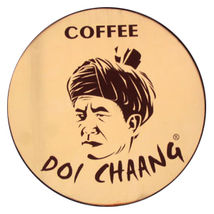

Examples of third stream in Thailand
GREEN NET
Doi Chaang Coffee
Organic Jasmine Rice Producers Group

Slide 19
DOI CHAANG COFFEE
After 20 years of cultivating and processing coffee, the farmers grew frustrated selling their high quality beans for minimal prices to coffee dealers. Their families decided it was time to directly offer the unique taste of their own premium, single-estate, organic Arabica coffee.
The villagers soon established themselves as independent, successful coffee producers, building their own processing plants, drying facilities, and storage warehouses.

Slide 20
Why Thailand should have fair trade?
39.6% of Thailand’s labor force is farmers.
Fair pay and working conditions for farmers and producers.
Better for the environment.
Supports communities.
Fair Trade is trade farmers can count on.

Slide 21
How can we become a fair trade?
Educate farmers and others.
Unify each sector of farmers into group.
Attend local Fair Trade events.
Government should support fair trade.

