Slide 1
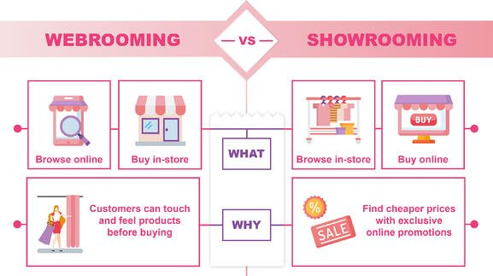
Group Assignment 3:
Showrooming vs. Webrooming

Slide 2
Group Assignment 3: Showrooming vs. Webrooming
Please refer the assignment to your group project category
What is showrooming and how does it apply to your retail industry/store?
What is webrooming and how does it apply to your retail industry/store?
What is the physical store (brick-and-mortar) shops current situation?
What is the future outlook and your suggestions to address this challenge?
Please create one page ppt. slide presentation to be due next Tuesday Feb.1st. Please design the one page by using photos, graphs, charts, visuals to make one page interesting ka.
Note: You can research more information and also use the 2 sources in the next 2 pages for your analysis.
Notes:
1

Slide 3
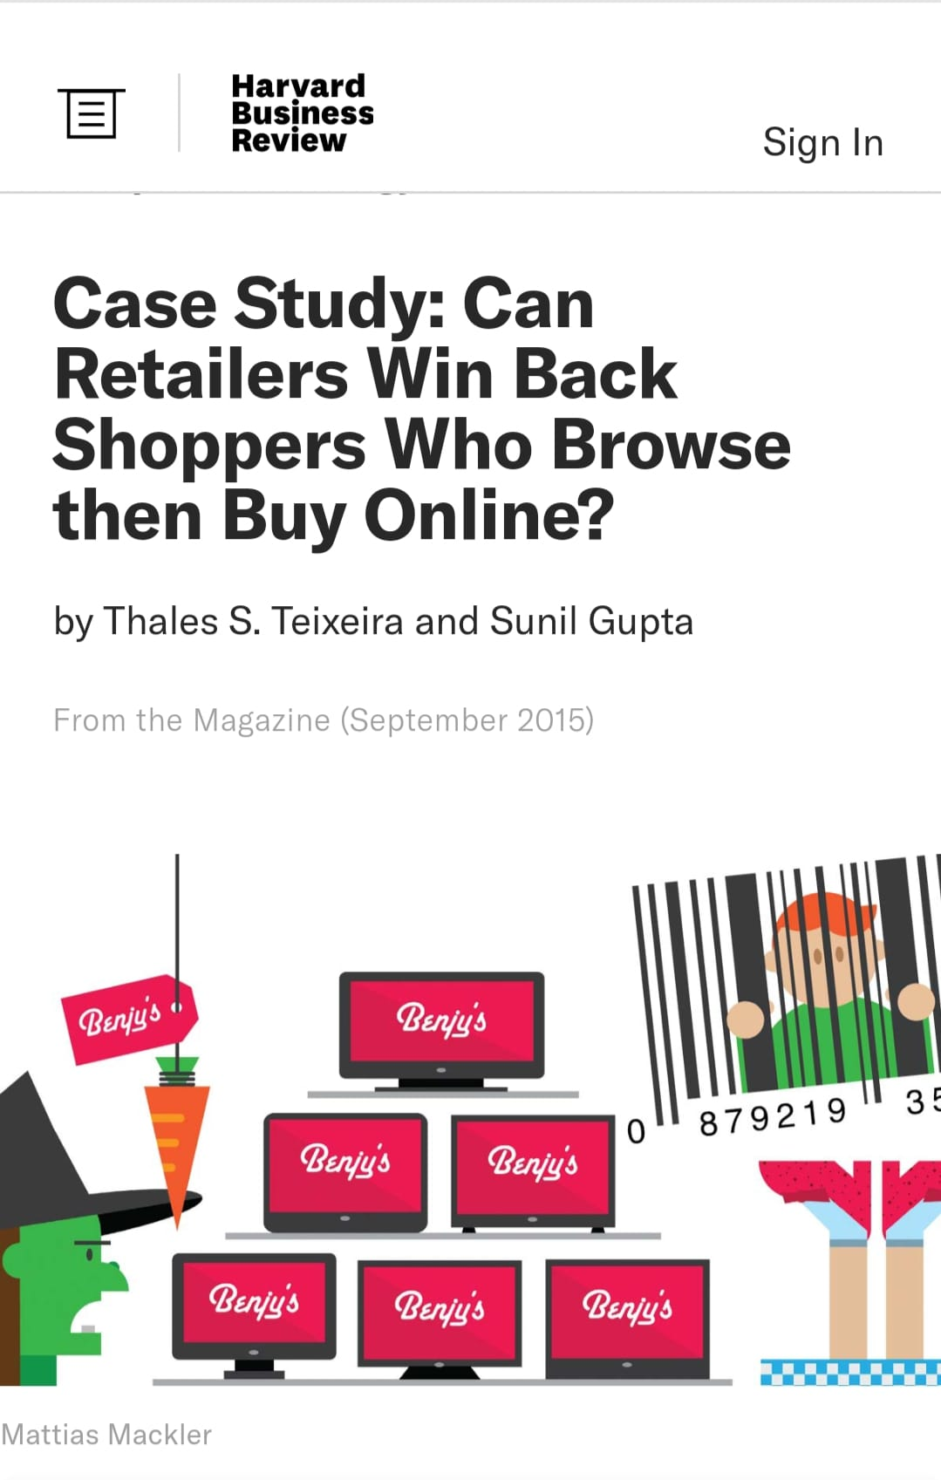
Case Study: Can Retailers Win Back Shoppers Who Browse then Buy Online? (hbr.org)

Slide 4



