Slide 1
FN 281: Personal Finance
Thanachote Rungsitivat, CFA, FRM

Slide 2
What Is a Mutual Fund?
Investment company that pools money from investors to buy stocks, bonds, and other investments. Investors own a share of the fund proportionate to the amount of the investment.

Slide 3
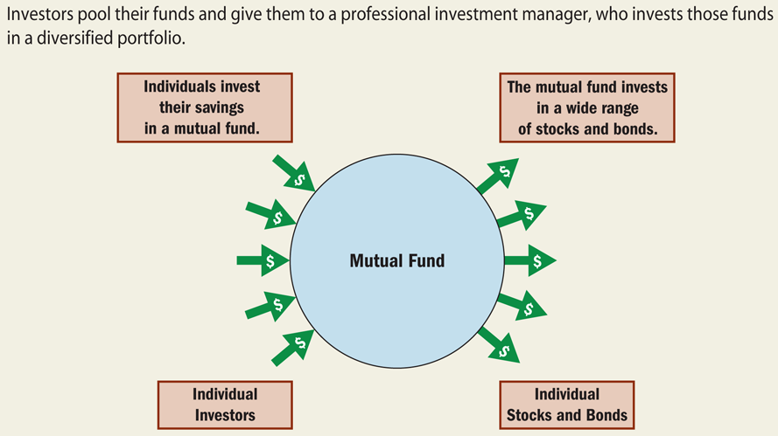
Why Invest in Mutual Funds?
Benefit the small investor – diversification and reduced risk.
Level the playing field between corporations and the individual investor.

Slide 4
Advantages of Mutual Fund Investing
Diversification -- owning numerous securities reduces risk
Professional management
Minimal transaction costs
Liquidity
Flexibility
Service
Avoidance of bad brokers

Slide 5
Disadvantages of Mutual Fund Investing
Lower-than-market performance
Costs
Risks -- Unsystematic risk
Risk -- Systematic risk
Capital gains taxes

Slide 6
To Operate, Mutual Funds
Pool money from investors with similar goals.
Invest in numerous securities.
Hire a management company to run the fund.

Slide 7
To Operate, Mutual Funds (cont’d)
Hire an investment advisor to manage the fund’s portfolio
Hire a
  a custodian to safeguard fund holdings
  a transfer agent to act as recordkeeper
  an underwriter to sell new shares

Slide 8
Ways of Making Money With Mutual Funds
Increases in market value (appreciation)
Dividends
Capital gains distribution

Slide 9
Types of Investment Companies
Open-end investment companies or mutual funds
Closed-end investment companies or mutual funds
Real estate investment trusts (REITs)

Slide 10
Open-End Investment Companies or Mutual Funds
Have an unlimited number of shares
Buy and sell shares directly to investors without a secondary market
Purchase and selling price is determined by the net asset value of the fund
NAV = value of all securities - liabilities total shares outstanding

Slide 11
Closed-End Investment Companies or Mutual Funds
Have a limited number of shares
Sell only the initial offering. Subsequent trades are done in a secondary market, similar to the common stock market.
Purchase and selling price is determined by supply and demand.

Slide 12
The Costs of Mutual Funds
Load funds-- sales commissions charged to the investor when purchasing fund shares.
Back-end load funds -- commissions charged to the investor when selling the shares
No-load funds -- no commission charged.

Slide 13
The Costs of Mutual Funds (cont’d)
Management fees and expenses -- fees associated with the operation of the company.
  expense ratio
  turnover rate
fees charged to cover the fund’s cost of advertising and marketing.

Slide 14
Types and Objectives of Mutual Funds
Money market mutual funds
Stock mutual funds
Balanced mutual funds
Asset allocation funds
Life-cycle funds
Bond funds

Slide 15
Money Market Mutual Funds (MMMFs)
Invest in short-term securities with maturities of less than 30 days
Work much like an interest bearing checking account with some limitations
Considered practically risk free

Slide 16
Stock Mutual Funds
Aggressive growth funds
Small-company growth funds
Growth funds
Growth-and-income funds
Sector funds
Index funds
International funds

Slide 17
Balanced Mutual Funds
Try to balance objectives of long-term growth, income, and stability of the capital invested
Invest in common stock, preferred stock, and bonds
Less volatile than stock funds

Slide 18
Asset Allocation Funds
Are similar to balanced mutual funds in the mix of securities
Practice market timing to attempt to outperform the market
Risky due to the turnover rate and associated transaction costs

Slide 19
Life-Cycle Funds
Are similar to asset allocation funds.
Tailor holdings to best meet the needs of investors in a certain stage of the life cycle, such as age or risk tolerance.

Slide 20
Bond Funds
A small investment buys shares in a diversified bond portfolio.
More liquid than individual bonds.
Provide professional management.
Provide regular income.

Slide 21
Bond Funds (cont’d)
Can incur more expenses than purchasing bonds directly.
Don’t mature to pay a guaranteed lump sum investment like individual bonds do.

Slide 22
Types of Bond Funds
Government bond funds
Corporate bond funds
Specialized maturity length (short-, intermediate-, and long-term) funds

Slide 23
ETFs or Exchange Traded Funds
Charge lower annual expenses but still pay trading commissions.
More tax-efficient than most mutual funds.
Allow investors to stake out an investment position in a sector, industry, or country.
Investors can make their move during the market’s trading hours.

Slide 24
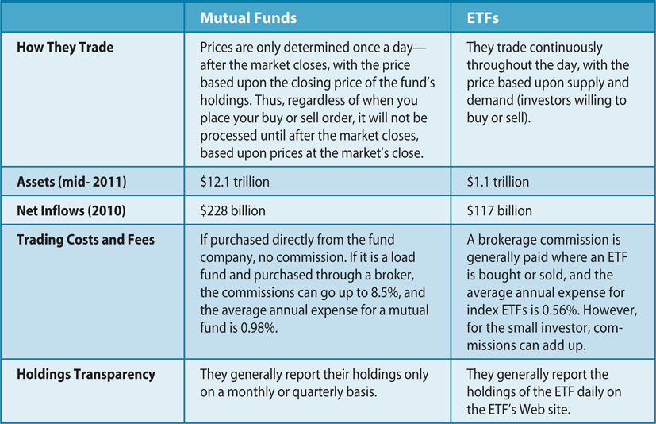
ETFs Versus Mutual Funds

Slide 25
Services Offered by Mutual Funds
Automatic investment and withdrawal plans
Automatic reinvestment of interest, dividends, and capital gains
Wiring and funds express options
Phone switching
Easy establishment of retirement plans
Check writing
Bookkeeping and help with taxes

Slide 26
Buying a Mutual Fund
Step 1: Determine your investment goals.
Step 2: Identify funds that meet your objectives.
Step 3: Evaluate the fund.

Slide 27
Step 1: Determine Your Investment Goals
Determine your time horizon for each goal
Determine your risk tolerance
Determine your personal investment preferences
Determine your tax planning strategies

Slide 28
Step 2: Identify Funds That Meet Your Objectives
Look to third-party publications
  Morningstar Mutual Funds
Determine the fund’s objective
Determine the fund’s investment style
  value
  growth
Read the prospectus

Slide 29
Information Contained in the Prospectus
The fund’s goal and investment strategy
The fund manager’s past experience
Any limitation on investments that the fund may have
Any tax considerations of importance to the investors

Slide 30
Information Contained in the Prospectus (cont’d)
The redemption and investment process for buying and selling shares in the fund
Services provided investors
Performance over the past 10 years or since the fund has been in existence
Fund fees and expenses
The fund’s annual turnover ratio

Slide 31
Step 3: Evaluate the Fund
Always compare funds with the same objective.
Evaluate the fund’s long-term performance.
Look at returns in both up and down markets.

Slide 32
Mutual Fund Quotes
NAV – net asset value (price)
NAV change – gain or loss from prior day’s NAV
Total return – NAV change plus accumulated income
Total return – NAV change plus income for different time periods, in percent.

Slide 33
Mutual Fund Quotes (cont’d)
Ranking – Performance comparison among funds with same objective for different time periods.
Max initial sales com – the largest allowable sales commission charged
Annual Exp – covers all expenses associated with running and advertising the fund

Slide 34
Calculating Fund Returns
Returns include distributions of dividends, distributions of capital gains, or NAV appreciation
Total return =
dividends + capital gains + (ending NAV – beginning NAV) beginning NAV

Slide 35
Calculating Fund Returns
With reinvestment of all distributions, total return includes the NAV share increase and the increased number of shares
Total return =
(No. of ending shares x ending price) –
(No. of beginning shares x beginning price)
(No. of beginning shares x beginning price)

Slide 36
Making the Purchase
Buy through a financial services broker, banker, planner
Buy directly from the mutual fund

Slide 37
The Situation
Brad has several friends that are investing in mutual funds. He has heard of mutual funds, but does not understand what they are and why so many people invest in them. Brad wants to understand more about mutual funds, and if they seem like a good investment, he wants to invest in them, too.

Slide 38
Characteristics of Mutual Funds
Brad learns that mutual funds can be classified as either closed – end mutual funds, exchange – traded funds, or open – end mutual funds. He learns that each of these types of mutual funds is traded in a different way and has different characteristics. He will investigate further and identify the differences between these different types of mutual funds.

Slide 39
Closed –End Funds
A closed-end fund is a fund whose shares are issued by an investment company only when the fund is first organized. After that the shares are traded among individuals on an organized stock exchange and in the over the counter market. Closed-end funds are actively managed by professional fund managers.
With these funds, there are only a certain number of shares available to investors. The chief difference between these funds and others is that the only way to withdraw from them is to sell the shares to another individual investor who is willing to purchase them. Investors cannot redeem the shares with the investment company that issued them. The shares of a closed-end fund have a market value that may be higher or lower than the value of the assets held by the mutual fund.

Slide 40
Exchange-Traded Funds
An exchange-traded fund is a mutual fund that invests in stocks contained in a specific stock or securities index, like the SET 50 stock index. The shares are traded on a securities exchange or in the over-the-counter market. These funds are passively managed funds.
Brad learns that closed-end funds and exchange-traded funds (ETFs) are very similar. The biggest difference is that ETFs are designed to mirror the performance of a particular index. This means that when the index moves up, the ETD should also move up and vice versa. Therefore, there is less need for a portfolio manager to make investment decisions. The passive management results in lower management fees. This is important since investors must pay commissions when the buy and sell shares.

Slide 41
Open-End Funds
An open-end fund is a mutual fund whose shares are issued and redeemed by the investment company at the request of investors. The number of shares in the mutual fund is constantly changing as investors either purchase more shares or redeem shares in the mutual fund from the investment company.
Brad learns that the most popular type of mutual fund is the open-end fund. All purchases and redemptions are handled by the investment company that operates the mutual fund.

Slide 42
Net Asset Value (NAV)
In order to understand mutual funds, it is important to understand the concept of net asset value. Brad learns that investors buy and sell open-end fund and is calculated at the end of each trading day. Investors who want to redeem their shares do so by contacting the investment company and the shares are redeemed at the day’s net asset value.
Suppose a mutual fund has 56,000,000 in assets, 4,000,000 in debt and 13,000,000 shares outstanding. Then the net asset value of this mutual fund is 4.00. If Brad owned 1,000 shares of this mutual fund today and wanted to redeem them, then he would get 4.00 x 1,000 or 4,000 from the investment company. The net asset value of the mutual fund changes daily as the value of the assets in the mutual fund change in value.

Slide 43
Fees on Mutual Funds
Management Fees – fees paid to investment companies that sponsor and manage a mutual fund
Distribution fee – an annual fee charged by some investment companies to defray the cost of distributing and marketing a mutual as well as commissions to brokers who sold the shares.
Expense Ratio – refers to all the different management fees, distribution fee, and additional fund operating costs for a specific mutual fund
As Brad continues to learn about mutual funds, he realizes that there can be several different fees charged by investment companies. All mutual funds have management fees. They are charged annually b the professional manager to compensate them for their work. In addition, distribution fees may be charged by some mutual funds. These fees are to cover the costs of sending out mailings and marketing the mutual fund to the general public. The expense ratio of a mutual fund gives an indication of the total fees charged by a particular mutual fund. Brad knows he needs to examine the expense ratio of any mutual fund that he is considering before he buys it.

Slide 44
Classification of Mutual Funds
Stock Funds – Mutual funds that invest in the stock of many companies
Bond Funds – Mutual funds that invest in the bonds of many companies or governments
Other Funds – Mutual funds that invest in moe than one type of asset.
As Brad has noted, the managers of mutual funds tailor their investment portfolios in order to achieve specific investment objectives, which can be found in a fund’s prospectus. The objective of the fund can often be determined from the name of the category that the mutual fund fits into. There are three main categories, within each category, there are many different mutual funds to choose from.

Slide 45
Family of Funds
A family of funds exists when one investment company manages a group of mutual funds. Each mutual fund within the family has a different financial objective.
Brad learns that he does not have to completely make up his mind about what mutual fund he wants to invest in, because many investment companies have family of funds. Brad can move his funds from one fund to another in the same family at little or no cost. This way if Brad changes his mind, or his needs change, he can change funds without having to change the investment companies. Brad is beginning to think that mutual funds look very attractive.

Slide 46
The Mechanics of a Mutual Fund Transaction
Return on Investment
  Income dividends
  Capital gains distributions
Taxes and Mutual Funds
Purchase Options
Withdrawal Options
It is interesting for Brad to find out how investors in mutual funds receive a return on their investments. Shareholders in mutual funds can receive a return through income dividends (which are the earnings a fund pays to shareholders from its dividend and interest income) or through capital gain distributions (which are the payments made to fund’s shareholders that result from the profits from the sale of securities in the fund’s portfolio). In addition, a shareholder makes money when the shareholder sells shares in the mutual fund at a higher price than the price paid. All of these transactions could be subject to taxes.

Slide 47
Withdrawal Options
Can redeem shares with investment company at any time at net asset value
Can withdraw a specified, fixed dollar amount each investment period (usually 3 months)
Can sell off or liquidate a certain number of shares each investment period.
Can withdraw a fixed percentage of asset growth
Can withdraw all asset growth that results from dividends and capital gain distributions earned by the fund during an investment period.
Brad learns that there are several options he can use to withdraw funds from his mutual fund. After learning all about mutual funds, Brad decides that these funds might be a good investment option. He decides to explore mutual funds more fully, so that he can find a mutual fund that fits his investment goals. He is going to do some more research on specific mutual funds to find one that suits him.

Slide 48
Mutual Fund Prospectus
Brad learns that all mutual funds must give potential investors a prospectus. The prospectus contains much information about the fund. One thing that is contained in the prospectus is a summary of the fund’s objective. The objective describes the types of securities the fund invests in and why they are investing in those assets. It also contains detailed financial information about the fund’s assets and liabilities.

Slide 49
Mutual Fund Prospectus
Statement describing the risk factors associated with the fund
Description of fund’s past performance
Statement describing the type of investments contained in the fund’s portfolio
Information about dividends, distributions, and taxes
Information about the fund’s management
Information on limitation or requirements the fund must honor when choosing investments
Process for investors to buy or sell shares in the fund
Description of services provided to investors and fees for services, if any
Information about how the fund’s portfolio changes.

Slide 50
Prospectus
Fixed Income Fund
Trigger Fund
Equity Fund
Infrastructure Funds

Slide 51
Prospectus – Fixed Income Fund
http://www.uobamth.co.th/th/upload/fund/mbook-5.pdf

Slide 52
Prospectus – Equity Trigger Fund
http://www.krungsriasset.com/EN/pdf/KFEQ5P5-1_factsheet_EN.pdf

Slide 53
IPO documents – Infrastructure Fund
BTSGIF
http://btsgif.listedcompany.com/misc/Prospectus/20130626-BTSGIF-Prospectus-EN.pdf

Slide 54
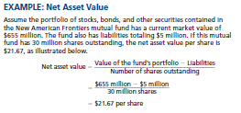
Appendix

Slide 55
Thank you

