Slide 1
Topic 10
Development Across Lifespan

Slide 2
Developmental Psychology
The study of progressive changes in behavior and abilities from conception to death.

Slide 3
Nature and Nurture
Reaction Range
Reaction Range: The limits environment places on the effects of heredity.

Slide 4
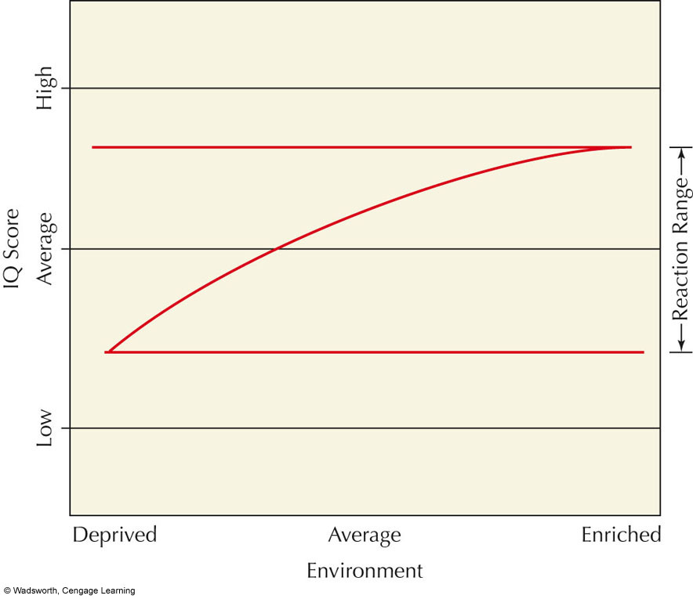
Notes:
FIGURE 3.5 The effect of heredity on the development of human traits,
such as intelligence, can often influenced by environmental circumstances. A
child with average genes for intelligence growing up in an average environment might have an average IQ score as an adult. However, growing up in a deprived environment might result in a somewhat lower IQ score and growing up in an enriched environment might result in a somewhat higher IQ score. In this way, the environment sets a range within which our hereditary potential is actually expressed. This range is called the reaction range.

Slide 5
Nature and Nurture
Reaction Range (cont.)
The Whole Person
The person’s development is determined by three factors: heredity, environment, and the person’s behavior.

Slide 6
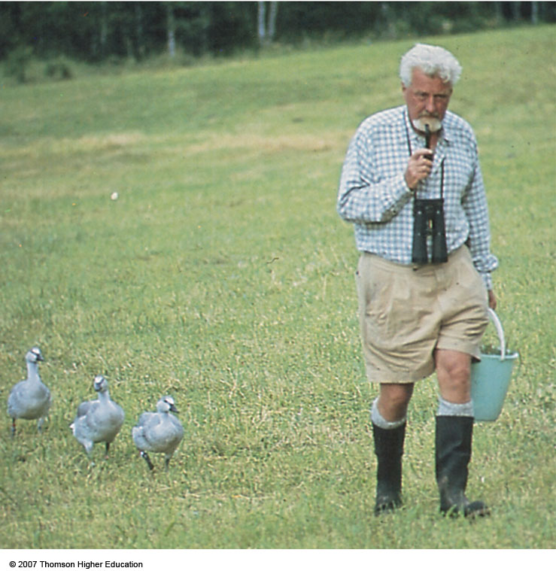
Imprinting (Lorenz)
p. 96
Notes:
“Mother” Lorenz leads his charges. The goslings have imprinted on Lorenz because he was the first moving object they saw after they hatched.

Slide 7
Nature and Nurture
Environment (cont.)
Sensitive Period
Sensitive Periods: A period of increased sensitivity to environmental influences; also, a time when certain events must occur for normal development to take place e.g. language development, attachment.

Slide 8
Nature and Nurture
Reaction Range (cont.)
The whole Peron (cont.)
New Born Temperament
Easy Children: 40 %; relaxed and agreeable
Difficult Children: 10 %; moody, intense, easily angered
Slow-to-Warm-Up Children: 15 %; restrained, unexpressive, shy
Remaining Children: Do not fit into any specific category

Slide 9
Social Development
Social Development: Development of self-awareness, attachment to parents or caregivers, and relationships with other children and adults

Slide 10
Social Development (cont.)
Attachment
Emotional Attachment:
Close emotional bond that infants form with their parents, caregivers, or others.
  Separation Anxiety
Crying and signs of fear when a child is left alone or is with a stranger; generally appears around 8-12 months.

Slide 11
Social Development
Attachment (cont.)
Attachment Quality (Mary Ainsworth)
  Secure: Stable and positive emotional bond
  Insecure-Avoidant: Tendency to avoid reunion with parent or caregiver; anxious or emotional bond

Slide 12
Social Development
Attachment (cont.)
  Quality of Attachment (Mary Ainsworth)
  Insecure-Ambivalent: Desire to be with parent or caregiver and some resistance to being reunited; also anxious emotional bond

Slide 13
Parental Influences
Parenting Styles (Baumrind-1991, 2005)
1.Authoritarian Parents: Enforce rigid rules and demand strict obedience to authority; children tend to be emotionally stiff and lacking in curiosity.
2.Overly Permissive: Give little guidance, allow too much freedom, or don’t hold children accountable for their actions; children tend to be dependent and immature and frequently misbehave

Slide 14
Parental Influences
Parenting Styles (cont.)
3.Authoritative: Provide firm and consistent guidance combined with love and affection; children tend to be competent, self-controlled, independent, and assertive

Slide 15
Language Development
Single-Word Stage:
  The child says one word at a time; 1 year –mama, dada
Telegraphic Speech:
  Two word sentences that communicate a single idea (e.g., “Want yogurt”) ; 18 – 24 months.

Slide 16
Cognitive Development : Think Like a Child
Piaget’s Theory of Cognitive Development
Piaget believed that all children pass through a set series of stages during their cognitive development.

Slide 17
Cognitive Development : Think Like a Child
Piaget’s Theory of Cognitive Development (Cont.)
1.Sensorimotor (0-2 Years): All sensory input and motor responses are coordinated; most intellectual development here is nonverbal
  Object Permanence: After 8 months old, children know that objects still exist when they are out of sight.

Slide 18
Cognitive Development : Think Like a Child
Piaget’s Theory of Cognitive Development (Cont.)
2.Preoperational Stage (2-7 Years): Children begin to use language and think symbolically, BUT their thinking is still intuitive and egocentric.

Slide 19
Cognitive Development : Think Like a Child
Piaget’s Theory of Cognitive Development (Cont.)
3.Concrete Operational Stage (7-11Years)
Children become able to use concepts of time, space, volume, and number BUT in ways that remain simplified and concrete, not abstract

Slide 20
Cognitive Development : Think Like a Child
Piaget’s Theory of Cognitive Development (Cont.)
  3.Concrete Operational Stage (Cont.)
  Reversibility of Thought: Relationships involving equality or identity can be reversed.
Conservation: Mass, weight, and volume remain unchanged when the shape or appearance of objects changes.

Slide 21
Cognitive Development : Think Like a Child
Piaget’s Theory of Cognitive Development (Cont.)
4.Formal Operations Stage (11 Years and Up)
Thinking now includes abstract, theoretical, and hypothetical ideas

Slide 22
Cognitive Development : Think Like a Child
Lev Vygotsky’s Sociocultural Theory
Children’s cognitive development is heavily influenced by social and cultural factors.
A child’s thinking develops through dialogues with more capable persons.

Slide 23
Cognitive Development : Think Like a Child
Lev Vygotsky’s Sociocultural Theory (Cont.)
Zone of Proximal Development
Range of tasks a child cannot master alone even though they are close to having the necessary mental skills; they need guidance from a skilled partner in order to complete the task.

Slide 24
Cognitive Development : Think Like a Child
Lev Vygotsky’s Sociocultural Theory (Cont.) Scaffolding
Framework or temporary support. Adults help children learn how to think by scaffolding, or supporting, their attempts to solve a problem or to discover principles
  Scaffolding must be responsive to a child’s needs

Slide 25
Adolescence and Young Adulthood Lawrence Kohlberg and Moral Development
Moral Development: When we acquire values, beliefs, and thinking abilities that guide responsible behavior
Stage theorist, like Freud and Erikson

Slide 26
Moral Development(cont.)
Basic Stages of Moral Development
Level 1: Pre-conventional Morality
Stage 1: Obedient and Punishment Orientation
Stage 2: Reward Orientation

Slide 27
Moral Development
Basic Stages of Moral Development (Cont.)
Level 2: Conventional Morality
Stage 3: “Good Boy” Morality
Stage 4: “Right” is what society defines as right. (conform to rules and laws)

Slide 28
Moral Development
Basic Stages of Moral Development (Cont.)
Level 3: Post-Conventional Morality
Stage 5: Individual Right, Self respect
Stage 6: Individual Principles & Conscience

Slide 29
Erik Erikson’s Eight Stages of Psychosocial Dilemmas

Slide 30
Stage One: Trust versus
Mistrust (Birth-1)
Trust: Established when babies given adequate warmth, touch, love, and physical care
  Mistrust: Caused by inadequate or unpredictable care and by cold, indifferent, and rejecting parents

Slide 31
Stage Two: Autonomy versus Shame and Doubt (1-3)
Autonomy: Doing things for themselves
Overprotective parents may cause children to doubt abilities and feel shameful about their actions

Slide 32
Stage Three: Initiative versus Guilt (3-5)
Initiative: Parents reinforce via giving children freedom to play, use imagination, and ask questions
Guilt: May occur if parents criticize, prevent play, or discourage a child’s questions

Slide 33
Stage Four: Industry versus Inferiority (6-12)
Industry: Occurs when child is praised for productive activities
Inferiority: Occurs if child’s efforts are regarded as messy or inadequate

Slide 34
Stage Five (Adolescence): Identity versus Role Confusion
Identity: For adolescents; problems answering, “Who am I?”
Role Confusion: Occurs when adolescents are unsure of where they are going and who they are

Slide 35
Stage Six (Young Adulthood): Intimacy versus Isolation
Intimacy: Ability to care about others and to share experiences with them
Isolation: Feeling alone and uncared for in life

Slide 36
Stage Seven (Middle Adulthood): Generativity versus Stagnation
Generativity: Interest in guiding the next generation
Stagnation: When one is only concerned with one’s own needs and comforts

Slide 37
Stage Eight (Late Adulthood): Integrity versus Despair
Integrity: Self-respect; developed when people have lived richly and responsibly
Despair: Occurs when previous life events are viewed with regret; experiences heartache and remorse

Slide 38
Death and Dying
Reaction to Impending Death
Kubler-Ross was a thanatologist: One who studies emotional and behavioral reactions to death and dying

Slide 39
Death and Dying
Reaction to Impending Death (Cont.)
1.Denial and Isolation: Denying death’s reality and isolating oneself from information confirming that death will occur: “It’s a mistake; the doctors are wrong.”
2. Anger: Asking “Why me?” Anger may then be projected onto the living.

Slide 40
Death and Dying
Reaction to Impending Death (Cont.)
3.Bargaining: Terminally ill will bargain with God or with themselves: “If I can live longer I’ll be a better person.”
4.Depression: Feelings of futility, exhaustion, and deep sadness
5.Acceptance: If death is not sudden, many will accept death calmly: person is at peace finally with the concept of death.

Slide 41
Reading Assignment
Psychology in Action: Effective Parenting – Always kiss Your Children Goodnight pp. 105 – 107.

