Slide 1
Summary on Property Rights
Property right or ownership is a bundle of rights entitling the owner to utilise a particular resource + duties to perform on that resource too (use + maintain, for example)
Private Property must be:
  Excludable – ex ante: incentive for investing; ex post: incentive for maintaining
  Rival – ex ante: incentive for acquiring new property; ex post: efficient consumption/utilisation

Slide 2
Summary on Property Rights
Property right is essential for efficient solution on the disputable use of resource (necessary condition)
  It acts as a basis for negotiation
  Disputing parties know what they have and what they are fighting for
Under some circumstances (described by Coase), just assigning and enforcing property rights would allow disputing parties to settle for the most economically efficient solution
  Well-defined and well-enforced property right

Slide 3
Summary on Property Rights
However, the circumstance that Coase mentioned is a ‘sufficient condition’ – a low transaction cost between disputing parties
Court/fiat ruling does not matter if both necessary and sufficient conditions are valid
Court ruling does matter if anyone of both conditions is invalid → inefficient outcome
  No property right has been defined
  High transaction cost between disputing parties
Ruling can alter the outcome (may not be efficient but can improve from the inefficient one)

Slide 4
Summary on Property Rights
When the property right has not been defined, it could possibly be:
  The law does not recognise it yet (e.g., just been discovered) OR
  It is not the private property
    Non-rival
    Non-excludable
    Both = public good
Legal ruling is important
  Defining
  Inventing new legal rules
    Including assign the right to the state/government for public goods

Slide 5
Summary on Property Rights
Providing the Coase theorem is held
Economically efficient outcome from negotiation
It is noted that some outcomes are different from the court verdict
  Private agreement
  Both are better off
  Both want that agreement to be enforced
  How can they be ascertained?
    Ex post opportunism/Moral hazard – behaving strategically to take advantage of the other.
    Ex ante opportunism/Adverse selection – selecting inefficient outcome

Slide 6
Origin of Contract Law
When private parties agreed on something, they want their agreement to be enforced
There is a chance that one party may cheat and the whole agreement collapse
Contract = legal recognition of private agreement
Private parties are using the state-provided judicial power to enforce their agreement.

Slide 7
Contract and Autonomy of Will
Private agreement must be economically efficient (according to Coase)
Both must be better off
Providing that both parties have acted according to their will (preference)
The agreement shall be exercised
Principle of Contract
  Pacta sunt servanda

Slide 8
Economics of Contract Law
What is the contract?
Formation of contract
Enforcement of contract
Breach of Contract
  Efficient breach
Compensation for breach of contract
Economic role of contract
Incomplete contract

Slide 9
Recognition of Private Agreement
CCC, Section 151 “An act is not void on account of its differing from a provision of any law if such law does not relate to public order or good morals.”

Slide 10
Definition of Contract
Bilateral/multilateral juristic act
Intention to be legally bound (legal binding)
“A meeting of the minds of two (or more) parties” – consensus ad idem

Slide 11
Juristic Act
Action/Expression
Lawful
Voluntary (autonomy of will or liberty of individual)
Requires legal recognition
Has an impact on ‘right’ (at least of the one who expressed that action)
  Illegal or impossible purposes are not recognised
  Action against public order or good moral

Slide 12
Invitation to a party
Juristic Acts
Will/Bequest
Contract
Taking a bus
Declaration of Intention (Willenserklarung)

Slide 13
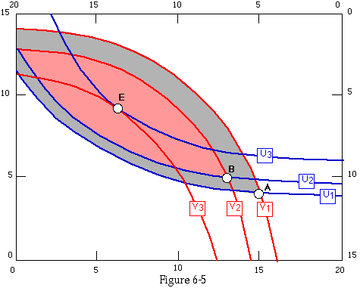

Slide 14
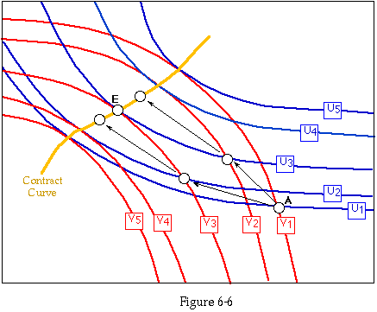

Slide 15
Formation of Contract
Contracting parties
  Capacity
  Duress or undue influence
Components of the contract
  Offer
  Acceptance
  Consideration
  Formalities

Slide 16
Offer
A statement of willingness to contract on specified terms made with intention that, if accepted, it shall become a (legally) binding contract
  Willingness
  Specified Terms
  Intention for being legally bound
Offer must be made to someone
Offer can be expired

Slide 17
Acceptance
Acceptance is not a counter-offer
Acceptance must be
  an unconditional assent to all terms of the offer
  § 366 “So long as the parties have not agreed upon all points of a contract upon which, according to the declaration of even one party, agreement is essential, the contract is, in case of doubt, not concluded. An understanding concerning particular points is not binding, even if they have been noted down…”
  Communicated from the offeree to the offerer
With intention of accepting

Slide 18
Consideration
Common Law only
A thing that a “promisee” gives to a “promisor” to induce a promise
All contract must benefit both parties
Offerer
offer
Offeree
acceptance
consideration

Slide 19
Formalities
Written Proof
Written Form
Written Form + Registration

Slide 20
Void vs Voidable
Void: invalid from the beginning = never exist = never recognised by law
Voidable: valid as long as no one invalidates it
Causes for refusal of contract
  Non est factum
  Impossibility
  Mistake
    Mistake of identity
    Mistake of properties
  Misrepresentation

