Slide 1
Psychology
Modules for Active Learning
11th ed. (2009)
Dennis Coon and John Mitterer

Slide 2
Chapter 1
Introducing Psychology and Research Methods

Slide 3
What is psychology?
Psyche = mind
Logos = knowledge or study

Slide 4
Definition
Psychology is a scientific study of behavior and mental processes
Behavior (overt behavior) can be directly observed.
Mental process (covert behavior) can not be directly observed.

Slide 5
What are the goals of psychology?
1. Describing behavior
2. Understanding the causes of behavior
3. Predicting behavior
4. Controlling behavior / Influencing behavior

Slide 6
History of Psychology
1.Wilhelm Wundt and Structuralism
“Father” of Psychology
  1879: Set up first lab to study conscious experience

Slide 7
History of Psychology
  - Introspection: Looking inward (i.e., examining and reporting your thoughts, feelings, etc.)
  Wundt’s ideas brought to the U.S. by Tichener and renamed Structuralism

Slide 8
History of Psychology
2. William James and Functionalism
  How the mind functions to adapt to our environment

Slide 9
History of Psychology
3. Behaviorism: Watson and Skinner
  Psychology must study observable behavior objectively

Slide 10
History of Psychology
4. Cognitive: Study thoughts, memory, expectations, perceptions, and other mental processes.

Slide 11
History of Psychology
5. Psychoanalytic: Freud
  Our behavior is largely influenced by our unconscious wishes, thoughts, and desires, especially sex and aggression.

Slide 12
History of Psychology
Freud performed dream analysis.

Slide 13
History of Psychology
6. Gestalt Psychology: “The whole is greater than the sum of its parts.”

Slide 14
History of Psychology
7. Humanism: Rogers and Maslow
  Goal of psychology is to study unique aspects of the person.

Slide 15
History of Psychology: Humanism
Each person has innate goodness and is able to make free choices

Slide 16
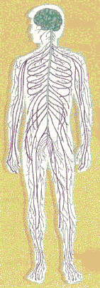
The Subfields of Psychology
1. Experimental psychology
    Methodological study of sensing, perceiving, learning and thinking
  2. Cognitive psychology
    Emphasis on higher mental processes

Slide 17
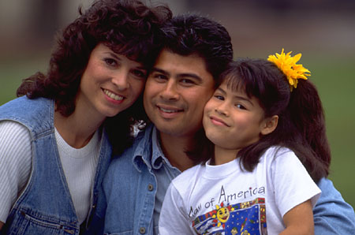
The Subfields of Psychology
  3.Developmental psychology
    Changes in behavior over the life span

Slide 18
The Subfields of Psychology
4.Personality psychology
Examines consistencies in people’s behavior over time and traits that differentiate us from one another

Slide 19
The Subfields of Psychology
  5.Health psychology
    Explores relationship between psychological factors and physical ailments or disease

Slide 20
The Subfields of Psychology
  6. Clinical psychology
    Study, diagnosis and treatment of psychological disorders

Slide 21
The Subfields of Psychology
7. Counseling Psychology focuses primarily on educational, social and career adjustment

Slide 22
The Subfields of Psychology
8. Industrial and Organizational Psychology is concerned with the psychology of workplace.

Slide 23

The Subfields of Psychology
  9. Social psychology
    Studies how people are affected by others
Notes:
Social psychology examines how people’s thoughts, feelings, and actions are affected by others. It is helpful to differentiate between this area and the field of sociology which examines social behavior.
Chapter 1 identifies child-rearing and perceptions of academic success as being examples of cross cultural psychology. This may also be applied to intelligence, psychotherapy, and family.

Slide 24
The Subfields of Psychology
10.Cross-cultural psychology
    Focuses on the similarities and differences in psychological functioning across cultures and ethnic groups
Notes:
Social psychology examines how people’s thoughts, feelings, and actions are affected by others. It is helpful to differentiate between this area and the field of sociology which examines social behavior.
Chapter 1 identifies child-rearing and perceptions of academic success as being examples of cross cultural psychology. This may also be applied to intelligence, psychotherapy, and family.

Slide 25
The Subfields of Psychology
  11. Clinical neuropsychology
    Focuses on relationships between biological factors and psychological disorders
Notes:
While discussing the advent of clinical neuropsychology, it is noteworthy to examine the risks and benefits for clinical psychologist to prescribe medication. Proponents view psychologist as being ideal “gate keepers” for the use of medication while others feel prescription privileges would compromise “talk therapy”
Evolutionary psychology examines the impact of our genetic heritage upon our behavior, it is helpful to mention the notion of depression, alcoholism, schizophrenia, etc. as having a strong genetic component
As a means to wrap up the diversity of the field, chapter 1 provides information concerning the demographics for the variety of settings in which psychologist work. Such positions as Clinical Psychologist in hospitals, clinics, and private practice as well as educators, researchers, industrial organizational, and school psychologist just to name a few.

Slide 26
More Helping Professionals
Psychiatrists: M.D.; usually use medications to treat problems; generally do not have extensive training in providing “talk” therapy
Psychoanalysts: Receive additional training post-Ph.D. or M.D. at an institute for psychoanalysis

Slide 27
It uses the systematic methods of science to gather information.
Why is psychology a science?

Slide 28
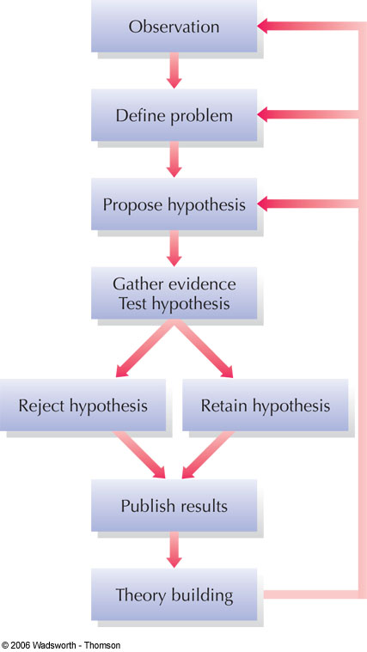
The Scientific Method
Figure 1.5
Notes:
Figure 1.5 Psychologists use the logic of science to answer questions about behavior. Specific hypotheses can be tested in a variety of ways, including naturalistic observation, correlational studies, controlled experiments, clinical studies, and the survey method. Psychologists revise their theories to reflect the evidence they gather. New or revised theories then lead to new observations, problems, and hypotheses.

Slide 29
Conducting Psychological Research

Slide 30
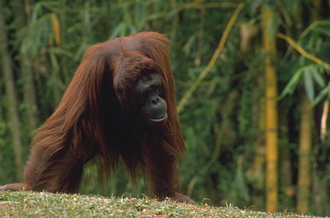
Research Methods
2.Naturalistic observation
  Observation of naturally occurring behavior without intervention
1.Archival
research
  - Use of existing data in order to test a hypothesis
Notes:
Chapter 2 provides the example of using college records in order to determine if there are gender differences in academic performance
Although archival research is relatively inexpensive, it does present its problems: the data may not be in a form that allows the researcher to test a hypothesis fully, the information may be incomplete, and the records needed may not exist
Naturalistic observation provides an opportunity to observe natural behavior without intervention. Observer effect – the experimenter inadvertently being seen by the observed thereby influencing their behavior, and observer bias – tendency for an experimenter to be sensitive to supporting data are two shortcomings to overcome

Slide 31
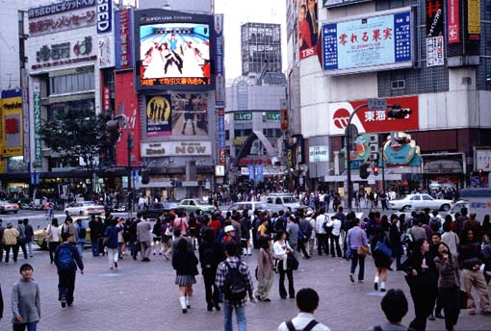
Research Methods
3.Survey research
  A sample of people are asked a series of questions about their behavior, thoughts, and attitudes in order to represent a larger population.
Notes:
As pointed out in the chapter, a sample of people is drawn from a population of interest. The methods of choosing the sample is critical in order to fairly represent the population as a whole. Problems occur when you have an insufficient number and/or a self-selection bias
Attrition and specificity of the questions are also major concerns in a survey

Slide 32
Research Methods
4. Case study
  An in-depth, intensive investigation of an individual or small group of people
Notes:
The book “Sybil” is a prime example of a case study.
Case studies are beneficial in clinical psychology and often times include psychological testing. They are also helpful in the area of physiological psychology

Slide 33
Research Methods
5.Correlational research
  The relationship between two sets of variables is examined to determine whether they are associated, or “correlated”
Notes:
Variables are any behavior that can “vary”. It is helpful to have students brainstorm how many behaviors fit this definition
Correlational studies are helpful to identify variables that have some “co-relationship” but do not give any insights to cause effect relationships
TV and aggression, studying and academic performance are helpful examples of positive correlation. Self-esteem and depression is a good example of negative correlation

Slide 34
6. Experimental Research
A study in which the investigator manipulates at least one variable (independent variable) while measuring at least one other variable (dependent variable)

Slide 35
Name the independent and dependent variable
Hypothesis
People study better while listening to music

Slide 36
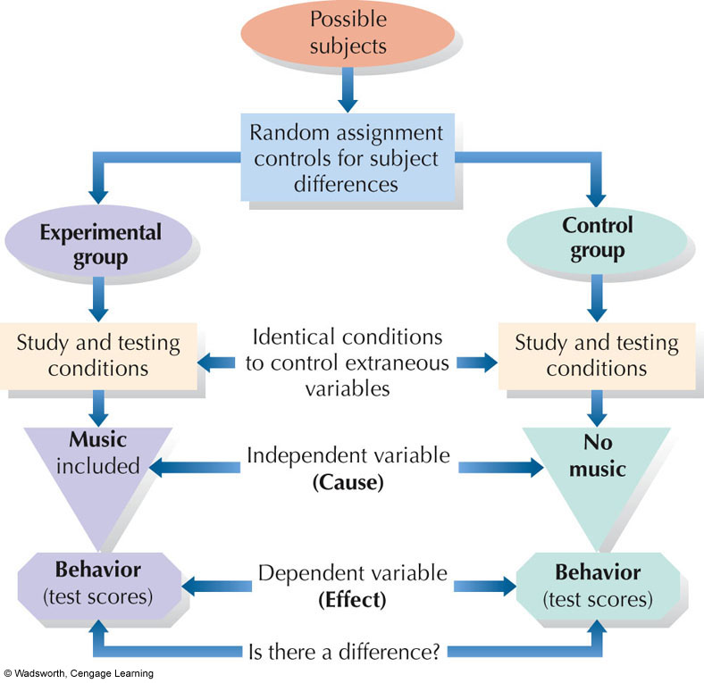
Notes:
FIGURE 1.6 Elements of a simple psychological experiment to assess the
effects of music during study on test scores

Slide 37
Important terminologies
1. Experimental group
The set of individuals who receive the treatment that the experiment designed to test.

Slide 38
2. Control Group
The set of individuals who are treated in the same way as the experimental group except for the procedure that the experiment is designed to test.

Slide 39
3. Confounding Variable
A variable that has an effect on the outcome (dependent variable), but it is not an independent variable e.g. temperature, time of the day, personality.

Slide 40
4. Random Assignment
A selection method in which the experimenter assigns subjects to either the experimental group or control group using a procedure based on chance.

Slide 41
5. Experimental bias
  Factors that distort how the independent variable affects the dependent variable in an experiment
    Experimenter expectations
    Participant expectations
Notes:
The unconscious tendency for researchers to be sensitive to their expectations during the course of research is offset by methods minimize bias – operational definitions, procedures, and formulating your hypothesis prior to the research
A discussion of the placebo effect is aided by the examination of medication research – Physicians Desk Reference that use placebos in a “placebo control group” and examine reported side effects and benefits by subjects

Slide 42
Methods to help counteract bias
1. Using blind observer who record data without knowing what the researcher is studying.

Slide 43
2. Using placebo
A placebo is a pill or other sham treatment that makes it very difficult for the subjects (single - blind) or the subjects and the experimenter (double- blind) to know who has received the treatment and who has not.

Slide 44
Pseudo-Psychologies
Pseudo means “false.” Any unfounded “system” that resembles psychology and is NOT based on scientific testing

Slide 45
Pseudo-Psychologies
  Palmistry: Lines on your hands (palms) predict future and reveal personality
  Phrenology: Personality traits revealed by shape of skull and bumps on your head

Slide 46
Pseudo-Psychologies Continued
Graphology: Personality revealed by your handwriting.
Astrology: The positions of the stars and planets at birth determine your personality and affect your behavior.

Slide 47
Why do we believe Pseudo-Psychologies?
1. Barnum Effect: Always have a little something for everyone. Make sure all palm readings, horoscopes, etc. are so general that something in them will always apply to any one person!

Slide 48
Why do we believe Pseudo-Psychologies? (continued)
2. Uncritical Acceptance: Tendency to believe positive or unflattering descriptions of yourself.

Slide 49
Why do we believe Pseudo-Psychologies? (continued)
3. Fallacy of Positive Instances: When we remember or notice things that confirm our expectations and forget the rest.

Slide 50
Separating Fact from Fiction
Be skeptical.
Consider the source of information.
Ask yourself, “Was there a control group?”

Slide 51
Separating Fact from Fiction
Look for errors in distinguishing between correlation and causation

Slide 52
Separating Fact from Fiction
Be sure to distinguish between observation and inference (e.g., Bernard is crying, but do we know why he is crying?).
Beware of oversimplifications, especially those motivated by monetary reasons.

Slide 53
Reading Assignments
1. The psychology of studying. (p. 1 -8)
The SQ4R method- How to tame a textbook.
The LISAN method – How to tame a lecture.
Study Strategies – Making a Habit of success.
Procrastination – Avoiding the Last Minute Blues.
Taking Tests – Are You a “Test Wise”?
2. Module 7 : Psychology in Action – Psychology in the Media p 53 -55.

