Slide 1
Hybrid innovation on transportation

Slide 2
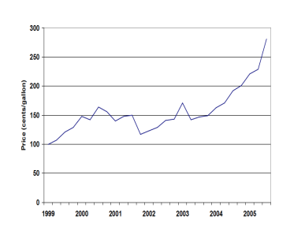
Oil scarce- affects transportation industry.
Disel fuel price, 1999-2005
The extremely rise of the oil price in the recently years and expected to rise even higher in the future due to the Middle East conflict and the demanding of more oil than the supply.
Since, transportation industry dealing with cars, trucks, planes etc. all are dependent with fuel price, meaning, higher logistic, road and delivery cost.

Slide 3
Oil scarce- affects transportation industry.
How can the business cope with this problem?
Many big companies use to respond to the high price of gasoline by using hybrid car
Hybrid car is a vehicle that has both conventional gasoline engine and the bank of batteries that shares the demand for power between two sources.
We are going to analyze on one ideal firm of hybrid technology, “Fedex”.

Slide 4
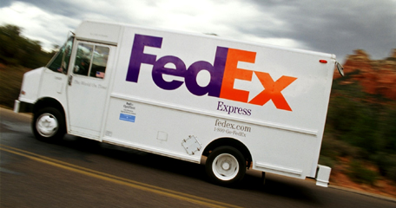
FedEx and Hybrid innovation
Nature of the business
Categorized to be The world’s largest express transportation company. FedEx deploys nearly 700 planes and tens of thousands of trucks and vans every day to deliver packages around the world.
In 2000, FedEx started to source for new generation of delivery trucks with improved fuel efficiency and environmental impact.
officially, FedEx embraced hybrid technology in 2004

Slide 5
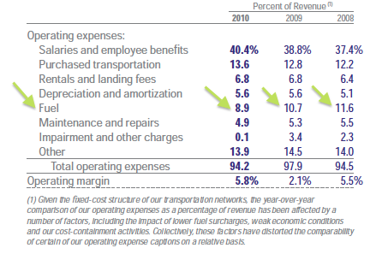
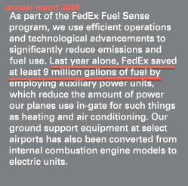
FedEx and Hybrid innovation
Operation with hybrid technology
Adapting hybrid technology on its transportation; vans trucks and planes.
saving fuel cost.
FedEx has an efficient operations and technological advancements on reducing both emissions and fuel usage. (Annual report of 2008)

Slide 6
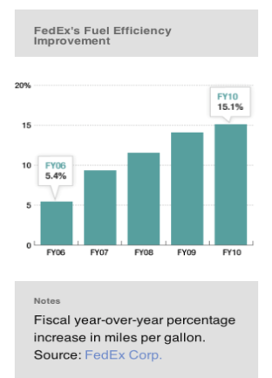
FedEx and Hybrid innovation
For delivery vans, FedEx is betting on electric or hybrid vehicles.
An all pickup and delivery van will operate at a 75 percent less per-mile cost than an internal combustion engine variant.
From FY05 to FY10 FedEx has increased over 10 percent in miles per gallon.
More deliveries are generated.

Slide 7
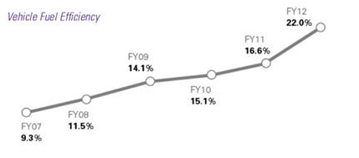
FedEx and Hybrid innovation
In 2011, FedEx Express expanded its fleet of all-electric and less polluting, energy efficient vehicles. FedEx Express placed 24 new all-electric vehicles into service, expanding to three new cities and more than doubling its fleet to 43 EVs.
The world’s largest express transportation company was bringing new all-electric delivery vehicles. At the same time, FedEx Express added more hybrid-electrics and upgrading over a tenth of its conventional vehicle fleet to more energy-efficient vehicles.
On high-mileage routes, FedEx is upgrading vehicles with 4,000 fuel efficient, lower emitting BlueTEC clean diesel Sprinter vans.

Slide 8
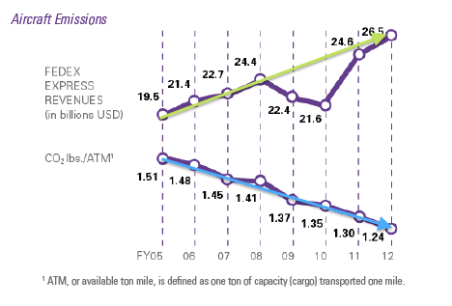

FedEx and Hybrid innovation
Since 2000,“FedEx have put close to 1.4 billion miles on these more fuel efficient vehicles, saving over 66 million gallons of fuel compared to their predecessors.
In 2013, FedEx Express will have 360 hybrid-electric vehicles and 200 electric vehicles in its fleet. To date, these vehicles have traveled more than 15 million miles in revenue service.
Notes:
Hybrid technology helps FedEx reduce emissions and fuel use as we work to increase the efficiency of our vehicle fleet,” said Mitch Jackson, director of Environmental Affairs and Sustainability, FedEx Corp. “We are eager for additional government and industry support to find more affordable options for hybrid trucks, so that we may adopt them into our fleet at a faster pace.”
In addition to the use of 264 hybrid vehicles in North America, Asia and Europe, FedEx has taken the following steps to increase vehicle fuel efficiency and reduce emissions in its fleet:
Since 2005, FedEx has been rebalancing its fleet with smaller, more fuel efficient sprinter vans and optimizing routes. As a result of these efforts, FedEx Express has saved 45 million gallons of fuel or 452,573 metric tons of carbon dioxide emissions.
FedEx Ground is testing hybrid hydraulic technology with Parker Hannifin Corporation and FCCC on a heavier-class vehicle (Class 6).
In London, FedEx operates liquid petroleum gas (LPG) sprinter vans, which reduce carbon dioxide emissions by 12 percent. FedEx will also use 10 zero-emission Modec electric delivery vehicles in the United Kingdom. FedEx Express has more than 320 LPG and electric-powered support units in use at the Roissy Charles de Gaulle hub in Paris and other operational facilities across Europe.
FedEx operates a large number of electric and alternative-fuel support vehicles worldwide, including more than 500 forklifts and 1,600 ground equipment units at airports.
Couriers in New York City and London’s West End deliver many of their packages on foot and bicycle.
Specifications for the FedEx Hybrid-Electric Retrofit Vehicles
In converting the standard delivery vehicles, the power-train equipment, including the engine, transmission, fuel tank and drive shaft, were replaced with a 2007 Cummins ISB 200 hp engine and Eaton hybrid-electric system. Costs were reduced by utilizing the existing chassis and body.
The vehicles feature a diesel engine coupled with an electric motor/generator and lithium-ion batteries. These batteries capture and store energy during the regenerative braking phase of vehicle operation, eliminating the need to plug into an electrical source. The sophisticated hybrid controller selects the most efficient mode of operation—diesel or electric—depending upon current operating conditions and driver demand.

Slide 9
Hybrid technology disadvantages
    Business issue
The hybrid cars can be expensive
    The initial cost is very high
The new innovation has a high cost of repair
Social issue
Quiet engine could be harmful

Slide 10
Hybrid technology advantages
    Business issue
hybrid cars are much cleaner and require less fossil fuel to run them
hybrid cars offer the best fuel efficiency
in US., there is the IRS’s clean Fuel Vehicle Tax Deduction
in US., there is the road tax break.
higher resale value compare to the standard gasoline engine powered vehicle
Social issue
emit up to 97% less toxic emissions and half as much greenhouse-causing carbon dioxide as the average

Slide 11
References
FedEx Annual report 2008
FedEx Annual report 2010
FedEx Annual report 2012
Oil Scare Turns FedEx On To Energy Efficiency, http://www.npr.org/2012/04/02/149703488/oil-scare-turns-fedex-onto-energy-efficiency

Slide 12
Thank you

