Slide 1

Leadership Development Overview
MK 341: Special Topics in Marketing 1
Marketing Leadership Development and Cross-cultural Management
By Ajarn Suwalya K.

Slide 2

HOPES & FEARS
Reflections
Write one thing you hope and fear in Leading

Slide 3
What we plan to achieve
Leadership Development Session Review
Review Course Outline- Highlights
Ground Rules for Leadership Development Exercises
Midterm Report & Group Project Briefing
Are great leaders made or born?
What is Leadership
Good and Bad Leaders
Leadership Analysis Exercise
Ethical Leadership
Managers vs. Leaders
Managers Network

Slide 4
About MK 341
This is Leadership Development is not your typical lecture class
- I will be your coach, trainer
Learning through leadership activities
Strengthen your understanding via activities both in-class and individual & group assignments
Help In changing your attitude and behavior
Each student will be given the opportunity to practice leadership
Each student will be given the the opportunity to practice team building – also being good team player
Highly interactive- both physical and emotional level
Every student must fully participate to experience leadership development
Sharing sessions both in -class and in -groups are aimed to improve your leadership skills
All students are required to give honest feedback to one another in order to improve individual leadership skills
Buddy System to help monitor progress

Slide 5

Leadership Development Course Outline
Moodle Key: 8543

Slide 6
Course Outline: 65% of Total Grade
Week | Date | Topic | Time(hrs.) | Instructor
2 | June 19 | Leadership Development | 13:00-16:00 | Ajarn Suwalya Khemvaraporn
 | June 21 | Leadership Development | 13:00-16:00 | Ajarn Suwalya Khemvaraporn
3 | July 3 | Midterm Paper due | 8:00-16:00 | Submit to BE office-no class
4 | July 10 | Leadership Development | 13:00-16:00 | Ajarn Suwalya Khemvaraporn
 | July 12 | Leadership Development | 13:00-16:00 | Ajarn Suwalya Khemvaraporn
5 | July 17 | Leadership Development | 13:00-16:00 | Ajarn Suwalya Khemvaraporn
 | July 19 | Leadership Development | 13:00-16:00 | Ajarn Suwalya Khemvaraporn
6 | July 24 | Leadership Development | 13:00-16:00 | Ajarn Suwalya Khemvaraporn
 | July 26 | Leadership Development | 13:00-16:00 | Ajarn Suwalya Khemvaraporn
 | July 31 | Project Presentation | 13:00-16:00 | Ajarn Suwalya Khemvaraporn
7 | Aug 6 | Final Exam | 13:30-15:30 | Ajarn Suwalya Khemvaraporn

Slide 7
Course Outline:
2.1 Individual Assessment:
Midterm Paper 10% (July 3,2018)
Final Exam 15% ( August 6, 2018)
Individual Attendance, Assignment and Participation 20%
There will be open discussions and ‘brainstorming’ on the context, marketing cases and various business issues - A highly interactive class- Active class participation and attendance is required for students to fully participate.

Slide 8
Course Outline:
2.2 Group Assessment:
Project Term Paper & Presentation 20%
The Marketing Leadership Project begins on June 19th with the formation of the project team. The team is required incorporate theories, concepts, models, and other relevant information (ex. Facts, figures, external source data) into the analysis for the project term paper as group work progress will be gradually developed throughout the summer session via project mini presentations and discussions.The final presentation of approximately 20 mins. will take place on the last day of class. The booklet will be due on the day of the final Exam. Peer evaluation review is also taken consideration to finalize the project grade.
2.3 Leadership Development field trip (TBC):
To complete this course, all students are required to attend a 2-day field trip focusing on Leadership Skills Development. The date and time will be later confirmed.

Slide 9
Course Outline:
Recommended Textbook:
-Afsaneh Nahvandi, The Art and Science of Leadership (2015), 7th Edition, Pearson Education Limited Global Edition ISBN 978-0-13-354676-7
-Jan Muhlfeit and Melina Costi(2017) The Positive Leader, First Edition published 2017@ Jan Muhlfeit and Melina Costi, U.K. ISBN 978-1-292-16615-5
-Gary Yukl (2013) Leadership in Organizations, 8th Edition, Pearson Education Limited Global Edition, England ISBN 987-0-13-277186-3
Supplementary Reading:
All related news and data from all sources, particularly on the Internet.

Slide 10
Course Outline:
Student Responsibility:
Student is expected to do the reading of the material well before time of instruction.
Every class assignment needs to be turned in on time. Late turn-in will be accepted with no score assigned to it.
The instructor may not, sometimes, cover the text and handouts in detail; however, if those missing details are stated in the course syllabus or notifications, it is therefore students’ responsibility to review the material.
Important notice: This course is highly interactive and requires active class participation and Attendance. Attendance is very important, therefore 2 lates equals 1 absent and 3 absents you are not allowed to take the final exam.

Slide 11
Individual Assessment:
Participation Scoresheet:
Participation is 20% of your grade, but in this class, it would be very different from other courses you have taken since participation if 20 will be designed into a “ Leadership Participation” Scoresheet.
Your total score of 20% will reflect the following:

Slide 12
Participation Scoresheet:
Time Management
1. Each student must be on time to class
Each student must be on time in all class activities
Each student must manage your own time effectively
Class Participation
Active participation includes
Sharing both in class and in groups
Speaking up- openly express your opinions and feelings both in class and sharing sessions
Being Proactive by providing suggestions for during class and group discussions

Slide 13
Participation Scoresheet:
Leadership Competency
Being an Active Leader by trying your best to practice leadership when nominated as leader
Proactive,openly speak up and lead your team
3. Continuous improve oneself – comments
taken from group sharing and reflection
should be used to improve yourself
4. Respect, trust and empower your team

Slide 14
Participation Scoresheet:
Team Player
1. Being a good follower
2. Actively share opinions and suggestions
during group sharing
3. Respect and trust your leader
4. Provide honest and constructive feedback for
your leader so he/she can grow

Slide 15
Participation Scoresheet:
Assignments
Hand in individual assignments on time
Provide quality work
3. Share assignments when required

Slide 16
Participation Scoresheet:
No. | Name | Time Management | Class Participation | Leadership Compentency | Team Player | Assigment | Score
1. | Wattana
2. | Suthita
3. | Pimticha
4. | Napassorn
5. | Kanjana
6. | Luksika
7. | Phatipol
8. | Krit
9. | Wachirawit
10. | Pasut
11. | Sirada
12. | Sansidhorn
13. | Nutthakit
14. | Napat
15. | Photmaetha
16. | Parncheeva
17. | Piangprae
18. | Jinna

Slide 17



What do the symbols mean?

Slide 18
Ground Rules for leaders and followers:
Leaders
Those who wear Leader Badge will have role as leaders
All Leaders will come up to me for briefing
Only leaders are allowed to ask me questions
Team Player
All team players will fully participate in activity
All team players will be open and honest during sharing session
If you have any questions, you are only allowed to consult your team leader
At the end of activity , I will give you questions to discuss.

Slide 19
Individual Midterm Report
& Group Project Briefing

Slide 20

Exercise 1: Shop to Win…

Slide 21
Shop to Win: Leaders and Followers…
Were your leaders effective in…
Giving Clear Direction?
Communicating all elements well?
Listening for your opinions?
Finding Creative Solutions?
Good at Problem Solving?
Empower team members?
Manage time efficiently?
**************

Slide 22
Shop to Win:Followers…
Were your followers effective in…
Giving good suggestions?
Cooperating?
Honest and Direct Feedback.
Respecting leader’s opinions?
Delegated Responsibility?
Manage time efficiently?
**************

Slide 23
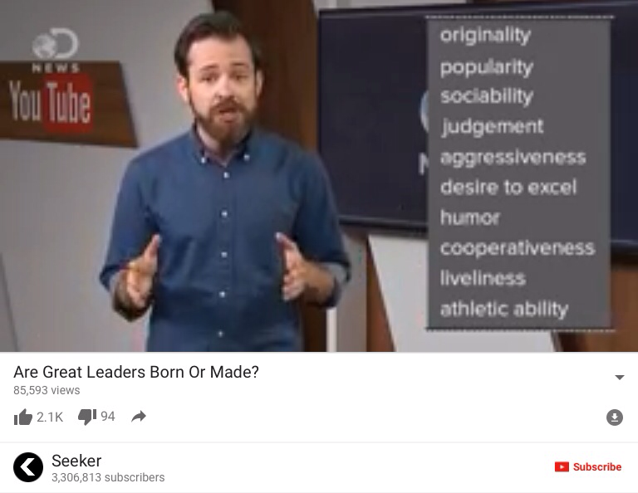

Slide 24
What is Leadership?

Slide 25
Definition of Leadership
The activity of leading a group of people or an organization or the ability to do this.
Leadership involves: establishing a clear vision, sharing that vision with others so that they will follow willingly, providing the information, knowledge and methods to realize that vision, and.

Slide 26
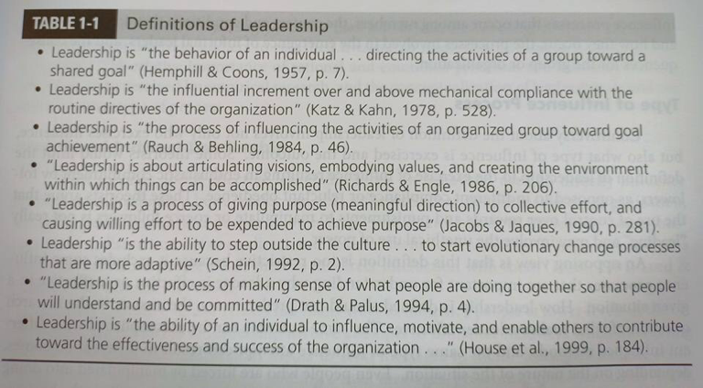
Definition of Leadership

Slide 27
Global Leaders who Changed the World

Slide 28

++++Leaders
Top Greatest Leaders if All Times, Leaders who Changed the World/Top 5 Battle

Slide 29
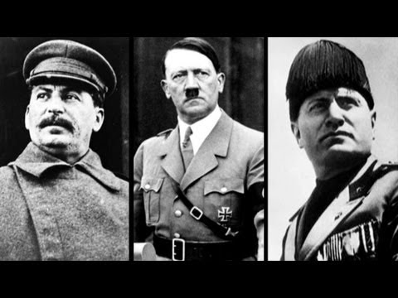
- - - Leaders
Top 10 Ruthless Dictators/ Watch Mojo.com

Slide 30
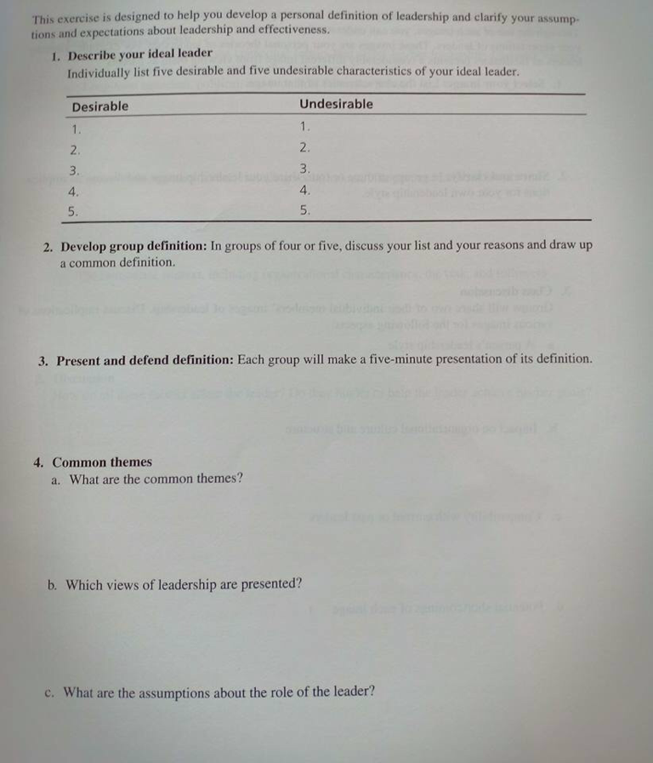
Exercise 2:What is Leadership?
Handouts
Briefing and group discussion

Slide 31
Ethical Leadership
Integrity
Altruism
Humility
Empathy and Healing
Personal Growth
Fairness and Justice
Empowerment

Slide 32

Manager vs. Leaders

Slide 33
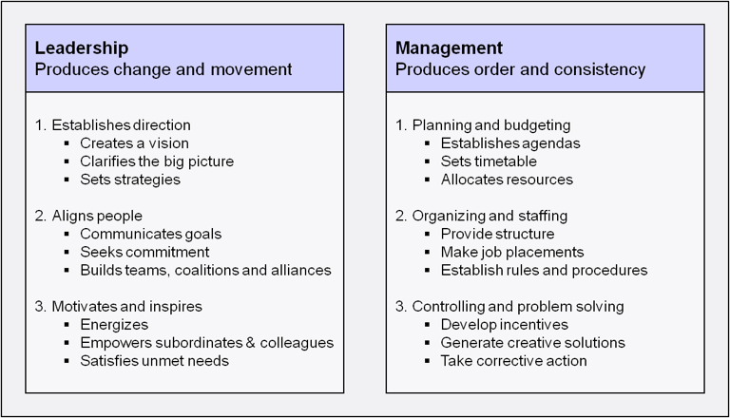
Managers vs. Leaders

Slide 34
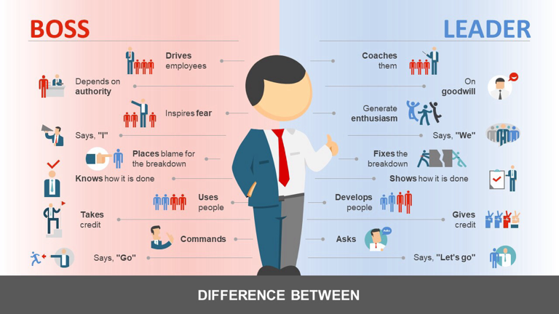
Boss vs. Leaders

Slide 35
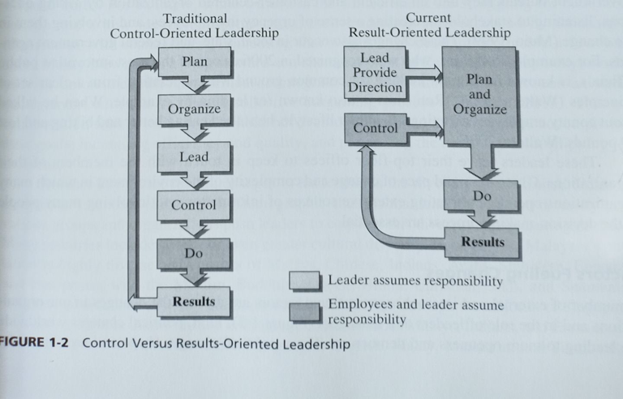
New Roles of Leaders

Slide 36
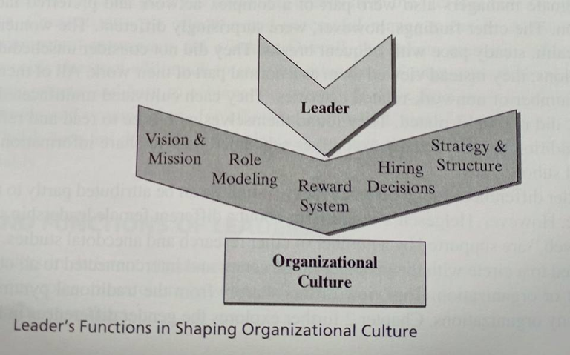
Functions of Leaders
1d

Slide 37
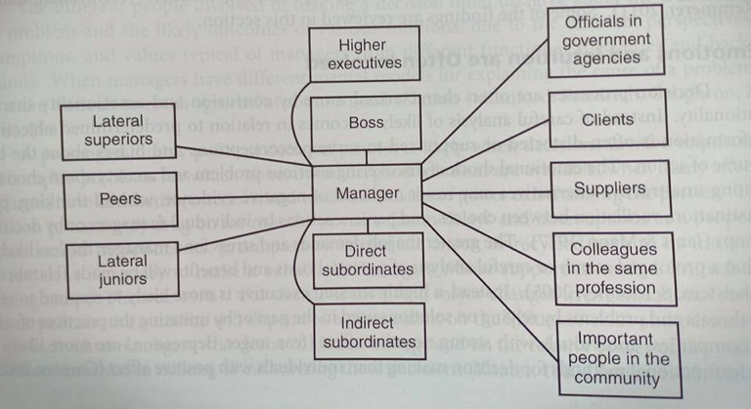
A Manager's Network of Contacts

Slide 38

A Manager's Network of Contacts

Slide 39
Individual Assignment:due next class
Inspirational Leader
You are to print out a picture of your ideal leader on A4- in color, who is your role model; who inspires you
Write a half page summary in your own words why you admire this person
Please indicate his strengths and weaknesses as a leader
If you were him/her what would you do to make you a better leader?
We will share this in next session

Slide 40
Individual Assignment:due next class
You are to bring to next class ( feel free to match your designs)
1) Folder to keep all documents especially during sharing session.
2) Diary for you to reflect your leadership learnings and experiences

Slide 41
What we accomplished
Leadership Development Session Review
Review Course Outline- Highlights
Ground Rules for Leadership Development Exercises
Midterm Report & Group Project Briefing
Are great leaders made or born?
What is Leadership
Good and Bad Leaders
Leadership Analysis Exercise
Ethical Leadership
Managers vs. Leaders
Managers Network

Slide 42


