Slide 1
China Factor
Impact of the U.S.-China Trade War
Bhanupong
Lecture 21
Required Readings:
Macroeconomic policy for emerging markets: Chapter 10
“Impact of the U.S.-China trade war on Thailand” Asian Economic Papers 18(3), 2019

Slide 2
Main themes
1. China rising
2. ASEAN Business Cycle Synchronization
3. Global rebalancing
4. The U.S.-China Trade War
5. The impact on Thailand
6. Hydropower on the Mekong

Slide 3
1. China Rising
China
USA
Japan

Slide 4
Imports from the three largest economies

Slide 7
Implication from the estimated elasticities
China’s import growth significantly impacts Thailand’s exports, which is highly sensitive to China business cycle.
Deviation from China’s stable growth path results in a more massive swing on demand for Thailand’s exports.
Growing reliance on interregional trade within ASEAN economies intensifies the interconnectedness of ASEAN economies through the trade channel.

Slide 8
Nominal Effective
Exchange Rate

Slide 9
Import demand from China dominates Thailand’s export sector, but not vice versa

Slide 11
The figure resonates with China’s competitive advantage over Thailand

Slide 12
High income elasticity of import demand for Thai products
High price elasticity of demand for imports from Japan

Slide 14
2. ASEAN Business Synchronization

Slide 15
China and ASEAN-4 Business Cycle

Slide 16
Collapses of export in 2009
V-shaped recovery of exports in 2010

Slide 17
Thailand’s exports synchronize with
China’s business Cycle
What caused exports to Vietnam different from other markets?

Slide 20
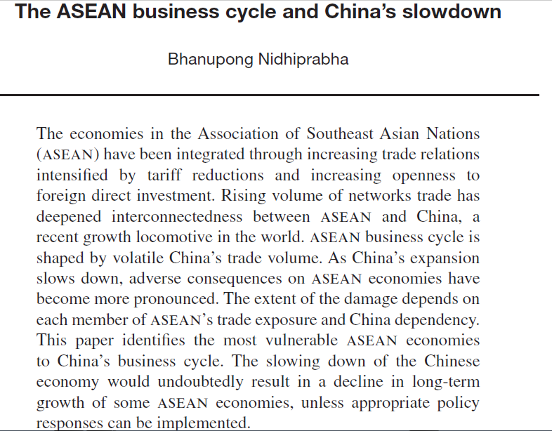
The impact depends on each country’s trade exposure and China dependency

Slide 21
The baht appreciates and depreciates together with the renminbi

Slide 22
The baht moves in line with the renminbi (ρ > 0)
ρ < 0: Baht moved in an opposite direction

Slide 23
3. Global rebalancing
The US trade deficit declines, when the yuan appreciates

Slide 24
China and the U.S trade disputes
When the issue of global rebalancing first emerged, it was focused squarely on the trade imbalance between China and the U.S.
However, the global economic turbulence of 2009-2010, and the subsequent economic fragility and uncertainty enveloping much of the global economy today, has begun to underscore how broad this issue really is.

Slide 25
To correct the huge trade deficit between the US and China
China has taken steps to contribute to possible rebalancing.
China’s currency has appreciated by over 30 percent against the US Dollar since 2005.
And it has experienced some decline in its trade surplus in recent years.
Nevertheless, the consumption share of GDP in China is still low (and even declined according to recent statistics).

Slide 26
Global rebalancing
Further, the US still has a current account deficit amounting to about 3.1 percent of GDP.
In 2011, the US maintained a trade deficit with at least 91 countries, most of which are in the developing world.
Thailand is one of those countries on the watch list of the US government.

Slide 27
To rebalance the trade disequilibrium between the two countries
( M – X ) = ( I-S ) + ( G-T )
For the U.S. to cutdown trade deficit with China, private and public saving must rise: lower domestic consumption, the US government must tax more and spend less (Lower absorption)
For China to cut down trade surplus with the U.S., private and public saving must fall: higher domestic consumption (Higher absorption)

Slide 28
Chinese government’s actions
The government has started to tackle several ingrained problems.
After a long period of overproduction of steel and coal, a campaign to close unused capacity restrained output and pushed up prices.
To reduce the property overhang, local governments bought millions of unsold homes from developers and gave them to poorer citizens.

Slide 29
Maturing Chinese Economy
Growth is bound to slow over time as China gets richer, but structural changes are also making growth more stable.
Thanks in part to a falling working-age population, which peaked in 2011.
This, in turn, is rebalancing the economy.
Excessive reliance on investment is giving way to consumption.
And heavy industry is giving way to services, which now account for more than half of GDP, up from a third two decades ago.

Slide 30
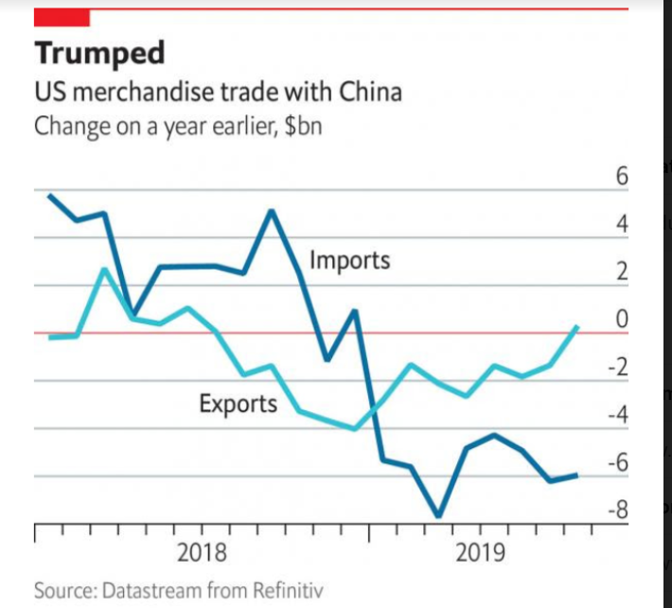

Slide 31
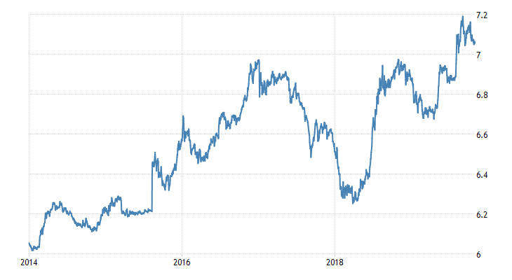
Is China a currency manipulator?
The weakening yuan alone will not solve trade imbalances
Renminbi has been weakening in response to the Trump tariff

Slide 32
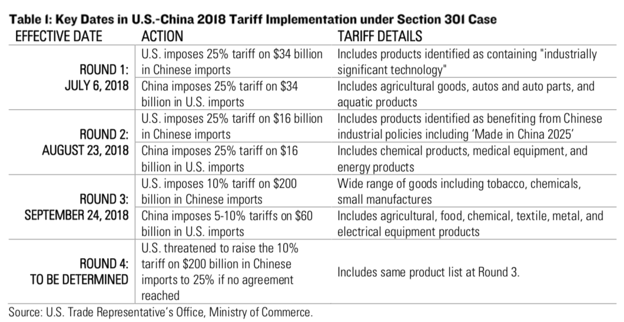
4. U.S.-China Trade War Tariffs, 2018
Notes:
https://oxfamblogs.org/fp2p/milanovic-on-inequality-continued-implications-for-politics-alliances-and-migration/

Slide 33
Chicken game
A chicken game is a set up that typically describes two players heading toward each other.
If the players continue on the same path, they bump into each other; if one swerves out of the way and other doesn’t,
The servers "loses" and is labeled the chicken, while the second, implicitly braver player, wins.

Slide 34
The Trade Conflict and China’s strategy
The conflict with Washington has prompted Chinese leaders to step up a marathon effort to encourage self-sustaining growth driven by domestic consumption and reduce reliance on exports and investment.
Beijing has cut tariffs, promised to lift curbs on foreign ownership of auto producers and taken other steps to rev up growth.
But leaders have refused to scrap plans such as "Made in China 2025," which calls for state-led creation of Chinese champions in robotics and other technologies.

Slide 35
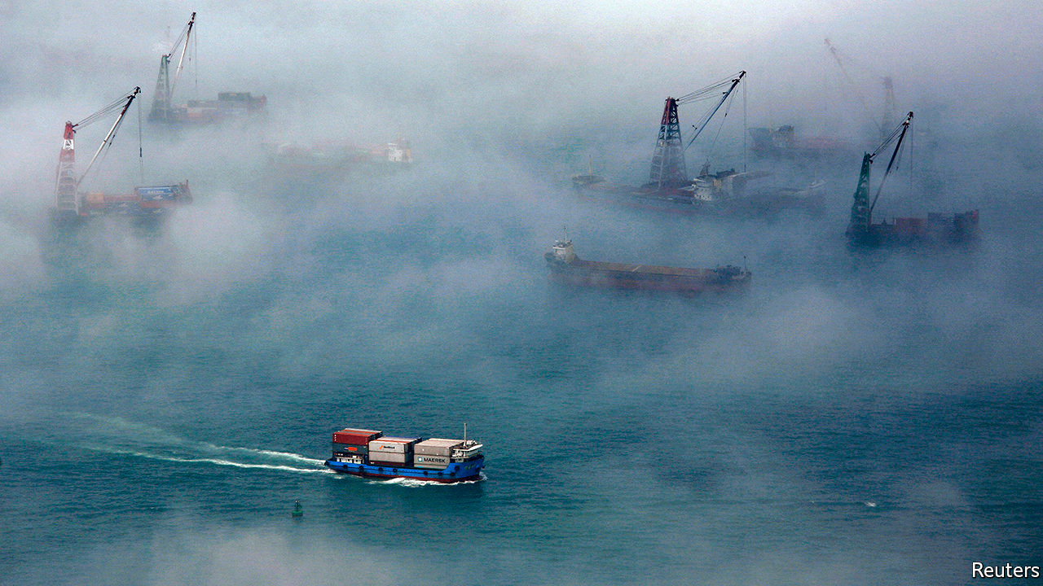
Foggy outlook
How the twists and turns of the trade war are hurting growth

Slide 36
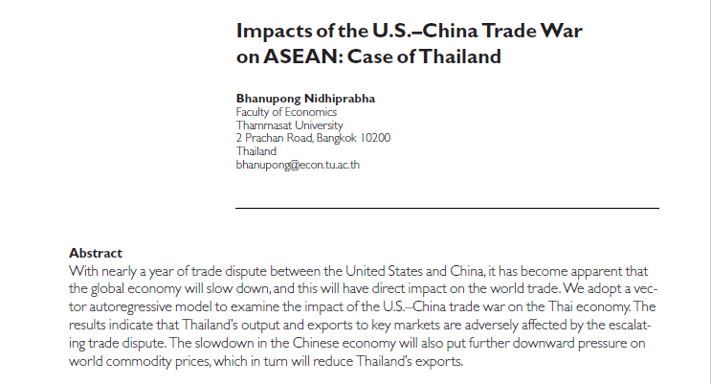
5. Impacts of the trade war on Thailand

Slide 37
Thailand’s export penetration in 2018
(% total imports)
Which commodities can Thailand
export more to the U.S. and China after the trade war?

Slide 38
Long-lasting consequences
A full-blown trade war between the U.S. and China would immediately generate a negative impact on Thailand’s output growth.
The adverse effect will be long-lasting. The reduction in the U.S. imports from China causes greater output losses for Thailand than when China retaliates the U.S. by imposing import restrictions.

Slide 39
Market exposures to shocks in exports of electrical machinery and equipment (% total exports in each country)

Slide 40
The fallout from the trade war
became apparent in Q3 2019

Slide 41
Round 1 : July 6, 2018
U.S. imposes 25% tariff on $34 billion in Chinese imports of “industrially significant technology”
China imposes 25% tariff on $34 billion of U.S. Imports of agricultural goods, autos and parts, and aquatic products

Slide 42
Round 2: August 23, 2018
U.S. imposes 25% tariff on $16 billion in Chinese exports benefiting from China’s industrial policies including “Made in China 2025”
China imposes 25% tariffs on $16 billion of U.S. Imports of chemical and energy products, medical equipment.

Slide 43
Round 3: September 24, 2018
U.S. imposes 10% tariff on $200 billion in various Chinese imports including tobacco, small manufactures, and chemicals
China imposes 5-10% tariff on $60 billion of U.S. Imports of agricultural, food, chemical, textile, metal, and electrical equipment products

Slide 44
Replacement effect depends on the substitutability and competitive advantage of Thailand’s products in the American and Chinese markets
U.S.
China
Japan
ROW

Slide 45
By December 2018, when reality checked in, export growth engine was completely shut down.

Slide 46
The Trump tariffs and wider impacts
Some of the Trump tariffs could remain even after the conclusion of the trade deal between the U.S. and China (Ratchet effect)
The chicken tax of 25% on light trucks imposed in 1964 still remains until today and it has shielded the U.S. car manufacturers from imports of one-ton pickup trucks from Thailand.
The slowdown in the U.S. economy delays the Fed’s interest normalization policy, causing capital inflows and appreciation of the baht and regional currencies

Slide 47
Indirect impact of the trade war
The trade war dampens consumer confidence and depress investor sentiment, exacerbating the slowdown of the global growth.
If stock markets falls because of the bad news from trade disputes, the wealth effect would further reduce private spending.
Due to a significant slowdown in China growth, commodity prices fall, decelerates the speed of poverty reduction and complicates income distribution issues.

Slide 48
Causal ordering: From China imports to raw materials, and food prices

Slide 49
Palm kernel is a close substitute to soybeans

Slide 50
Negative output effect is stronger than Thailand’s ability to replace the fallout from American and Chinese exports products
According to the estimated income and the real effective exchange rate elasticities, the negative impacts of the trade war on shrinking world trade volume outweigh the positive substitution effects on Thailand’s exports.
The latter effect depends on Thailand’s ability to compete successfully in the United States and Chinese markets.
When considering the output and substitution effects among different export markets, the simulation from the trade war hurts countries that raise trade barriers more than hurting their trading partners.

Slide 51
The third parties caught in the middle of the trade war are affected by decelerating global growth and experience an economic downturn.
There is also a negative terms of trade effect on commodity prices, which are influenced by China’s declining demand for commodities.
A full-blown trade war between the United States and China would immediately generate a negative impact on Thailand’s output growth.
The adverse effect will be long-lasting.

Slide 52
Negative indirect impacts
The indirect impact of Trump’s tariffs is on the global slowdown, particularly in Thailand’s major trading partners.
The negative effect on output is stronger than the positive diversion effect that might occur from substitution effects.
Thailand’s GDP contracts, because of a slowdown in economic activities in the United States, China, and Japan.

Slide 53
Profound negative indirect impacts
The negative impact on Thailand’s GDP will be even higher if we incorporate the negative effect of slackening global demand, which crimps on consumer and investor confidence.
China’s economic slowdown translates into lower demand for commodities.
The result in declining commodity prices further complicates poverty eradication and might retard long-term growth of the economy because capital spending is curtailed for the sake of agricultural subsidies.

Slide 54
Potential benefits from relocation of FDI
There is also a long-term impact on output and exports in Southeast Asian emerging economies that might benefit from the relocation of production networks from China by the United States and Chinese companies.
The effect will be permanent as it will change the structure of value chains of manufacturing productions.
Because ASEAN economies have a different degree of vulnerability to trade shocks, the relative recessionary impact of the trade war would hinge on the individual country’s international trade exposure as well as domestic policy responses.

Slide 55
1. Concluding remarks
The baht real effective exchange rate moves in line with the renminbi and other ASEAN real effective exchange rates.
The policy implication is that stimulus policy packages of China can ameliorate the contractionary effect of the trade war.
The People’s Bank of China and the U.S. Federal Reserve have already considered implementing monetary policy stimulus. China’s fiscal policy has become more expansionary in 2019.

Slide 56
2. Concluding remarks
Unless China maintains high growth and currency appreciation, the U.S.–China trade disputes will remain for many years to come.
The indirect impact of the Trump tariffs is on the global slowdown, particularly in Thailand’s major trading partners.
The negative effect on output is stronger than the diversion effect that might occur from substitution and diversion effects.

Slide 57
3. Concluding remarks
Thailand’s GDP responds positively to output expansion in the US, China, and Japan.
The negative impact on GDP will be higher if we incorporate the negative impact of global growth deceleration on consumer confidence and investor sentiment on aggregate spending.
The policy implication is that stimulus policy packages of these large economies can ameliorate the contractionary effect of the trade war.

Slide 58
4. Concluding remarks
Unless these economies sustain high growth, other countries in the region will also experience growth slowdown.
Since ASEAN economies have a different degree of vulnerability to trade shocks, the relative contractional impact of the trade war would hinge on the individual country’s international trade exposure as well as domestic policy responses.

Slide 59
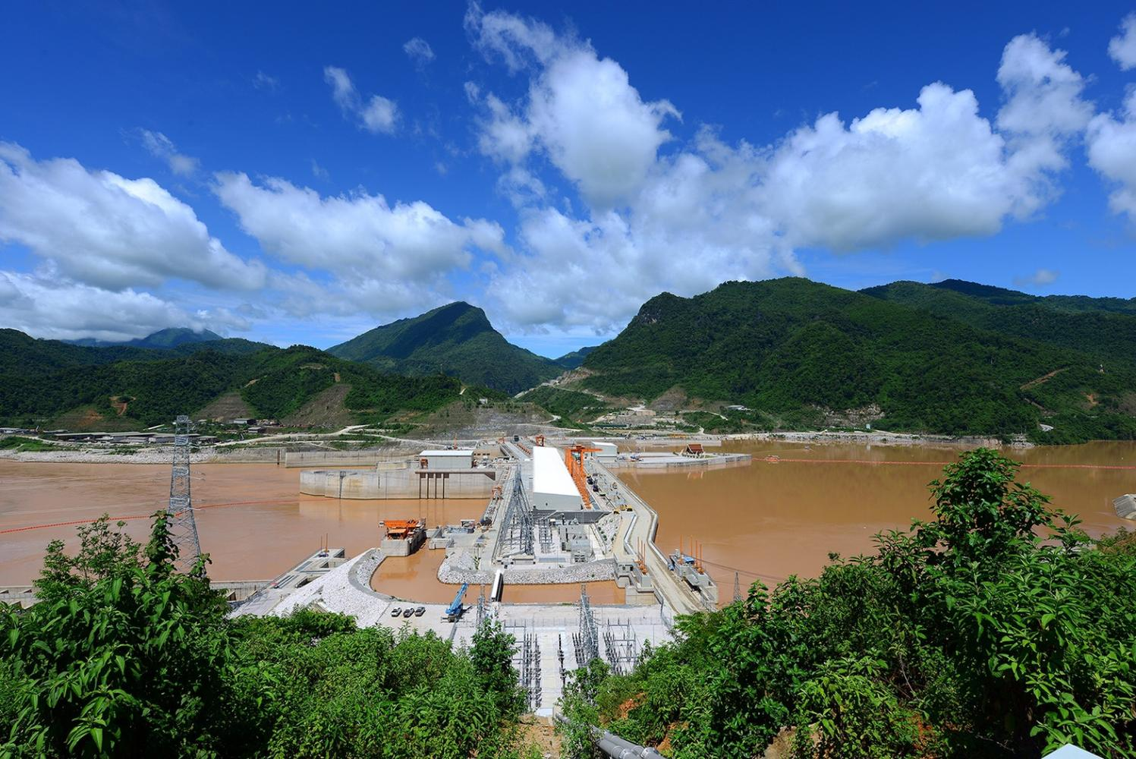
6. Epilog: China factor
Hydropower on the Mekong

Slide 60
The 130-billion-baht Xayaburi
Hydroelectric Power Plant in Laos
The power generation was set to start October 1, 2019 at the Xayaburi dam in northern Laos.
Since construction began in 2010, some 5million cubic meters of concrete have been poured into raising a 38-metre wall and structures on the greatest of all South-East Asian waterways.
The Mekong is the world’s largest inland fishery, and the most biodiverse river after the Amazon.
Critics warn of devastating consequences for the flow of fish, sediments and nutrients of a river that feeds tens of millions of people.

Slide 61
Laos exports electricity to Thailand
CKP holds a 37.5% stake via Xayaburi Power Co with Natee Synergy Co holding 25%, Electricite du Laos (EdL) 20%, Electricity Generation Plc 12.5%, and others 5%.
The seven turbine generators have a capacity of 175MW each and all 1,225MW is sold to Egat through
A 500-kilovolt (kV) transmission line in Tha Li district, Loei province.
The remaining capacity of 60MW is sold to EdL through a 115kV transmission line in Laos.

Slide 62
Negative transboundary impacts
Unlike Chinese dams, any projects proposed on the lower Mekong must be tabled for discussion among the governments of the four countries -- Thailand, Laos, Cambodia and Vietnam -- that signed the Mekong Agreement in 1995 and formed the Mekong River Commission (MRC).
MRC cannot veto the projects but only raise concerns about negative transboundary impacts.
The hydroelectric power plant has a capacity of 1,285 megawatts.

Slide 63
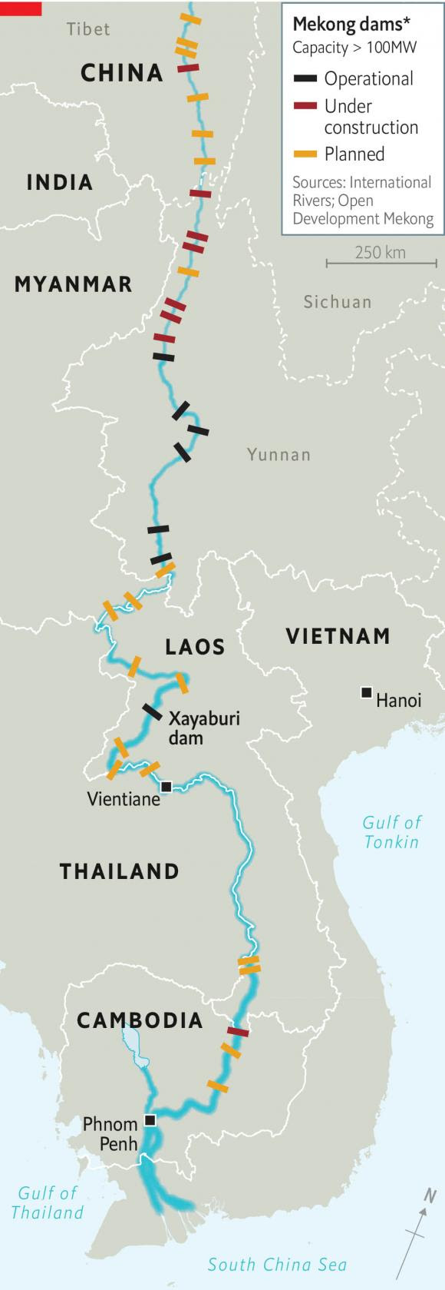
Upstream Dam construction belongs to China’s sovereignty
LCTV must agree on dam
Construction at the lower Mekhong
Under construction
operational
Xayaburi is only the first of a planned 11 dams on the Lower Mekong (9 are in Laos; 2 in Cambodia).
10 Planned dams

Slide 64
Sold down the river: hydropower on the Mekong
The World Bank and the Asian Development Bank refused to back the project.
Thailand, whose banks financed it, will buy 95% of the energy.
The power and the profits will remain in Thailand and Laos;
The environmental and social consequences will largely be borne by the lower riparian countries, Cambodia and Vietnam.

Slide 65

Fiery crossing to Laos from
MookDaharn: October 2019

Slide 66

Tractor on the river floor: Dried up Mekong River
Leoi province: October 2019

