Slide 1

D
BI 201 Principle of Management
by Parichat Jantori

Slide 2


Slide 3
Task 1: Self – Introduction

Slide 4
Task 2: Let’s move your body Activity

Slide 5
Task 3: Let’s Speed Dating

Slide 6
Task 4: Forming up a group of 5

Slide 7
Task 5: Creative Thinking Activity
“Create a product & present”

Slide 8
Keys to take away:
Presentation skill
The power of “What If”

Slide 9

The power of “What if”
“What if” questions provokes us and challenge our thinking. They challenge us to discover the business model.

Slide 10

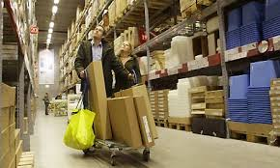
What if furniture buyers picked up components in flat pack from a large warehouse and assemble the products themselves in their home.

Slide 11

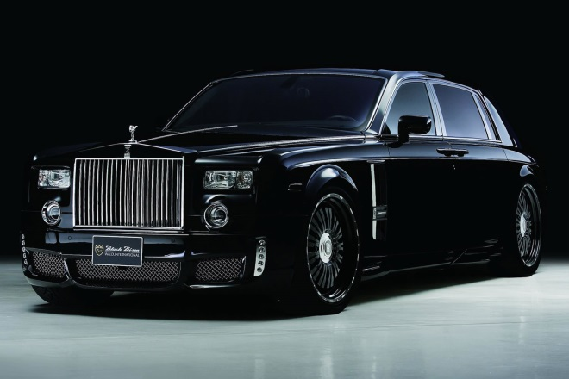
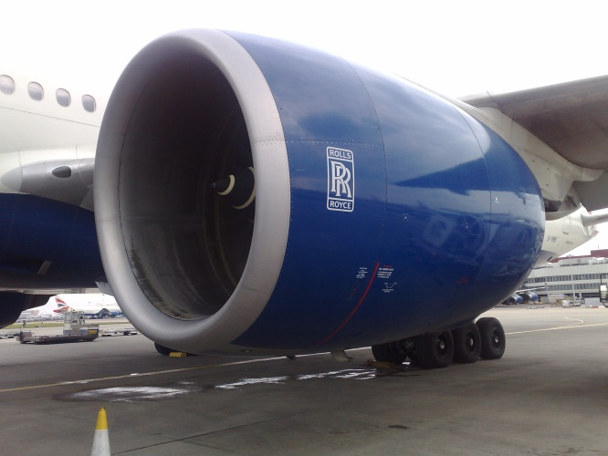
Airlines didn’t buy engines for their airplane, but paid for every hour an engine runs?
Rolls-Royce transformed itself from a money-losing British Manufacturer into a service firm that today is the world’s second biggest provider of large engine.
Notes:
Rolls-Royce Limited was founded in 1906 by Henry Royce and Charles Rolls at the Midland Hotel, Manchester, as a manufacturer of luxury cars, before diversifying into aircraft engine manufacturing. The production of road vehicles remained a major activity of the company until the car business was split off in 1973 as Rolls-Royce Motors.
รถราคา 30 ล้าน

Slide 12

Voice call were free worldwide?
In 2003 Skype launched a service that allowed free voice calling via Internet. After 5 years Skype had 400 millions registered users. It was bought by Ebay 2.6 Billion and then by Microsoft 8.5 Billion Dollars.
Notes:
In September 2005, eBay acquired Skype for $2.6 billion.^{[18]} In September 2009,^{[19]} Silver Lake, Andreessen Horowitz, and the Canada Pension Plan Investment Boardannounced the acquisition of 65% of Skype for $1.9 billion from eBay, valuing the business at $2.75 billion. Skype was later acquired by Microsoft in May 2011 for $8.5 billion.

Slide 13
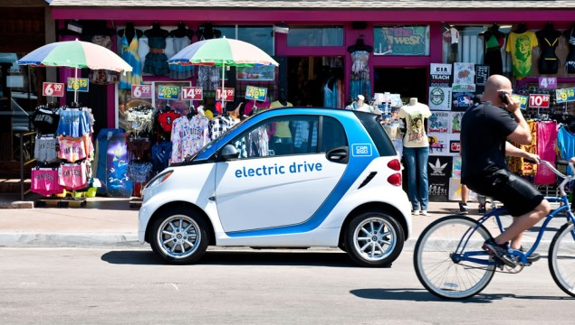
Car Manufacturers didn’t sell cars but provide mobility services?
Notes:
In September 2005, eBay acquired Skype for $2.6 billion.^{[18]} In September 2009,^{[19]} Silver Lake, Andreessen Horowitz, and the Canada Pension Plan Investment Boardannounced the acquisition of 65% of Skype for $1.9 billion from eBay, valuing the business at $2.75 billion. Skype was later acquired by Microsoft in May 2011 for $8.5 billion.

Slide 14

Every villager in Bangladesh had access to a telephone?
Grammenphone is a joint venture between Telenor and Grameen Teleco Corporation, a non-profit sister concern of the microfinance organization and community development bankGrameen Bank. Grameenphone was the first company to introduce GSM technology in Bangladesh, and built the first cellular network to cover 99% of the country. Today Grameenphone is Bagladesh’s largest taxpayer.
Notes:
In September 2005, eBay acquired Skype for $2.6 billion.^{[18]} In September 2009,^{[19]} Silver Lake, Andreessen Horowitz, and the Canada Pension Plan Investment Boardannounced the acquisition of 65% of Skype for $1.9 billion from eBay, valuing the business at $2.75 billion. Skype was later acquired by Microsoft in May 2011 for $8.5 billion.

Slide 15
Task 6: Imagine you want to start your dream business. What do you need to make your dream business comes true.
Make a list on your own.
Discuss with your group.
Pick up one business (or create new one), draw a picture and present it in front of the class.

Slide 16
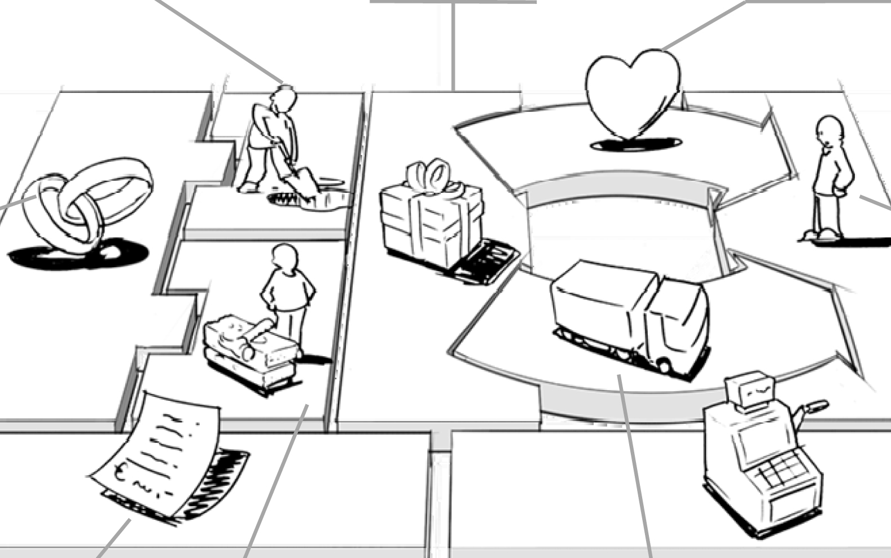
Business Model

Slide 17
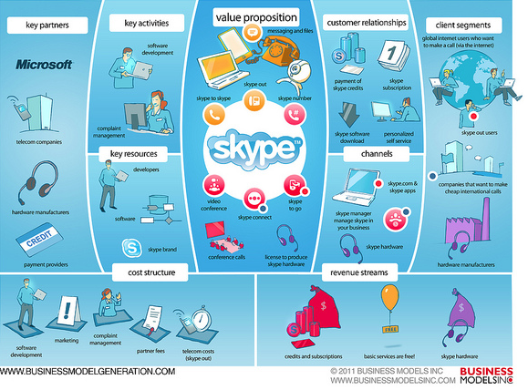
Business Model

Slide 18
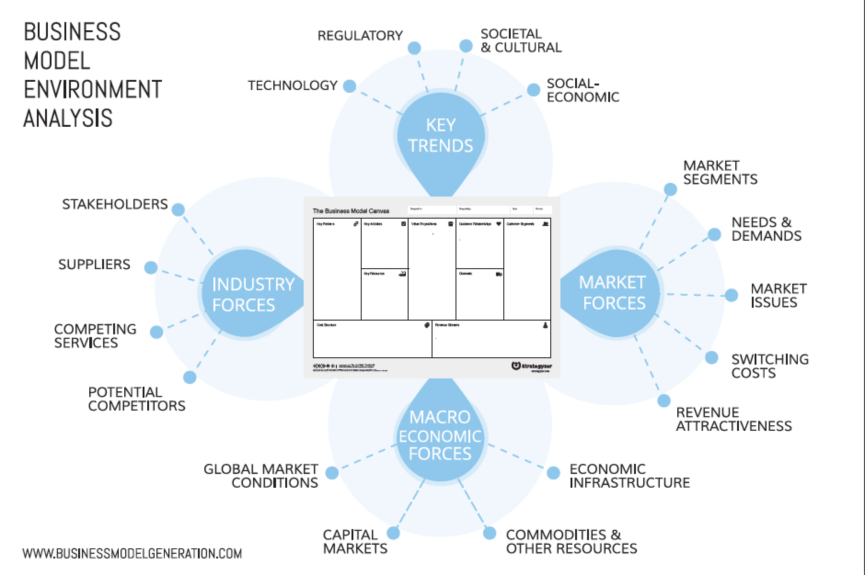

Slide 19
Business Model
A business model describes the rational of how an organization creates, delivers, and capture value
Value:
The extent to which a good or service is perceived by its customer to meet his or her needs or wants, measured by customer's willingness to pay for it
Summarization of why a consumer should buy a product or use a service
customer's perception of the worth of the product than on its intrinsic value

Slide 20
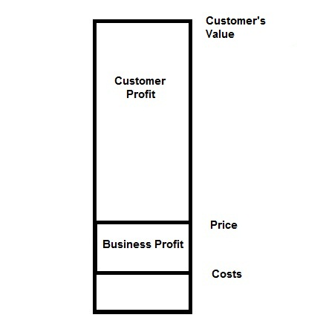
Price Profit Value

Slide 21
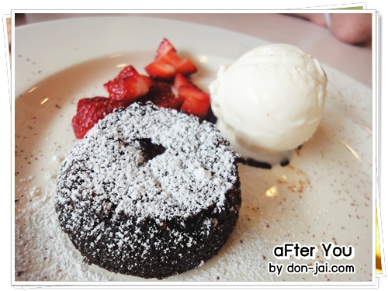
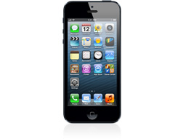

Slide 22

Business Model
Customer segments
Customer is the heart of any business model
Customer segment means group of customers that distinct from each other
Different segments means different offer, distribution channels, type of relationship, profit and willingness to pay.

Slide 23
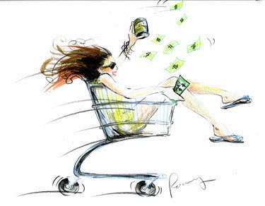
Business Model
Value Propositions
Reason why customers turn to one company over another.
Newness, Design, Performance, Quality, Price, Speed of service, Customization, Accessibility, Convenience, Usability

Slide 24
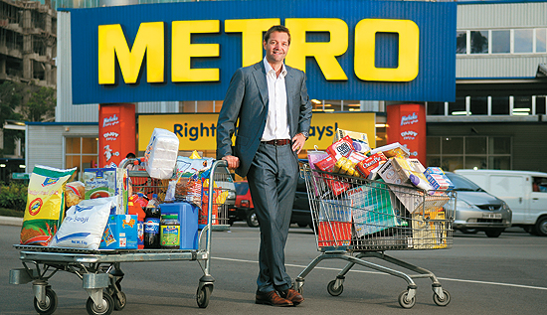
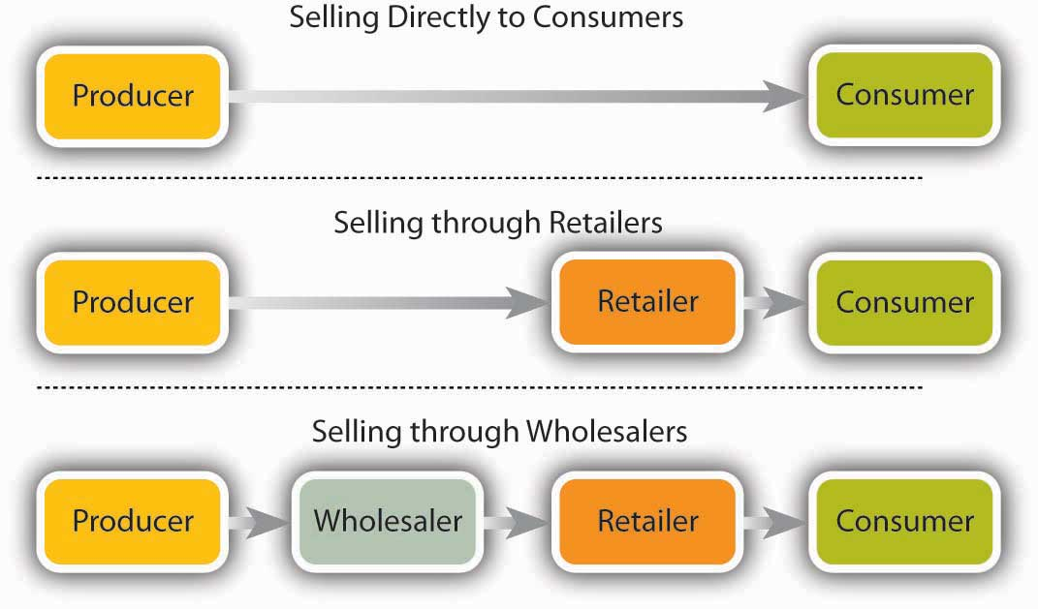
Business Model
Channels
How a company communicates with and reaches its customer segments to deliver a value proposition

Slide 25
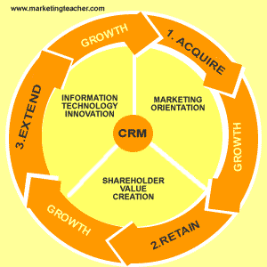
Business Model
Customer Relationships

Slide 26

Business Model
Revenue streams
The cash a company generates from each customer segment
Transaction revenues
Recurring revenues

Slide 27
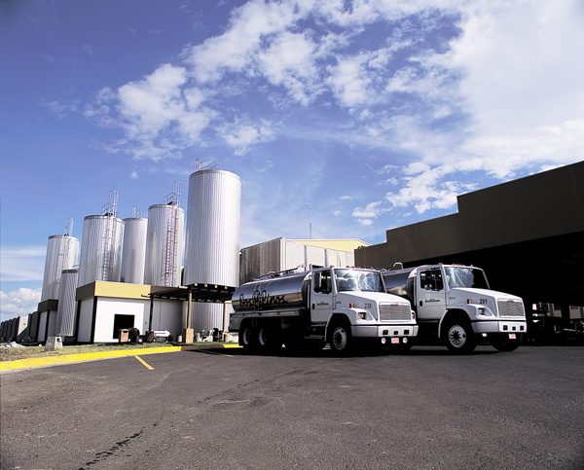

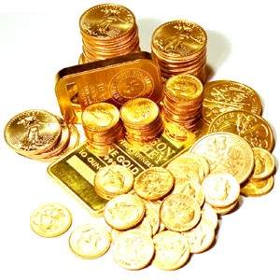

Business Model
Key Resources
The assets required to make a business model work

Slide 28
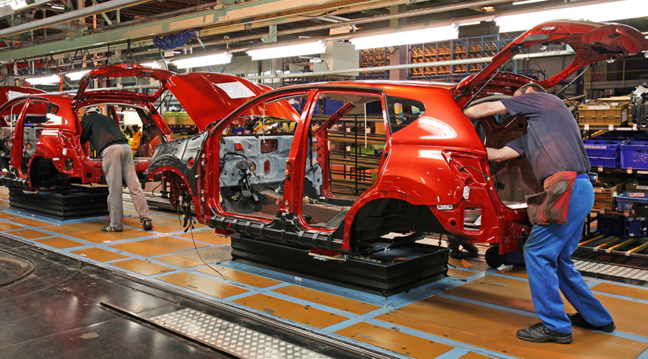

Business Model
Key activities
The most important actions a company must take to operate successfully

Slide 29

Business Model
Key Partnerships
Networks/ alliances of suppliers and partners that make the business model work.
Optimize business model
Reduce risks or uncertainty
Acquired resources and particular activities

Slide 30
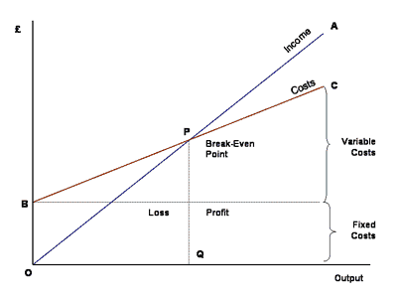
Business Model
Cost structure
All the cost incurred to operate business model
- Fix cost, Variable cost

Slide 31
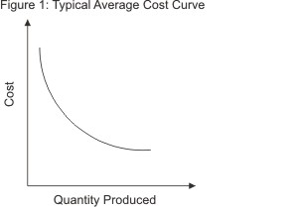

Economies of scale & Economies of scope

Slide 32
Task 7: Think and set your goal
Notes:
คนเล็กหัวใจใหญ่ https://www.youtube.com/watch?v=gVpZ1tmJ3_4

Slide 33
Key to take away
Course content and method
Lessons from VDO
Homework
Recommend Reading: “Business Model Generation”

