Slide 1
ECOnomic reform in clMv
Januar Hakim, phd
Visiting instructor, Faculty of economics
Thammasat university

Slide 2
What is ECONOMIC reform?
Periods of uncertainty, economic downturn, government budget deficits
Production becomes inefficient, people cannot afford to buy their needs
There is pressure for change. Government should take action.
Economic reform
  lessen government restrictions in an economy
  put in place policies to enable greater private entity participation
  objective: to allow the economy to be more competitive and enable economic growth

Slide 3
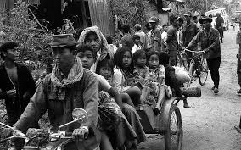
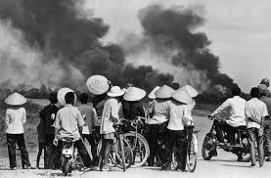
War and social conflict – Viet Nam
Exodus to the countryside - Cambodia

Slide 4
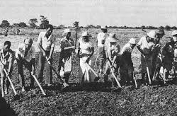
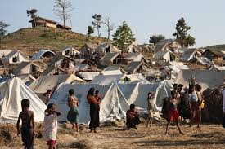
Collective farming – Viet Nam
Ethnic conflict - Myanmar

Slide 5
Reform Measures
Short term: macroeconomic stability: control inflation and stabilize exchange rates. This could be done through borrowing
Medium term: open economy to foreign capital/investments. This will require creating a conducive business climate
Long term: structural adjustment: ensure that economy is sustainable; will require changes in regulations, institutions and accepted norms

Slide 6
Structural adjustment
Examples
Rationalize state-owned enterprises
Decentralize state functions
Build human resource capacity
Better manage the environment
Increase productivity

Slide 7
ECONOMIC REFORM: benefits and risks
Benefits
Generate foreign exchange
Enable the country to compete internationally
Further socioeconomic development
Strengthen government institutions
Risks
Crowd out domestic investors
Financial sector instability – vulnerable to external shocks
Risk of environmental degradation
Increase inequality

Slide 8
Economic reform in clmv
Post World War II (1960-1980)
Period of instability and social conflict
CLMV caught cold war between capitalism and communism
Transition period (1980-1990)
State led economic growth (central planning); inefficient production
Isolation from the rest of the world; mounting debt
Reform era (1990-onwards)
Shift from central planning to market-based economy
Introduction of reform measures
Inflow of foreign aid and investments

Slide 9
Cambodia
1979: End of Khmer Rouge, bringing more stability to Cambodia
1991: Paris Peace Talks unites conflicting parties to form coalition
1993: UN aids Cambodia towards peaceful political and economic transition
Reform policies and strategies: National Socioeconomic Development Plans, Rectangular Strategy
With the introduction of reforms, ODA and FDI began to flow
GDP growth averaged 10% (2000-2008) and 6% (2010-2016)
Main income generating sectors: garment, construction, agriculture, tourism
Challenges: natural disasters (flood and drought), widening gap between rich and poor; dependency on the 4 sectors; weak governance

Slide 10
Lao PDR
1975: Monarchy was abolished and Pathet Lao comes to power
1986: 4th Congress passes the New Economic Mechanism (NEM)
1997: Lao PDR joins ASEAN, joins AFTA in 2008
NEM: transition from central planning to market-based; stabilize the macro-economy, deregulate private sector, stabilize food prices, decentralization
Subsequent agricultural, enterprise and land laws issues
GDP growth averaged 7% since 2004
Main income generating sectors: hydropower, natural resources and tourism
Challenges: weak human capacity and governance, environmental degradation, low agricultural productivity; low volume of exports

Slide 11
Viet nam
1975: Reunification of North and South Viet Nam
1986: 6th Congress passes the Doi Moi (renovation) policy
1997: Lao PDR joins ASEAN, joins AFTA in 2008
Doi Moi: shift from central planning to market-based; stabilize the macro-economy, price liberalization, financial reform
Agriculture law and policies to increase rice production
Enterprise law and polices to attract foreign investment and private sector
GDP growth increase: 2.7 times (2000-2019)
Poverty reduction: 26% in 1990 to 12% in 2017
Challenges: widening inequality, environmental degradation and pollution, balance between rural and urban development

Slide 12
Myanmar
1948-1962: successive civilian governments followed by military coup d’etat
1987: reorientation towards market economy; however reform not carried out
2011: civilian government returns and pursues economic reform
Reform thrust: macroeconomic stabilization, adjustment of currency rate, relaxed import restrictions
Restructuring of state-owned enterprises (telcom, finance, energy)
Revaluation of the Myanmar Kyat resulted in large inflows of capital
Reforms of SOEs not forthcoming; limited inflow of capital
Challenges: lack of skilled workers, technology, skepticism from foreign investors, over reliance on extractive industries (mining, forest products, energy)

Slide 13
conclusion
Since All CLMV countries except Myanmar have experienced annual GDP growth of between 6-10% (except during the 2007-08 global financial crisis)
Economic reforms have focused on macroeconomic stabilization, opening up the economy to foreign capital and private sector deregulation; however structural adjustment is lagging behind
The agricultural sector is still dominant in terms of employment; however productivity (except Viet Nam) is quite low. Tourism is becoming an important source of income.

Slide 14
conclusion
Exports are increasing; however these are mostly low value goods (extractive and labor intensive manufacturing). Human skills, capital and technology are needed to produce higher value goods.
Government will need to focus on human development (education, vocational skills, management) and health programs (access to health facilities, improving health care quality) to increase productivity and ensure competitiveness.

