Slide 1
Data Visualization
Presenting data in a chart format

Slide 2
Why do we visualize data?

Slide 3
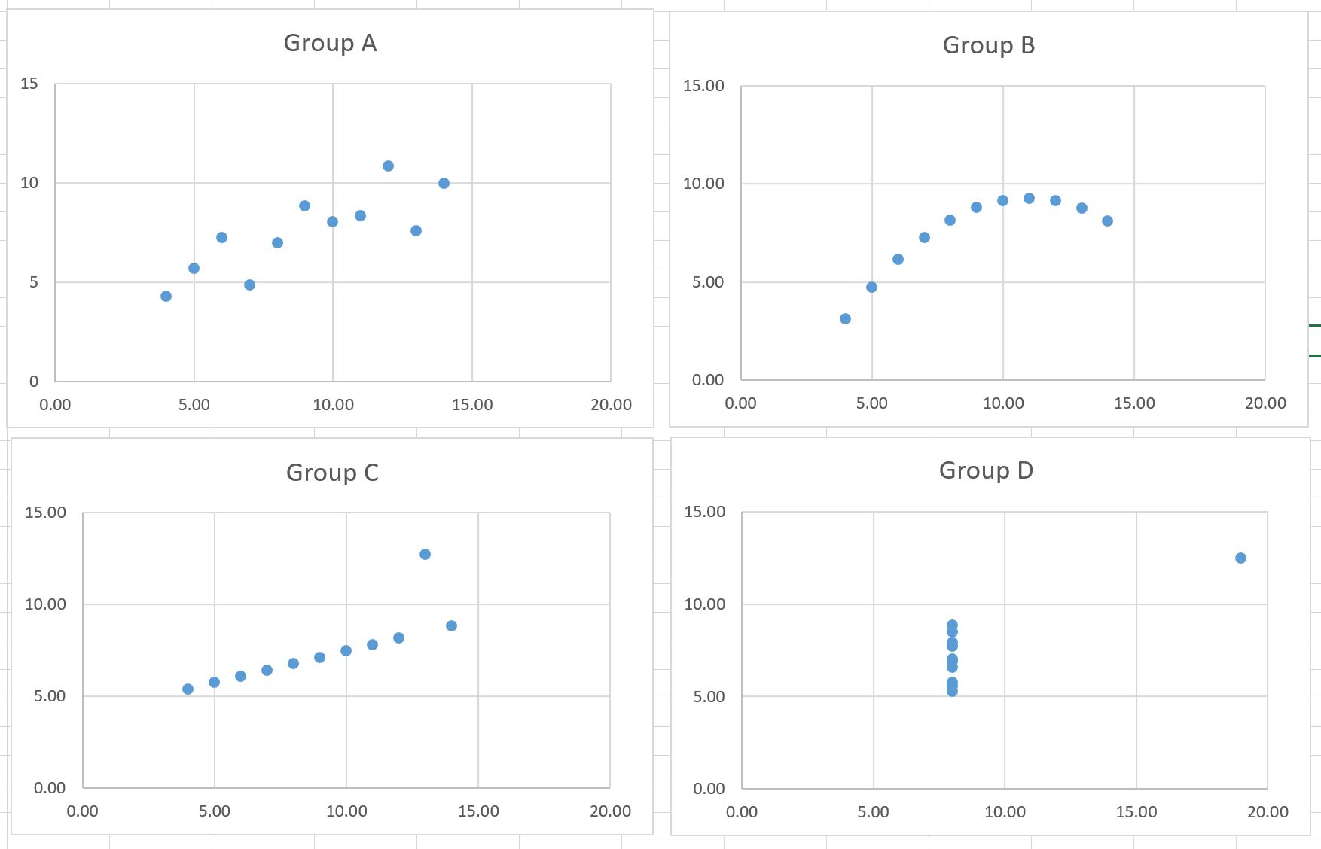

Slide 4
Understand how you data is distributed or spread out
Scatter plot
Line
Bar
column

Slide 5
Analyze trends in you data
Column
Line

Slide 6
Compare values
Bar
Column
Line
Scatter

Slide 7
Understand how the components of your data is made up
Pie
Stacked Bar
Stacked Column
Area

Slide 8
Understand the relationship of subsets of data
Scatter Plot
Line
Bubble

Slide 9
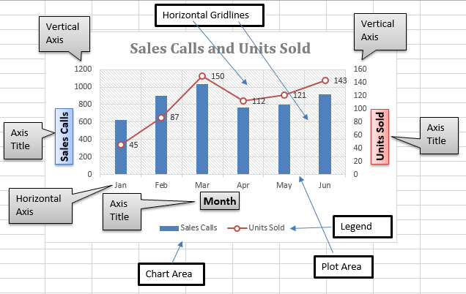
Chart elements (in excel)
Source: https://www.exceldemy.com/elements-of-an-excel-chart/

Slide 10
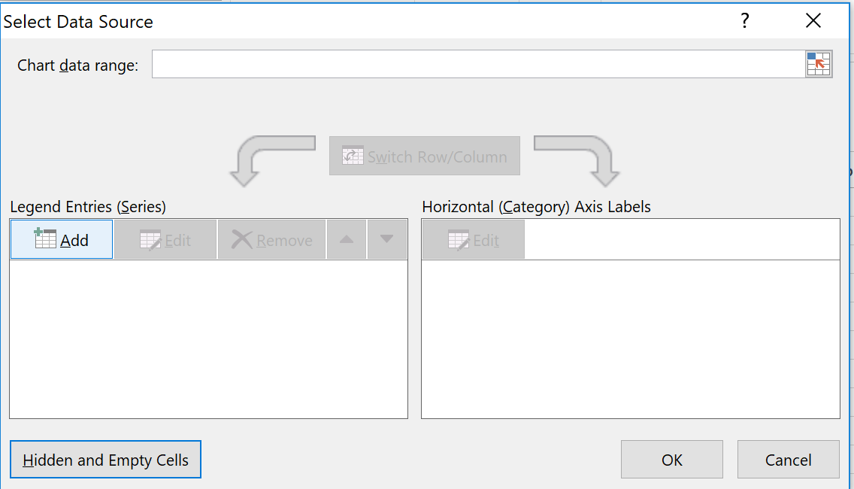
Common steps to create chart
Go to Insert tab > choose chart type that you want
Right click on the blank chart > choose “select data”
Click Add to add data values you want to plot
Edit horizontal axis labels if needed

