Slide 1
Equilibrium Analysis in Economics
Pawin Siriprapanukul
CW Ch.3

Slide 2
Outline
The meaning of equilibrium
Partial market equilibrium – A linear model
Partial market equilibrium – A nonlinear model
General market equilibrium*
Equilibrium in National-Income Analysis*

Slide 3
The Meaning of Equilibrium
An equilibrium is a state of selected interrelated variables so adjusted to one another that no inherent tendency to change prevails in the model which they constitute
Equilibrium depends on selected variables included into the model under consideration.
In order for equilibrium to occur, all variables in the model must simultaneously be in a state of rest. Moreover, the state of rest of each variable must be compatible with that of every other variable.
In defining an equilibrium, the state of rest involved is based only on the balancing of the internal forces of the model, while the external forces are assumed to be fixed.

Slide 4
The Meaning of Equilibrium
An equilibrium for a specified model is a state where internal forces are balanced and in the absence of external influences, the equilibrium will not change
It is for this reason that the analysis of equilibrium is referred to as statics.
This is the concept of rest point, where if this point is attained, it will be there forever, fixing any changes in the external forces.

Slide 5
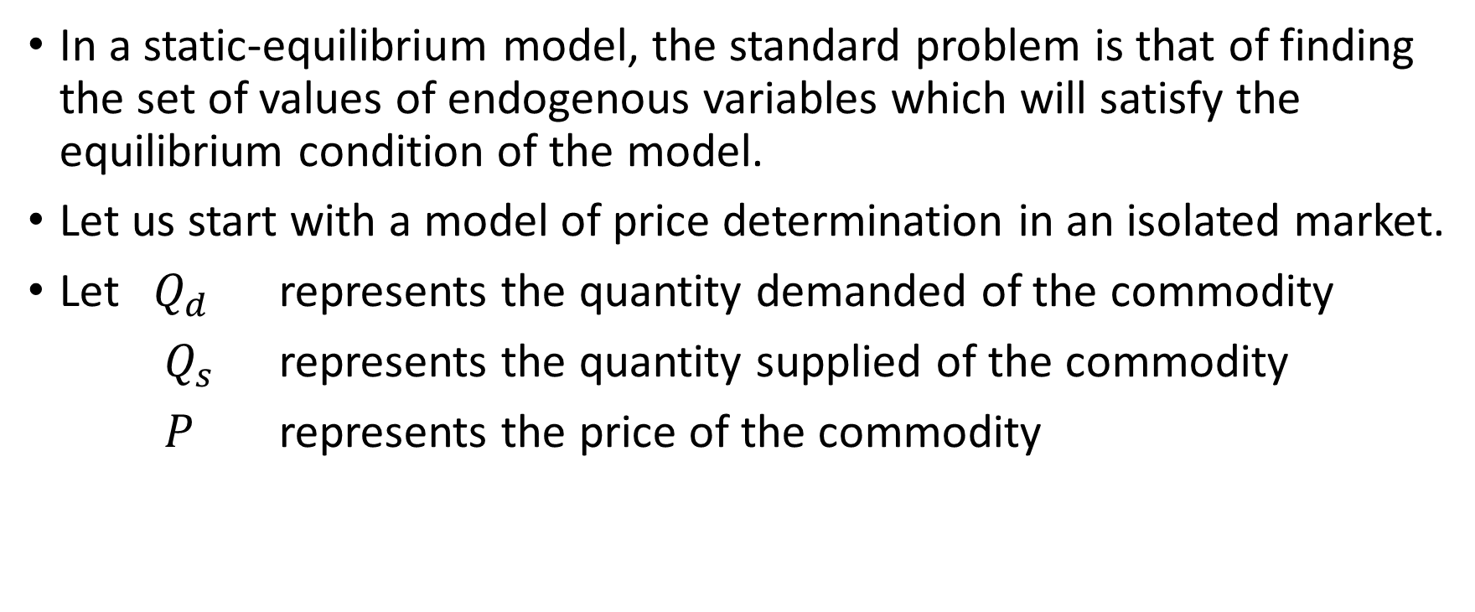
Partial Market Equilibrium – A Linear Model
In a static-equilibrium model, the standard problem is that of finding the set of values of endogenous variables which will satisfy the equilibrium condition of the model.
Let us start with a model of price determination in an isolated market.
Let $Q_{d}$ represents the quantity demanded of the commodity
$Q_{s}$ represents the quantity supplied of the commodity
$P$ represents the price of the commodity

Slide 6
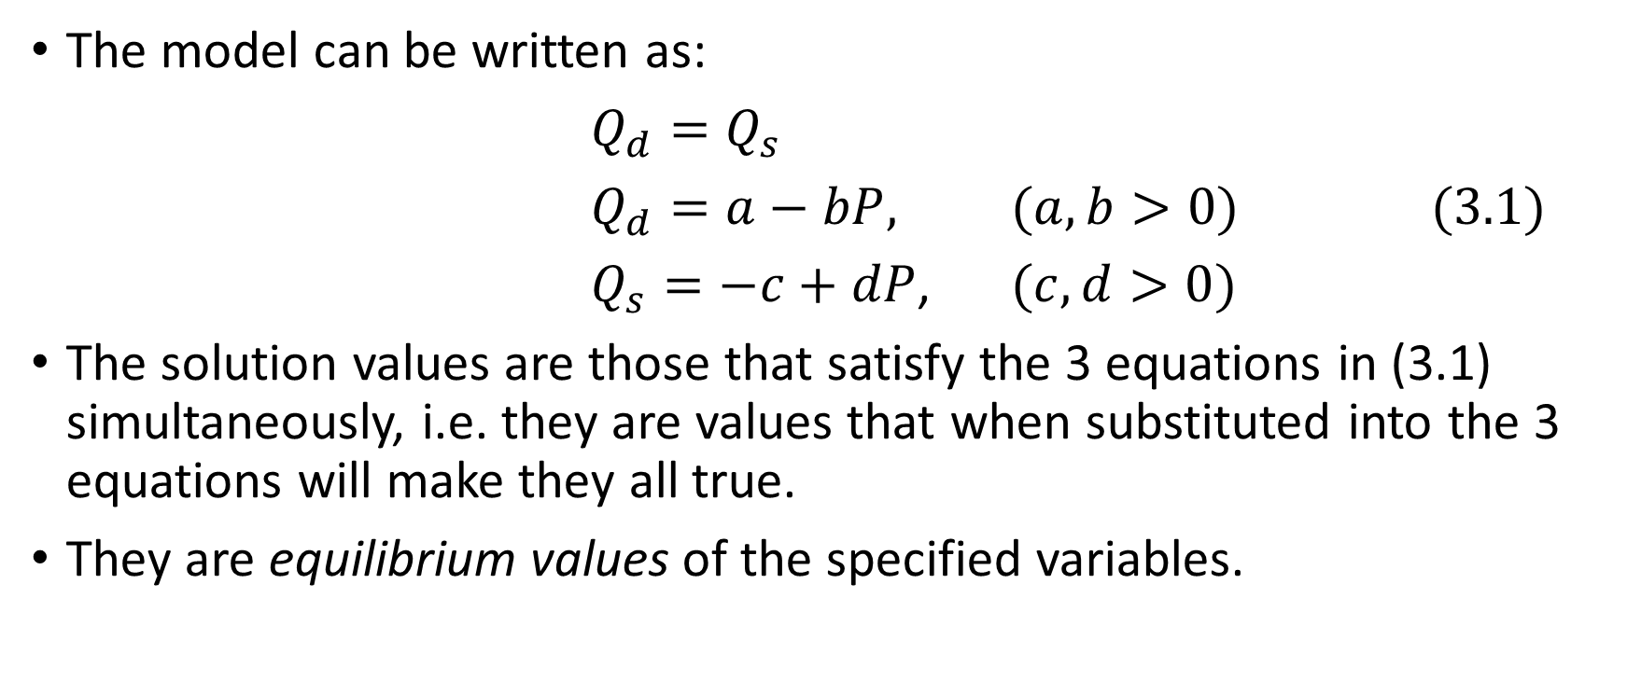
Model of Price Determination in An Isolated Market
The model can be written as:
$Q_{d}=Q_{s}$
$Q_{d}=a−bP$, $(a,b>0)$ (3.1)
$Q_{s}=−c+dP$, $(c,d>0)$
The solution values are those that satisfy the 3 equations in (3.1) simultaneously, i.e. they are values that when substituted into the 3 equations will make they all true.
They are equilibrium values of the specified variables.

Slide 7
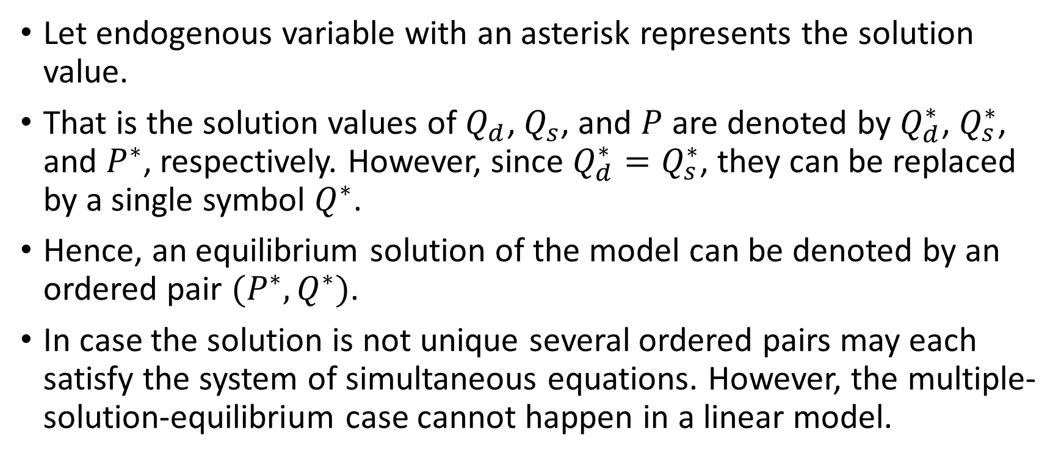
Equilibrium Notation
Let endogenous variable with an asterisk represents the solution value.
That is the solution values of $Q_{d}$, $Q_{s}$, and $P$ are denoted by $Q_{d}^{∗}$, $Q_{s}^{∗}$, and $P^{∗}$, respectively. However, since $Q_{d}^{∗}=Q_{s}^{∗}$, they can be replaced by a single symbol $Q^{∗}$.
Hence, an equilibrium solution of the model can be denoted by an ordered pair $(P^{∗},Q^{∗})$.
In case the solution is not unique several ordered pairs may each satisfy the system of simultaneous equations. However, the multiple-solution-equilibrium case cannot happen in a linear model.

Slide 8
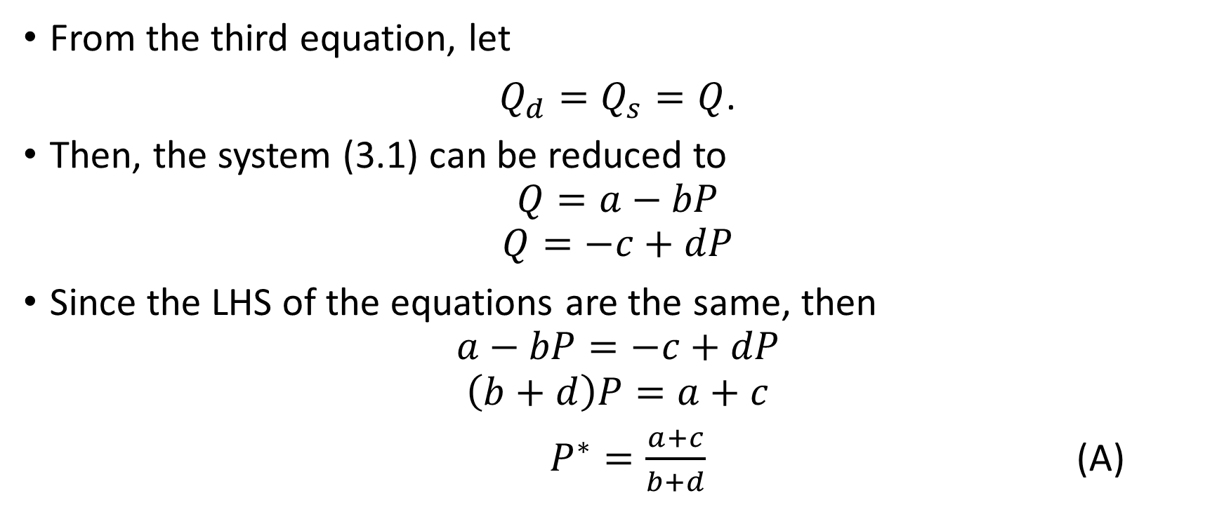
A Solution Method
(by Elimination of Variables)
From the third equation, let
$Q_{d}=Q_{s}=Q$.
Then, the system (3.1) can be reduced to
$$Q=a−bP$$
$$Q=−c+dP$$
Since the LHS of the equations are the same, then
$$a−bP=−c+dP$$
$$\left(b+d\right)P=a+c$$
$P^{∗}=\frac{a+c}{b+d}$ (A)

Slide 9
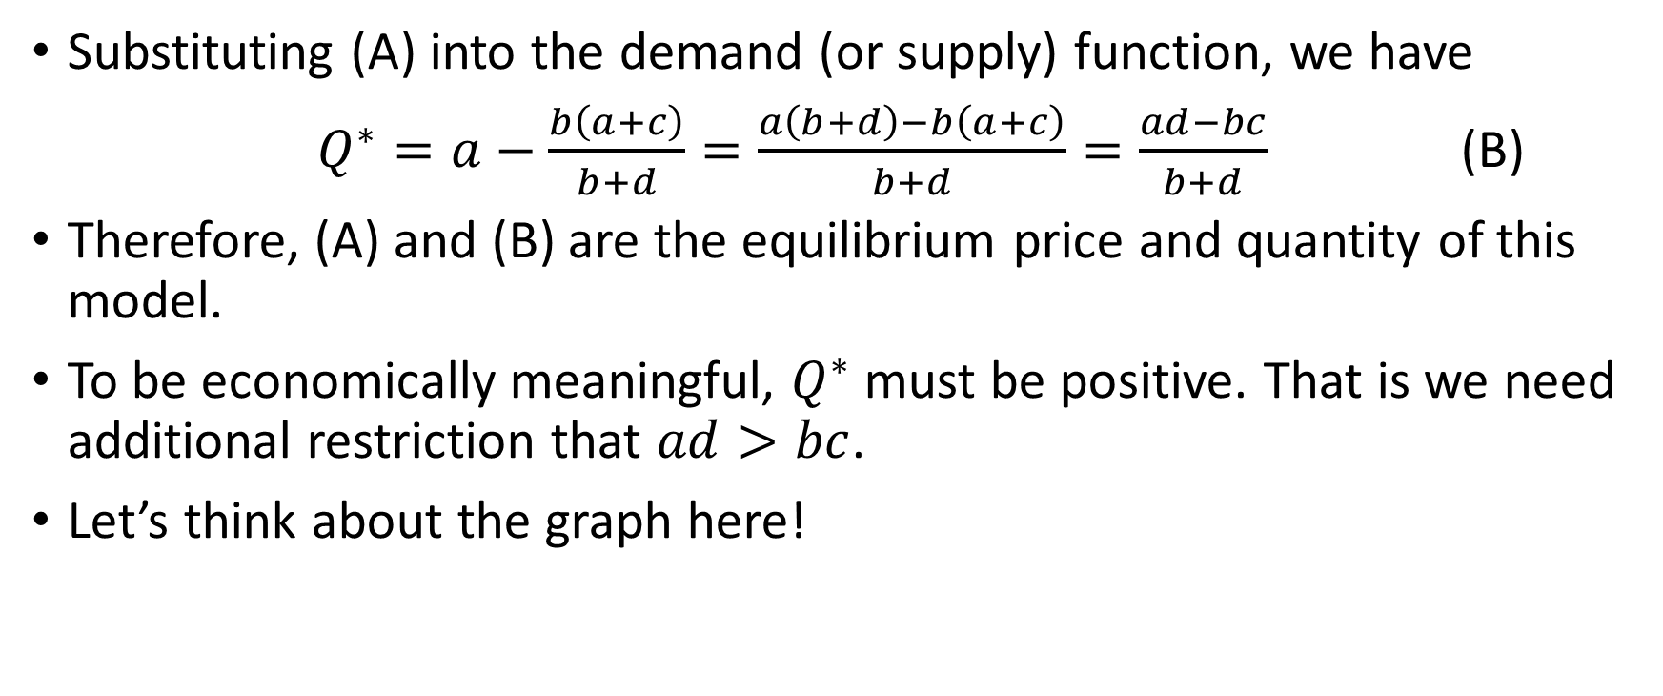
A Solution Method
Substituting (A) into the demand (or supply) function, we have
$Q^{∗}=a−\frac{b\left(a+c\right)}{b+d}=\frac{a\left(b+d\right)−b\left(a+c\right)}{b+d}=\frac{ad−bc}{b+d}$ (B)
Therefore, (A) and (B) are the equilibrium price and quantity of this model.
To be economically meaningful, $Q^{∗}$ must be positive. That is we need additional restriction that $ad>bc$.
Let’s think about the graph here!

Slide 10
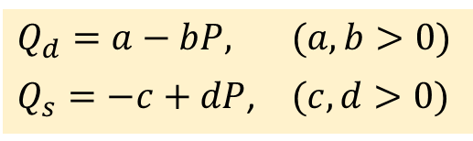
The Graph
$Q_{d}=a−bP$, $(a,b>0)$
$Q_{s}=−c+dP$, $(c,d>0)$
P
0
Q

Slide 11
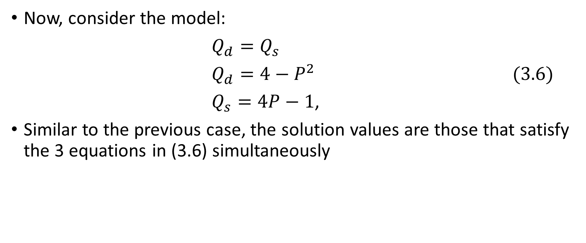
Partial Market Equilibrium – A Nonlinear Model
Now, consider the model:
$Q_{d}=Q_{s}$
$Q_{d}=4−P^{2}$ (3.6)
$Q_{s}=4P−1$,
Similar to the previous case, the solution values are those that satisfy the 3 equations in (3.6) simultaneously

Slide 12
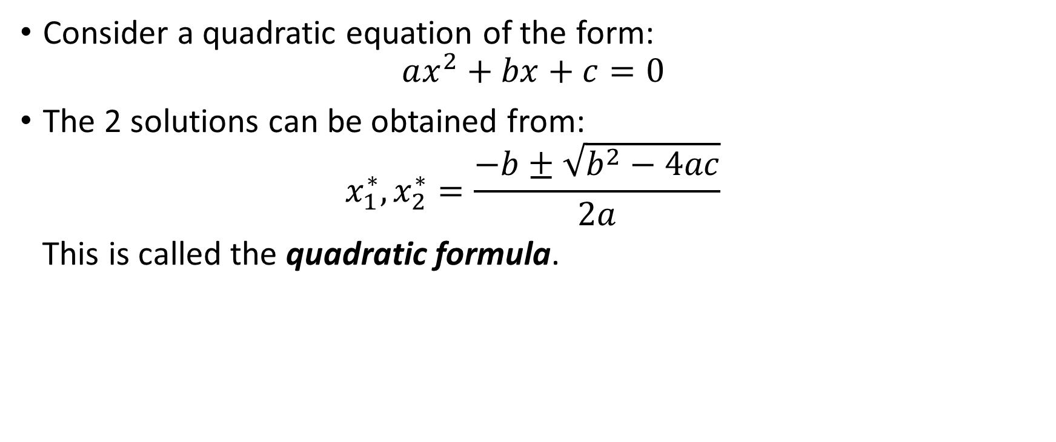
*The Quadratic Formula
Consider a quadratic equation of the form:
$$ax^{2}+bx+c=0$$
The 2 solutions can be obtained from:
$$x_{1}^{∗},x_{2}^{∗}=\frac{−b±\sqrt{b^{2}−4ac}}{2a}$$
This is called the quadratic formula.

Slide 13
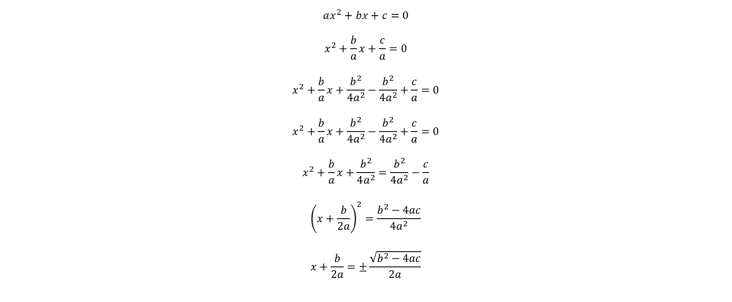
*The Quadratic Formula: Derivation
$$ax^{2}+bx+c=0$$
$$x^{2}+\frac{b}{a}x+\frac{c}{a}=0$$
$$x^{2}+\frac{b}{a}x+\frac{b^{2}}{4a^{2}}−\frac{b^{2}}{4a^{2}}+\frac{c}{a}=0$$
$$x^{2}+\frac{b}{a}x+\frac{b^{2}}{4a^{2}}−\frac{b^{2}}{4a^{2}}+\frac{c}{a}=0$$
$$x^{2}+\frac{b}{a}x+\frac{b^{2}}{4a^{2}}=\frac{b^{2}}{4a^{2}}−\frac{c}{a}$$
$${\left(x+\frac{b}{2a}\right)}^{2}=\frac{b^{2}−4ac}{4a^{2}}$$
$$x+\frac{b}{2a}=±\frac{\sqrt{b^{2}−4ac}}{2a}$$

Slide 14
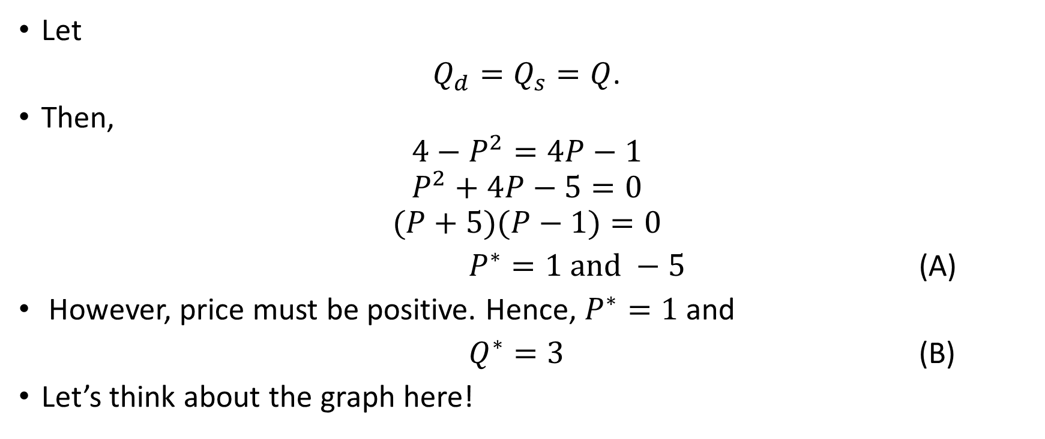
A Solution Method
(by Elimination of Variables)
Let
$Q_{d}=Q_{s}=Q$.
Then,
$$4−P^{2}=4P−1$$
$$P^{2}+4P−5=0$$
$$(P+5)(P−1)=0$$
$P^{∗}=1 and −5$ (A)
However, price must be positive. Hence, $P^{∗}=1$ and
$Q^{∗}=3$ (B)
Let’s think about the graph here!

Slide 15
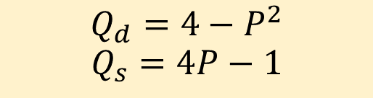
The Graph
$$Q_{d}=4−P^{2}$$
$$Q_{s}=4P−1$$
P
0
Q

Slide 16
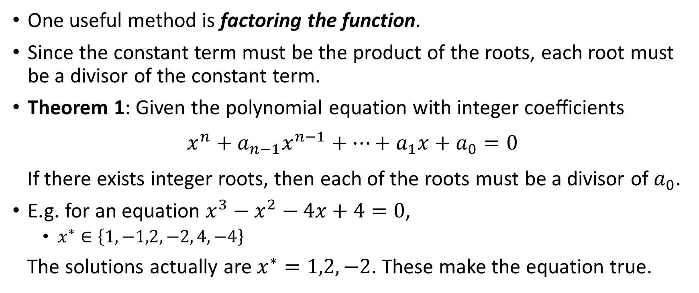
Higher-Degree Polynomial Equations
One useful method is factoring the function.
Since the constant term must be the product of the roots, each root must be a divisor of the constant term.
Theorem 1: Given the polynomial equation with integer coefficients
$$x^{n}+a_{n−1}x^{n−1}+…+a_{1}x+a_{0}=0$$
If there exists integer roots, then each of the roots must be a divisor of $a_{0}$.
E.g. for an equation $x^{3}−x^{2}−4x+4=0$,
  $x^{∗}∈\left\{1,−1,2,−2, 4,−4\right\}$
The solutions actually are $x^{∗}=1,2,−2$. These make the equation true.

Slide 17
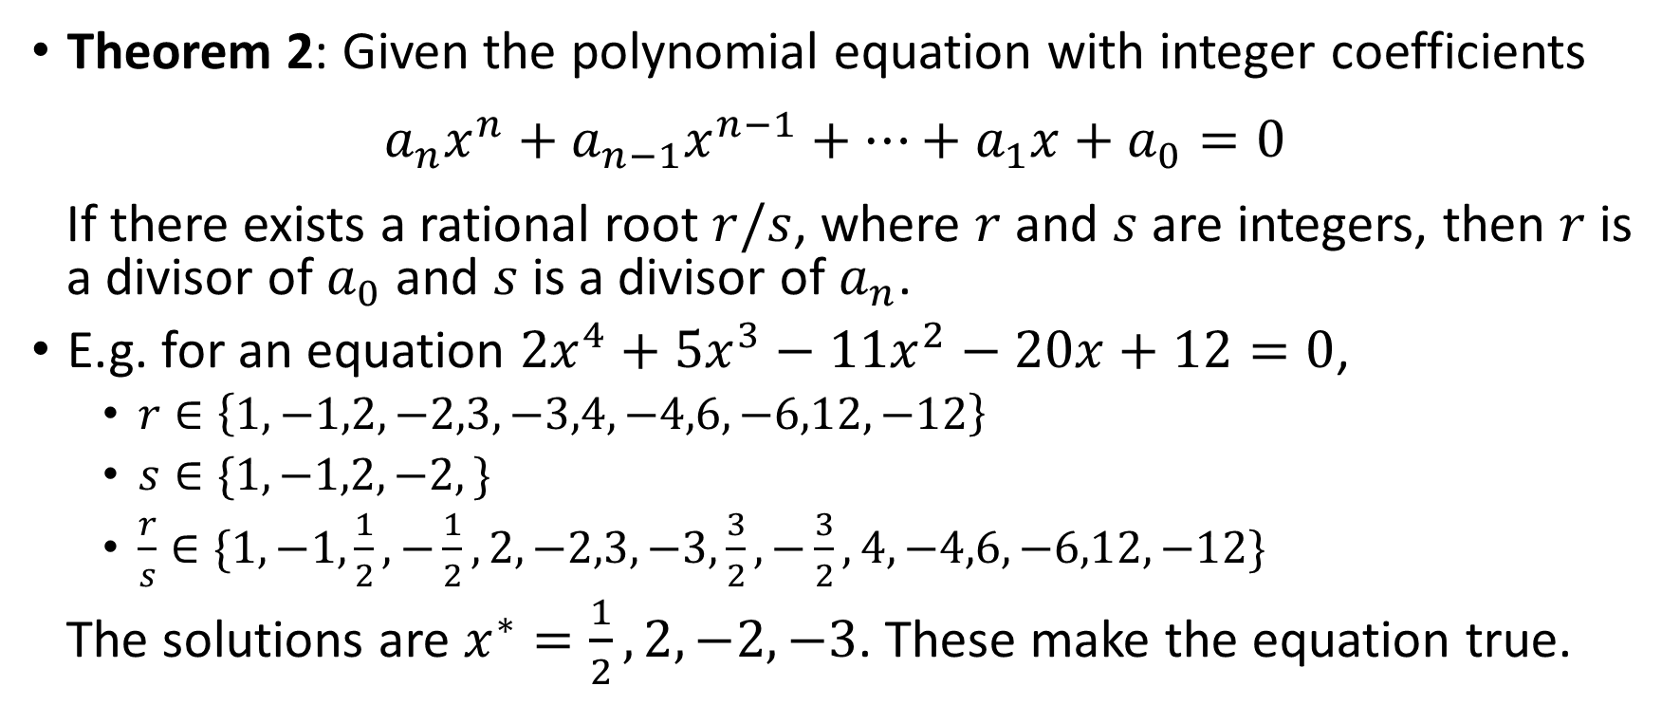
Higher-Degree Polynomial Equations
Theorem 2: Given the polynomial equation with integer coefficients
$$a_{n}x^{n}+a_{n−1}x^{n−1}+…+a_{1}x+a_{0}=0$$
If there exists a rational root $r/s$, where $r$ and $s$ are integers, then $r$ is a divisor of $a_{0}$ and $s$ is a divisor of $a_{n}$.
E.g. for an equation $2x^{4}+5x^{3}−11x^{2}−20x+12=0$,
  $r∈\left\{1,−1,2,−2,3,−3,4,−4,6,−6,12,−12\right\}$
  $s∈\{1,−1,2,−2,\}$
  $\frac{r}{s}∈\{1,−1,\frac{1}{2},−\frac{1}{2},2,−2,3,−3,\frac{3}{2},−\frac{3}{2},4,−4,6,−6,12,−12\}$
The solutions are $x^{∗}=\frac{1}{2},2,−2,−3$. These make the equation true.

Slide 18
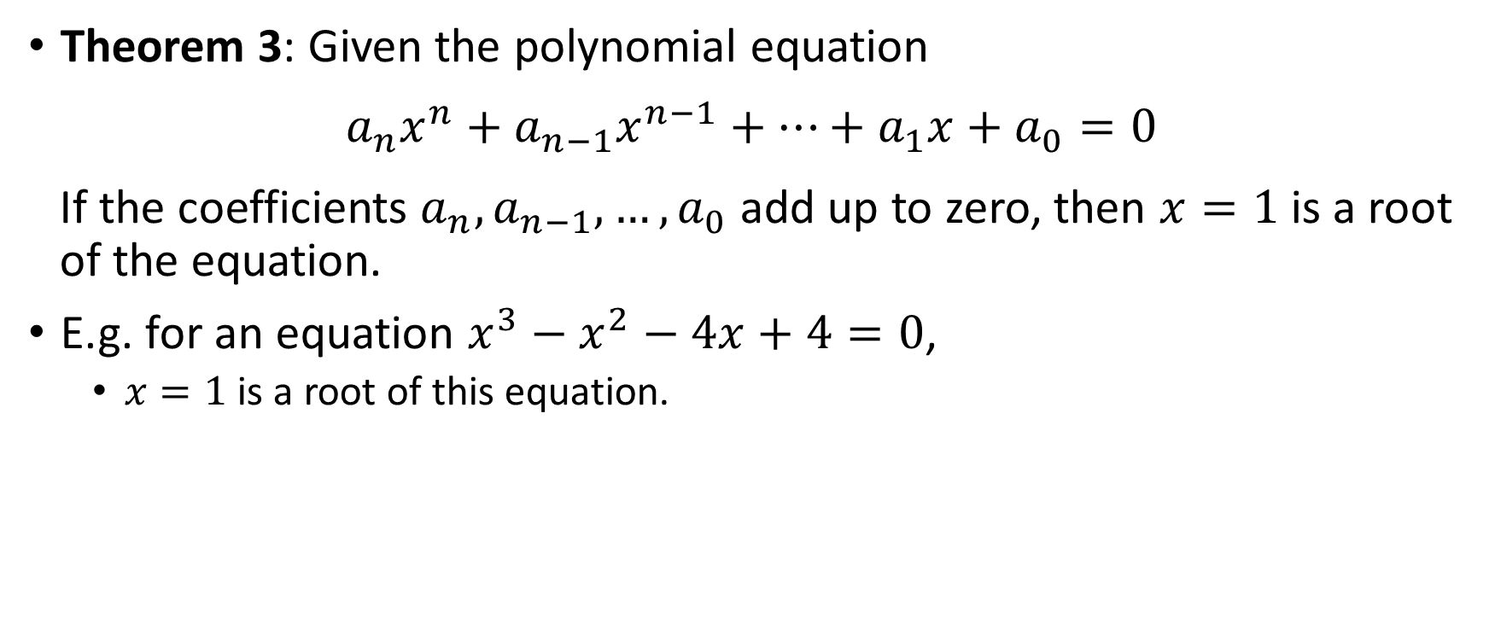
Higher-Degree Polynomial Equations
Theorem 3: Given the polynomial equation
$$a_{n}x^{n}+a_{n−1}x^{n−1}+…+a_{1}x+a_{0}=0$$
If the coefficients $a_{n},a_{n−1},…,a_{0}$ add up to zero, then $x=1$ is a root of the equation.
E.g. for an equation $x^{3}−x^{2}−4x+4=0$,
  $x=1$ is a root of this equation.

