Slide 1
STATA Section

Slide 2

Content
-Why stata?
-Do-file
-Import Data From Excel
-Window Interface
-Rename and Label
-Basic Statistic
-Graph(Scatter) and Line Fit Gen.
-Regression
-Variable Gen.
-HAM(Heteroscedasticity, Auto Correlation, Multi collinearity)

Slide 3

Why Stata ?

Slide 4
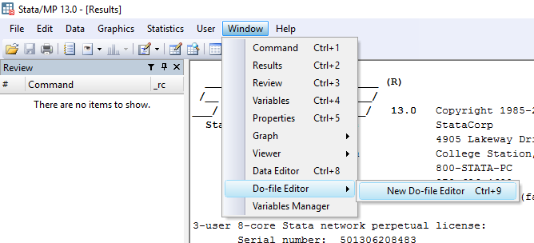
Do-file

Slide 5
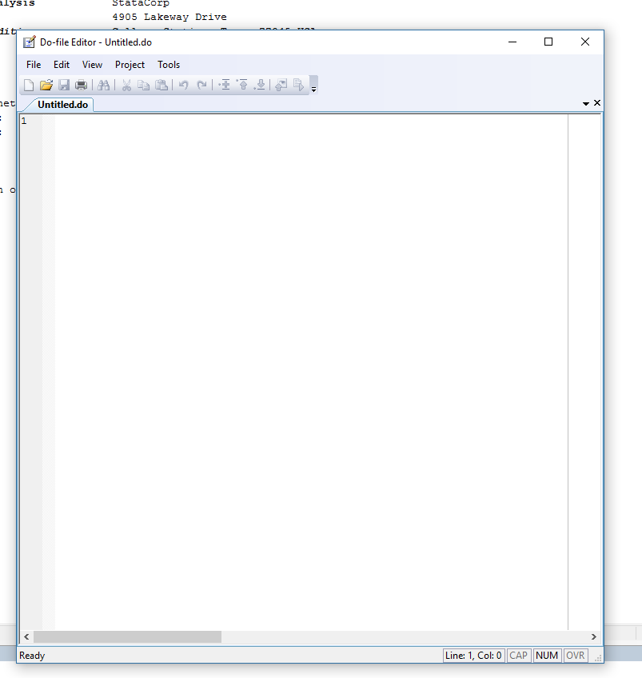
Do-file

Slide 6
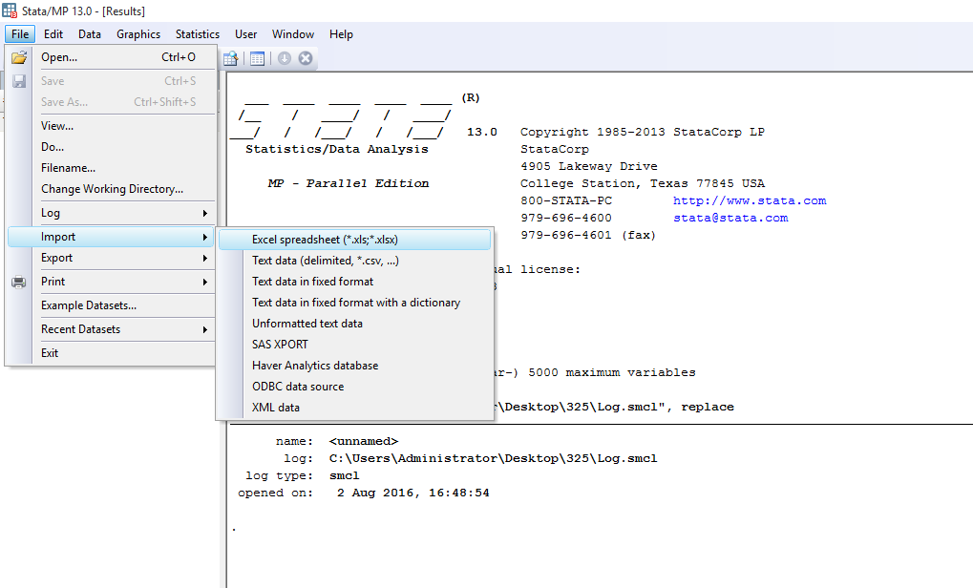
Import Data From Excel

Slide 7
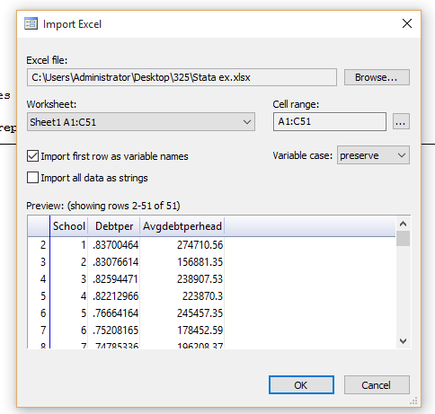
Import Data From Excel
Don’t forget

Slide 8
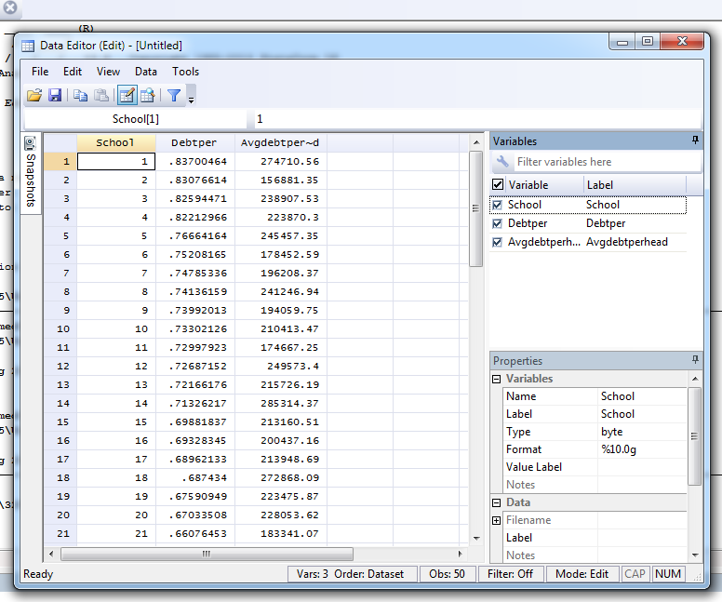
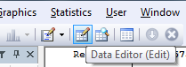
Import Data From Excel

Slide 9
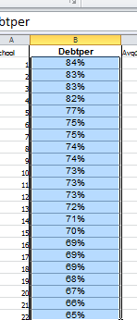
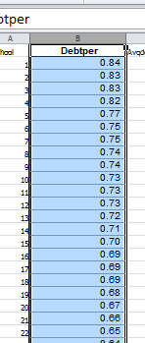
Import Data From Excel
-Before import the data from excel make sure that the data is suitable for our work.
-For example, make sure that the data is numerical for quantitative analysis.
-Not that we cant do it in Stata, but it is sometimes easier in excel.

Slide 10
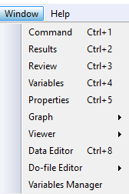
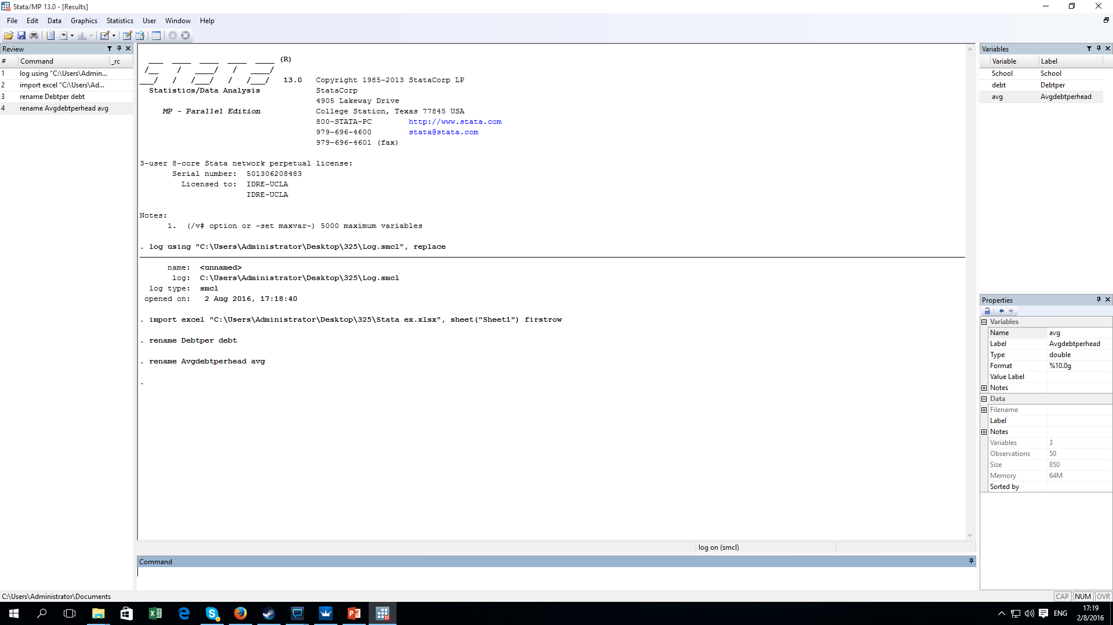
Window interface

Slide 11
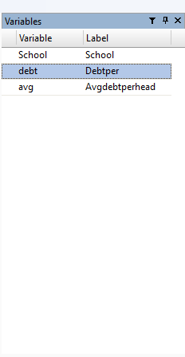
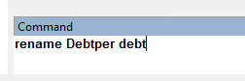
Rename
New name
Old name

Slide 12
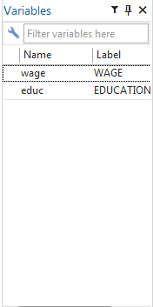
Label
variable
New Label

Slide 13
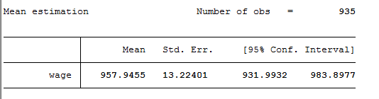
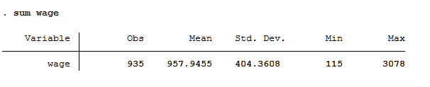
Basic statistic
mean wage
sum wage

Slide 14
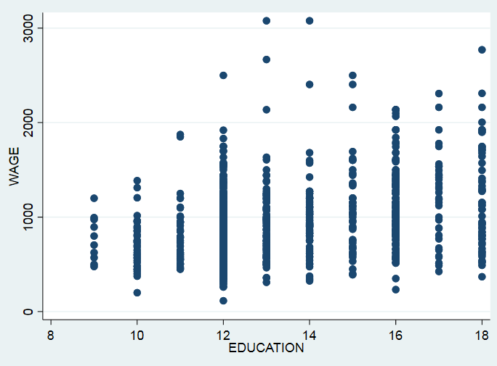
Graph and Line Gen.
Scatter/Dot
twoway scatter wage educ
X axis
Types of twoway graph
Y axis

Slide 15
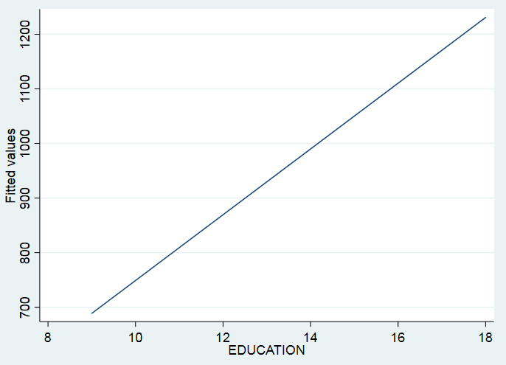
Graph and Line Gen.
twoway lfit wage educ

Slide 16
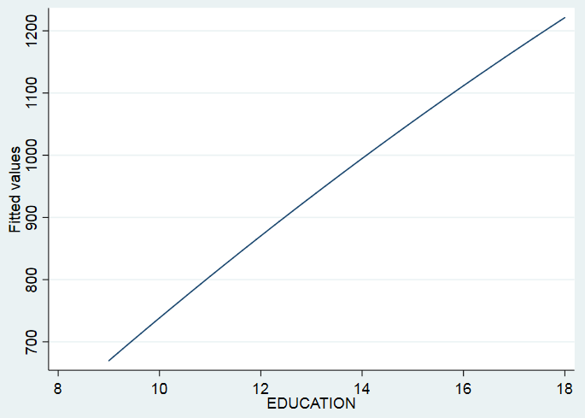
Graph and Line Gen.
twoway qfit wage educ

Slide 17
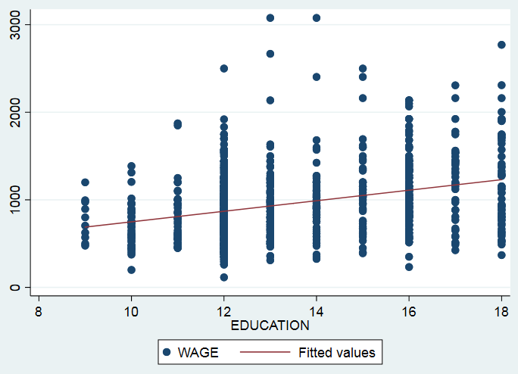
Graph and Line Gen.
twoway scatter wage educ || lfit wage educ
twoway (scatter wage educ)(lfit wage educ)
OR

Slide 18
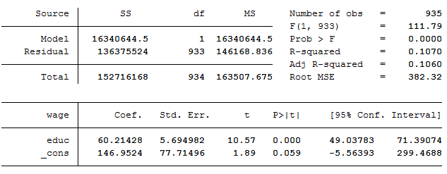
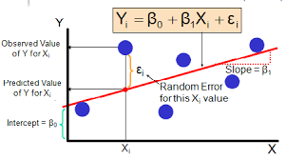
Regression
Model 1: wage = β0+ β1educ + u
Reg wage educ
Y axis
X axis

Slide 19
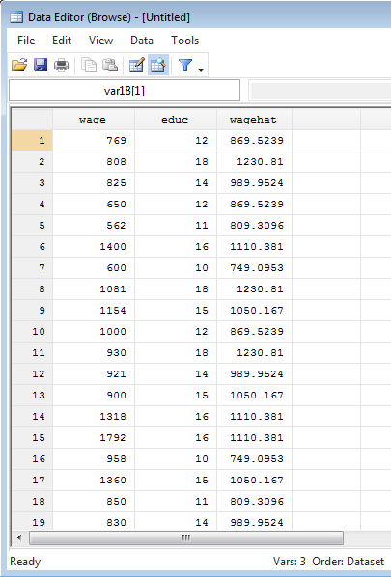
Regression
These next two commands will be applied for the latest regression.
predict wagehat,xb
Name of predicted var
xb means linear prediction

Slide 20
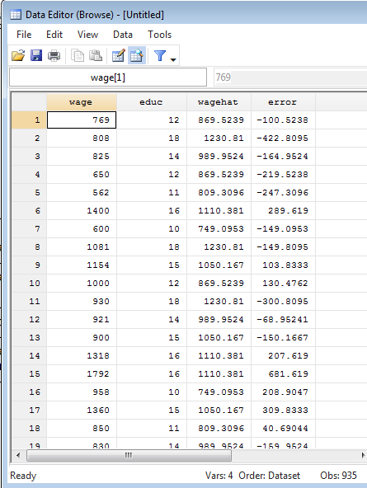
Regression
predict error,resid
Name of predicted var
resid means residual or error term

Slide 21
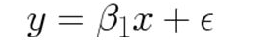
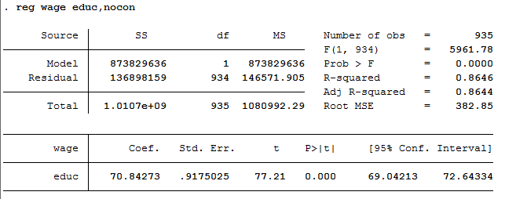
Regression
No intercept model
reg wage educ,nocon

Slide 22
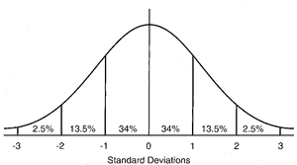
Regression
There are two variables that are not statistically significant.
What should we do about it ? Cut one of them or both ?
debt | Coef. | Std. error | t | P > |t|
y | 210704 | 136820 | 1.54 | .88
avg | 2.58e-06 | 2.07e-07 | 12.46 | 0.00
_cons | -0.56 | 17.5 | 0.032 | .975

Slide 23
Regression
r^2
Beta2
Beta1
2 tailed P-Value

Slide 24
Regression
F Cal
ESS
RSS
Root MSE = Avg amount of different in estimated and actual Y

Slide 25
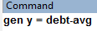
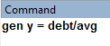
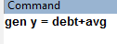
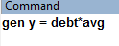
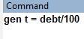
Variable gen.
+ = plus
= minus
/ = divide
* = multiply
New var name
Constant is also fine

Slide 26
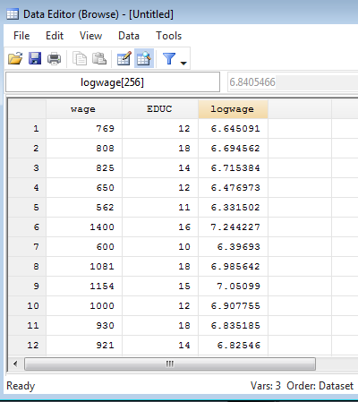
Variable gen.
Log / ln
gen logwage = log(wage)

Slide 27
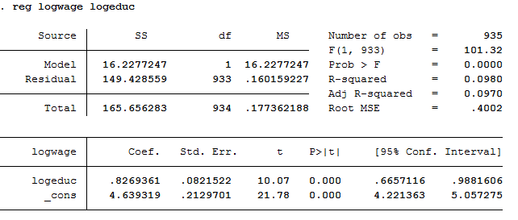
Log-Log model
Model 2: log(wage) = β0+ β1log(educ) + u
reg logwage logeduc

Slide 28
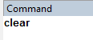
Multi Variables regression
Clear all data

Slide 29
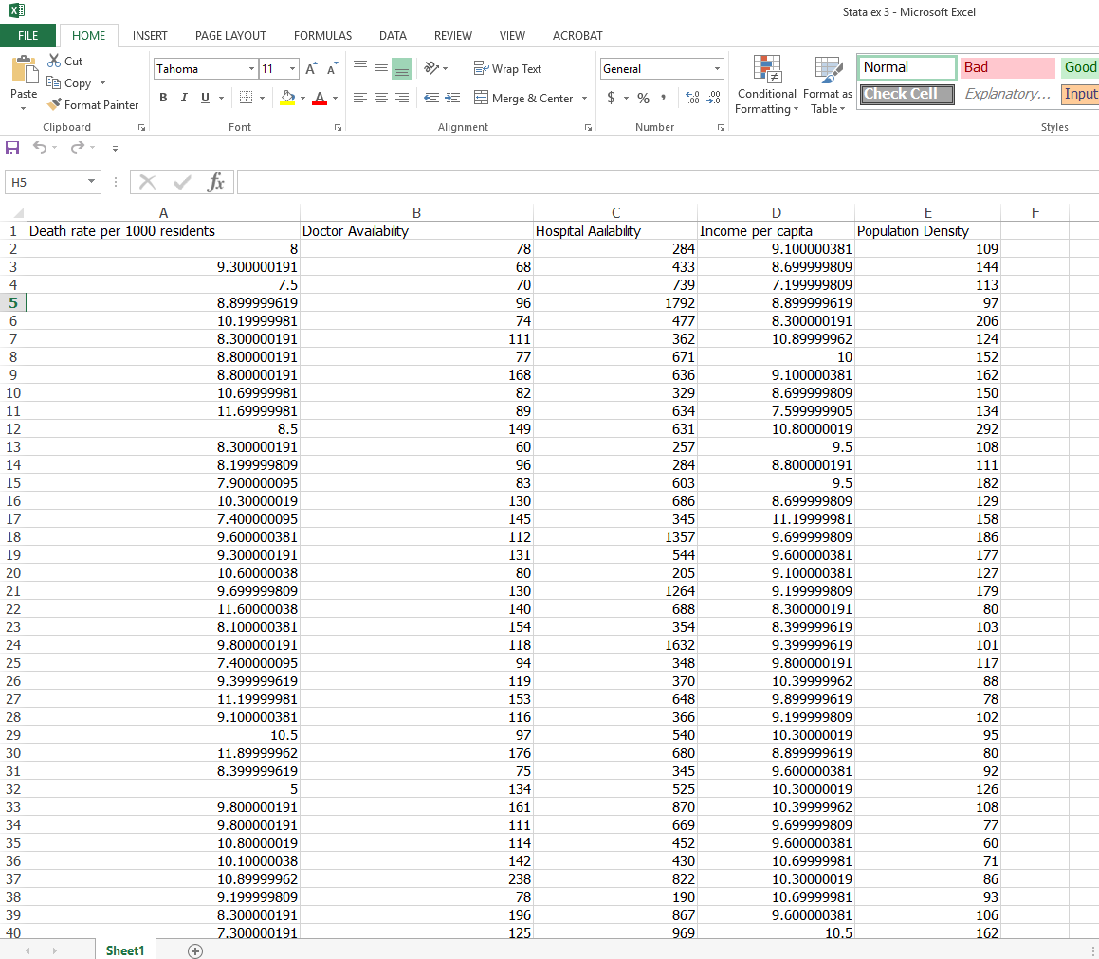
Multi Variables regression
Use file “stata ex 3”

Slide 30
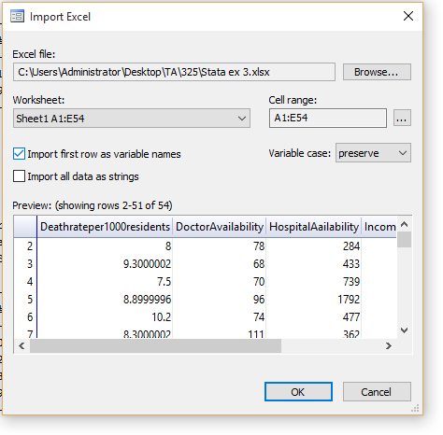
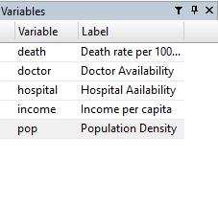
Multi Variables regression
-Import file
-rename and labor

Slide 31
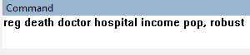
Multi Variables regression
Dependent variable
Independent variables

Slide 32
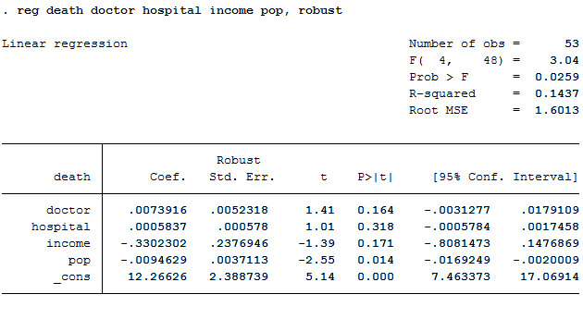
Multi Variables regression

Slide 33
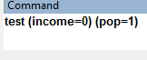
Hypothesis Testing
- It will use the latest regression as a tested data.
Command
variables

Slide 34
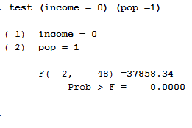
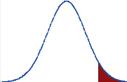
Hypothesis Testing
Ho

