Slide 1


Economics of Services Sector
Trade in Services

Slide 2
Did you know?
Over the past 20 years, trade in services has become the most dynamic segment of world trade, growing more quickly than trade in goods.
Developing countries and transition economies have played an increasingly important role in this area, increasing their share in exports of world services from a quarter to one-third over this period.
Source: WTO (2015)

Slide 3
Trade in service by developing economies
Source: WTO (2015)

Slide 4
General Agreement on Trade in Services (GATS)
The GATS entered into force in 1995.
It remains the only set of multilateral rules covering international trade in services.
It reflects the gradual transfer of responsibility for many services from government-owned suppliers to the private sector and the increased potential for trade in services brought about by advances in ICT.
Services covered by the GATS are not automatically opened to competition. WTO members guarantee access to their markets only in those sectors and modes of supply specified in their “schedules of commitments”, subject to any “limitations” they wish to maintain.
The only obligation that applies across all services covered by the GATS is the most-favoured-nation (MFN) principle, meaning suppliers of services from all countries are treated in the same way.
Source: WTO (2015)

Slide 5
The GATS covers all services (see below), with the exception of “services provided in the exercise of governmental authority” and the bulk of air transport services.
Main services sectors
Source: WTO (2015)

Slide 6
How are services traded?
The GATS defines trade in services in terms of modes of supply:
Mode 1: services supplied from one country to another (for example, call centre services).
Mode 2: consumers or firms making use of a service in another country (for example, through international tourism).
Mode 3: a foreign company setting up subsidiaries or branches to provide services in another country (such as a bank setting up a branch overseas).
Mode 4: individuals travelling from their own country to supply services in another (for example, a consultant travelling abroad to provide an IT service).
Source: WTO (2015)

Slide 7
How are services traded?
Mode 2 is by far the most liberalized mode in terms of commitments by WTO members. This is mostly due to governments being less likely to restrict the movements of citizens outside domestic borders (e.g. tourists).
Mode 1 is not often committed, mostly because it is impossible for many services to be supplied remotely (e.g. construction services)
Mode 3 is more open, reflecting its crucial role in driving the international supply of services, transferring know-how and improving the capacity of economies to participate in global value chains.
Mode 4 has the lowest depth of commitments, probably due to a number of sensitivities involved with the movement of foreign workers.
Source: WTO (2015)

Slide 8
How are services traded?
In 2014, trade in services totalled USD 4,800 billion, representing 21 per cent of world trade in goods and services.
However, this total does not cover services delivered via foreign affiliates (i.e. essentially mode 3).
The total trade in services is therefore estimated to be much larger, even twice as large, as mode 3 represents 55 per cent of total services trade

Slide 9
GATS Commitments
Note:
Total of approximately 160 sectors
Unlike in the General Agreement on Tariffs and Trade (GATT), where tariffs are the only permissible restrictions, the limitations attached to WTO members’ GATS commitments cover a broad range of measures, including numerical quotas, limits on foreign ownership, and discriminatory subsidies.
Source: WTO (2015)

Slide 10
GATS Commitments
Source: WTO (2015)
The sector most commonly included in WTO members’ schedules of commitments is tourism, followed by infrastructure services (financial services, business services, and telecommunications).
The sectors least frequently included in commitments are education and health services, reflecting the high levels of direct government provision in these services

Slide 11
Extending commitment through sectoral negotiation
At the end of the Uruguay Round in 1994, members agreed that their commitments in financial services, telecommunications, maritime transport and mode 4 were unsatisfactory and decided to extend negotiations in these areas.
These negotiations resulted in enhanced commitments by some 70 WTO members in telecommunications and financial services in 1997. The talks achieved more limited success in mode 4 but no agreement could be reached in maritime transport services.
Negotiations in telecommunications and financial services were conducted among a subset of members. But the resulting commitments were on a “most-favoured nation” basis, meaning they were extended to the benefit of all WTO members.
The negotiations in telecoms also led to the adoption of a “Reference Paper” setting out regulatory principles to reinforce the opening up of the telecoms market.
Source: WTO (2015)

Slide 12
Information on Trade in Service
The WTO and the World Bank joined forces to establish the Integrated Trade Intelligence Portal for services (I-TIP services).
Launched in 2013, I-TIP services is a set of databases listing services commitments by WTO members in the GATS and regional trade agreements, the measures they have actually applied and related services statistics.
For more information, visit I-TIP services at:
http://i-tip.wto.org/services.
Source: WTO (2015)

Slide 13
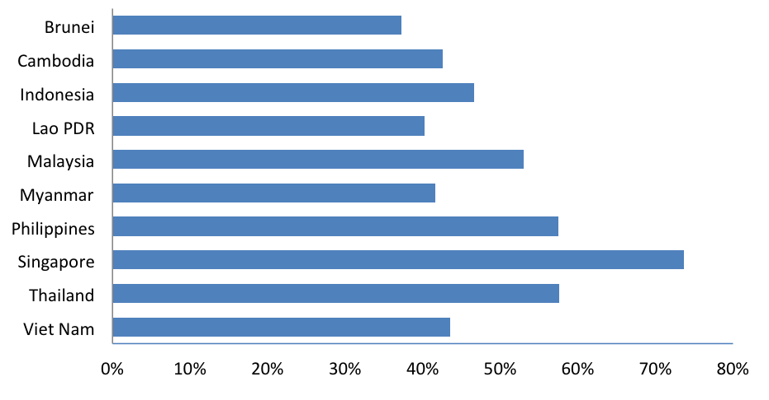
Service sectors in ASEAN member countries
Chart 1
Services as Percentage of GDP, 2016
(Source: ASEANStats, 2015)
https://asean.org/asean-economic-community/sectoral-bodies-under-the-purview-of-aem/services/

Slide 14
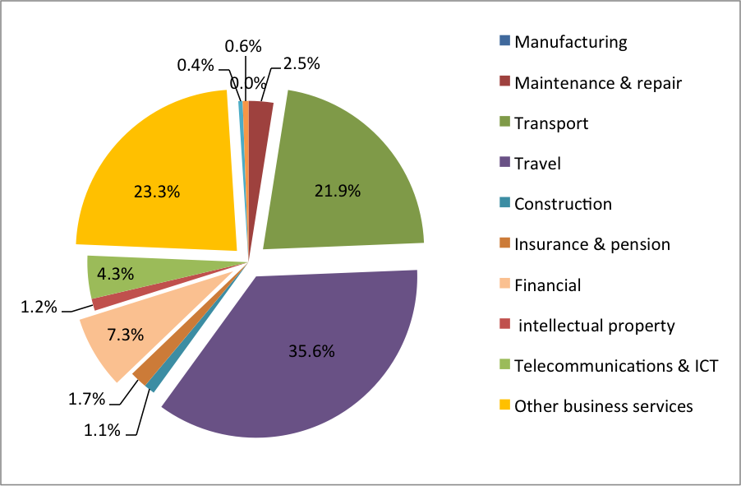
ASEAN Export by sectors
Source: https://www.iseas.edu.sg/images/pdf/ISEAS_Perspective_2019_54.pdf

Slide 15
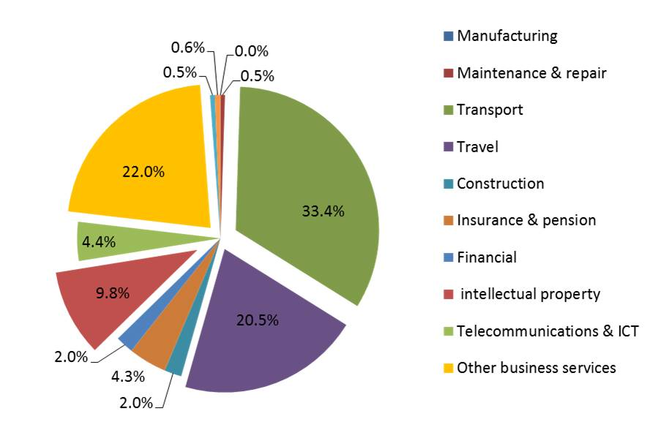
ASEAN Import by sectors
Source: https://www.iseas.edu.sg/images/pdf/ISEAS_Perspective_2019_54.pdf

Slide 16
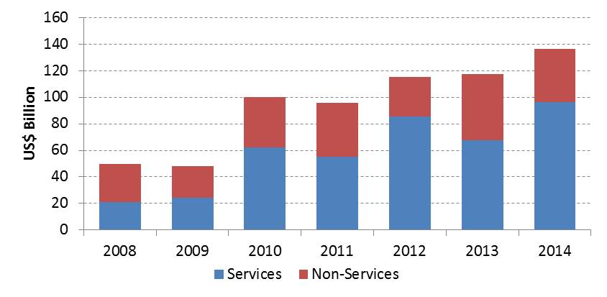
FDI inflows to ASEAN by sectors
Source: https://www.iseas.edu.sg/images/pdf/ISEAS_Perspective_2019_54.pdf

Slide 17
Service trade agreement in ASEAN
ASEAN has pursued services liberalization since 1995, by expanding the scope and coverage of its commitments in the ASEAN Framework Agreement on Services (AFAS) that was used to guide services liberalization.
  MRA on Engineering Services (9 December 2005)
  MRA on Nursing Services (8 December 2006)
  MRA on Architectural Services and Framework Arrangement for the Mutual Recognition of Surveying Qualifications (19 November 2007)
  MRA on Medical Practitioners and MRA on Dental Practitioners (26 February 2009)
  MRA Framework on Accountancy Services (26 February 2009) and subsequently as MRA on Accountancy Services (13 November 2014)
  MRA on Tourism Professionals (9 November 2012).
The shift from AFAS to ASEAN Trade in Services Agreement (ATISA) in 2019 is envisaged to advance services liberalization, and ultimately closer regional economic integration.
Source: https://www.iseas.edu.sg/images/pdf/ISEAS_Perspective_2019_54.pdf

