Slide 1
Economic Tools and Policy Evaluation
Sommarat Chantarat
Puey Ungphakorn Institute for Economic Research
Bank of Thailand
EE469 Guest lecture

Slide 2
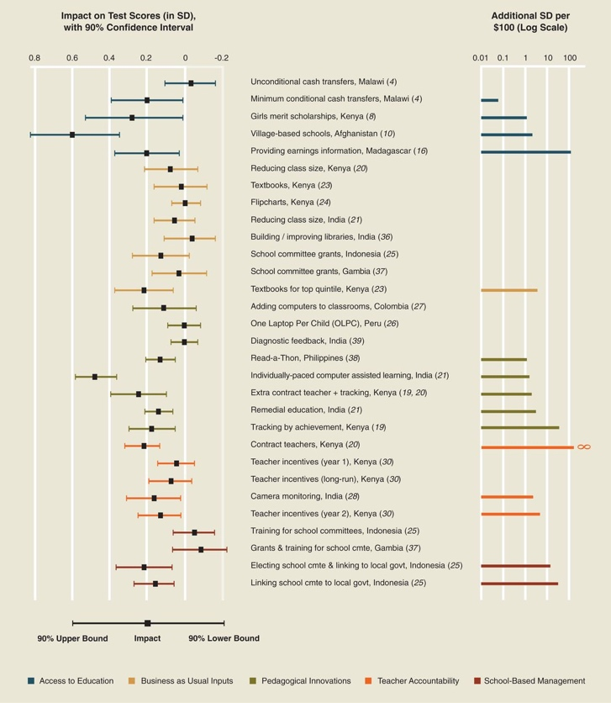

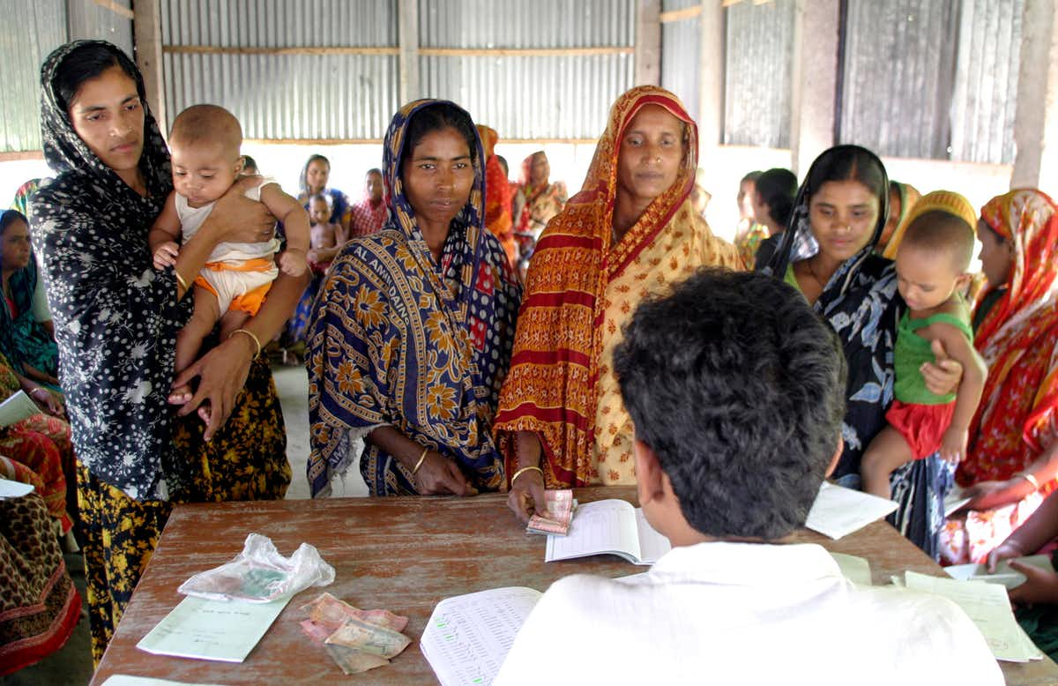
Evidence based policy making: Why?
Kremer et al. 2013

Slide 3
Evidence based policy making in the policy process
Design Implementation Evaluation
What policy?
How policy leads to intended outcome?
Who and how to target?
How to bring policy to target group?
What are the impacts and cost effectiveness?
What mechanism might policy affect outcome?
Is it worthwhile to scale up, how?

Slide 4
Evidence based policy making & Economic tools
Policy
question
Casual
inference
Framework
Data
Difference in difference
Instrumental variable
Regression discontinuity
Matching
Randomization
Structural modeling
Big data & mixed model
Macro/micro
ST/LT
Mechanism
Hypothesis
Existing
Need to collect

Slide 5
Casual inference
Main but challenging job for economics
Challenges in measuring impact of program on outcome(s)
In program
Not in program
b
Impact’
d
Outcome
c
Impact
a
Before After
(After) – (Before): Impact = - but…other things also happen during the time?
(After) – (Before):
b
a
(In program) – (Not in program) Impact = - but…are control and
treatment different even before the program? → selection problem
(In program) – (Not in program):
d
b

Slide 6
If data before and after program available
Difference in difference
In program
Not in program
Compare changes in outcomes over time between treatment and control groups
b
  Correct for initial difference of treatment and control groups
  Assume both groups move with similar time trend without program
d
Impact
c
Outcome = Income
a
  But…do control and treatment change with same time trend?
Before After

Slide 7

If data before program NOT available
Instrument variable (IV)
In program
Not in program
Find instrument that are not related to outcome but can induce subject into treatment/control groups
  Correct for initial difference of treatment and control groups
  Ex) Angrist (1990) estimate impacts of military service on labor outcome
    IV: draft lottery
  Ex) Angrist and Krueger (1991) estimate effects of compulsory school on earnings
    IV: quarter of birth in the census
    (In the US, students can enter school when they turn 6 in Jan and have to stay in school until they reach 16)
b
d
Impact
c
Outcome = Income
a
Before After

Slide 8
If data before program NOT available
Regression discontinuity
Rice yield before the program
Compare control and treatment within the neighborhood of eligibility threshold
  Correct for initial difference of treatment and control groups
  Assume subjects cannot manipulate their eligibility … but
Rice yield after the program

Slide 9
If data before program NOT available
Matching
In program
Construct control group that have statistically similar to treatment based on observed characteristics
Correct for initial difference of treatment and control groups
Assume sorting based on observed characteristics
Not in program
Propensity score
  But…how can we be ensure that control and treatment are not different based on unobserved characteristics?

Slide 10
If new data collection is possible
Randomization
Pure randomization: Randomly assign subject to program (treatment) and control group
  Correct for initial difference of treatment and control groups
Challenges
Noncompliance→
quasi randomization
  feasible?
  Costly?
  Complex, macro policy
  External validity?

Slide 11
If new data collection is possible
Randomization
  Ex) Behrman et al.(2005) evaluate Progressa CCT program
  Randomly select villages in treatment and controls
  Compare eligible households in control and treatment groups

Slide 12
Other method and the use of big/admin data
Structural modeling:
develop model and calibrate with data with good variations
simulate what would happen to outcome with policy options
Ex) Townsend evaluate Thailand village funds
Big/admin data: ex) researchers in the US have been exploiting census data
1) Cover before and after program
2) track for long-term outcomes
3) large coverage → external validity and impact heterogeneity
  Ex) Duflo 2001, Chetty’s work with tax records, etc.

Slide 13
Duflo’s famous paper using Indonesia Census
Birthplace
Birthday

Slide 14
Choosing economic tools to do evidence based policy
Policy
question
Casual
inference
Framework
Data
Difference in difference
Instrumental variable
Regression discontinuity
Matching
Randomization
Structural modeling
Big data & mixed model
Macro/micro
ST/LT
Mechanism
Hypothesis
Existing
Need to collect

