Slide 1
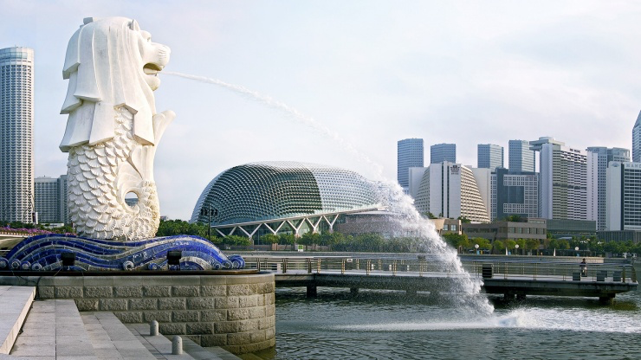
Singapore
Singapore
Singapore

Slide 2
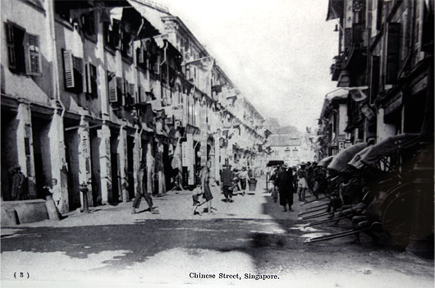

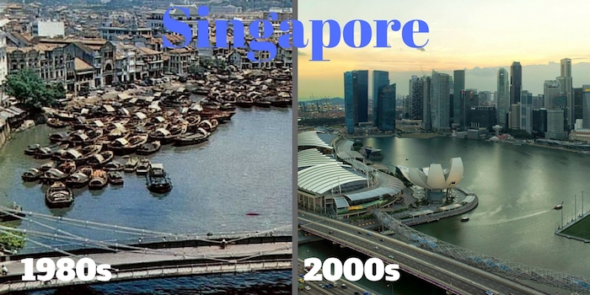
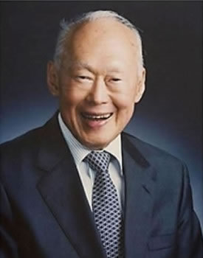
History of Singapore Economic development
Low GDP = Undeveloped country
-small domestic market
-limited natural resources
-high level of unemployment and poverty
-Singapore was under British control after WWII
70% of lived in bad condition
Lacked of skilled labor
fetid slums and racial tensions
President Lee Kuan Yew
“From third world to first”

Slide 3
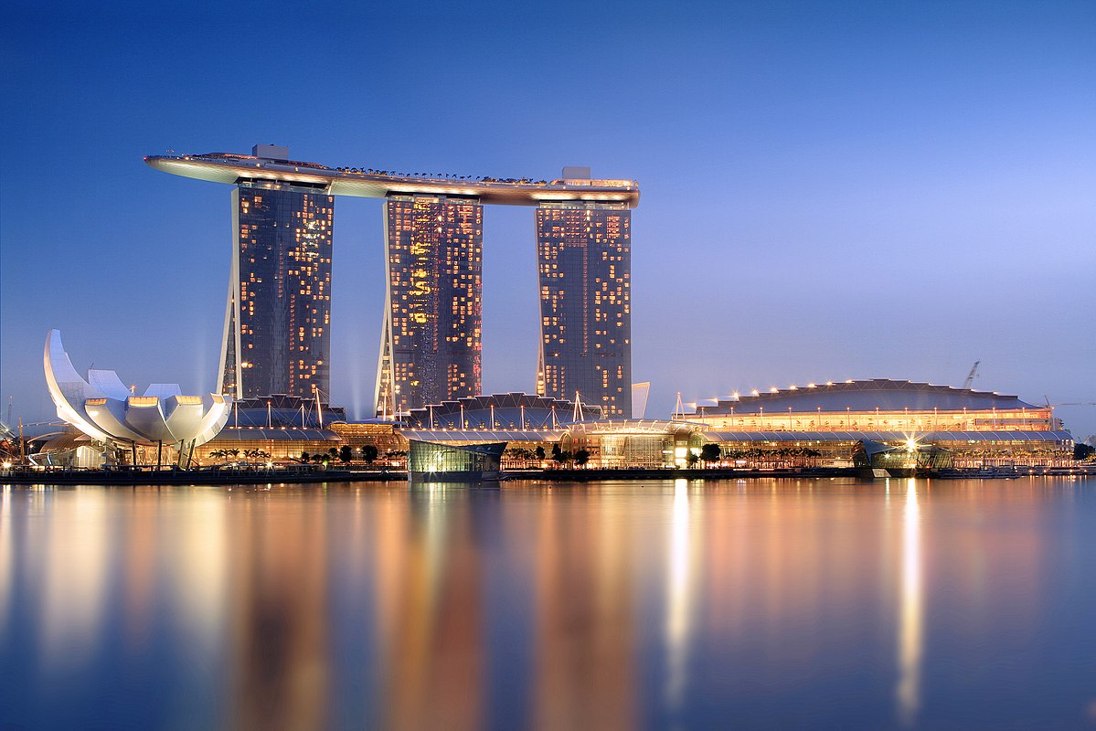
Status of Singapore in ASEAN

Slide 4

A new World Economic Forum development index shows that countries can be measured on a range of factors, including healthy life expectancy, GDP per capita and distribution of wealth

Slide 5
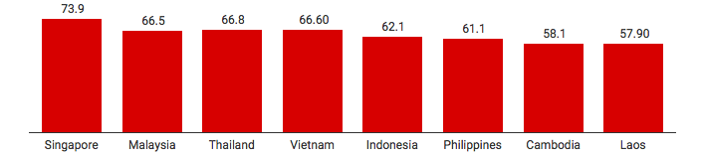
Healthy life expectancy
This is the average amount of years that a person can expect to live in full health. That means the number doesn’t include any periods of time when a person is injured, ill or in general in less than full health.

Slide 6
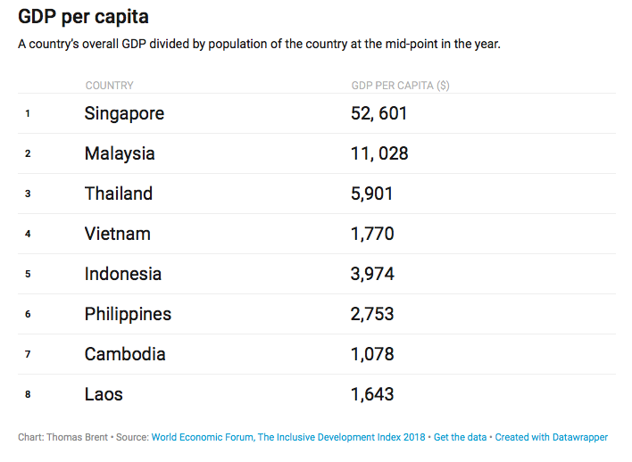

GDP per capita
Singapore’s GDP per capita is in the top 40% among the advanced economies.

Slide 7
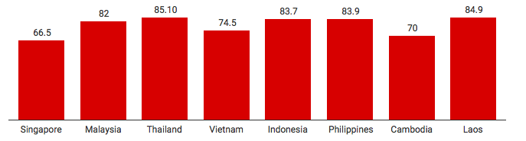
Wealth GINI
This measures the differences in the distribution of wealth in a country.
it does show how the wealth of a country is distributed.Basically, the closer to zero, the more equally the wealth is distributed, and the closer to 100, the less equally the wealth is distributed.

Slide 8
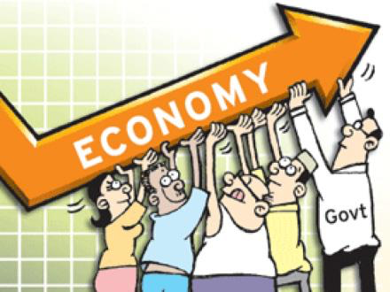
Over the last five years all the countries in the region mentioned in the report except for Singapore have seen an increase in their wealth GINI number, meaning that the distribution of wealth in the countries has become less equal.
Wealth GINI

Slide 9
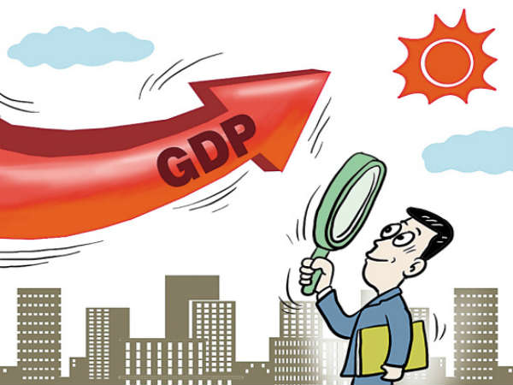
Gross domestic product

Slide 10
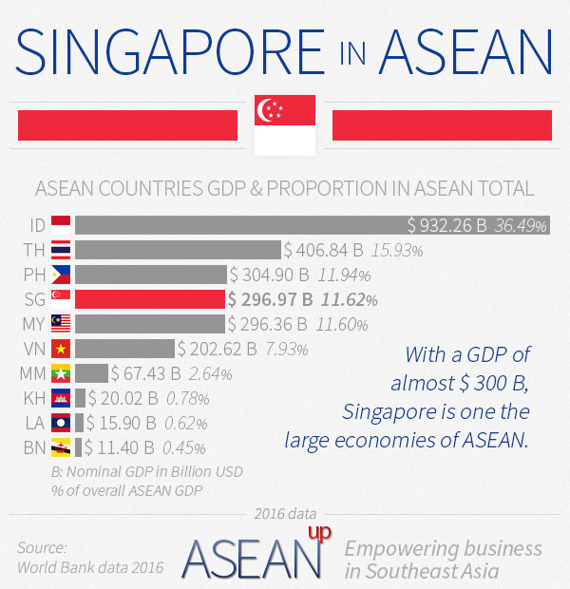

Gross domestic product (GDP) in ASEAN
Gross domestic product (GDP)
is a monetary measure of the market value of all final goods and services produced in a period (quarterly or yearly) of time.

Slide 11
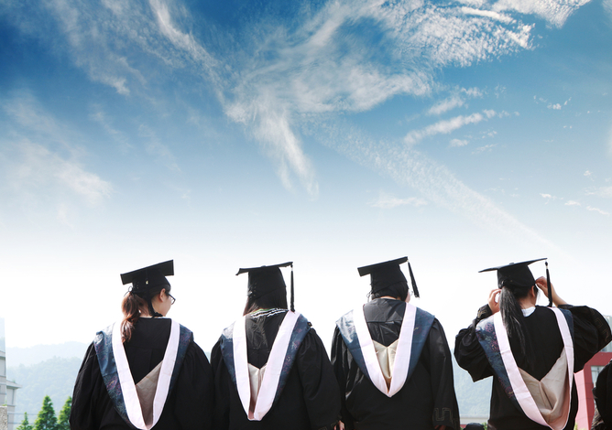
Education
Education

Slide 12
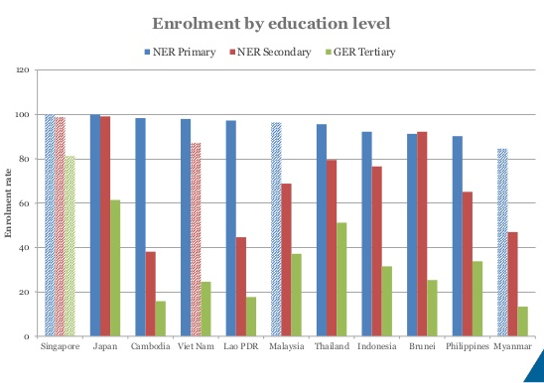
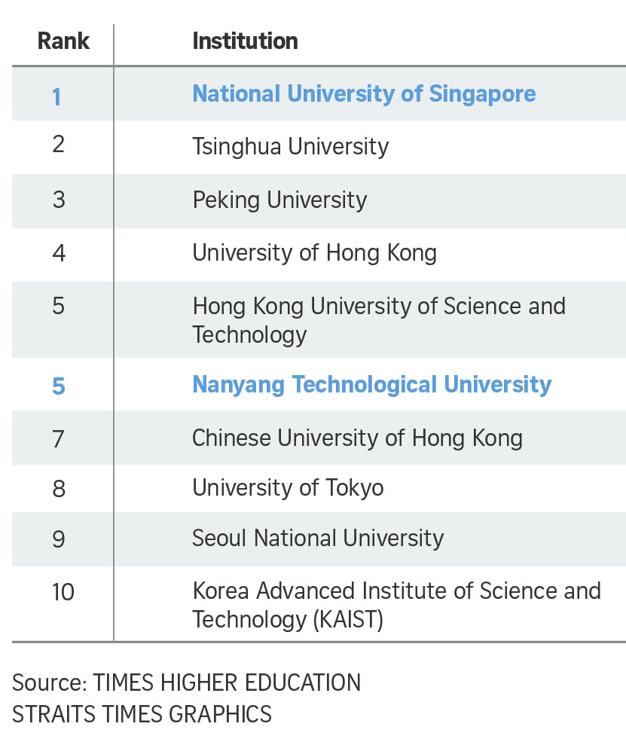
Education and skills in ASEAN countries
Top 10 ASIAN University

Slide 13
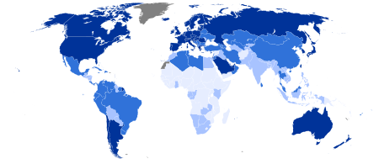
Human Index

Slide 14
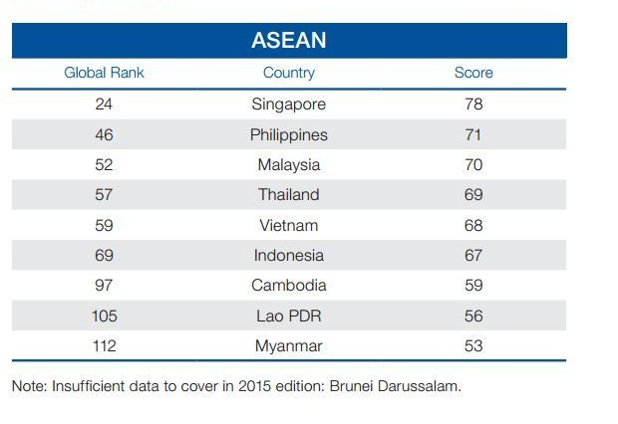

Human Capital Index 2015- ranking of ASEAN countries

Slide 15

Competitiveness index

Slide 16
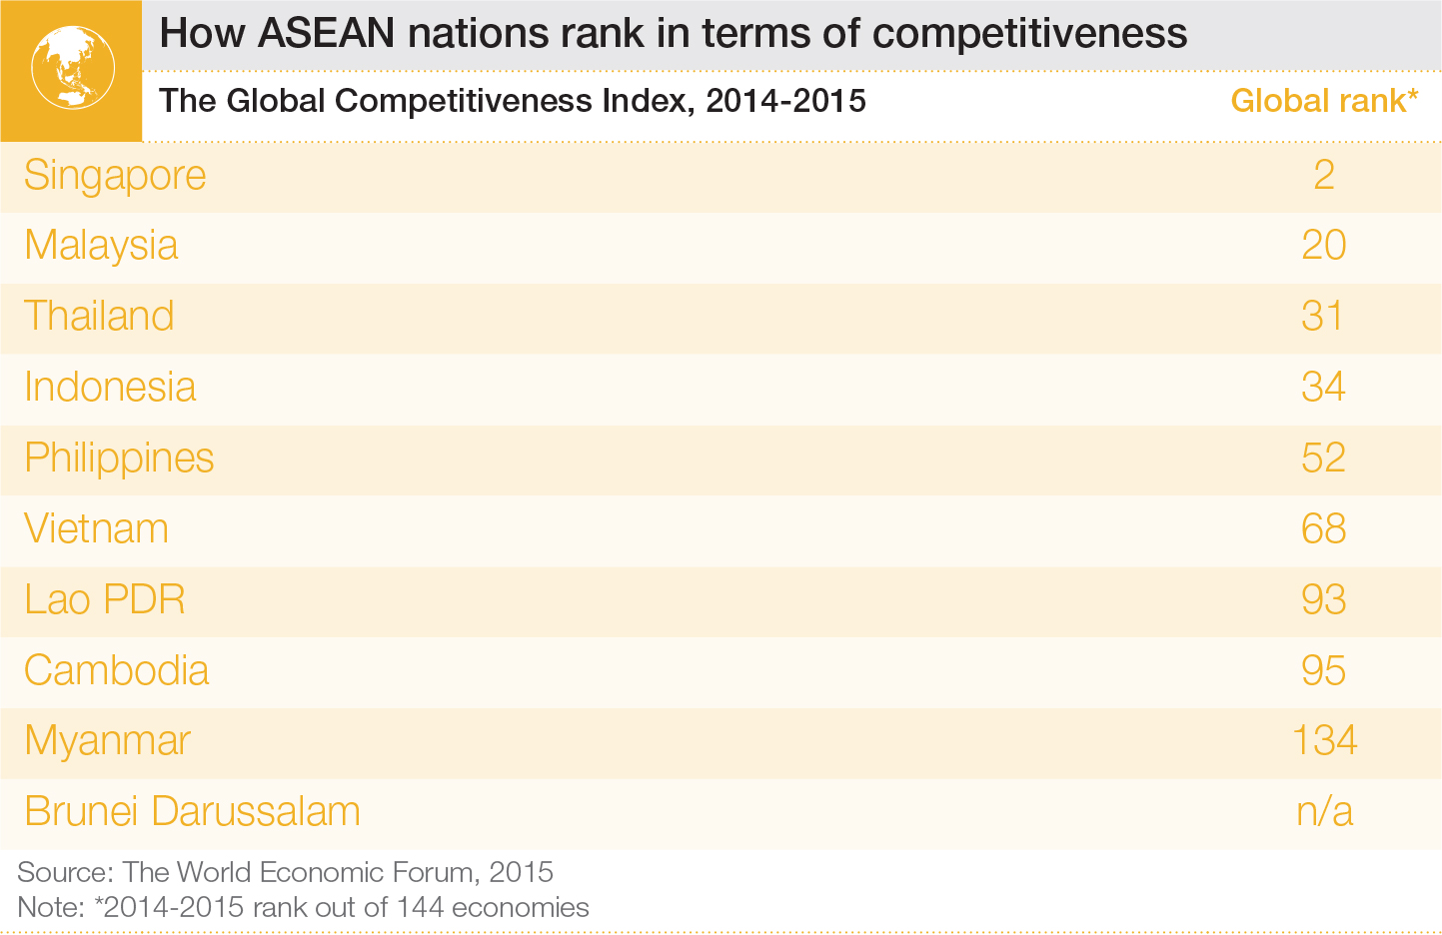
Singapore is the ASEAN country that is the most competitive

Slide 17
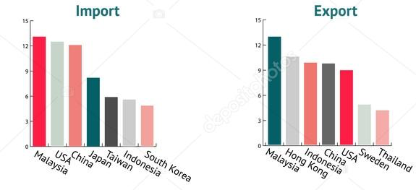
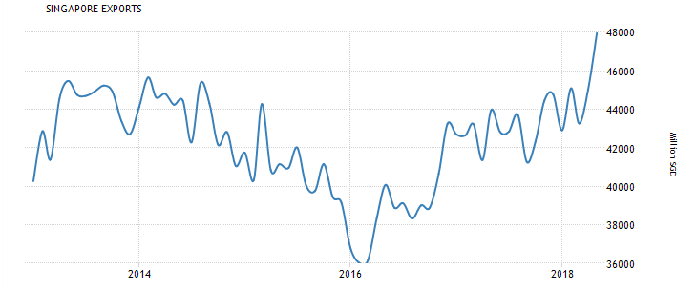
Export
In 2016,Singapore export $208B is the 20th largest exporter in the world.
1.Refined petroluem 16%
2.Integrated circuits 13%
3.Oxygen Amino compounds 3.3%

Slide 18
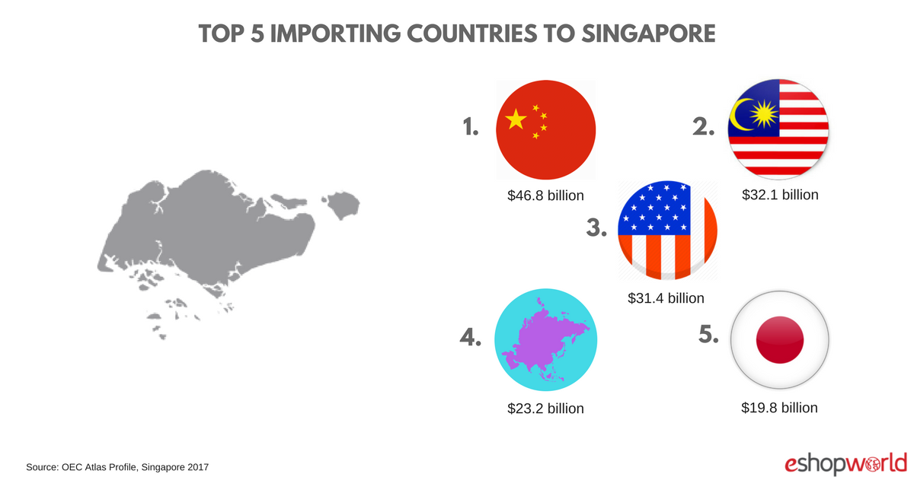
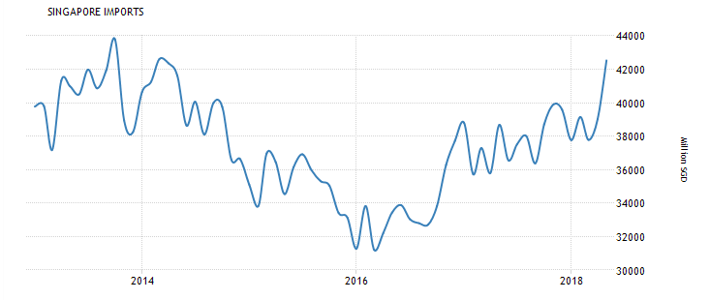
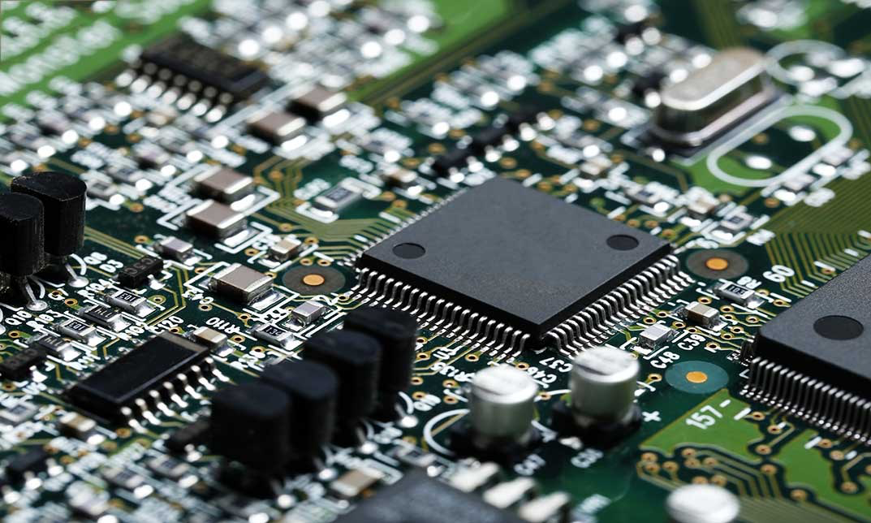
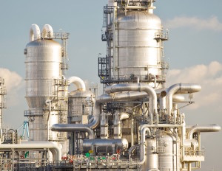
Import
In 2016 Singapore import $279B ,making it the 16th largest importer in the world.
1.Integrated circuits 18%
2.Refined petroluem 11%
3.Cruded petroluem 5%

Slide 19
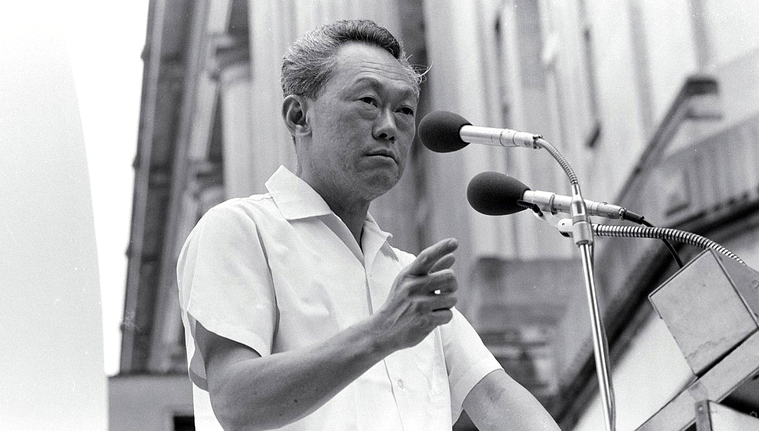
Lee Kuan Yew: Former Prime Minister of Singapore
1. Clarity of vision : From one poor country in 1965 to rich and modern city state
2. People first : The only resource is “Human”

Slide 20
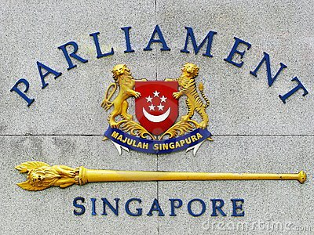
MPH: Meritocracy, Pragmatism, and Honesty
Meritocracy: country picks its best citizens, not the relatives of the ruling class, to run a country
Pragmatism : Never reinvent the wheel. Adapt the old one and use it effectively.
Honesty: Corruption is the single biggest reason why most Third World countries have failed.

Slide 21
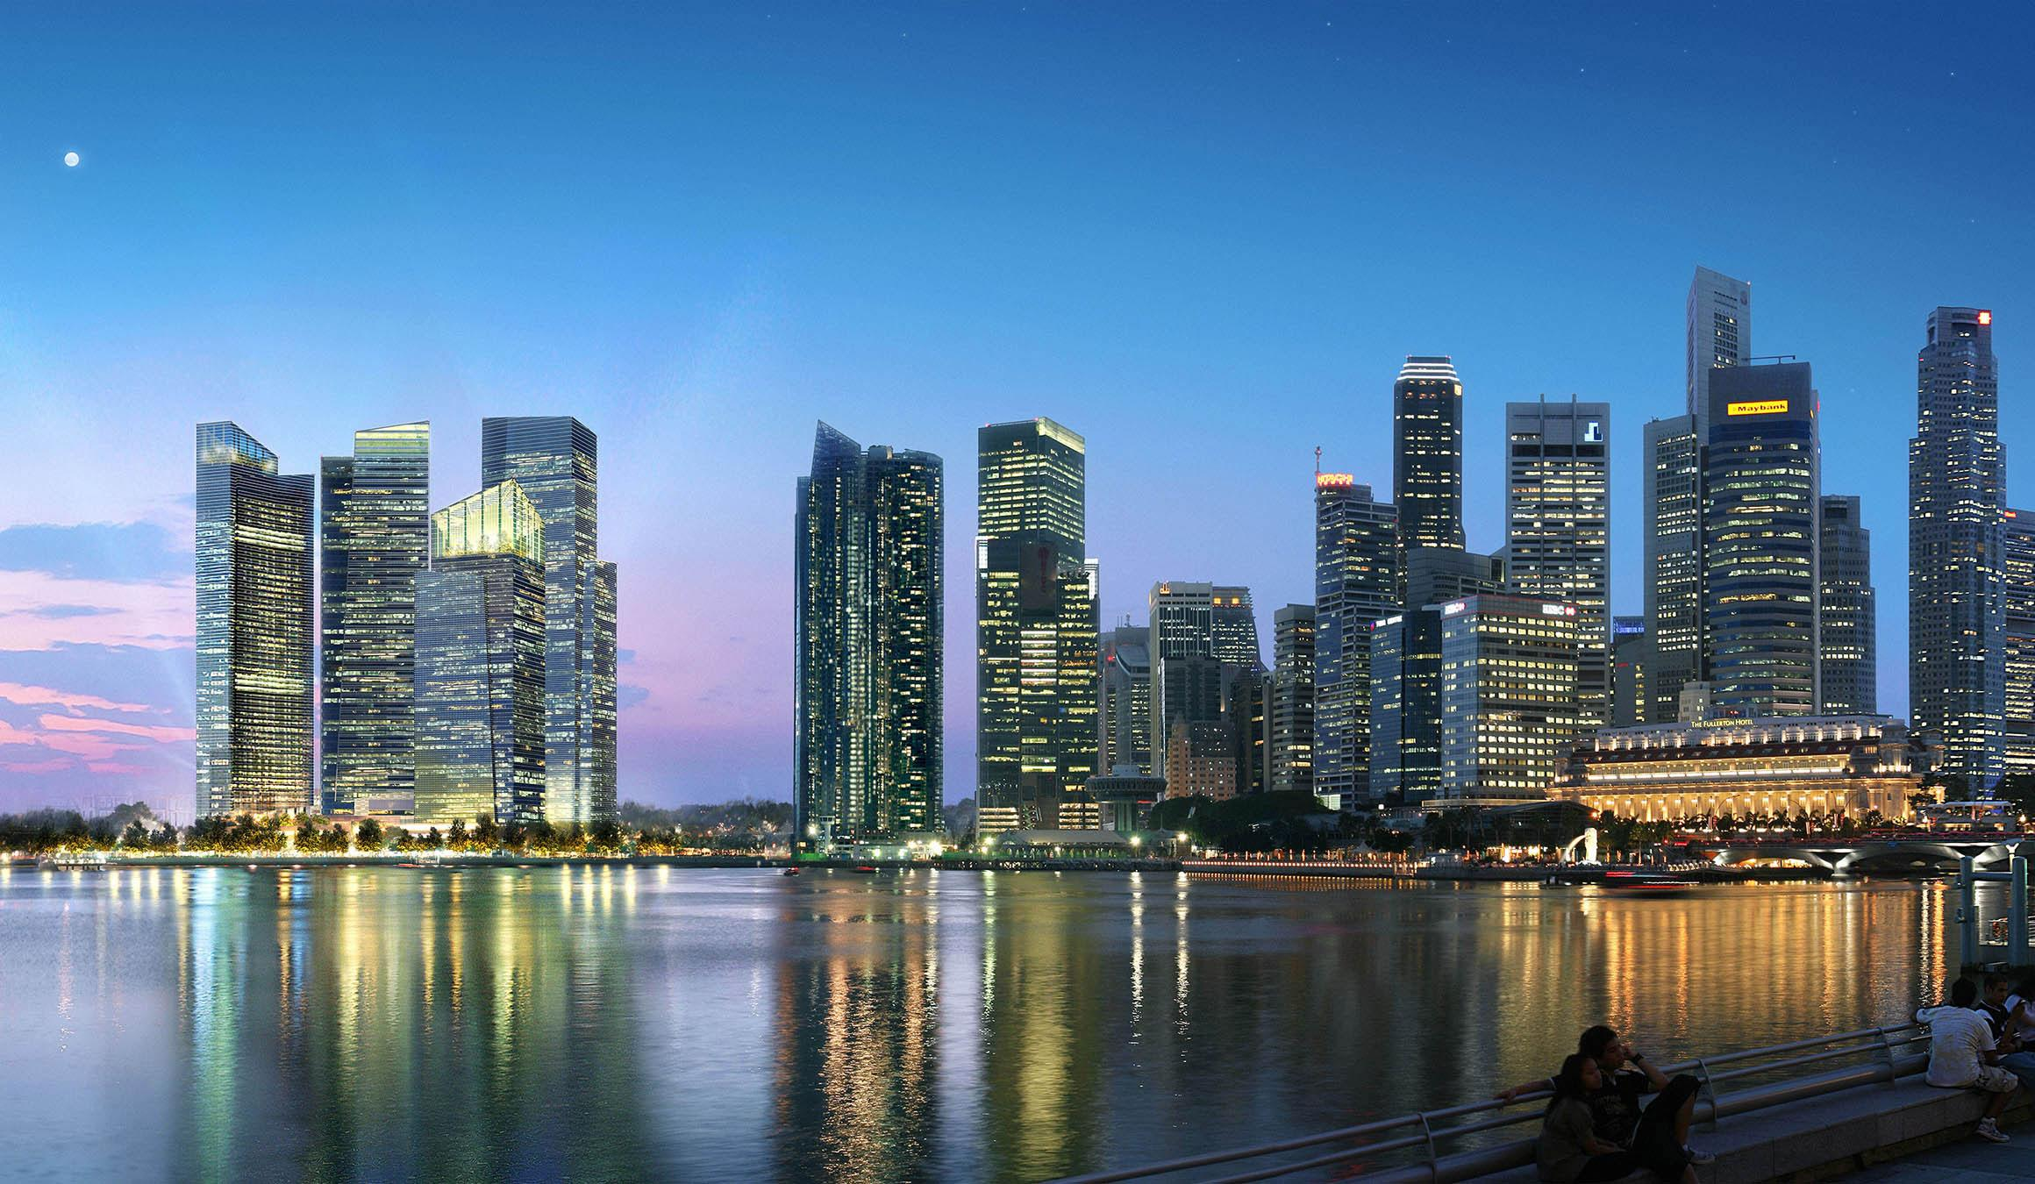
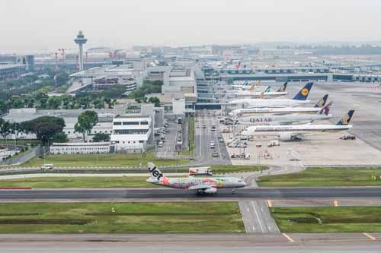
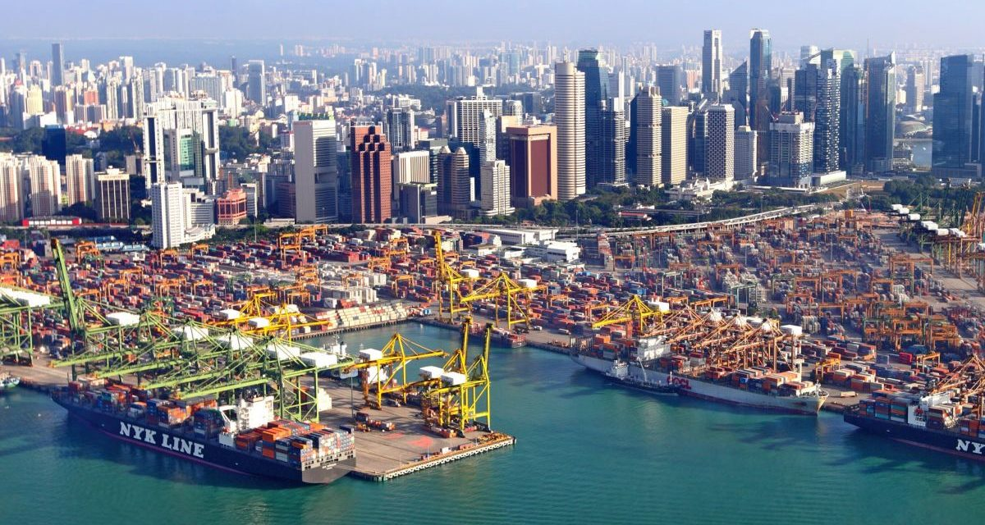
Sustainable Development
Center of trading
Financial center of the region
Investment in infrastructure to ensure that the infrastructure built will be meeting realistic business needs.
Highest-performing logistics hub in the region
Changi airport, The world best airport.
Well organizing and managing resource of land of the country
Boost Singapore's economy : attract foreign investments from multinational corporations

Slide 22
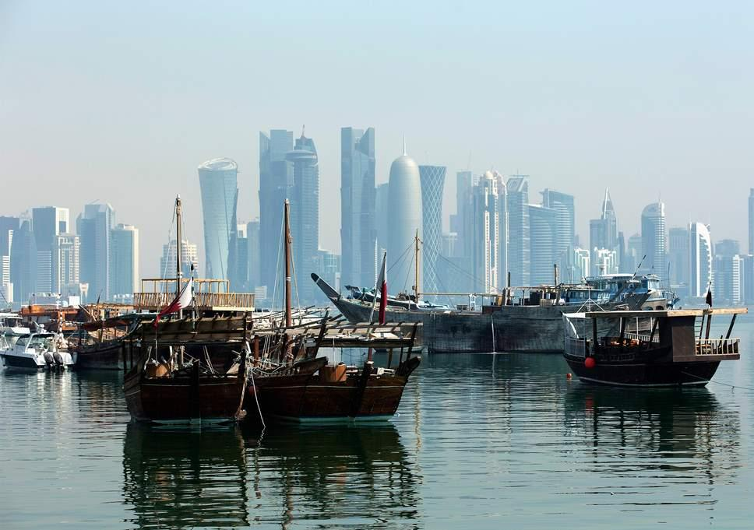
Government Policy
Government Policy

Slide 23

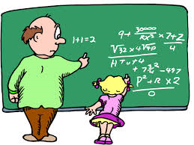
Education programme
Highly selective academic programme
Enhance the quality of teacher
Normal classes GEP classes
(gifted education programme)
“Teach less, Learn more”
A lot of investment on education

Slide 24


Language planning and policy in singapore
The government influences the acquisition of languages and their respective functions within the speech community through the education system. Language planning aims to facilitate effective communication within the speech community, which can result in a language shift or language assimilation.

Slide 25

Speak good English movement
Singapore Government campaign to "encourage Singaporeans to speak grammatically correct English that is universally understood". The purpose was to ensure that Singaporeans recognise the importance of speaking Standard English and to encourage its usage.
hello
fine
Good morning
...

Slide 26
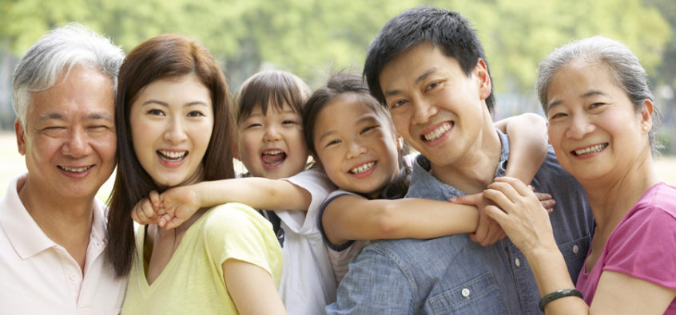
Population planning in Singapore
Government try to control the birth rate (not too low,not too high)
1970 Baby boom period
Government try to reduce birth rate by
-Stop at two
-Abortion and sterilisation were legalised
1986 Falling birth rates
-Encouraging higher birth rates
-Have three or more

