Slide 1
Production Linkages between Thailand and Mainland ASEAN
Kriengkrai Techakanont
Thammasat University
July 6, 2016
Notes:
Thank you Mr. Co-Chair,
Good afternoon, Ladies and Gentlemen,
I have only 5 mins to give you a short brief of Thai government policy on automotive industry. I will speak very fast, so please fasten your seat belt.
,/ after my presentation Khun Thanawat Koomsin, president of TAIA (Thai Automotive Industry Association) / will make presentation on/ overview of Thai automotive industry in 2014.

Slide 2
Outline
Significance
Strategies to rebalancing production network
Data Collection
Findings
Concluding remarks

Slide 3
Research focus
The main focus is the roles of Thai firms in shaping the pattern of production sharing, division of labor, and product fragmentation.
We focus three cases; 1) autoparts, 2) garment, and 3) electronics
Focus on the roles of road network that links Thailand with those four countries on productive integration in automobile production between Thailand and CLMV economies.
It is expected that Japanese affiliates in Thailand (as well as Thai firms) need to strengthen linkages within the value chain and this would result in a new pattern of technology transfer.

Slide 4
Related concepts
Industrial Organization
Production network
Production linkage
Technology transfer
Economic development

Slide 5
Data Collection
Field survey
Qualitative research
Interviews with key person

Slide 6
Vernon (1966)
Basic ideas;
He assumes that although firms (in developed or developing countries) can freely and equally access to scientific knowledge, they would face different situation to apply such knowledge to serve their market.
Entrepreneurs' consciousness of and responsive to opportunities vary with the ease of communication (customers or suppliers), thus proximity is a relevant factor.

Slide 7
Vernon (1966)
Where should innovation be taken place first? Or Location of innovation:
  Developed countries (USA in his paper)
  Save transportation costs and proximity to suppliers and customers
What forms?
  Product innovation (or process innovation),
  Labor saving (machine) or high-income product (income elastic goods)
When?
  Entrepreneurs realize customers’ needs and can apply their technological knowledge to such innovation
  Thus, it confirms that the early stage of new product will be in the home country

Slide 8
Vernon (1966)
Reasons
  Manufacturers still need to adjust design or change supply
  Elasticity of demand is not high → Firms have market power to set price
  Intensive communication with suppliers, customers and competitors is necessary

Slide 9
Vernon (1966)
The maturing product → demand expands and degree of standardization takes place
Demand from other countries also developed and exports (international trade) began
Product differentiation becomes less important
Costs become more crucial for competition, thus location of production is concerned.

Slide 10
Relocation of production
Producers have to balance a number of complex considerations when they decide to setting up a new facility (either domestic or abroad) where demand exists.
International location can produce for both host country and export to other countries.
Production becomes more standardized
Price competition is intense

Slide 11
Standardized product
Less developed countries may offer competitive advantage as a production location.
Production function would require significant inputs of labor (or labor-intensive)
Firms prefer to set up foreign producing plant only when they have monopolistic advantage
Firms also have other alternatives, licensing technology to a local firm or to do foreign direct investment

Slide 12
Minimum Wage 2001-2013

Slide 13
Real Minimum Wage Rate 2001-2013 (2011 = 100)

Slide 14
Labour Productivity and Average Real Minimum Wage (2001 = 100)

Slide 15
Flow of Internal Labour Mobility (2002 to 2011)

Slide 16
Case 1 - Wire harnesses
Investment in 43 countries, 160 affiliates, 444 locations
Investment in Thailand – 50+ years
2000 in Laos → 2013 in Cambodia
Thai wage increase & auto industry expand → global integration → Cambodia and Vietnam

Slide 17
Case 1 - Wire harnesses
Cambodia plant
  3,500 employees, 11 Thai + 3 Japanese provide support
Maesot plant
  Subcontract basis
  Use 300 Myanmar workers
  Train 7 days + OJT 7 days → operate in the factory
  ISO 9001/2008

Slide 18
Case 1 - Wire harnesses
Logistics
Cambodia plant
  Raw material from Thailand, assembly in Cambodia
  Lead time can be within 24 hours
Maesot plant
  Raw material from Bangkok, Pitsanulok
  1-2 trucks everyday
  Controlled by the HQ

Slide 19
Case 2 – Electronics product (Digital Camera)
95% of Nikon DSLRs is produced in Thailand
Employment – max 16,000 in 2005 → 6,700 in 2015
Establish an affiliate in Lao in 2013
  Flood in Thailand and cheaper labor cost
Raw materials are produced mainly in Thailand and some in Myanmar (Lens), mostly by Japanese firms

Slide 20
Case 2 – Electronics product (Digital Camera)
Lao plant has 1,000 workers
Thai management team (about 20 persons)
Technology transfer
  Explicit knowledge – machines from Thailand, operation manual in Lao language
  Tacit knowledge – training in Thai language
Production linkage
  Lao plant produces some processes and deliver to plant in Thailand to do the finishing process
  Lao plant will take some new models and will play the same role as the Thai plant in the future

Slide 21
Case 3 – Lingerie (Garment)
Establish in Thailand in 1970s
Joint venture with Japan and set up a Thai factory to support some activities for the joint venture business
5 locations
  Bangkok, Sriracha, Kabinburi, Lamphun, and Maesot

Slide 22
Case 3 – Lingerie (Garment)
Supply chain management
Bangkok produces high quality, high value models (fashion model) and link with Sriracha
Lamphun, Maesot, and Myanmar factories produce mass model or standard model (low price, high volume)
Lamphun plant was established in 1992
  Cheaper wage, abundant workers, high skill in handicraft
  370 workers
  Capacity 110,000 pcs/month
  Raw material from Bangkok (delivery 2 times a week)

Slide 23
Case 3 – Lingerie (Garment)
Maesot plant was established in 2010 and has a role to support Lamphun plant
Some processes are done in Maesot, and Maesot plant has another connection with a plant in Pa An
  Maesot plant provides technical support to Pa An factory
  Pa An factory has 60 workers and run on a subcontracting basis (local investor constructed a factory, bought old machine) and Maesot factory provides technical support
  Logistics – once a week shipment to Maesot and Maesot combine order and ship back to distribution center in Bangkok
This firm opens a factory in Myanmar not only because of the high wage in Thailand but also wants to penetrate Myanmar market.

Slide 24
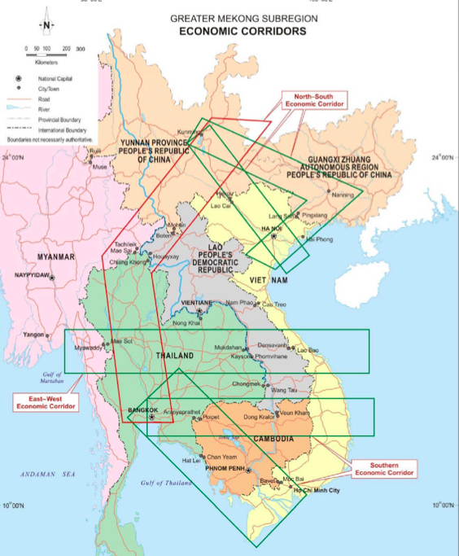
Economic corridors connect Thailand and CLMV

Slide 25
Concluding remarks
Japanese production network is prominent in ASEAN
Production and supply chain linkages among Thailand and CLMV is increasing
Each country will be specialized in some specific processes.
Operation in Thailand need to be leveled up and provide technical support or technology transfer to neighboring countries. The process is incremental

Slide 26
Q & A

