Slide 1

BA 291 – Management process
By Aj. Parichat Jantori

Slide 2
Management process
Management is a process designed to acheive an organization‘s objectives by using its resources effectively and effieciently in a changing environment
Effectiveness
- Selecting the proper goal and achieving it
- Satisfy customer needs
- Concerning the business environment
Efficiency
Using minimum resources in order to maximize output
Reducing waste (waiting time,, unnecessary process or movement, overproduction, defects, inventory)

Slide 3

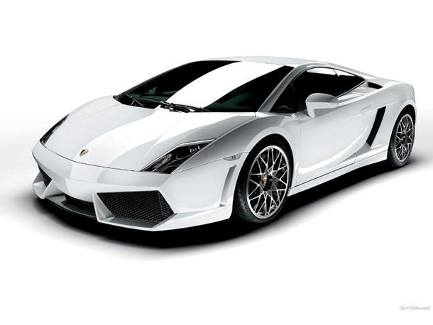
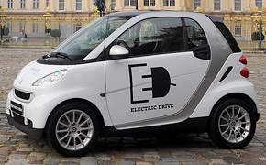
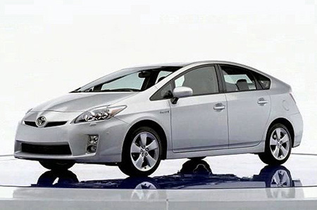
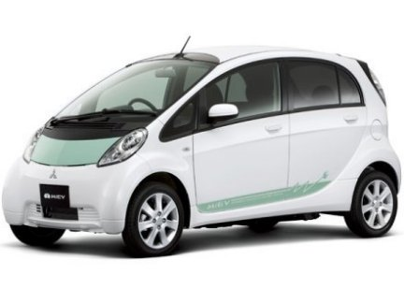
Efficiency vs. Effectiveness

Slide 4
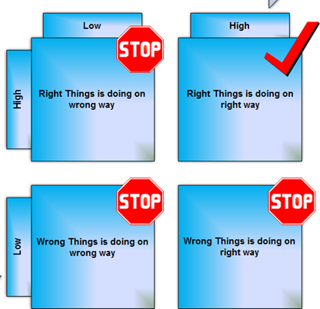
Efficiency vs. Effectiveness
Efficiency
Effectiveness

Slide 5
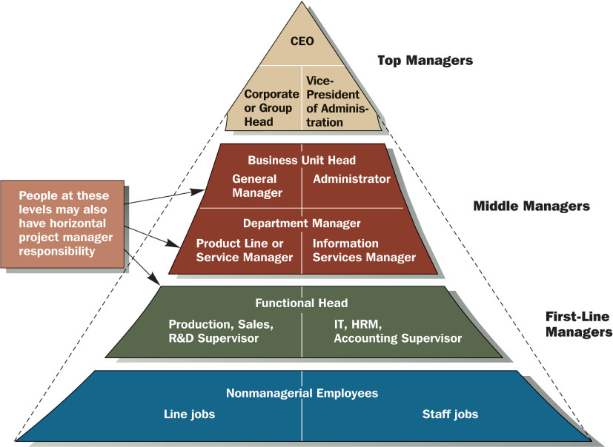
Level of management

Slide 6
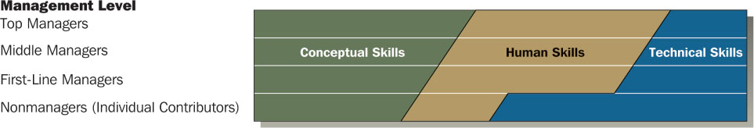
Managerial skills
Conceptual Skills – cognitive ability to see the organization as a whole system, ability to think strategically
Human Skills – the ability to work with and through other people
Technical Skills – the understanding and proficiency in the performance of specific tasks

Slide 7
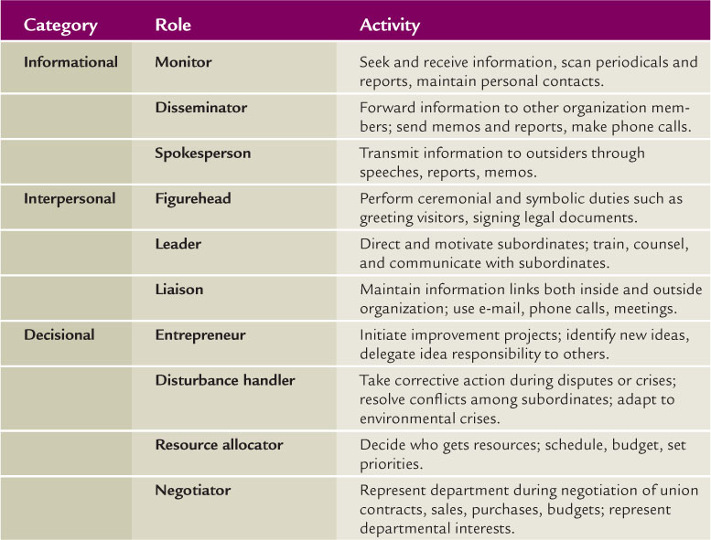
Managerial roles

Slide 8
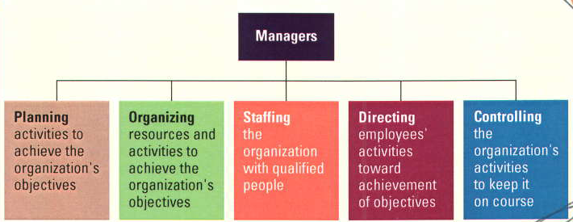
Management functions
Organizing
Leading

Slide 9
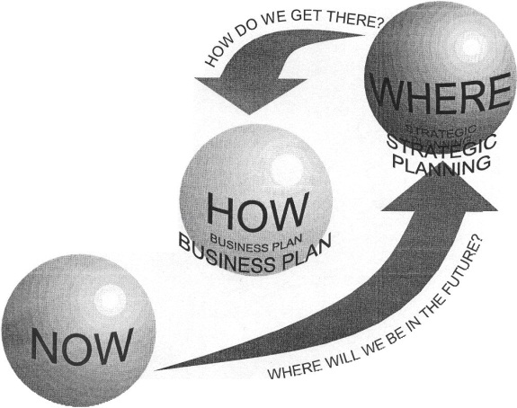
Planning
Defining the organization’s goals, establishing an overall strategy for achieving those goals, and developing plans for organizational work activities.
Planning
Provides direction (where are the goals and how to get there?)
Resource allocation (how to use existing resource to achieve goals)
Reduces uncertainty (scenario analysis, find Plan B)
Minimizes waste and redundancy
Used as standard in controlling process

Slide 10
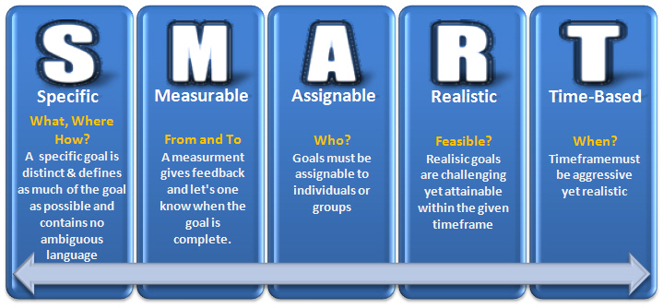
Goal
Goals provide a clear, engaging sense of direction and specify what is to be accomplished

Slide 11
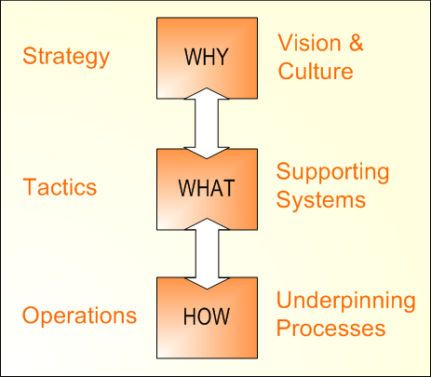
Planning type
Long-term vs. short-term plans
Single-use vs. standing plans
Top-down vs. bottom-up
Strategic, tactical and operational plan

Slide 12

Example: Planning type at GM (2007)
Strategic goals
To get the company back to the track
To prevent company from bankruptcy
Tactical goals – To enhance the reputation of GM’s most important Brand “Chevrolet”
Tactical plans
Increase the number of advertising and PR activities
Buying ads on website
Sponsoring the events
Operational goals - Process 150 sales each week, Achieve 90% of deliveries on time. Increase customers show room visit
Operational plans - Train the sales personnel and improve dealer service quality. Improve production standard. Reduce takt-time.

Slide 13
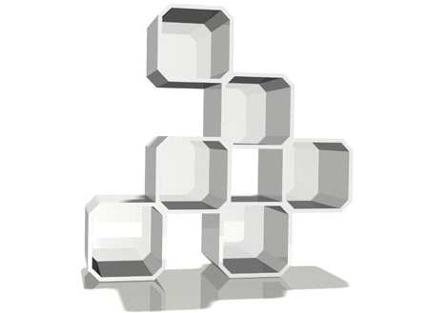
Organizing
The deployment of resources to achieve strategic goals by dividing labor into specific departments and job, formal lines and authority and mechanisms for coordinating diverse organizational tasks
Organization structure
defines how set of formal tasks are assigned
defines formal reporting relationships
ensures effective coordination of employees across department
Notes:
Organizational structure is
dynamic, not static, because of the
constant change in the
organizational environment

Slide 14
Designing organizational structure
Choosing the right organization structure is one of the most
important decisions in the company
There is no “one right way” to design organizational structure
There are no universal organization principles which are good for all cases
Organizational structure is dynamic, not static, because of the constant change in the organizational environment. Therefore, companies may change its structure when it’s necessary.
Notes:
Organizational structure is
dynamic, not static, because of the
constant change in the
organizational environment

Slide 15
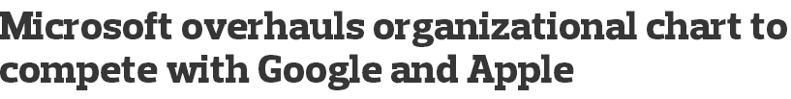
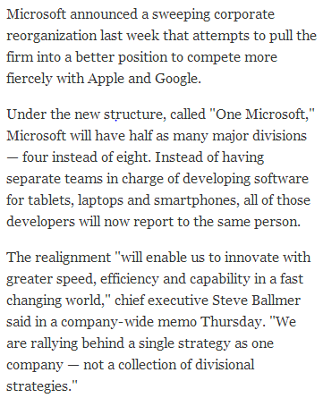
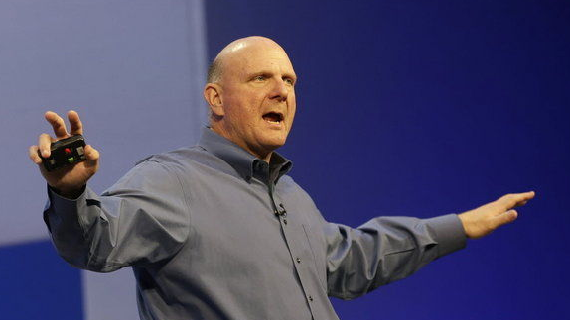
Designing organizational structure
Notes:
http://www.masslive.com/business-news/index.ssf/2013/07/microsoft_overhauls_organizational_chart.html

Slide 16

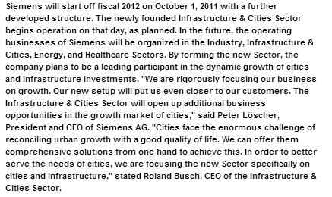
Designing organizational structure

Slide 17
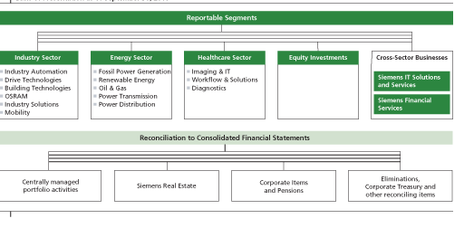
Siemens

Slide 18
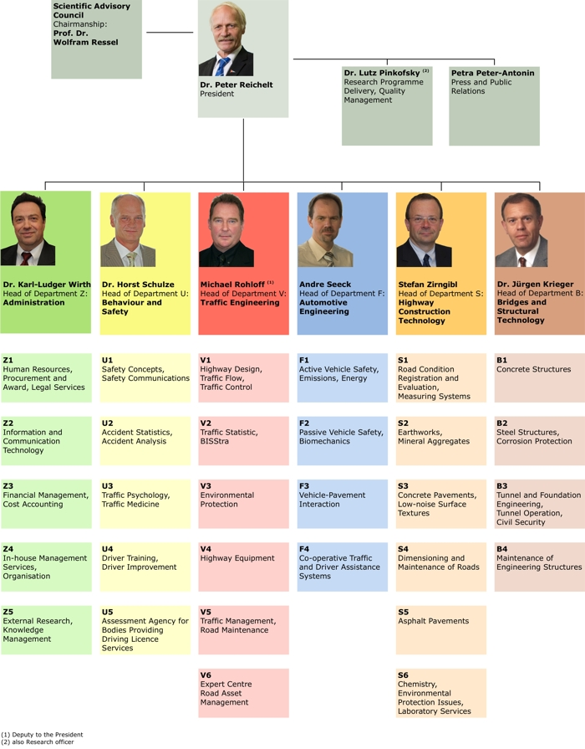
Organization Chart
Organization chart is a diagram that shows the structure of an organization and the relationships and relative ranks of its parts and positions/jobs
Visual representation of org structure
Set of formal tasks/ Departmentalization
Framework for vertical control
Formal reporting relationships
Communication

Slide 19

Organizational Structure – vertical structure
Work specialization
Sometimes called „division of labor“
The degree to which organizational task are subdivided into individual jobs so employees within each department perform only the tasks relevant to their specialize function
Jobs tend to be small, but they can be performed efficiently
Contra
Isolation
Lack of creativity and motivation
Boredom, stress
Poor quality
Pro
Efficiency
Learning effect
Productivity

Slide 20
Chain of Command
The line of authority extending from upper organizational levels to the lowest levels, which clarifies who reports to whom
Associated with two underlying principles
Unity of Command: each employee is held accountable to only one supervisor
Scalar Principle: a clearly defined line of authority in the organization that includes all employees
All persons in the organization should know to whom they report as well as the successive management levels all the way to the top

Slide 21

Work Delegation
Delegation: The process managers use to transfer authority and responsibility to positions below them in the hierarchy
Most of the organizations today encourage managers to delegate authority to the lowest possible level to provide flexibility to meet customer needs and adapt to the environment
How to delegate:
Delegate the whole task
Select the right person
Delegate both authority & responsibility
Give thorough instruction
Maintain feedback, evaluate and reward performance

Slide 22
Authority, Responsibility, and Accountability
Responsibility: The duty to perform the task or activity an employee has been assigned. Typically, managers are assigned authority commensurate with responsibility
Authority: The power to make committment, to use resource and take actions.
Accountability: The people with authority and responsibility are subjected to reporting and justifying task outcomes to those above them in the chain of command.
For organization to function well, everyone needs to know what they are accountable for and accept the responsibility and authority to performing it.

Slide 23
Span of Management
The number of employees reporting to a supervisor
Traditionally: 7 subordinates per manager, Today: 30-40 subordinates
Supervisor Involvement
  must be closely involved with subordinates, the span should be small
  need little involvement with subordinates, it can be large

Slide 24
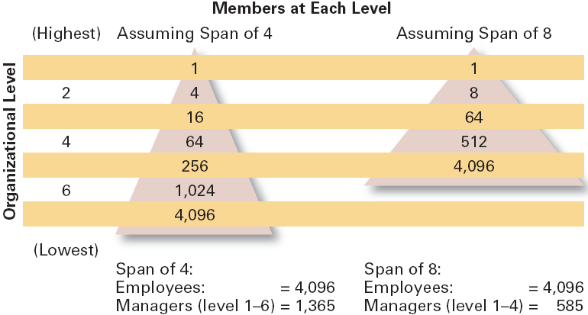
Span of Management

Slide 25
Span of Management – small or large?
Work is stable and routine
Subordinates perform similar work tasks
Subordinates are not concentrated in a single location
Subordinates are highly trained
Rules and procedure defining task activities are not available
Support systems and personnel are not available for the manager
Little time is required in nonsupervisory activities
Managers’ preferences and styles favor a large span

Slide 26
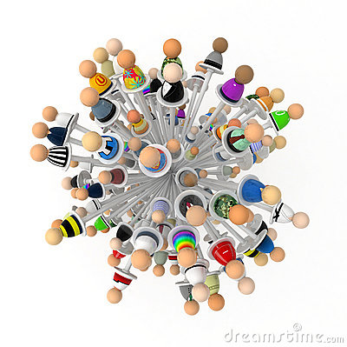
Centralization vs. Decentralization
Centralization: the location of decision authority
near top organizational levels
Decentralization: Decision making authority is
dispersed throughout the organization

Slide 27
Centralization vs. Decentralization
  Environment is stable.
  Lower-level managers are not as capable or experienced at making decisions as upper-level managers.
  Lower-level managers do not want to have a say in decisions.
  Organization is facing a crisis or the risk of company failure.
  Company is large and want to maintain unity.
  Effective implementation of company strategies depends on managers retaining say over what happens.
  Environment is complex, uncertain.
  Lower-level managers are capable and experienced at making decisions.
  Lower-level managers want a voice in decisions.
  Corporate culture is open to allowing managers to have a say in what happens.
  Company is geographically dispersed.
  Effective implementation of company strategies depends on managers having involvement and flexibility to make decisions.
Centralization
Decentralization

Slide 28
Departmentalization – Horizontal structure
The basis for grouping positions into departments and departments into the total organization
Traditional approaches:
Functional structure
Division structure
Matrix structure
Contemporary approaches:
Team-based structure
Network structure
Virtual structure

Slide 29
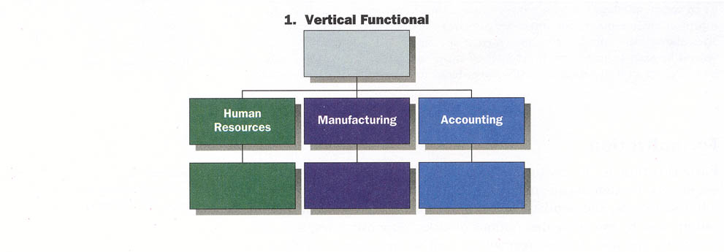
Functional Structure
Grouping of positions into departments based on similar skills, expertise, work activities, and resource use
Strengths: Cost-saving advantages from specialization, minimal duplication of people and equipment
Weakness: Functional specialist become insulted and have little understanding of what other units are doing, slow response to external changes
Notes:
It is applied in:
❖ small and middle companies
❖ if company produces one or several similar
products by using same technology for the
same market (oil, sugar, cement, beer)

Slide 30
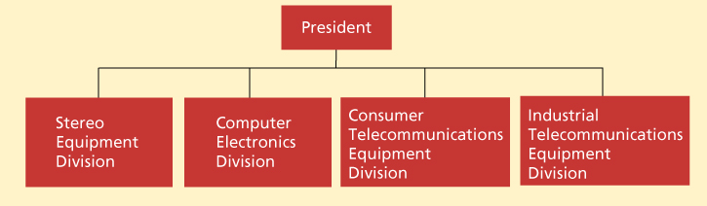
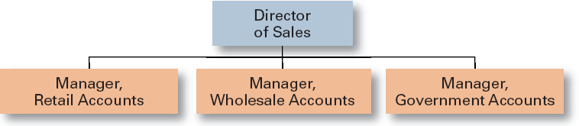
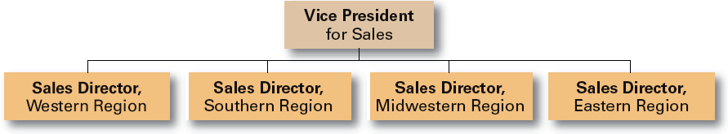
Division Structure
An organizational structure in which departments are grouped based on similar organizational outputs, namely
Product
Customer
Geographic

Slide 31
Division Structure
Strengths
- Allows for focus on specific customers/ markets/ products
- Good structure for growth along geographical/ product lines
- Easy pinpointing responsibility (division managers are responsible for what happens to their products and service)
- Fast response and flexible to local needs
Weakness
Duplication of activities and resources increases cost and reduces efficiency
Coordinating and integration are difficult
May be difficult to manage diverse product lines

Slide 32
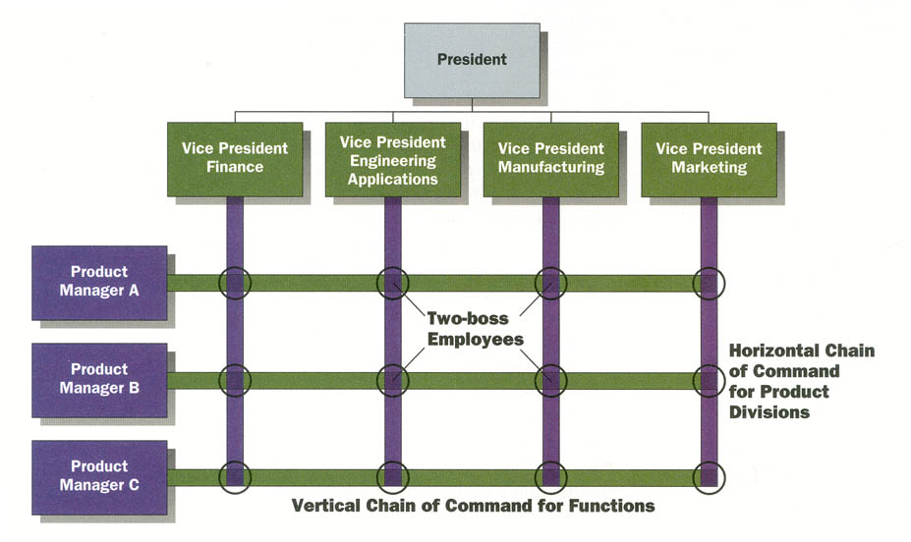
Matrix Structure
A structure in which the tasks of the organization are grouped along two organizational dimensions simultaneously (vertical and horizontal).
Matrix structure has dual lines of authority (2 supervisors)

Slide 33
Matrix structure
Strengths
Fluid and flexible design that can respond to environmental changes
Faster decision making
Interdisciplinary cooperation
Development of both generalist and specialist
Do not have to create new department to perform specific task
Weakness
Lack of control
“two bosses” may lead to conflict
Communication difficulties

Slide 34
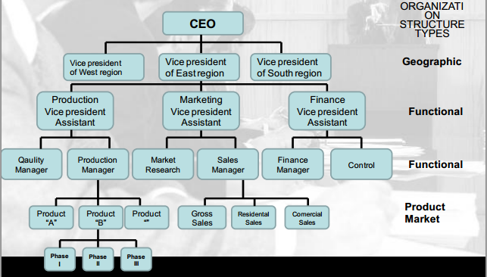
Mixed organization structure
It is also called conglomerate organization
Type of organization structure where at every organization level dominates some other type of organization structure
In practice that is most common situation

Slide 35
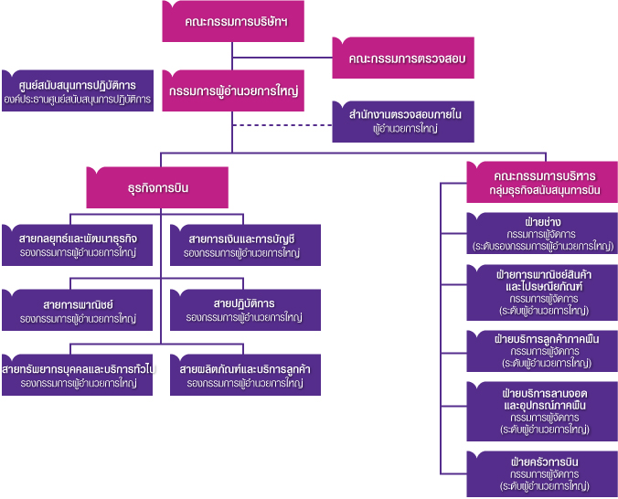

Slide 36
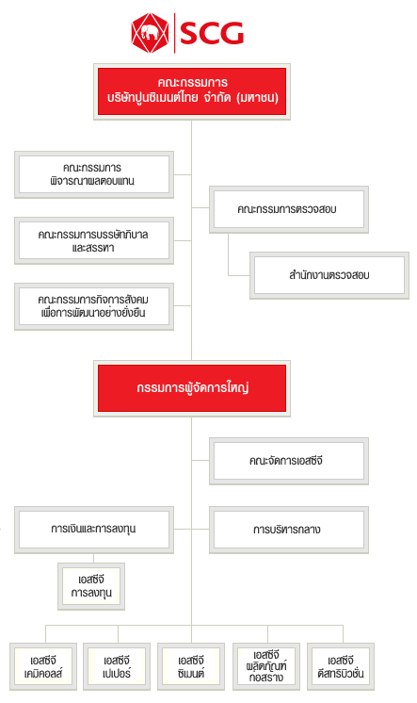

Slide 37
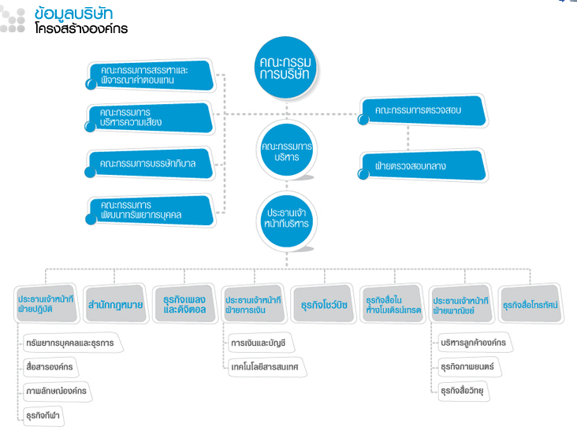
RS promotion

Slide 38
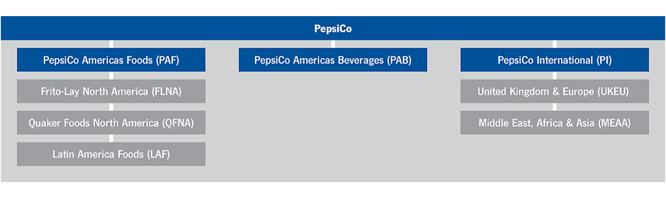
PepsiCo

Slide 39
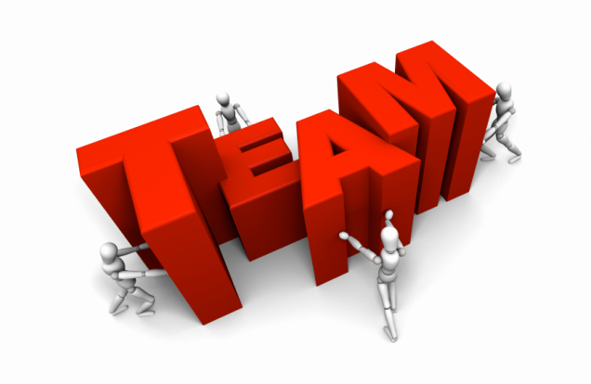
Team Approach
Most widespread trend in departmentalization in recent years
Gives managers a way to delegate authority, push responsibility to lower levels and be more flexible to responsive to changes
Team-based structure: Structure in which the entire organization is made up of teams that coordinate their work and work directly with customers to accomplish the organization‘s goals

Slide 40
Team-based Structure
Advantages
Reduce barriers among departments, increased compromise
Shorter response time, quicker decisions
Employee are more involved and empowered – high motivation
Reduced administrative overhead
Disadvantages
No clear chain of command, Dual loyalties and conflict
Time and resources spent on meeting

Slide 41
Network Approach
An organizational structure that disaggregates major functions to separate companies that are brokered by a small headquarters organization
- Operating an “outsource” mode
HUB
Designer
HR Agency
Marketer
Manufacturer
Notes:
http://www.thaiairways.com/about-thai/company-profile/en/organization-chart.htm

Slide 42
Network approach
Advantages
Global competitiveness
Workforce flexibility challenge
Reduced administrative overhead
Disadvantages
Fragmentation make it difficult to develop control system
Can lose organization part
Difficult to develop employee loyalty

Slide 43
Virtual Network Structure
A contemporary organizational structure that is founded on a set of alliances with other organizations what serve a wide variety of functions
Cooperation decisively relying on information technology
Advantages
Worldwide pool of expertise
High flexibility and response
Reduced administrative overhead
Disadvantages
Lack of control, weak boundaries
Greater demands on managers
Communication difficulties and potential for misunderstanding

Slide 44
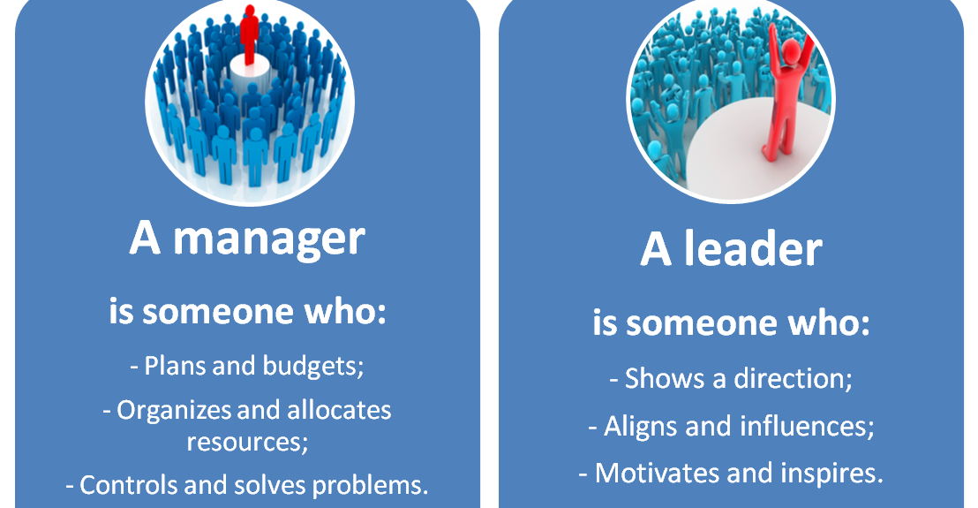
Leading
Leadership: The ability to influence a group toward the achievement of goals

Slide 45
Major roles of leaders
Vision
Inspiration
Momentum
Positive image of what the firm could become
The ability to move people to action
The ability to earn people people’s trust and respect

Slide 46
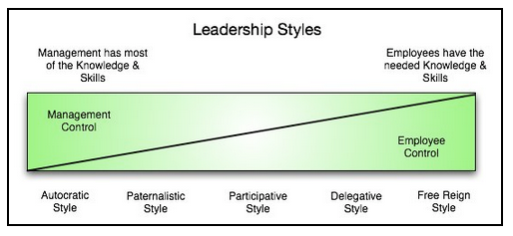
Leadership styles
A leadership style is a leader's style of providing direction, implementing plans, and motivating people.
No one style of leadership fits all situations.
Notes:
http://www.nwlink.com/~donclark/leader/leadstl.html

Slide 47
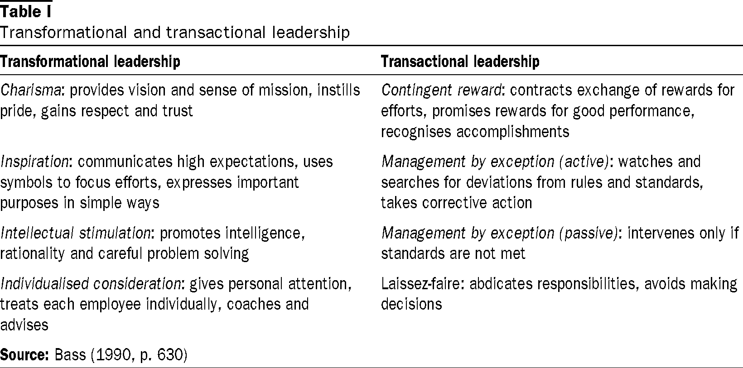
Leadership styles
Notes:
http://www.nwlink.com/~donclark/leader/leadstl.html

Slide 48

Controlling
The systematic process through which managers regulate organizational activities to make them consistent with expectations established in plans
Managers control:
  Work processes
  Employee behavior
  Financial resources
  Profitability

Slide 49
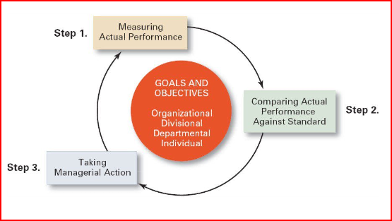
The control process
Setting standard and measurung: what we measure, how we measure
Comparing: determines the degree of variation between actual performance and the standard
Taking action: Action taken when the performance variation is unsatisfactory. Corrective action can be change in strategy, structure, redesign job or process, training program, fire employees
Notes:
http://www.managementstudyguide.com/controlling_process.htm

Slide 50
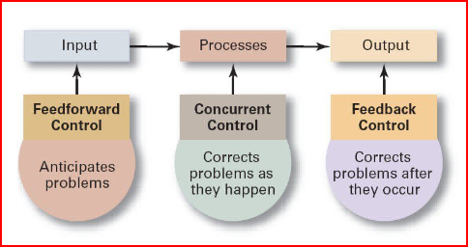
Type of control

