Slide 1

MK 322 Retail Management
Chapter 14: Retail Pricing Part I
By Ajarn Suwalya K.

Slide 2
Value
Value is ratio of what customers receive(the perceived benefit of the products and services offered by the retailer) to what they have to pay for it.
Retailers can increase value and stimulate more sales (exchanges) by either increasing the perceived benefits offered or reducing the price
Notes:
1

Slide 3


Value
Notes:
1

Slide 4

Pricing Strategies

Slide 5
Pricing Strategies
Two basic pricing strategy
High/ low pricing strategy
EDLP
Notes:
1

Slide 6
High/Low Pricing
Retailers use this strategy frequently
Often weekly
Discount the initial prices for merchandise through sales promotions
Customers learn to expect frequent sales and simply wait until the merchandise they want goes on sale and then stock up at low prices
Notes:
1

Slide 7
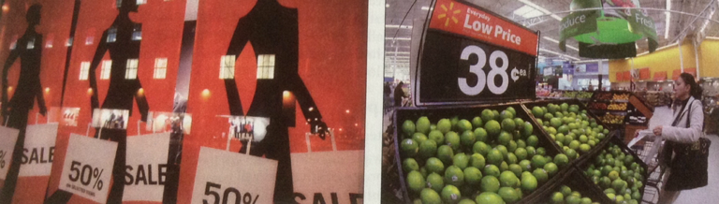
Pricing Strategies
The retailer on the left is using a high/low pricing strategy, whereas the one on the right is using everyday low pricing strategy.
Notes:
1

Slide 8
Everyday Low Pricing (EDLP)
This strategy emphasizes the continuity of retail prices at a level somewhere between the regular nonsale price and the deep-discount sale price of high/low retailers
They occasionally have sales
Although retailers use EDLP, may not be lowest price in the market, but their sale may be lowest
Notes:
1

Slide 9
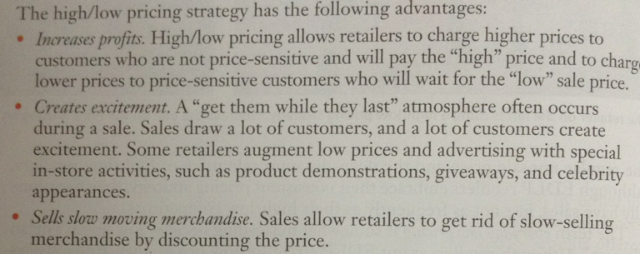
Advantages of High/Low Pricing
Notes:
1

Slide 10
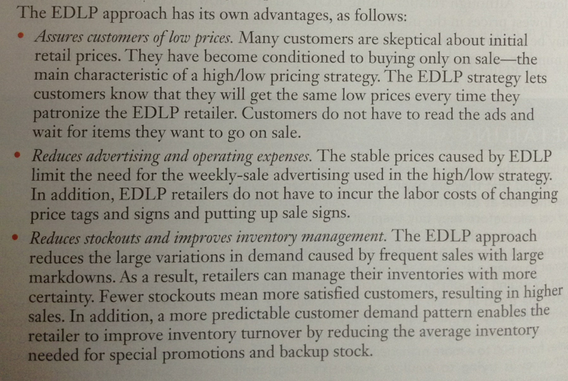
Advantages of Everyday Low Pricing (EDLP)
Notes:
1

Slide 11

Considerations in Setting Retail Prices

Slide 12
Considerations in Setting Retail Prices
The price sensitivity of consumers
The cost of the merchandise
Competition
Legal constraints
Notes:
1

Slide 13
Customer Price Sensitivity and Cost
Generally as price of product increase, and sales decrease due to fewer customers feel the product is good value
Price sensitivity of consumers determines how many units will be sold at different price levels
Price-sensitive reactions to a price decrease?
Notes:
1

Slide 14
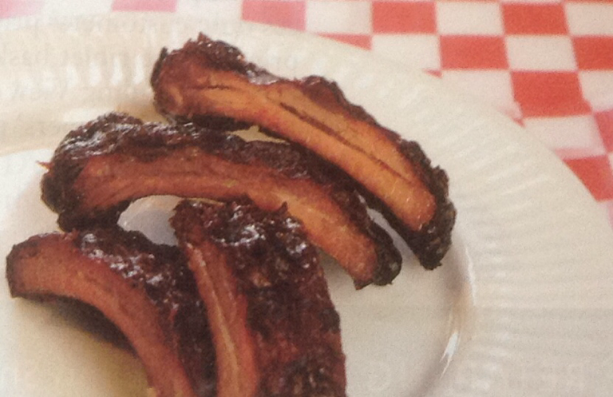

Customer Price Sensitivity and Cost
Experiment
Notes:
1

Slide 15
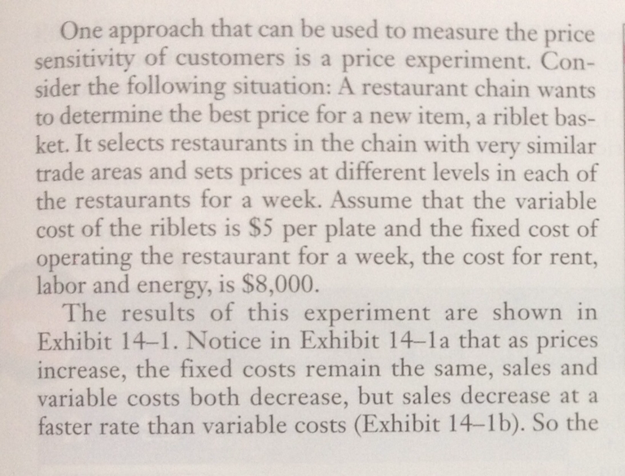
Customer Price Sensitivity and Cost
Notes:
1

Slide 16
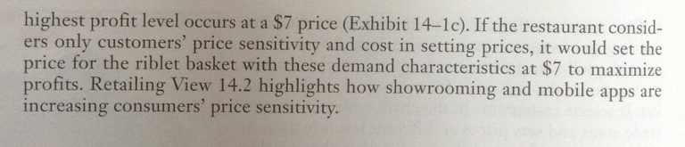
Customer Price Sensitivity and Cost
Notes:
1

Slide 17
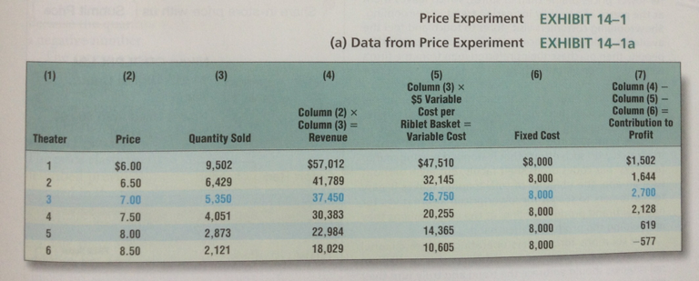
Customer Price Sensitivity and Cost
Notes:
1

Slide 18
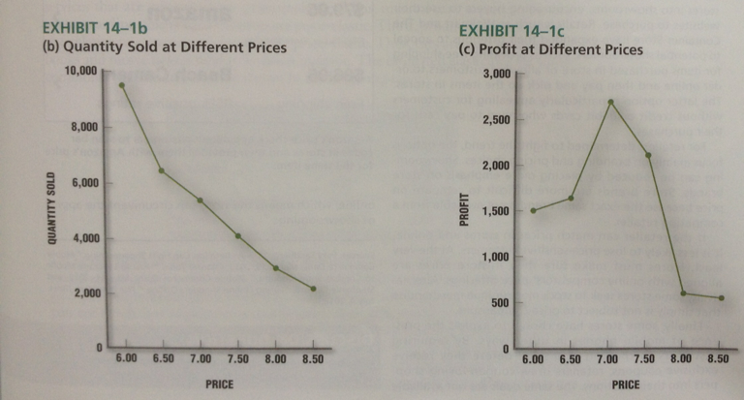
Customer Price Sensitivity and Cost
Notes:
1

Slide 19
Customer Price Sensitivity and Cost
Factors affecting price sensitivity
Substitutes- fastfoods (price-elastic)
Products and Service that are neccesity – medicare (price-inelastic)
Products that are expensive relative to consumer's income- cars (price-elastic)
Notes:
1

Slide 20
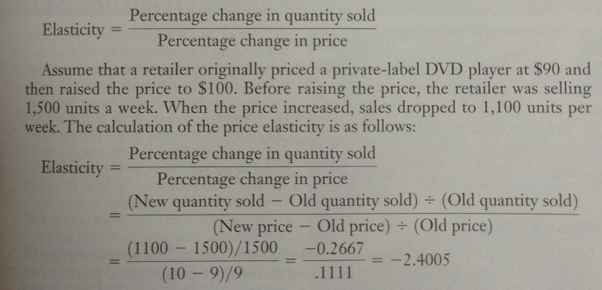
Customer Price Sensitivity and Cost
Notes:
1

Slide 21
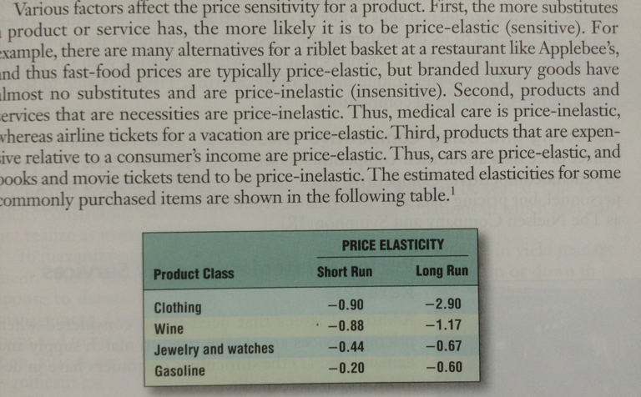
Customer Price Sensitivity and Cost
Notes:
1

Slide 22
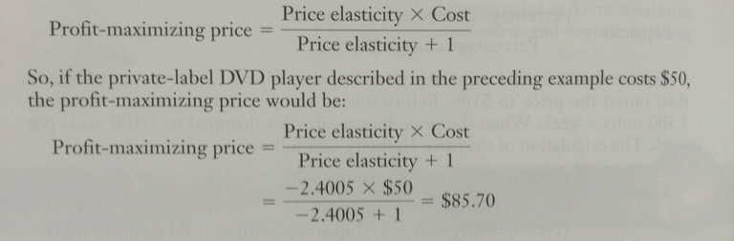
Customer Price Sensitivity and Cost
Notes:
1

Slide 23
Competition
Retailers need to consider competitor's pricing when setting their own
Routinely collect price data and adjust prices to remain competitive
Notes:
1

Slide 24
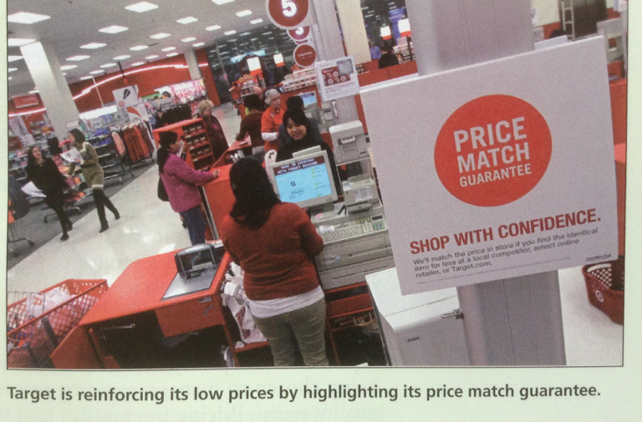
Pricing Strategies
Retail price = Cost of merchandise + Markup
Notes:
1

Slide 25

Pricing Strategy Used by Services Retailers
The need to match supply and demand
The difficulties customers in determining service quality
Notes:
1

Slide 26
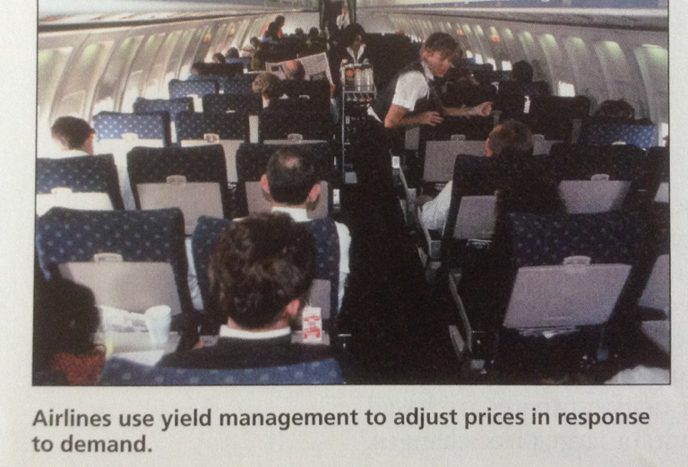
Pricing Strategy Used by Services Retailers
Notes:
1

Slide 27
Matching Supply and Demand
Yield management is the practice of adjusting prices up or down in response to demand to control sales generated
Computerized programs monitor the reservations and ticketing for each flight and adjust prices according to capacity utilization
Prices are lowered on flights when sales are below forecasts and there is significant excess capacity
As ticket sales approach capacity, prices are increased
Notes:
1

Slide 28
Determining Service Quality
Often difficult for customers to assess service quality due to intangibility
Assessment offered to fees charge, ie. Legal service
Higher risk situations tend to arise in relation to credence services – legal, medical services, and even hair salons
Need to carefully select price as customers depend on price as cue for quality and helps retailers in capacity management
Notes:
1

Slide 29


