Slide 1
Overview of CLMV Economy

Slide 2
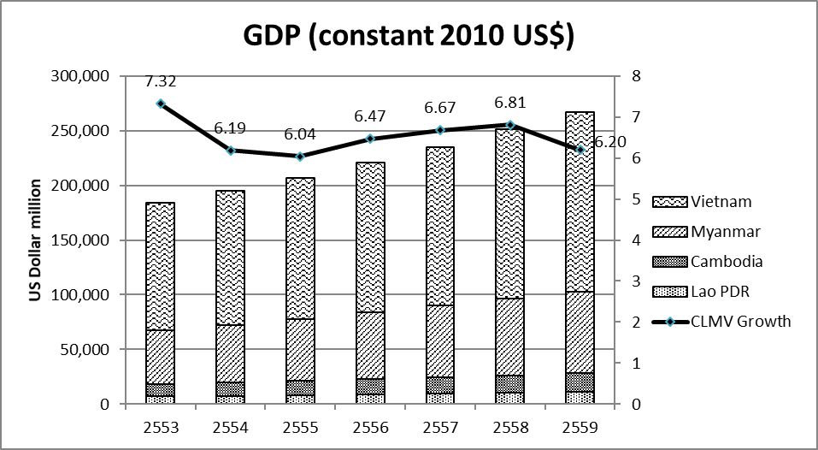
CLMV economy
In 2016, CLMV GDP is around 266.7 billion US$
Vietnam is the largest economy (164.1 billion US$), followed by Myanmar (74.5 billion US$) Cambodia(17 billion US$) and Lao PDR (11.1 billion US$)

Slide 3
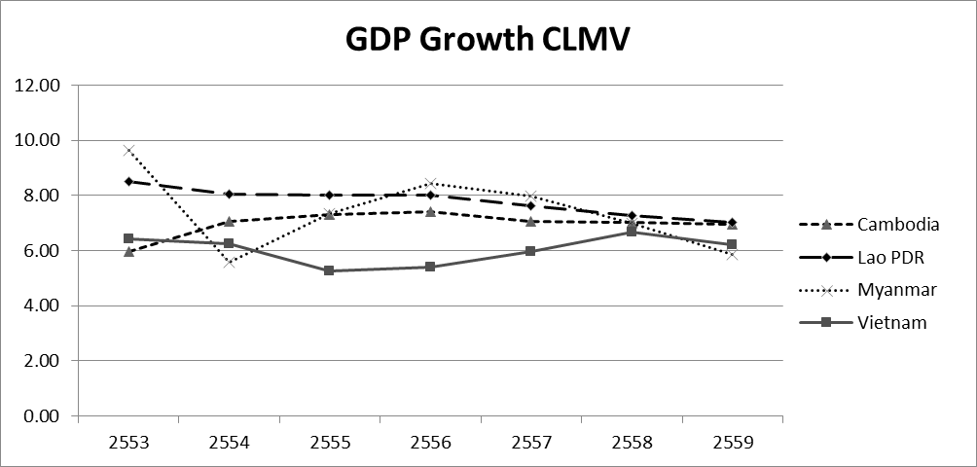
Economic Growth
GDP Growth is considerably high
LAO PDR has the highest growth rate while Vietnam has the lowest growth rate.
Myanmar growth is fluctuate while Cambodia’s is quite stable

Slide 4
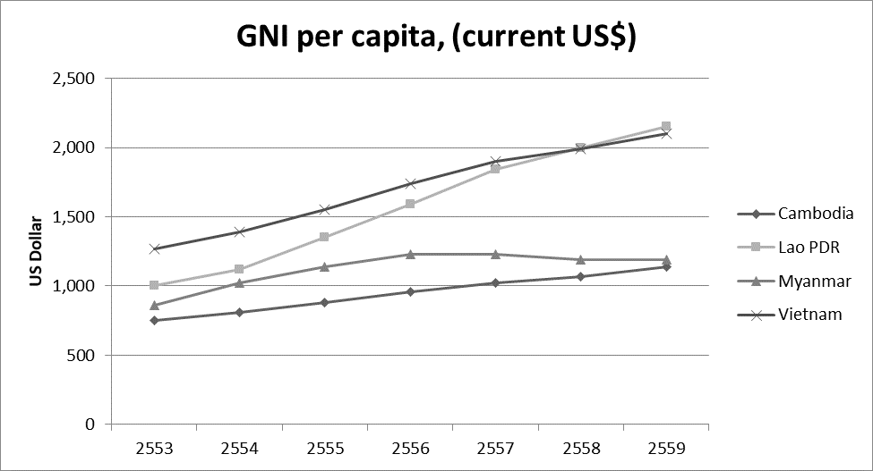
Per capita Income
VN has the highest per capita income
All countries GNI per capita is higher than 1,025 US$➔lower-middle income economies by WB definition
VN, LA and MM has become a lower-middle income economy in 2009, 2011, 2012 and 2015 respectively.

Slide 5
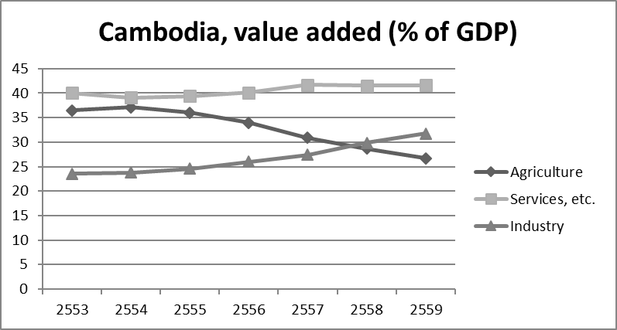
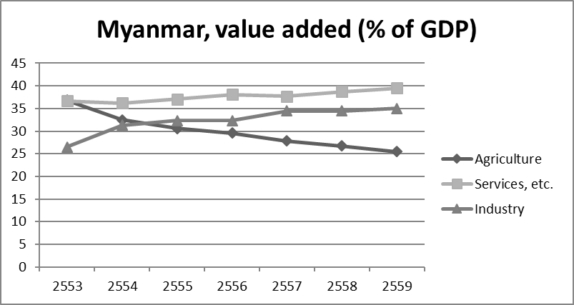
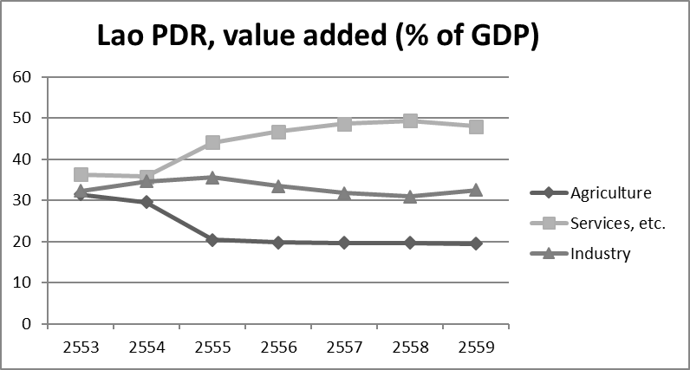
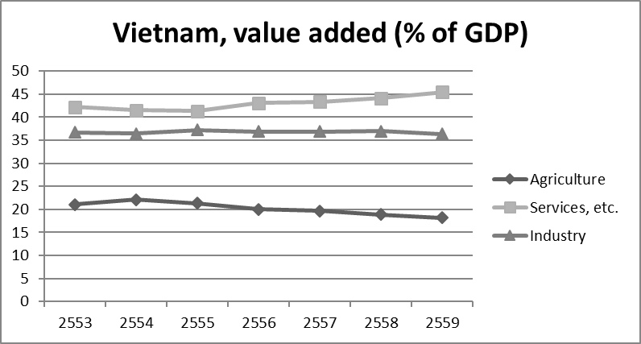
Economic Structure
Service sector is the main contributor (more than 35% of GDP in each country)
Agriculture sector is getting smaller.

Slide 6
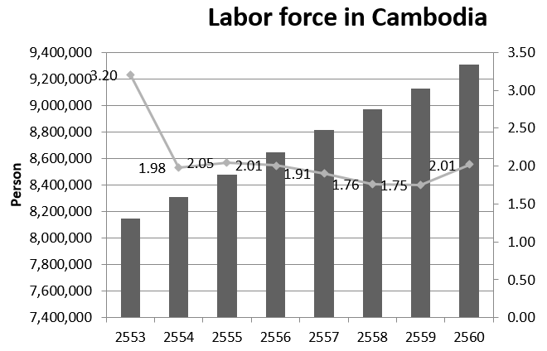
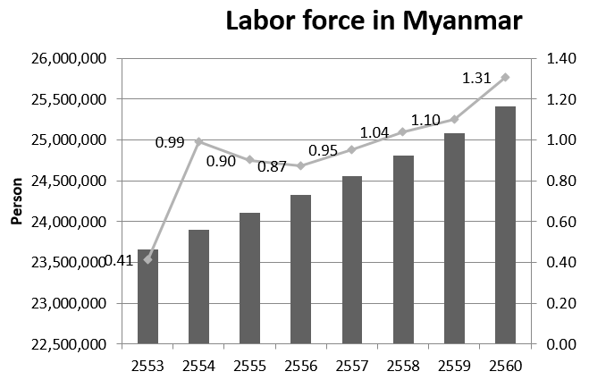

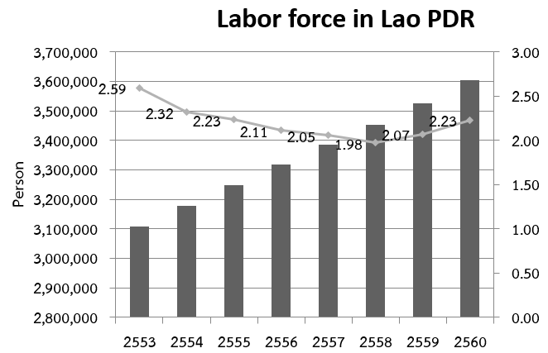
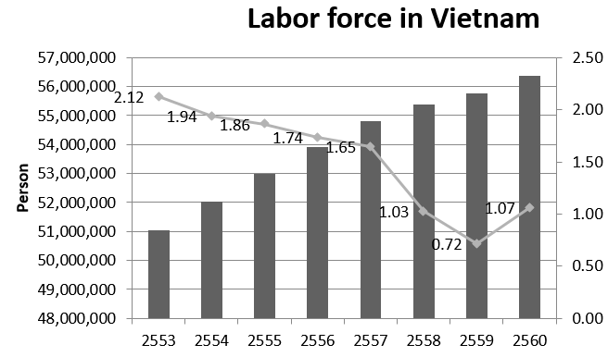
Labor force
VN has the largest labor force (in 2017, 56.4 mil.) while LA has the smallest labor force (3.6 mil) .
Labor force in CLMV is growing, about 1-2% growth recently.

Slide 7
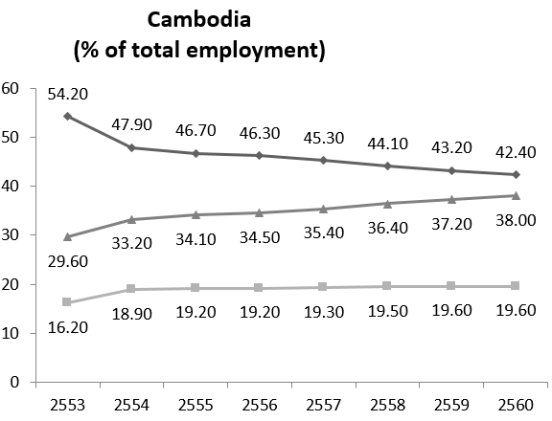
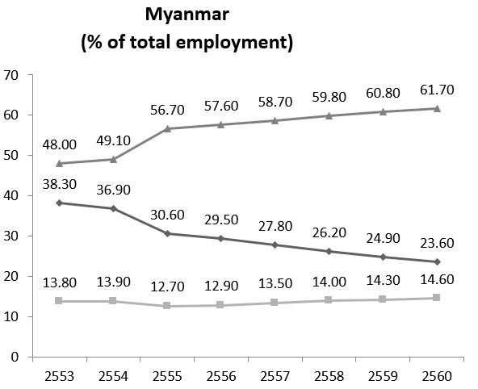
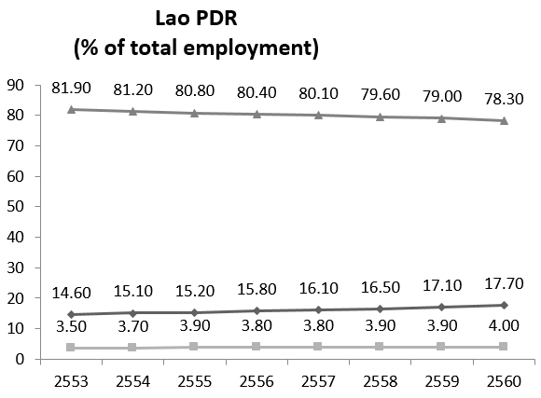
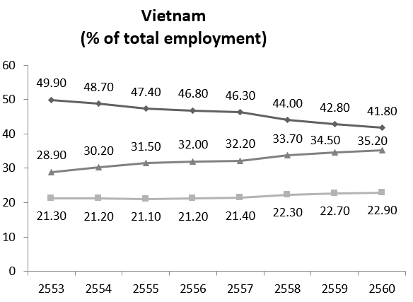

Employment by sector
For CA, LA and VN most employment are in Agricultural sector
For MM, most employment are in service sector
For VN, GDP in agriculture is low (about 20%) but utilize a large share of labor force.
Note: for LAO diagram, the legend switched. The employment in agriculture should have been employment in service.

Slide 8
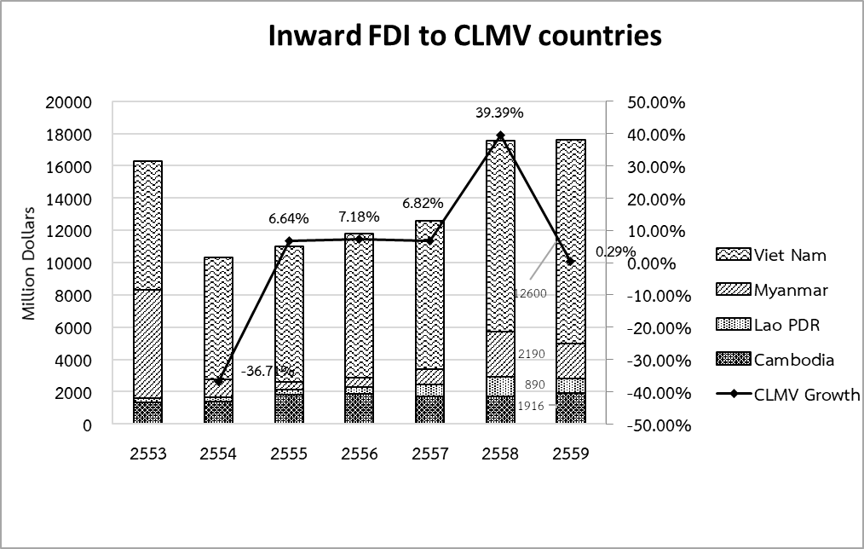
FDI to CLMV
Main investors are China, South Korea, Singapore and Thailand

Slide 9
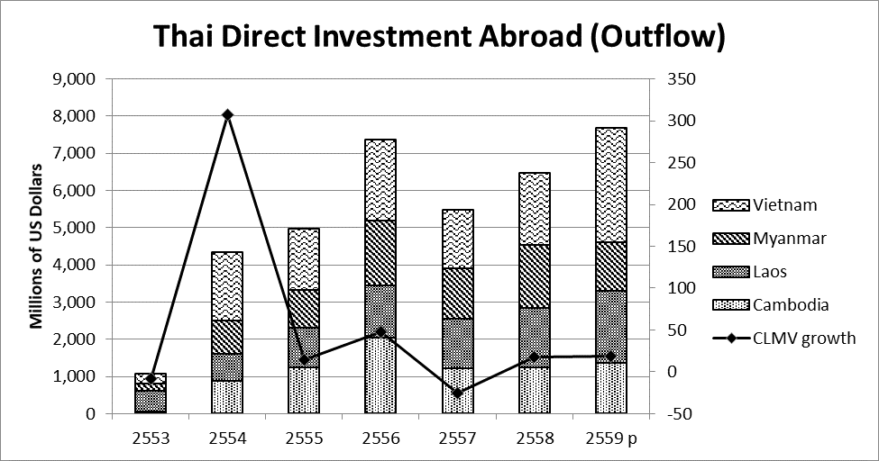
Thailand’s FDI in CLMV

Slide 10
International trade in CLMV
C
M
Export to | % | Import from | %
USA | 21.3 | China | 36.8
UK | 9.5 | Thailand | 15.4
Germany | 9 | Vietnam | 11.4
Japan | 8.2 | Taiwan | 5.7
Canada | 6.5 | Singapore | 4.6
Export to | % | Import from | %
China | 40.8 | China | 34.4
Thailand | 19.2 | Singapore | 14.5
India | 8.9 | Thailand | 12.7
Singapore | 7.6 | Japan | 8
Japan | 5.7 | India | 7
L
V
Export to | % | Import from | %
China | 36.1 | Thailand | 61.9
Thailand | 31.3 | China | 18.2
Vietnam | 17.2 | Vietnam | 10.1
India | 2.8 | Japan | 2.2
Japan | 1.9 | South Korea | 2
Export to | % | Import from | %
USA | 20.7 | China | 29.8
China | 10.2 | South Korea | 16.6
Japan | 8.7 | Japan | 8.6
South Korea | 5.5 | Taiwan | 6.6
Hongkong | 4.3 | Thailand | 5

Slide 11
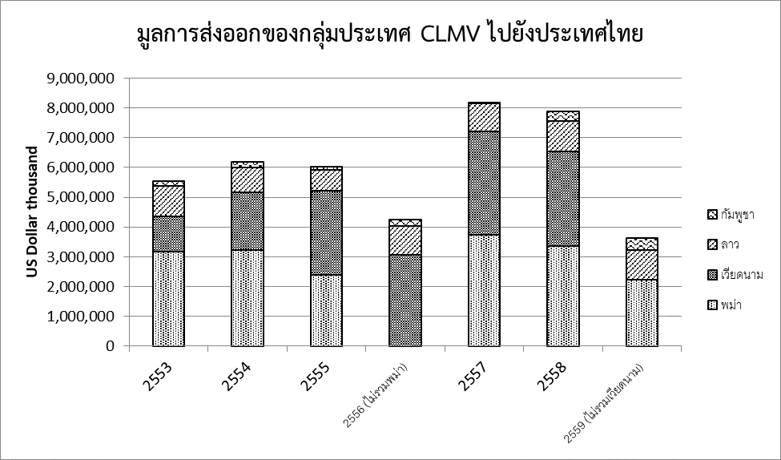
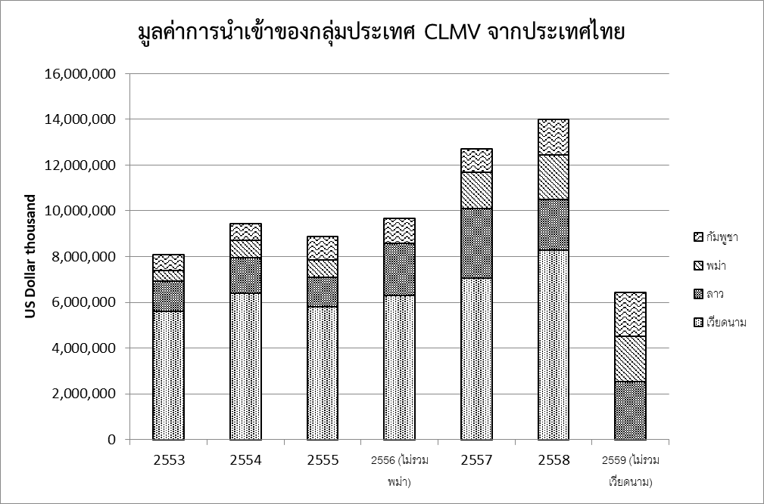
Trade b/w Thailand and CLMV
Export from CLMV to Thailand
Export from Thailand to CLMV
Thailand has a trade surplus with CLMV (except for MM where Thailand has a trade deficit)
MM is the major exporter to Thailand (followed by VN , LA and CA respectively)
VN is the major importer from Thailand

Slide 12
Competitive Index

Slide 13
Ease of Doing Business Ranking

