Slide 1
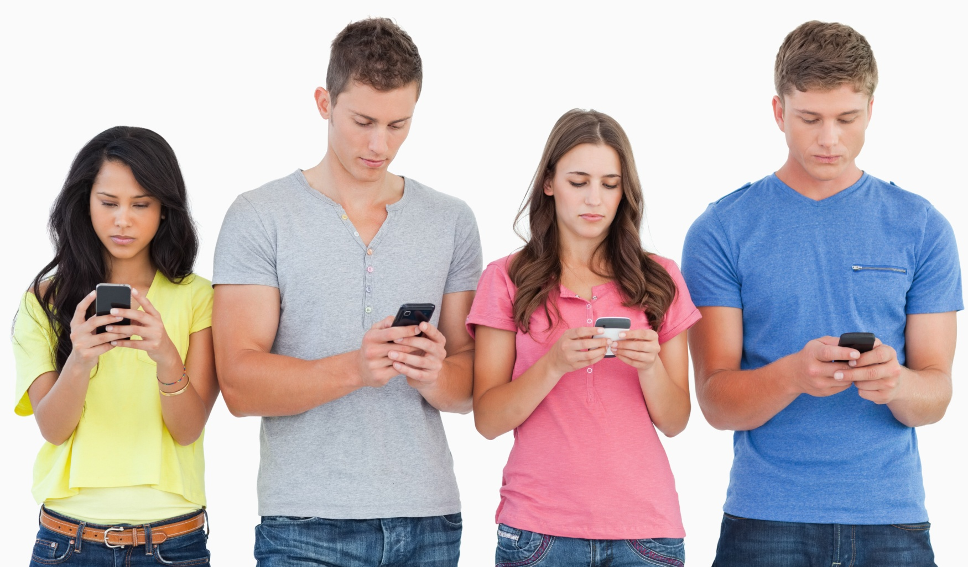
Consumers in Smartphone industry

Slide 2
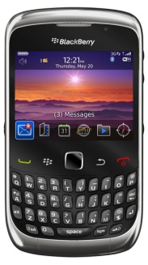
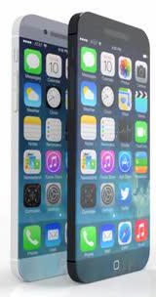
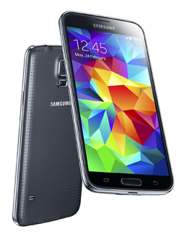
Start of a Revolution
•1999 -Blackberry creates its email device - birth of the smartphone market
•2000 - Ericsson uses the magic word when marketing its mobile phone
•2007- Apple releases revolutionary iPhone
•2008 - Google opens up the world of smartphone software by creating Android
•2010 - Android devices overtake Apple devices in sales
•2010 - New player Microsoft enters the modern-day market with Windows Phone
•2011 - 491.4 million smartphones sold worldwide.
•2012 - 500 million active android users.
•2016 - Projected 1 billion smartphone annual sales.

Slide 3




Group of consumers
High income household has income more than 75,000 USD per year
High income job - Financial examiners, engineer, business person
11% of household have income more than 75,000 USD per year.
High income people are count as 22% of smartphone users.
Low income household has income less than 25,000 USD per year
Low income job – labor, farmer
47% of household have income less than 25,000 USD per year.
Low income people are count as 16% of smartphone users

Slide 4
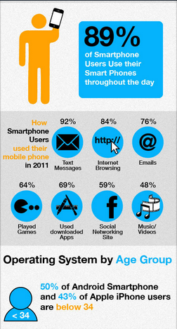
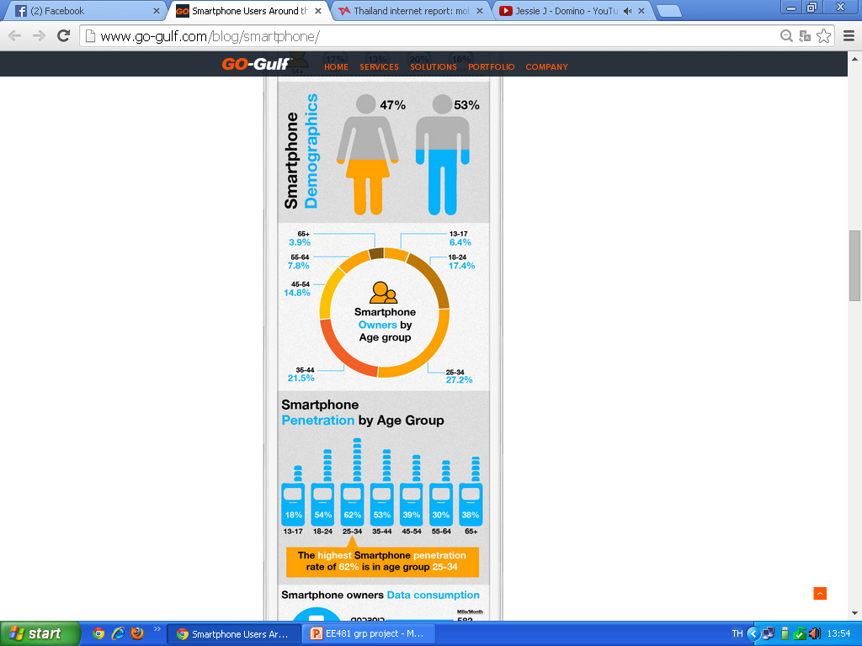

Statistics and facts of smartphone users around the world

Slide 5
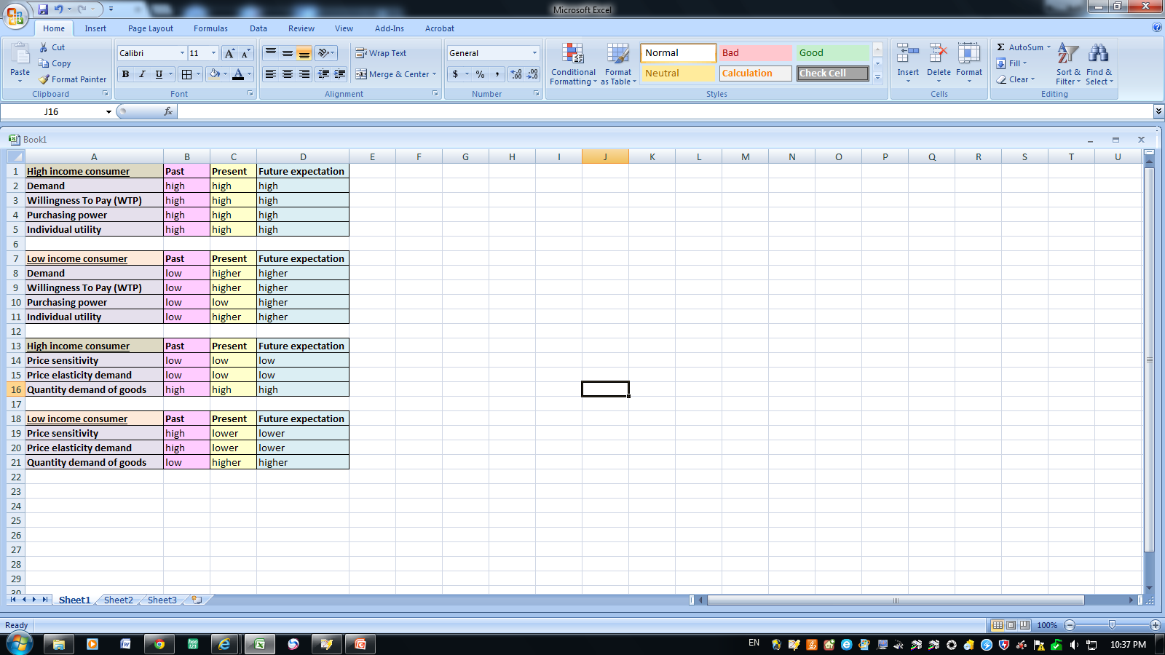
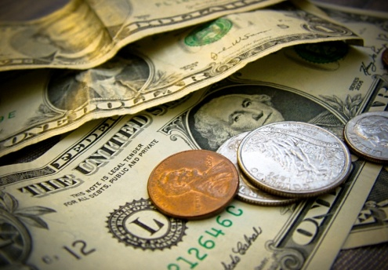


Consumer’s willingness to pay (WTP) and demand

Slide 6

Consumer’s price elasticity demand

Slide 7
Consumer behaviors
Past
- Only business and high income people used
the smart phone for doing business activities
(eg. Sending e-mails, making an appointment)
Present
- High income people use smartphone for
doing business activities, socializing and using some
application such as sports and health care application
- Low income people use smartphone for
socializing, playing games and blogging.

Slide 8


Consumer behaviors
Future expectation
- Everyone will have a smartphone to socialize, do business activities and be able to do other things effectively more through Smartphone
e.g. Smartwatch, 3D screen, Health and
fitness monitoring

Slide 9
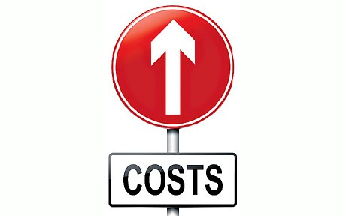
Switching cost
In the past, there wasn’t a Mobile Number Portability
Different operating system
(IOS, Android, Windows phone and etc.)
Applications
(Some applications are not free)

Slide 10
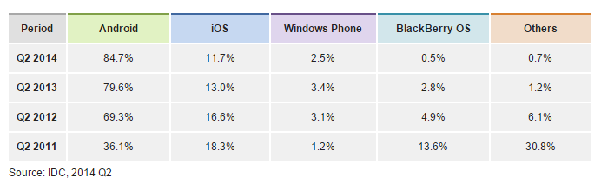

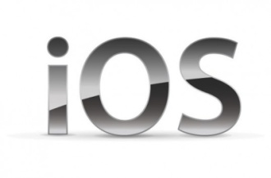
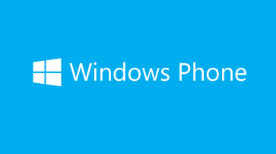

Operating system trend

Slide 11
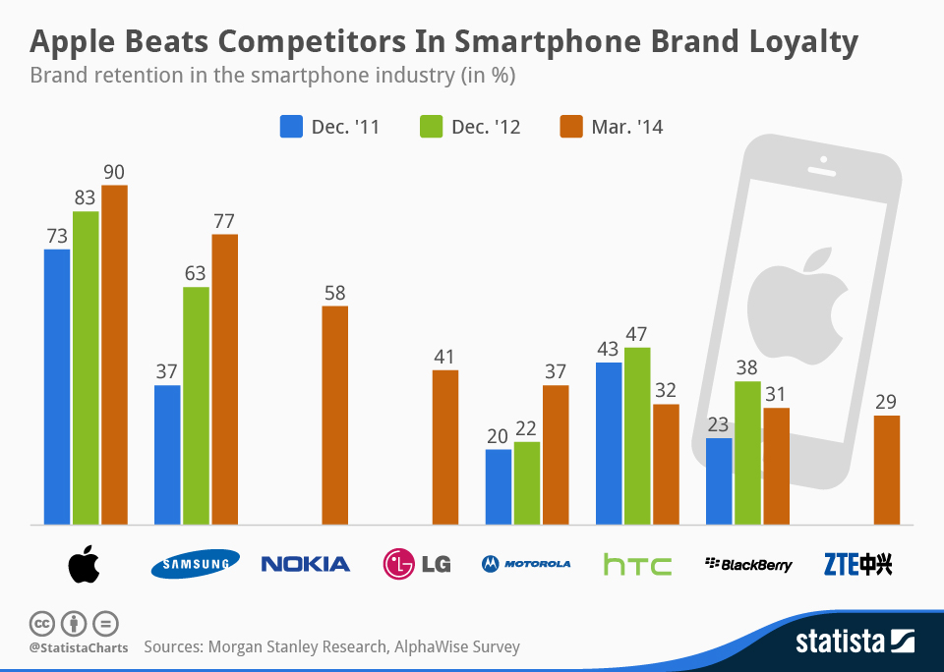
Comparison of operating systems
Apple maintains a high-tier stranglehold. iOS accounted for 19 percent of
smartphone shipments in 2013.
Apple vs. Android target markets
Brand Loyalty for Apple
Notes:
Although it has fallen significantly behind Android in recent years it
remains the leading priority for a large proportion of developers because of its premium
positioning, the profile of its users and their high level of engagement. This compares with
Android, which is spread across a far broader range of prices and consequently has a more
diverse customer profile.
Apple targets the high-tier market, while android targets the entire market from low-income to high-income. That’s why Android has such a large market share, but Apple generates higher profits

Slide 12
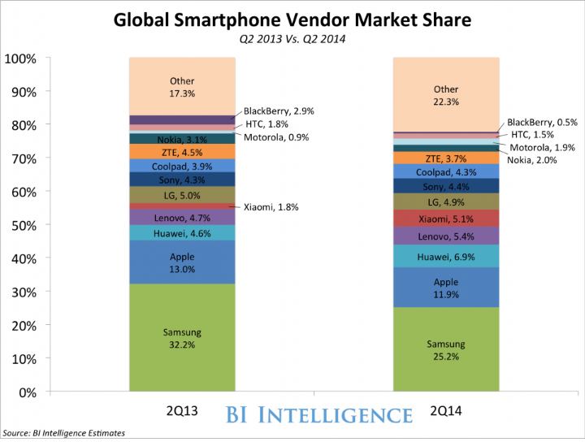
Trends of global Smartphone market shares
Notes:
because of increase of competitors in the market. Leads to diversification. Beneficial to consumer (prices are more competitive, more products for consumer), bad for producers.
As competitors enter the market, the market share between Samsung and Apple becomes diluted
Relatively new competitor Huawei has started gaining market share by focusing on low-tier markets.

Slide 13
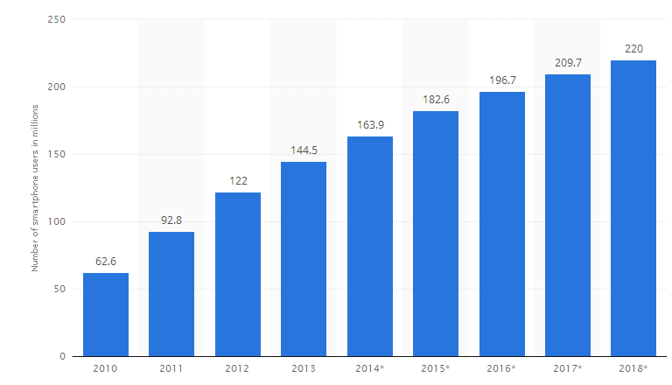

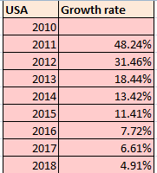
Market size of smartphone users in the US

Slide 14
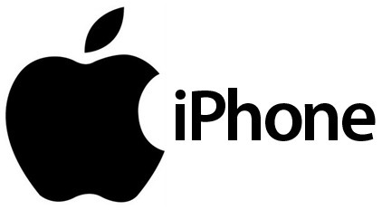

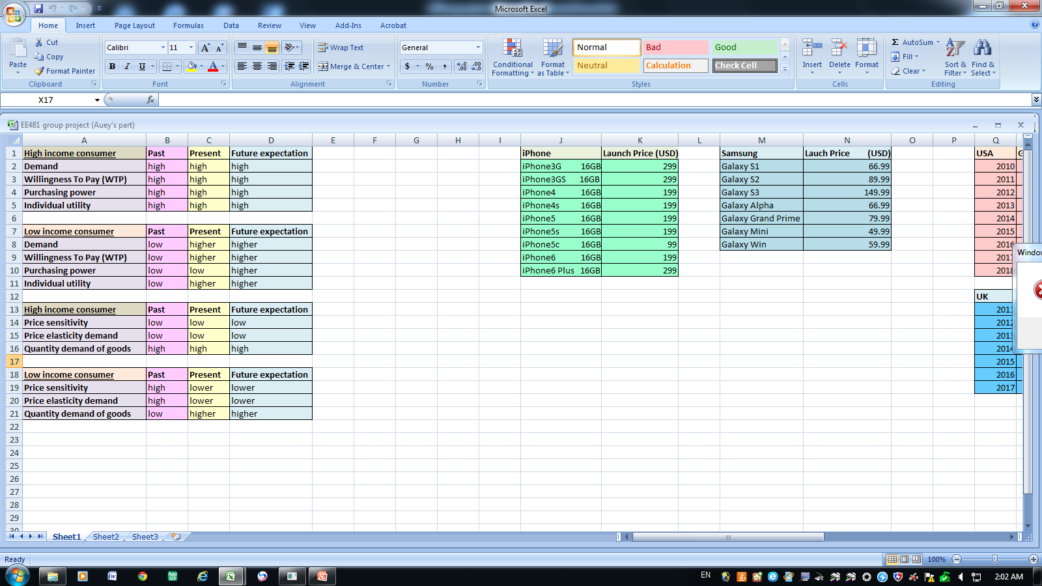
Trend of US Smartphone price

Slide 15

Market trends
Average sales price for a smartphone was $337 dollars in 2013, down from $387 in 2012. Projected to reach $265 by 2017.
Analysis: Industry is being driven and targeted towards a low-income market. As prices decrease, more consumers will be able to access the smartphone industry.
Companies are innovating to be able to create products that can be accessed by the low-income market
Just 25 percent of smartphones will be shipped to mature markets in 2018
The shift to smartphones is expected to continue in all regions.

Slide 16
Market size of smartphone users in Thailand
14 million smartphone users in Thailand as of 2012, which is a 43 percent increases from 2011.
Thailand already has 120% mobile phone penetration—more than one phone per person
Almost 3 million smartphones were sold in the first quarter of 2014

Slide 17
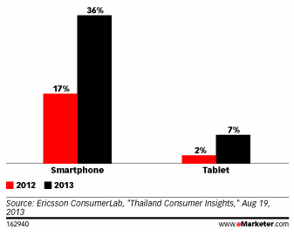
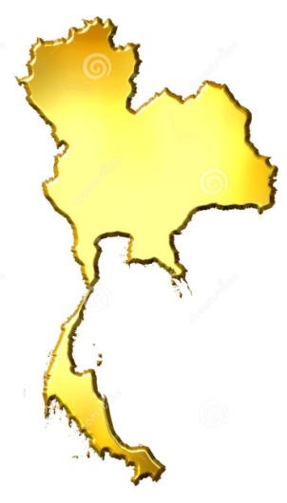
Market size of smartphone users in Thailand
The demand of smartphone users is rising in the rural north
Incredible growth between 2012 and 2013 in urban Thailand

Slide 18
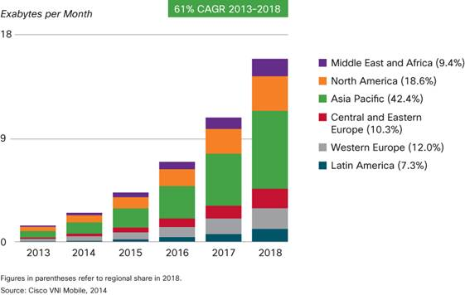
Global trend of internet usage

Slide 19
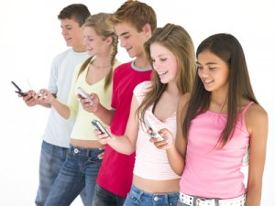
Network Effect
Effect that one user of a good or service has on the value of that product to other people
When the effect is present, the value of a product or service is dependent on the number of others using it
Chat Applications- Line, Whatsapp, Facebook, Twitter
Social Network = big aspect of what makes a smartphone desirable.
  creates a higher demand and makes the demand more inelastic

Slide 20
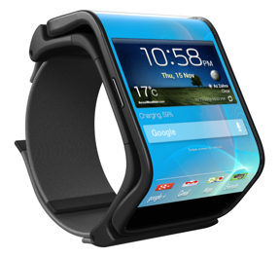
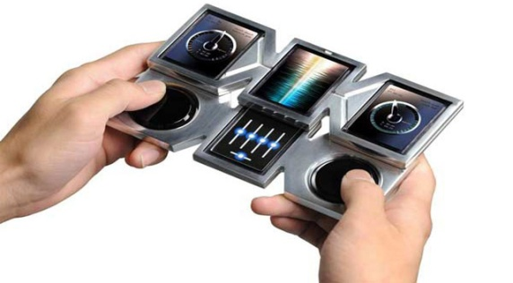
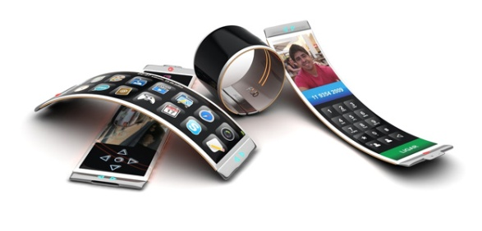
Future expectation
Technology
  Smartwatches (aimed to increase demand for smartphones); Augmented reality, advanced voice control. Modular Phones (to help expand the market); flexible screens
    Convergence
      Everyone becomes more integrated.
      All phones have similar qualities
    Convenience
      Ease of use (talking to your phone, having a smartwatch, being able to pay from your phone)
      – Makes product more appealing to the consumer.
      -- No more charging cable

Slide 21
Sources
https://www.boundless.com/economics/textbooks/boundless-economics-textbook/economic-surplus-4
http://www.statista.com/statistics/201207/us-smartphone-user-share-since-2010-by-os/
http://www.statista.com/statistics/270821/smartphone-user-in-the-united-kingdom-uk/
http://www.eiu.com/industry/article/1890881373/thailand-mobile-number-of-smartphone-users-rises-rapidly/2013-08-22
http://www.businessinsider.com/the-state-of-the-smartphone-industry-2014-9
http://www.facebook.com/l.php?u=http%3A%2F%2Fwww.digitaltrends.com%2Fmobile%2Fsmartphone-switching-the-problem-isnt-cost-its-choice%2F&h=9AQGbuJwY

