Slide 1
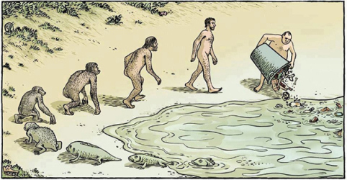
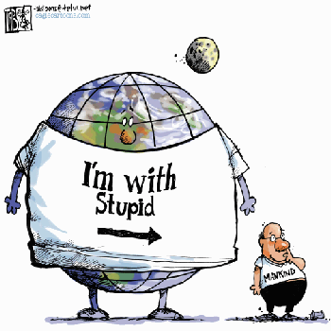
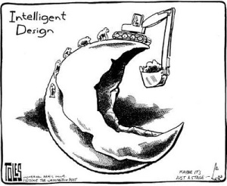
International trade & investment VS environment

Slide 2
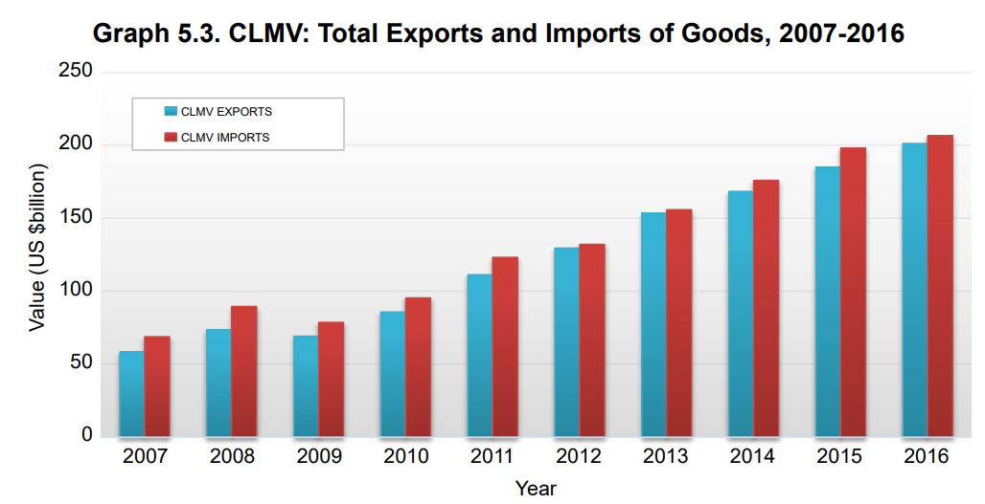


Slide 3
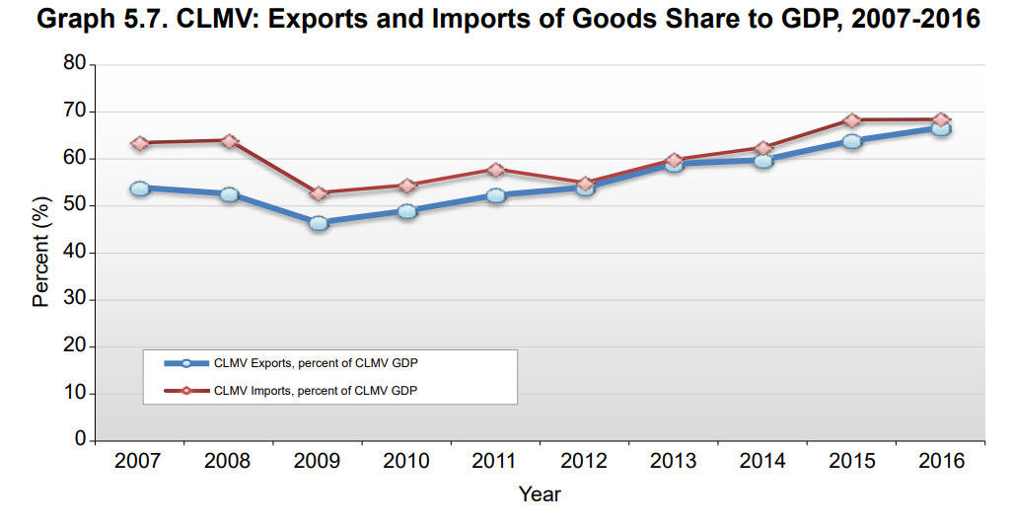

Slide 4
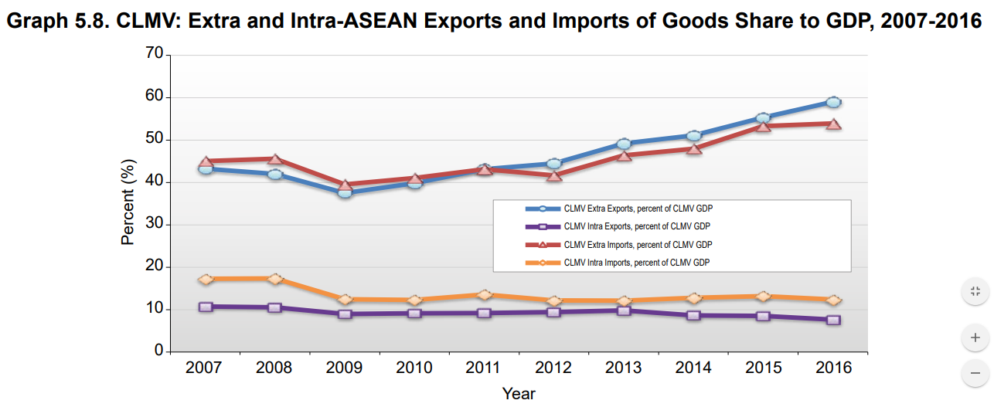

Slide 5
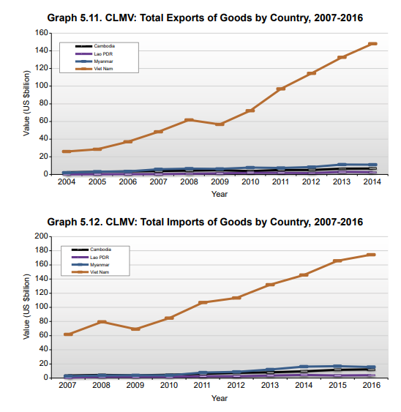

Slide 6
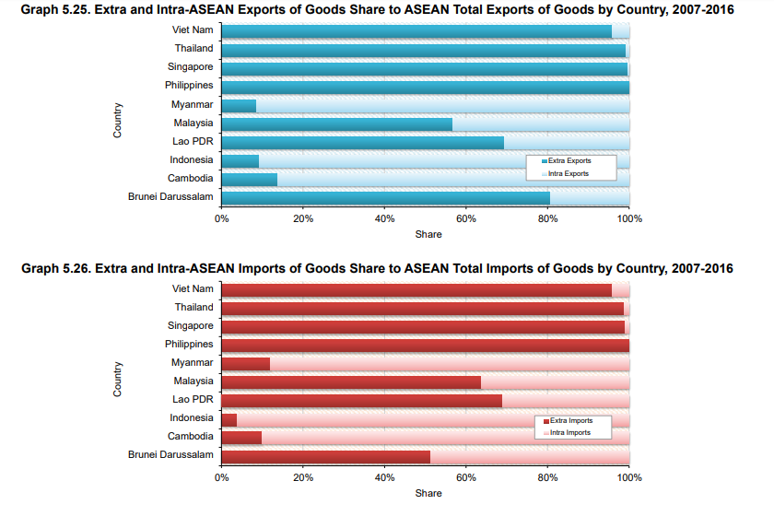

Slide 7
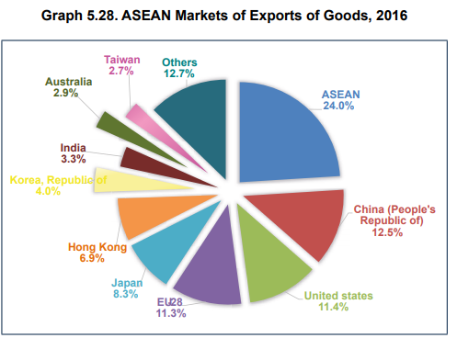
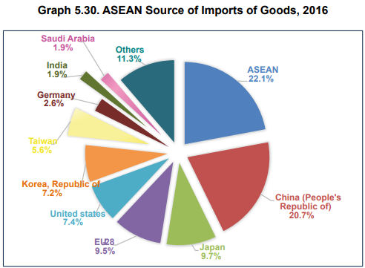

Slide 8
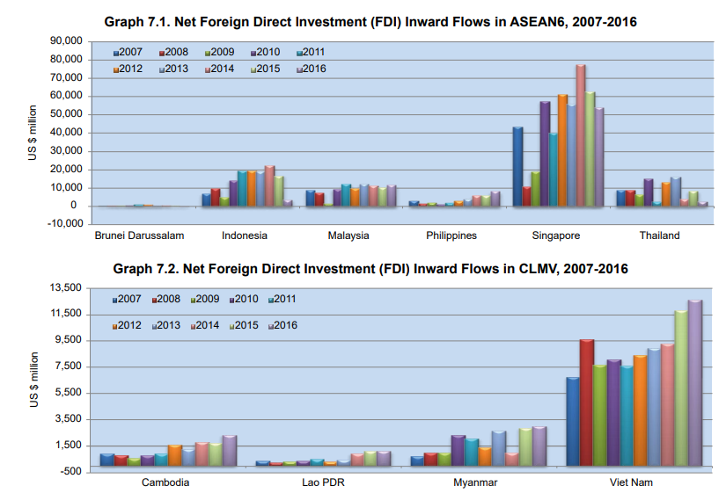

Slide 9
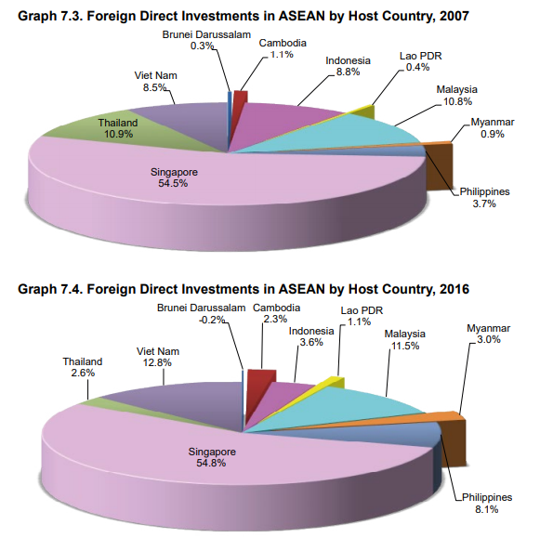

Slide 10
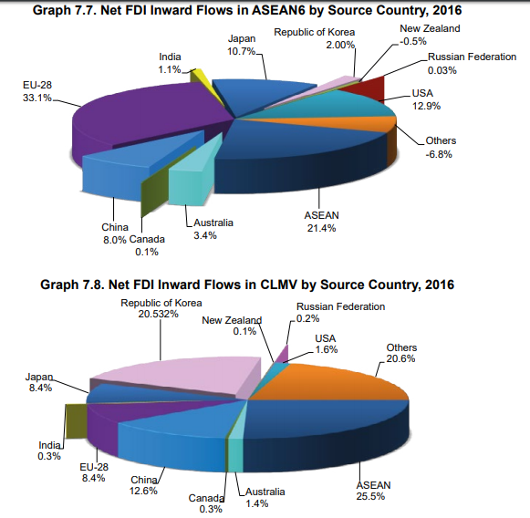

Slide 11
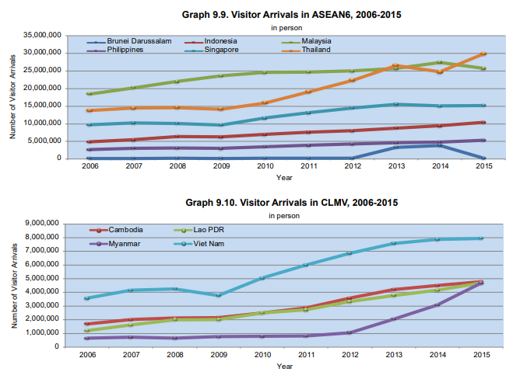

Slide 12
Group discussion: (30 mins)
Why do countries trade?
Why do countries invest in other countries?
PROs and CONs of free trade and investment?
Is trade/FDI good or bad for the environment?

Slide 13
Growth and the Environment
Environmental Kuznets Curve (EKC)
Research has examined whether a relationship exists between economic growth and pollution
A model of this relationship is the environmental Kuznets curve (EKC), an inverted U shape, implying that:
  Early stages of industrialization are linked to relatively high pollution levels when growth is a priority
  environmental controls are lenient or nonexistent
  More advanced economic development ➔ greater concern for environmental quality and a strengthening of environmental regulation
A consensus is forming that this tradeoff is not as severe as once believed

Slide 14
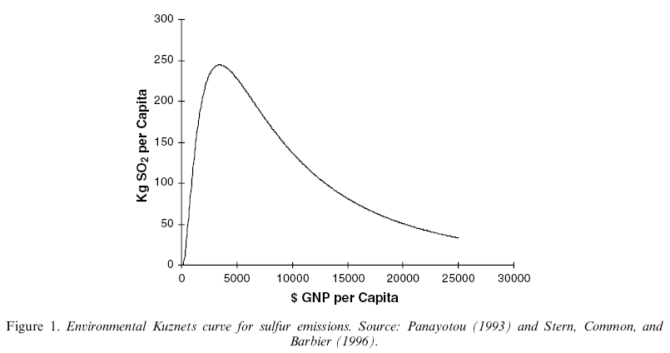
Environmental Kuznets Curve
Early stages of industrial development
Pollution
More advanced stages of development
EKC
Income per capita

Slide 15
The Environmental Kuznets Curve
Why does the curve rise at low levels of development? Possible explanations:
Why does pollution tend to fall at higher levels of development? Possible explanations:

Slide 16
Pollution heaven and race to the bottom
  Reducing barriers to trade and investment will reinforce the tendency for countries to export commodities that make use of resource-intensive production factors OR move production bases to the countries with less environmental regulations (“pollution havens”).
  This may directly affect environmental standards (“race to the bottom”).

Slide 17
Discussion: Resource Curse
There are evidences that many oil-, gas- and mineral-rich countries have failed to reach their full potential as a result of their natural resource wealth.
“The resource curse, also known as the paradox of plenty, refers to the paradox that countries with an abundance of natural resources (like fossil fuels and minerals), tend to have less economic growth, less democracy, and worse development outcomes than countries with fewer natural resources.”
Oil, mineral and gas wealth is distinct from other types of wealth because
  its large upfront costs, long production timeline, site-specific nature, scale, price and production volatility, non-renewable nature, and the secrecy of the industry.

Slide 18
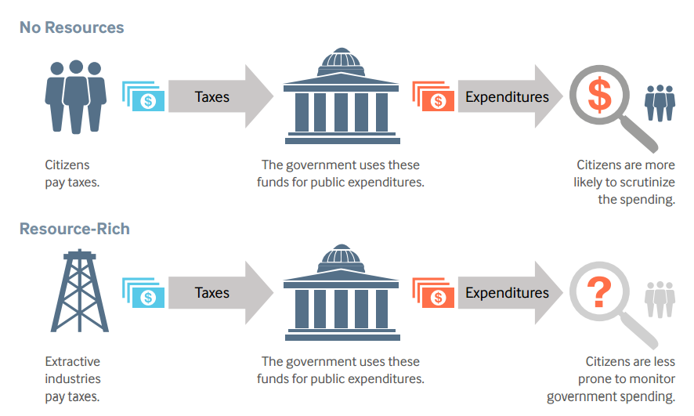
Cause of resources curse
Democracy
  Natural resource wealth has made it more likely for governments to become or remain authoritarian.
  large revenues from natural resources ➔ less dependent on levying taxes on citizens ➔ Politicians and government officers are less directly tied to citizen requests or demands.
  when resource revenues are secret, citizens do not have a clear sense of whether the resource revenues are being spent well or not.

Slide 19
Cause of resources curse
Conflict: natural resources can provoke and sustain internal conflicts as different groups fight for control of the resources or use natural resources to finance their fighting.
Inefficient spending and borrowing: The amount that governments collect in resource revenues can change drastically from year to year because of changes in commodities prices and production.

Slide 20
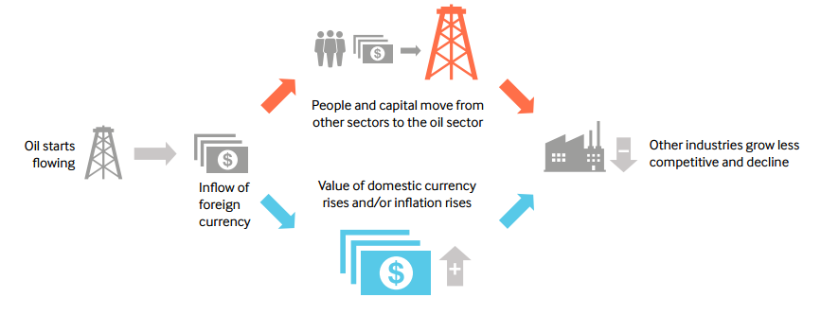
Cause of resources curse
Dutch disease: A large increase in natural resource revenues can hurt other sectors of the economy, particularly export-based manufacturing, by causing inflation or exchange rate appreciation and shifting labor and capital from the non-resource sector to the resource sector

Slide 21
Cause of resources curse
• Limited government capture of benefits:
  In some cases, only a small share of the production value of the resource stays in the country
  fail to compensate the state and communities for depleting their resources and related environmental damage or loss of livelihood.
  The point-source nature of extractive industries often creates challenges when trying to balance the needs of the people and environments that surround the mining area.

Slide 22
Environmental problem : Negative Externalities
By-products of consumption and production may harm others.
  Driving releases GHGs to the atmosphere
  Air pollution from power plants cause respiratory diseases.
Consumers and producers only take into account of private cost when they decide how much to consume and how much to produce.
Social cost = Private cost + Externality cost.
With externalities, consumers and producers tend to consume and produce too much.
  Think about gasoline consumption. from the social planner’s perspective, you consume too much?

Slide 23
How to solve environmental problem?
Command-and-Control
Tax
Information

Slide 24
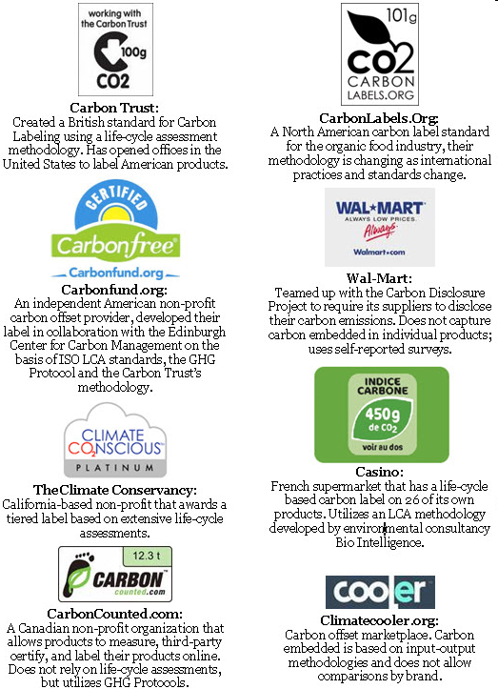

Slide 25
Environmental problem
  Local problem
  Regional problem
  Global problem

Slide 26
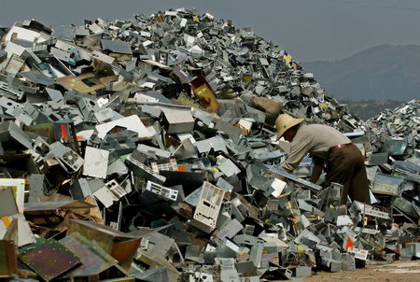
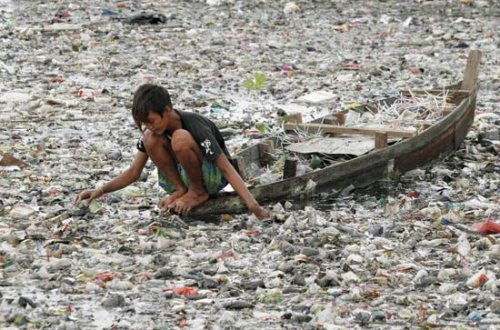
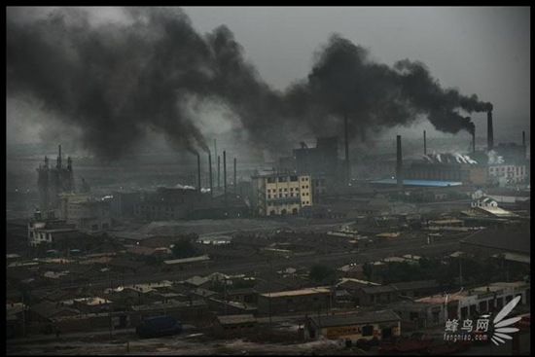
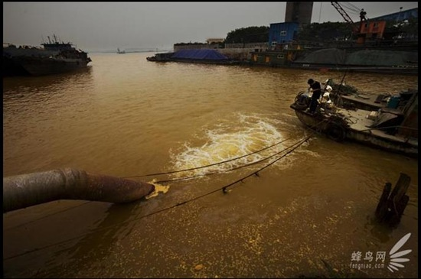
Environmental problem

Slide 27

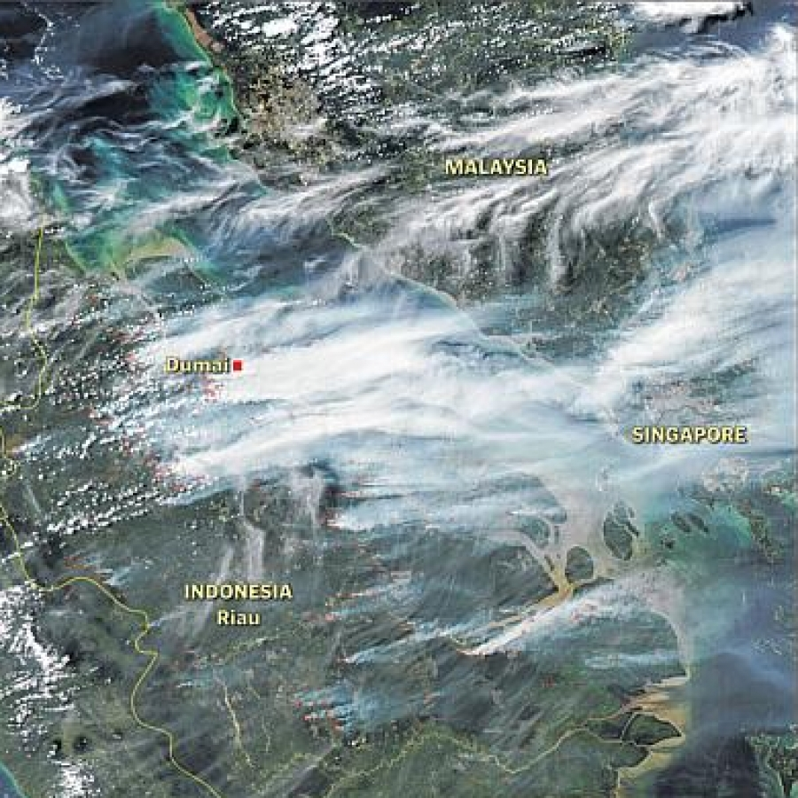
Regional environmental problem
https://www.nationalgeographic.com/magazine/2018/06/the-journey-of-plastic-around-the-globe/

Slide 28
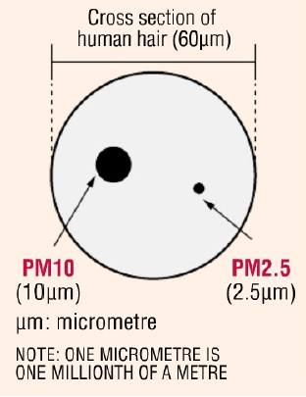
Transboundary pollution problem in ASEAN: HAZE
HAZE : Atmospheric moisture, dust, smoke and vapor suspended in the air to form a partially opaque condition and impair visibility.

Slide 29
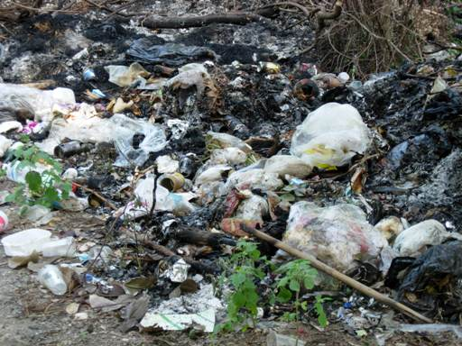
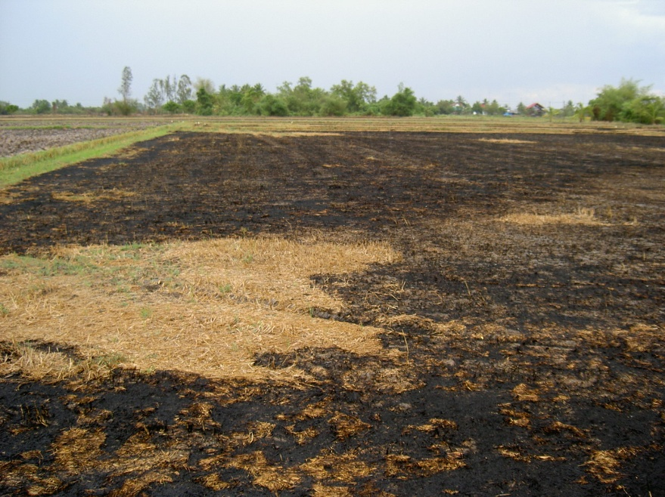
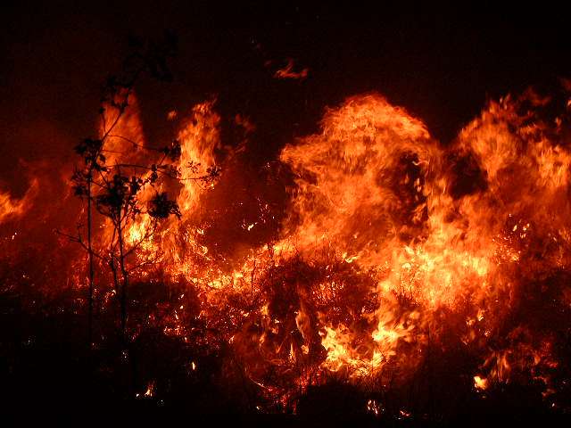
Haze resulted from 3 main activities;
Solid Waste Burning
Agricultural Waste Burning
Forest Fire

Slide 30
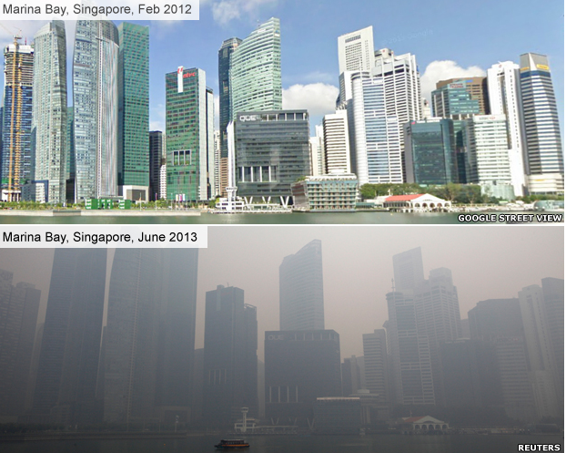

Slide 31
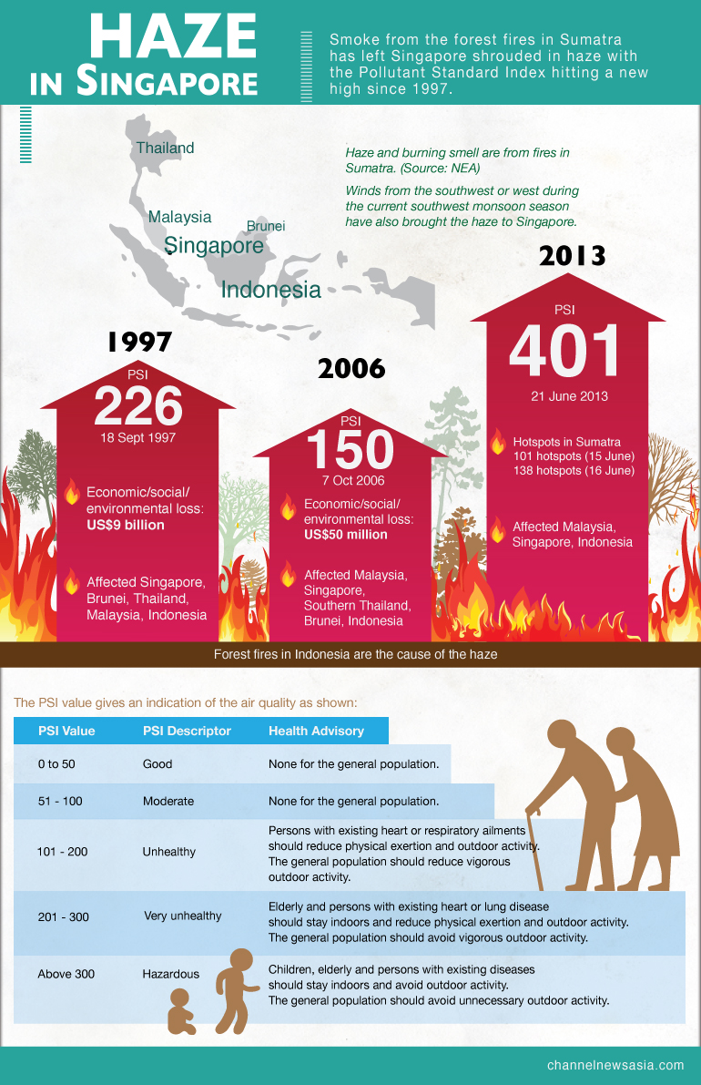

Slide 32


Slide 33
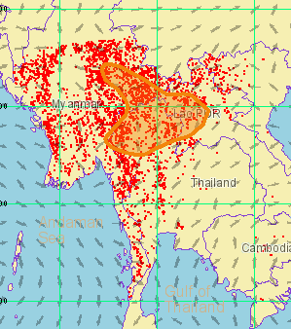
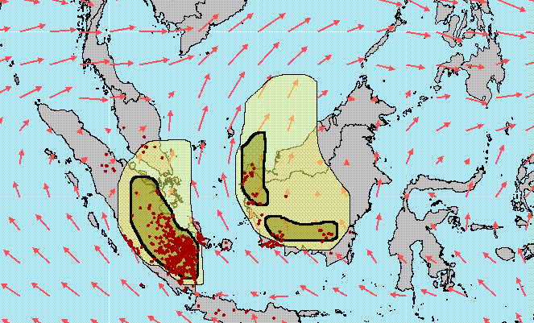
Haze Situation in Southeast Asia
During dry season in the Northern Hemisphere (January - April), hotspot in Mekong Sub-Region was found to increase. These burning activities result in transboundary haze pollution which can be seen clearly in the satellite images
On the other hand, fire in the Southern Part of the Region is found to be more intense during June – September particularly in Sumatra and Borneo.

Slide 34
Southern Smoke Haze Episode in 1997
The economic loss suffered by countries during this environmental disaster was enormous. Several economic sectors, including air, water and land transport, tourism and agriculture have been severely affected
Poor visibility making airlines canceling flights to several airports in the region
Implicated as a factor in the crash of a commercial aircraft in Sumatra on 26 September 1997, that killed all 243 people abroad

Slide 35
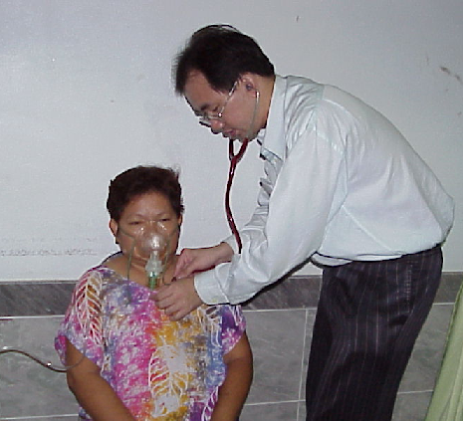
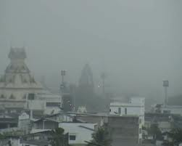

Haze pollution has also resulted in considerable health impact on the people of the countries affected. An increase in number of sick people who required clinic visits or hospital admission was reported from Malaysia, Singapore and Thailand.
More than 20,000 and 4,000 cases were reported in Malaysia and Singapore, respectively, and several thousands cases in Thailand.

Slide 36
ASEAN Agreement on
Transboundary Haze Pollution
Objective:
The Agreement aims to prevent and monitor transboundary haze pollution as a result of land and/or forest fires which should be mitigated, through concerted national efforts and intensified regional and international co-operation.

Slide 37
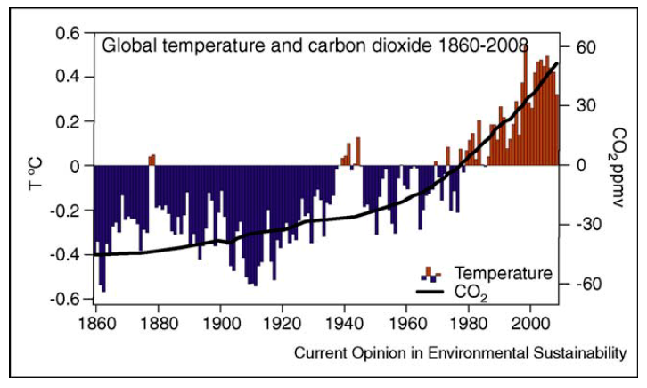
Global Environmental Problem
Stock vs Flow of “pollution”
Public good and free rider
Inter-generation problem
Far distant future
High uncertainty
Notes:
http://www.cgd.ucar.edu/cas/Trenberth/trenberth.papers/EnergyDiagnostics09final2.pdf
See http://www.economist.com/node/21533360 for a comparison of HadCru to Nasa, Noaa, Berkeley Earth….same.

Slide 38
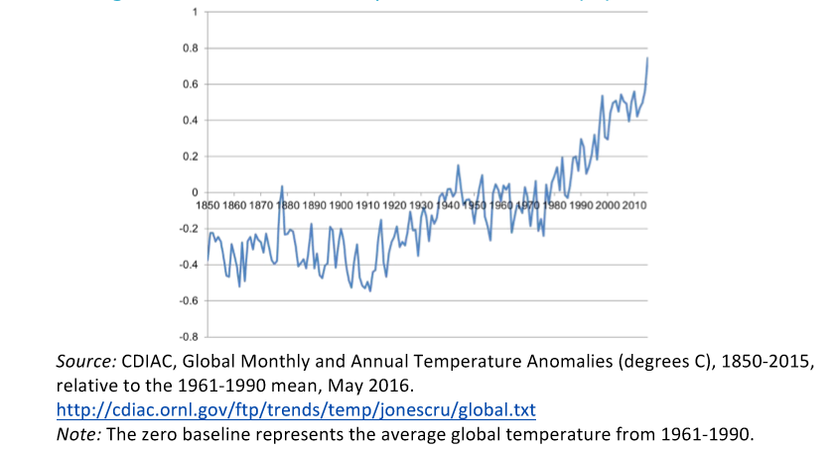
Global Annual Temperature Anomalies (°C), 1850–2015

Slide 39
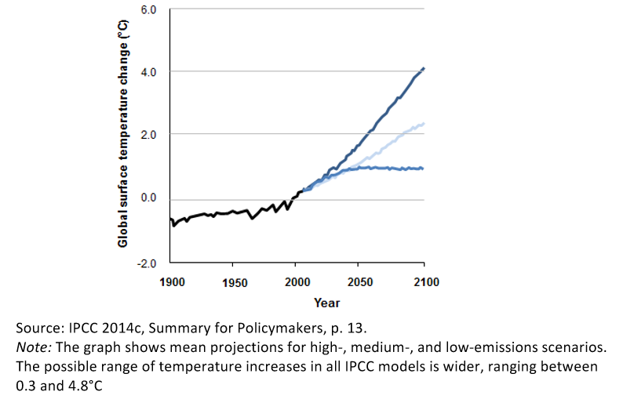
Global temperature trend 1900 - 2100
https://climate.nasa.gov/interactives/climate-time-machine

Slide 40
Will trade opening lead to more pollution (GHGs)?
Trade opening can affect the amount of emissions in three principal ways
The scale effect : increased level of economic activity will require greater energy use and will therefore lead to higher levels of greenhouse gas emissions.

Slide 41
Will trade opening lead to more pollution (GHGs)?
The composition effect : opening changes the structure of a country’s production in response to changes in relative prices. The effect on a country’s greenhouse gas emissions will depend on whether a country has a comparative advantage in emission-intensive sectors and whether these sectors are expanding or contracting.
differences in environmental regulations between countries “pollution haven hypothesis”

Slide 42
Will trade opening lead to more pollution (GHGs)?
Finally, the technique effect refers to improvements in the methods by which goods and services are produced, so that the emission intensity of output is reduced.
  more open trade can increase the availability, and lower the cost of, climate-friendly goods and services. ➔ help meet the demand in countries whose domestic industries do not produce these climate-friendly goods and services in sufficient quantities or at affordable prices.
  WTO’s trade negotiations under the Doha Round, which aim to open markets for environmental goods and services

Slide 43
Will trade opening lead to more pollution (GHGs)?
Second, the increase in income levels that trade opening brings about can lead the general public to demand lower greenhouse gas emissions (a cleaner environment is a “normal” good)
Grossman and Krueger (1993) conjecture that this public demand is perhaps the most important outcome of the technique effect.
governments need to respond to the public’s demands with the appropriate fiscal and regulatory measures.
Only if such measures are put in place will firms adopt cleaner production technologies, so that a given level of output can be produced with lower greenhouse gas emissions.
The “environmental Kuznets curve” : inverted U-shaped relationship between environmental quality and income

Slide 44
Technological spillovers from trade
several channels by which technological dissemination through trade
through the importation of innovations embodied in both intermediate goods (i.e. manufactured or processed goods which are used in further production processes) and capital goods (e.g. machinery or equipment used in the production of other goods and services) which a country could not have produced on its own.
the transfer of knowledge about new production methods and design from developed countries.

Slide 45
Border measures to prevent carbon leakage
absence of an internationally agreed price on carbon and since emission reduction policies, such as taxes and/or trading schemes, are not applied universally, the implementation of emission reduction policies has given rise to concerns about competitiveness as well as about environmental efficiency, i.e. “carbon leakage”
if environmental policies in different countries impose different levels of costs on competing firms, thus creating a price advantage for firms located in countries with less stringent environmental policies ➔ pollution heaven

Slide 46
Border tax adjustment (BTA)
the imposition of a tax on imported products, corresponding to a tax borne by similar domestic products (i.e. BTA on imports);
The overall economic objective of a BTA is to level the playing field between taxed domestic industries and untaxed foreign competitors.

Slide 47
GATT and WTO
GATT : General Agreement on Tariffs and Trade
The WTO provides a forum for negotiating agreements aimed at reducing obstacles to international trade and ensuring a level playing field for all, thus contributing to economic growth and development.
The WTO also provides a legal and institutional framework for the implementation and monitoring of these agreements, as well as for settling disputes arising from their interpretation and application.

Slide 48
Most-Favoured-Nation (MFN)
With respect to customs duties and charges of any kind …, any advantage, favor, privilege or immunity granted by any contracting party to any product originating in or destined for any other country shall be accorded immediately and unconditionally to the like product originating in or destined for the territories of all other contracting parties.

Slide 49
National Treatment (NT)
The products of the territory of any contracting party imported into the territory of any other contracting party shall be accorded treatment no less favorable than that accorded to like products of national origin in respect of all laws, regulations and requirements affecting their internal sale, offering for sale, purchase, transportation, distribution or use.

Slide 50
Criteria for Like product
The physical properties of the products
The extent to which the products are capable of serving the same or similar end-uses.
the extent to which consumers perceive and treat the products as alternative means of performing particular functions in order to satisfy a particular want or demand;
Does production methods not reflected in the product itself are relevant for likeness?

Slide 51
Criteria for Like product
An important question for climate change measures is whether products may be considered “unlike” because of differences in the way in which they have been produced (referred to as non-product-related processes and production methods (PPMs))

Slide 52
Process and production method (PPMs)
process and production method is the way in which a product is made.
For example, making paper requires trees to be grown and harvested, the wood to be processed, the pulp often to be bleached, and so on.
The various processes will have different sorts of environmental impacts—on biodiversity, on human health from chemical pollution of waterways, or in terms of air pollution and energy use.
Other paper may be made from post-consumer waste, a different process involving a different set of environmental impacts.
An important distinction is the difference between a product-related PPM and a non-product related PPM

Slide 53
Product-related PPMs vs Non-product-related PPMs
The distinction rests on how the PPM affects the final product.
Consider two products—say two rolls of newsprint.
  one is produced using 50 per cent recycled content, and
  the other is produced from 100 per cent virgin fiber.
But the key question is whether the final product has different qualities that would cause it to be treated differently in its use?
If the recycled newsprint performs in every sense the same as the virgin-content product, then the recycled-content process is a non-product related PPM, since it has a negligible impact on the final product.
Non-product related PPM ➔ “like product”

Slide 54
Art. XX – General Exceptions
Subject to the requirement that such measures are not applied in a manner which would constitute a means of arbitrary or unjustifiable discrimination between countries where the same conditions prevail, or a disguised restriction on international trade, nothing in this Agreement shall be construed to prevent the adoption or enforcement by any contracting party of measures:
(a) necessary to protect public morals;
(b) necessary to protect human, animal or plant life or health;
(d) necessary to secure compliance with laws or regulations which are not inconsistent with the provisions of this Agreement, including those relating to customs enforcement, the enforcement of monopolies operated under paragraph 4 of Article II and Article XVII, the protection of patents, trade marks and copyrights, and the prevention of deceptive practices…
(g) relating to the conservation of exhaustible natural resources if such measures are made effective in conjunction with restrictions on domestic production or consumption;

Slide 55
Article XX
to be justified under Article XX, a member must perform a two-tier analysis proving:
  First, that its measure falls under at least one of the exceptions (e.g. paragraphs (b) and/or (g), two of the ten exceptions under Article XX); and,
  Second, that the measure satisfies the requirements of the introductory paragraph (the “chapeau” of Article XX), i.e. that it is not applied in a manner which would constitute “a means of arbitrary or unjustifiable discrimination between countries where the same conditions prevail”, and is not “a disguised restriction on international trade”

Slide 56
Shrimp/Turtle (1998)
Facts:
In 1987, the U.S Congress issued regulation requiring to all the US flag shrimp trawlers in the Gulf of Mexico and Atlantic Ocean to use « turtle excluder devices (TED) » so as to protect sea turtles, included in the 1973 CITES Convention. (Convention on International Trade in Endangered Species of Wild Fauna and Flora)
any import of shrimps from a country that did not meet the US standards would be prohibited through embargo.
India, Pékistan, Malaysia and Thailand VS US : the violation of Article XI th

Slide 57
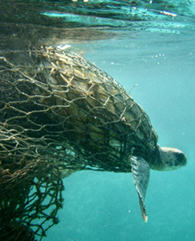
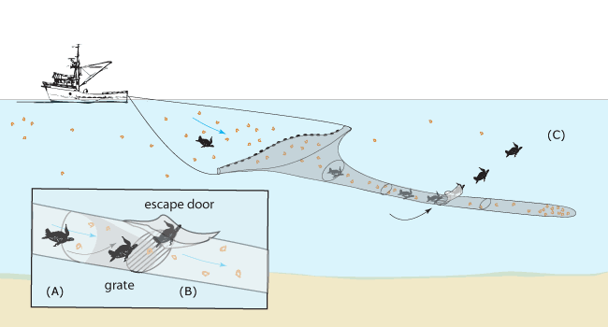
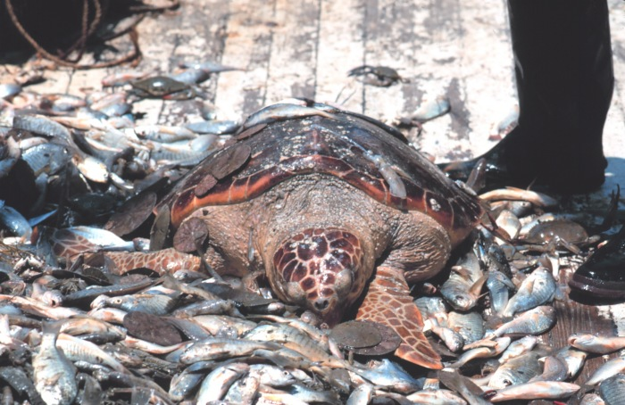

Shrimp/Turtle case

Slide 58
Shrimp/turtle (1998)
the Panel must first examine the measure to see whether it fits within one of the exceptions under Article XX and then consider the chapeau, that is, whether the measure constitutes unjustified or arbitrary discrimination
in this case, the Panel found that these were measures to conserve an exhaustible natural resource . It did interprete the concept of exhaustible natural resources holding that living species, though in principle capable of reproduction, are in certain circumstances susceptible of depletion, exhaustion, and even extinction because of human activities
as a result, the measures satisfied the exemption under Article XX(g)

Slide 59
Chapeau
as regards the chapeau requirements, the Panel found that the US measures were unjustified discrimination because:
the US measures were rigid and unbending, requiring that its trading partners adopts the same conservation measures as the US
the US provides technical helps to some countries
trade measures are the “heaviest weapon” and can only fairly be used after other measures, such as attempts at bilateral or multilateral treaties have failed.

Slide 60
Canada –EC Asbestos case
Chrysotile asbestos is generally considered to be a highly toxic material, exposure to which poses significant threats to human health causing lung cancer.
To control the health risks associated with asbestos, the French Government, which had previously been an importer of large quantities of chrysotile asbestos, imposed a ban on the substance as well as on products that contained it. The European Communities justified its prohibition on the grounds of human health protection.
the Panel found that the French ban could be justified under Article XX(b). In other words, the measure could be regarded as one which was “necessary to protect animal, human, plant life or health.” It also met the conditions of the chapeau of Article XX. It therefore ruled in favour of the European Communities.

Slide 61
Border carbon adjustment?
From an environmental perspective, it makes sense to also be able to discriminate at the border between otherwise like goods that were produced in clean and dirty ways
To solve carbon leakage problem, carbon-intensive product should pay “tax” when imported to the country that can produce the “like product” using lower carbon technology.
Product related PPMs or non product related-PPMs?

Slide 62
Discussion
In your opinion, which environmental problem should be addressed immediately? Why?
How can we reduce the conflict of economic growth and environment?

